Slide 1
Humanism
and the Italian Renaissance

Slide 2
The Renaissance
French for “rebirth”
(from re [again] and nascere [to be born])
Origins: Italy, 14th c.
“High Renaissance,” 1450-1527
Art flourished most during this period

Slide 3
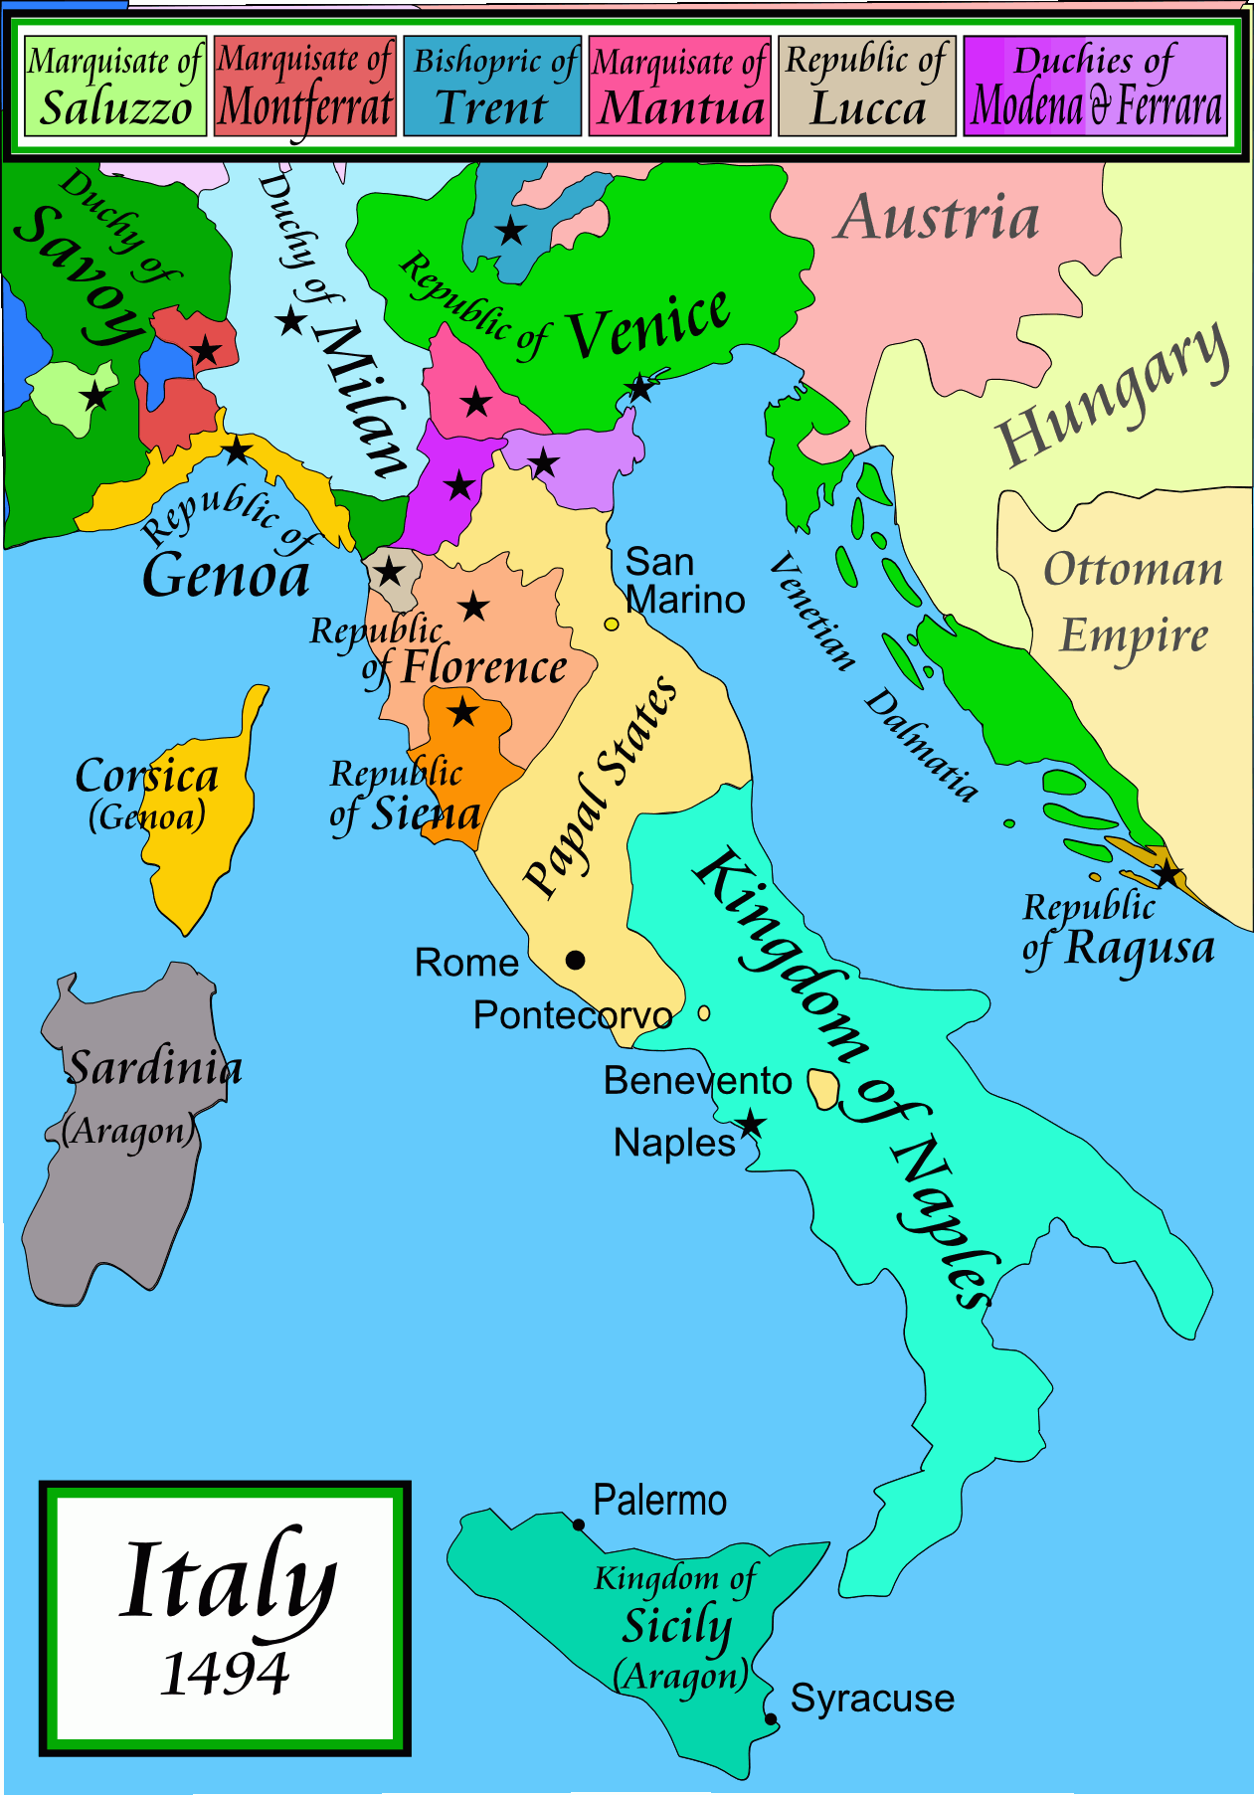

Slide 4
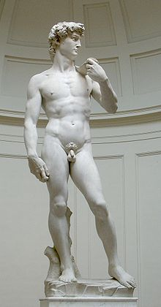
Understanding the Renaissance
The Values:
Humanism
Individualism
Secularism
The Vehicles:
Commerce
Invention

Slide 5
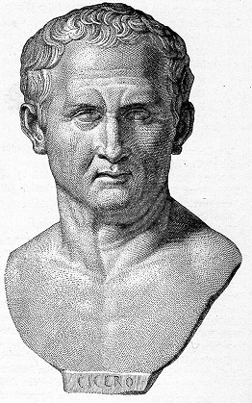
Classical Studies
Humanism
“the study of humanity”
From studia humanitatis
coined by Cicero to describe the education of a cultivated human being
Classics
Prominent works of Greek, Roman, and Biblical literature
Emphasis: original languages

Slide 6
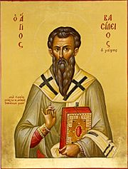
Classics in the Christian Era
St. Basil the Great (c. 333-379)
Bishop and Theologian
Address to Young Men on the Right Use of Greek Literature

Slide 7
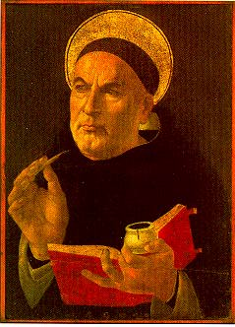
Classics in the Christian Era
St. Thomas Aquinas (1225-1274)
Summa Theologica
Attempt to reconcile Aristotle’s philosophy with Christian teaching

Slide 8
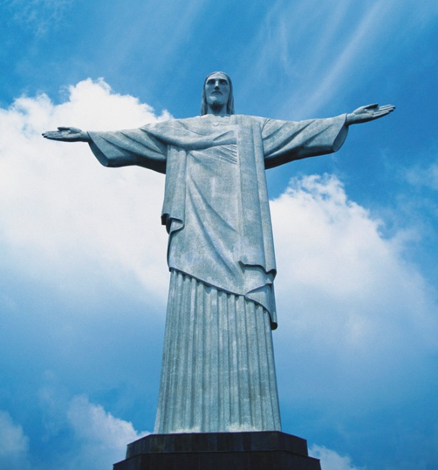
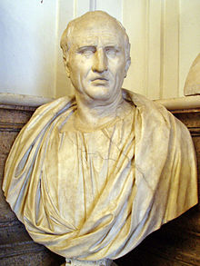
Classics in the Christian Era
Classical literature seen as a means to an end…

Slide 9
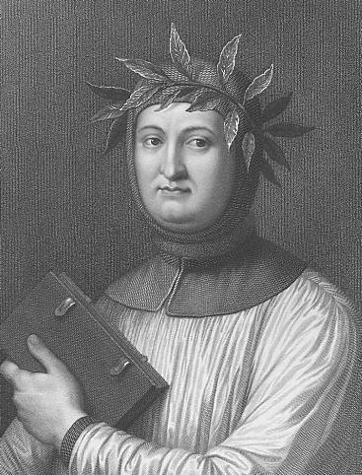
The Rebirth
of Classical Studies
Petrarch (c. 1304-1374)
“Father of Humanism”
“The First Tourist”
Recovered crumbling Latin texts, including some of Cicero’s works
“Dark Ages”
Petrarch

Slide 10
The Rebirth
of Classical Studies
“Each famous author of antiquity whom I recover places a new offence and another cause of dishonor to the charge of earlier generations, who, not satisfied with their own disgraceful barrenness, permitted the fruit of other minds, and the writings that their ancestors had produced by toil and application, to perish through insufferable neglect… they robbed posterity of its ancestral heritage.”
Petrarch
Read Petrarch’s Letter to Posterity

Slide 11
The Robbery The Periochae of Livy http://www.livius.org/li-ln/livy/periochae
The Fall of Carthage
as summarized by some unknown medieval monk:
When Hasdrubal surrendered to Scipio during the final stage of the siege, his wife, who had -only a few days before- been unable to convince her husband to escape to the victor, threw herself from the citadel into the flames of the burning city with her two children.

Slide 12
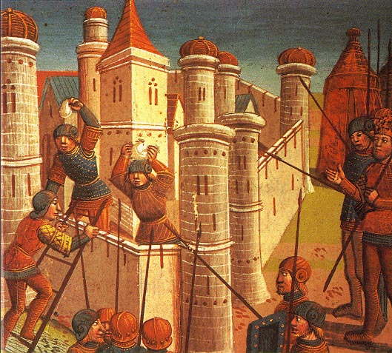
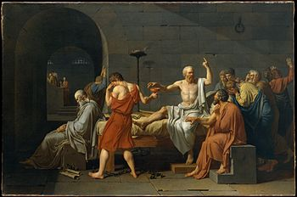
Greek Literature
Fall of Constantinople (1453)
Turks close Christian universities
Greek scholars flee to Italy
with Ancient texts
Plato’s complete works translated into Latin for the first time.

Slide 13
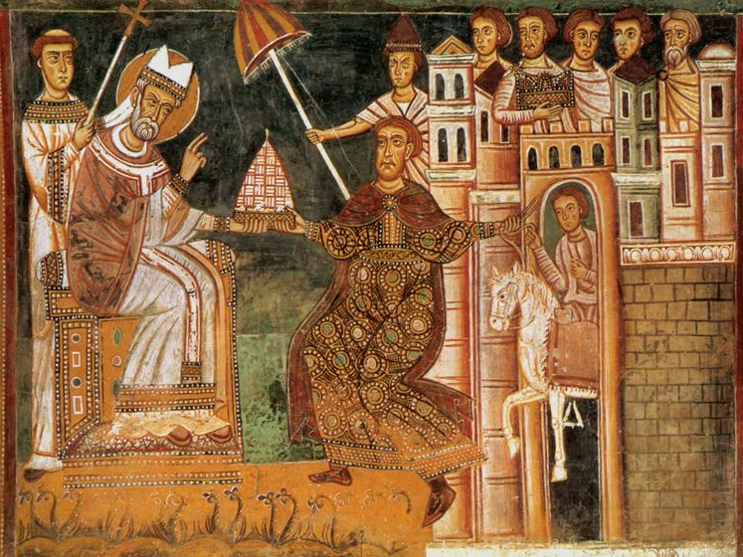
NOPE!

Slide 14
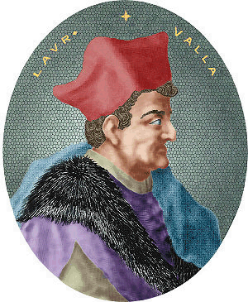
Textual Criticism
Lorenzo Valla
Discourse on the Forgery of the Alleged Donation of Constantine [Text]

Slide 15
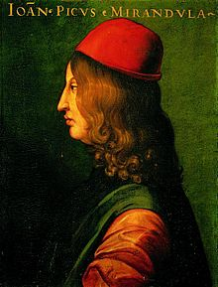
The Rebirth
of Human Dignity
Pico della Mirandola (1463-1494)
Oration on the Dignity of Man
The “Manifesto of the Renaissance”
900 Theses
Syncretism
Pico
Note Classical Lettering

Slide 16
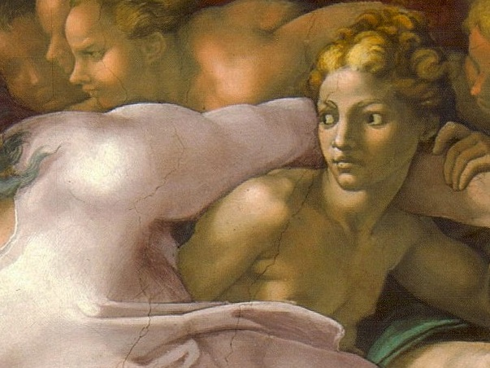
Even the angels envy us…

Slide 17
Secularism
Although Petrarch and other Renaissance humanists were devout Christians, they studied the classics for his own enjoyment and edification… an end in themselves.
NOTE: Secularism does not necessarily imply an anti-religious or irreligious mindset.
Petrarch

Slide 18
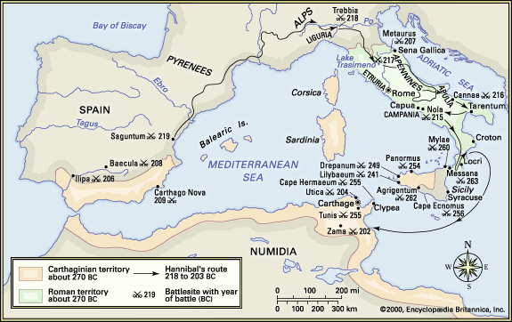
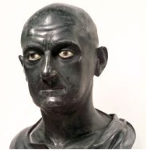
Africa
Poet Laureate
Petrarch’s epic poem, written in Latin, about the exploits of Scipio Africanus during the Second Punic War

Slide 19
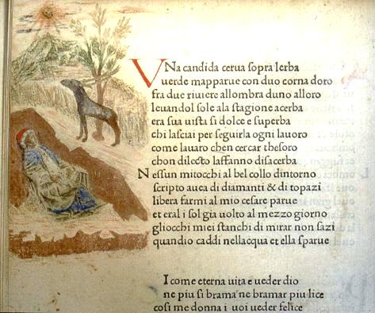
Canzoniere
Poet Laureate
Collection of Petrarch’s vernacular poetry
Mostly Sonnets
Mostly to “Laura”
Links:
English/Italian
Full English Text
Full Italian Text

Slide 20
Laura
The Love of Petrarch’s Life
Laura, illustrated by her virtues and well-celebrated in my verse, appeared to me for the first time during my youth in 1327, on April 6, in the Church of Saint Claire in Avignon, in the first hour of the day; and in the same city, in the same month, on the same sixth day at the same first hour in the year of 1348, withdrew from life, while I was at Verona, unconscious of my loss.... Her chaste and lovely body was interred on the evening of the same day… her soul, as I believe, returned to heaven, whence it came.
-- Written in a Manuscript of Virgil
?
http://petrarch.petersadlon.com/laura.html

Slide 21
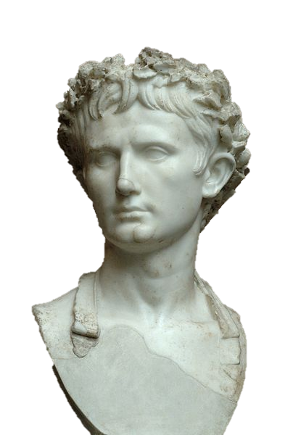
CIVIC VIRTUE
The Art of
Leadership

Slide 22
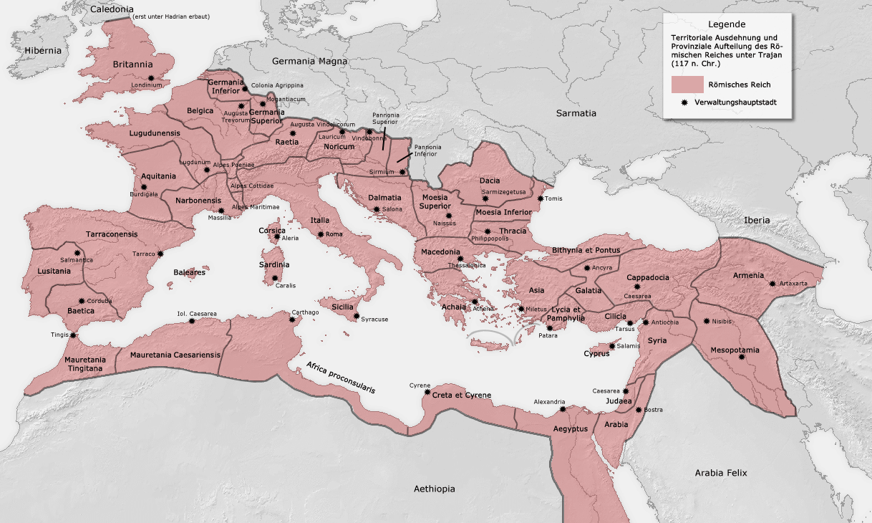
The Roman Empire
http://www.armenian-history.com/Nyuter/HISTORY/ArmeniaBC/Roman_Empire_map.png

Slide 23
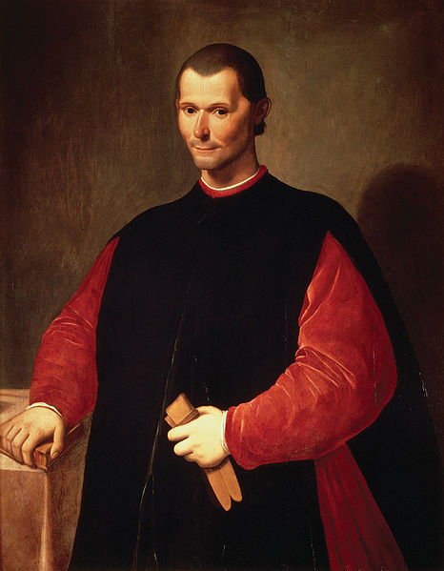
Machiavelli
The Prince
Advice to rulers
“Machiavellian”
The end justifies the means

Slide 24
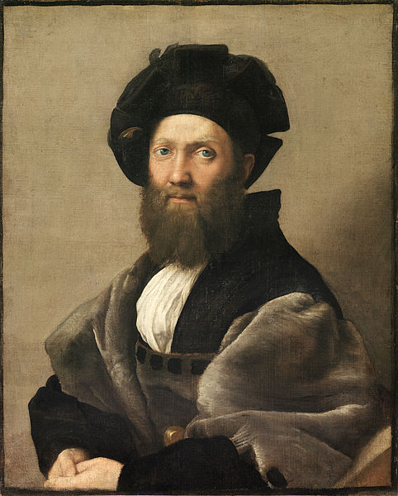
Baldassare Castiglione
The Book of the Courtier
A guide on how to be a respectable (and respected) gentleman (or lady)
Portrait of Baldassare Castiglione by Raphael

Slide 25
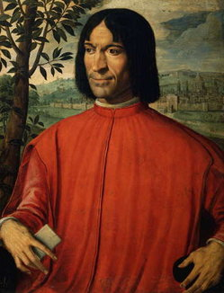
Commerce
Usury
Lending money with interest
Prohibited by RCC during Middle Ages
LIMITED INVESTMENT
Medici Family
Prominent in Florence, Italy
Medici Bank
Patrons of the Arts
Lorenzo de Medici

Slide 26
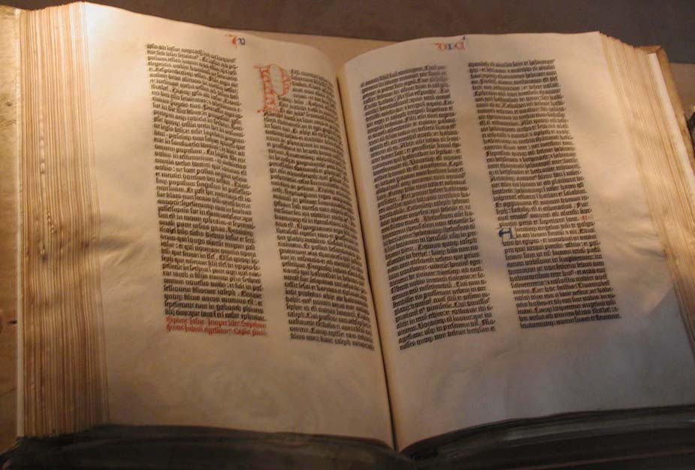
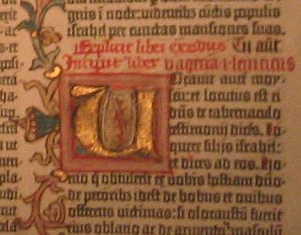
Invention
Printing Press
1454 – Gutenberg experiments with movable type
Gutenberg Bible (1456)
About 180 copies produced
Information can spread more quickly than ever before… and at a fraction of the cost!

