Slide 1
The End of World War II
Ch 12 Sec 4

Slide 2
Collapse of the Third Reich
Paris is liberated on Aug. 25, 1944.
Hitler’s last desperate attempt to stop the Allies: a massive offensive at the Belgian border.
The Battle of the Bulge: Dec 1944-Jan 1945.
aka The Ardennes Counteroffensive.
By Christmas, Germans were out of fuel and weakened.
Jan. 8- Germans began to withdraw.

Slide 3
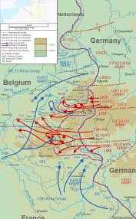

Slide 4
War End in Europe
Meanwhile, Soviet troops attack from the east.
By Feb 1945, Soviets were only 35 miles away from Berlin and Americans were at the Rhine.
April 12- Franklin Roosevelt dies; Truman sworn in
April 16- Soviets enter Berlin
April 25- United Nations conference in San Francisco
April 28- Mussolini is assassinated in Italy
April 30- Hitler commits suicide
May 7- Germany surrenders
May 8- V-E Day (Victory in Europe Day)

Slide 5
Germany was divided into 4 occupation zones after the war:
Berlin was in the Soviet sector, and would be divided into East and West Berlin.
Germany was then divided into East Germany and West Germany- with Berlin divided between them- until 1989.

Slide 6
Japan Defeated
Tokyo was firebombed Nov 1944
Battle of Iwo Jima- February 1945
60,000 marines land on Iwo Jima. 6,800 died.
67 Japanese cities were firebombed with napalm in order to destroy Japanese war production.
But US believed Japan would not surrender unless it was invaded.
Invasion of Okinawa-
Island was chosen because it was only 350 miles from mainland.
Would make invasion of Japan easier.
US wants Emperor Hirohito to step down in surrender.

Slide 7
Marines at Iwo Jima

Slide 8
The Manhattan Project
Influence of physicist Leo Szilard and Albert Einstein
Splitting uranium atoms
FDR forms committee to research atomic bomb in 1939, and joins British committee that were already working on it.
Funds the Manhattan Project to build the bomb.
First tested in Los Alamos, NM- July 1945 at a secret lab led by J. Robert Oppenheimer.

Slide 9
Hiroshima and Nagasaki
July 1945- Allies warned Japan of “total destruction”
August 6, 1945- First bomb dropped on Hiroshima (industrial city).
80,000-120,000 died instantly
August 9, 1945- Soviet Union declares war on Japan.
Same day- US drops second bomb on Nagasaki
35,000-74,000 dead instantly
Hirohito orders immediate surrender
August 15, 1945- V-J Day (Victory in Japan Day)

Slide 11
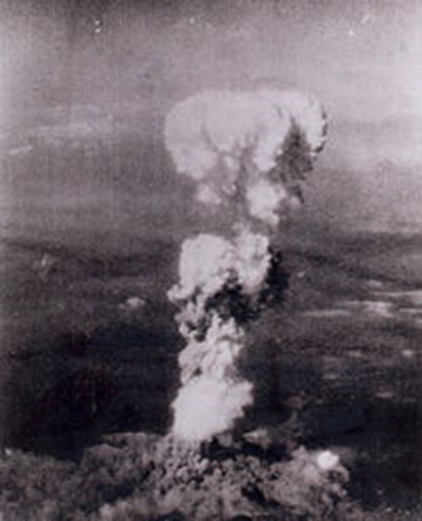
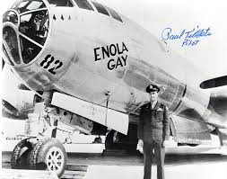
Paul Tibbets and B-29 Bomber The Enola Gay dropped the bomb on Hiroshima

Slide 12
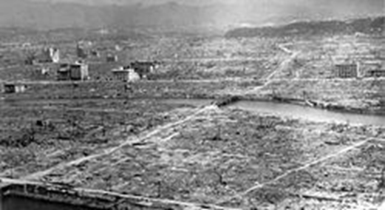
Hiroshima

Slide 13
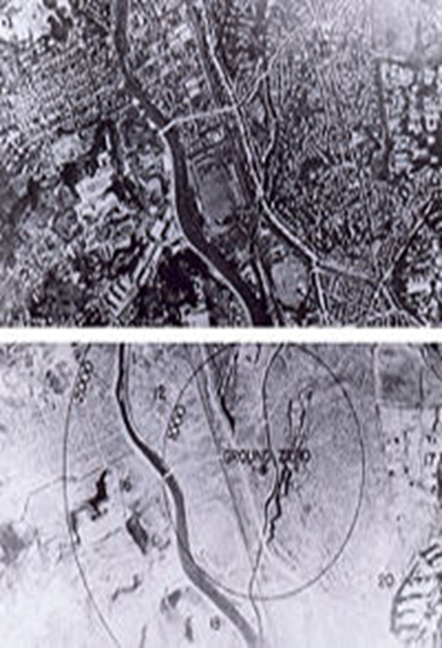
Nagasaki

Slide 14
