Slide 1
Early Cold War Years
Ch. 13 Sections 1 and 2

Slide 2
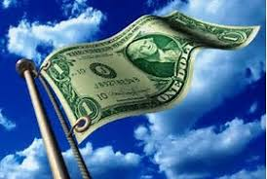
A New World after WWII
America is a superpower
Creates the World Bank
U.$. Dollar is the world’s reserve currency

Slide 3
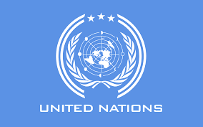
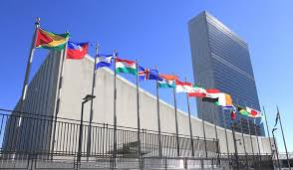
A New World After WWII
The United Nations is established in New York City
Security Council: USA, USSR, Britain, France, China
To keep peace and diplomacy

Slide 4
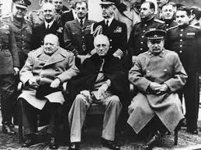
Origins of the Cold War
The Yalta Conference- Feb. 1945
Division of Germany
Stalin set up puppet communist governments in Eastern Europe, refused to hold free elections.
Soviets stripped East Germany of industry, keeping East Germany weak and poor.

Slide 5
The Truman Years
Harry Truman distrusted Stalin
Potsdam Conference- July 1945
Wants Germany’s economy to recover
Wants to intimidate Stalin
Stalin successfully created communist “satellite states” in Eastern Europe.
W. Churchill: An “Iron Curtain” divided the Communist East and Democratic West.

Slide 6
Containment
“The Long Telegram”: American diplomat George Kennan’s message to D.C. explaining Soviet behavior:
Soviet’s world view comes from “Russian sense of insecurity” and fear of the West.
They feel they are in a historic struggle against capitalism.
Best way to deal with the USSR is to contain communism.

Slide 7
The Truman Doctrine
America will always work to defend democracy and capitalism against Communist forces, wherever needed.
The Marshall Plan- money and aid to any nation that needed to rebuild their economy after WWII. Even the USSR!
The USSR rejected it.
Billions of dollars were pumped into Europe- especially France, Britain, and West Germany.

Slide 8
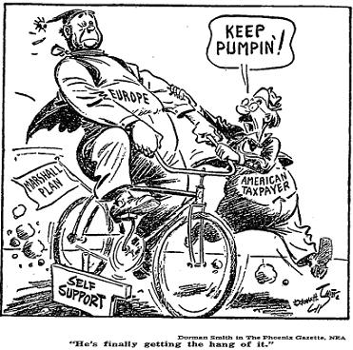
The Marshall Plan

