Slide 1
The Railroads and Robber Barons
Ch 3 Lesson 2

Slide 2
The Government’s Relation to Business
Laissez-Faire: Government doesn’t regulate business.
Low taxes, low government spending
U.S. was largest free trade area in the world
Sometimes, government has to get involved in business to promote business and protect property.

Slide 3
The Government’s Relation to Business
The North’s ideal:
  High tariffs to protect American manufacturers from cheap foreign goods
  Support federal subsidies (grants) for companies building railroads, canals, and roads.
The South’s ideal:
  Lower tariffs to promote free trade
  Against subsidies
The North won, so high tariffs and subsidies were the norm- but they are not very “laissez-faire”!

Slide 4
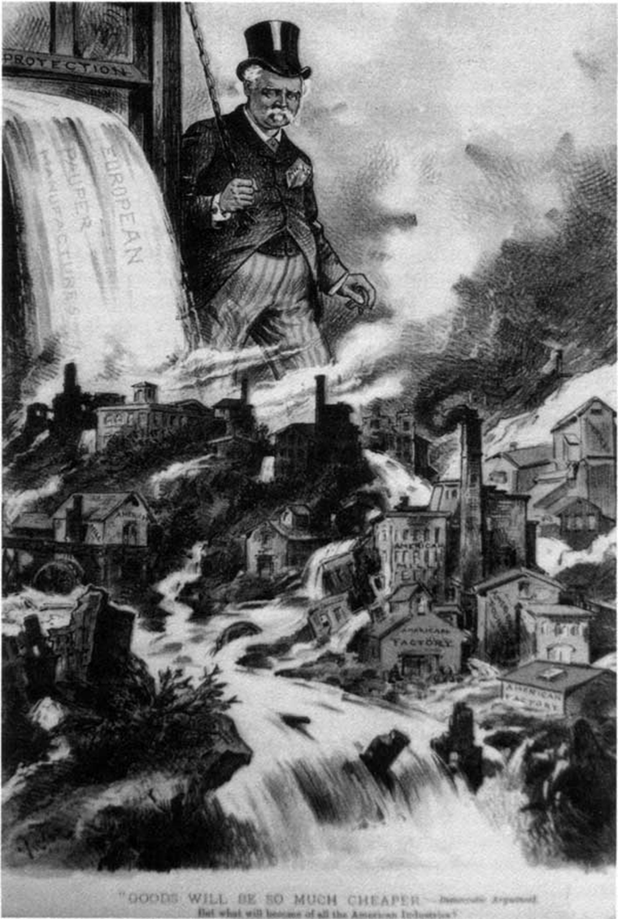
American Protectionism

Slide 5
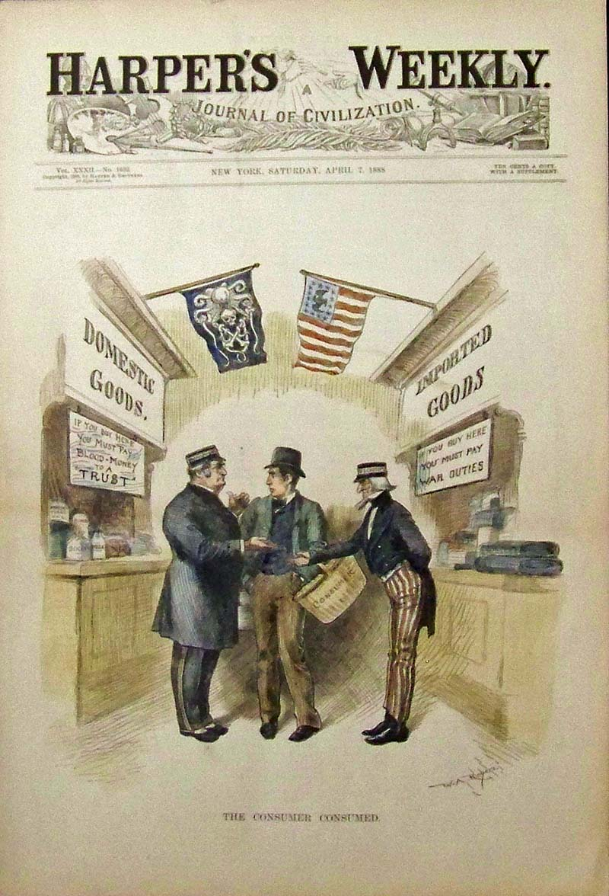
“The Consumer Consumed”

Slide 6
The Railroads
They linked the nation:
  Transcontinental Railroad was completed in 1866.
Union Pacific and Central Pacific companies meet at Promontory Summit, Utah.
U.P. employed Civil War vets, Irish immigrants, miners, farmers, cooks, and ex-cons.
  C.P. employed 10,000 Chinese workers.
  Central Pacific was started by “Big Four” Californians: Leland Stanford, Charley Crocker, Mark Hopkins, and Collis Huntington.
    All made huge fortunes.

Slide 7
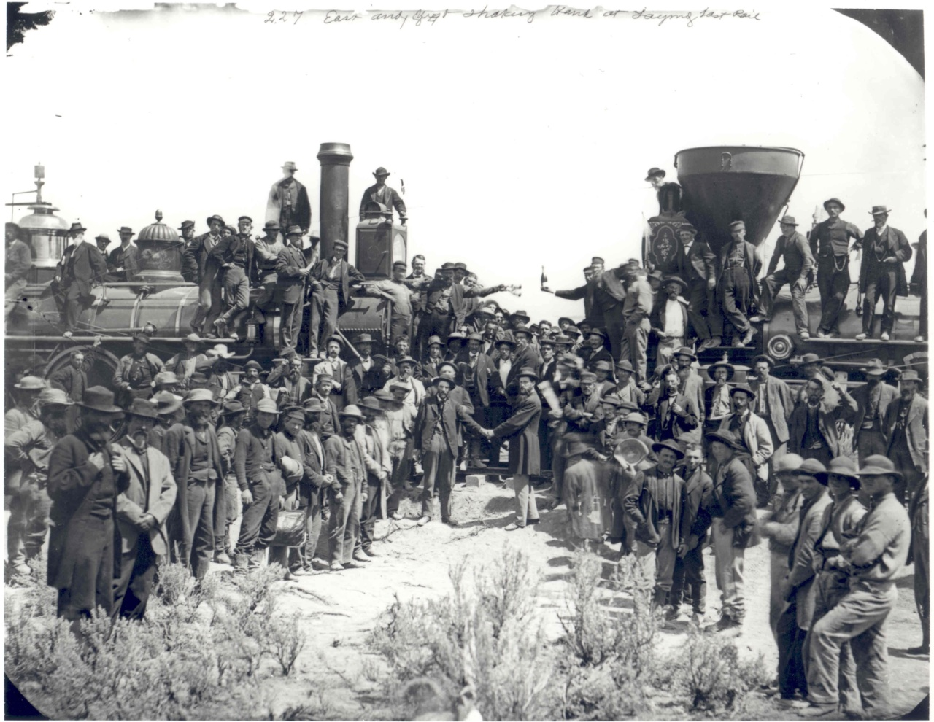
The Meeting of the Rails

Slide 8
The Railroads
Spurred growth in other industries
  Coal, iron, steel, timber, and telegraphs
Federal government gave each railroad company free land along their routes to build the railroads.
RR companies would then sell the land to settlers, real estate agents, companies to raise $$$ to build the railroad.
  Opens the door to a lot of fraud and corruption

Slide 9
The “Robber Barons”
Railroad entrepreneurs so wealthy, they were accused of corruption, fraud, bribery, and swindling investors, taxpayers, and banks.
Jay Gould was the most notorious:
  Insider trading
  Bribery and manipulated stock prices
Many entrepreneurs would just sell the free railroad land and walk away with the money- without building the railroad.

Slide 10
The Credit Mobilier Scandal
Construction Company set up by Union Pacific stockholders and members of Congress.
They sold other members of Congress cheap railroad land, then bribed Congress to give them more land. They made themselves very rich.
Caused anger and distrust of RR businessmen.
Robber barons= people who loot an industry and become rich quickly and unethically.

Slide 11
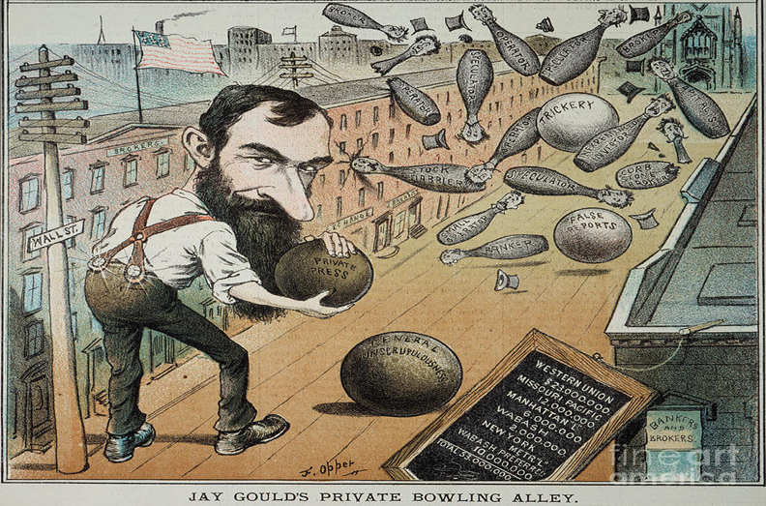
Jay Gould

Slide 12
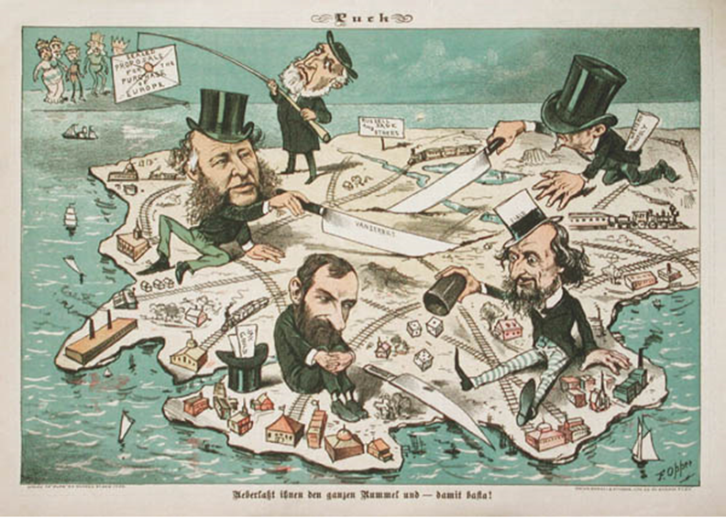
The Robber Barons

