Slide 1
A Clash of Values and Different Economies of the 1920s

Slide 2
Not everyone prospered and consumed:
Farmers in crisis:
Farmers are often the last to prosper, first to suffer in economy
Earned less than 1/3 of American workers
Produced more, thanks to technology in agriculture, but prices fell.
Placed themselves in debt to buy land and equipment, but could not sell surpluses after the war.
Urban and rural Americans tend to have different values as a result of economic disparity.

Slide 3
Nativism and Immigration
Recessions, immigration, tension =
Xenophobia (fear of foreigners) and intolerance.
Sacco and Vanzetti Case
Italian immigrants accused of robbery and murder in Massachusetts.
They were known radical anarchists.
There was no real evidence against them.
Found guilty anyway and executed 8/23/1927.
Reflection of fears and prejudice.

Slide 4
Nicola Sacco and Bartolomeo Vanzetti

Slide 5
Return of the Ku Klux Klan
More than 4 million members by 1924, including Congress members.
Targeted Catholics, Jews, and all immigrants, and spread far beyond the South.
National Origins Act: response to nativism.
1921 Emergency Quota Act restricted annual admission to 2% of each ethnic group represented in 1890 Census (which was before the wave of immigrants from Eastern Europe came).

Slide 6
KKK March on Washington 1926

Slide 7
Clash of Cultures
Nativists wanted to save “traditional values” and feared “new morality”.
Women:
Suffrage
Personal freedom in lifestyle and fashion
Careers, education, marriage changed
Freudian theories of sexuality
Contributions to medicine and law
Margaret Sanger: birth control

Slide 8
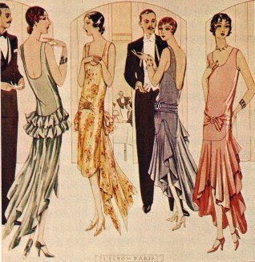

Slide 9
Religious Fundamentalism
New “culture” was viewed as evidence of “moral decline”.
Christian Fundamentalism: belief that every word of the Bible is literally true.
Evangelical preachers (Billy Sunday)
1925 Scopes “Monkey” Trial- Tennessee
Religion vs Science
Business vs Science?

Slide 10
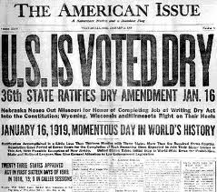
Prohibition
18th amendment: 1919

Slide 11
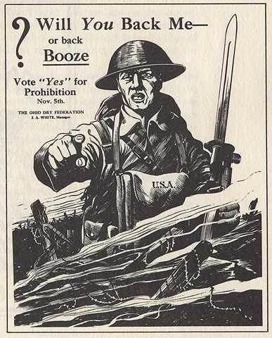

Slide 14
Prohibition
Sale, manufacture, and transport of alcohol prohibited.
Increased power of the federal police forces.
Increased police and law corruption, organized crime, mafia, bootlegging, and smuggling.
Repealed by the 21st Amendment in 1933, after not solving a single problem but creating many.
*It’s the only amendment to take away a freedom, rather than protect it.

