Slide 1
America in the War

Slide 2
The “Sleeping Giant”
“ I fear all we have done is to awaken a sleeping giant and fill him with a terrible resolve ”
—Quote attributed to Japanese admiral Isoroku Yamamoto

Slide 3
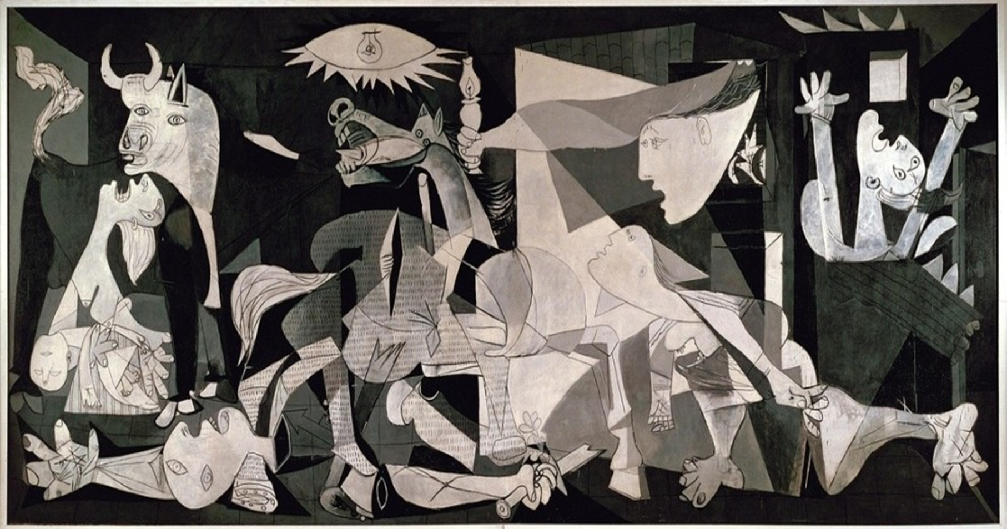
Guernica, by Pablo Picasso. 1937. Museo Reina Sofia, Madrid.

Slide 4
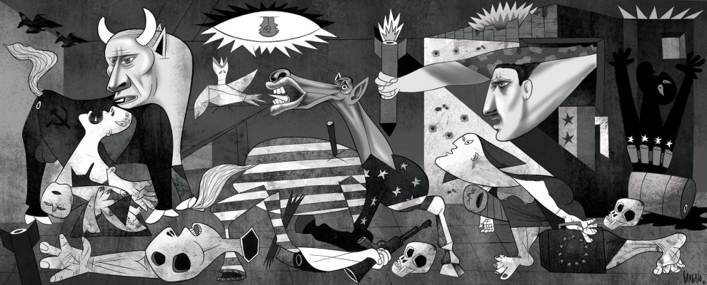
Alepponica, by Vasco Gargamo. 2016.

Slide 5
What is America’s new role?
America can no longer be called a “sleeping” giant, so what is America’s role in world conflicts today?
What does Vasco Gargamo’s depiction of America in “Alepponica” say about American strength and sacrifices?

