Slide 1
How neutral was America before World War II?

Slide 2
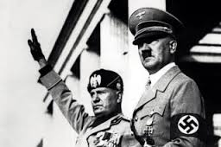
Post-WWI
Americans discouraged by:
Rise of fascism/totalitarianism in Europe
Failure of League of Nations
Weapons manufacturers profited from WWI

Slide 3
Neutrality Acts- 1935
Supported by FDR
Banned sale of weapons to any nation at war
October 1935- Italy invades Ethiopia
But FDR supported internationalism: idea that trade is good for peace and prosperity between nations.

Slide 4
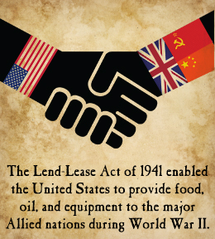
Axis Aggression
1937: Japan invades China
FDR sells weapons to China anyway.
Dec. 1940: Lend-Lease Act
Allowed U.S. to sell weapons to any nation “vital to the defense of the U.S.” (So…Britain)

Slide 5
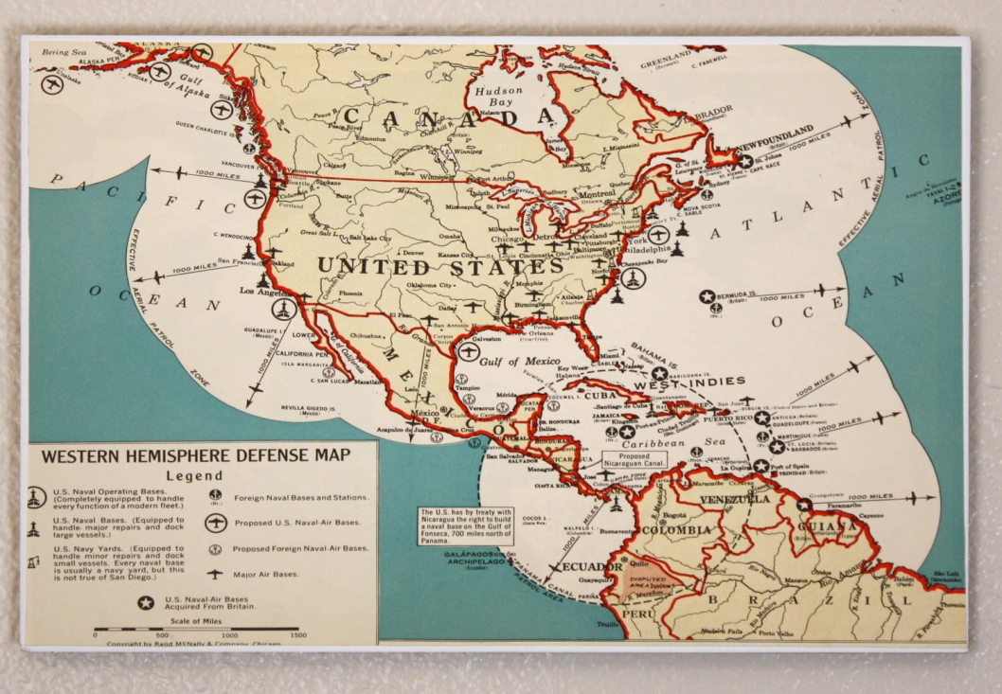
“Hemispheric Defense Zone”
FDR claimed the Western hemisphere was neutral, and ordered U.S. Navy to patrol Western Atlantic.
U.S. Navy reported locations of German subs to the British.

Slide 6
The Atlantic Charter
August 1941: Churchill and FDR commit to “defense of democracy”.
September 1941- German sub fired on an American destroyer that was spying on it.
FDR orders “shoot-on-sight” policy.
Oct. 1941- Germany bombed American ship, the Reuben James, killing 100 sailors.

