Slide 1
Antebellum America
Chapter 1 Lesson 3

Slide 2
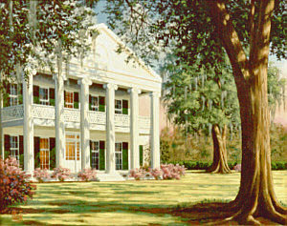
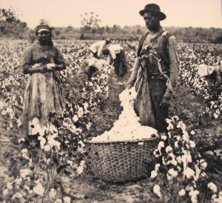
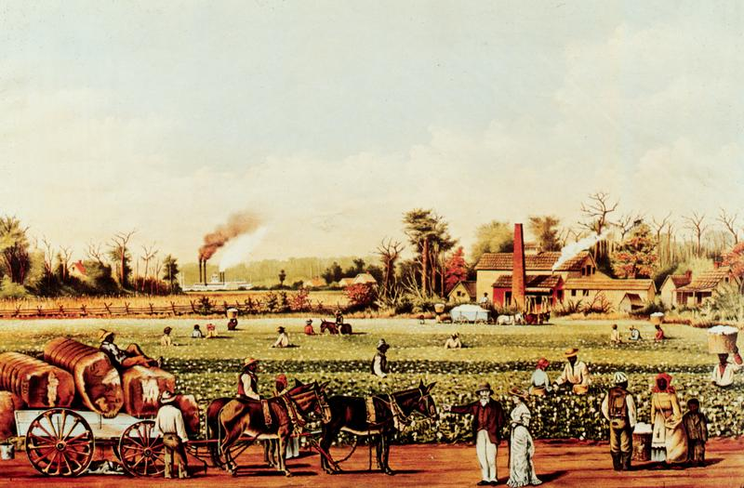
Antebellum
Latin for “Before the War”
Also known as the Plantation Era
Often romanticized by some Southerners

Slide 3
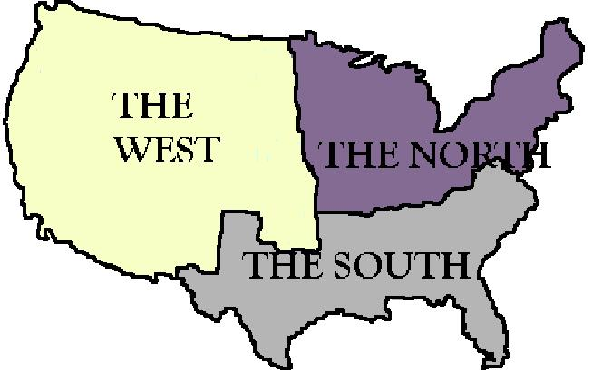
Sectionalism
Loyalty to the interests of one’s own region or section of the country, rather than to the interests of the nation as a whole.
Usually a precursor to separatism.

Slide 4
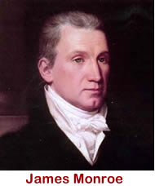
The Nation Matures
After the War of 1812, America entered the “Era of Good Feelings”.
Rise in nationalism- a feeling of intense pride and patriotism.
America was asserting itself as a legitimate western power.
James Monroe was elected President.

Slide 5
How did America grow as a nation?
Missouri Compromise took on the issue of slavery again.
The Federalist party lost power and fell apart- only one political party remained (for now).
1816: The Second Bank of the US is established
Monroe Doctrine: US asserts its power in the west to dominant Europe.
McCullough vs Maryland:
Congress has power to establish Second Bank
Federal government can do anything necessary to carry out its responsibilities, as long as it is within the law.
The state cannot interfere with any federal agency within that state’s borders.

Slide 6
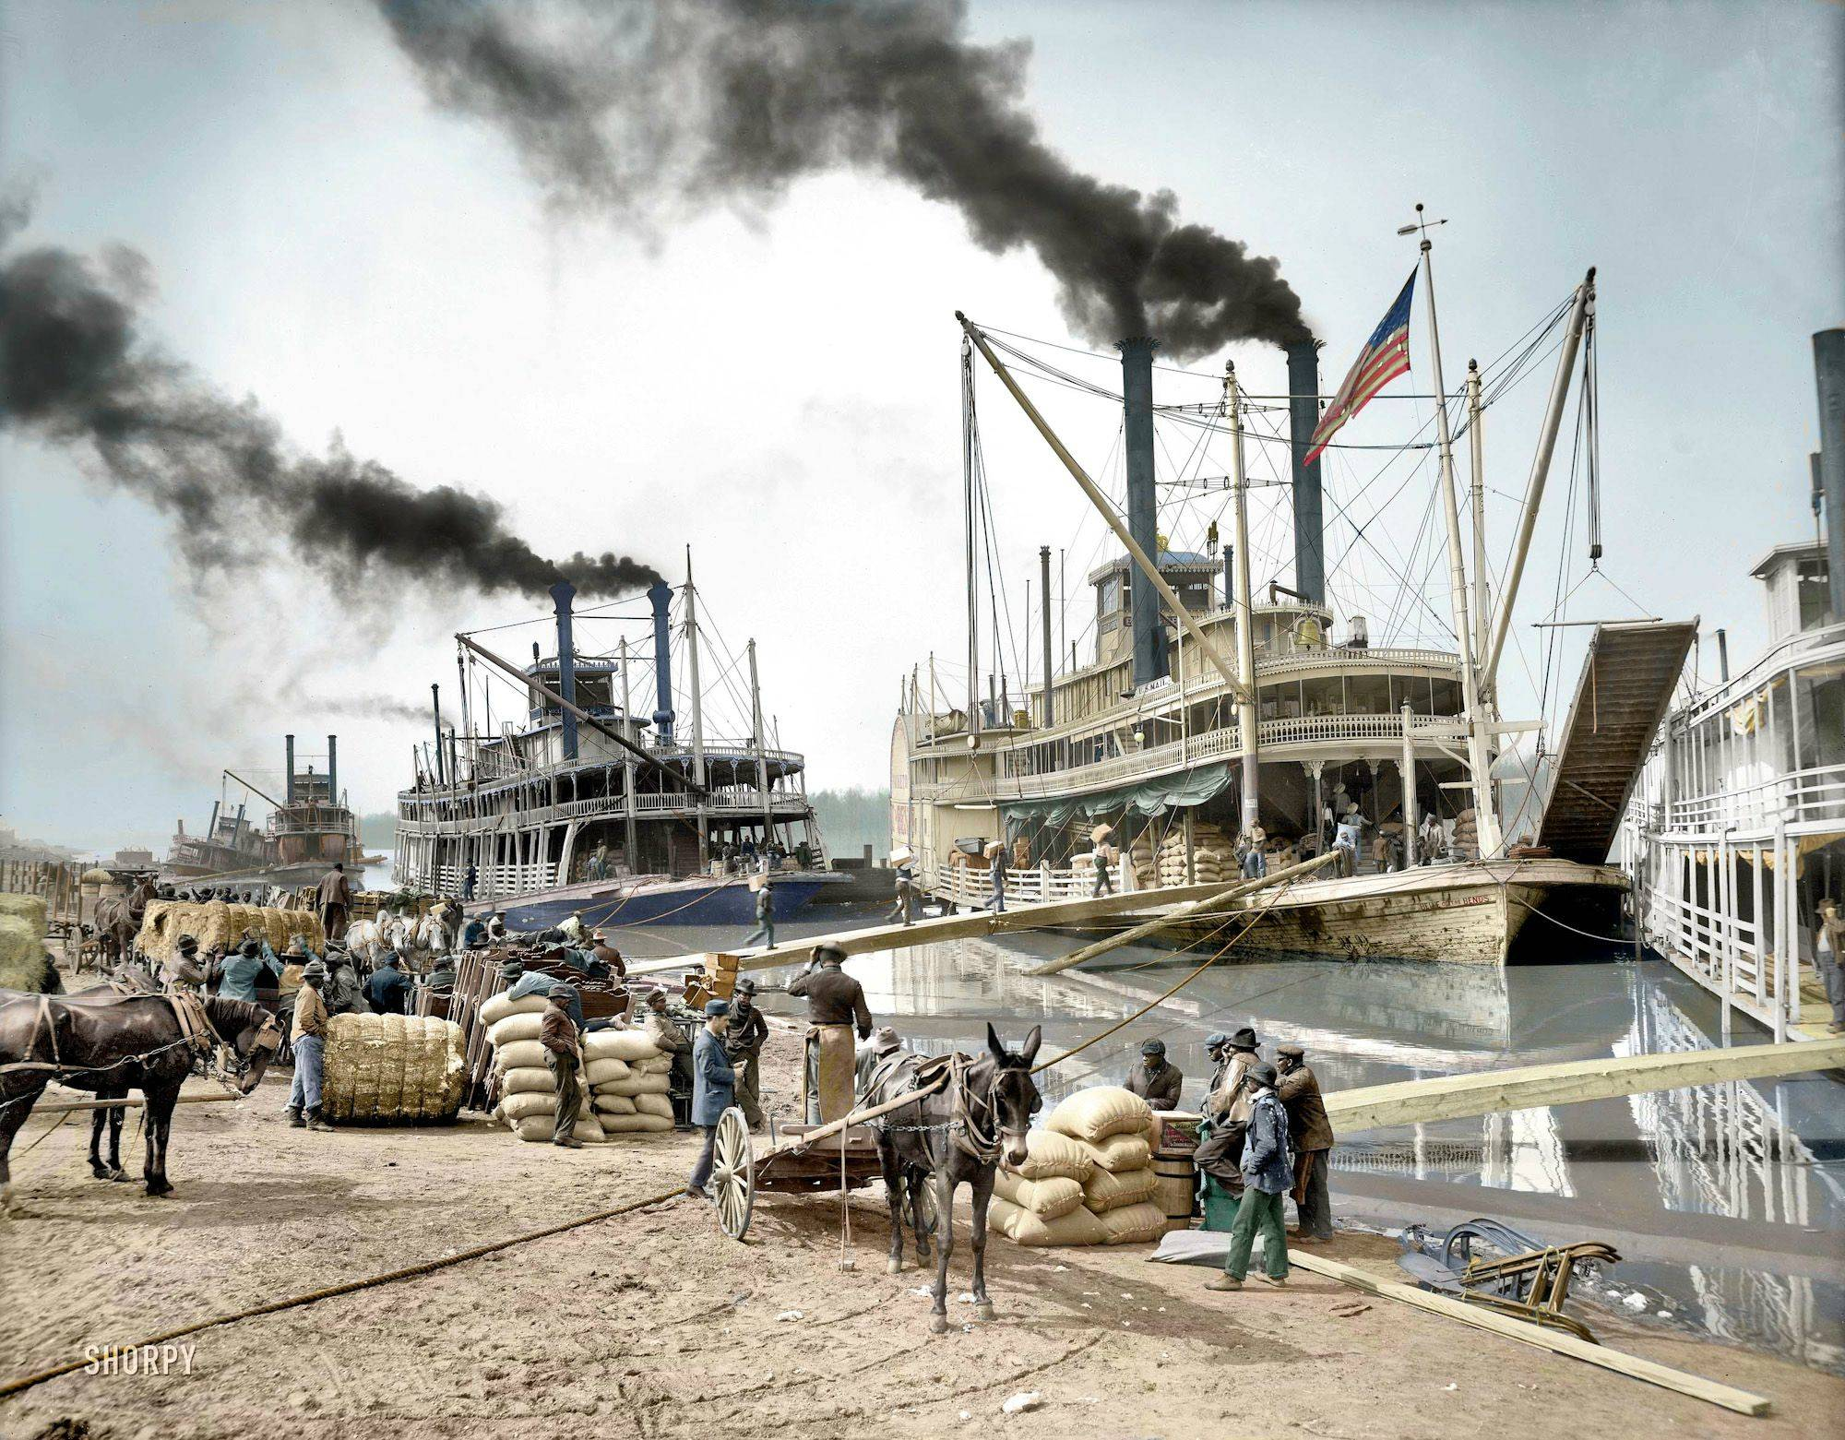
How did America grow as a nation?
American manufacturing began to compete with British goods.
Transportation improved:
Roads
Canals
Steamboats for easy river travel
East-West highway
Railroads

Slide 7
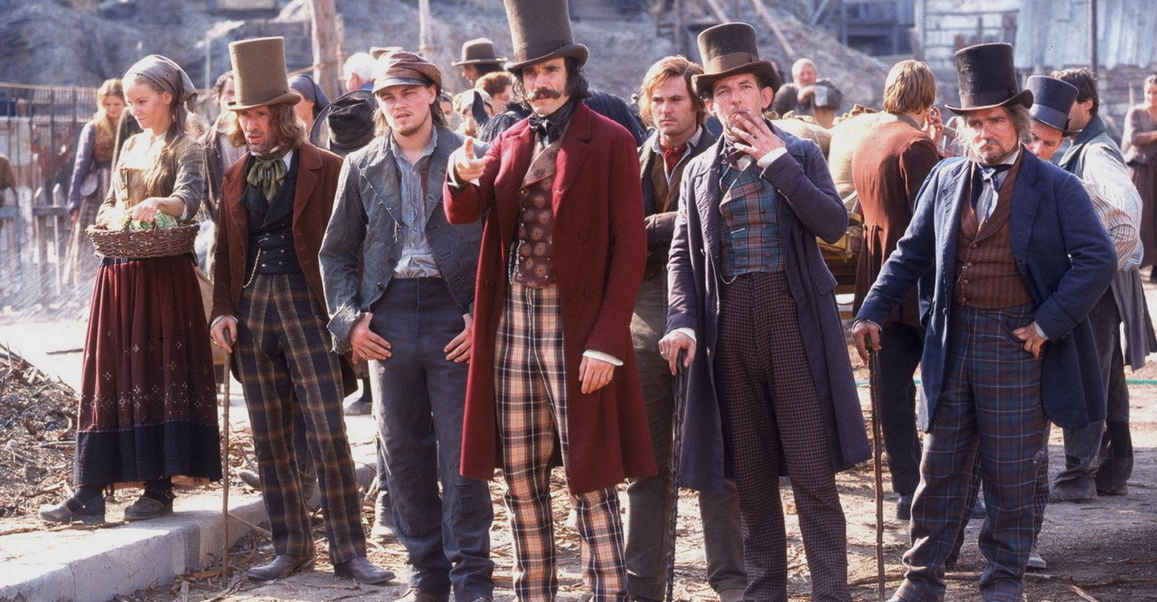
Distinct regions and cultures
North:
Factories, manufacturing, business
Anti-slavery
Large influx of immigrants from Ireland and Germany, mostly Catholic
Spurred growth of “nativist” anti-immigrant, anti-Catholic groups.

Slide 8
Distinct regions and cultures
South:
After the invention of the cotton gin, “Cotton is King!”
Slavery was prominent, normalized, and accepted as necessary- even by non-slaveholders.
Slaves resisted ACTIVELY. The abolition movement was already causing a desire for freedom.
Few free African Americans in the South, but there were 200,000 free in the North.

Slide 9
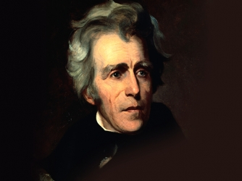
The Age of Andrew Jackson: 1829-1837
Elected in 1828; Democratic-Republican; slaveholder
American war hero and son of Irish immigrants
Supported the power of the federal government:
During the Nullification Crisis (tariffs)
Dismantled the Second Bank
Supported the “spoils system”
But did not support the power of the federal government when Georgia chose to force Cherokees to march west and leave the state.
Responsible for the deaths of thousands of Native Americans due to the Indian Removal Act of 1830 (“The Trail of Tears”).

Slide 10
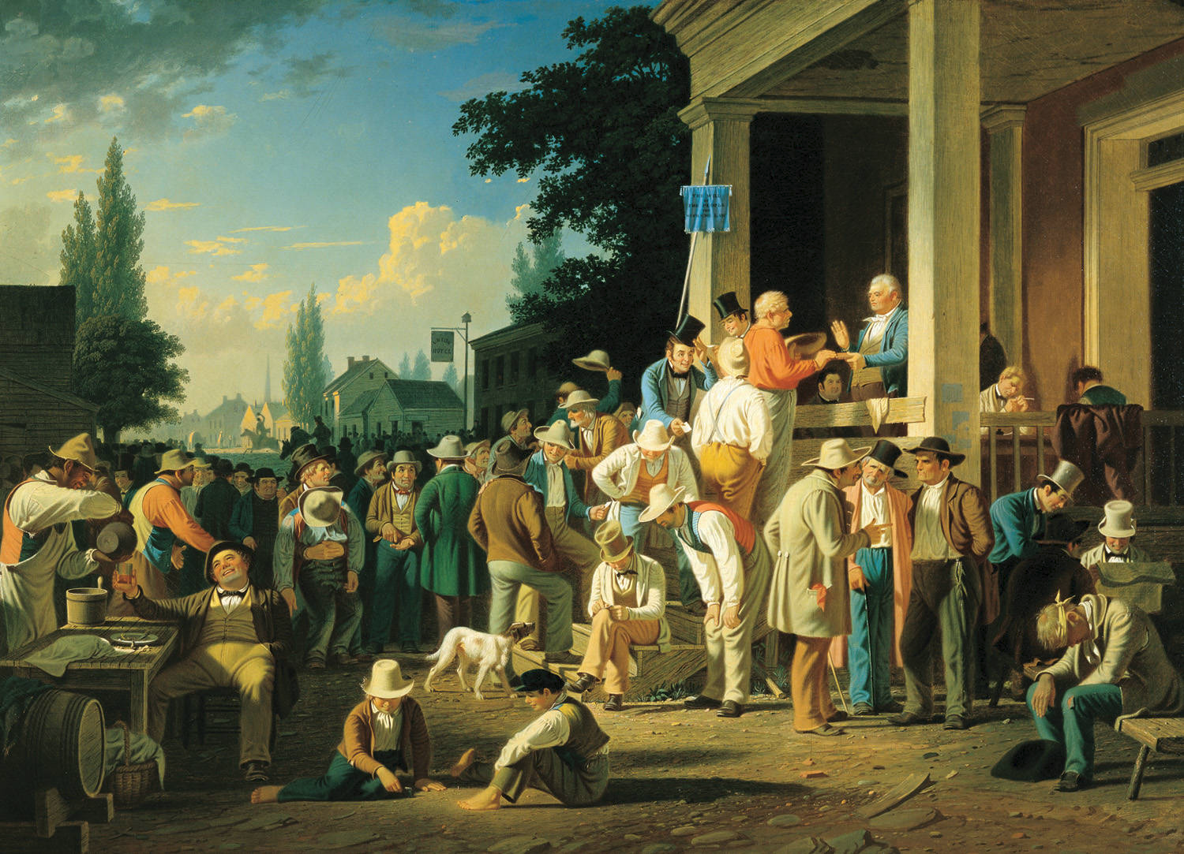
The County Election, 1851. By George Caleb Bingham.

Slide 11
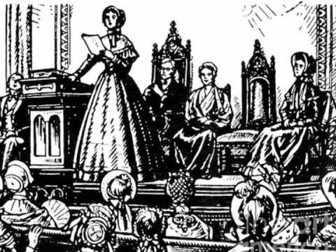
Reforming Society in Antebellum Society: 1830s-1850
Temperance Movement
Overcrowded prisons replaced by large state penitentiaries
Asylums for the mentally ill
Abolitionism
Women’s Rights:
1848 Seneca Falls Convention
Organized by Lucretia Mott and Elizabeth Cady Stanton
Focus was on women’s suffrage (the right to vote). Also known as the enfranchisement of women.

