Slide 1
Art- 1920s
Surrealism, Expressionism, and the Lost Generation

Slide 2
Modern Art and Literature
Inspiration:
Rejection of tradition and authority
Disillusionment after WWI
Bohemian unconventional lifestyle, usually in cities
City life: jazz, transportation, technology, crowds
Women
Inner moods, emotions of people
Loss of spirituality
Consumer society and materialism
“meaninglessness” of modern life, moral decline

Slide 3
Popular Culture
Movies and Radio Shows
Silent films
Mass media
Newspapers, magazines, film, music
Sports
Baseball and boxing were the most popular

Slide 4
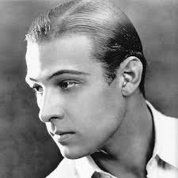
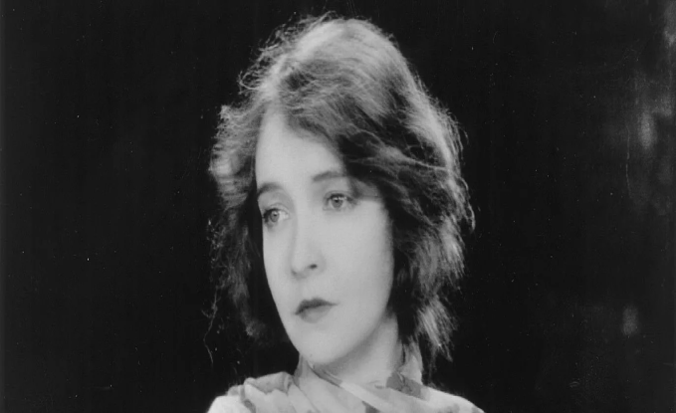
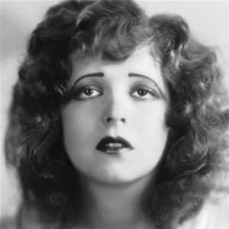
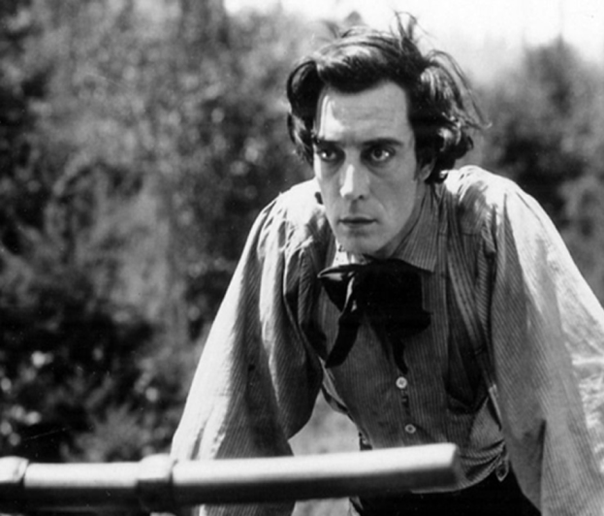
Silent Film Stars
Rudolf Valentino
Charlie Chaplin
Lilian Gish
Clara Bow
Buster Keaton

Slide 5
Edward Hopper Automat- 1927

Slide 6
Edward Hopper Automat- 1927
Many artists and writers focused on the isolation and alienation of modern society. A group of artists who painted urban life became known as the "Ashcan Realists." The writers who described modern life as spiritually empty and materialistic became known as the "Lost Generation."
Edward Hopper studied with one of the founders of the Ashcan Realist movement. This painting, Automat, expresses the loneliness and isolation many young people felt during the 1920s. An automat was a place where a person could buy food or drinks from a vending machine.

Slide 7
Georgia O’Keefe Red Canna- 1924

Slide 8
Georgia O’Keefe
Mainly known for her naturalistic imagery, Georgia O'Keefe was chiefly responsible for legitimizing American art across the globe. Her abstract styles, constantly challenging the boundaries of imagery, greatly influenced American art. O'Keefe's paintings present both sharp forms and subtle tones and inspired generations of artists.
O’Keefe painted flowers, landscapes, and animal skulls, and is regarded as the “Mother of American Modernism”.

Slide 9
Horace Pippin Giving Thanks

Slide 10
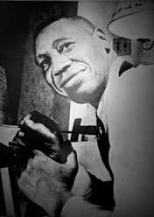
Horace Pippin
Self-taught African American painter
Served in the 369th regiment in WWI as a Harlem Hellfighter
Heavily influenced by racism, segregation, the war, and painted in a simplified abstract style.

Slide 11
George Luks Bleeker and Carmine Streets

Slide 12
George Luks
One of the founders of American realism, George Luks focused on paintings of urban life and helped to establish what is known as the Achcan School. Luks painted the truth as he saw it, grim and ironic. Often immigrants were the focus of his city paintings, portrayed in vivid color, in squalor and destitution.

Slide 13
F. Scott Fitzgerald
“They were careless people. Tom and Daisy- they smashed up things and creatures and then retreated back into their money or their vast carelessness, or whatever it was that kept them together, and let other people clean up the mess they had made.”
- The Great Gatsby, 1925

Slide 14
Ernest Hemingway
“The world breaks everyone and afterward many are strong at the broken places. But those that will not break it kills. It kills the very good and the very gentle and the very brave impartially. If you are none of these you can be sure it will kill you too but there will be no special hurry.”
- A Farewell to Arms, 1929
(a novel set during the Italian
campaign of WWI).

Slide 15
Gertrude Stein
“There ain't no answer.
There ain't gonna be any answer.
There never has been an answer.
There's your answer.”
Gertrude Stein was an American writer (from Oakland, CA) who moved to Paris and hosted salons with the great artists and writers of the “Lost Generation”, a term she first coined.

Slide 16
Gertrude Stein

Slide 17
Babe Ruth

Slide 18
Newly built Yankee Stadium, 1923

Slide 19
Dempsey and Firpo, 1924 by George Bellows

Slide 21
Jack Dempsey and Babe Ruth

