Slide 1
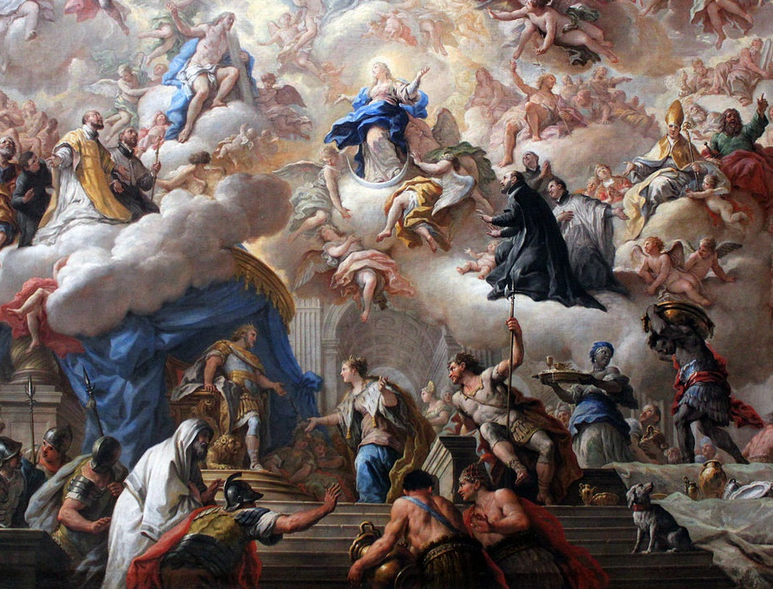
The Baroque

Slide 2
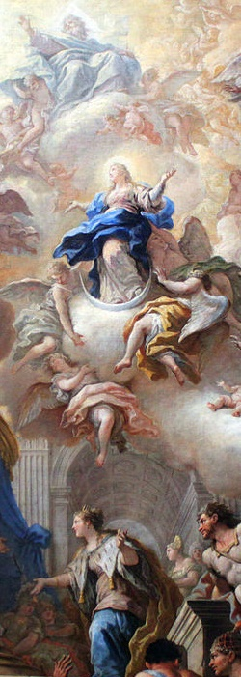
The Baroque
When? 1600-1750
Origins: Italy
Historical Context:
Counter-Reformation
Absolutism

Slide 3
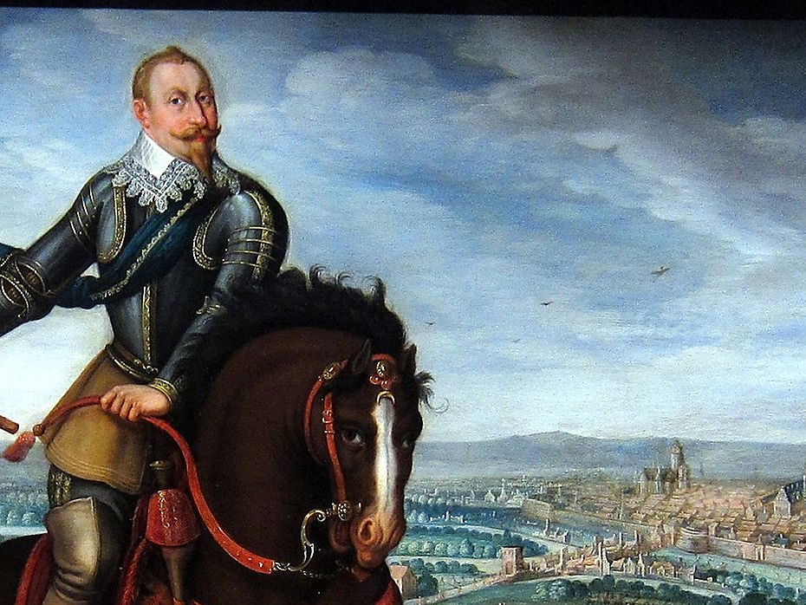
TURBULENT TIMES

Slide 4
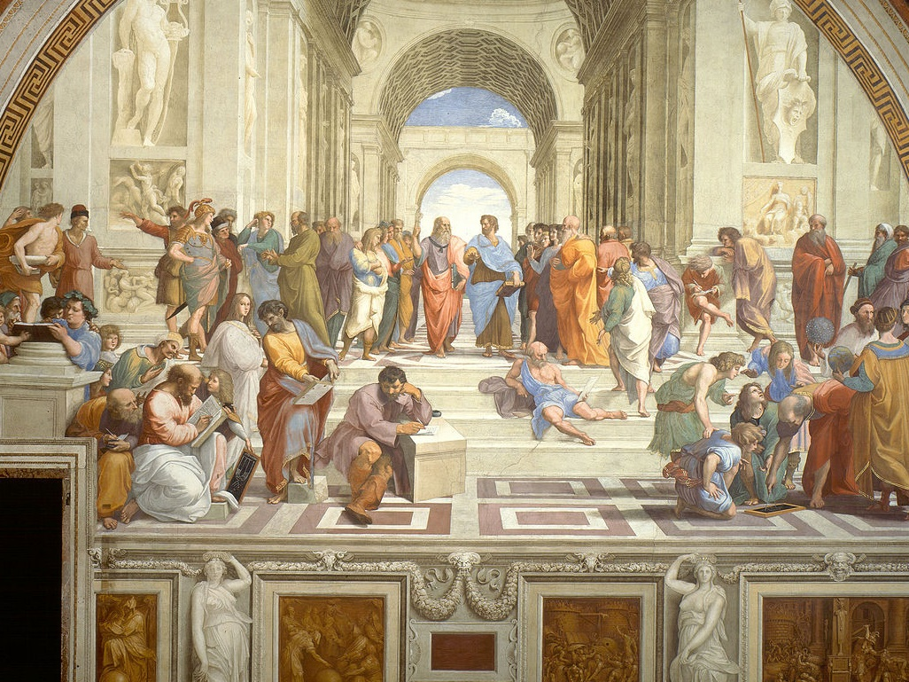
REJECTION
OF RENAISSANCE RESTRAINT

Slide 5
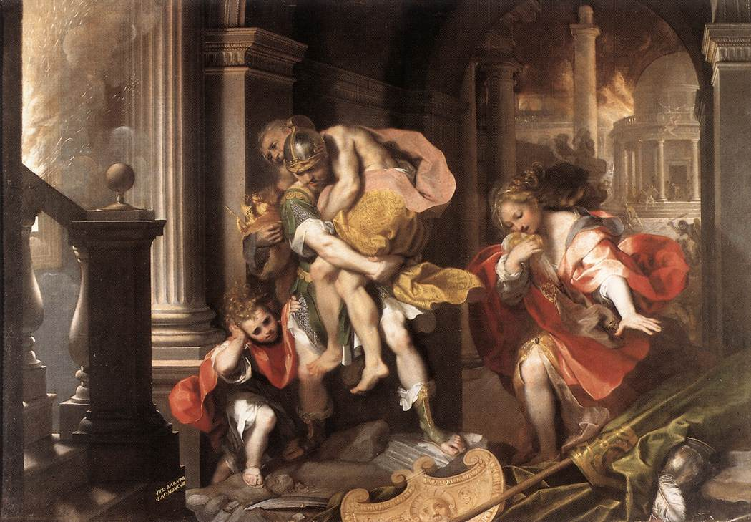
(BUT NOT OF RENAISSANCE THEMES)
Aeneas Flees Burning Troy, Federico Barocci, 1598

Slide 6
Baroque
Motion
Emotion
TurBuLEnCe
GRANDEUR
Contrast

Slide 7
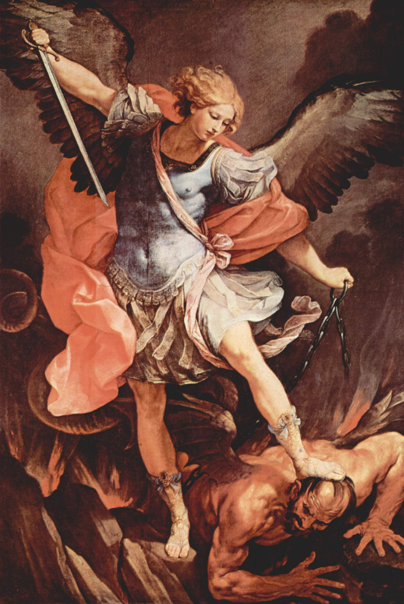
EMBRACE of the EXTRA
Guido Reni, St. Michael the Archangel (1636)

Slide 8
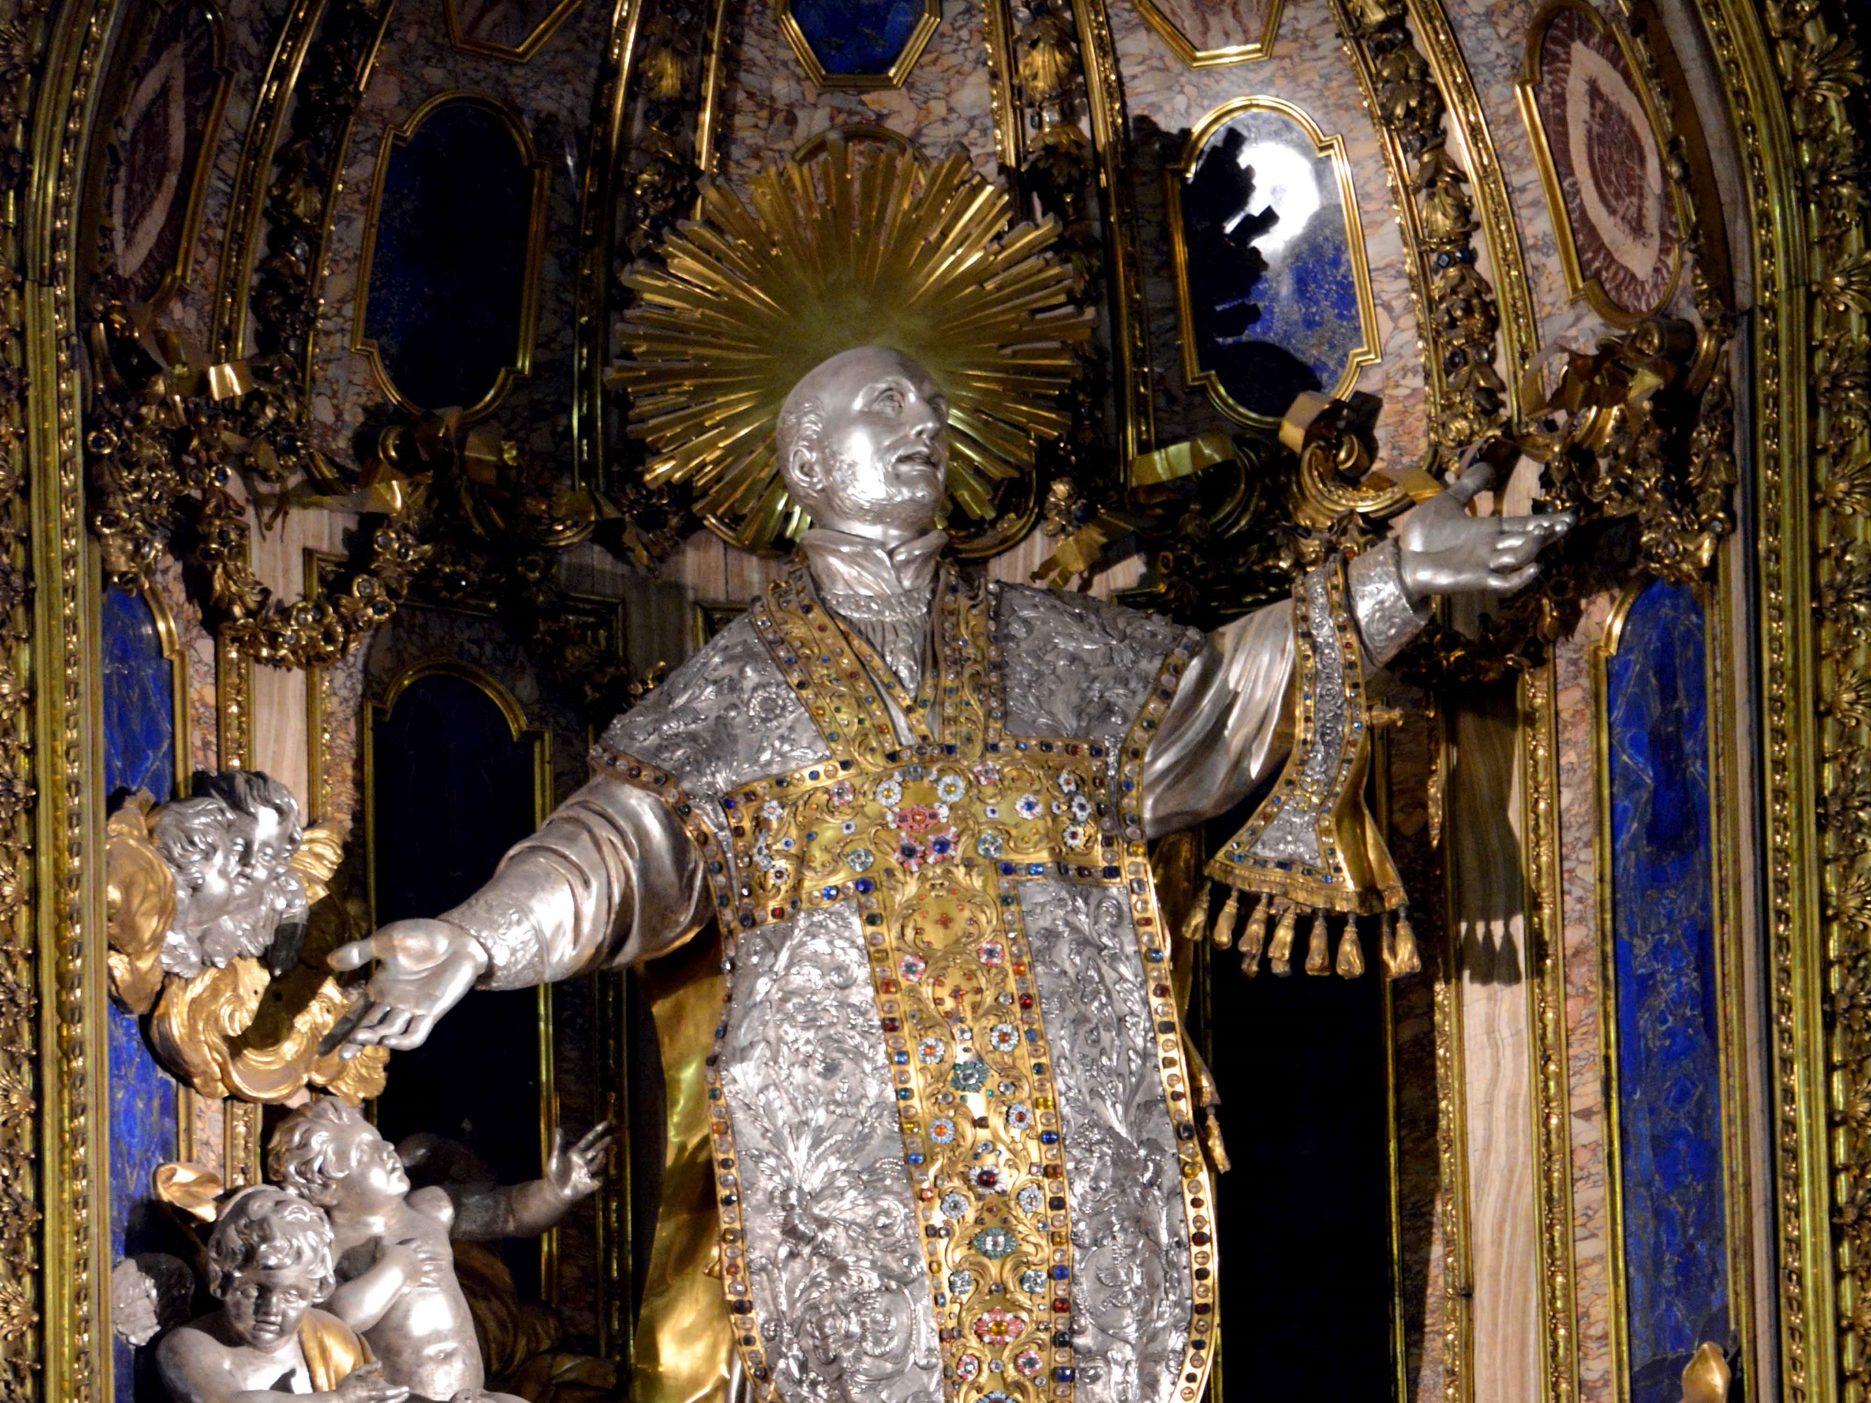
BLING IT ON
Photo by Roy Sebastian, SJ

Slide 9
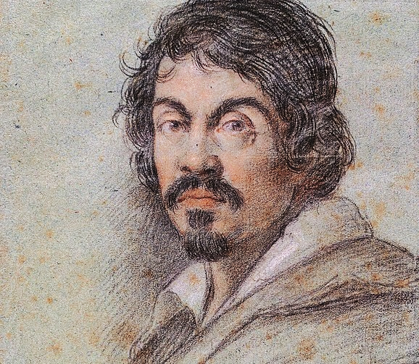
Caravaggio
Baroque Painter

Slide 10
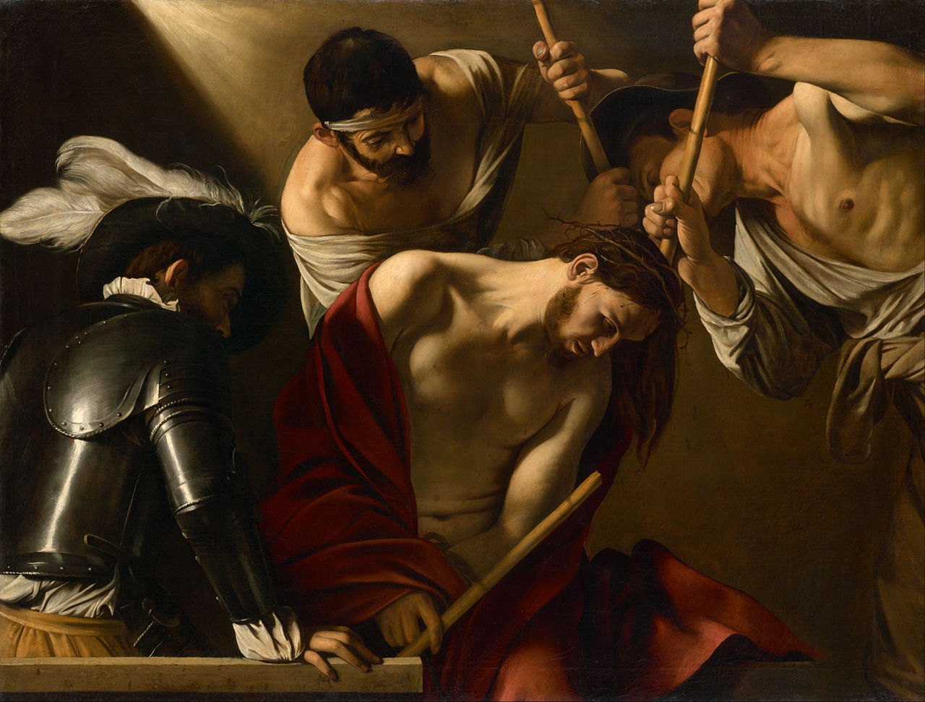
Caravaggio, The Crowning with Thorns (1602-1604)

Slide 11
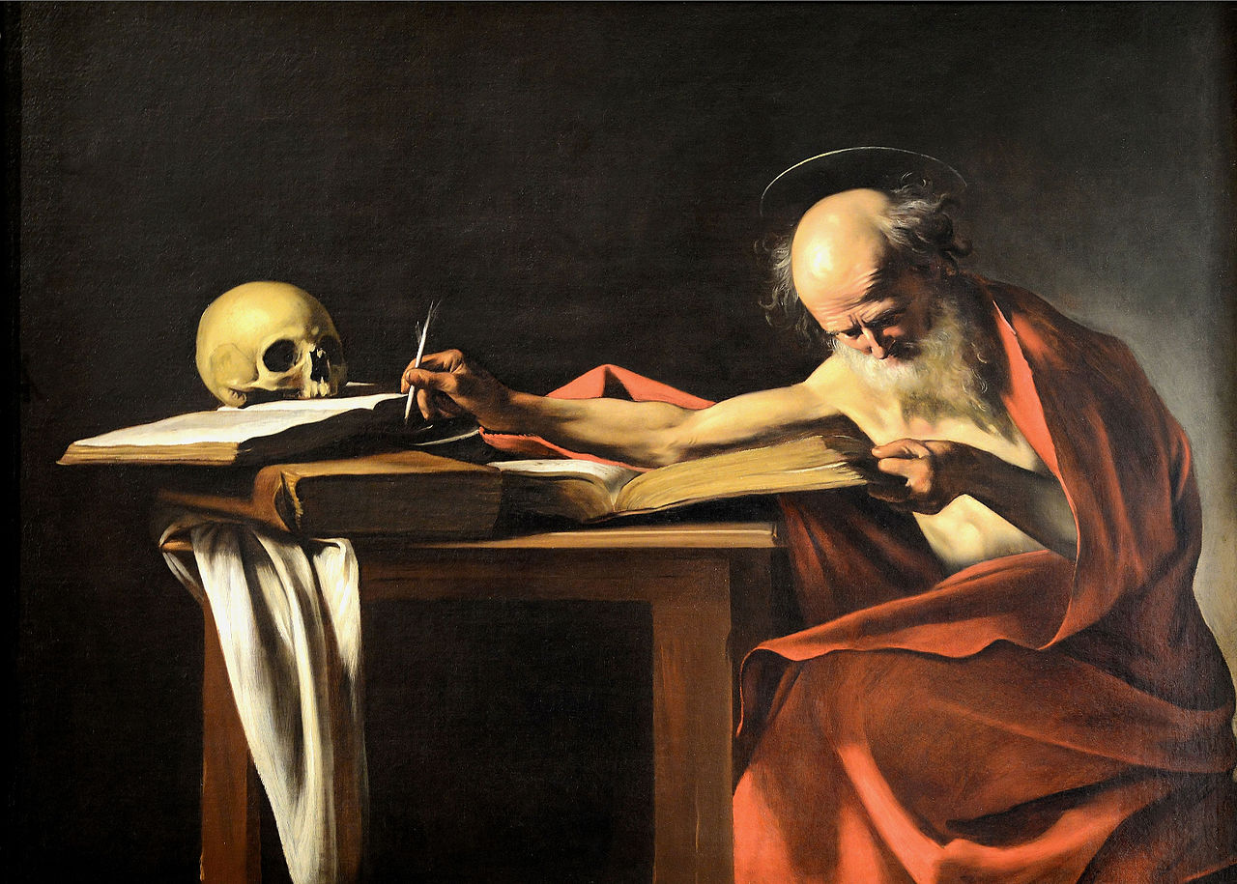
Caravaggio, St. Jerome (1610)

Slide 12
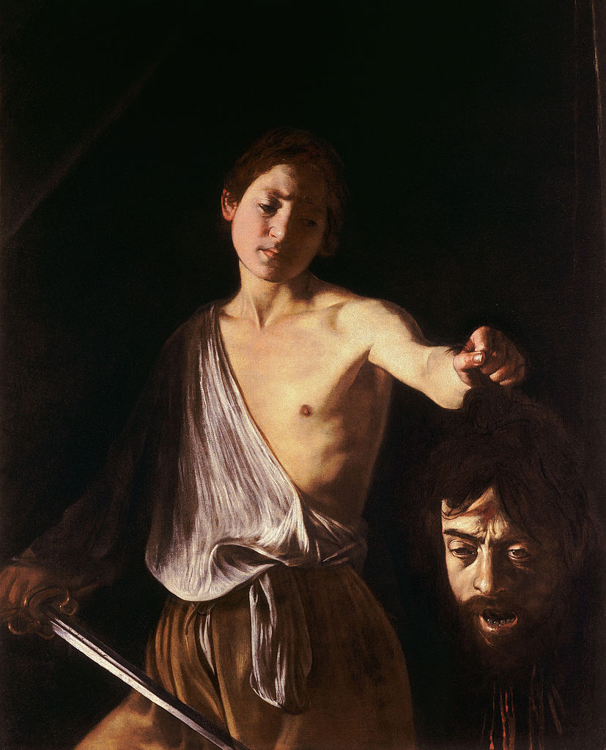
Caravaggio, David with the head of Goliath (1606-1607)

Slide 13
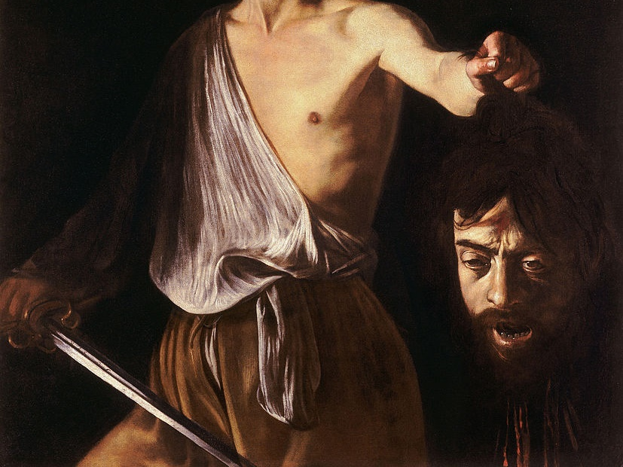
WHEN YOUR NECK FEELS
A LITTLE BAROQUE

Slide 14
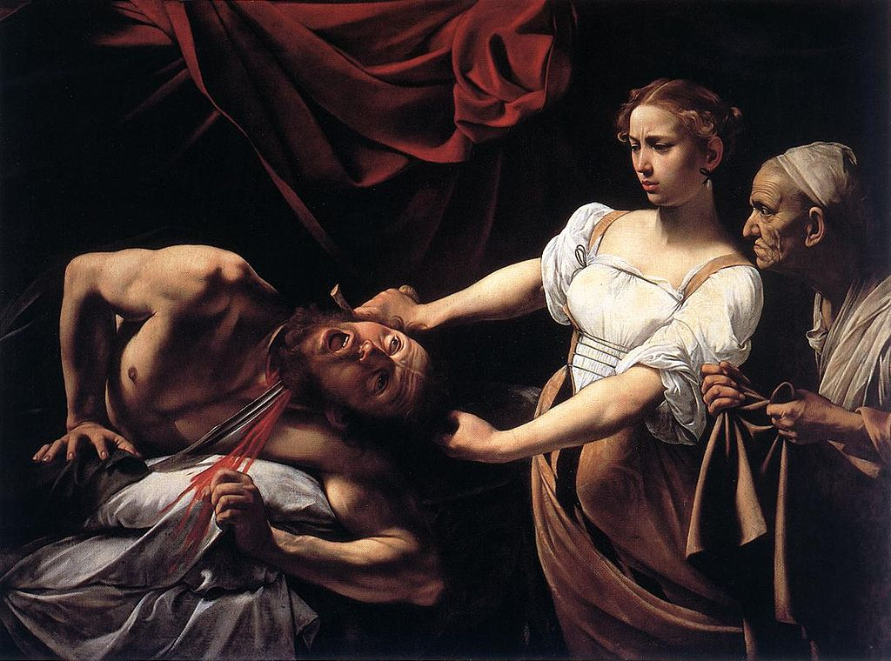
A Moment of Action and Emotion
Caravaggio, Judith Beheading Holofernes (1598-1599)

Slide 15
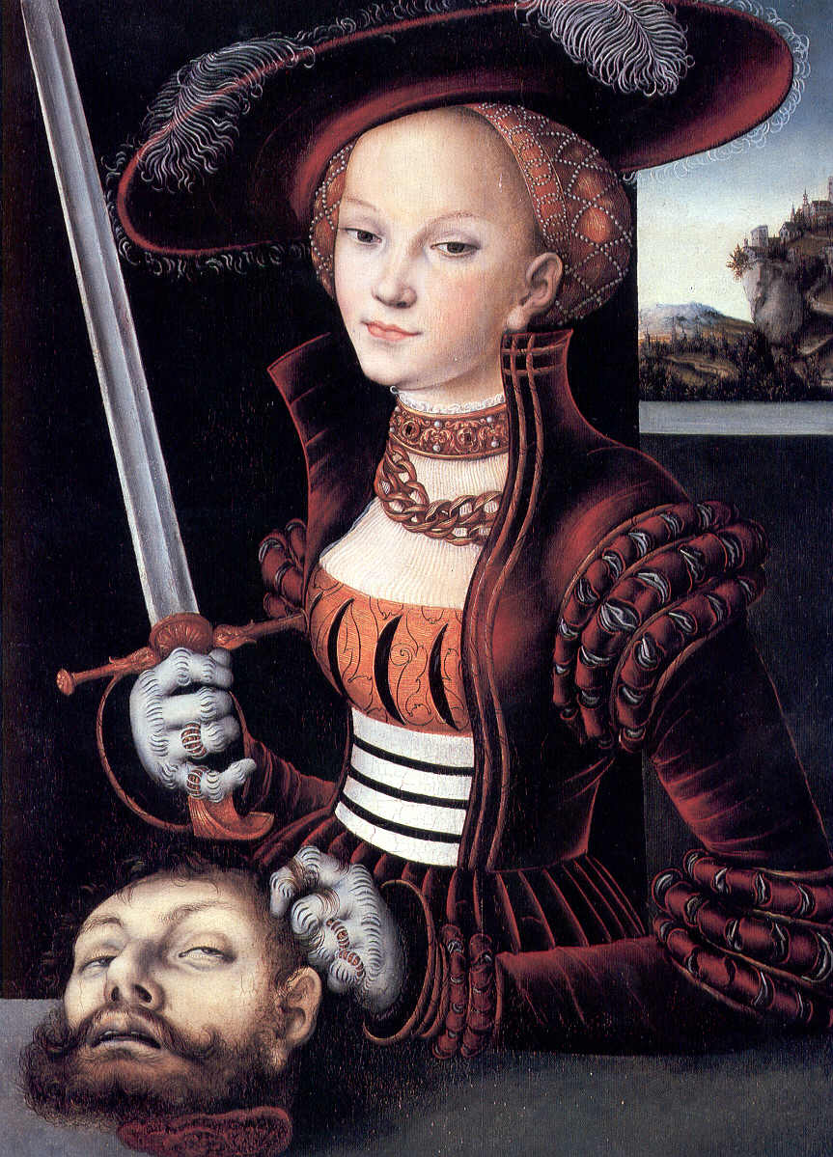
COMPARE
How does Caravaggio’s artistic interpretation of this story compare with Cranach’s?
Judith with the Head of Holofernes,
Lucas Cranach the Elder, 1530

Slide 16
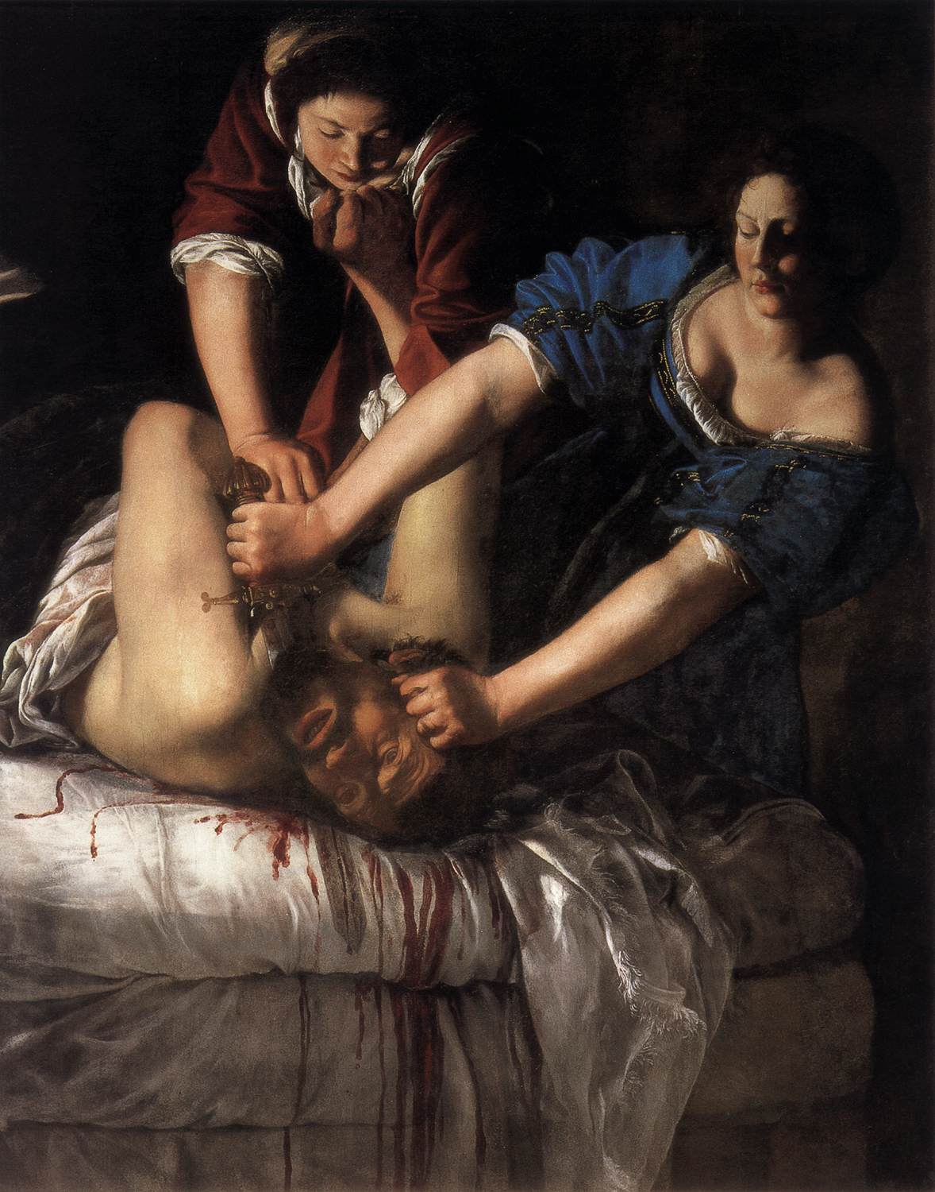
A Woman’s Interpretation
Artemisia Gentileschi’s painting of the same event was based on Caravaggio’s but offers a more intense perspective.
Judith Slaying Holofernes, Artemisia Gentileschi, c. 1620

Slide 17
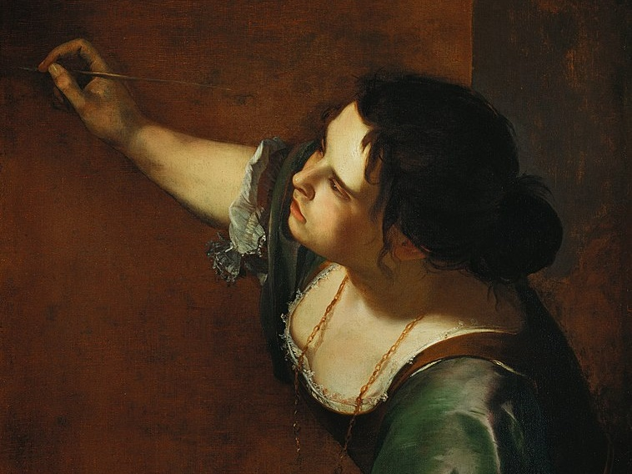
Artemisia Gentileschi
Self-Portrait as the Allegory of Painting, 1638–9

Slide 18
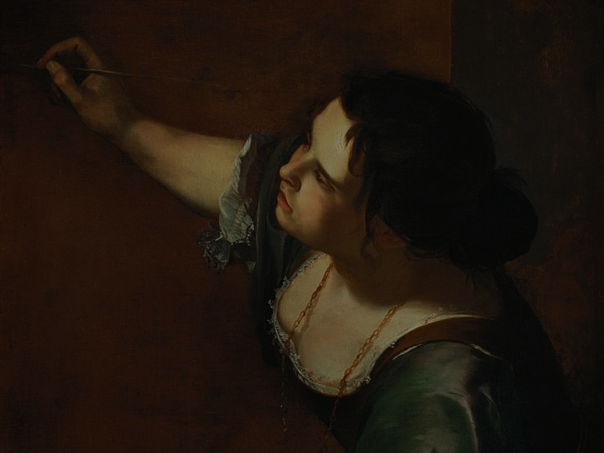
Artemisia Gentileschi, the daughter of a painter, was the first woman to be admitted into the Academy of Fine Arts of Florence.
As a young woman, she was raped by the man who was hired to be her tutor.
Self-Portrait as the Allegory of Painting, 1638–9

Slide 19
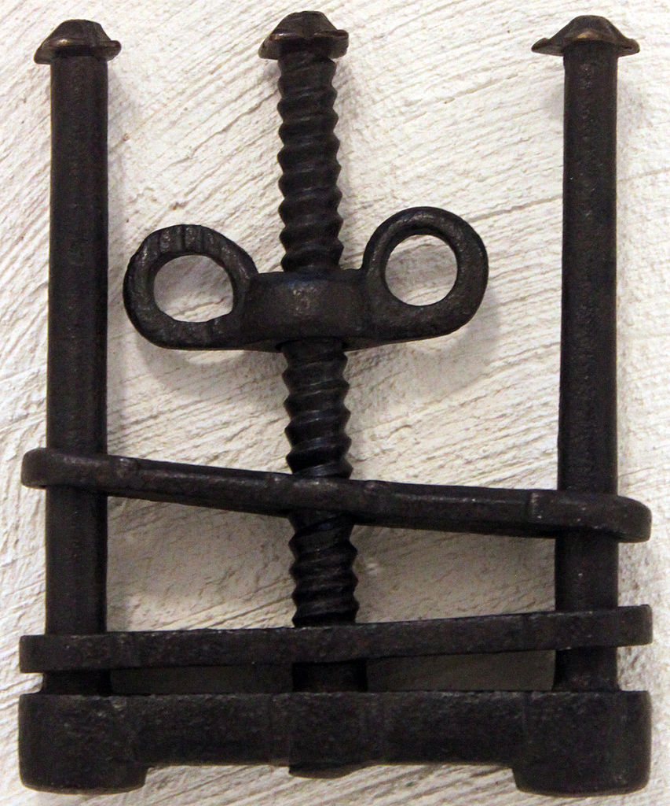
TORTURE
During the course of a seven month trial, Gentileschi was tortured with thumbscrews to test the veracity of her testimony against her rapist.
Photo by Anagoria

Slide 20
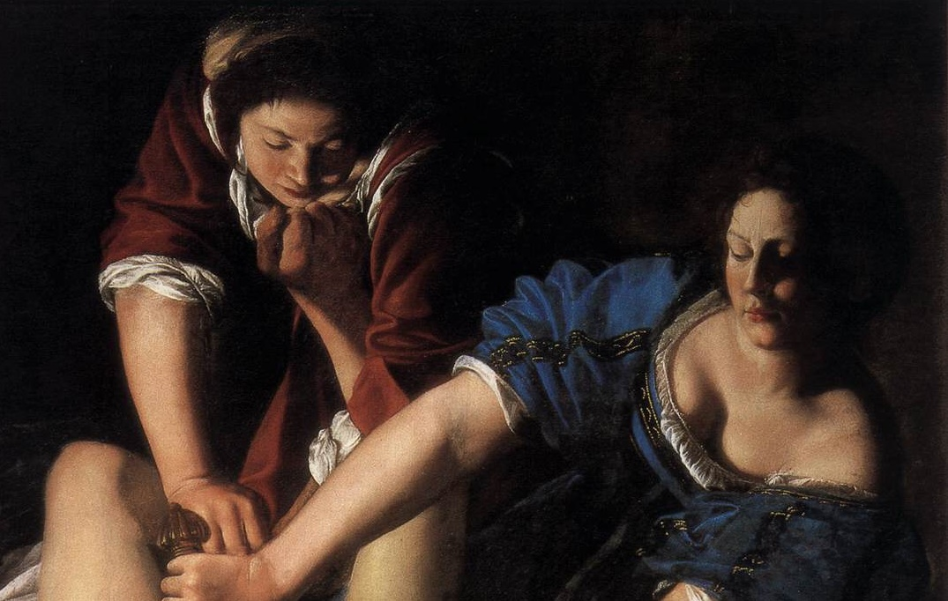
Let’s Take a Closer Look
Artemisia Gentileschi’s painting of the same event was based on Caravaggio’s but offers a more intense perspective.

Slide 21
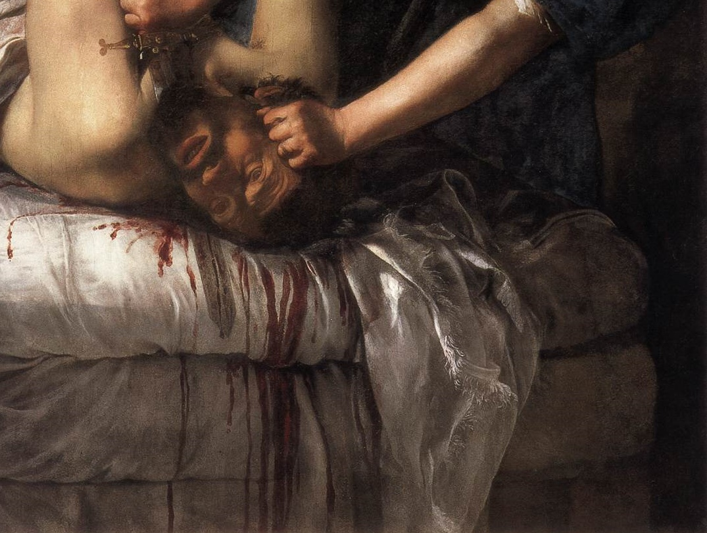
RAPIST
The Face of Her

Slide 22
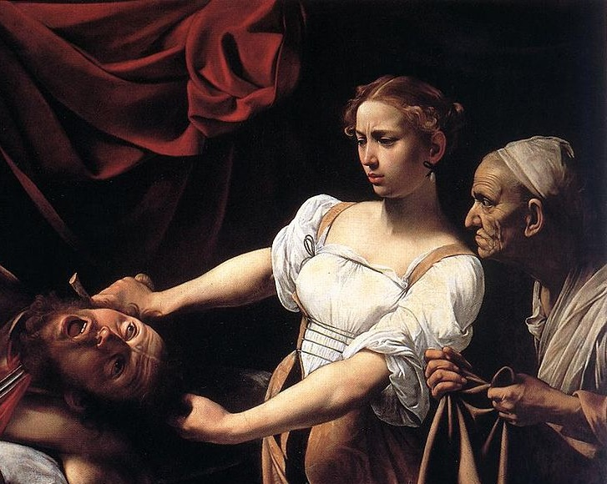
COMPARE
Artemisia Gentileschi’s painting of the same event was based on Caravaggio’s but offers a more intense perspective.

Slide 23
REVENGE

Slide 24
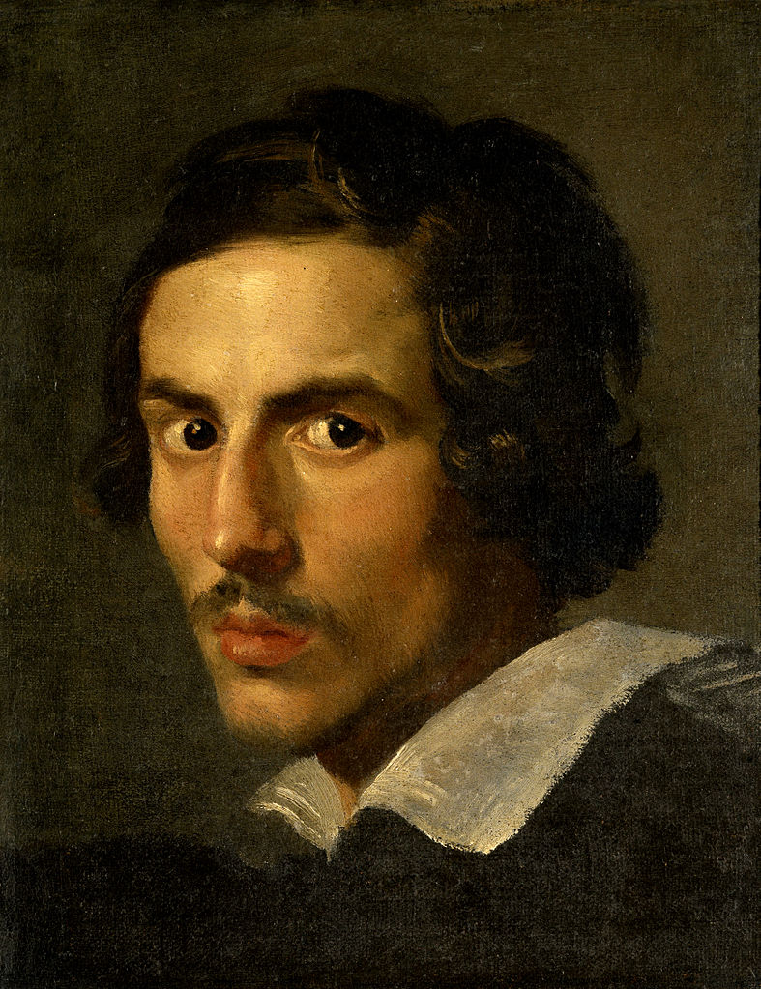
Bernini
Baroque Sculptor

Slide 25
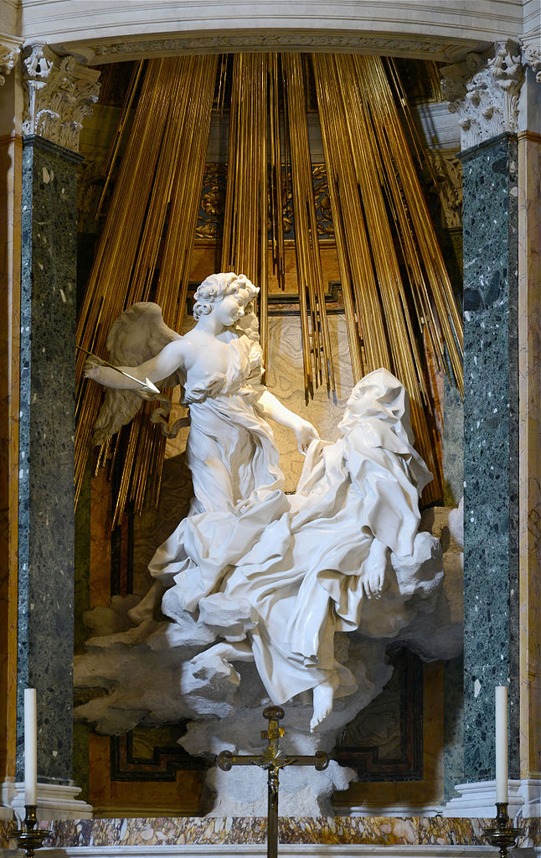
The Ecstasy of St. Teresa
Bernini
Santa Maria della Vittoria, Rome
Photo by Alvesgaspar

Slide 26
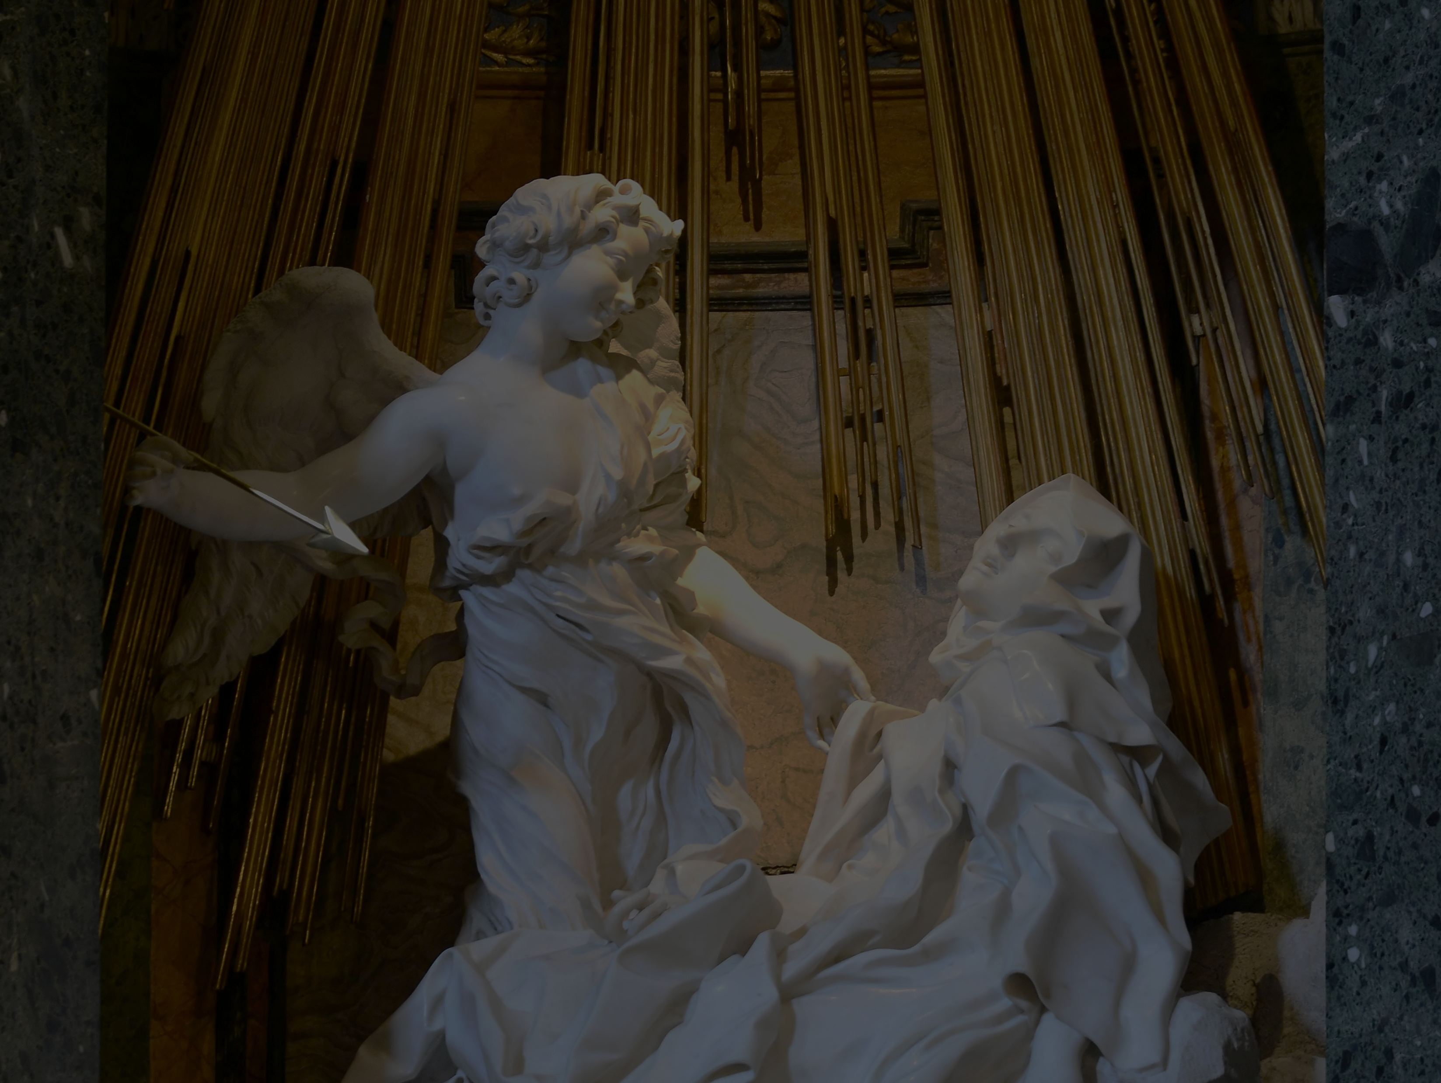
Transverberation
Spiritual Marriage
Photo by Alvesgaspar
Notes:
https://srhelena.blogspot.com/2009/08/st-teresas-transverberation.html

Slide 27
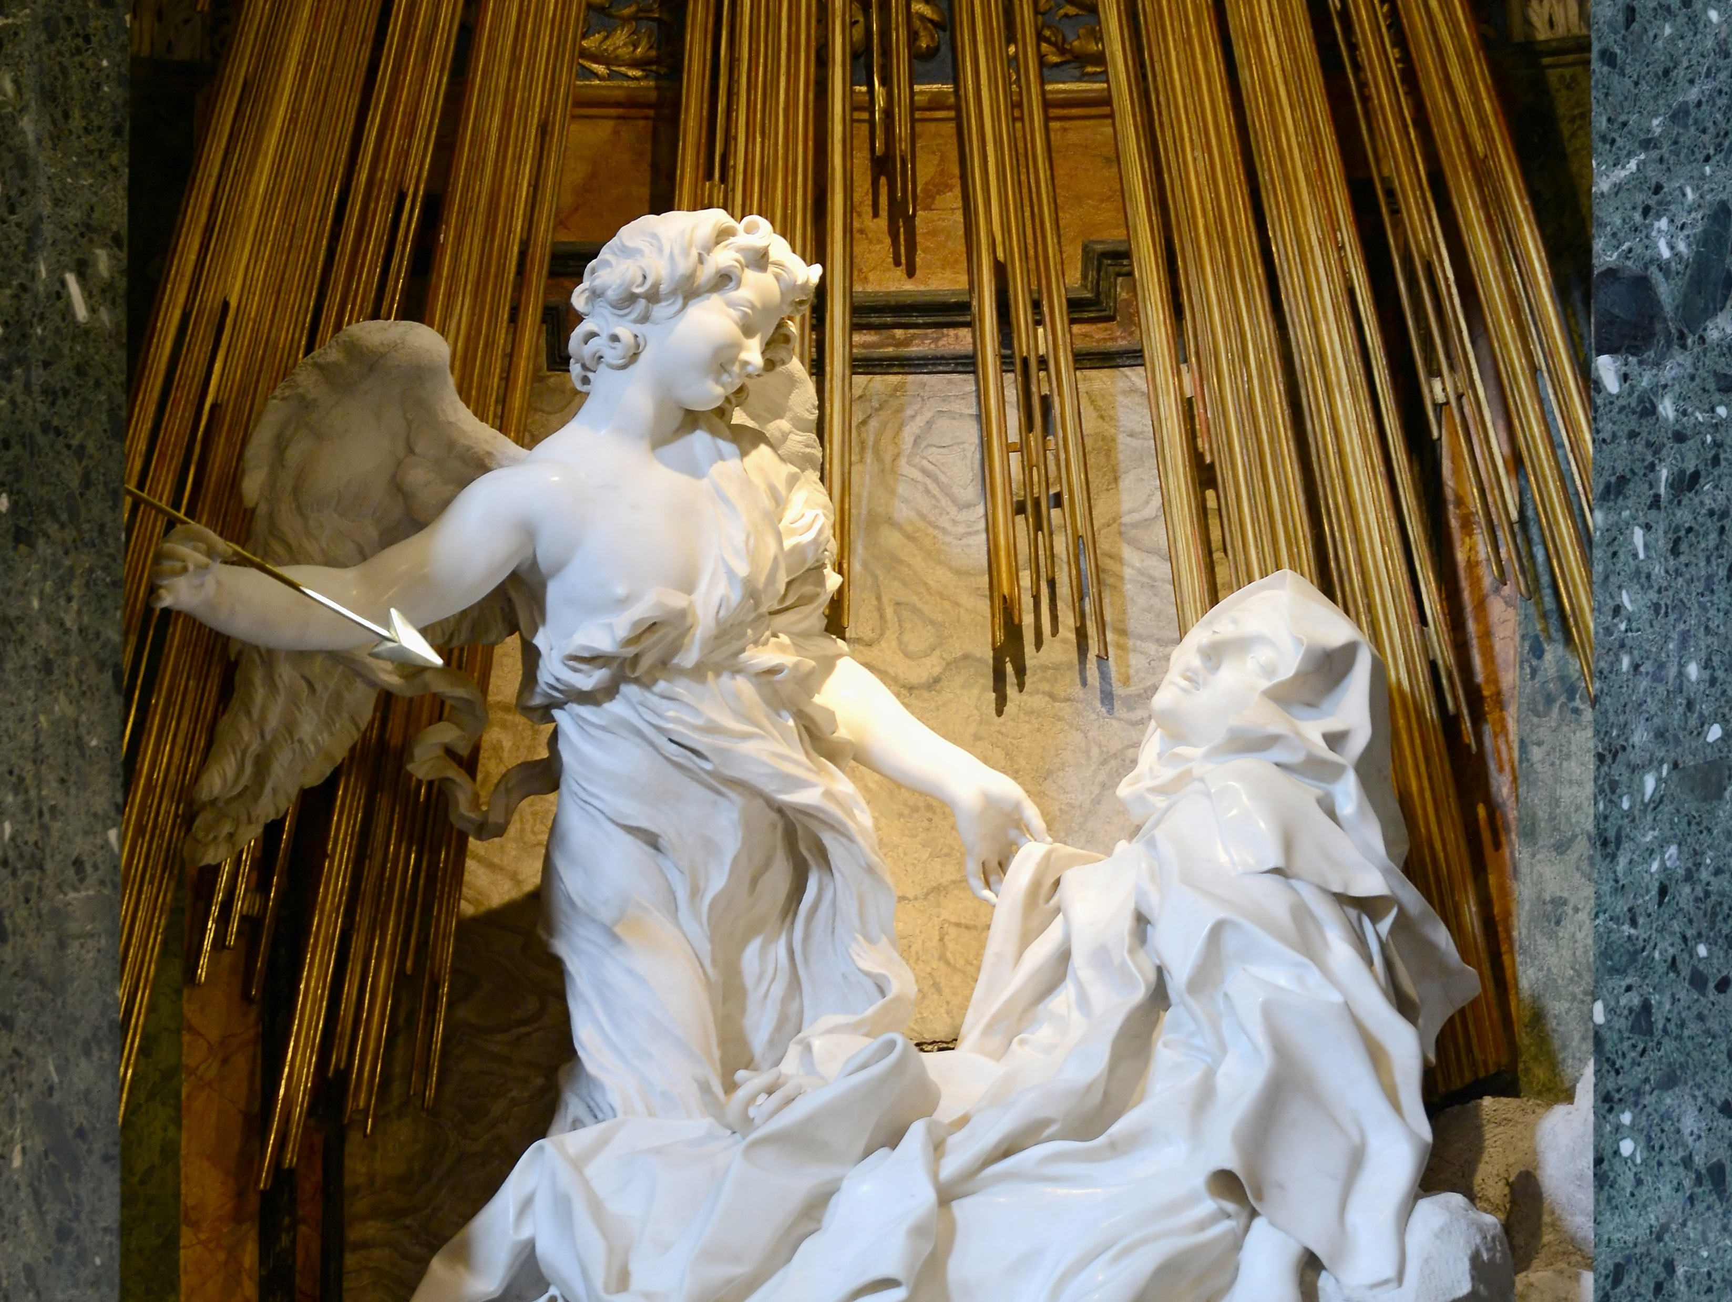
Photo by Alvesgaspar

Slide 28
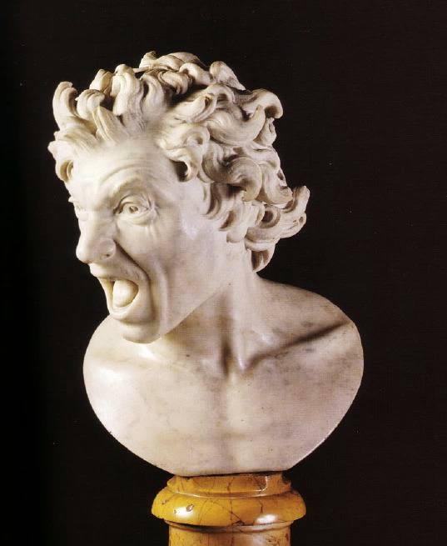
ETERNAL DAMNATION
GOT ME LIKE
A Damned Soul by Bernini
Photo by rjhuttondfw

Slide 29
David (Bernini)
Photo by Dennis Heller

Slide 30
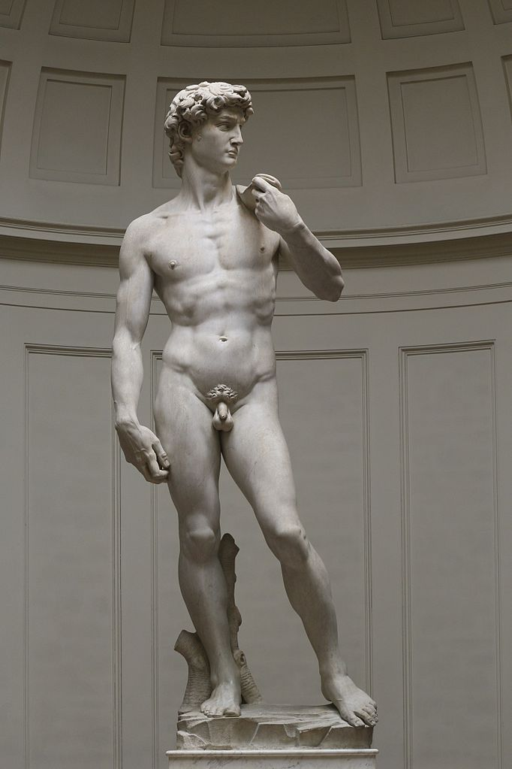
Compare
Photo by Dennis Heller
Photo by:
Jörg Bittner Unna

Slide 31
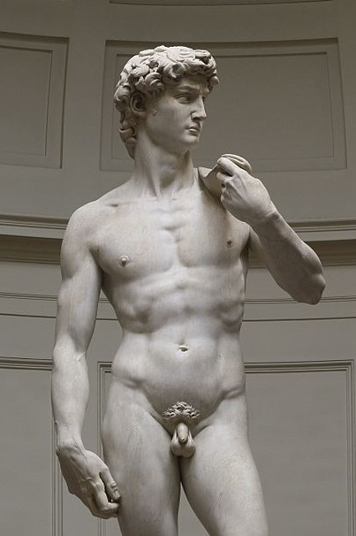

Slide 32
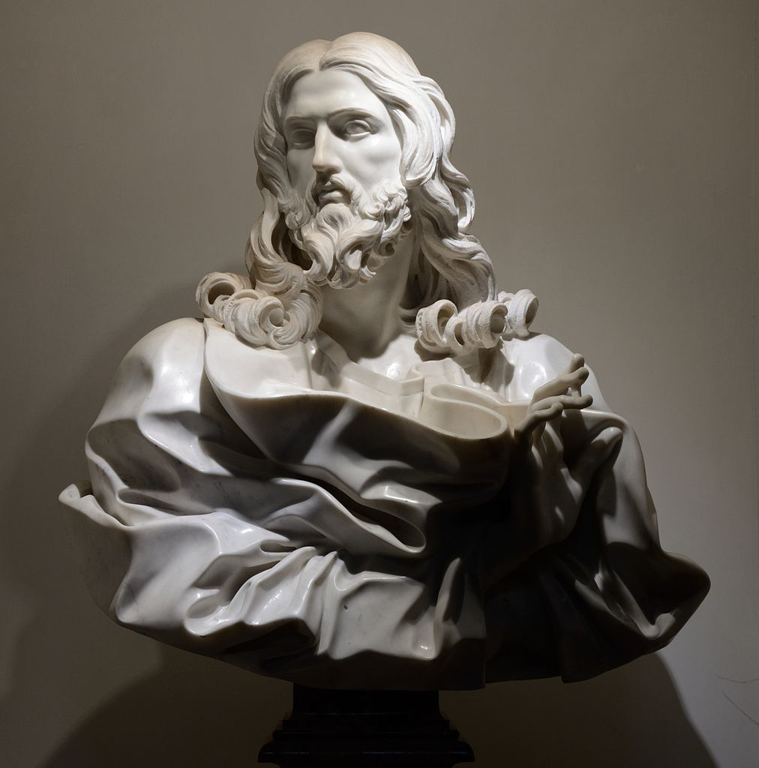
Bernini’s Jesus
Photo by Livioandronico2013

Slide 33
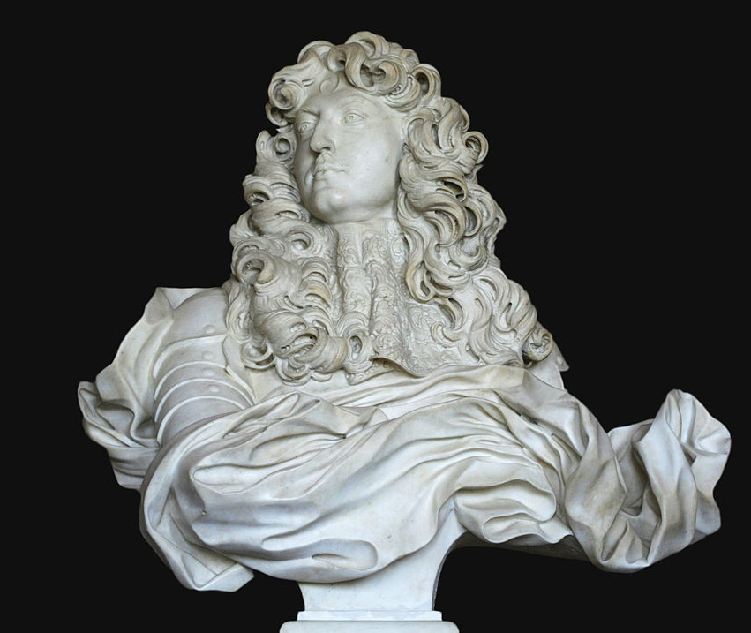
APPROPRIATED
BY THE ABSOLUTISTS
The grandeur of the Baroque style suited the purposes of absolute monarchs.
Bust of Louis XIV by Bernini
Photo by Coyau

Slide 34
Equestrian Statue of Louis XIV
(He didn’t like it.)
Photo by Fred Romero

Slide 35
St. Peter’s Square
Bernini as Architect
Photo by Matt Brisher

Slide 37
Wealth and Power
of the Catholic Church

Slide 38
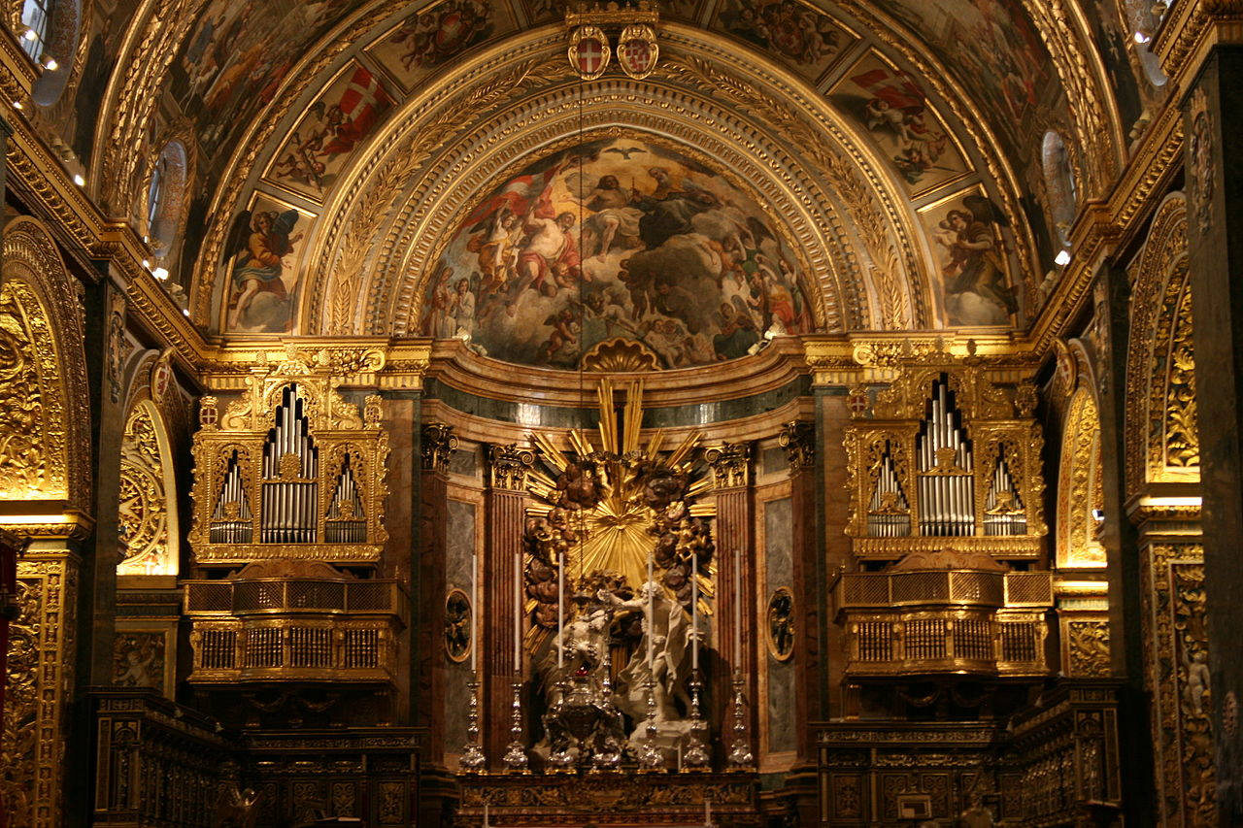
ALL GOLD EVERYTHING
The High Baroque altar of Saint John's Co-Cathedral
Photo by A,Ocram

Slide 39
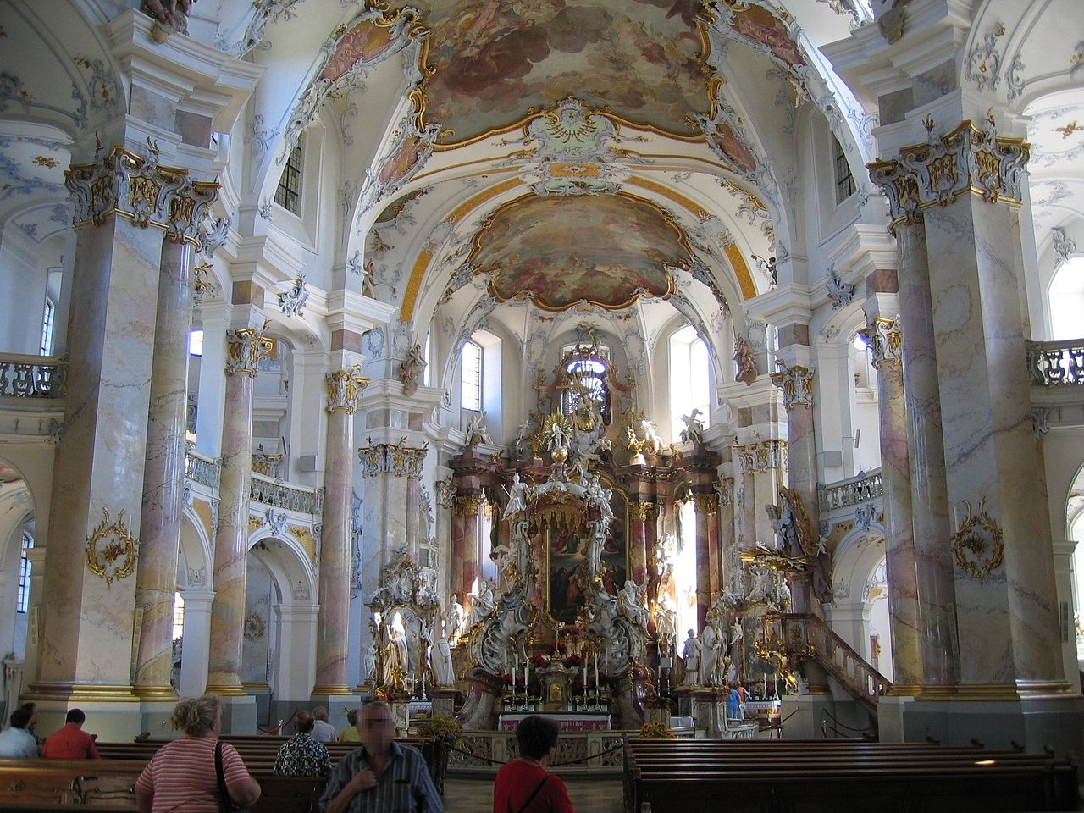
Interior of Vierzehnheiligen church in Bavaria
Photo by Asio otus

Slide 40
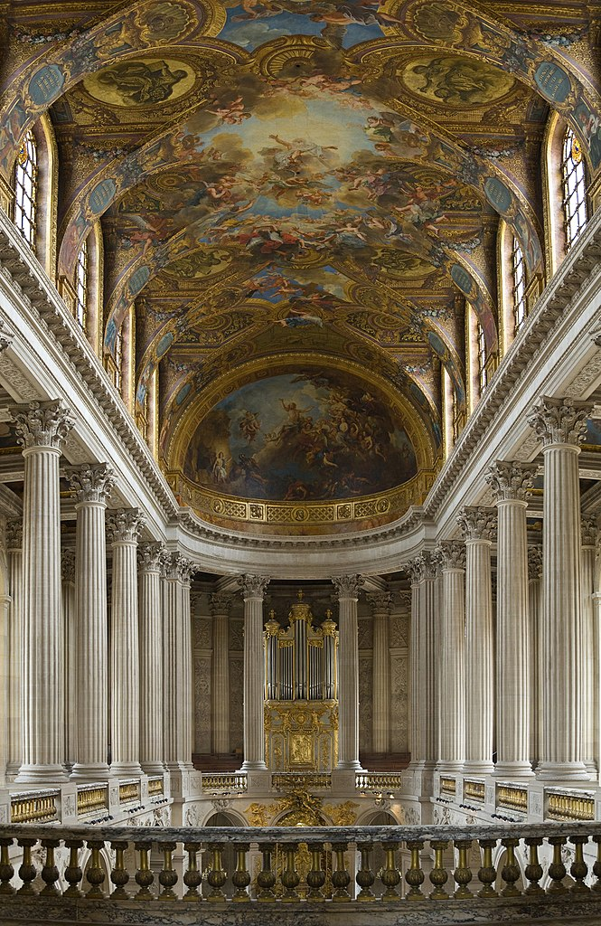
The Chapel at Versailles
The French Court adapted the Baroque style to project an unprecedented sense of grandeur.
Photo by Diliff

Slide 41
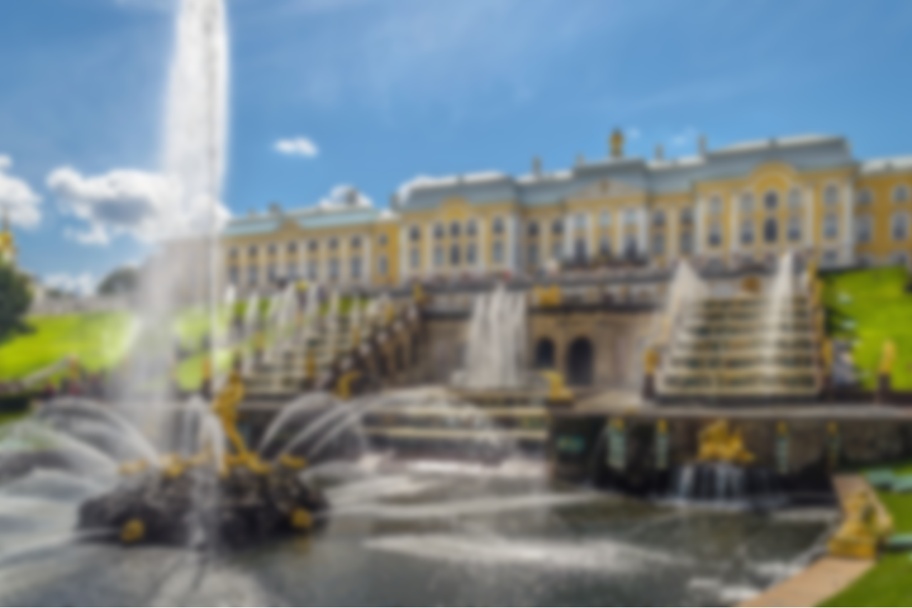
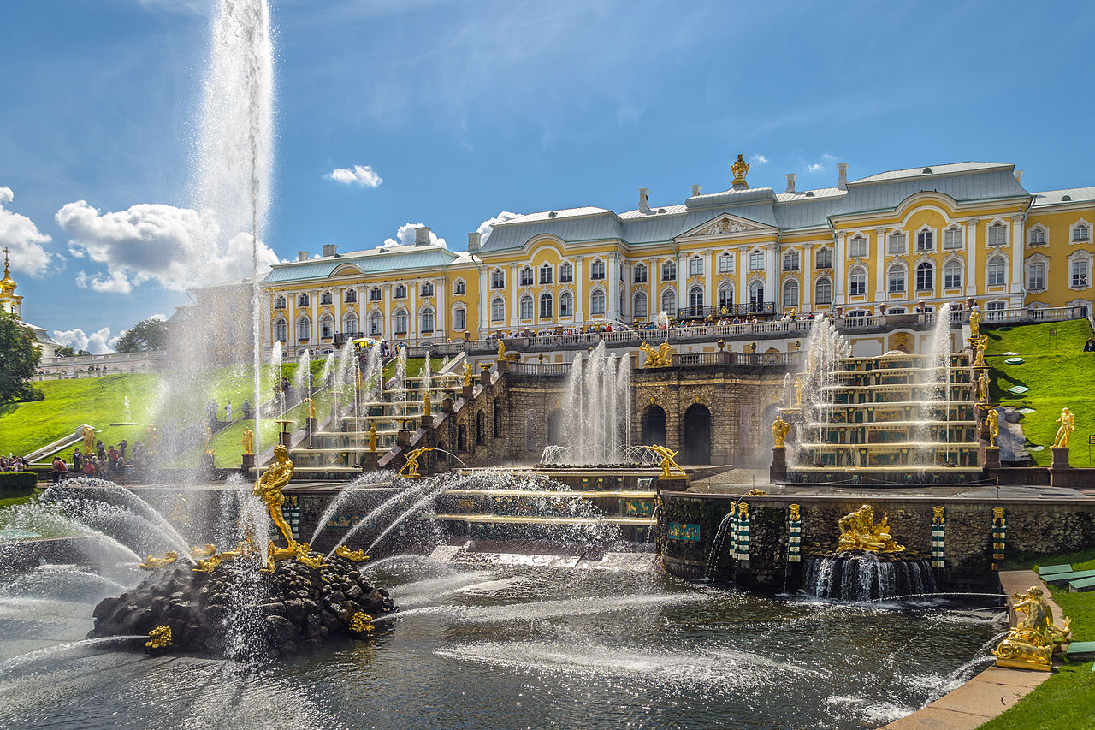
Grand Cascade of Peterhof
Photo by Florstein

Slide 42
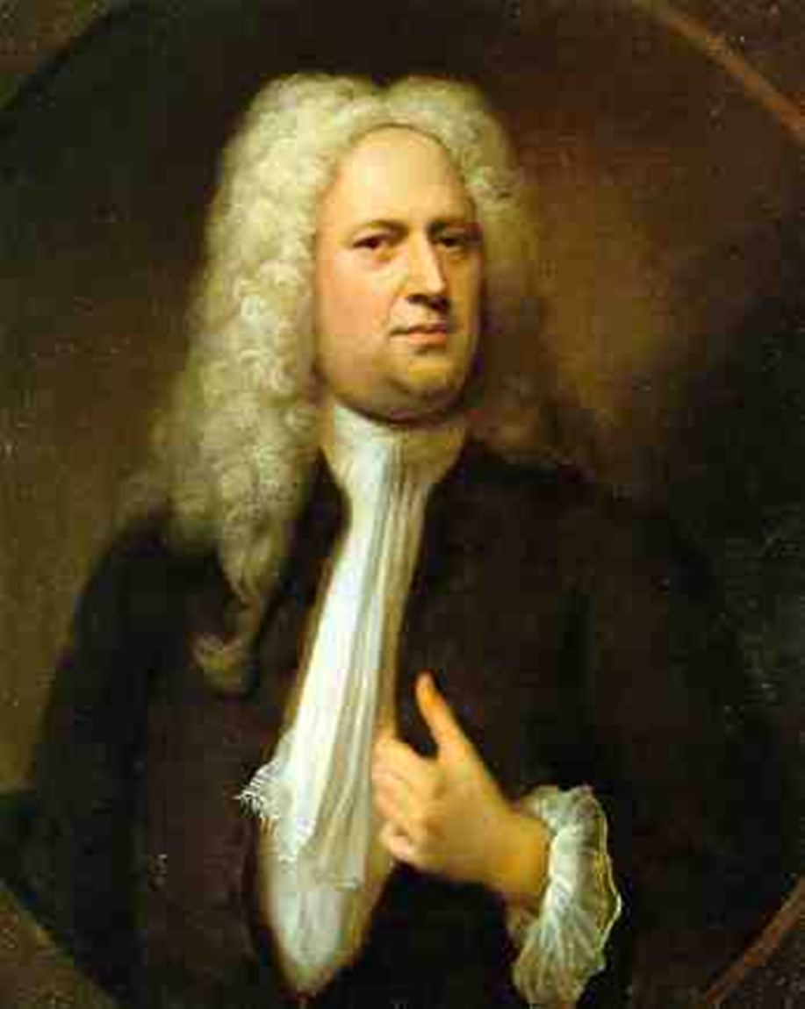
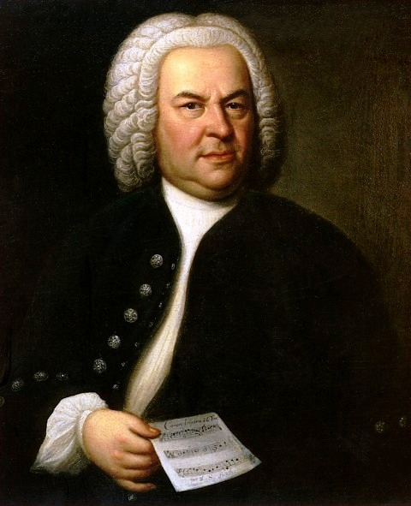
Baroque Music
Handel
Bach

Slide 43
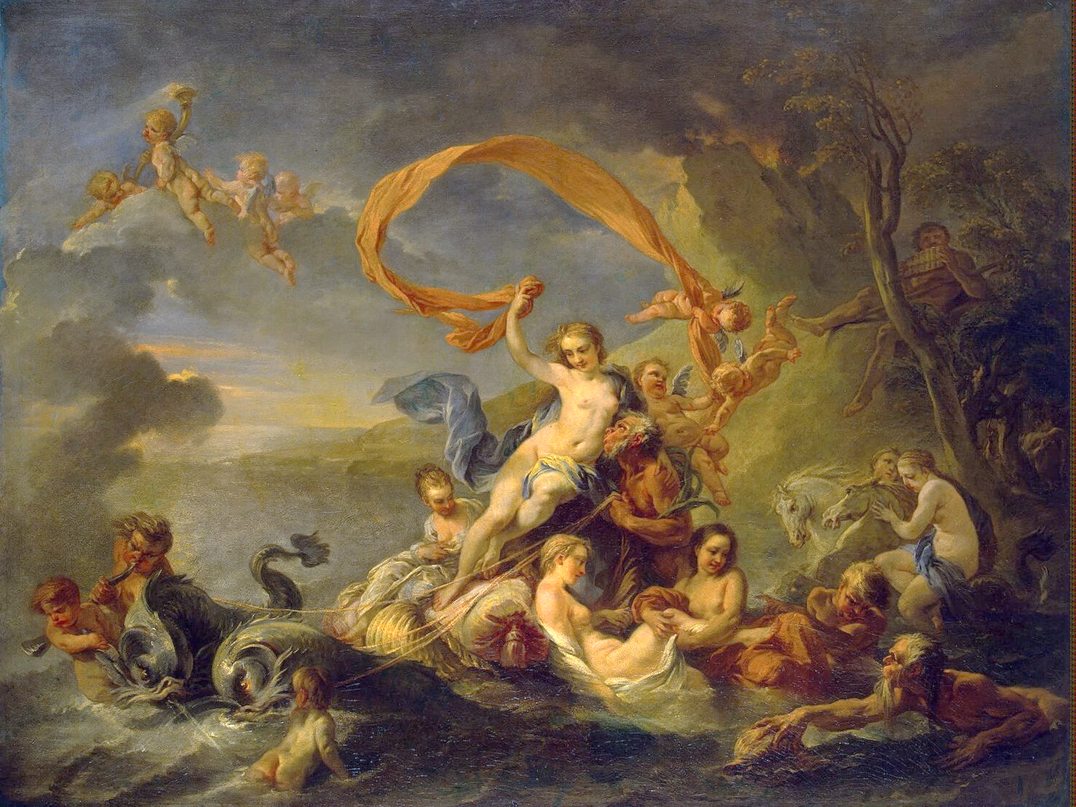
Rococo
“Late Baroque”
Jean-Baptiste van Loo, The Triumph of Galatea (1720)

Slide 44
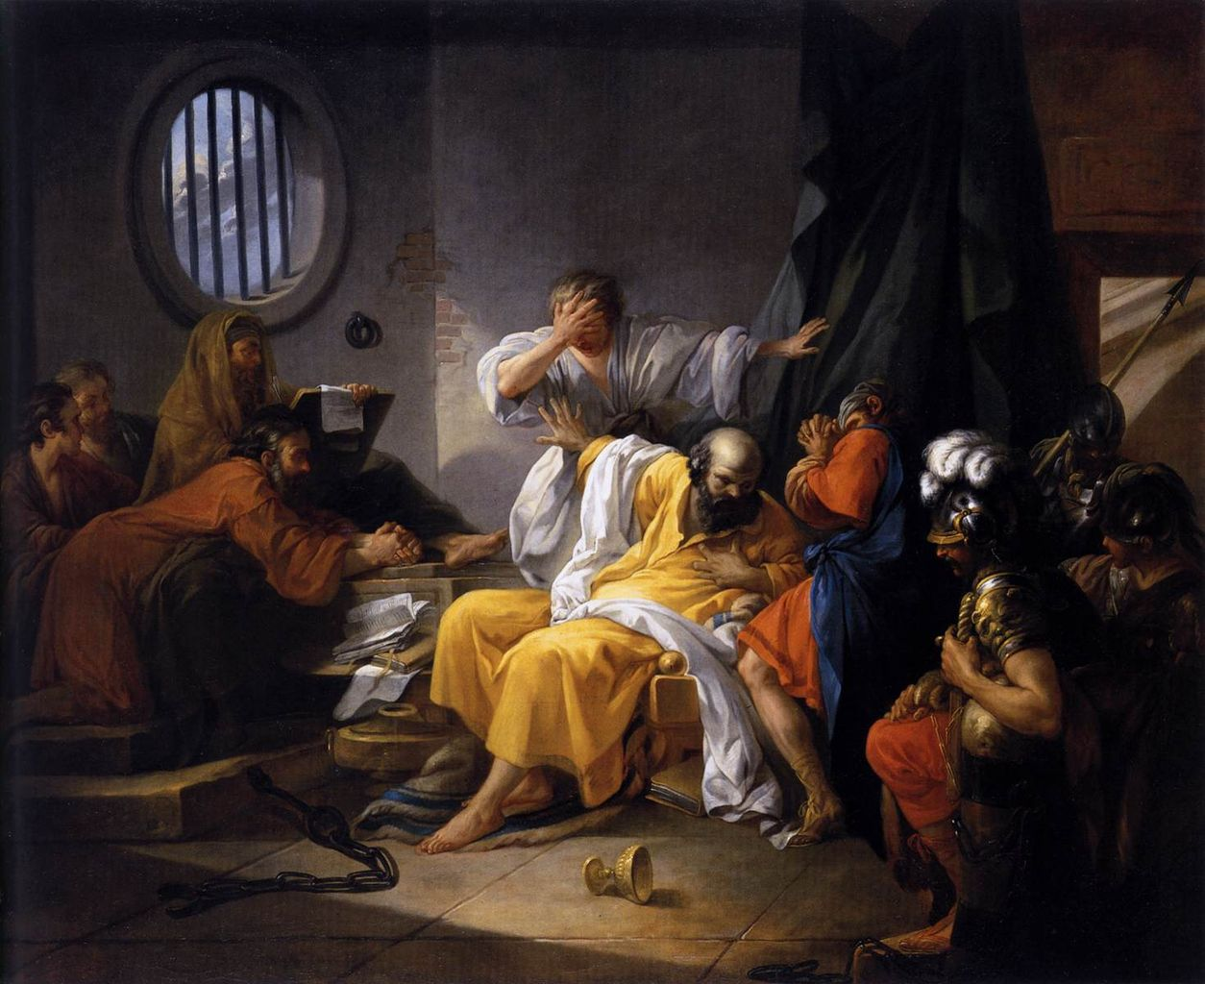
Jacques-Philippe-Joseph de Saint-Quentin,
The Death of Socrates (1762)

Slide 45
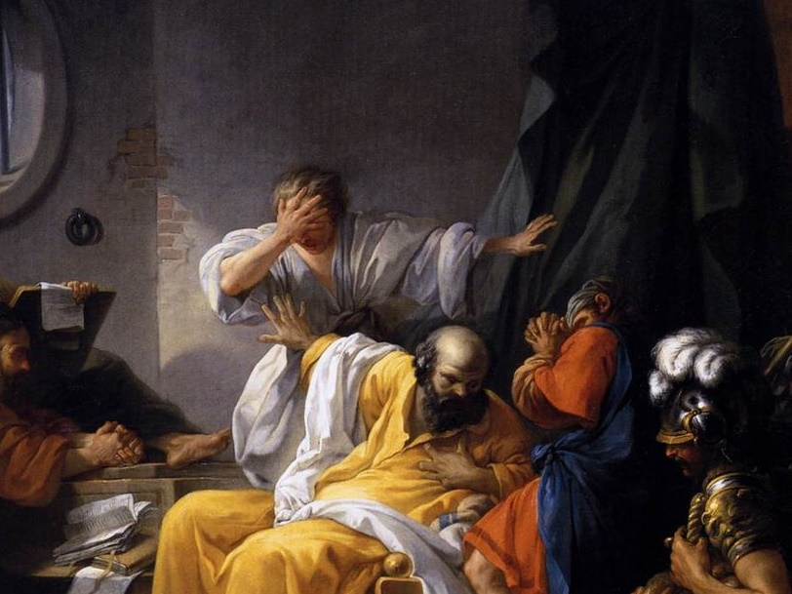
DAB ON THEM HATERS

Slide 46
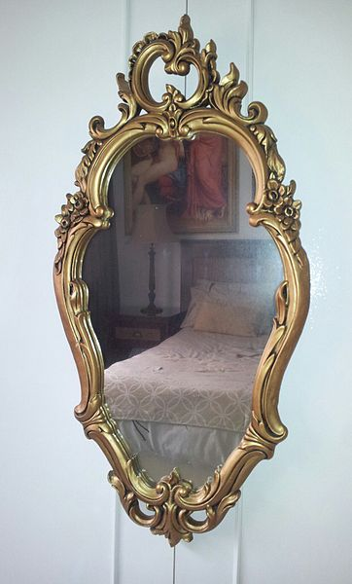
Rococo Mirror
Note the Asymmetrical Design
Photo by Aleph500Adam

Slide 47
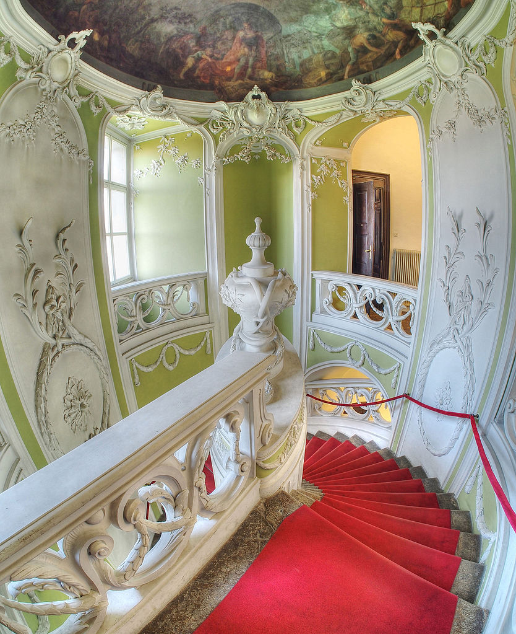
STAIRCASE
Photo by Petar Milošević

Slide 48
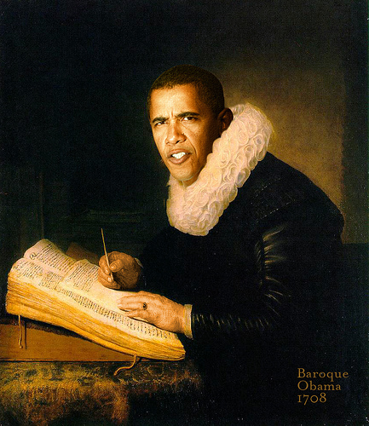
Baroque Obama

Slide 49
REVIEW
Baroque artists rejected Renaissance conventions to create art that projected a greater sense of grandeur, motion, and emotion.

Slide 50
REVIEW
The Catholic Church used Baroque art and architecture to enhance its stature during the Counter-Reformation.

Slide 51
REVIEW
Absolute monarchs used the grandeur of the Baroque style to show off their increasing wealth and power.

Slide 52
REVIEW
Rococo art pushed the Baroque to new limits of rejecting symmetry and restraint.

