Slide 1
State Building and the
Search for Order in the
Seventeenth Century
Chapter 15

Slide 2
Focus Questions
​What economic, social, and political crises did Europe experience in the first half of the seventeenth century?
​What was absolutism in theory, and how did its actual practice in France reflect or differ from the theory?
​What developments enabled Brandenburg-Prussia, Austria, and Russia to emerge as major powers in the seventeenth century?
​What were the main issues in the struggle between king and Parliament in seventeenth-century England, and how were they resolved?
​How did the artistic and literary achievements of this era reflect the political and economic developments of the period?

Slide 3
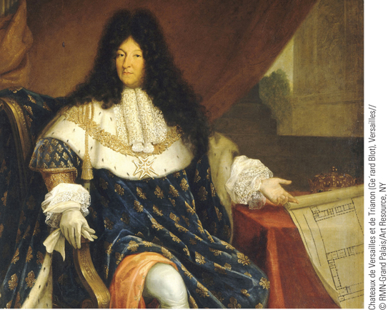
Nicolas-Rene´ Jollain the Elder’s portrait of Louis XIV captures the king’s sense of royal grandeur
p432
Notes:
Nicolas-Rene´ Jollain the Elder’s portrait of Louis XIV captures the king’s sense
of royal grandeur.

Slide 4
Social Crises, War, and Rebellions
The Coming of Crisis
  Economic contraction
  Changing population trends
The Witchcraft Craze: The spread of witchcraft
    Increased persecution and executions
      Accusations: allying and fornicating with the devil; causing harm
    Contributing factors
      Religious uncertainty
      Social conditions and changes to charity
    Women as primary victims
    1450-1750- 100,000 to 110,000 trials; 50 percent of the leading executions; 75 to 80% percent of executed were women (many older women)
    “Genderized mass murder” or gender neutral hysteria about witches?
    Decline

Slide 5
Continuing Superstition
Belief in magic and the occult persisted through the end of the 17th c.
  Witch hunts: 70,000–100,000 put to death, 1400–1700; 80% women
    Mostly in Germany- why?
  Maleficium: black or harmful magic
    Believed witches harmed their neighbors, attended sabbats, cannibalized children, and could fly.
  Village origins: “cunning” or “simple” folk helped people deal with problems.
    Having magic powers made someone important.
    Most vulnerable people in society often claimed to have such powers.

Slide 6
Continuing Superstition
Influence of the clergy:
  “simple” or cunning folk were spiritual authorities; competed with spiritual authority of the church.
  Powers are not innate to humans- they must come from God or the devil.
Political significance: Princes tried to exert authority over their villages and change “customary” laws.
  Way to show absolute political and spiritual authority over a village

Slide 7
Who were the witches??
80% were women, mostly single over 40.
Widows, midwives, and herbal healers were specifically targeted.
Malleus Malleficarum, or “The Hammer of Witches” by Heinrich Kramer
  Der Hexenhammer in German
    Argued women were naturally prone to witchcraft
  Misogyny Conspiracy: hatred of women at a time when women were starting to gain some freedoms.
    Sexual fear of strong/independent women

Slide 8
End of the witch hunts
Emergence of a more scientific world view.
Advances in medicine, rise of insurance companies and lawyers made people feel more secure against physical and natural calamities.
Witch hunts got out of hand… imagine that.
  Threat of anarchy

Slide 9
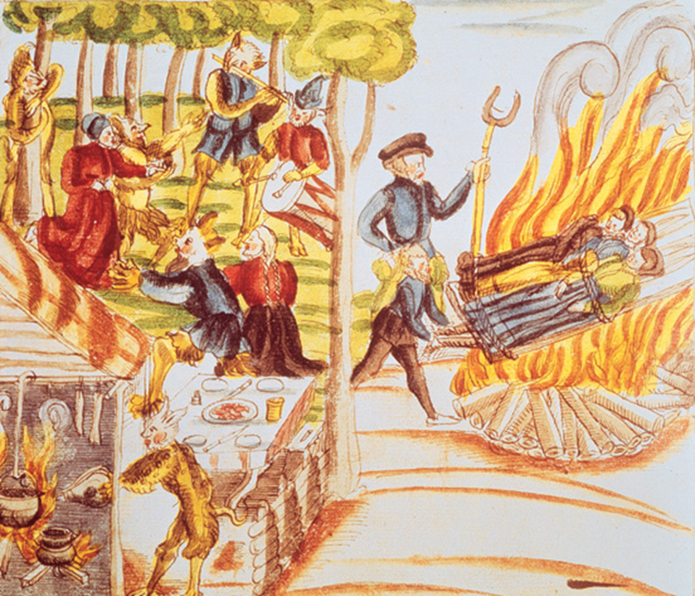
Three witches burned alive in Baden, Germany

Slide 10
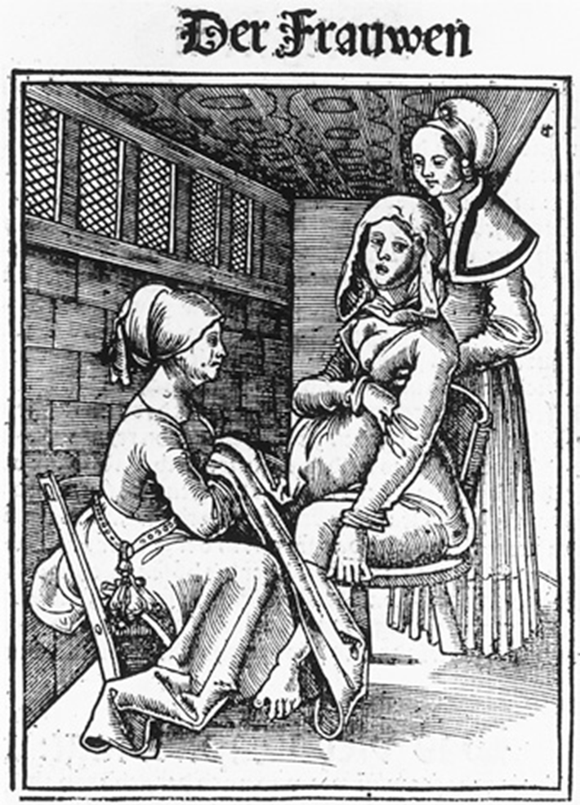
Midwives helping a woman in labor- why would midwives by accused of witchcraft?

Slide 11
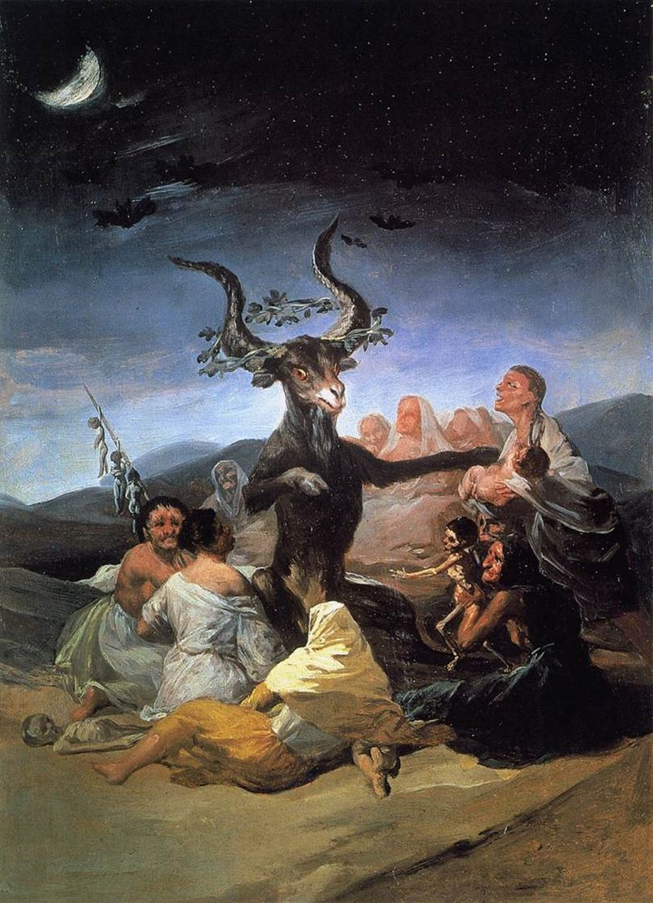
Francisco Goya’s
Witches Sabbat (1789)
Depicts the Devil flanked by Satanic witches. The witch-cult hypothesis states that such stories are based upon a real-life pagan cult that revered a horned god.

Slide 12


Slide 13
Social Crises, War, and Rebellions
The Thirty Years War (1618 – 1648)
  “Last of the religious wars”
  Background to the war
    Religious division and constitutional crisis in the Holy Roman Empire
  The Bohemian Phase (1618 – 1625)
  The Danish Phase (1625 – 1629)
  The Swedish Phase (1630 – 1635)
  The Franco-Swedish Phase (1635 – 1648)
  Outcomes of the War
    Peace of Westphalia (1648)
    End of the Holy Roman Empire
    Social and economic effects debated

Slide 14
Preconditions for The Thirty Years War
Fragmented Germany – Germany was an almost ungovernable land of 360 autonomous political entities.
    Was Europe’s highway for trade and travel.
    Peace of Augsberg gave them this sovereignty.
      Recognized rights of Lutherans, but not Calvinists.
      Many German states had become Calvinist
    After Council of Trent, Protestants were afraid that Catholics would attempt to recreate the Catholic Europe of pre-Reformation times.
Religious Divisions in the Holy Roman Empire
    Between the equally-numbered Catholics and Protestants
    Between liberal and conservative Lutherans
    Between Lutherans and Calvinists

Slide 15
Preconditions:
Ruler of the Palatinate: Frederick IV- a Calvinist.
  Forms the Protestant Union- a Protestant military league.
To his south: The Duke of Bavaria, Maximilian- a Catholic.
  Organizes the Catholic League in response.
Habsburgs want to strengthen rule over HRE.
  German princes resist- they want their rights.
Two armed alliances:
  Habsburgs vs. German princes
  (Spain, Austria) (aided by France and other Protestant kings)

Slide 16
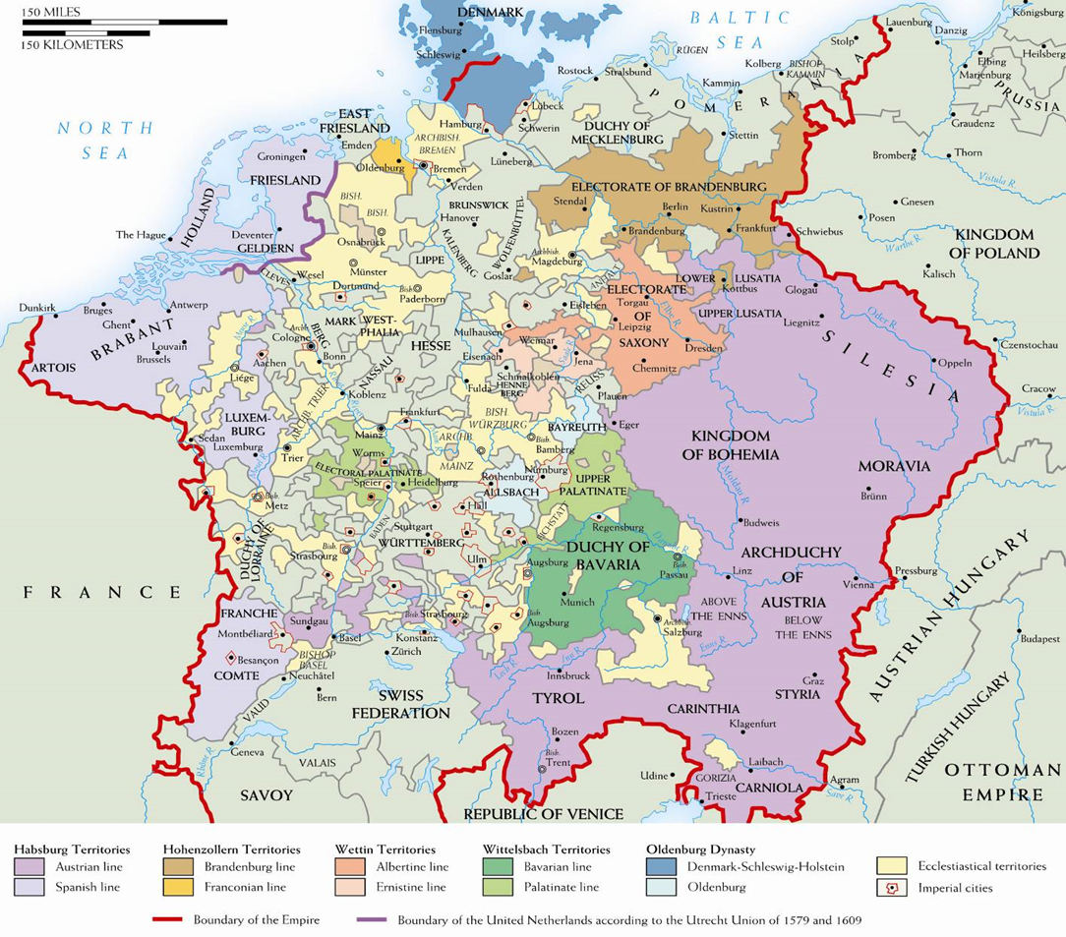
“Germany” in 1570

Slide 17
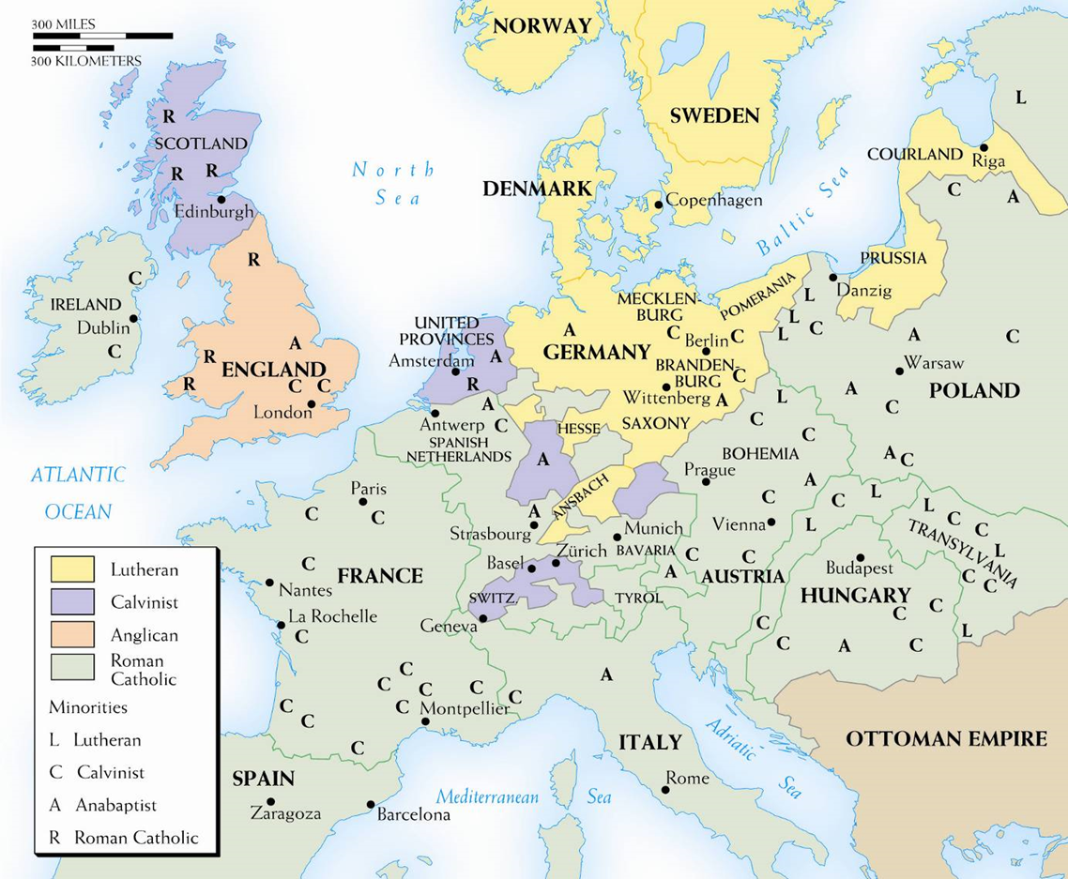
Religious divisions in Europe- 1600
Remember: Edict of Nantes in France- 1598

Slide 18
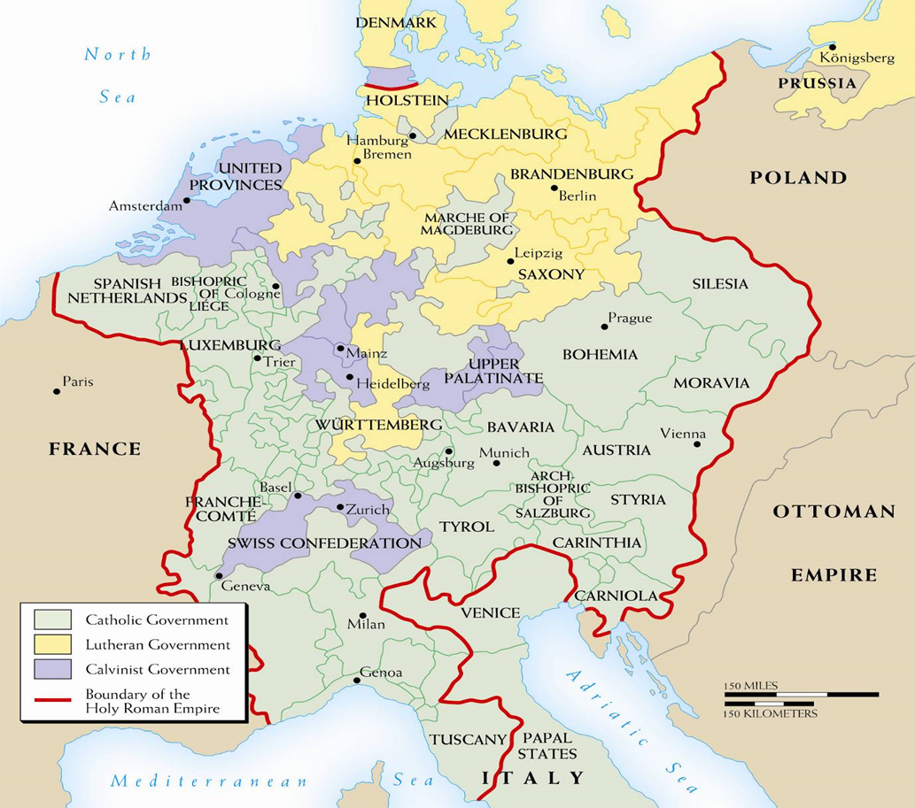
The Holy Roman Empire, 1618

Slide 19
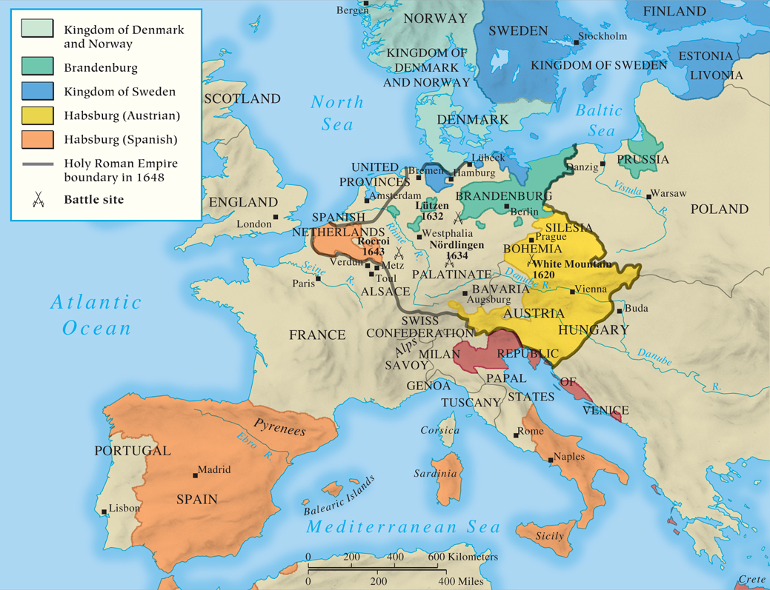
MAP 15.1 The Thirty Years’ War
Map 15.1 p436
Notes:
MAP 15.1 The Thirty Years’ War. The conflict began in the German states as Europe’s major
powers backed either the northern Protestant Union or the southern Catholic League. As the war
progressed, religion receded in importance, replaced by a dynastic struggle between the French
Bourbons and the Spanish and Austrian Habsburgs.

Slide 20
1: The Bohemian Phase: 1618-1625
Bohemia: a Habsburg territory
Calvinist Bohemian nobles revolt against their king, Habsburg Archduke Ferdinand
  He wants to re-Catholicize Bohemia
THE DEFENESTRATION OF PRAGUE starts the conflict.
Bohemians seize control and elect their man as ruler of the Palatinate(Frederick IV).
Meanwhile… Ferdinand is now HR Emperor. (#Awkward)
  Spain comes to his aid, and they defeat the Protestants at White Mountain- 1620
  Spain invades the Palatinate, Frederick flees to United Provinces (Netherlands), so Spain attacks the Dutch again.
WINNER: #TeamCatholics #HabsburgsRule

Slide 21
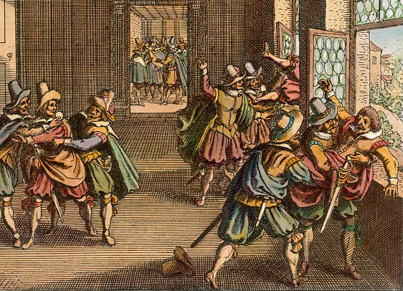
The Defenestration of Prague

Slide 22
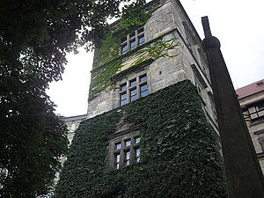
The window at Prague Castle

Slide 23
2: The Danish Phase (1625-1629)
King Christian IV of Denmark- a Lutheran
  Intervenes on Protestant behalf; invades northern Germany
Meanwhile…
  HRE Ferdinand doesn’t trust Duke Maximilian, so he hires Protestant mercenary Albrecht von Wallenstein.
  He humiliates King Christian, takes Baltic ports, and marks the end of Danish supremacy in the north.
Ferdinand issues the Edict of Restitution:
  All property taken from Catholic Church is given back
German princes fear he is too powerful and force him to fire Wallenstein.
WINNER: #TeamCatholic #WallensteinIsScary

Slide 24
3. The Swedish Phase (1630-1635)
King Gustavus Adolphus of Sweden- a Lutheran
  Military genius; changes warfare forever.
  Invades northern Germany and chases Catholics to central Germany.
  Ferdinand rehires Wallenstein.
  1632- Sweden wins at Lutzen, but Gustavus Adolphus is killed in the battle.
  1634- Ferdinand has Wallenstein assassinated.
    This shows the war’s real motives: greed and politics.
    Then the HRE defeats the Swedes, guaranteeing that southern Germany will remain Catholic.
    Ferdinand tries to make peace by revoking the Edict of Restitution, but the Swedes want revenge, and call on their friends: the French.
  WINNER: #TeamNobody #Thiswarispointlessnow

Slide 25
4. The French-Swedish Phase (1635-1648)
Longest, deadliest, most brutal phase
Religious issues were forgotten and irrelevant now: it’s just war for the sake of war.
  Purely political, but also resentful and bitter
  Spanish, Swedish, and French troops tear each other apart in Germany.
France (Catholic!) allies with Sweden and Germans to fight against the Austrian and Spanish Hapsburgs.
  France is led by Cardinal Richelieu
  By 1648, 1/3 of Germany’s population had been killed.
  WINNER: #Nobody #HabsburgsWereWeakened #AtLeastWeHaveWestphalia

Slide 26
The Aftermath
German towns were destroyed
European trade was crippled
Massive inflation in Germany
Agriculture was destroyed → Famine
8 million dead (worst tragedy since the Plague)
At the beginning, it was Catholics vs. Protestants.
By the end, Habsburg power was threatened, and war was about greed, revenge, and politics.
But Europeans, exhausted from war, craved peace:
  The Peace of Westphalia

Slide 27
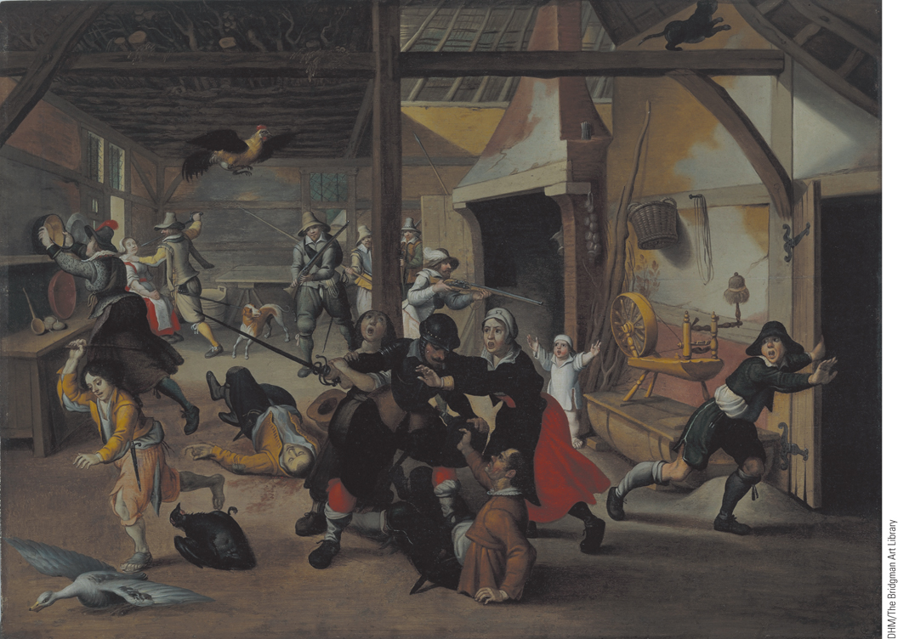
The Thirty Years’ War: Soldiers Plundering a Farm
This 1620 painting shows a group of soldiers running amok and plundering a farm. This scene was typical of many that occurred during the Thirty Years’ War, especially in Germany, where the war caused enormous destruction.
p437
Notes:
The Thirty Years’ War: Soldiers Plundering a Farm. (p.437)
This 1620 painting shows a group of soldiers
running amok and plundering a farm. This scene was typical of many that occurred during the Thirty Years’
War, especially in Germany, where the war caused enormous destruction.

Slide 28
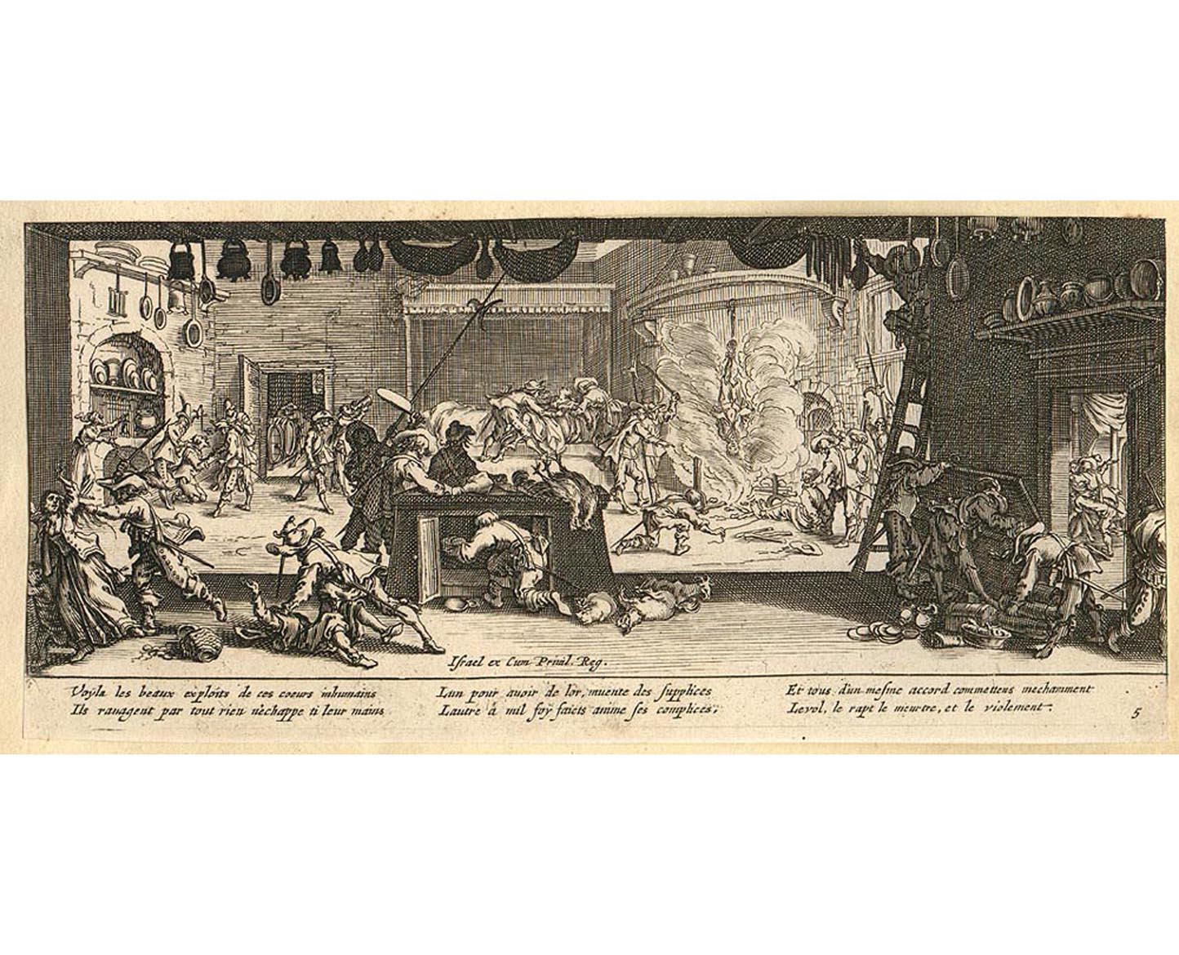
Jacques Callot: The Miseries of War
The Plundering of a Farm

Slide 29
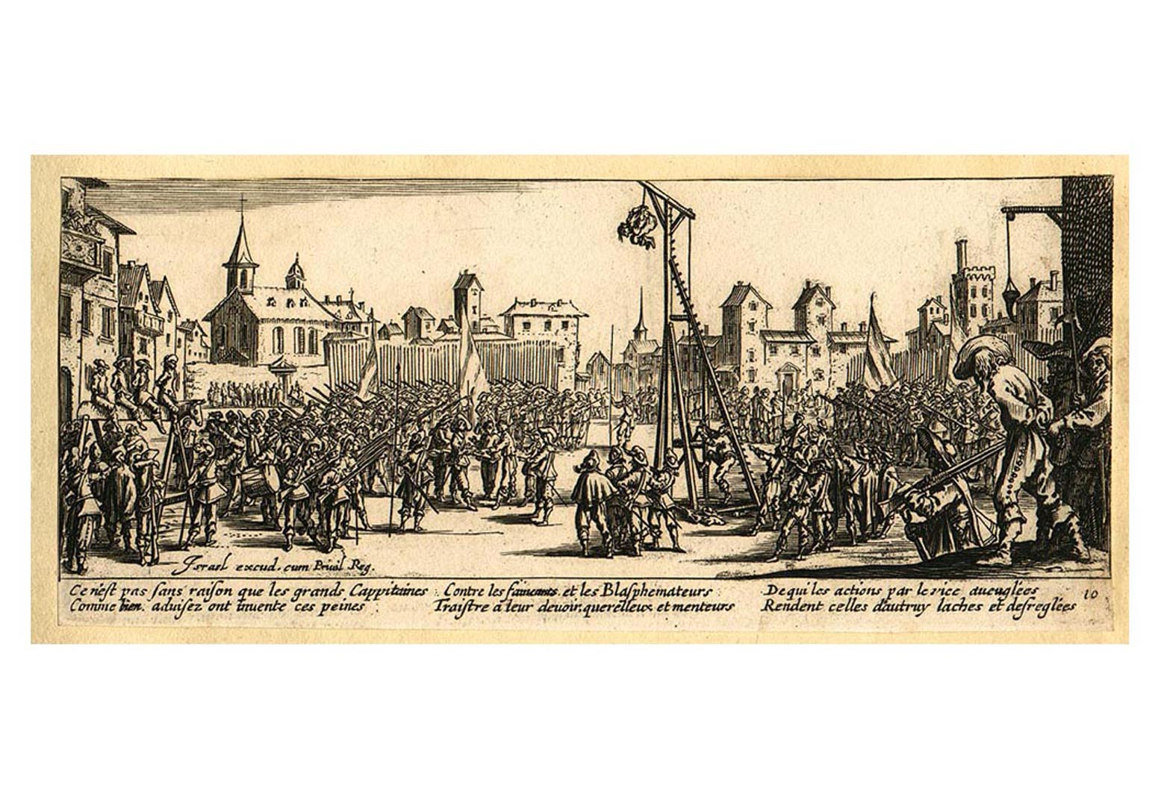
Jacques Callot: The Miseries of War
The Strapado

Slide 30
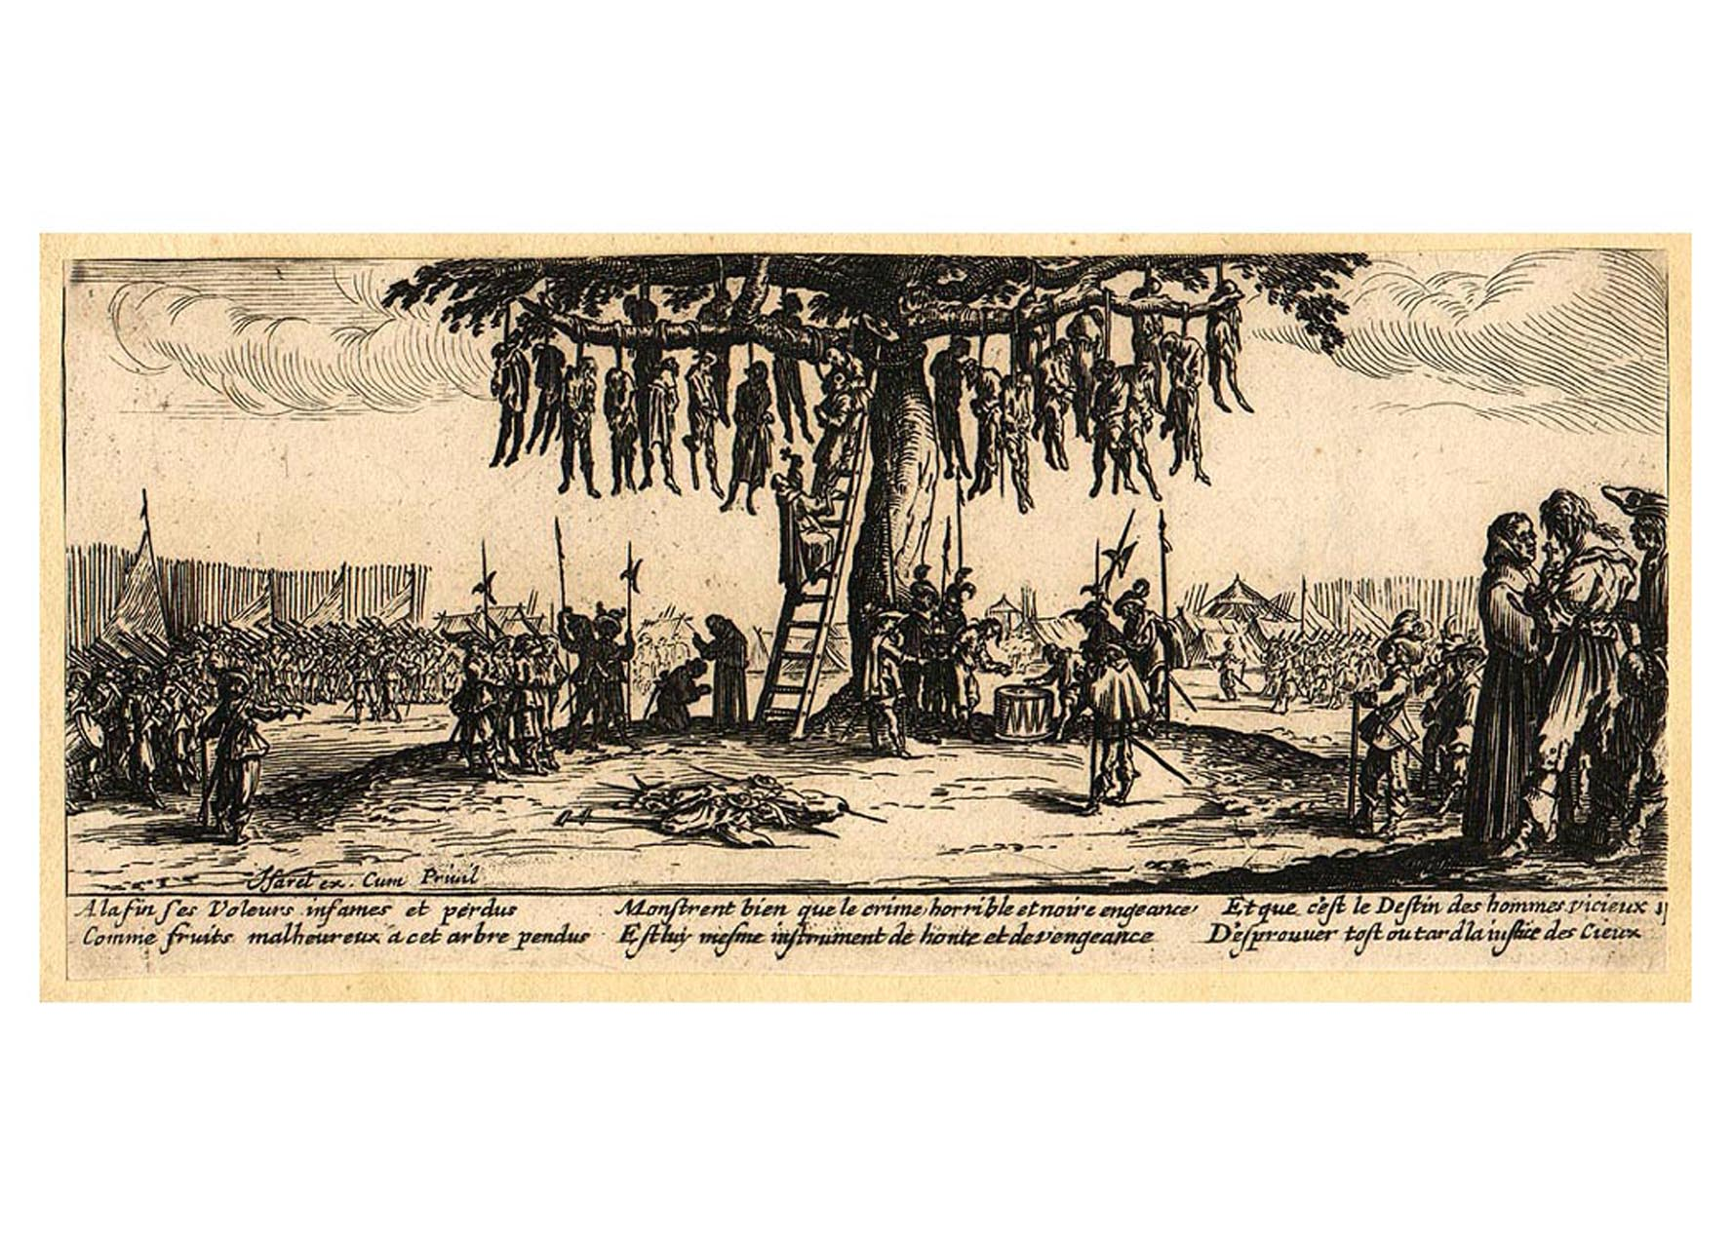
Jacques Callot: The Miseries of War
The Hangman’s Tree

Slide 31
The Peace of Westphalia
Religious Provisions:
  Freedom of Religion: Princes could determine state religion, but individuals were allowed to practice their own faith.
    Calvinists were finally free to worship.
    Did not apply to Habsburg lands (Austria). #StillCatholic
  Separation of Church and State in the HRE
    Emperor just a figurehead
    Pope had no say in affairs of state
    Beginning of political secularization in Europe.

Slide 32
The Peace of Westphalia
Political Provisions
  France got land: Alsace and Rhine area (German border) and Metz, Toul, Verdun (Austrian border)
    France now the dominant power in Europe.
  Habsburgs lost authority in parts of “Germany”
  German states were sovereign and independent states.
    But- Germany would not be a unified state until 1870.
    Brandenburg and Prussia become powerful German states.
  Switzerland was now free of the HRE.
  United Provinces officially independent as Dutch Netherlands (Belgium still under Spanish control).

Slide 33
CHRONOLOGY The Thirty Years’ War
(Slide 1 of 2)
Event/Leader | Dates
Protestant Union | 1608
Catholic League | 1609
Election of Habsburg Archduke Ferdinand as king of Bohemia | 1617
Bohemian revolt against Ferdinand | 1618
Bohemian phase | 1618–1625
Battle of White Mountain | 1620
p438
Notes:
CHRONOLOGY The Thirty Years’ War

Slide 34
CHRONOLOGY The Thirty Years’ War
(Slide 2 of 2)
Event | Dates
Danish phase | 1625–1629
Edict of Restitution | 1629
Swedish phase | 1630–1635
Battle of Lützen | 1632
Battle of Nördlingen | 1634
Franco-Swedish phase | 1635–1648
Battle of Rocroi | 1643
Peace of Westphalia | 1648
Peace of the Pyrenees | 1659

Slide 35
Social Crises, War, and Rebellions
(Slide 3 of 3)
Was There a Military Revolution?
  The necessity of an effective military machine
    The reforms of Gustavus Adophus (1611 – 1632)
    The link between the military and taxes
Rebellions
  Peasant revolts (1590 – 1640)
    France, Austria, Hungary, Portugal, and Catalonia
    Upheavals in Naples, Sicily, and the northern states
    Russia’s urban uprisings (1641, 1645, and 1648)
  Noble revolts in France (1648 – 1652)

Slide 36
The Practice of Absolutism:
Western Europe
Absolute Monarchy in France
  Belief in divine right monarchy
    Government is ordained by God, so the king rules as God would.
  Foundations of French Absolutism: Cardinal Richelieu (1624 – 1642)- Machiavellian
    Weakening challengers: Huguenots and nobles
    Strengthening the crown: the intendants
  Cardinal Mazarin (1642 – 1661)
    The Fronde – noble revolt
      Crushed by Mazarin- never forgotten by Louis.

Slide 37
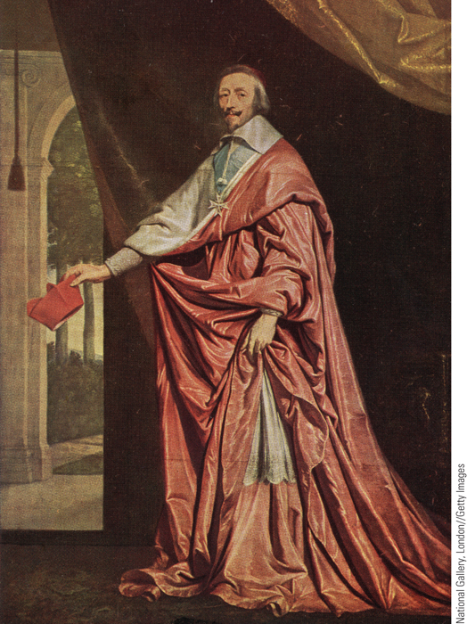
Cardinal Richelieu
A key figure in the emergence of a strong monarchy in France was Cardinal Richelieu, pictured here in a portrait by Philippe de Champaigne.
p440
Notes:
Cardinal Richelieu. A key figure in the emergence of a strong
monarchy in France was Cardinal Richelieu, pictured here in a portrait
by Philippe de Champaigne. Chief minister to Louis XIII, Richelieu
strengthened royal authority by eliminating the private armies and
fortified cities of the Huguenots and by crushing aristocratic conspiracies.

Slide 38
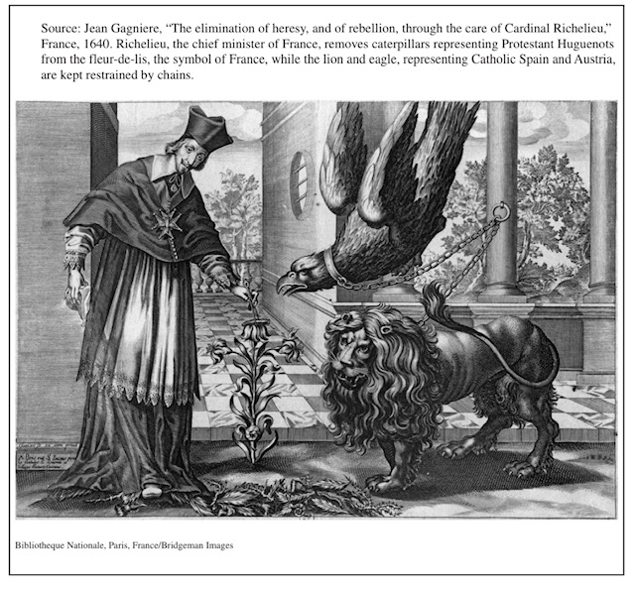

Slide 39
Reign of Louis XIV (1643 – 1715)
Administration of the Government
  Restructuring central policy-making
    Taming the high nobility
  Problems with administration in the provinces
Religious Policy
  Edict of Fontainebleau (1685) revokes Edict of Nantes
    “One king, one law, one faith”
Financial Issues- strictly mercantilism
  Jean Baptist Colbert (1619 – 1683)- Controller-General
  Increase exports of new luxury industries
  Built roads, canals to transport those goods
  Place tariffs on imported good to decrease imports

Slide 40
Reign of Louis XIV
How effective were Colbert’s mercantilist policies?
  Self-defeating, as mercantilism usually is.
  Made France wealthy, but..
    Smuggling
    Foreign retaliation for high tariffs
    The more he made, the more Louis spent.
Daily Life at the Court of Versailles
  The emphasis on ceremony and etiquette
  Set a standard to be imitated by all European royalty in the future.
  Visible manifestation of France’s (and Louis’) wealth and power
  Louis was at the center of all court ceremony
  “Bread and Circuses”: entertainment, distraction= control of the nobility.

Slide 41
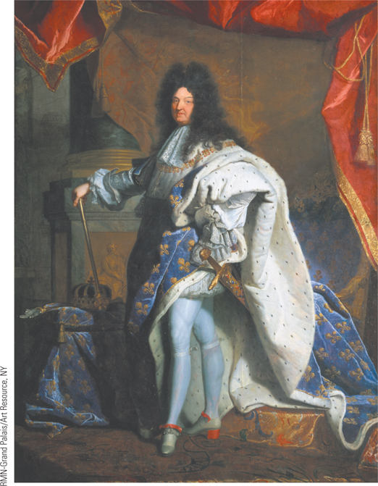
Global Perspectives: Sun Kings, West and East
Louis ruled France from 1643 to 1715. This portrait by Hyacinthe Rigaud captures the king’s sense of royal dignity and grandeur. One person at court said of the king: “Louis XlV’s vanity was without limit or restraint.”
p442
Notes:
Louis XIV (p.442)
Louis ruled France from 1643 to 1715. This portrait by Hyacinthe Rigaud (ee-ah-SANT ree-GOH) captures the king’s sense of royal dignity and grandeur. One person at court said of the king: “Louis XlV’s vanity was without limit or restraint.”

Slide 42
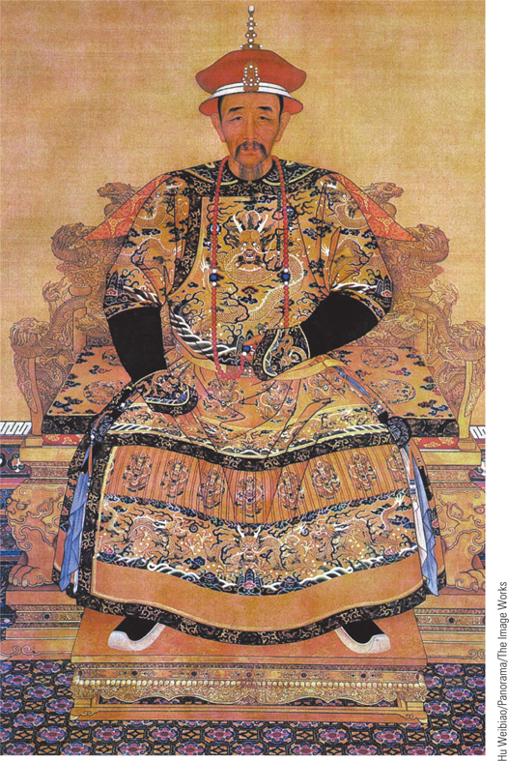
Global Perspectives: Sun Kings, West and East
Kangxi ruled China from 1661 to 1722. This portrait shows him seated in majesty on his imperial throne.
p442
Notes:
Kangxi. (p.442)
Kangxi ruled China from 1661 to 1722. This portrait shows him seated in majesty on his imperial throne.

Slide 43
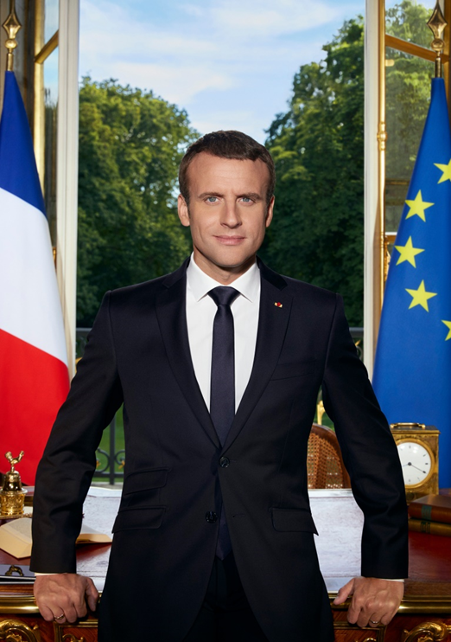
Emmanuel Macron
Current President of
France
How does one “read”
a presidential portrait?

Slide 44


Slide 45
Reign of Louis XIV (1643 – 1715)
The Wars of Louis XIV
  Professional army
    100,000 in peace; 400,000 at war
  First war versus the Triple Alliance (1667 – 1668)
    Invades Spanish Netherlands (Belgium) and Franche-Comté (east)
    Dutch, English, and Swedes ally against him, and he sues for peace, but gains some Belgian towns.
  Dutch War (1672 – 1678)
    Still bitter, so he invades Netherlands again, but is confronted by another Triple Alliance (Brandenburg, Spain, HRE)
    Receives Franche-Comté from Spain, but wants more.

Slide 46
The Reign of Louis XIV
War of the League of Augsburg (1689 – 1697)
  Gained Alsace, Lorraine, Strasbourg in the HRE.
  But the HRE, Spain, Netherlands, Sweden, England ally against him- again.
  Treaty of Ryswick- Got to keep Alsace and Strasbourg, but brought famine and depression to France. Not really worth it as far as the French people were concerned!
War of the Spanish Succession (1702 – 1713)
  Over the succession to the Spanish throne.
  Charles II of Spain- sickly, inbred Habsburg with no kids. Dead. Leaves kingdom of Spain to the grandson of Louis XIV, Philip V.
    Charles II’s half-sister, Maria Theresa, was Louis XIV’s first wife. So Philip is half Spanish, half French.

Slide 47
War of the Spanish Succession 1702-1713
New coalition against Louis- no one wants too much French (Bourbon) power.
France (w/ Bavaria, and parts of Spain) vs England, Netherlands, parts of Spain, German states, and Austria.
  Treaty of Utrecht- 1713:
  Philip V confirmed as King of Spain (and Spanish Bourbons would rule until the present day).
  Thrones of Spain and France to be forever separated.
  Austria gained Milan, Naples, and Sp. Netherlands
    But it’s the end of the Spanish Habsburgs.
  England gained Gibraltar and French lands in Canada
  Brandenburg-Prussia merge into a powerful state.
  Louis died 2 years later, leaving France in debt and surrounded by enemies of France.

Slide 48
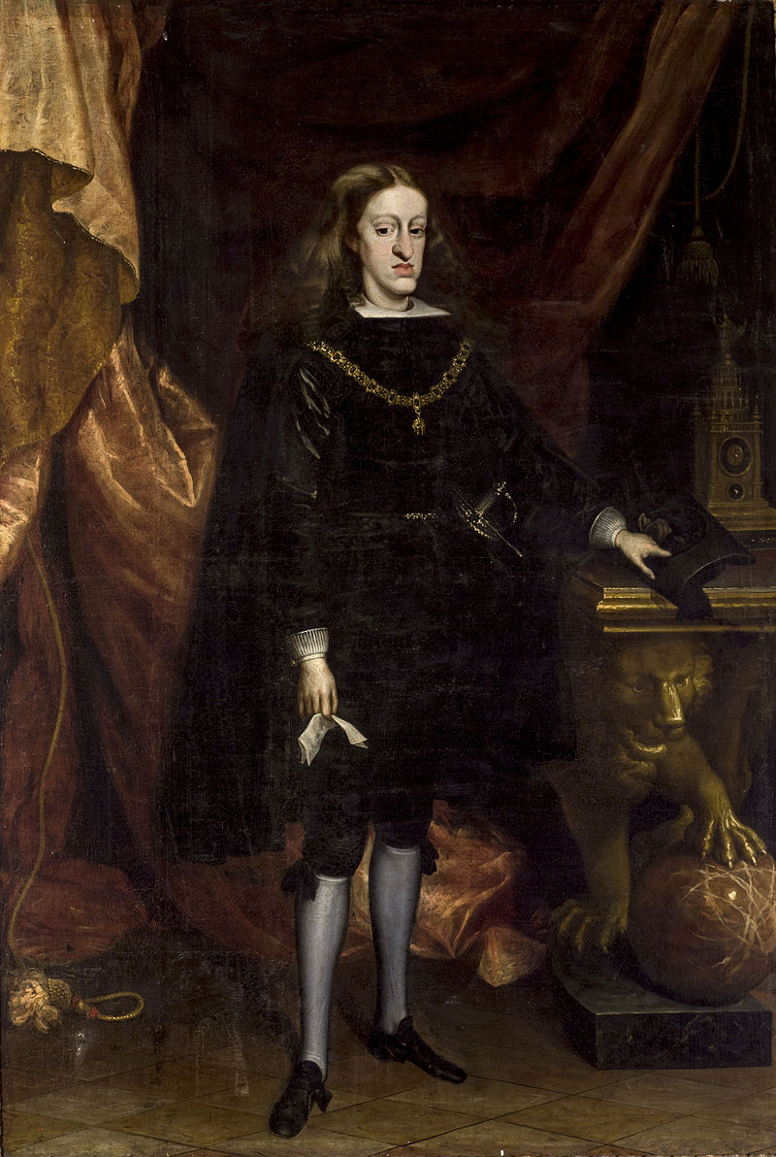
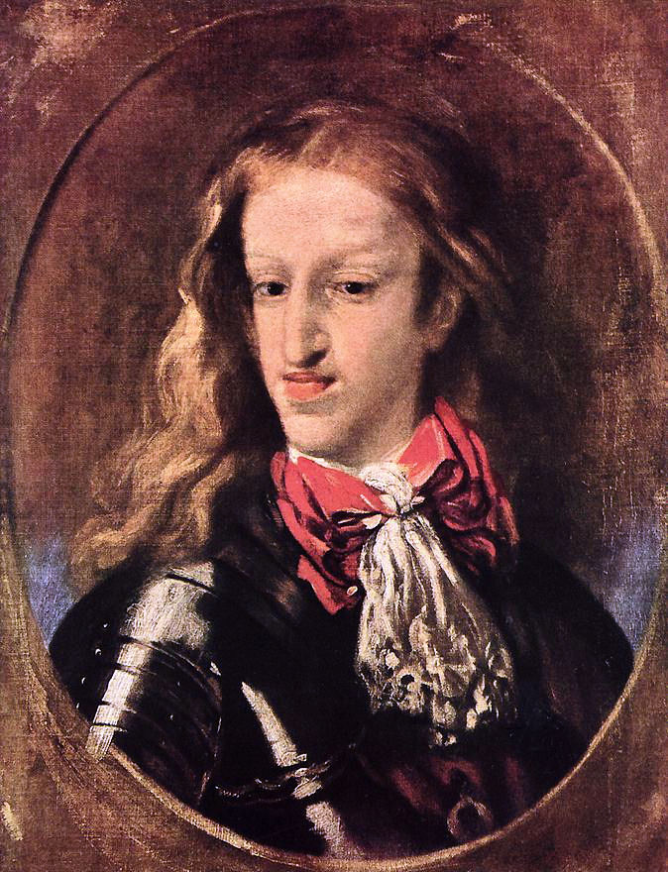
Charles II of Spain- “The Bewitched” or, “El Hechizado”

Slide 49
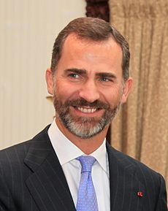
Current King of Spain
HRH Felipe VI
of the House of Bourbon
Since June 2014
Son of Juan Carlos I of
Spain and Sofia of Greece and Denmark.
Married to Letizia Ortiz, a journalist.

Slide 50
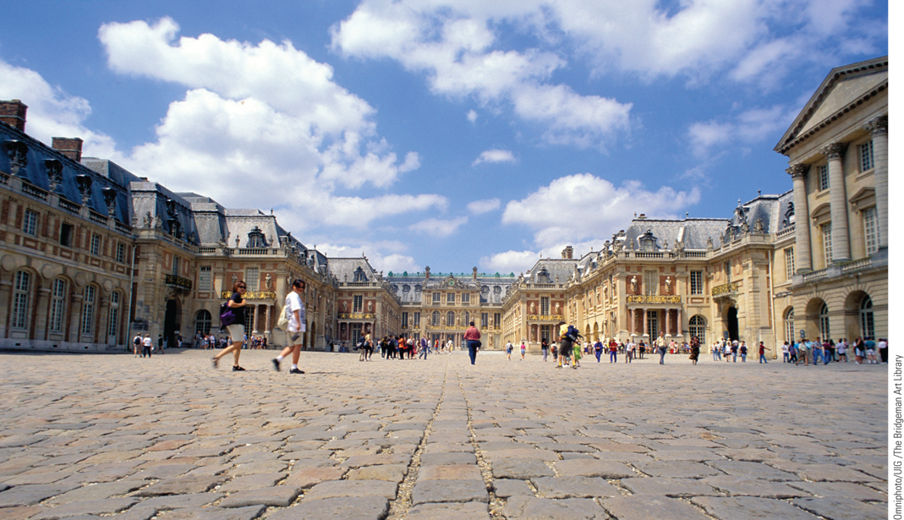
The Palace of Versailles
Louis XIV spent untold sums of money on the construction of a new palace at Versailles. As is evident in this exterior view, the palace was enormous, being more than a quarter of a mile long.
p443
Notes:
The Palace of Versailles. Louis XIV spent untold sums of money on the construction of a new palace at
Versailles. As is evident in this exterior view, the palace was enormous, being more than a quarter of a
mile long. In addition to being the royal residence, it also housed the members of the king’s government
and served as home for thousands of French nobles. As the largest royal residence in Europe, Versailles
impressed foreigners and became a source of envy for other rulers.

Slide 51
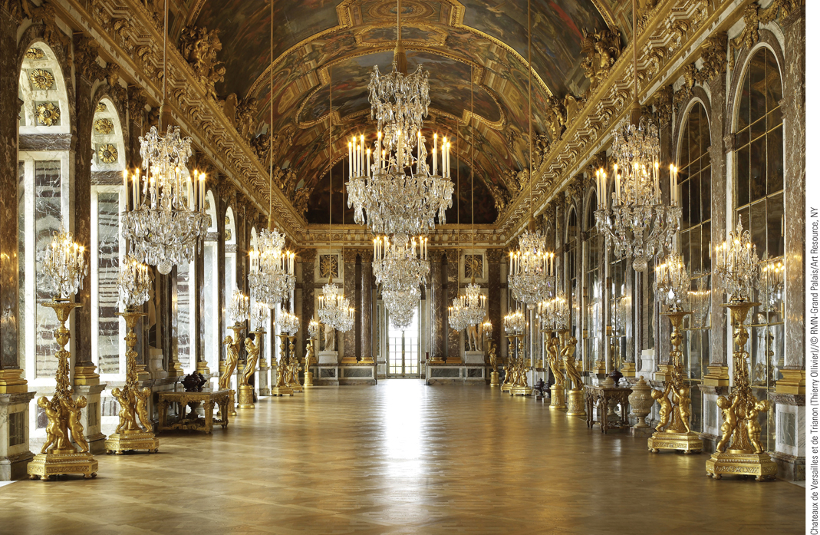
Interior of Versailles: The Hall of Mirrors
This photo shows the Hall of Mirrors after the restoration work that was
completed in June 2007, a project that took three years, cost 12 million euros (more than $16 million), and included the restoration of the Bohemian crystal chandeliers.
p444
Notes:
Interior of Versailles: The Hall of Mirrors. Pictured here is the exquisite Hall of Mirrors at Versailles.
Located on the second floor, the hall overlooks the park below. Three hundred and fifty-seven mirrors
were placed on the wall opposite the windows to create an illusion of even greater width. Careful planning
went into every detail of the interior decoration. Even the doorknobs were specially designed to reflect the
magnificence of Versailles. This photo shows the Hall of Mirrors after the restoration work that was
completed in June 2007, a project that took three years, cost 12 million euros (more than $16 million), and
included the restoration of the Bohemian crystal chandeliers.

Slide 52
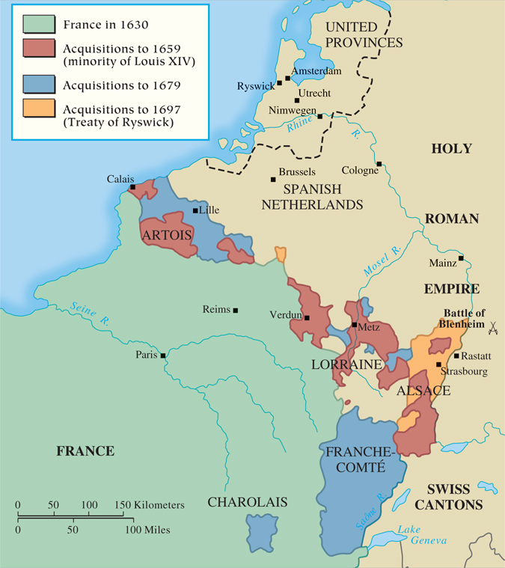
MAP 15.2 The Wars of Louis XIV
Map 15.2 p446
Notes:
MAP 15.2 The Wars of Louis XIV. The Sun
King instigated several wars in his efforts to
expand the power of France and the Bourbon
dynasty. A coalition of European states met
each military thrust, however, so Louis’s gains
were minimal despite the amount of blood
spilled and capital spent.

Slide 53
The Decline of Spain
The Consequences of Financial Weakness
  Bankruptcies in 1596 and in 1607
  Philip III (1598 – 1621)
Reign of Philip IV (1621 – 1665)
  Minister Gaspar de Guzman, the count of Olivares
    Attempts at reform
  The Thirty Years’ War
    The expense of military campaigns
    Revolts and civil war
    The loss of the Netherlands

Slide 54
CHRONOLOGY Absolutism in Western Europe: France
Event/Leader | Dates
Louis XIII | 1610–1643
Cardinal Richelieu as chief minister | 1624–1642
Ministry of Cardinal Mazarin | 1642–1661
First Fronde | 1648–1649
Second Fronde | 1650–1652
Louis XIV | 1643–1715
First war (versus Triple Alliance) | 1667–1668
Dutch War | 1672–1678
Edict of Fontainebleau | 1685
War of the League of Augsburg | 1689–1697
War of the Spanish Succession | 1702–1713
p447
Notes:
CHRONOLOGY Absolutism in Western Europe

Slide 55
CHRONOLOGY Absolutism in Western Europe: Spain
Leader | Dates
Philip III | 1598–1621
Philip IV | 1621–1665

Slide 56
Central, Eastern, and Northern Europe
The German States
  Westphalia had left HRE fragmented (“300 little Germanies”)
  The Rise of Brandenburg-Prussia:
  The work of the Hohenzollern dynasty
    Frederick William the Great Elector (1640 – 1688)
      Standing army and General War Commissariat
      Relationship with the nobles (the Junkers)
      He ran the government, they had top military offices and total control over peasants/serfs.
        Nobles also exempt from taxation
      Nobles would not question his authority
      Economics of mercantilism favored nobility
    Frederick III (1688 – 1713; king of Prussia, 1701)

Slide 57
Central, Eastern, and Northern Europe
The Emergence of Austria
  Habsburgs lost Germany but gained an empire in southeast Europe.
  Leopold I (1658 – 1705)
    Eastward expansion and conflicts with the Turks
      Siege of Vienna (1683)
  The development of a multinational empire
    After War of Spanish Succession: lost Spain but gained northern Italy, Hungary, Transylvania, Croatia, Slovenia (the Balkans)

Slide 58
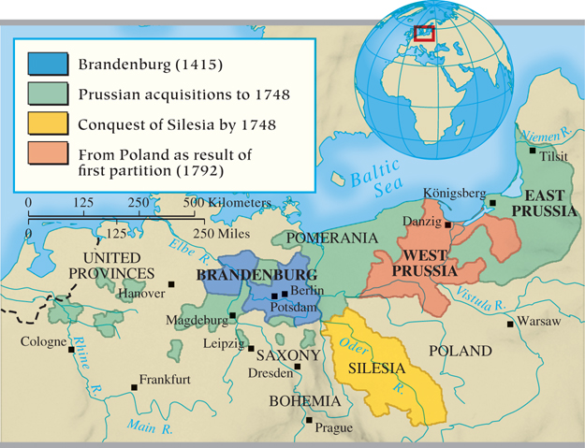
MAP 15.3 The Growth of Brandenburg-Prussia
Map 15.3 p448
Notes:
MAP 15.3 The Growth of Brandenburg-Prussia.
Frederick William the Great Elector laid the
foundation for a powerful state when he increased the
size and efficiency of the army, raised taxes and
created an efficient bureaucracy to collect them, and
gained the support of the landed aristocracy. Later
rulers added more territory.

Slide 59
Absolutism in Central, Eastern, and Northern Europe
Italy: From Spanish to Austrian Rule
  Emperor Charles V, Philip II, and the Spanish presence in Italy
  Consequences of the War of the Spanish Succession- Spain lost influence in Italy.
    Austria’s emergence as the dominant power in Italy

Slide 60
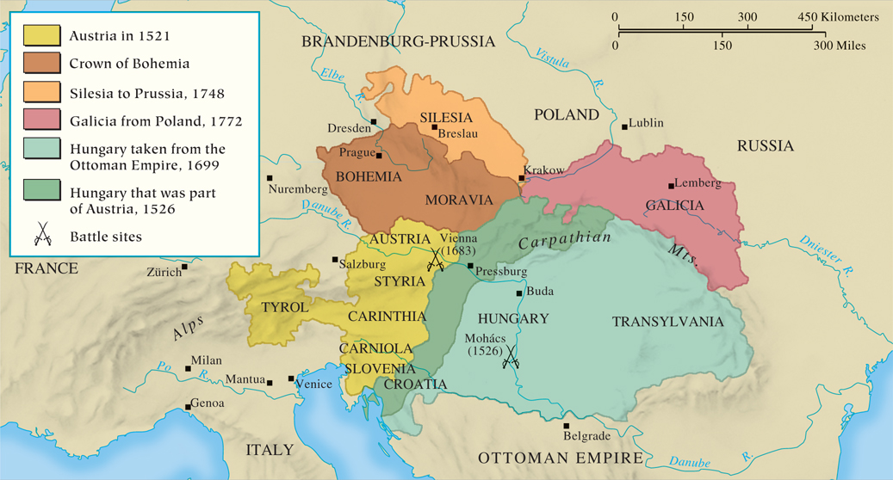
MAP 15.4 The Growth of the Austrian Empire
Map 15.4 p449
Notes:
MAP 15.4 The Growth of the Austrian Empire. The Habsburgs had hoped to establish a German
empire, but the results of the Thirty Years’ War crushed that dream. So Austria expanded to the east
and the south, primarily at the expense of the Ottoman Empire, and also gained the Spanish
Netherlands and former Spanish territories in Italy.

Slide 61
Russia: From Fledgling Principality to Major Power
The Leadership of Moscow
  Ivan IV the Terrible (1533 – 1584), the first tsar
  Romanov Dynasty (1613 – 1917)
  Western cultural movements had little impact in Russia (Renaissance, Reformation, etc)
The Reign of Peter the Great (1689 – 1725)
  Big, crude, and rude
  Visits to the West (1697 – 1698)
  Desire to “westernize” Russia

Slide 62
Reign of Peter the Great
Reorganization of armed forces and central government
  Division of Russia into provinces
  Drafted men to serve 25 year terms in military for an army of 210,000!
  Wanted Russians to have a sense of civic duty- but how did his personality impede this?
  Required nobles to serve as military or civil officers.
  Table of Ranks: organized way of promoting nobles and non-nobles.
Mercantilist policies not enough to fund military- resorted to taxing the peasants.

Slide 63
Reign of Peter the Great
Control of the Russian church: the procurator, head of Holy Synod
  State control over Russian Orthodox Church
Introduction of Western customs and styles
Many resented this and regarded him as tyrant
Forced nobles to shave beards and dress “western European”
  Positive impact of reforms on women

Slide 64
Russia: From Fledgling Principality to Major Power
Russia as a Military Power
  Goal: “Open a window to the West”
  Conflicts with Sweden
    Battle of Narva (1700)
    Great Northern War (1701 – 1721)
    Battle of Poltava (1709)
    Peace of Nystadt (1721)
    Russia gains control of Estonia, Livonia and Karelia
  Built the city of St. Petersburg

Slide 65
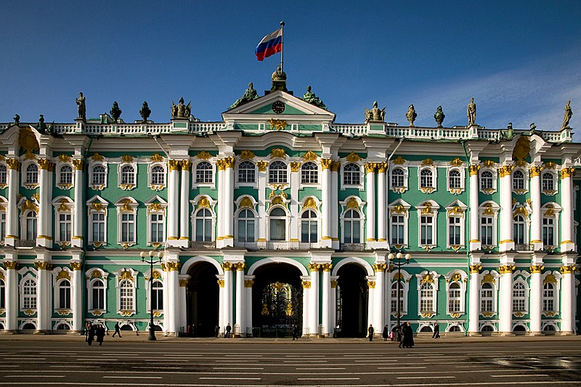
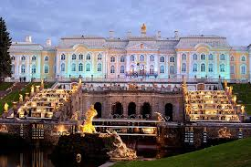
St Petersburg

Slide 66
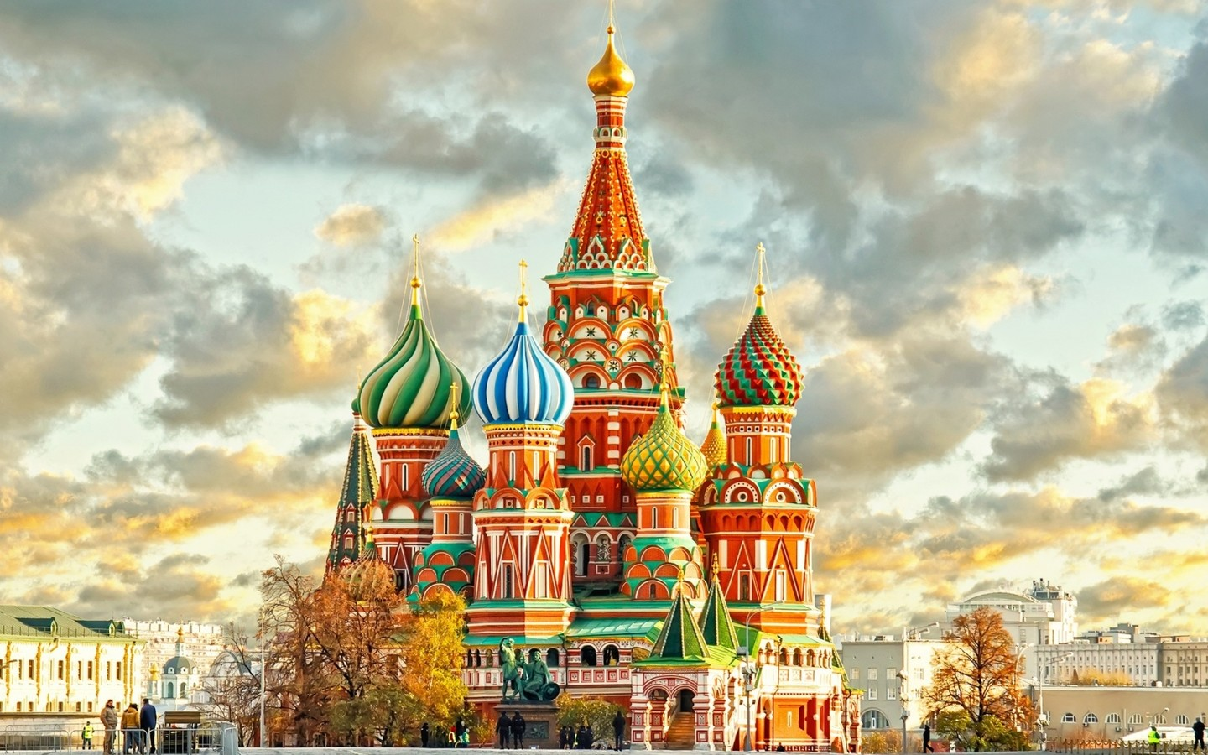
Moscow
St. Basil’s Cathedral

Slide 67
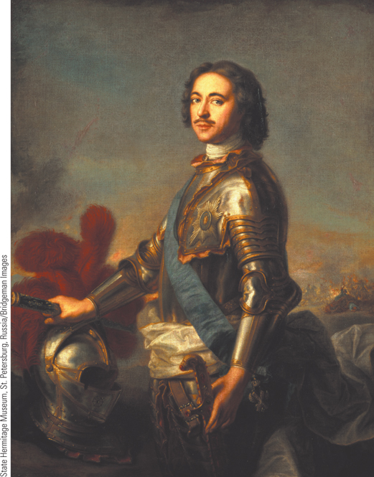
Peter the Great
Peter the Great wished to westernize Russia, especially in the realm of technical skills. His goal was the creation of a strong army and navy and the acquisition of new territory in order to make Russia a great power.
p452
Notes:
Peter the Great. (p.452)
Peter the Great wished to westernize Russia, especially in the realm of technical skills. His goal was the creation of a strong army and navy and the acquisition of new territory in order to make Russia a great power. Jean Marc Nattier, a French artist, painted this portrait of the tsar dressed in military armor in 1717.

Slide 68
Great Northern States
Denmark
  Losses in the Thirty Years’ War and the Northern War (1655 – 1660)
    Constitutional crisis and revolution (1660)
    Absolutist constitution proclaimed (1665)
Sweden
  Gustavus Adolphus (1611 – 1632)
    The monarchy’s relationship with the ‘‘First Estate’’
  Christina (1633 – 1654)
    The protest of the Riksdag
  Charles XI (1660 – 1697): building absolutism
  Charles XII (1697 – 1718) and loss of empire

Slide 69
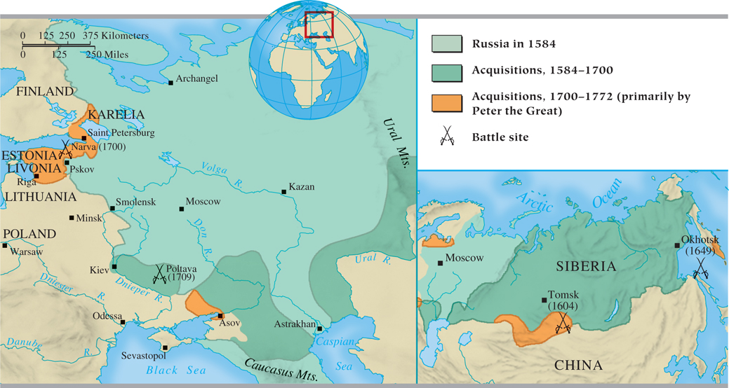
MAP 15.5 Russia: From Principality to Nation-State
Map 15.5 p452
Notes:
MAP 15.5 Russia: From Principality to Nation-State. Russia had expanded its territory since its
emergence in the fifteenth century. Peter the Great modernized the country, instituting
administrative and tax reforms and building up the military. He won territory on the Baltic from
Sweden, enabling Russia to have a port at Saint Petersburg.

Slide 70
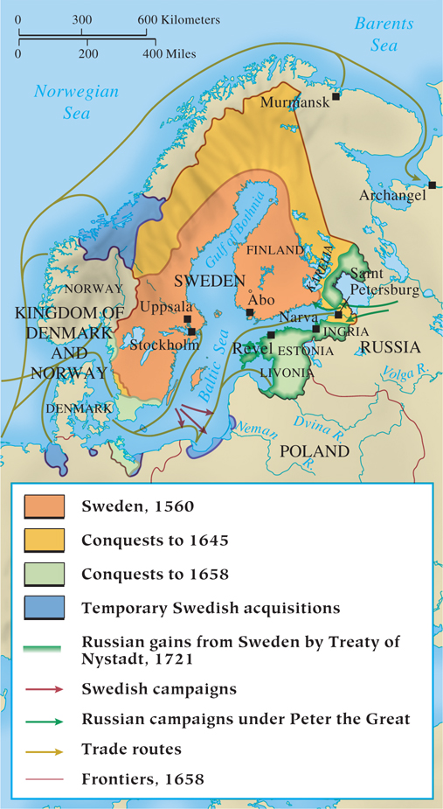
Sweden in the Seventeenth Century
p453
Notes:
Sweden in the Seventeenth Century

Slide 71
The Ottoman Empire
Suleiman the Magnificent (1520 – 1566)
  Attacks against Europe
  Advances in the Mediterranean
Ottoman Strength in the Seventeenth Century
  Ottomans viewed as a European power
  Bureaucratic and military power
    The Janissaries
  New offensives in eastern Europe

Slide 72
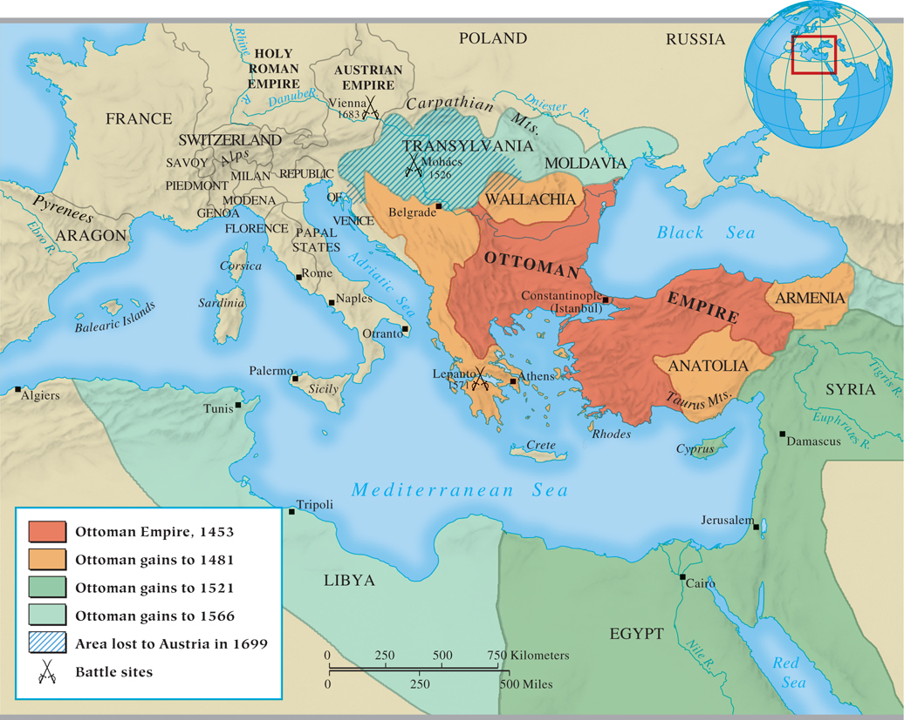
MAP 15.6 The Ottoman Empire
Map 15.6 p454
Notes:
MAP 15.6 The Ottoman Empire. In the sixteenth and seventeenth centuries, the Ottoman Empire
possessed an effective bureaucracy and military. During this period, it conquered much of the
Balkans and made inroads into eastern Europe; by 1699, however, it had lost the farthest reaches of
its European territory and would never again pose a serious threat to Europe.

Slide 73
CHRONOLOGY Absolutism in Central, Eastern, and Northern Europe: Brandenburg Prussia
Event | Dates
Hohenzollerns established in Brandenburg | 1415
Hohenzollerns acquire East Prussia | 1618
Frederick William the Great Elector | 1640–1688
Elector Frederick III (King Frederick I) | 1688–1713
p455
Notes:
CHRONOLOGY Absolutism in Central, Eastern, and
Northern Europe

Slide 74
CHRONOLOGY Absolutism in Central, Eastern, and Northern Europe:
Austrian Empire
Event | Dates
Leopold I | 1658–1705
Turkish siege of Vienna | 1683
Treaty of Karlowitz | 1699

Slide 75
CHRONOLOGY Absolutism in Central, Eastern, and Northern Europe: Russia
Event/Leader | Dates
Ivan IV the Terrible | 1533–1584
Time of Troubles | 1598–1613
Michael Romanov | 1613–1645
Peter the Great | 1689–1725
First trip to the West | 1697–1698
Great Northern War | 1701–1721
Construction of St. Petersburg begins | 1703
Battle of Poltava | 1709

Slide 76
CHRONOLOGY Absolutism in Central, Eastern, and Northern Europe: Denmark
Event | Dates
Christian IV | 1588–1648
Christian V | 1670–1699

Slide 77
CHRONOLOGY Absolutism in Central, Eastern, and Northern Europe: Sweden
Event | Dates
Gustavus Adolphus | 1611–1632
Christina | 1633–1654
Charles X | 1654–1660
Charles XI | 1660–1697
Charles XII | 1697–1718

Slide 78
The Limits of Absolutism
The Findings of Recent Historical Studies
  Power of rulers not absolute
  Power of local institutions
    The authority of local agents in carrying out the monarch’s wishes
    The privileges, liberties, and exemptions of special interests
  Power of the aristocracy

Slide 79
Limited Monarchy and Republics
The Weaknesses of the Polish Monarchy
  Consequences of the end of the Jagiello dynasty
    Foreign intrusions and elective kingship
The Golden Age of the Dutch Republic
  Internal dissension
    The House of Orange and the stadholders
    The States General versus the House of Orange
      William III (1672 – 1702)
    Economic prosperity, damaged by wars
  Life in seventeenth-century Amsterdam
    Role as a commercial and financial center of Europe

Slide 80
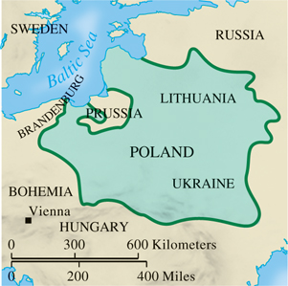
Poland in the Seventeenth Century
p456
Notes:
Poland in the Seventeenth Century

Slide 81
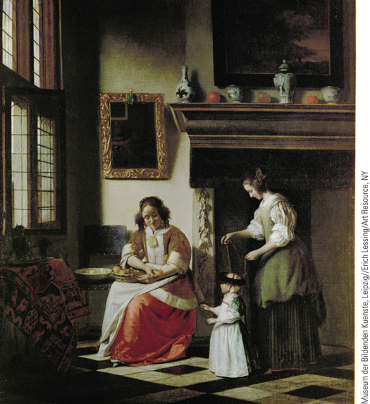
Dutch Domesticity (Slide 1 of 3)
In Two Women Teach a Child to Walk, the artist shows a well-furnished and spotless interior.
p457
Notes:
Dutch Domesticity

Slide 82
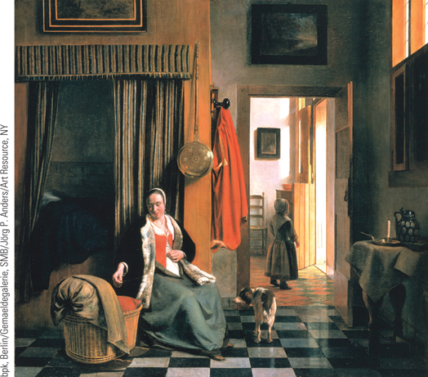
Dutch Domesticity (Slide 2 of 3)
In The Mother, de Hooch portrays a tranquil scene of a mother with her infant and small daughter.
p457
Notes:
Dutch Domesticity

Slide 83
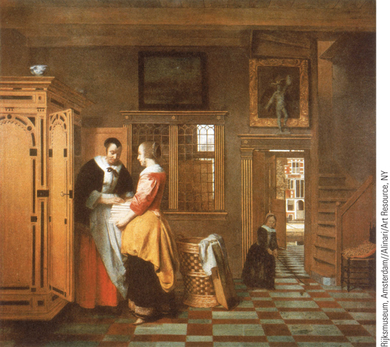
Dutch Domesticity (Slide 3 of 3)
In The Linen Cupboard, a Dutch mother, assisted by her daughter, is shown storing her clean sheets in an elegant cupboard in another well-polished Dutch room.
p457
Notes:
Dutch Domesticity

Slide 84
England and the Emergence of Constitutional Monarchy
King James I (r. 1603 – 1625) and Parliament
  James’s support of the divine right of kings
    His mother was Catholic (Mary Queen of Scots) but he was Protestant.
      Witch burnings in England and Scotland
      Persecuted Puritans
  Parliament and the power of the purse
  Problematic religious policies
    The Puritans and the rejection of the bishops
    England’s gentry (wealthy landowners, non-noble)- many converted to Calvinism
      Important part of the House of Commons, and James dismissed them.

Slide 85
England and the Emergence of Constitutional Monarchy
Charles I (r. 1625 – 1649) and the move toward Revolution
  Petition of Right- a sort of Bill of Rights, acknowledges rights of Parliament and people.
    No taxation without Parliament’s consent, no cruel/unusual punishment, no quartering of troops…
    Would not fund Charles’ projects if he did not sign it.
  “Personal Rule” (1629 – 1640): rule without Parliament after he dissolves it.
    Collected “ship money” in lieu of taxes
  Religious policy: a Catholic queen, increasing ritual = Catholic restoration?

Slide 86
England and the Emergence of Constitutional Monarchy
The Long Parliament (1640-1660)
  Charles forced to summon Parliament back to fund troops to crush a Scottish revolt.
  Parliament places severe limits on his power.
  Triennial Act- must meet every 3 years
  Charles tries to arrest some Puritans in Parliament, but his plan backfires: Civil War breaks out.

Slide 87
England and the Emergence of Constitutional Monarchy
Civil War (1642 – 1648) in England
  Roundheads (Parliament) vs Cavaliers (Royalists)
  The First Phase (1642 – 1646)
    Parliament’s success against the king
      New Model Army and Oliver Cromwell (1599 – 1658)
      The parliamentary split: Presbyterians and Independents
  The Second Phase (1648)
    After Charles tries to flee, he is recaptured, and moderate MPs are purged, leaving only radical Puritans in Parliament (“Rump Parliament”)
    The execution of Charles I (January 30, 1649)

Slide 88
Cromwell’s New Governments
  Ruled England 1653-1658
  Abolished monarchy, House of Lords
  Declared England a republic.
    Crushes uprisings in Ireland and Scotland with stunning brutality (“War of the Three Kingdoms”)
      Many Irish and Scottish sent to American colonies as indentured servants by Cromwell.
    Cromwell’s troubles with radicals and Parliament
      Crushes the “Levellers” at home
    The policies of the Lord Protector:
      England ruled by Puritan military generals that answered to him.
      More tyrant than Charles I ever was.
      Dies in 1658, and the English decide having a king wasn’t so bad after all.

Slide 89
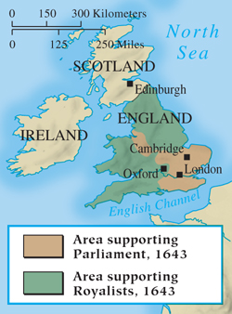
Civil War in England
p459
Notes:
Civil War in England

Slide 90
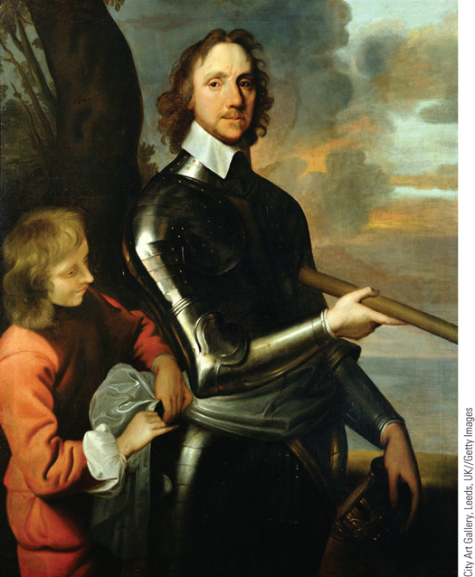
Oliver Cromwell
Oliver Cromwell was a dedicated Puritan who helped form the New Model Army and defeat the forces supporting King Charles I.
p459
Notes:
Oliver Cromwell. Oliver Cromwell was a dedicated Puritan who
helped form the New Model Army and defeat the forces supporting King
Charles I. Unable to work with Parliament, he came to rely on military
force to rule England. Cromwell is pictured here in 1649, on the eve of
his military campaign in Ireland.

Slide 91
England and the Emergence of
Constitutional Monarchy
Restoration of the Monarchy: Charles II (r. 1660 – 1685)
  Parliament gets to keep much of its power.
  Problems of religion
    Declaration of Indulgence (1672)- toleration for Catholics
    Test Act (1673): only Anglicans could hold military and civil offices
  Parliament tried to pass a bill to prevent his Catholic brother James from the throne.
    Parliament was split in two factions:
    The Whigs: Wanted to exclude James and establish Protestant King
    The Tories: Supported the king and hereditary throne.

Slide 92
England and the Emergence of
Constitutional Monarchy
  The Accession of King James II (r. 1685 – 1688), a devout Catholic
  Declaration of Indulgence (1687)
  Protestant daughters Mary and Anne superseded by a Catholic son, born 1688
  Mary is married to William of Orange III of the Dutch Republic.

Slide 93
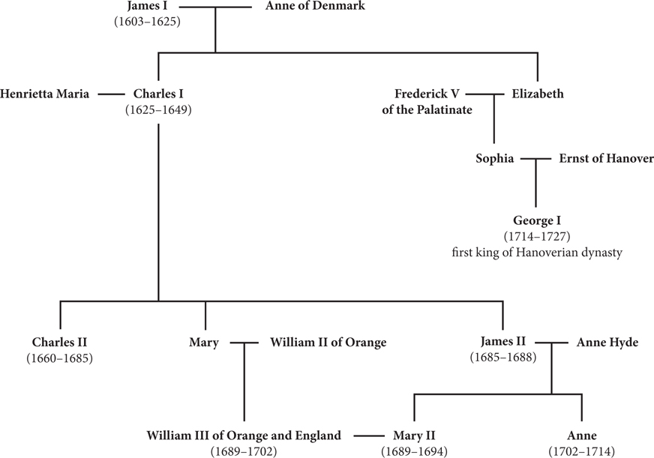
CHART 15.1 A Simplified Look at the Stuart Dynasty
p461
Notes:
CHART 15.1 A Simplified Look at the Stuart Dynasty

Slide 94
England and the Emergence of
Constitutional Monarchy
A Glorious Revolution- no bloodshed
  Parliament’s invitation to Mary and William of Orange
    The English Bill of Rights- 1689
    The Toleration Act of 1689- did not bring total religious equality, but did put an end to most religious persecution in England forever.
  Establishes firm role for Parliament in government
  Ends divine right theory in England- William was made king by Parliament, not God.
    Role reversal of King and Parliament- who makes who?
  James’ Stuart (Catholic) descendants still alive in France, Italy → revolts in Scotland later.

Slide 95
Responses to the Revolution
  Thomas Hobbes (1588 – 1679): Leviathan
    Lived during the English Civil War
    People form a commonwealth, no right to rebel
    People are naturally bad and life is nasty; we need a strong authoritarian to keep us civil.
  John Locke (1632 – 1704): Two Treatises of Government
    Lived during the Glorious Revolution
    Inalienable rights: life, liberty, and property
    People have the right to revolt and overthrow government if necessary.
    Really only applies to wealthy gentry/nobles, not the landless poor
Origins of Enlightenment thought.

Slide 96
CHRONOLOGY Limited Monarchy and Republics: Poland
Event/Leader | Dates
Merger of Poland and Lithuania | 1569
Sigismund III | 1587–1631
Beginning of liberum veto | 1652
p463
Notes:
CHRONOLOGY Limited Monarchy and Republics

Slide 97
CHRONOLOGY Limited Monarchy and Republics: United Provinces
Event/Leader | Dates
Official recognition of United Provinces | 1648
House of Orange – William III | 1672–1702

Slide 98
CHRONOLOGY Limited Monarchy and Republics: England (Slide 1 of 2)
Event/Leader | Dates
James I | 1603–1625
Charles I | 1625–1649
Petition of Right | 1628
First Civil War | 1642–1646
Second Civil War | 1648
Execution of Charles I | 1649
Commonwealth | 1649–1653
Death of Cromwell | 1658
Restoration of monarchy | 1660

Slide 99
CHRONOLOGY Limited Monarchy and Republics: England (Slide 2 of 2)
Event/Leader | Dates
Charles II | 1660–1685
Cavalier Parliament | 1661
Declaration of Indulgence | 1672
Test Act | 1673
James II | 1685–1688
Declaration of Indulgence | 1687
Glorious Revolution | 1688
Bill of Rights | 1689

Slide 100
The Flourishing of European Culture
The Changing Faces of Art
  Mannerism
    Attempt to break away from balance, harmony, and moderation of High Renaissance
    Means “in the manner of”. It imitated Renaissance masters, but with a personal flair of new artists
    Distorted rules of proportion; elongated bodies
    Sense of suffering and darkness with intense emotions
    Often religious themes

Slide 101
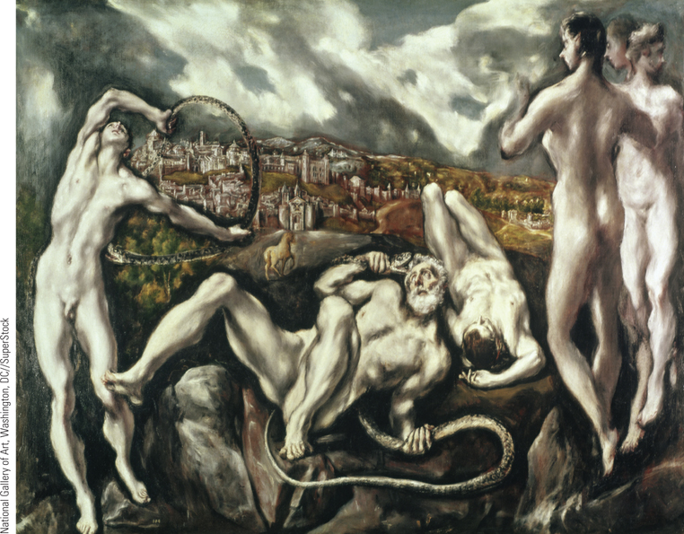
El Greco, Laocoon
Mannerism reached its height in the work of El Greco. Born in Crete, trained in Venice and Rome, and settling finally in Spain, El Greco worked as a church painter in Toledo. Pictured here is his version of the Laocoon, a Hellenistic sculpture discovered in Rome in 1506.
p464
Notes:
El Greco, Laocoon. Mannerism
reached its height in the work of El
Greco. Born in Crete, trained in Venice
and Rome, and settling finally in Spain,
El Greco worked as a church painter in
Toledo. Pictured here is his version of
the Laocoon, a Hellenistic sculpture
discovered in Rome in 1506. The
elongated, contorted bodies project a
world of suffering while the somber
background scene of the city of Toledo
and the threatening sky add a sense of
terror and doom.

Slide 102
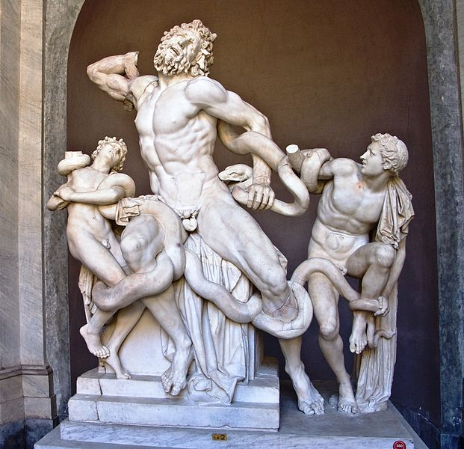
Original inspiration: Laocoon and His Sons (The Laocoon
Group). Ancient statue discovered in Rome in 1506.

Slide 103
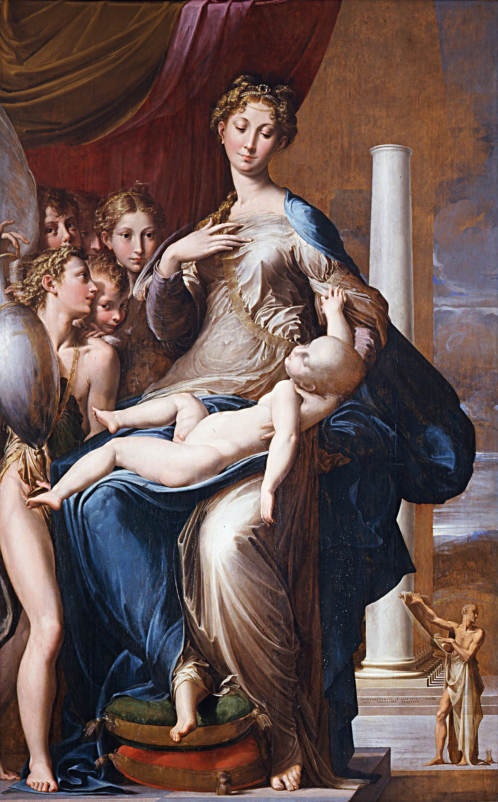
Madonna with the
Long Neck
Parmigianino
1535
Uffizzi Gallery
Florence

Slide 104
The Flourishing of European Culture
The Baroque Period
  Harmony of Classical ideals of Renaissance art and religious revival
  Popular in Catholic courts
  “Heavy” and very ornate
  3-D depiction of “raw energy”, action and motion captured in an image
  Intensely emotional and moving
  Dramatic ornamentation: BLING
  Rejection of Renaissance restraint, but not of Renaissance themes (still religion and classics)
  Many curved lines and fleshy bodies, wild faces

Slide 105
The Flourishing of European Culture
French Classicism
  Emphases: clarity, simplicity, balance and harmony of design
  Not as “showy”, less committed to Renaissance ideals
  Less emotion, but extra grandeur and ornamentation
Dutch Realism
  Realistic portrayals of secular, everyday life
  Commissioned by wealthy moddle class, not nobles, and it is reflected in art by depicting “regular” people.

Slide 106
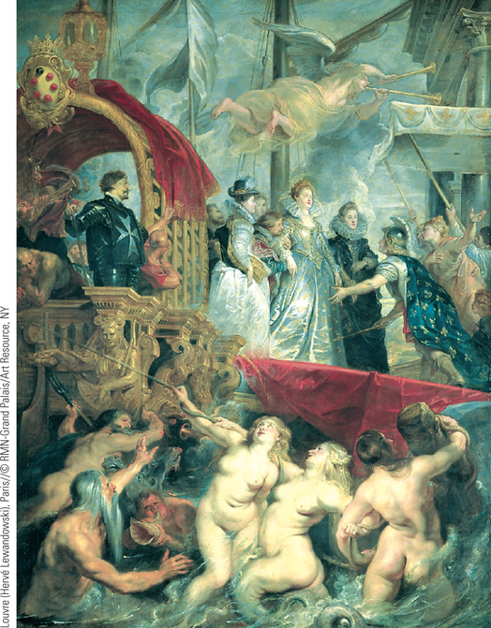
Peter Paul Rubens, The Landing of Marie de’ Medici at Marseilles
Peter Paul Rubens played a key role in spreading the Baroque style from Italy to other parts of Europe. In The Landing of Marie de’ Medici at Marseilles, Rubens made dramatic use of light and color, bodies in motion, and luxurious nudes to heighten the emotional intensity of the scene.
p465
Notes:
Peter Paul Rubens, The Landing of Marie de’ Medici at
Marseilles. Peter Paul Rubens played a key role in spreading the
Baroque style from Italy to other parts of Europe. In The Landing of
Marie de’ Medici at Marseilles, Rubens made dramatic use of light and
color, bodies in motion, and luxurious nudes to heighten the emotional
intensity of the scene. This was one of a cycle of twenty-one paintings
dedicated to the queen mother of France.

Slide 107
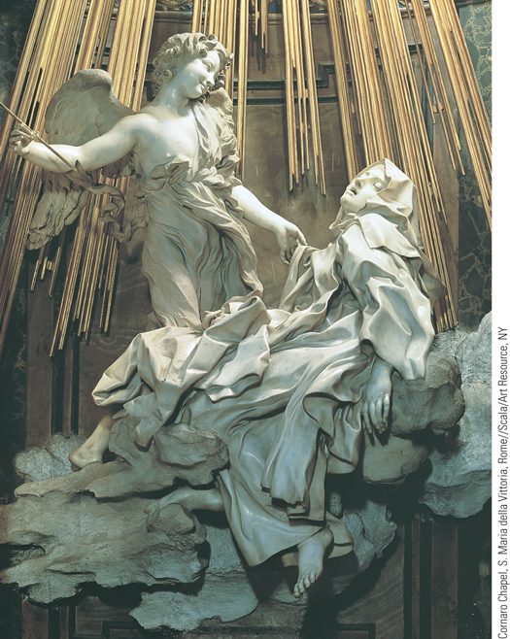
Gian Lorenzo Bernini, Ecstasy of Saint Theresa
One of the great artists of the Baroque period was the Italian sculptor and architect Gian Lorenzo Bernini. The Ecstasy of Saint Theresa, created for the Cornaro Chapel in the Church of Santa Maria della Vittoria in Rome, was one of Bernini’s most famous sculptures.
p465
Notes:
Gian Lorenzo Bernini, Ecstasy of Saint Theresa. One of the great
artists of the Baroque period was the Italian sculptor and architect Gian
Lorenzo Bernini. The Ecstasy of Saint Theresa, created for the Cornaro
Chapel in the Church of Santa Maria della Vittoria in Rome, was one of
Bernini’s most famous sculptures. Bernini sought to convey visually
Theresa’s mystical experience when, according to her description, an
angel pierced her heart repeatedly with a golden arrow.

Slide 108
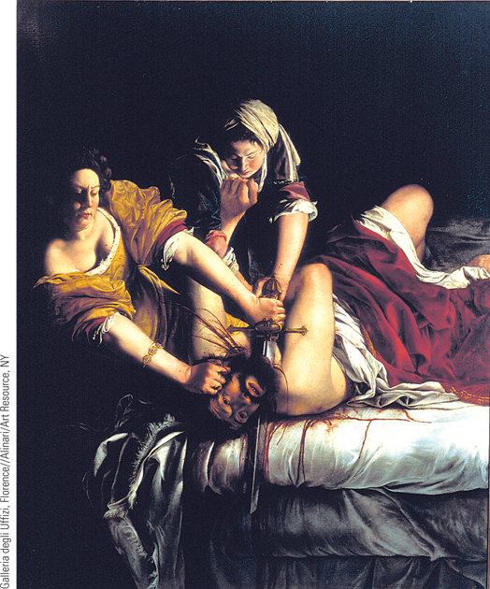
Artemisia Gentileschi, Judith Beheading Holofernes
Artemisia Gentileschi painted a series of pictures portraying scenes from the lives of courageous Old Testament women.
p466
Notes:
Artemisia Gentileschi, Judith Beheading Holofernes. Artemisia
Gentileschi painted a series of pictures portraying scenes from the lives
of courageous Old Testament women. In this painting, a determined
Judith, armed with her victim’s sword, struggles to saw off the head of
Holofernes. Gentileschi realistically and dramatically shows the
gruesome nature of Judith’’s act.

Slide 109
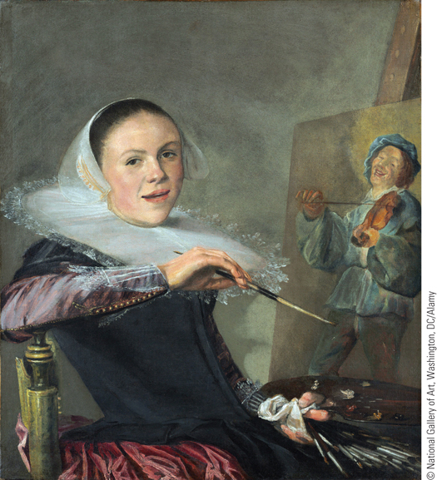
Judith Leyster, Self-Portrait
Although Judith Leyster was a well-known artist to her Dutch contemporaries, her fame diminished soon after her death. In the late nineteenth century, a Dutch art historian rediscovered her work.
p466
Notes:
Judith Leyster, Self-Portrait. Although Judith Leyster was a well-known
artist to her Dutch contemporaries, her fame diminished soon
after her death. In the late nineteenth century, a Dutch art historian
rediscovered her work. In Leyster’s Self-Portrait, painted in 1635, she is
seen pausing in her work painting one the scenes of daily life that made
her such a popular artist in her own day.

Slide 110
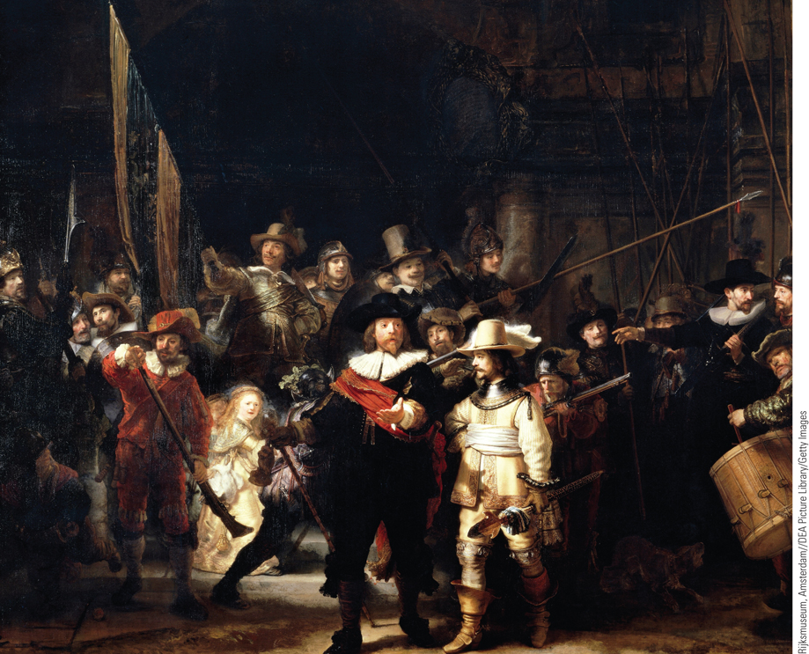
Rembrandt van Rijn, The Night Watch
The Dutch enjoyed a golden age of painting during the seventeenth century. The burghers and patricians of Dutch urban society commissioned works of art, and these quite naturally reflected the burghers’ interests. In his painting The Night Watch, Rembrandt portrays the two leaders and sixteen members of a civic militia preparing for a parade in the city of Amsterdam.
p467
Notes:
Rembrandt van Rijn, The Night Watch
The Dutch enjoyed a golden age of painting during the seventeenth century. The burghers and patricians of Dutch urban society commissioned works of art, and these quite naturally reflected the burghers’ interests. In his painting The Night Watch, Rembrandt portrays the two leaders and sixteen members of a civic militia preparing for a parade in the city of Amsterdam.

Slide 111
NAME THE STYLE!
Baroque
Mannerism
French Classicism
Dutch Realism

Slide 112
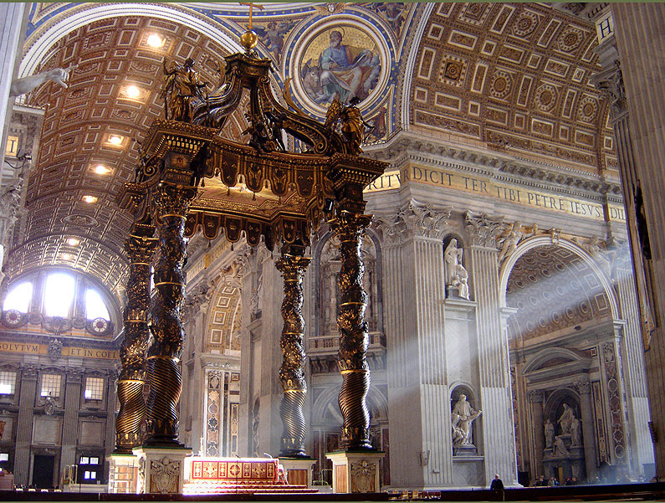
Gianloranzo Bernini, St. Peter’s Basilica, The Vatican

Slide 113

El Greco, Pietá, or The Lamentation of Christ, 1575. Philadelphia Museum of Art.

Slide 114

Johannes Vermeer, Girl With a Pearl Earring. 1665. Mauritshuis, The Hague, Netherlands.

Slide 115

The Hall of Mirrors, Versailles

Slide 116

Peterhof Castle Grand Cascade,
St. Petersburg, Russia

Slide 117

The Great Gallery at Schonbrunn Palace, Vienna, Austria. Summer residence of the Habsburgs.

Slide 118

Rembrandt van Rijn, Abraham and Isaac, 1634. Hermitage Museum.

Slide 119


GianLorenzo Bernini
Apollo and Daphne, 1625
Galleria Borghese, Rome.
The Ecstasy of St. Theresa,
1652, Santa Maria della Vittoria

Slide 120

Peter Paul Reubens, The Fall of Phaeton, 1608. National Gallery of Art, Washington D.C.

Slide 121

Peter Paul Reubens, Christ on the Cross Between Two Thieves, 1620. Royal Museum of Fine Arts, Antwerp.

Slide 122
The Flourishing of European Culture
A Wondrous Age of Theater
  William Shakespeare (1564 – 1614)
    Golden Age of Elizabethan Literature (1580 – 1640)
    The Globe Theater
    Lord Chamberlain’s Company
  Spain’s Golden Century
    Lope de Vega (1562 – 1635)
      Wrote 1500 plays – about 1/3 survive
  French Drama- for the nobility, not the masses.
    Jean Baptiste Molière (1622 – 1673)
      The Misanthrope
      Tartuffe

Slide 123

Chapter Timeline
p469

Slide 124
Discussion Questions
Why were so many women targeted during the witchcraft craze?
How did the Thirty Years’ War affect the different participants?
What changes were brought about with the Peace of Westphalia?
What were the chief characteristics of absolutism?
How did Western ideas influence the reign of Peter the Great in Russia?
What gains did Parliament make at the expense of the monarchy during the course of the seventeenth century in England?
How did English political thinkers react to the English revolutions?

