Slide 1
The Eighteenth Century: European States, International Wars, and Social Change
Chapter 18

Slide 2
Focus Questions
​What were the main developments in France, Great Britain, the Dutch Republic, the Mediterranean states, and the Scandinavian monarchies in the eighteenth century? What do historians mean by the term enlightened absolutism, and to what degree did eighteenth-century Prussia, Austria, and Russia exhibit its characteristics?
​How did the concepts of “balance of power” and “reason of state” influence international relations in the eighteenth century? What were the causes and results of the Seven Years’ War?
​What changes occurred in agriculture, finance, industry, and trade during the eighteenth century?
​Who were the main groups making up the European social order in the eighteenth century, and how did the conditions in which they lived differ both between groups and between different parts of Europe?

Slide 3
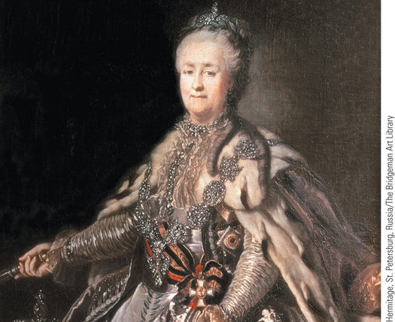
A 1793 portrait of Catherine the Great of Russia by Johann Lampi
p528
Notes:
A 1793 portrait of Catherine the Great of Russia by Johann Lampi

Slide 4
The European States
Enlightened Absolutism?
From Natural Laws to Natural rights
Characteristics
The American Declaration of Independence
The need for enlightened rulers
What made rulers enlightened?
Allow for religious toleration, freedom of speech and press, and the right to hold property
Foster the arts, sciences, and education
Obedience to the laws and fair enforcement
The debate over enlightened despotism:
Philosophes did not believe in giving all people the right to vote/political equality; they supported a strong ruler guided by Enlightenment thought.
Distrustful of the masses and “mob rule”.

Slide 5
The Atlantic Seaboard States
France: the Problems of the French Monarchs
Not affected by the Enlightenment (ironic) and resisted any reforms
Louis XIV left France in poor shape: too much debt, unhappy people, too much territory to manage, and a 5-year old on the throne.
The long rule of Louis XV (1715 – 1774)
Lazy, weak, and scandalous
Lost its empire in the Seven Years War
The financial woes of Louis XVI (1774 – 1792)
Weak and incompetent ruler with his Austrian wife, Marie Antoinette

Slide 6
The Atlantic Seaboard States
Great Britain: King and Parliament
Glorious Revolution and the fact that the new kings were actually German = prevented absolutism
Shared powers: king, ministers, and Parliament
The Hanoverians and their ministers
George I (1714 – 1727) and George II (1727 – 1760)
Robert Walpole, 1721 – 1742, FIRST prime minister
William Pitt, the Elder, and empire
George III (1760 – 1820)– HE WAS INSANE BTW
William Pitt, the Younger (1759 – 1806), and reform
Parliament: legislate, levy taxes, pass budgets, influence king’s ministers
House of Lords: peers (nobles) sat for life
House of Commons: landed gentry. Still controlled by aristocracy

Slide 7
The Atlantic Seaboard States
Decline of the Dutch Republic
Decline in economic power as Britain grew stronger
Power struggle between the burghers (middle class townspeople/Patriots) and the Orangist stadtholders.
Burghers revolt and demand democratic reforms
Prussia sends military to crush revolt
**Shows Prussia’s growing military power

Slide 8
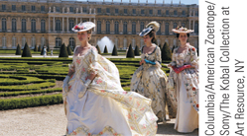
Film & History: Marie Antoinette (2006)
Marie Antoinette (Kirsten Dunst) at Versailles.
p530
Notes:
Marie Antoinette (Kirsten Dunst) at Versailles.

Slide 9
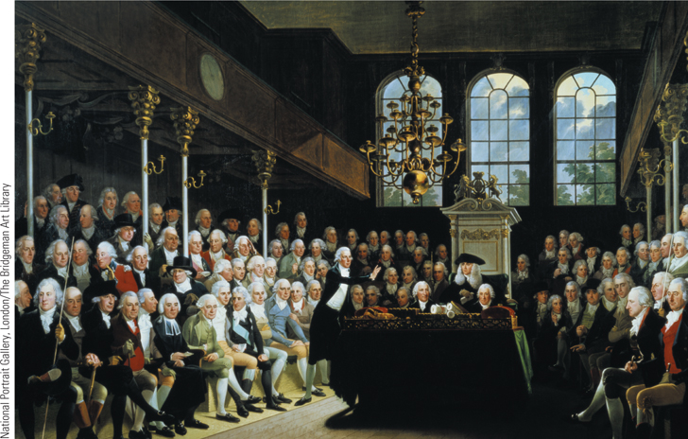
The British House of Commons
Parliament was divided into the House of Lords and the House of Commons. This painting shows the House of Commons in session in 1793 during a debate over the possibility of war with France.
p530
Notes:
The British House of Commons. A
sharing of power between king and
Parliament characterized the British political
system in the eighteenth century.
Parliament was divided into the House of
Lords and the House of Commons. This
painting shows the House of Commons in
session in 1793 during a debate over the
possibility of war with France. William Pitt
the Younger is addressing the House.

Slide 10
CHRONOLOGY The Atlantic Seaboard States: France
Ruler | Dates
Louis XV | 1715–1774
Louis XVI | 1774–1792
p532
Notes:
CHRONOLOGY The Atlantic Seaboard States

Slide 11
CHRONOLOGY The Atlantic Seaboard States: Great Britain
Ruler | Dates
George I | 1714–1727
George II | 1727–1760
Robert Walpole | 1721–1742
William Pitt the Elder | 1757–1761
George III | 1760–1820
William Pitt the Younger | 1783–1801

Slide 12
Absolutism in Central and Eastern Europe
Prussia: the Army and the Bureaucracy
Frederick William I (1713 – 1740)
General Directory
Highly efficient bureaucracy
Expansion of the army
Bond between the Junker nobility and the army
Frederick II, the Great (1740 – 1786)
Well educated in Enlightenment thought
Reforms: law code, civil liberties
Limits of reform: socially and politically conservative policies
Expanded Army
Seized Austrian province of Silesia
Added Polish territory between Prussia and Brandenburg

Slide 13
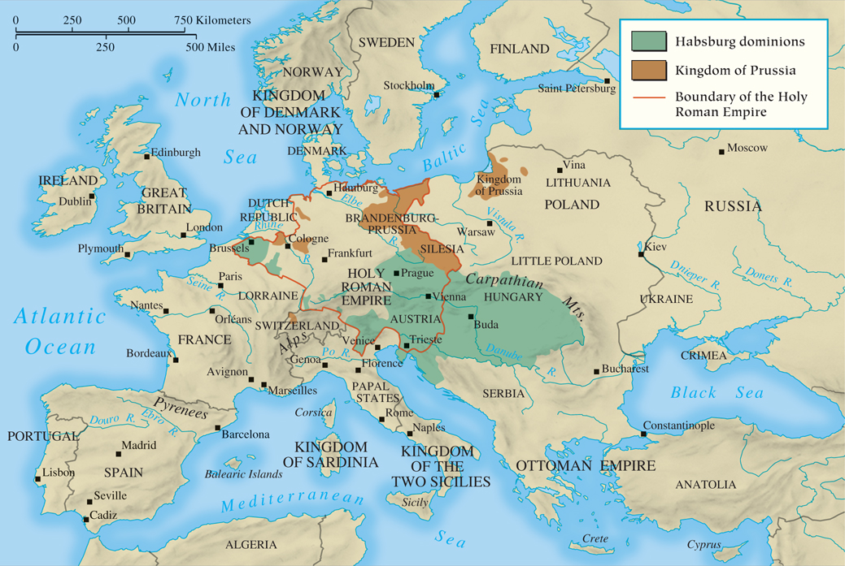
MAP 18.1 Europe in 1763
Map 18.1 p533
Notes:
MAP 18.1 Europe in 1763. By the middle of the eighteenth century, five major powers dominated
Europe—Prussia, Austria, Russia, Britain, and France. Each sought to enhance its power both
domestically, through a bureaucracy that collected taxes and ran the military, and internationally, by
capturing territory or preventing other powers from doing so.

Slide 14
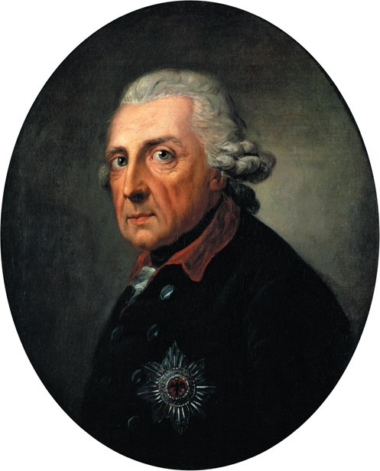
Frederick II
Frederick II was one of the most cultured and best educated
European monarchs.
p535
Notes:
Frederick II. Frederick II was one of the most cultured and best educated
European monarchs. He is seen here in a portrait done five
years before his death by the Swiss artist Anton Graff. The painting is
regarded as Graff’s masterpiece, and contemporaries considered it the
best and most accurate portrait of the ruler.

Slide 15
The Austrian Empire of the Hapsburgs
The Rule of Empress Maria Theresa (1740 – 1780)
The loss of Silesia in the War of the Austrian Succession
Challenges of Austria’s many divisions
Practical reforms but conservative
Joseph II (1780 – 1790)
Far-reaching reform program: abolition of serfdom; new penal code; religious toleration
Failure
Overwhelming change and alienation of the people

Slide 16
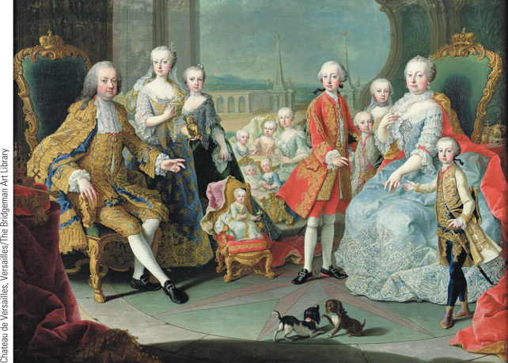
Maria Theresa and Her Family
Maria Theresa governed the vast possessions of the
Austrian Empire from 1740 to 1780.
p535
Notes:
Maria Theresa and Her Family. Maria Theresa governed the vast possessions of the
Austrian Empire from 1740 to 1780. Of her ten surviving children, Joseph II (shown here in
red standing beside his mother) succeeded her; Leopold became grand-duke of Tuscany and
the ruler of Austria after Joseph’s death; Ferdinand was made duke of Modena; and Marie
Antoinette became the wife of King Louis XVI of France.

Slide 17
Russia under Catherine the Great (1762 – 1796)
Goals
Reform Russia through Enlightenment ideas Instruction (1767): questioning institutions
Policies
Strengthens landholders at expense of serfs
Rebellion of Emelyan Pugachev, 1773-1775
Territorial expansion, westward and southward
The Destruction of Poland
Partitions of 1772, 1792, and 1795
The gains of Russia, Prussia, and Austria

Slide 18
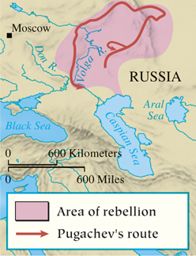
Pugachev’s Rebellion
p537
Notes:
Pugachev’s Rebellion

Slide 19
CHRONOLOGY Central and Eastern Europe: Prussia
Ruler | Dates
Frederick William I | 1713–1740
Frederick II the Great | 1740–1786
p537
Notes:
CHRONOLOGY Central and Eastern Europe

Slide 20
CHRONOLOGY Central and Eastern Europe: Austrian Empire
Ruler | Dates
Maria Theresa | 1740–1780
Joseph II | 1780–1790

Slide 21
CHRONOLOGY Central and Eastern Europe: Russia
Event/Ruler | Dates
Catherine II the Great | 1762–1796
Pugachev’s rebellion | 1773–1775
Charter of the Nobility | 1785

Slide 22
CHRONOLOGY Central and Eastern Europe: Poland
Partition | Dates
First partition | 1772
Second partition | 1793
Third partition | 1795

Slide 23
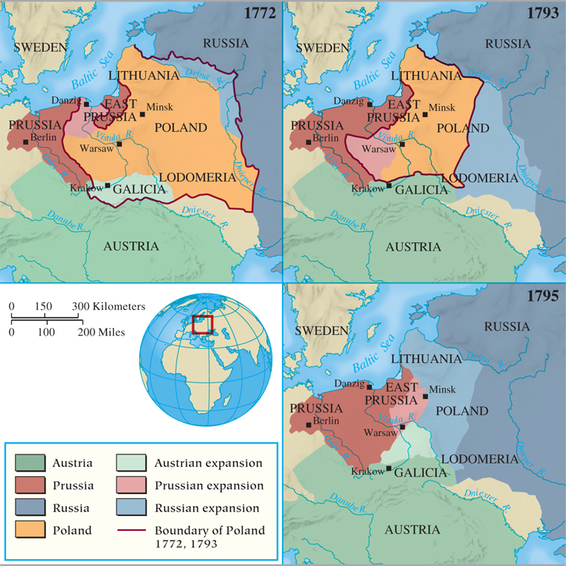
MAP 18.2 The Partitioning of Poland
Map 18.2 p538
Notes:
MAP 18.2 The Partitioning of Poland. Crowded by three great powers, Poland lay primarily on a
plain with few easily defensible borders. This fact, combined with a weak and ineffectual monarchy, set
the stage for Poland’s destruction. By 1795, Austria, Prussia (Germany in 1870), and Russia had long
borders with each other, a situation that would contribute to the outbreak of World War I in 1914.

Slide 24
The Mediterranean World and the Scandinavian States
Spain
Philip V (1700 – 1746): the primacy of Castile
Charles III (1759-1788) gained power over church
Ambitious reforms tempered by aristocratic power
Portugal
Brief revival: the marquis of Pombal (1750 – 1777); Lisbon earthquake of 1755
The Italian States
Increasingly impotent in international affairs
The Scandinavian States
Attempted reform and aristocratic opposition in Sweden and Denmark

Slide 25
Enlightened Absolutism Revisited
Motives and Policies
Only Joseph II sought radical changes based on Enlightenment ideas
Necessities of state and tradition trumped reform
Monarchs guided by concern for power and security of their states
Challenges posed by political and social realities
The power of the hereditary aristocracy

Slide 26
CHRONOLOGY The Mediterranean World and Scandinavia: Spain
Ruler | Dates
Philip V, the first Bourbon king | 1700–1746
Charles III | 1759–1788
p539
Notes:
CHRONOLOGY The Mediterranean World and Scandinavia

Slide 27
CHRONOLOGY The Mediterranean World and Scandinavia: Portugal
Ruler | Dates
Marquis de Pombal | 1750–1777

Slide 28
CHRONOLOGY The Mediterranean World and Scandinavia: Sweden
Ruler | Dates
Charles XII | 1697–1718
Gustavus III | 1771–1792

Slide 29
CHRONOLOGY The Mediterranean World and Scandinavia: Denmark
Ruler | Dates
Christian VII | 1766–1808

Slide 30
Wars and Diplomacy
​How did the concepts of “balance of power” and “reason of state” influence international relations in the eighteenth century?
Philosophes hated war, but rulers ignored this trend.
European governments were rooted in self-interest of the ruling class and monarchy.
European Rivalries:
Balance of power- Countries always tried to counterbalance the growing power of another.
Armies were both offense and defense
Reason of state- rulers actually looked beyond their own dynasties to the real future of the state.
Age of mercantilism: land = wealth = power

Slide 31
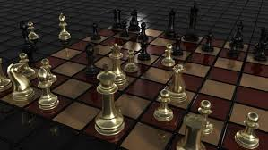
Wars and Diplomacy
Chess became incredibly popular among the aristocracy in the 18th century. Why?

Slide 32
Wars and Diplomacy
War of the Austrian Succession (1740 – 1748)
The Pragmatic Sanction: Charles VI, Habsburg ruler, negotiated with other rulers to recognize his daughter Maria Theresa as his true heir.
Frederick the Great invades Silesia (Austria).
France allied with Prussia because… they just never liked Austria.
Austria gets Britain’s help because… the British really don’t like the French.
France takes Austrian Netherlands and Madras (India) from Britain
Brits take French fortress in North America
Treaty of Aix-la-Chapelle (1748)
Everyone gets their land back, except Austria. Prussia kept Silesia. This guaranteed another war.

Slide 33
War and Diplomacy
Seven Years’ War, 1756 – 1763
Diplomatic revolution: realignment of alliances
Achieved by Austria- MAJOR shift in alliances.
France and Britain clash in New England
Great Britain joined forces with Prussia
Why did Britain’s George II side with Prussia?
France and Austria agreed to defensive alliance.
Marriage of Louis XVI and Marie Antoinette
Why did Austria want to side with France, its sworn enemy?
Beginning of French-German rivalry that will last to WWII
The first world war?
Conflict in Europe
War in India
Robert Clive (1725 – 1774)
The French and Indian War
Winners and losers

Slide 34
The Seven Years War
European Theater: England and Prussia versus France and Austria.
Colonial Theater: Britain thrashes France
William Pitt and North America: How does Britain “win America on the plains of Germany”?
The French and Indian War: the biggest conflict
French allied with Native Americans, Brits had help from American colonists
Pitt put most effort into North America… why??
In India: Britain and France supported rival princes, but the British won under Robert Clive.
Treaty of Paris (1763) made Britain into a world power, through World War II.
France lost its empire

Slide 35
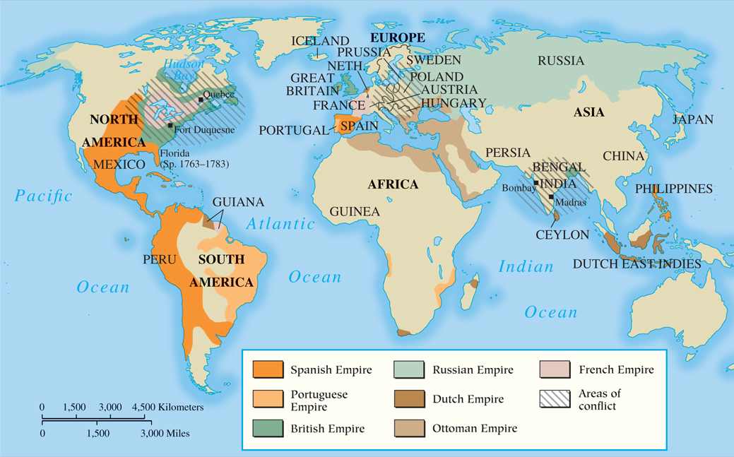
MAP 18.3 Battlefields of the Seven Years’ War
Map 18.3 p540
Notes:
MAP 18.3 Battlefields of the Seven Years’ War. A major struggle among the five great powers,
the Seven Years’ War was truly a worldwide conflict. In central Europe, Prussia survived against the
combined forces of France, Austria, and Russia, while Britain emerged victorious against France in
the struggle for empire, gaining control of French North America and India.

Slide 36
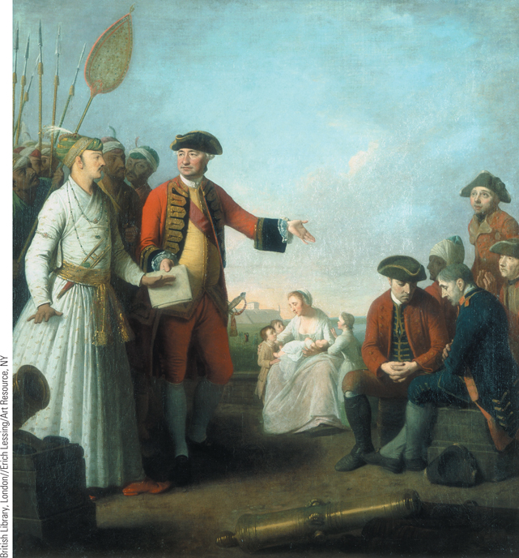
Robert Clive in India
Robert Clive was the leader of the army of the British East India Company. He had been commanded to fight the ruler of Bengal in order to gain trading privileges.
p541
Notes:
Robert Clive in India. Robert Clive was the leader of the army of the British East India
Company. He had been commanded to fight the ruler of Bengal in order to gain trading
privileges. After the Battle of Plassey in 1757, Clive and the East India Company took
control of Bengal. In this painting by Edward Penny, Clive is shown receiving a grant of
money for his injured soldiers from the local nabob or governor of Bengal.

Slide 37
Wars and Diplomacy
European Armies and Warfare
Professional standing armies became a feature characteristic of European nations.
Composition of armies
Reflection of the hierarchical structure of European society
Landed aristocrats as officers
Middle-class filled middle ranks of officer corps
Rank-and-file soldiers from the lower classes
Foreign and native troops- many nations relied on mercenaries, like Britain.
Maritime service- Criminals were pressed into service
British and Dutch were maritime powers, while France and Prussia had powerful armies.

Slide 38
Wars and Diplomacy
The nature of warfare
Increased size of armies did not make wars more violent than before.
Based on limited rather than ideological objectives
Did not seek out to destroy tax-paying populations either.
Wars became more “formal” with rules of engagement.
Wars were more expensive now (cost of technology and weapons), so leaders had to be clever.
Elaborate maneuvers and sieges
Siege warfare: honorable surrender and negotiation rather than medieval destruction and slaughter.

Slide 39
CHRONOLOGY The Mid-Century Wars
Event | Dates
War of the Austrian Succession | 1740–1748
Peace of Aix-la-Chapelle | 1748
Seven Years’ War | 1756–1763
Diplomatic revolution | 1756
Battle of Rossbach | 1757
British capture of Forts Duquesne and Louisbourg | 1758
Battle of Quebec | 1759
Peace of Hubertusburg | 1763
Treaty of Paris | 1763
p542
Notes:
CHRONOLOGY The Mid-Century Wars

Slide 40
Economic Expansion and Social Changes
Growth of the European Population
Slow but steady rise starting in 1750
Falling death rate
Improvements in diet
Ideal growing conditions
New crops
Family, Marriage, and Birthrate Patterns
Child care
Criticism of traditional attitudes and practices
Problems of infanticide and abandonment
Marriage and birthrates
Late marriages and the nuclear family
Limits on the birthrate

Slide 41
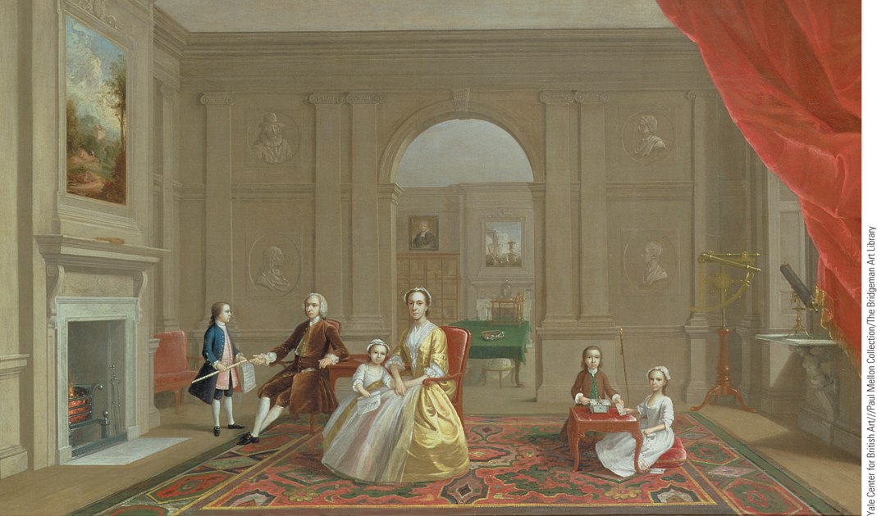
Children of the Upper Classes
This painting of John Bacon and his family illustrates an important
feature of upper-class family life in Great Britain in the first half of the eighteenth century.
p545
Notes:
Children of the Upper Classes. This painting of John Bacon and his family illustrates an important
feature of upper-class family life in Great Britain in the first half of the eighteenth century. The children
appear as miniature adults, dressed in clothes modeled after the styles of their parents’ clothes.

Slide 42
Economic Expansion and Social Change
Historian’s Debate: Was There an Agricultural Revolution?
No: Significant change only in England and was not sustained after 1750
Yes: It was more widespread and long-lasting
Factors of growth in traditional view of Agricultural Revolution: more farmland; increased crop yield; healthier; more abundant livestock; and improved climate
Gains in production displaced agricultural workers
New techniques required larger holdings
England: Enclosure Acts; destroyed traditional patterns of English village life

Slide 43
Economic Expansion and Social Change
New Methods of Finance
The creation of national banks
The Bank of England and national debt
Troubles with speculation
Cottage industry for textiles
European Industry
Cottage industry
Shift of textile production to the countryside
The “putting-out” or “domestic” system
A family enterprise for rural people
New methods and new machines
Cotton importation leads to innovation
Richard Arkwright (1732 – 1792) and the water frame
The development of mechanized looms

Slide 44
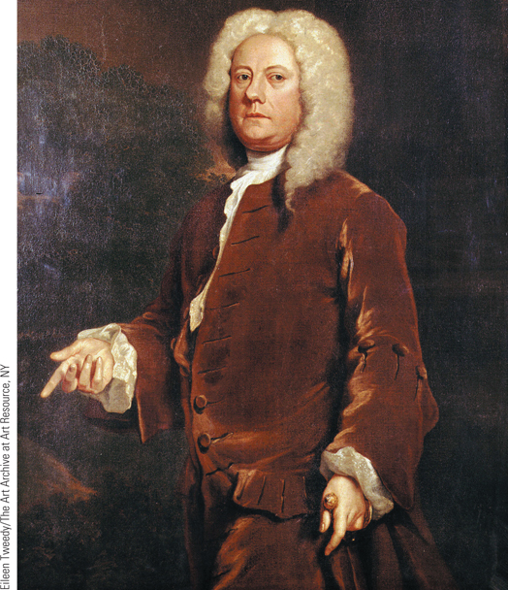
Jethro Tull and the Seed Drill (Slide 1 of 2)
The seed drill was invented by Jethro Tull, one of the many landed aristocrats who participated in the scientific experimentation of the age.
p546
Notes:
Jethro Tull and the Seed Drill. A major innovation in the new
agricultural practices of the eighteenth century was the development of
seed drills that enabled farmers to plant seeds in rows and prevent them
from being picked up by birds. The seed drill was invented
by Jethro Tull, one of the many landed aristocrats who participated
in the scientific experimentation of the age.

Slide 45
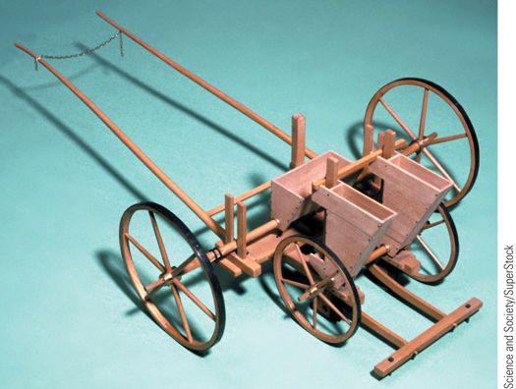
Jethro Tull and the Seed Drill (Slide 2 of 2)
A major innovation in the new agricultural practices of the eighteenth century was the development of seed drills that enabled farmers to plant seeds in rows and prevent them from being picked up by birds.
p546
Notes:
Jethro Tull and the Seed Drill. A major innovation in the new
agricultural practices of the eighteenth century was the development of
seed drills that enabled farmers to plant seeds in rows and prevent them
from being picked up by birds. The seed drill pictured here was invented
by Jethro Tull, one of the many landed aristocrats who participated
in the scientific experimentation of the age.

Slide 46
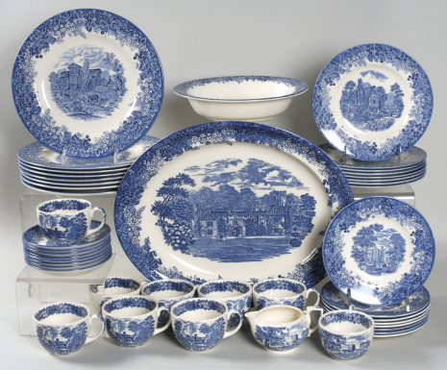
Economic Expansion and Social Change
The New Consumers
The origins of a consumer revolution
Agricultural workers decline
Growth of small merchants, craftspeople and shopkeepers
Primarily in England
Europe overtakes China in production of Porcelain
Showroom of Josiah Wedgewood
Mercantile Empire and Worldwide Trade

Slide 47
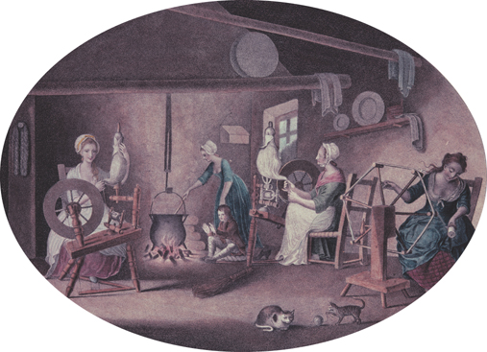
Cottage Industry
One important source of textile production in the eighteenth century was the cottage industry, truly a family enterprise. Shown here is a family at work producing flax.
p548
Notes:
Cottage Industry. (p.548)
One important source of textile production in the eighteenth century was the cottage industry, truly a family enterprise. Shown here is a family at work producing flax. It was customary in the cottage industry for women to spin and wind the yarn.

Slide 48
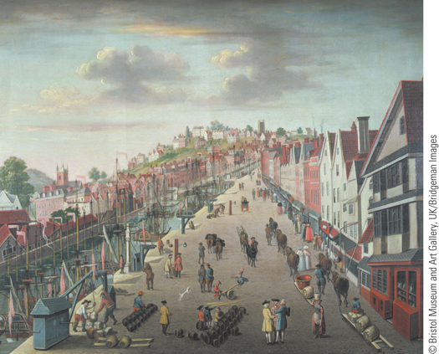
Bristol
After the discovery of the New World, Bristol became an important British shipping port. By the seventeenth century, it was the second-largest port in the kingdom.
p549
Notes:
Bristol. (p.549)
After the discovery of the New World, Bristol became an important British shipping port. By the seventeenth century, it was the second-largest port in the kingdom. Portrayed here in a painting dated 1760 is Bristol’s quay, where woods were unloaded and loaded.

Slide 49
The Social Order of the Eighteenth Century
Tradition and Change
The Peasants
Variety of experiences, depending on location
Some subject to compulsory services as well as legal and economic limitations
The village
The peasant diet
The Nobility
Privileges, service, and social mobility
The aristocratic way of life: the country house
The aristocratic way of life: the grand tour

Slide 51
Eighteenth-century France had some of the best roads in the world, but they were often built with forced labor. French peasants were required to work part of each year on such projects. This system, called the corvée, was not abolished until the French Revolution in 1789.
Joseph Vernet, “Construction of a Road.” Louvre, Paris, France. Bridgeman-Giraudon/Art Resource, NY

Slide 52
Beer Alley and Gin Lane, by William Hogarth England, 1751

Slide 53
Emelyan Pugachev (1726–1775) led the largest peasant revolt in Russian history. In this contemporary propaganda picture he is shown in chains. An inscription in Russian and German was printed below the picture decrying the evils of revolution and insurrection.

Slide 54
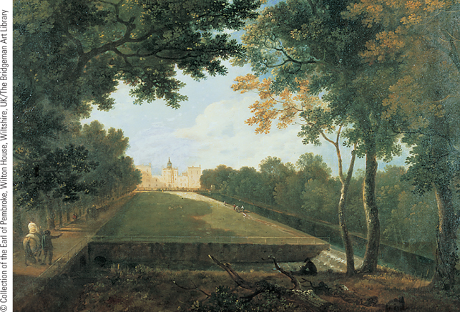
Images of Everyday Life: The Aristocratic Way of Life
The painting, by Richard Wilson, shows a typical English country house of the eighteenth century surrounded by a simple, serene landscape.
p553
Notes:
The Aristocratic Way of Life

Slide 55
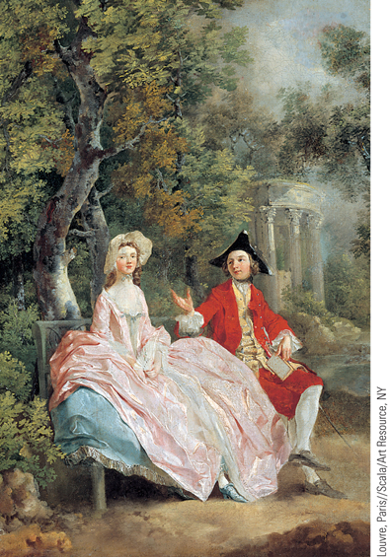
Images of Everyday Life: The Aristocratic Way of Life
Thomas Gainsborough’s Conversation in the Park, captures the relaxed life of two aristocrats in the park of their country estate.
p553
Notes:
The Aristocratic Way of Life

Slide 56
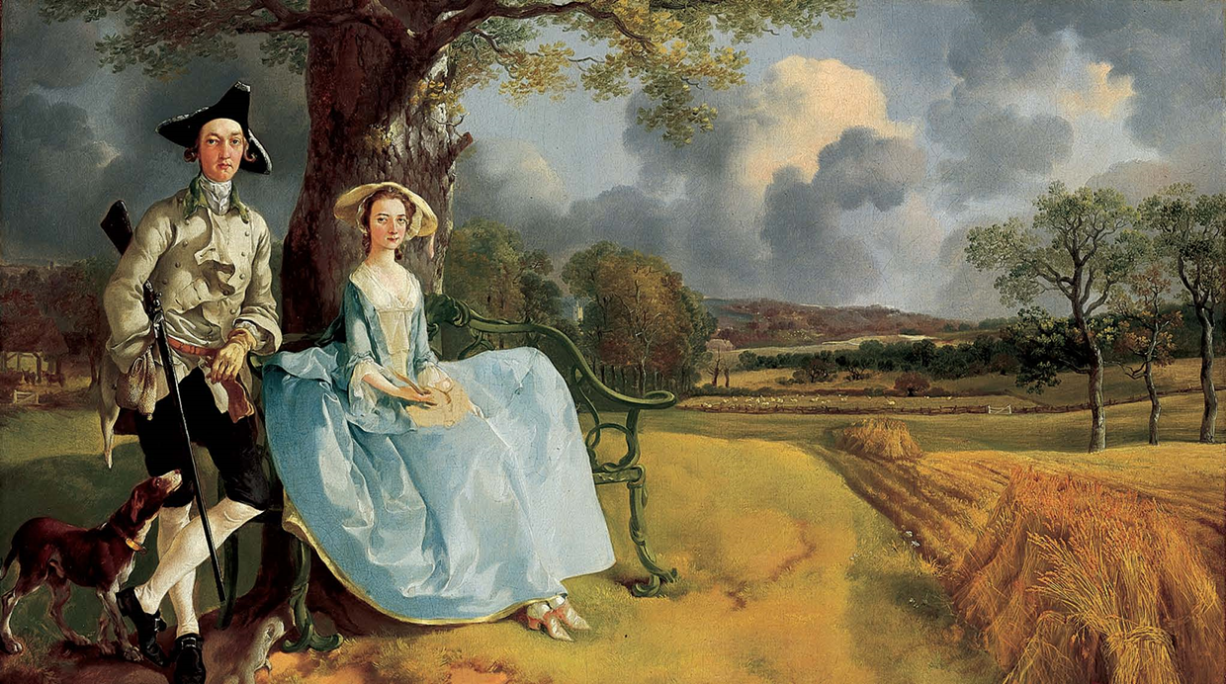
An Aristocratic Couple Portraits, such as this one of the English landowner, Robert Andrews and His Wife, by Thomas Gainsborough (1728–1788), contain many clues to the aristocratic dominance of landed society

Slide 57
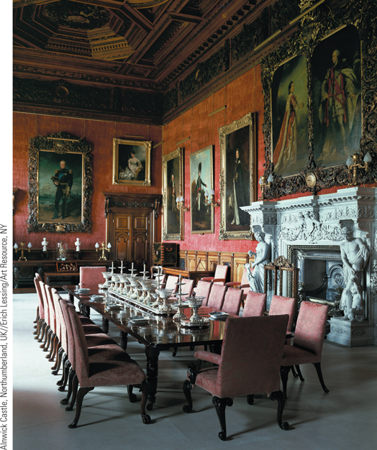
Images of Everyday Life: The Aristocratic Way of Life
The illustration shows the formal dining room of a great British country house.
p553
Notes:
The Aristocratic Way of Life

Slide 58
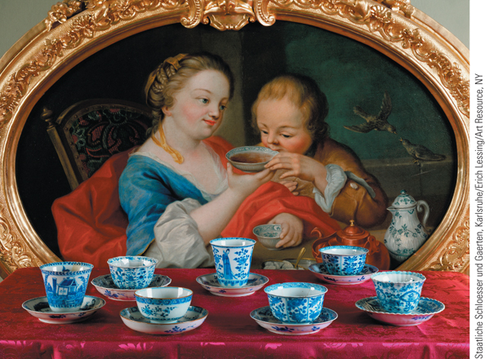
Images of Everyday Life: The Aristocratic Way of Life
The illustration at the lower right shows Chinese cups without
handles, which became extremely fashionable.
p553
Notes:
The Aristocratic Way of Life

Slide 59
The Inhabitants of Towns and Cities
The Importance of Cities
Function as centers of culture
Urban hierarchy
Patrician oligarchy
Middle class
Petty bourgeoisie
Laborers
Sanitation
The Problem of Poverty
Changing ideas about charity

Slide 60
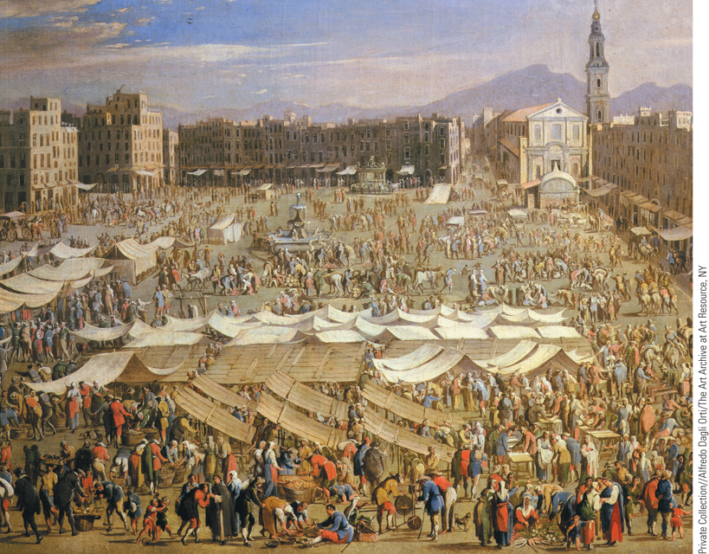
A Market Square in Naples
Below the wealthy patrician elites who dominated the towns and cities
were a number of social groups with a wide range of incomes and occupations. This remarkable diversity is evident in this eighteenth-century painting by Angelo Costa, which shows a fair being held in the chief
market square of the Italian city of Naples.
p555
Notes:
A Market Square in Naples. Below the wealthy patrician elites who dominated the towns and cities
were a number of social groups with a wide range of incomes and occupations. This remarkable diversity
is evident in this eighteenth-century painting by Angelo Costa, which shows a fair being held in the chief
market square of the Italian city of Naples.

Slide 61
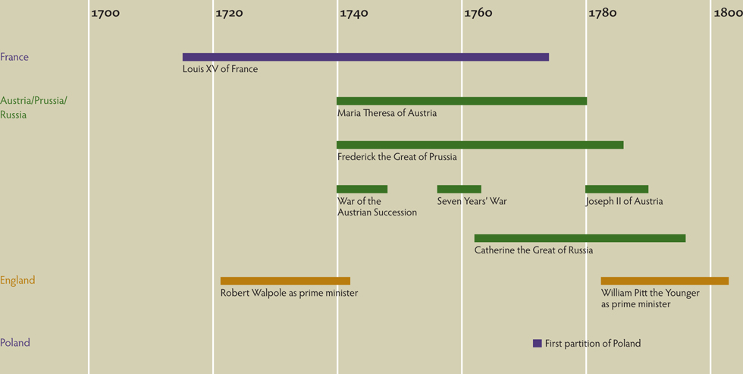
Chapter Timeline
p557

Slide 62
Discussion Questions
How did Enlightenment ideas help form Enlightened Absolutists in Europe in the 18th century?
What are the reasons for the rise of Enlightened monarchs in Central Europe?
Who was Frederick II, and what was his impact on the history, culture, and laws of Europe?
What started the Seven Years’ War? How did the war progress and ultimately who won?
What were some of the changes in social order in the 18th century?
What was the fate of Poland, and why?

