Slide 1
A Revolution in Politics: The Era of the French Revolution and Napoleon
Chapter 19

Slide 2
Focus Questions
​What were the causes and results of the American Revolution, and what impact did it have on Europe?
​What were the long-range and immediate causes of the French Revolution?
​What were the main events of the French Revolution between 1789 and 1799? What role did each of the following play in the French Revolution: lawyers, peasants, women, the clergy, the Jacobins, the sans-culottes, the French revolutionary army, and the Committee of Public Safety?
​Which aspects of the French Revolution did Napoleon preserve, and which did he destroy?

Slide 3
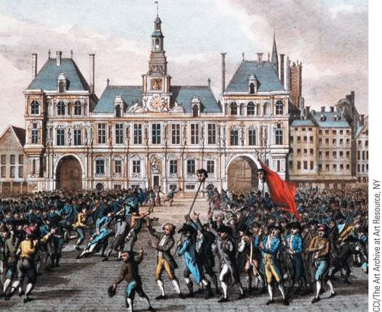
The storming of the Bastille
p559
Notes:
The storming of the Bastille

Slide 4
The Beginning of the Revolutionary Era: the American Revolution
Reorganization, Resistance, and Rebellion
New policies create imperial crisis
Declaration of Independence, 1776
The War for Independence
The war effort
The leadership of George Washington (1732 – 1799)
The internal divisions of civil war
The role of European aid
The Treaty of Paris, 1783

Slide 5
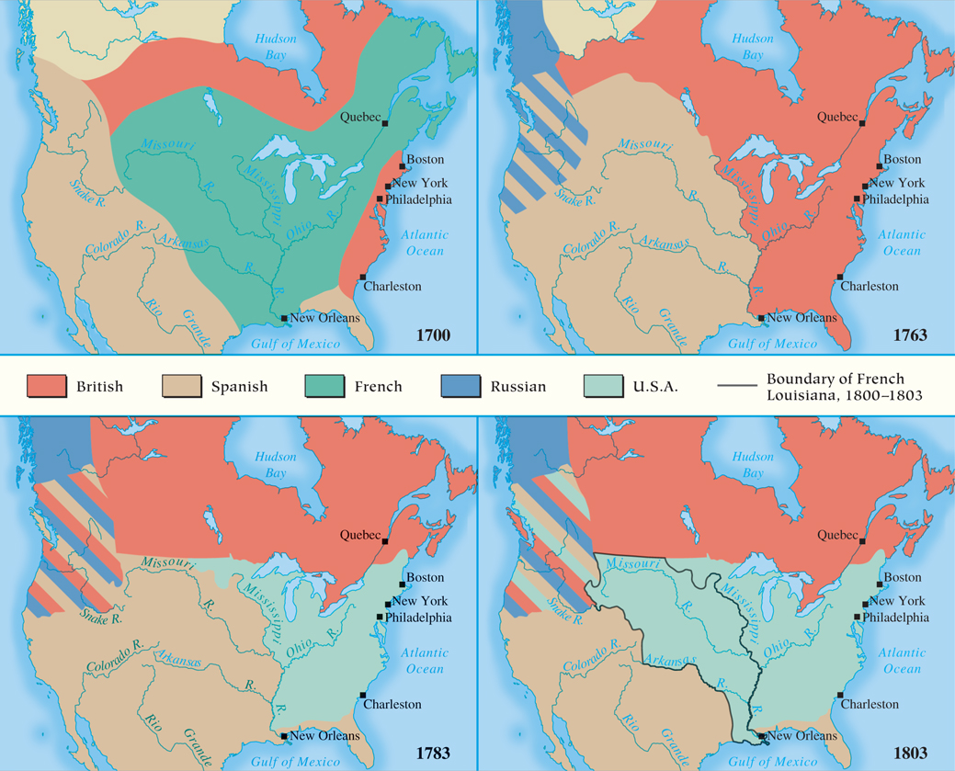
MAP 19.1 North America, 1700–1803
Map 19.1 p561
Notes:
MAP 19.1 North America, 1700–1803. At the end of the Seven Years’ War, Britain had gained
much territory in eastern North America, but its efforts to obtain new revenues from the American
colonies to help pay for the war sparked the American Revolution. The 1803 Louisiana Purchase
nearly doubled the size of the United States and spurred westward expansion to the Pacific Ocean.

Slide 6
The American Revolution
Forming a New Nation
The Articles of Confederation, 1781 – 1789
The Constitution, approved in 1788
Central government with separation of powers
Bill of Rights added in 1789
The embodiment of the Enlightenment’s political dreams
The Impact of the American Revolution on Europe
Proved freedom and rights were not just utopian ideals

Slide 7
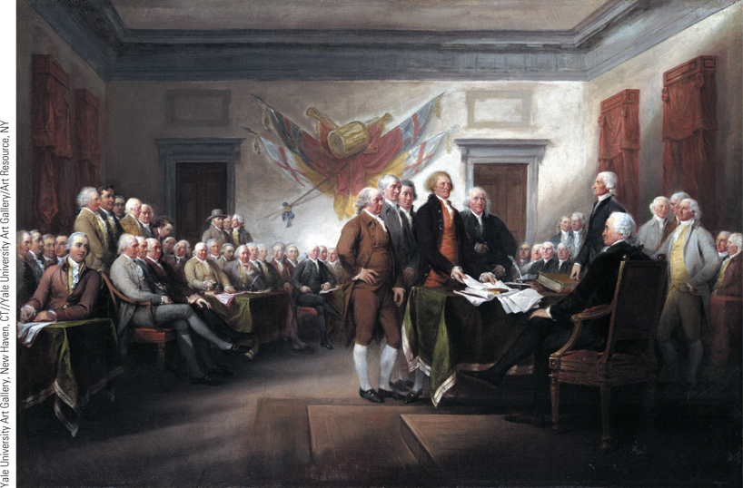
The Declaration of Independence
The Declaration of Independence, approved on July 4, 1776, by the Second Continental Congress, opened the door to the war for American independence.
p562
Notes:
The Declaration of
Independence. The
Declaration of
Independence, approved on
July 4, 1776, by the Second
Continental Congress,
opened the door to the war
for American independence.
John Trumbull’s famous
painting, The Signing of the
Declaration, shows the
members of the committee
responsible for the
Declaration of Independence
(from left to right, John
Adams, Roger Sherman,
Robert Livingston, Thomas
Jefferson, and Benjamin
Franklin) standing before
John Hancock, president of
the Second Continental
Congress.

Slide 8
Background to the French Revolution
Social Structure of the Old Regime
The First Estate: Clergy (130,000), owned 10% of the land
Clergy divided; wealthy higher clergy and often poor parish priests
The Second Estate: Nobility (350,000), owned 25-30% of the land
Nobility of the Sword, Nobility of the Robe
The Third Estate
Commoners
Peasants = 75-80% of the population, owned 35-40% of the land
Skilled artisans, shopkeepers, and wage earners
Bourgeoisie (middle class; 8% of the population)
Owned 20-25% of the land but lacked power
Many opposed to “old order”

Slide 9
Other Problems Facing the French Monarchy
Specific Problems in the 1780s
Bad harvests in 1787 and 1788
One-third of the population poor
Ideas of the Philosophes
Criticisms of privileges and institutions
Failure to Make Reforms
Power of the parlements
Financial crisis
Growing debt, costly expenditures, little aid
Summoning the Estates-General

Slide 10
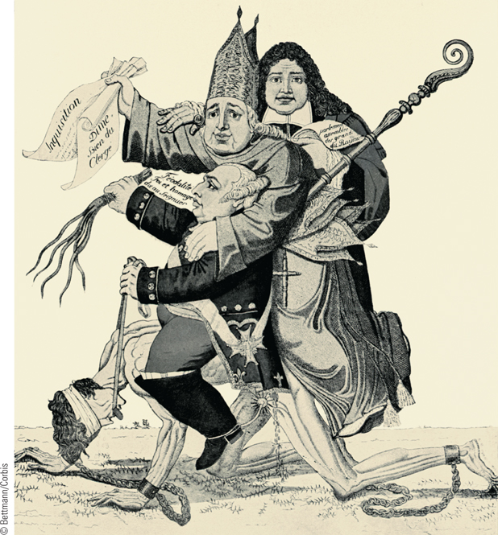
The Three Estates
This French political cartoon from 1789 reveals a critical view
of France’s privileged orders.
p564
Notes:
The Three Estates. This French political cartoon from 1789 reveals a critical view
of France’s privileged orders. Shown in the cartoon is a naked common man held in
chains and being ridden by an aristocrat, a clergyman, and a judge. The message is
clear: most ordinary French people (the Third Estate) are suffering horribly as a result
of the privileges of the First and Second Estates.

Slide 11
The French Revolution
From Estates-General to a National Assembly
Composition and actions of the Estates-General
300 delegates each to the First and Second Estate; 600 delegates to the Third Estate
Cahiers de doléances
Estates General meets May 5, 1789
Abbé Sieyès, “What is the Third Estate?”
National Assembly
Constituted, June 17; Tennis Court Oath, June 20
Intervention of the Common People
Attack on the Bastille, July 14
Peasant rebellions and the Great Fear

Slide 12
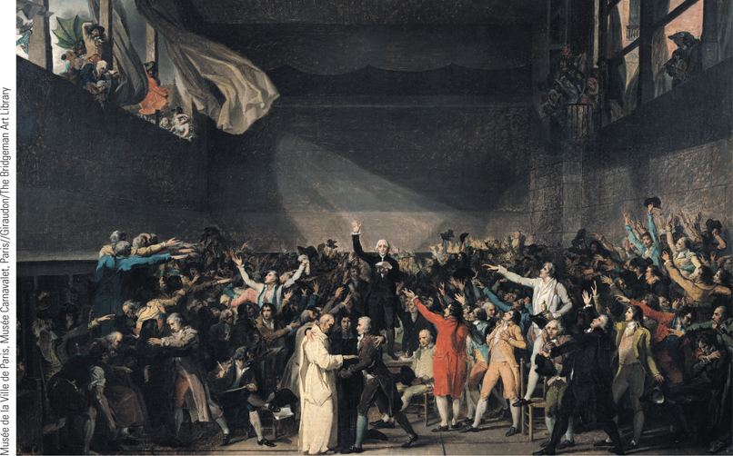
The Tennis Court Oath
Finding themselves locked out of their regular meeting place on June 20, 1789, the deputies of the Third Estate met instead in the nearby tennis courts of the Jeu de Paume and committed themselves to continue to meet until they established a new constitution for France.
p567
Notes:
The Tennis Court Oath.
Finding themselves locked out of
their regular meeting place on
June 20, 1789, the deputies of the
Third Estate met instead in the
nearby tennis courts of the Jeu
de Paume and committed
themselves to continue to meet
until they established a new
constitution for France. In this
painting, the Neoclassical artist
Jacques-Louis David presents a
dramatic rendering of the Tennis
Court Oath.

Slide 13
Destruction of the Old Regime
Signs of Change
Seigneurial rights abolished, August 4, 1789
The Declaration of the Rights of Man and Citizen
Charter of basic liberties, adopted August 26
Does this include women?
Olympe de Gouges, Declaration of the Rights of Woman and the Female Citizen, 1791
The Women’s March to Versailles
The demand for bread becomes a demand for the king’s return to Paris, October 5, 1789

Slide 14
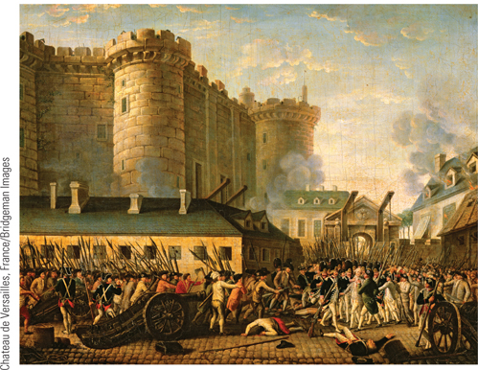
Global Perspectives: Revolution and Revolt in France and China
At the top is a scene from the storming of the Bastille in Paris in 1789.
p569
Notes:
(p.569) At the top is a scene from the storming of the Bastille in Paris in 1789.

Slide 15
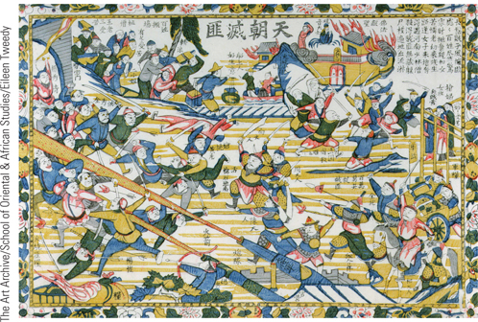
Global Perspectives: Revolution and Revolt in France and China
Pictured is a scene from one of the struggles during the Taiping Rebellion, a major peasant revolt in the mid-nineteenth century in China.
p569
Notes:
(p.569) Pictured is a scene from one of the struggles during the Taiping Rebellion, a major peasant revolt in the mid-nineteenth century in China. An imperial Chinese army is shown recapturing the city of Nanjing from Taiping rebels in 1864.

Slide 16
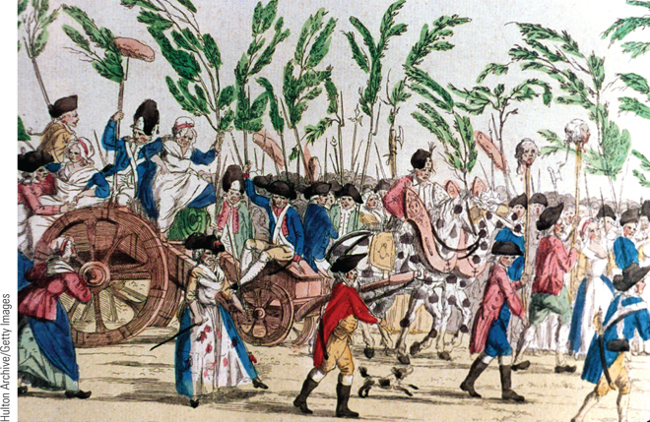
The Women’s March to Versailles
On October 5, 1789, thousands of Parisian women marched to Versailles to confront King Louis XVI and to demand bread for their
starving children.
p570
Notes:
The Women’s March to
Versailles. On October 5,
1789, thousands of Parisian
women marched to Versailles
to confront King Louis XVI and
to demand bread for their
starving children. This
contemporary print shows a
group of dedicated marchers;
some are armed with pikes and
other weapons while others pull
an artillery piece.

Slide 17
Destruction of the Old Regime
The Catholic Church
Civil Constitution of the Clergy, July 1790
Church lands confiscated and sold as assignats, causing mass inflation.
Clergy was elected and paid state salary
Secularization of the church- possibly where the revolution started to go wrong?
Makes the church the enemy of the Revolution
Opposition: grounds for counterrevolution
A New Constitution
1791- A constitutional monarchy in France
Power in the Legislative Assembly
Electoral and administrative restructuring
Power still preserved in hands of elite

Slide 18
Assignats: government bonds backed by confiscated church lands

Slide 19
Destruction of the Old Regime
Opposition from Within
Peasants angered over attack on the church and inflation caused by assignats
The debate over greater radicalism
The Jacobin clubs- bourgeois lawyers- often offered radical solutions
Flight to Varennes June 1791; shattered illusion of loyal king and people’s faith in him.
Opposition from Abroad
Most ultra royalists emigrate
Declaration of Pillnitz from Prussia and Austria
1791: Legislative Assembly orders émigrés to return
Declaration of war on Austria, April 20, 1792

Slide 21
France at War
Why would the French want war?
Reactionary: Some hoped it would cool off the revolution and bring unity
Royals: War might bring back the old regime
Revolutionaries: Hoped war would strengthen revolution and spread it beyond France.
Fear of invasion → paranoia → more radicalism:
Paris Commune: radical group made of working classes (sans-culottes) in Paris
Attacked the king, forcing the Legislative Assembly to call for a convention with universal male suffrage.
Demands for a republic.

Slide 22
Edmund Burke: The Conservative Response
Wrote Reflections on the Revolution in France (1790) – predicted political chaos (check), deaths of monarchs (check) and said the revolution will end in military despotism (yup).
His book became a conservative’s guidebook.
American Revolution hero Thomas Paine disagreed with him.
Wrote The Rights of Man, defended age of revolution.
Other European nations agreed with Burke when France declared war on Austria.

Slide 23
The Radical Revolution
The new Paris Commune
Georges Danton (1759 – 1794)
National Convention, September 1792
Composition
Young lawyers, professional, and property owners
Actions
Universal male suffrage
Abolition of the monarchy, September 21
Domestic Crises
Factionalism: the Girondins and the Mountain
Execution of Louis XVI: January 21, 1793
Limitations in the National Convention’s rule

Slide 24
The Radical Revolution
Domestic Crises
Factionalism: the Girondins and the Mountain
Girondins: Represent interests of the provinces of France, and want the king alive
The Mountain (Montagnards)- represent the interests of Paris, and want the king dead
The Mountain is victorious in their convention:
Execution of Louis XVI: January 21, 1793
Limitations in the National Convention’s rule:
Overpowered by the radical Paris Commune
Girondins were arrested and executed
Peasant revolts like in the Vendée region (also revolted against the new military draft)
Provincial towns believed Paris was too radical

Slide 25
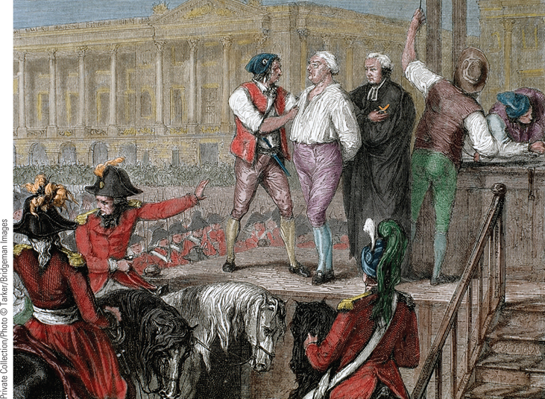
Execution of the King
At the beginning of 1793, the National Convention decreed the death of the king, and on January 21 of that year, Louis XVI was executed.
p574
Notes:
Execution of the King.
At the beginning of 1793, the National Convention decreed the death of the king, and on January 21 of that year, Louis XVI was executed. As seen in this engraving, a new revolutionary device, the guillotine, was used to execute the king.

Slide 26
The Radical Revolution
Foreign Crisis
Military losses against a European coalition of Prussia, Britain, Austria, Portugal, Spain, Dutch
Danton uses war to ignite nationalism
Levée en masse- military draft and TOTAL WAR
Increasing the power of the Committee of Public Safety
Maximilien Robespierre (1758 – 1794)- a Jacobin who loved “the people”
Wants a “republic of virtue”
“To achieve liberty, criminals must lose their heads”
“Terror without virtue is fatal; Virtue without terror is impotent.”

Slide 27
The Radical Revolution
A Nation in Arms
Mobilization of the nation
Creation of a “people’s” government; wars were now “people’s” wars.
Ferocious, with appalling carnage
With the levée-en-masse, an army of 1.7 million was raised by Sept 1794
Source of modern nationalism
Taught Europe what a “nation in arms” could do, and set the tone for future wars
Civilian deaths and total war

Slide 28
The Radical Revolution
Committee of Public Safety and Reign of Terror, July 1793 – July 1794
Punishing enemies
Victims of revolution drawn from all classes; c. 250,000 killed (17,000 by guillotine)
Revolutionary Tribunal- short public trials
Suppression of the Vendée rebellion
Louis Saint-Just: “Since the French people has manifested its will, everything opposed to it is outside the sovereign. Whatever is outside the sovereign is an enemy.”
Laws against defending oneself at trial; against “hoarding” food and supplies, and speaking out against the revolution (or simply not supporting it, or being related to/associated with an “enemy” of the revolution)

Slide 29
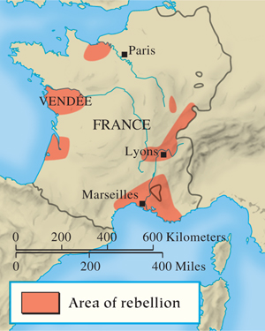
Rebellion in France
p574
Notes:
Rebellion in France

Slide 30
The Radical Revolution
The “Republic of Virtue”
Creation of new republican order and citizens
Price controls
The Role of Women
Political activism criticized by men
De-christianization and the New Calendar
Equality and Slavery
Revolt in Saint Dominigue and Haitian independence
Decline of the Committee of Public Safety
Turned again the Paris Commune
French military successes (#ThanksNapoleon) made terror less “necessary”
Execution of Maximilien Robespierre, July 28, 1794

Slide 31
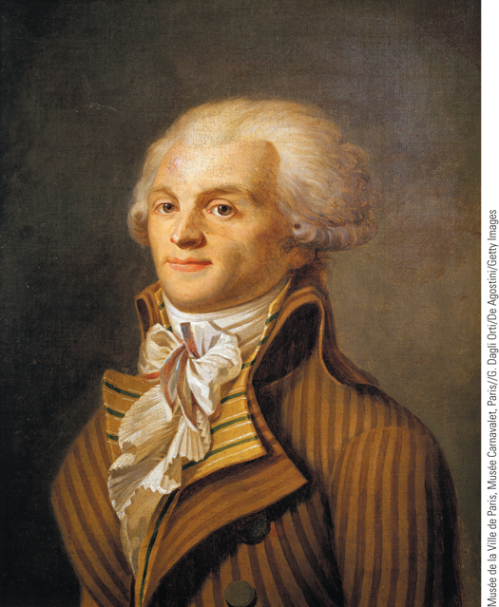
Robespierre
“He who fights monsters
might take care, lest he
becomes a monster himself;
And if you gaze for long into
the abyss, the abyss will
gaze back unto you.”
- Friedrich Nietzche
Maximilien Robespierre, see here in a portrait by an
unknown artist, eventually became the dominant figure in the
Committee of Public Safety.
p581
Notes:
Robespierre. Maximilien Robespierre, see here in a portrait by an
unknown artist, eventually became the dominant figure in the
Committee of Public Safety. Fear of Robespierre, however, led many in
the National Convention to condemn him, and on July 28, 1794, he was
executed.

Slide 32
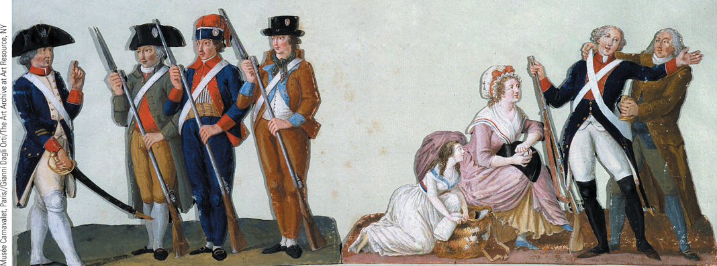
Citizens in the New French Army (Slide 1 of 2)
To save the Republic from its foreign enemies, the National Convention created a revolutionary army of unprecedented size.
p575
Notes:
Citizens in the New French Army. To save the Republic from its
foreign enemies, the National Convention created a revolutionary army
of unprecedented size. The illustration, from a book of paintings
on the French Revolution by the Lesueur brothers, shows three citizens
learning to drill, while a young volunteer is being armed and outfitted by
his family.

Slide 33
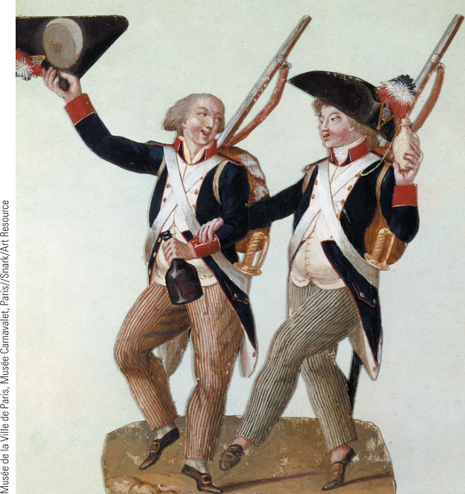
Citizens in the New French Army
The illustration, by the Lesueur brothers,
shows two volunteers joyfully going off to fight.
p575
Notes:
Citizens in the New French Army. To save the Republic from its
foreign enemies, the National Convention created a revolutionary army
of unprecedented size. The illustration, by the Lesueur brothers,
shows two volunteers joyfully going off to fight.

Slide 34
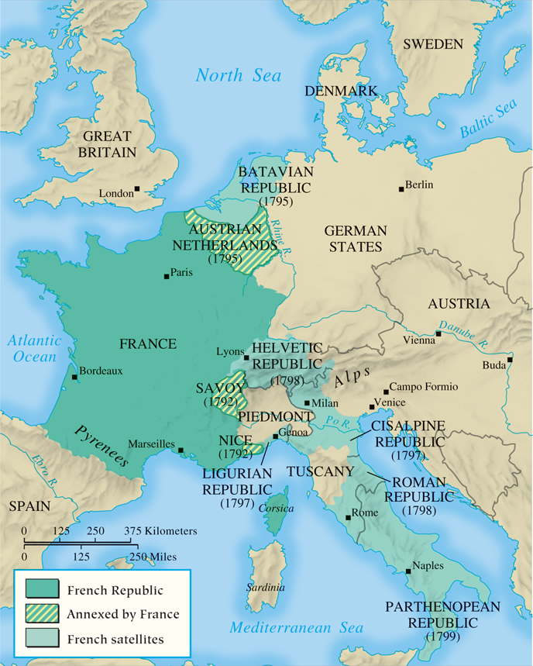
MAP 19.2 French Expansion During the Revolutionary Wars, 1792–1799
Map 19.2 p576
Notes:
MAP 19.2 French Expansion During the
Revolutionary Wars, 1792–1799. The
conservative rulers of Europe, appalled at
the republican character of the French
Revolution, took up arms to restore the
Bourbon monarchy. The French responded
with a people’s army, the largest ever seen,
which pushed the invaders out of France,
annexed the Austrian Netherlands and
some Italian territory, and created a
number of French satellite states.

Slide 35
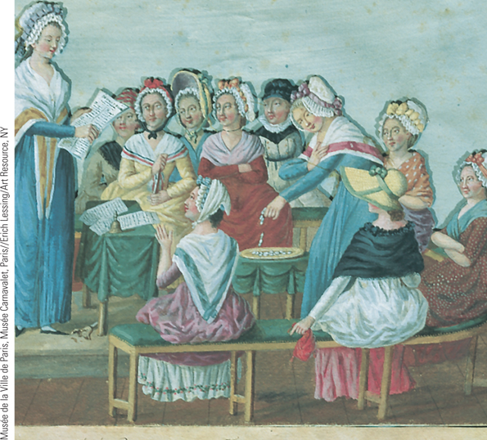
Women Patriots
Women played a variety of roles in the events of the French Revolution. This picture shows a middle-class women’s patriotic club discussing the decrees of the National Convention.
p579
Notes:
Women Patriots. Women played a variety of roles in the
events of the French Revolution. This picture shows a
middle-class women’s patriotic club discussing the decrees of
the National Convention, an indication that some women had
become highly politicized by the upheavals of the Revolution.
The women are also giving coins to create a fund for
impoverished families.

Slide 36
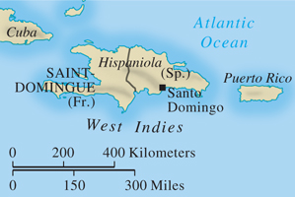
Revolt in Saint-Domingue
p580
Notes:
Revolt in Saint-Domingue (Haiti)

Slide 37
Reaction and the Directory
Thermidorian Reaction and the Directory
Curtailment of many of the Terror’s policies; a Conservative reaction to the Revolution
Jacobins shut down
Churches reopened
Aristocratic fashion was “in” again
Weird “bloody neck” parties were trending
The “White Terror”: Young aristocrats, sometimes named “Bands of Jesus” terrorized and attacked revolution supporters around the country in revenge

Slide 38
Reaction and the Directory
Constitution of 1795
Two-chamber legislature
Elected from a narrow base of voters
Five-person Directory: like having 5 presidents!
Period of revolutionary stagnation
Materialistic reaction: still controlled by elite bourgeoisie
2/3 members had to be chosen from upper ranks
Set off a riot that had to be put down by the military, led by Napoleon
Showed that the Directory had no real power without the military
Couldn’t deal with France’s problems: Economy was still bad, food shortages persisted, and war continued.

Slide 39
CHRONOLOGY The French Revolution (Slide 1 of 2)
Event | Dates
Assembly of notables | 1787
National Assembly (Constituent Assembly) | 1789–1791
Meeting of Estates-General | May 5, 1789
Formation of National Assembly | June 17, 1789
Tennis Court Oath | June 20, 1789
Fall of the Bastille | July 14, 1789
Great Fear | Summer 1789
Declaration of the Rights of Man and the Citizen | August 26, 1789
Women’s march to Versailles; king’s return to Paris | October 5–6, 1789
Civil Constitution of the Clergy | July 12, 1790
Flight of the king | June 1791
p582
Notes:
CHRONOLOGY The French Revolution

Slide 40
CHRONOLOGY The French Revolution (Slide 2 of 2)
Event | Dates
Legislative Assembly | 1791–1792
France declares war on Austria | April 20, 1792
Attack on the royal palace | August 10, 1792
National Convention | 1792–1795
Abolition of the monarchy | September 21, 1792
Execution of the king | January 21, 1793
Universal mobilization of the nation | August 23, 1793
Execution of Robespierre | July 28, 1794
Directory | 1795–1799
Constitution of 1795 is adopted | August 22, 1795

Slide 41
Age of Napoleon
Which aspects of the French Revolution did Napoleon preserve, and which did he destroy??

Slide 42
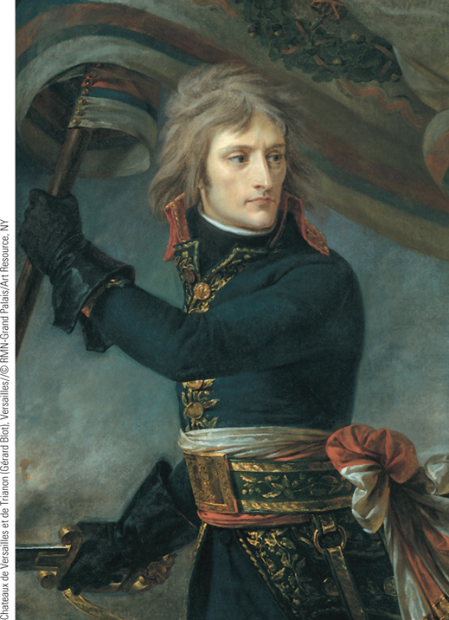
Napoleon as a Young Officer
Napoleon rose quickly through the military ranks, being promoted to the rank of brigadier general at the age of twenty-five.
p583
Notes:
Napoleon as a Young Officer. Napoleon rose quickly through the
military ranks, being promoted to the rank of brigadier general at the
age of twenty-five. This painting of Napoleon by the Romantic painter
Baron Antoine-Jean Gros (GROH) presents an idealized, heroic image of
the young leader.

Slide 43
The Age of Napoleon
The Rise of Napoleon (1769 – 1821)
Background and education
Napoleon’s military career
Commissioned a lieutenant, 1785
Promoted to brigadier general, 1794
Victory in Italy, 1797- Demonstrated patriotic commitment to rank and file soldiers. Or at least for now….
Defeat in Egypt, 1799- Abandoned his plague-struck army in Egypt when he was defeated!

Slide 44
Bonaparte Visiting Plague Victims at Jaffa, 1804.
Jean-Antoine Gros, The Louvre, Paris.

Slide 45
Napoleon takes power
Napoleon in Control
Coup d’état, 1799: Overthrew the Directory
Creates a Consulate with 3 Consuls
Napoleon as First Consul
First Consul for Life, 1802
Crowned Emperor Napoleon I, 1804
This brings France back to Square One: A monarchy
As time went on, he became ever more dictatorial
Practiced democratic despotism: illusion of democracy, but he called all the shots.

Slide 46
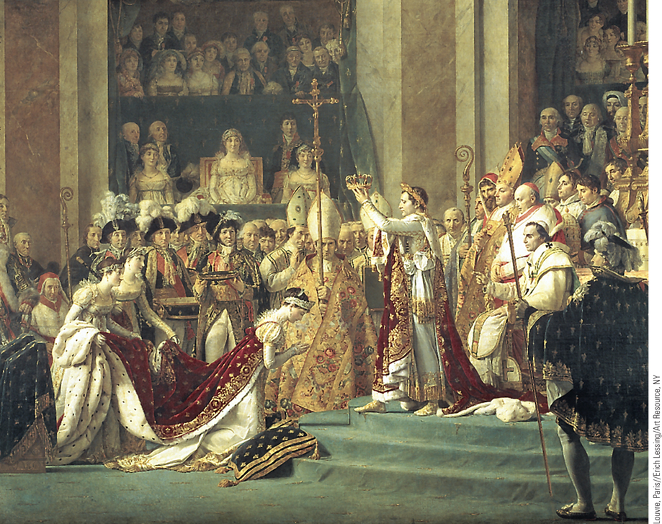
The Coronation of Napoleon
In 1804, Napoleon restored monarchy to France when he crowned
himself emperor.
p585
Notes:
The Coronation of Napoleon. In 1804, Napoleon restored monarchy to France when he crowned
himself emperor. In the coronation scene painted by Jacques-Louis David, Napoleon is shown crowning
the empress Josephine while the pope looks on. Shown seated in the box in the background is Napoleon’s
mother, even though she was not at the ceremony.

Slide 47
The Domestic Policies of Emperor Napoleon
Napoleon and the Catholic Church
Concordat of 1801: stabilization of regime by making peace with the Church and keeping it under state control.
A New Code of Laws
Code Napoléon (Civil Code)
Preservation of revolutionary gains and property rights: Equality, religious toleration, abolition of serfdom
Curtailment of rights for women- they didn’t have many rights to begin with, but Napoleon took whatever was left!

Slide 48
Domestic Policies of Emperor Napoleon
The French Bureaucracy
Centralization of administration: the prefects: government agents and police that worked directly for him
Professional tax collectors; professional EVERYTHING based on merit, not birth.
Napoleon’s Growing Despotism
Censorship and inequality
Conscription (military draft)
“benevolent dictatorship”
Some viewed him as a tyrant, others as a hero

Slide 49
Napoleon on His
Imperial Throne,
1806.
Musée des Beaux-Arts,
Rennes.
Notes:
This portrait of Napoleon on his throne by Jean Ingres (1780–1867) shows him in the splendor of an imperial monarch who embodies the total power of the state.
Jean Auguste Dominique Ingres (1780–1867), Napoleon on His Imperial Throne, 1806. Oil on canvas, 259 × 162 cm. Musée des Beaux-Arts, Rennes. Photograph © Erich Lessing/Art Resource, NY

Slide 50
Napoleon’s Empire and the European Response
Fighting the Coalitions
Peace of Amiens, 1802- with Britain; didn’t last
Renewal of war in 1803; victories against the Third Coalition of Britain, Austria, Russia 1805-1807, giving him chance to reconstruct Europe.
In defeating Austria, he also became “King of Italy”
Reorganized German states as the Confederation of the Rhine in order to undermine Prussia and Austria- thus he ended the Holy Roman Empire.
In 1810, he divorced Josephine and married Marie Louise, daughter of Austrian Emperor Francis I, as a peace accord. She bore him a son and heir.

Slide 51
Napoleon’s Empire and Europe’s Response
Napoleon’s Grand Empire
Three states: French empire, dependent states, and allied states
Attempted reform: the last of the enlightened absolutists?
Put his own friends and family on thrones of Europe:
Brother Jerome- King of Westphalia
Brother Joseph- King of Spain
Urged them to be “liberal constitutional monarchs”
Spread of nationalist and liberal ideas throughout Europe

Slide 52
Notes:
In this 1806 caricature by the famous English artist James Gillray, Napoleon is shown as a baker who creates new kings as easily as gingerbread cookies. His new allies in the Rhine Confederation, including the rulers of Württemberg, Bavaria, and Saxony, are placed in the “New French Oven for Imperial Gingerbread.”
‘Tiddy- Doll, the Great French Gingerbread Maker, Drawing Out a New Batch of Kings. His Man, Hopping Talley, Mixing Up the Dough’, pub. by Hannah Humphrey, 23rd January 1806 (aquatint), Gillray, James (1757–1815). Leeds Museums and Galleries (City Art Gallery) U.K./The Bridgeman Art Library International

Slide 53
Napoleon’s Problems with Empire
The Problem of Great Britain
Could not overcome Britain’s naval superiority
The failed Continental System, 1806-1807
Attempt to cut off Britain’s trade, but it backfired
Europe’s economy was strangled by it, and other states were tired of French power
Led to cheating and smuggling
Caused the War of 1812, involved America
Had to sell Louisiana Territory to Thomas Jefferson for $$$

Slide 54
Napoleon’s Problems with Empire
Nationalism-
intense patriotism, stemmed from French Revolution- fraternité- solidarity against other nations.
Based on cultural identity, common language, religion, national symbols, etc
Nationalism made France’s military victories
Napoleon “accidentally” spread nationalism and revolutionary ideas, by making the French hated oppressors, and by showing what a nation in arms could do.

Slide 55
Nationalism against Napoleon
Invaded Spain in 1808- which kept Napoleon spread thin in Spain for years
He deposed the king of Spain, a Bourbon, and replaced him with his own brother
Caused Latin American Revolutions, starting in Mexico in 1810.
Inspired German nationalism- a dream a strong, united Germany in Europe.
Inspired Prussia to modernize its army and politics… he actually made Prussia stronger

Slide 56
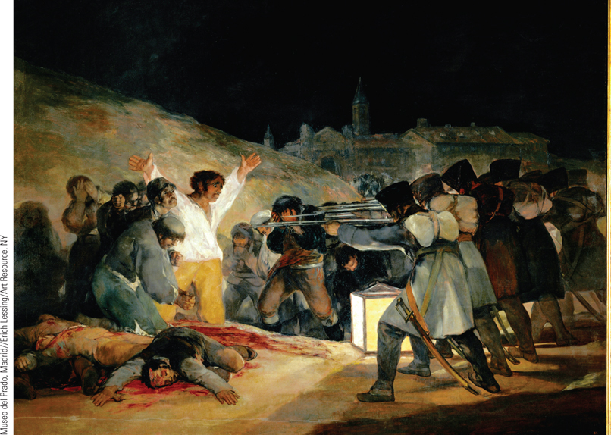
Francisco Goya, The Third of May 1808
After Napoleon imposed his brother Joseph on Spain as its king, the Spanish people revolted against his authority, and a series of riots broke out in Madrid. This painting by Francisco Goya shows the French response—a deliberate execution of Spanish citizens to frighten people into submission.
p588
Notes:
Francisco Goya, The Third of May 1808. After Napoleon imposed his brother Joseph on Spain as its
king, the Spanish people revolted against his authority, and a series of riots broke out in Madrid. This
painting by Francisco Goya shows the French response—a deliberate execution of Spanish citizens to
frighten people into submission. Goya portrays the French troops as a firing squad, killing people
(including a monk) reacting in terror. The peasant in the middle throws out his arms in a gesture
reminiscent of crucifixion. Goya painted many scenes depicting the horrors of war in Napoleonic Spain.

Slide 57
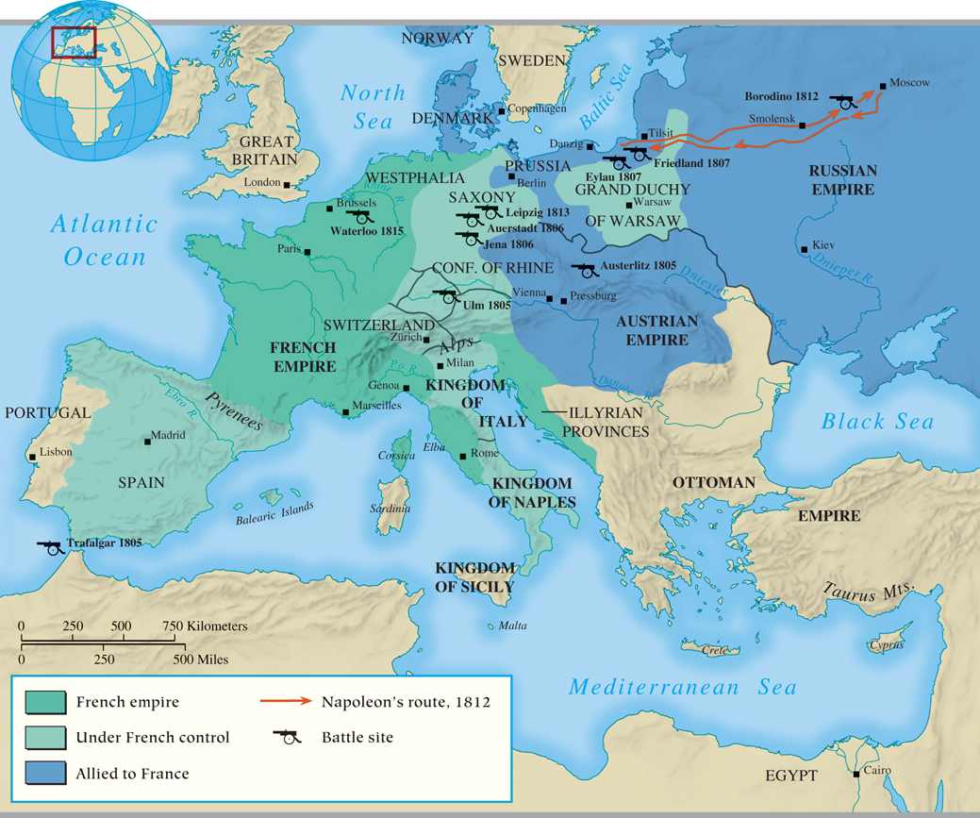
MAP 19.3 Napoleon’s Grand Empire in 1810
Map 19.3 p587
Notes:
MAP 19.3 Napoleon’s Grand Empire in 1810. Napoleon’s Grand Army won a series of victories
against Austria, Prussia, and Russia that gave the French emperor full or partial control over much of
Europe by 1807.

Slide 58
The Fall of Napoleon
The Quest for Victory
Invasion of Russia, 1812. Could not let Tsar Alexander I defect from Continental System.
Raised “Grand Army” of 600,000, and came home with only 40,000 men.
Defeat, April 1814
The Defeated Emperor
Exiled to Elba- given title “King of Elba” as ridicule
Escape from Elba, 1815, then marched on Paris with a new army of loyal followers
Battle of Waterloo, June 18, 1815
Exile to St. Helena
The Bourbon Restoration to the throne- Louis XVIII

Slide 59
CHRONOLOGY The Napoleonic Era, 1799–1815 (Slide 1 of 2)
Event | Dates
Napoleon as first consul | 1799–1804
Concordat with Catholic Church | 1801
Emperor Napoleon I | 1804–1815
Battle of Ulm (defeat of Austria) | 1805
Battle of Austerlitz (defeat of Russia) | 1805
Battle of Trafalgar (naval defeat of Napoleon’s forces) | 1805
Battle of Jena and Auerstadt (defeat of Prussia) | 1806
Continental System established | 1806
p589
Notes:
CHRONOLOGY The Napoleonic Era, 1799–1815

Slide 60
CHRONOLOGY The Napoleonic Era, 1799–1815 (Slide 2 of 2)
Event | Dates
Battles of Eylau and Friedland (defeat of Russia) | 1807
Invasion of Russia | 1812
War of liberation | 1813–1814
Exile to Elba | 1814
Battle of Waterloo; exile to Saint Helena | 1815
Death of Napoleon | 1821

Slide 61
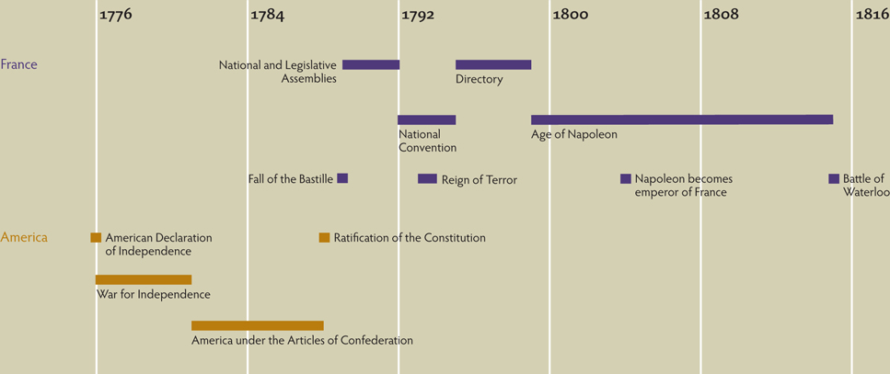
Chapter Timeline
p590

Slide 62
Discussion Questions
What role did the Enlightenment play in the American and French Revolutions?
Compare the urban and rural revolutions in France.
How did other European states respond to the French Revolution, and why?
What impact did the French Revolution have on the Catholic Church in France?
What changes in society were brought about by the French Revolution?
Examine Napoleon’s rise to power. What lasting changes did his reign have on Europe? What were his military mistakes?

