Slide 1
The Industrial Revolution and Its Impact on European Society
Chapter 20

Slide 2
Focus Questions
​Why was Great Britain the first state to have an Industrial Revolution? Why did it happen in Britain when it did? What were the basic features of the new industrial system created by the Industrial Revolution?
​How did the Industrial Revolution spread from Great Britain to the continent and the United States, and how did industrialization in those areas differ from British industrialization?
​What effects did the Industrial Revolution have on urban life, social classes, family life, and standards of living? What were working conditions like in the early decades of the Industrial Revolution, and what efforts were made to improve them?

Slide 3
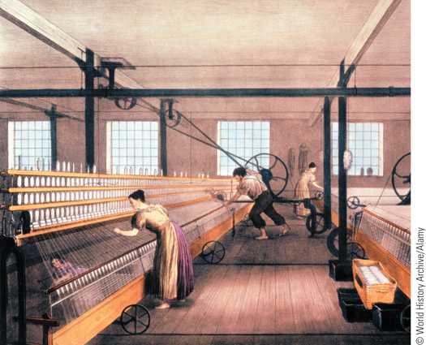
Power looms in an English textile factory
p592
Notes:
Power looms in an English textile factory

Slide 4
The Industrial Revolution in Great Britain
Origins
Precursor: agricultural revolution
Supply of capital
Profits from trade and cottage industry
Effective central bank and flexible credit systems
Early industrial entrepreneurs
Mineral resources
Role of government
Favorable business climate
Markets
Foreign and domestic demand

Slide 5
Technological Changes and New Forms of Industrial Organization
The Cotton Industry
Water frame, Crompton’s mule, and Edmund Cartwright’s power looms: efficiency and entrepreneurial opportunity
Concentration of labor in factories
The Steam Engine
Revolutionizing the production of cotton goods
James Watt (1736 – 1819)
A tireless source of power, reliant on coal
The Iron Industry
Puddling, using coke to burn away impurities
From pig iron to wrought iron

Slide 6
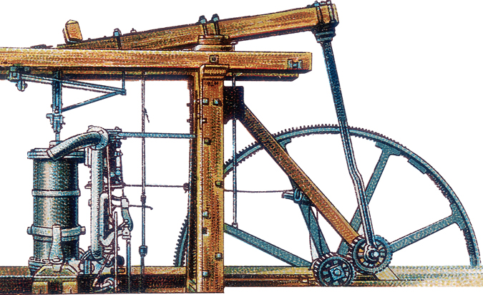
A Boulton and Watt Steam Engine
Encouraged by his business partner, Matthew Boulton, James Watt developed the first genuine steam engine. Pictured here is a typical Boulton and Watt engine.
p596
Notes:
A Boulton and Watt Steam Engine. Encouraged by his business partner, Matthew Boulton,
James Watt developed the first genuine steam engine. Pictured here is a typical Boulton and
Watt engine. Steam pressure in the cylinder on the left drives the beam upward and sets the
flywheel in motion.

Slide 7
Technological Changes and New Forms of Industrial Organization (Slide 2 of 2)
A Revolution in Transportation
New roads and canals
Railroads and economic progress
Richard Trevithick’s steam-powered locomotive
George Stephenson’s Rocket
Greatly accelerated Industrial Revolution
By 1850, 6,000 miles of railroad track
Created demand for other industrial products, entrepreneurial interests
Altered perceptions of time, space and nature
The Industrial Factory
Factory laborers and time-work discipline
Creating and imposing new values

Slide 8
Railroad Line from Liverpool to Manchester
The railroad line from Liverpool to Manchester, opened in 1830, relied on steam locomotives.
p597
Notes:
Railroad Line from Liverpool to Manchester. The railroad line from Liverpool to Manchester,
opened in 1830, relied on steam locomotives. As is evident in this illustration, carrying passengers was the
railroad’s main business. First-class passengers rode in covered cars; second- and third-class passengers, in
open cars.

Slide 9
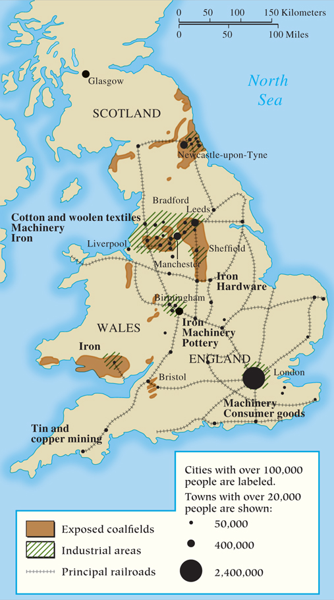
MAP 20.1 The Industrial Revolution in Britain by 1850
Map 20.1 p597
Notes:
MAP 20.1 The Industrial Revolution in Britain by 1850. The
Industrial Revolution began in the mid-1700s. Increased food
production, rapid population growth, higher incomes, plentiful
capital, solid banking and financial institutions, an abundance of
mineral resources, and easy transport all furthered the process,
making Britain the world’s wealthiest country by 1850.

Slide 10
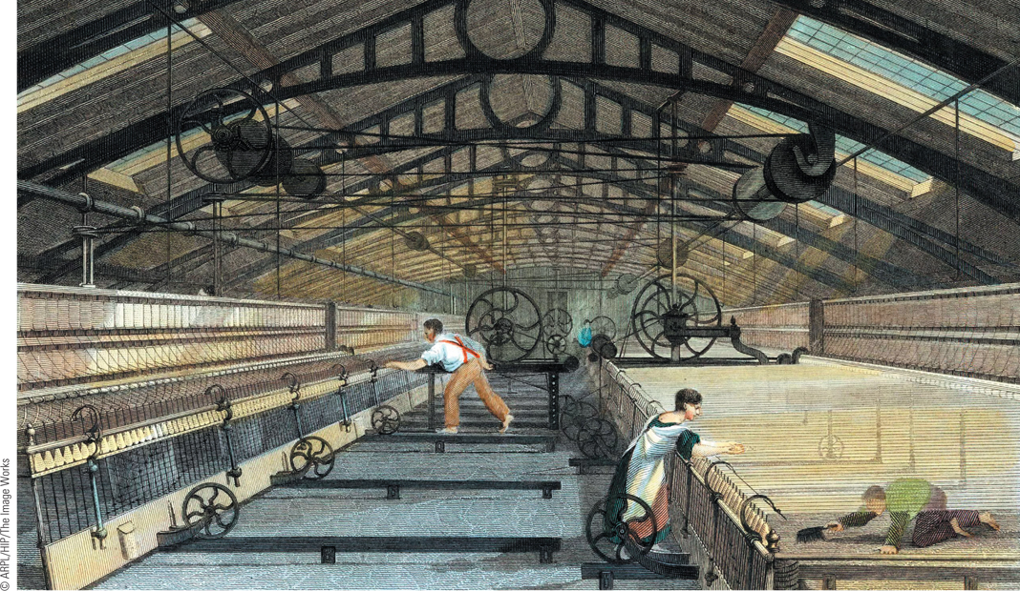
A British Textile Factory
The development of the factory changed the relationship between workers and employers as workers were encouraged to adjust to a new system of discipline that forced them to work regular hours under close supervision.
p598
Notes:
A British Textile Factory. The development of the factory changed the relationship between workers
and employers as workers were encouraged to adjust to a new system of discipline that forced them to
work regular hours under close supervision. This 1835 illustration shows women and men working in
a British textile factory.

Slide 11
Britain’s Great Exhibition of 1851
The World’s First Industrial Fair
Housed at the Crystal Palace
Covered 19 acres, 100,000 exhibits
The impact of the Great Exhibition
A display of Britain’s wealth and imperial power
Britain as “workshop, banker, and trader of the world”

Slide 12
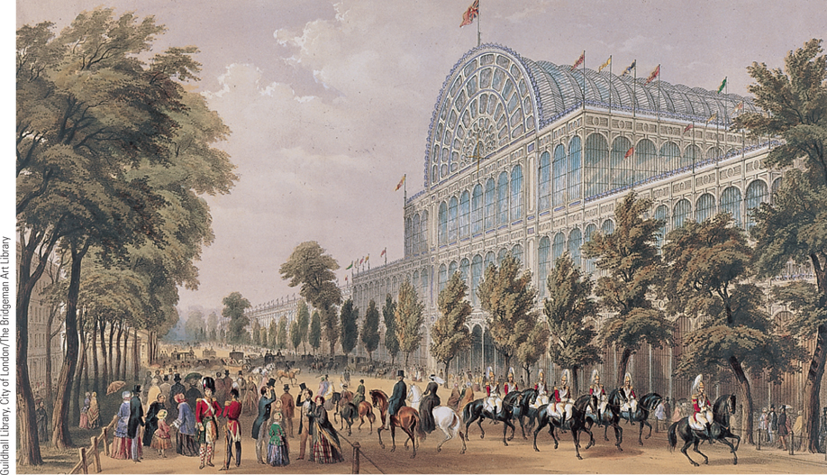
The Great Exhibition of 1851 (Slide 1 of 2)
The Great Exhibition of 1851 was a symbol of the success of Great Britain, which had become the world’s first industrial nation and its richest.
p600
Notes:
The Great Exhibition of 1851. The Great Exhibition of 1851 was a symbol of the success of Great Britain,
which had become the world’s first industrial nation and its richest. More than 100,000 exhibits were housed in the
Crystal Palace, a giant structure of cast iron and glass. The illustration shows the front of the palace and some
of its numerous visitors.

Slide 13
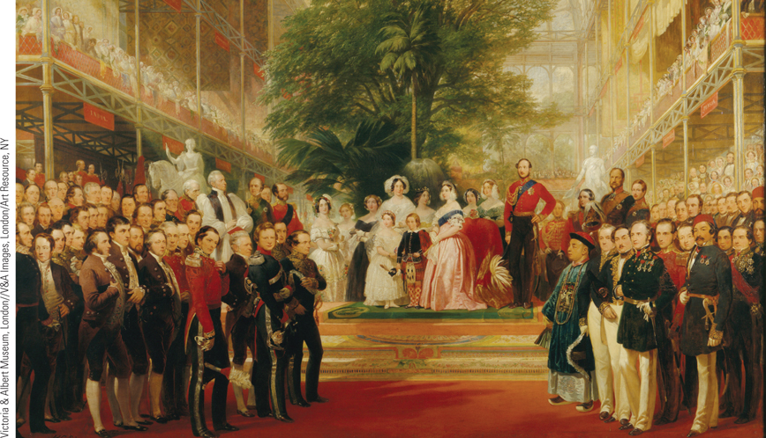
The Great Exhibition of 1851 (Slide 2 of 2)
The illustration shows the opening day ceremonies. Queen Victoria is seen at the center with her family, surrounded by visitors from all over the world.
p600
Notes:
The Great Exhibition of 1851. The illustration shows the opening day ceremonies. Queen Victoria is seen at the center with
her family, surrounded by visitors from all over the world. Note the large tree inside the building, providing a
visible symbol of how the Industrial Revolution had supposedly achieved human domination over nature.

Slide 14
The Spread of Industrialization
Industrialization on the Continent
Reasons for the late development
Lack of roads, guild restrictions, aversion to risk
Borrowing techniques and practices
Building and improving on British successes
Establishment of technical schools
Role of government
Funded industrialization
Protective tariffs
Centers of Continental industrialization
Belgium, France, and the German states
Changes in cotton manufacturing and metallurgy
Impact of the steam engine, iron, and coal

Slide 15
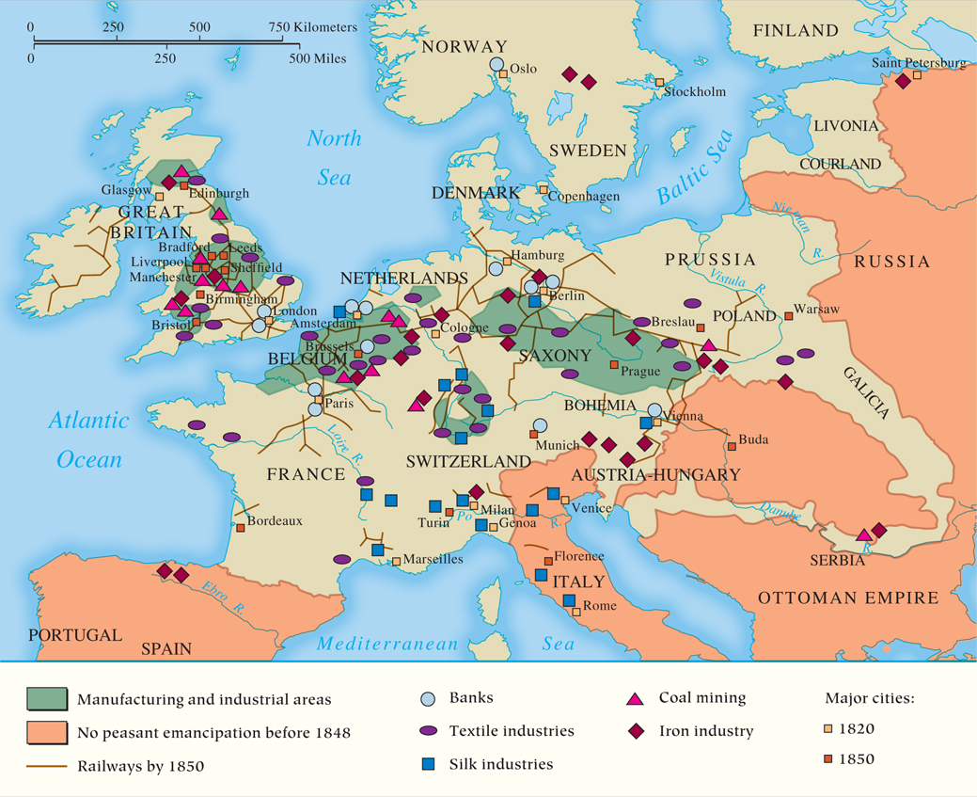
MAP 20.2 The Industrialization of Europe by 1850
Map 20.2 p602
Notes:
MAP 20.2 The Industrialization of Europe by 1850. Great Britain was Europe’s first industrialized
country; by the middle of the nineteenth century, however, several regions on the Continent, especially
in Belgium, France, and the German states, had made significant advances in industrialization.

Slide 16
The Industrial Revolution in the United States
Borrowing from Britain
Samuel Slater : the first textile factory
Harpers Ferry arsenal and the so-called American system
The Need for Transportation
Development of the steamboat and railroads
The Labor Force
Women: 80% of labor in the textile factories
Capital-intensive pattern

Slide 17
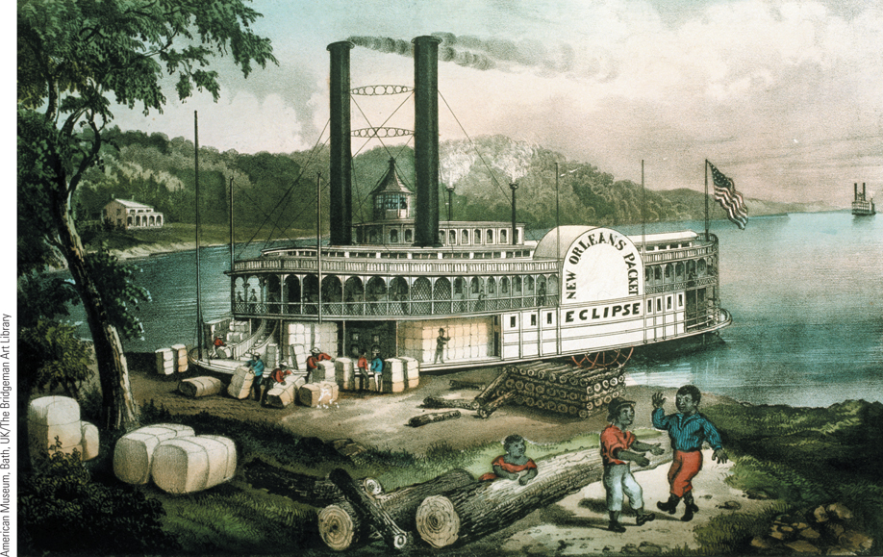
The Steamboat
The steamboat was an important means of transportation for American products and markets.
p604
Notes:
The Steamboat. The steamboat was an important means of transportation for American products and
markets. Steamboats like the one shown in this illustration regularly plied the Mississippi River, moving
the farm products of the Midwest and the southern plantations to markets in New Orleans. After the
American Civil War, railroads began to replace steamboats on many routes.

Slide 18
Limiting the Spread of Industrialization to the Nonidustrialized World
Lagging Behind
Deliberate policy to prevent growth of mechanized industry
Eastern Europe remained largely rural and agricultural
The Example of India
Prioritizing exportation of raw materials
Spinners and handloom weavers put out of work
Cut off credit, increased land and rent prices, and raised transportation costs
Forced to import finished goods from Britain

Slide 19
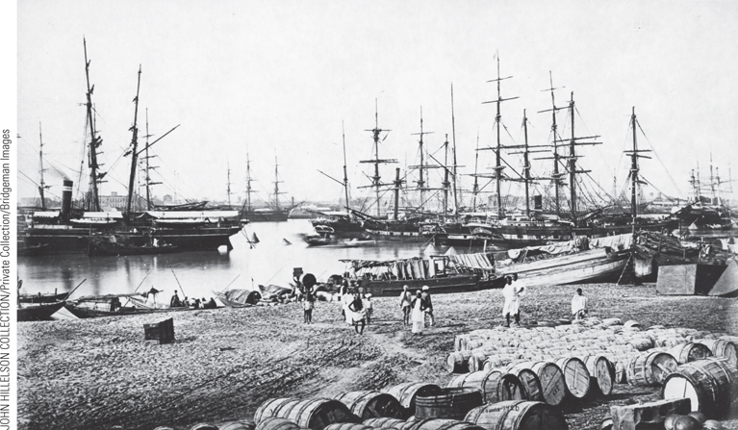
British Ships in Calcutta
By the second half of the nineteenth century, the British had increased their trade and development in India. Shown here in this 1865 photograph are British clipper ships at the port of Calcutta, India.
p605
Notes:
British Ships in Calcutta. (p.605)
By the second half of the nineteenth century, the British had increased their trade and development in India. Shown here in this 1865 photograph are British clipper ships at the port of Calcutta, India (p.605).

Slide 20
The Social Impact of the Industrial Revolution
Population Growth
Decline of birth and death rates, increase in food supply
Congestion in the countryside
The Great Hunger
Background and crisis
Irish population growth
Reliance on the potato
Potato crop fails, 1845 – 1851
Catastrophic population loss
Emigration

Slide 21
The Growth of Cities
Urban Living Conditions in the Early Industrial Revolution
Sanitary and living conditions
Suburbs
Row houses
Adulteration of food
Moral consequences of urban life
Urban Reformers
Edwin Chadwick (1800 – 1890)
Report on the Condition of the Laboring Population of Great Britain, 1842
Advocating new public health measures

Slide 22
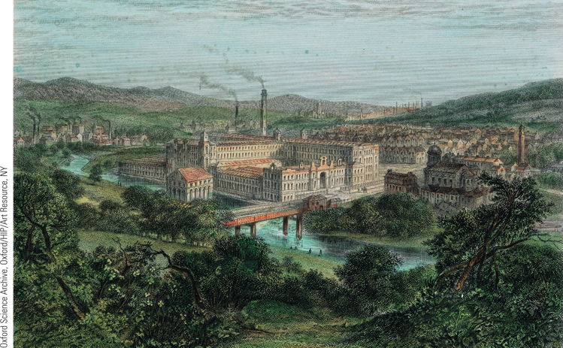
A New Industrial Town
Cities and towns grew dramatically in Britain in the first half of the nineteenth century, largely as a result of industrialization.
p607
Notes:
A New Industrial Town. Cities and
towns grew dramatically in Britain in
the first half of the nineteenth century,
largely as a result of industrialization.
Pictured here is Saltaire, a model textile
factory and town founded near
Bradford by Titus Salt in 1851. To
facilitate the transportation of goods,
the town was built on the Leeds and
Liverpool canals.

Slide 23
New Social Classes: The Industrial Middle Class
The New Industrial Entrepreneurs
Qualities: resourcefulness, initiative, and ambition
Diversity of origins
Mercantile trades
Dissenting religious minorities
Aristocrats
Significance of Industrial Entrepreneurs
Creation of a new business aristocracy

Slide 24
New Social Classes: Workers in the Industrial Age
Composition of the Working Class
Working Conditions for the Industrial Working Class
Harsh environments in the mills and mines
Child labor
Pauper apprentices
Women and working patterns
Factory Acts
Impact on women and children
Historians Debate: Did Industrialization Bring an Improved Standard of Living?
Widening gap between rich and poor

Slide 25
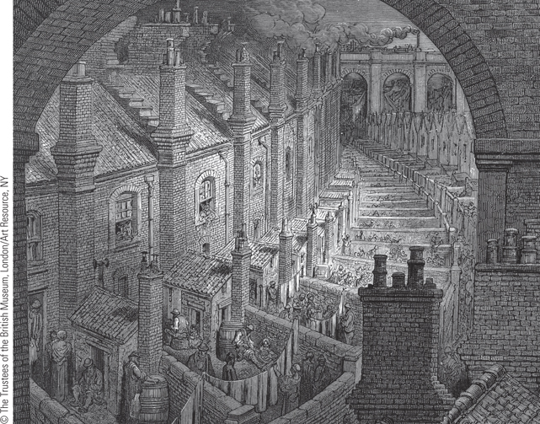
Living Conditions of London’s Poor (Slide 1 of 3)
French illustrator Gustave Doré created illustrations for a guide to London called London: A Pilgrimage.
p608
Notes:
Living Conditions of London’s Poor

Slide 26
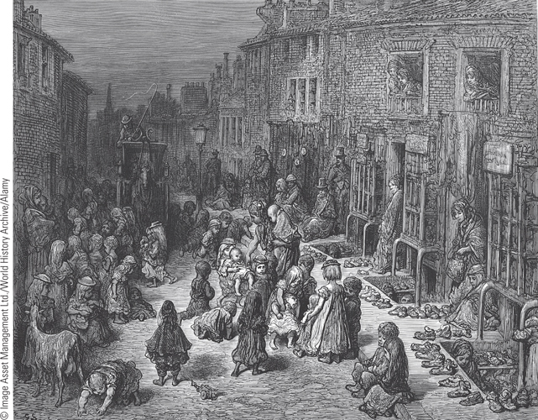
Living Conditions of London’s Poor (Slide 2 of 3)
The image depicts an open air market on Dudley Street, where men,
women, and children are attempting to sell their wares.
p608
Notes:
Living Conditions of London’s Poor

Slide 27
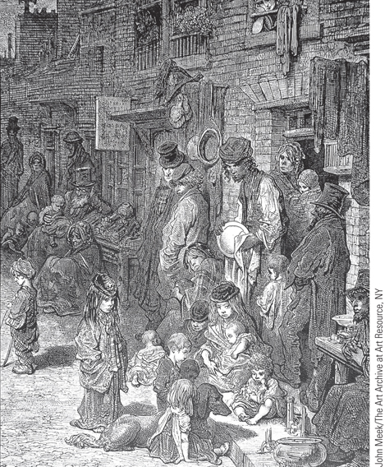
Living Conditions of London’s Poor (Slide 3 of 3)
Children in ragged clothes play in the street.
p608
Notes:
Living Conditions of London’s Poor

Slide 28
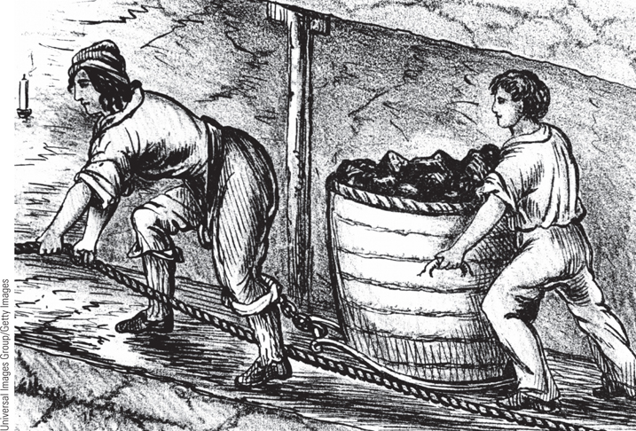
Women and Children in the Mines
Women and children were often employed in the factories and mines of the early nineteenth century.
p613
Notes:
Women and Children in the Mines.
Women and children were often employed
in the factories and mines of the early
nineteenth century. This illustration shows a
woman and boy in a coal mine struggling to
draw and push a barrel filled with coal. In
1842, the Coal Mines Act forbade the use of
boys younger than ten and women in the
mines.

Slide 29
Efforts at Change
Efforts at Change: the Workers
The Trade Union Movement
Luddites
Chartism
Politics and the People’s Charter during the 1840s
Efforts at Change: Reformers and Government
Government action
Factory acts, 1802 – 1819
Strengthening and expanding earlier legislation: the Factory Act of 1833
The Coal Mines Act, 1842

Slide 30
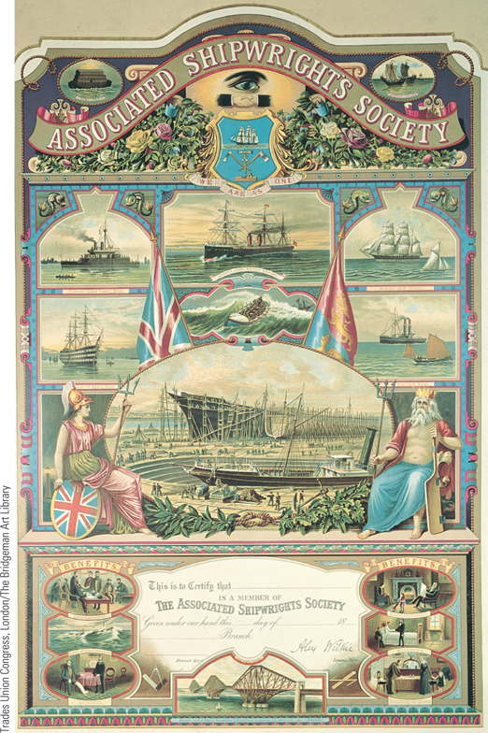
A Trade Union Membership Card
Skilled workers in a number of new industries formed trade unions in an attempt to gain higher wages, better working conditions, and special benefits.
p616
Notes:
A Trade Union Membership Card. Skilled workers in a number of
new industries formed trade unions in an attempt to gain higher wages,
better working conditions, and special benefits. The scenes at the bottom
of this membership card for the Associated Shipwrights Society illustrate
some of the medical and social benefits it provided for its members.

Slide 31
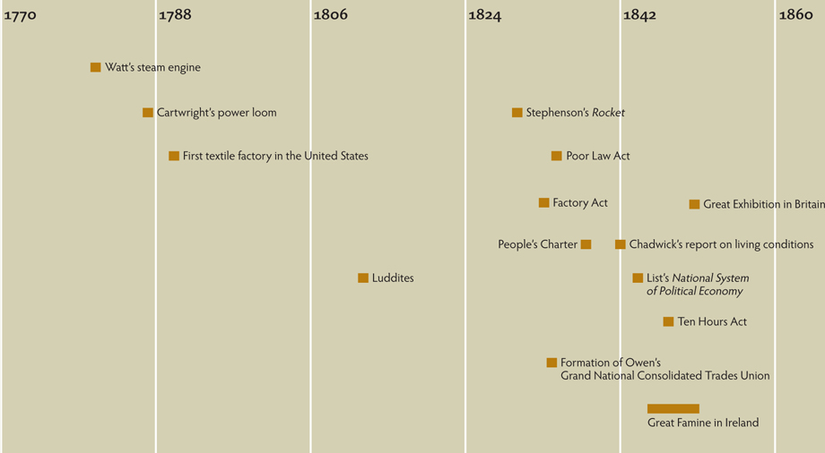
Chapter Timeline
p618

Slide 32
Discussion Questions
What were the factors, or conditions, that gave Britain the edge in the Industrial Revolution?
How did the textile industry develop a dependency on American cotton?
How was transportation changed in England as a result of the Industrial Revolution?
Why did England see Germany as a threat but not the United States?

