Slide 1
Mass Society in an “Age of Progress,” 1871–1894
Chapter 23

Slide 2
Focus Questions
​What was the Second Industrial Revolution, and what effects did it have on European economic and social life? What roles did socialist parties and trade unions play in improving conditions for the working classes?
​What is a mass society, and what were its main characteristics? What role were women expected to play in society and family life in the latter half of the nineteenth century, and how closely did patterns of family life correspond to this ideal?
​What general political trends were evident in the nations of western Europe in the last decades of the nineteenth century, and how did these trends differ from the policies pursued in Germany, Austria-Hungary, and Russia?

Slide 3
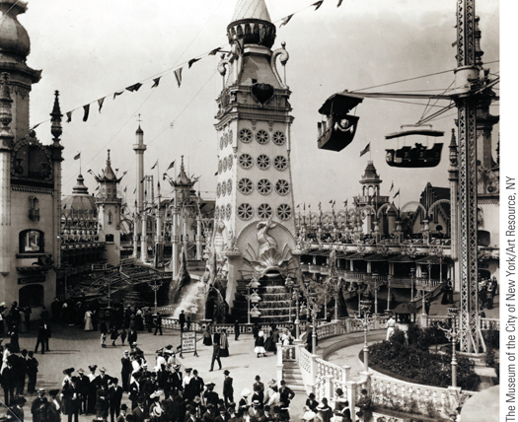
Coney Island fun
p686
Notes:
Coney Island fun

Slide 4
The Growth of Industrial Prosperity
New Products
Substitution of steel for iron
Chemicals
Soda, dyes, and photographic plates and film
Germany takes the lead!
Electricity
Advances in lighting (light bulb), communication (telephone and telegraph), and transportation
Transformation of factories
The internal combustion engine
The rise of the automobile and airplane
Henry Ford (1863-1947) and mass production

Slide 5
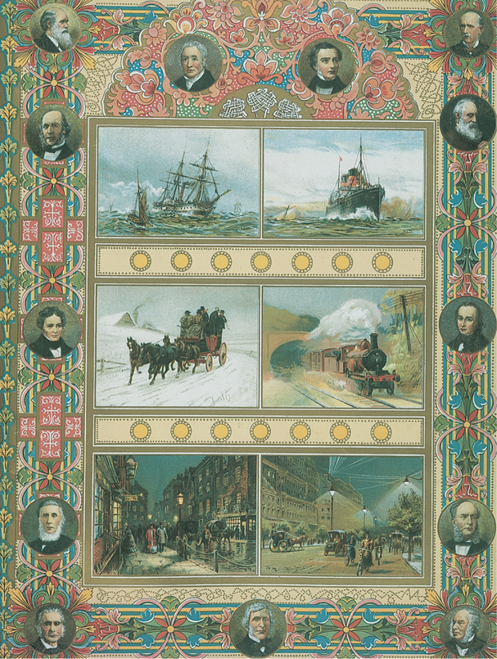
An Age of Progress
In the decades after 1871, the Second Industrial Revolution led many Europeans to believe that they were living in an age of progress when most human problems would be solved by scientific achievements.
p688
Notes:
An Age of Progress. In the decades after 1871, the Second
Industrial Revolution led many Europeans to believe that they
were living in an age of progress when most human problems
would be solved by scientific achievements. This illustration is
taken from a special issue of the Illustrated London News
celebrating the Diamond Jubilee of Queen Victoria in 1897. On
the left are scenes from 1837, when Victoria came to the British
throne; on the right are scenes from 1897. The vivid contrast
underscored the magazine’s conclusion: ‘‘The most striking . . .
evidence of progress during the reign is the ever increasing speed
which the discoveries of physical science have forced into
everyday life. Steam and electricity have conquered time and
space to a greater extent during the last sixty years than all the
preceding six hundred years witnessed.’’

Slide 6
The Growth of Industrial Prosperity
New Markets
Saturation of foreign markets
Domestic markets
Increased wages
Britain and Germany doubled/tripled national incomes
Consumerism
Mass marketing
The department store
Tariffs and cartels
Increased competition and protectionism
Larger factories
Introduction of scientific management to maximize efficiency
Charlie Chaplin’s Modern Times!

Slide 7
The Growth of Industrial Prosperity
New Patterns in an Industrial Economy
Cycles of crisis and growth
The boom of la belle époque
German industrial leadership
Loss of British initiative in the Second Industrial Revolution
European economic zones
Advanced industrial core in west and north, little development in east and south
Impact on agriculture
The spread of industrialization
A world economy
Europe dominates world economy by end of 19th century

Slide 8
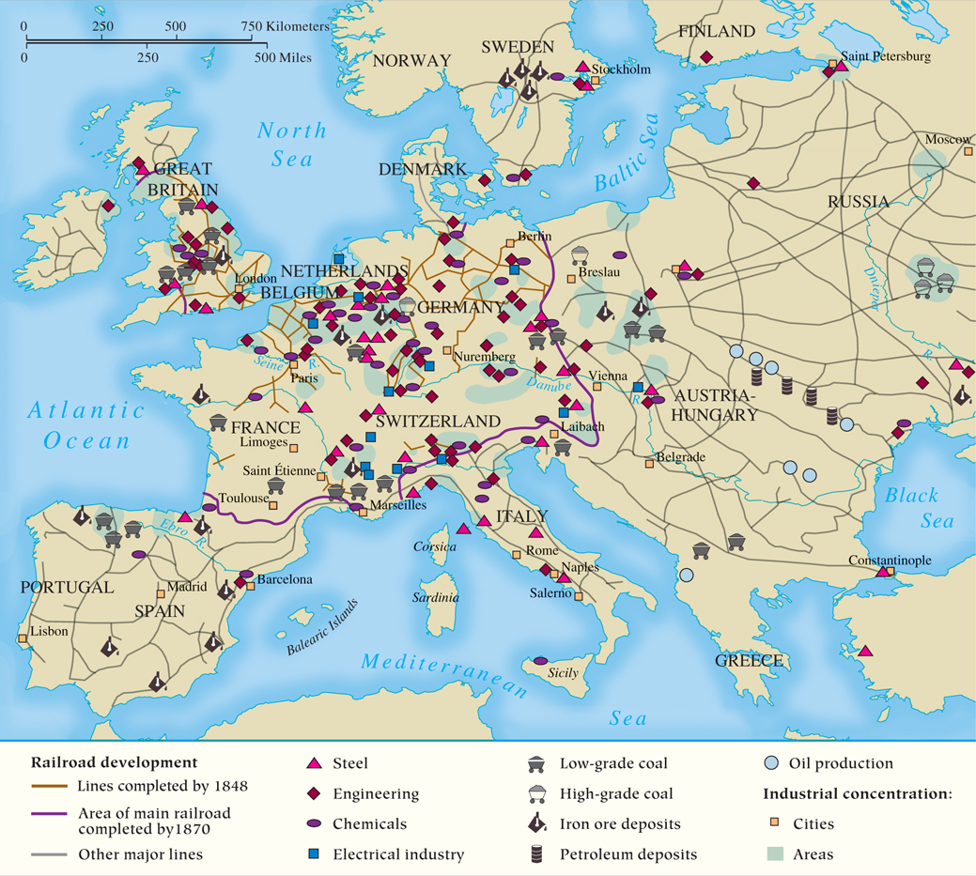
MAP 23.1 The Industrial Regions of Europe at the End of the Nineteenth Century
Map 23.1 p691
Notes:
MAP 23.1 The Industrial Regions of Europe at the End of the Nineteenth Century. By the end of
the nineteenth century, the Second Industrial Revolution—in steelmaking, electricity, petroleum, and
chemicals—had spurred substantial economic growth and prosperity in western and central Europe;
it also sparked economic and political competition between Great Britain and Germany.

Slide 9
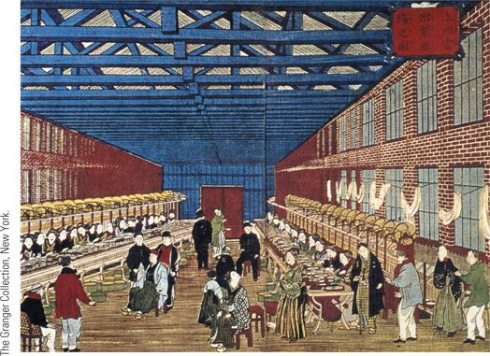
Global Perspectives: Textile Factory Work (Slide 1 of 2)
Shown here is one of the earliest industrial factories in Japan, the Tomioka silk factory, built in the 1870s.
p692
Notes:
A Textile Factory in Japan. (p.692)
Shown here is one of the earliest industrial factories in Japan, the Tomioka silk factory, built in the 1870s. Silk was one of the few Japanese products foreigners wanted to buy; thus, the success of silk factories created capital that could be invested in other industries. Note that although women are doing the work in the factory, the managers are men.

Slide 10
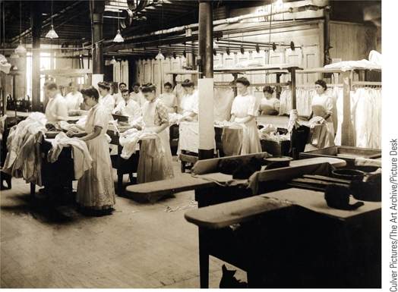
Global Perspectives: Textile Factory Work (Slide 2 of 2)
Above is an 1890s photograph of garment workers in New York City.
p692
Notes:
1890s photograph of garment workers in New York City. (p.692)

Slide 11
Women and Work: New Job Opportunities
Impact of the Second Industrial Revolution
Controversy over “right to work”
Ideal of domesticity; The Cult of Domesticity
Sweatshops: with little opportunity, and out of desperation, poor women had to work.
White-Collar Jobs
Shortage of male workers opened opportunities for women
Shop clerks, secretaries, and teachers
The “petite bourgeoisie”
Freedom from domestic patterns and “dirty” work
Prostitution

Slide 12
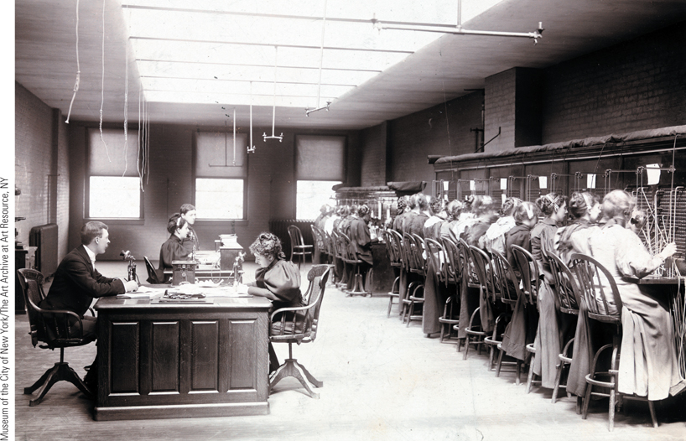
New Jobs for Women: The Telephone Exchange
The invention of the telephone in 1876 soon led to its widespread
use. As is evident from this illustration of a telephone exchange in New York, most of the telephone operators were women.
p693
Notes:
New Jobs for Women: The
Telephone Exchange. The
invention of the telephone in
1876 soon led to its widespread
use. As is evident from this
illustration of a telephone
exchange in New York, most
of the telephone operators
were women. This was but
one of a number of new job
opportunities for women
created by the Second
Industrial Revolution.

Slide 13
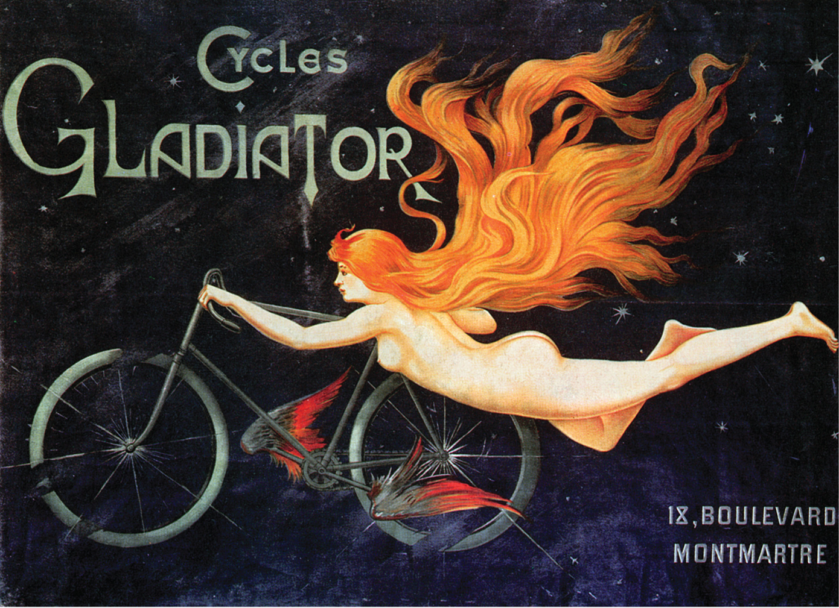

Slide 14
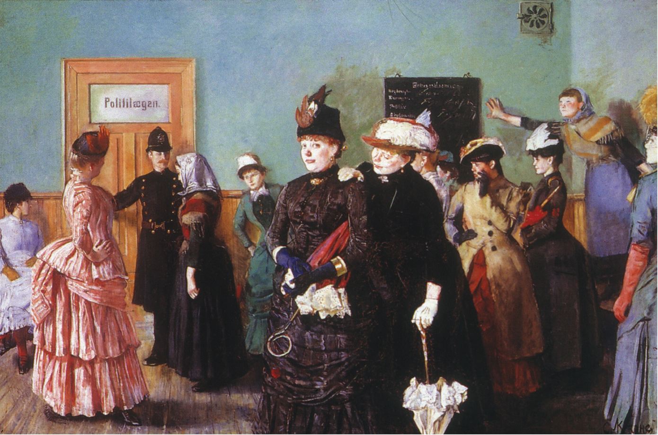

Slide 15
Middle Class Women
The Cult of Domesticity
Did not work outside the home if possible.
A stay-at-home wife became a symbol of her husband’s success. (i.e. “trophy wife”)
Took care only of domestic duties- did not help husband with business duties.
Reflects the notion that home was to be a haven away from business/marketplace
Might enjoy domestic comfort/luxury, but her talents, ambitions, and intelligence were ignored.
All domestic activity was within strict social boundaries, norms, & expected behaviors.
Much advertising was marketed to women

Slide 17
Organizing the Working Class
Trade union membership- early 1800’s
Socialist Parties
Looked to improve conditions of the working class
Based on ideas of Karl Marx
German Social Democratic Party (SPD)
Revolutionary Marxist theory organized as a mass political party
Very popular despite efforts to destroy it
Limited socialist successes and cooperation in other states
France: based on French revolutionary tradition
Russia: Marxist Social Democratic Labor Party
Second International (1889)- international association

Slide 18
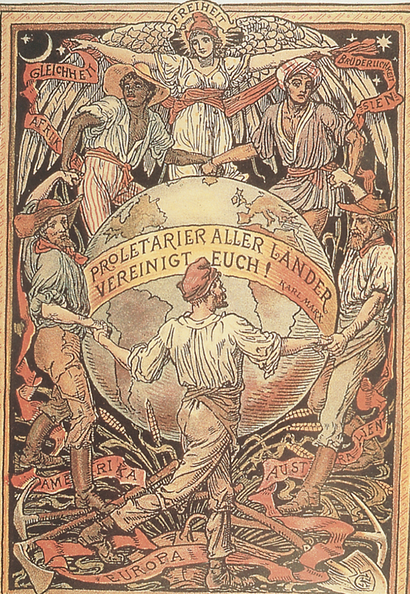
Proletarians of the World, Unite
To improve their working and living conditions, many industrial workers, inspired by the ideas of Karl Marx, joined working-class or socialist parties. Pictured here is a socialist sponsored poster that proclaims in German the closing words of The Communist Manifesto: ‘‘Proletarians of the World, Unite!’’
p695
Notes:
‘‘Proletarians of the World, Unite.’’ To improve their working and
living conditions, many industrial workers, inspired by the ideas of Karl
Marx, joined working-class or socialist parties. Pictured here is a socialist sponsored
poster that proclaims in German the closing words of The
Communist Manifesto: ‘‘Proletarians of the World, Unite!’’

Slide 19
Organizing the Working Class
International socialism had two big obstacles:
Revisionism and Nationalism
Evolutionary Socialism (Revisionism)
Does not believe in the revolutionary aspect of Marx’s theory; it is not “pure” Marxism.
Eduard Bernstein (1850 – 1932)
Spent years n Britain
Influenced by moderate British socialism and parliamentary reforms.
Argues Marx is wrong about the middle class: it is not shrinking, it is actually expanding
Even the proletariat are improving in their condition
Socialist goals will be achieved by democratic reform

Slide 20
Organizing the Working Class
The Problem of Nationalism
Marx said “working men have no nation”
Actually socialist parties did vary in concerns according to country
This is proven true in World War I
The Role of Trade Unions
Won the right to strike in 1870
Program: better living and working conditions
Very numerous in Britain
France: unions tied to socialist causes
Germany: largest socialist trade unions
Strikes and collective bargaiing worked, so they avoided revolution.

Slide 21
Organizing the Working Class
The Anarchist Alternative
Socialist parties became less radical due to some political gains and improvements in conditions.
Many Marxist socialists then became anarchists.
Freedom is achieved by abolishing the state and all social institutions
Anarchists in Russia, Portugal, Spain, Italy
Russia: Michael Bakunin-
Small groups of anarchists can create so much violence, eventually the state will collapse.
Use of assassination as a political tool
The state never did collapse.

Slide 22
TABLE 23.1 European Populations, 1851–1911 (in Thousands) (Slide 1 of 2)
Country | 1851 | 1881 | 1911
England and Wales | 17,928 | 25,974 | 36,070
Scotland | 2,889 | 3,736 | 4,761
Ireland | 6,552 | 5,175 | 4,390
France | 35,783 | 37,406 | 39,192
Germany | 33,413 | 45,234 | 64,926
Belgium | 4,530 | 5,520 | 7,424
Netherlands | 3,309 | 4,013 | 5,858
Denmark | 1,415 | 1,969 | 2,757
Norway | 1,490 | 1,819 | 2,392
Sweden | 3,471 | 4,169 | 5,522
Source: B. R. Mitchell, European Historical Statistics, 1750–1970 (New York: Macmillan, 1975).
Table p697
Notes:
TABLE 23.1
European Populations, 1851–1911 (in Thousands)

Slide 23
TABLE 23.1 European Populations, 1851–1911 (in Thousands) (Slide 2 of 2)
Country | 1851 | 1881 | 1911
Spain | 15,455 | 16,622 | 19,927
Portugal | 3,844 | 4,551 | 5,958
Italy | 24,351 | 28,460 | 34,671
Switzerland | 2,393 | 2,846 | 3,753
Austria | 17,535 | 22,144 | 28,572
Hungary | 18,192 | 15,739 | 20,886
Russia | 68,500 | 97,700 | 160,700
Romania | — | 4,600 | 7,000
Bulgaria | — | 2,800 | 4,338
Greece | — | 1,679 | 2,632
Serbia | — | 1,700 | 2,912
Source: B. R. Mitchell, European Historical Statistics, 1750–1970 (New York: Macmillan, 1975).

Slide 24
The Emergence of a Mass Society
Population Growth
Decline in the death rate
Causes
Medical discoveries and environmental conditions
Improved publication sanitation
Improved nutrition
Emigration
Inability of industrialized regions to absorb rural surplus
Destinations: United States, Latin America, and Canada
Non-economic motives for oppressed minorities

Slide 25
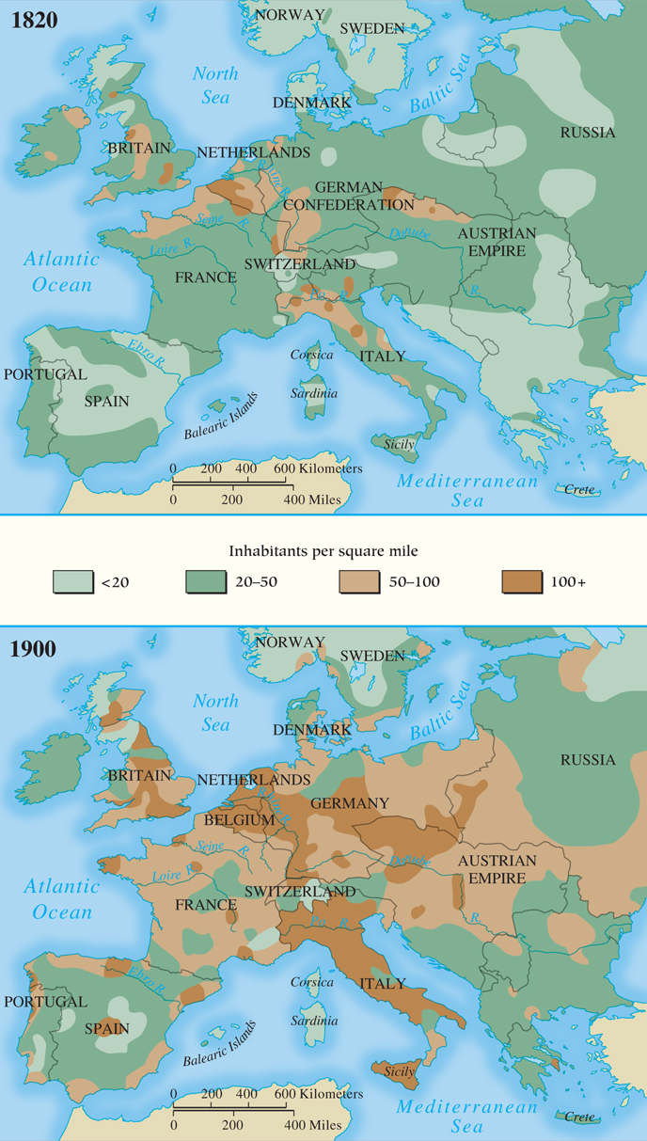
MAP 23.2 Population Growth in Europe, 1820–1900
Map 23.2 p698
Notes:
MAP 23.2 Population Growth in Europe, 1820–1900. Europe’s population increased
steadily throughout the nineteenth century. Advances in medical science, hygiene, nutrition,
living conditions, and standards of living help account for the population increase, even
though emigration to the United States, South America, and other regions reduced the total
growth numbers.

Slide 26
TABLE 23.2 European Emigration, 1876–1910 (Average Annual Emigration to Non-European Countries per 100,000 Population) (Slide 1 of 2)
Country | 1876–1880 | 1881–1885 | 1886–1890 | 1891–1895 | 1896–1900 | 1901–1905 | 1906–1910
Europe | 94 | 196 | 213 | 185 | 147 | 271 | 322
Ireland | 650 | 1,422 | 1,322 | 988 | 759 | 743 | 662
Great Britain | 102 | 174 | 162 | 119 | 88 | 127 | 172
Denmark | 157 | 380 | 401 | 338 | 117 | 292 | 275
Norway | 432 | 1,105 | 819 | 597 | 312 | 903 | 746
Sweden | 301 | 705 | 759 | 587 | 249 | 496 | 347
Germany | 108 | 379 | 207 | 163 | 47 | 50 | 44
Belgium | — | — | 86 | 50 | 23 | 57 | 69
Netherlands | 32 | 136 | 111 | 76 | 25 | 45 | 58
France | 8 | 14 | 49 | 14 | 13 | 12 | 12
Source: R. Gildea, Barricades and Borders: Europe, 1800–1914 (Oxford: Oxford University Press, 1987), p. 283.
Table 23.2 p699
Notes:
TABLE 23.2 European Emigration, 1876–1910 (Average Annual Emigration to Non-European Countries per 100,000 Population)

Slide 27
TABLE 23.2 European Emigration, 1876–1910 (Average Annual Emigration to Non-European Countries per 100,000 Population) (Slide 1 of 2)
Country | 1876–1880 | 1881–1885 | 1886–1890 | 1891–1895 | 1896–1900 | 1901–1905 | 1906–1910
Spain | — | 280 | 437 | 434 | 446 | 391 | 758
Portugal | 258 | 356 | 423 | 609 | 417 | 464 | 694
Italy | 396 | 542 | 754 | 842 | 974 | 1,706 | 1,938
Austria | 48 | 90 | 114 | 182 | 182 | 355 | 469
Hungary | — | 92 | 156 | 134 | 205 | 437 | 616
Russia | 6 | 13 | 42 | 47 | 32 | 63 | 67
Source: R. Gildea, Barricades and Borders: Europe, 1800–1914 (Oxford: Oxford University Press, 1987), p. 283.

Slide 28
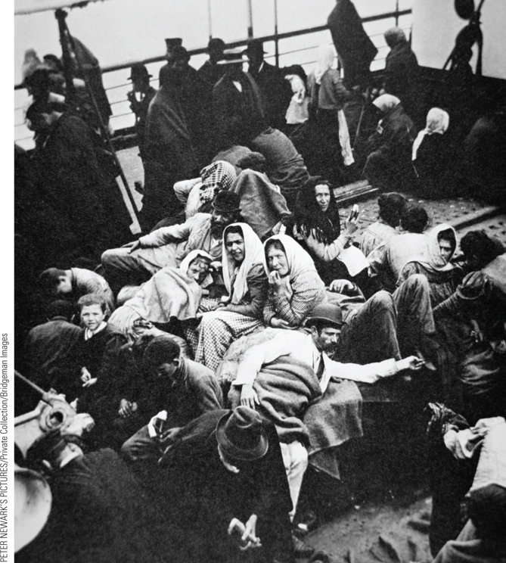
European Emigration
In the nineteenth century, nearly 34 million people emigrated from Europe to the United States.
p699
Notes:
European Emigration. (p.699)
In the nineteenth century, nearly 34 million people emigrated from Europe to the United States. At mid-century, the average transatlantic voyage took one to three months; the introduction of larger ships and engines decreased the length of the journey by the end of the nineteenth century. However, most passengers could only afford to take the journey in the cramped conditions found in steerage. Shown here in an early twentieth-century photograph are steerage passengers enjoying fresh air as they enter the New York harbor.

Slide 29
Transformation of the Urban Environment
Improving Living Conditions
Urban Reformers
Linked living conditions to disease
Expanded the role of municipal authorities
Addressing problems of water, waste, and pollution
Housing Needs
From private enterprise to public law
Linking living conditions to political and moral health of the nation
Many reformers were middle class– why??
Redesigning the Cities
Reconstruction plans create separation of home and work for many Europeans

Slide 30
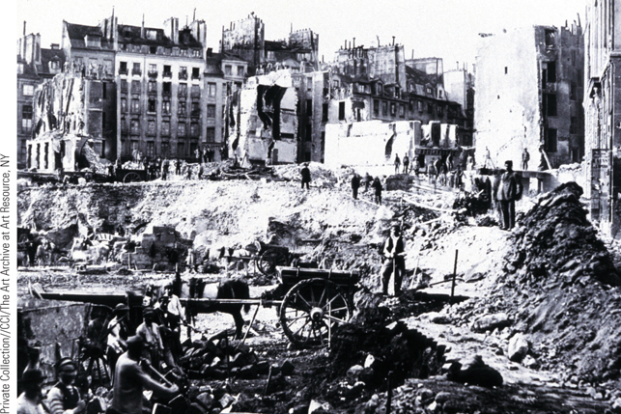
Paris Transformed (Slide 1 of 2)
This photo the of L’avenue de l’Ope´ra, shows the degree of destruction that was needed to create the grand boulevards and monuments of late-nineteenth-century Paris. The photograph was taken in 1865.
p702
Notes:
Paris Transformed. This photo the of L’avenue de l’Ope´ra, shows the
degree of destruction that was needed to create the grand boulevards and monuments of
late-nineteenth-century Paris. The photograph was taken in 1865.

Slide 31
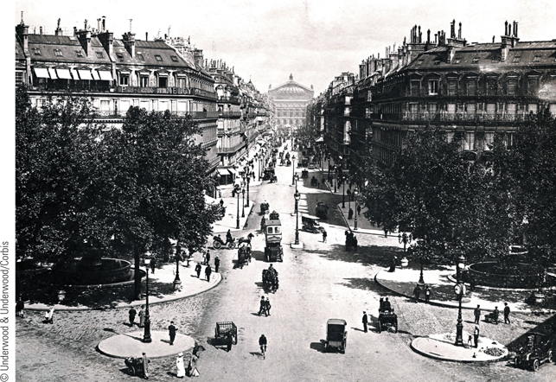
Paris Transformed (Slide 2 of 2)
This photograph of L’avenue de l’Ope´ra shows new uniform buildings, gas street lamps, and broad boulevards that linked the city’s great cultural sites, such as the Ope´ra, shown in the background—the most expensive building constructed during the Second Empire.
p702
Notes:
Paris Transformed. This photograph of L’avenue de l’Ope´ra shows new uniform buildings, gas street
lamps, and broad boulevards that linked the city’s great cultural sites, such as the Ope´ra,
shown in the background—the most expensive building constructed during the Second
Empire.

Slide 32
Social Structure of the Mass Society
The Upper Classes (5 percent)
Controlled 30 to 40 percent of wealth
Alliance of wealthy plutocrats and traditional aristocracy
The Middle Classes
Variety: upper middle, middle middle, lower middle
Middle class values of hard work and propriety
White collar workers
Victorian Britain: “The Model of Middle Class Society”
Lifestyle and values dominated society

Slide 33
Social Structure of the Mass Society
The Lower Classes (80 percent)
Agricultural
Landholding, laborers, sharecroppers
Eastern Europe: most were farming peasants
Western Europe: prosperous peasants shared values with middle class (hard work, national loyalty)
Urban
skilled; unskilled; domestic servants
Britain: 1 in 7 were domestic servants (mostly women)
Rising wages in 1880s-1890s
Actually did experience improved living and work conditions

Slide 34
The Ages of the Worker, Leon Frederic. 1895 Belgium.

Slide 35
The “Woman Question”: The Role of Women
Marriage and Domesticity
Many still aspired to the ideal of femininity
Birthrates and Birth Control
The Middle-Class Family
Togetherness, leisure, and traditions
The Working-Class Family
Changing work patterns
Higher paying jobs made it possible to live on the husband’s wages
Limit size of the family
Reduced work week

Slide 36
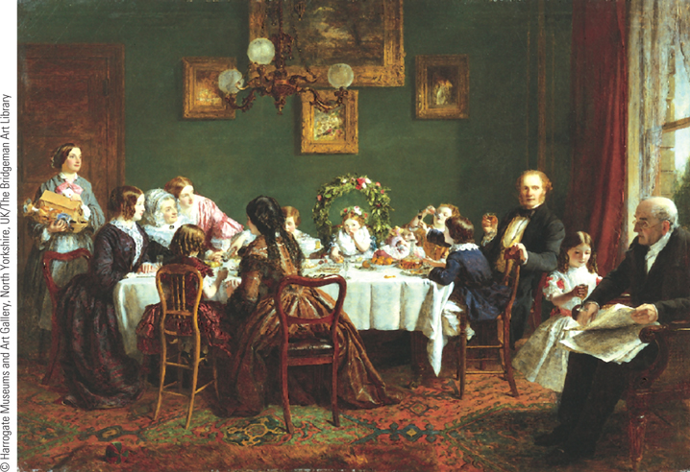
Images of Everyday Life: The Middle-Class Family
The painting by William P. Frith, titled Many Happy Returns of the Day, shows grandparents, parents, and children taking part in a family birthday celebration for a little girl.
p706
Notes:
The Middle-Class Family

Slide 37
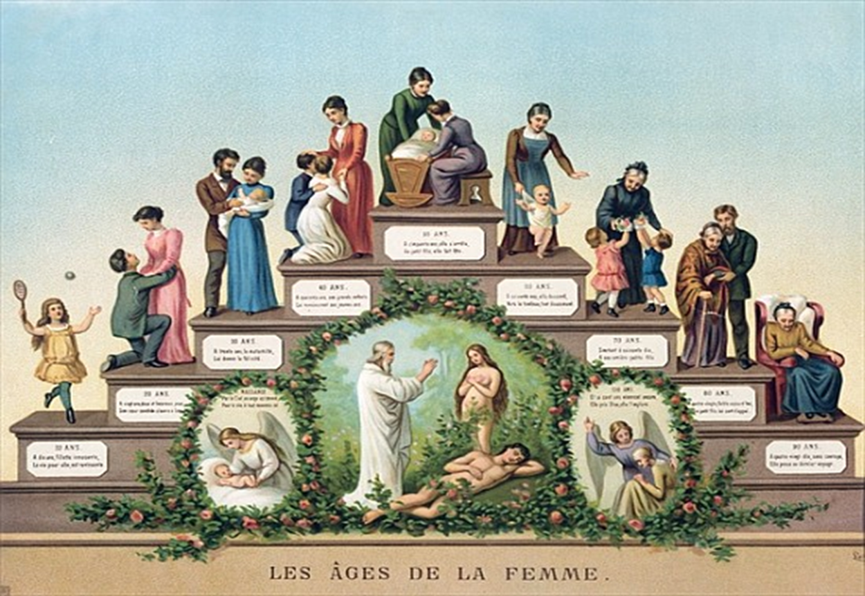
The Ages of Woman, 19th century France

Slide 38
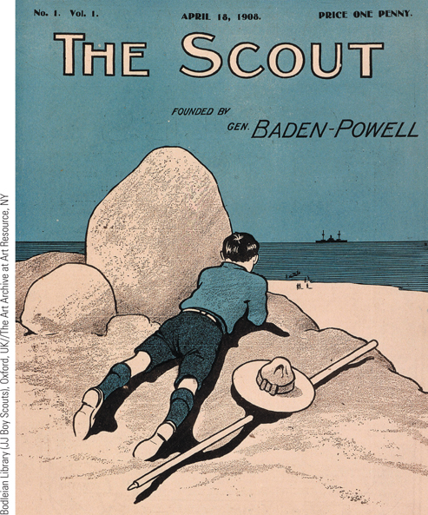
Images of Everyday Life: The Middle-Class Family (Slide 2 of 3)
The illustration shows the cover of The Scout, a magazine of the scouting movement founded by Robert Baden-Powell. The cover shows one of the new scouts wearing his uniform and watching a ship at sea, an activity that could later have military value in time of war.
p706
Notes:
The Middle-Class Family

Slide 39
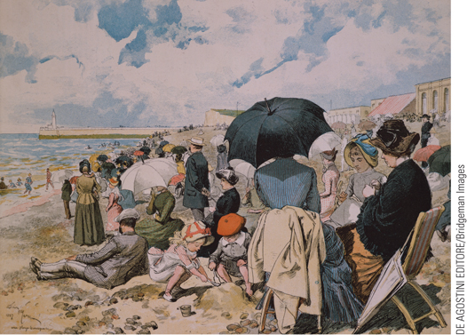
Images of Everyday Life: The Middle-Class Family (Slide 3 of 3)
Middles-Class family taking a vacation on the beach in France
p706
Notes:
The Middle-Class Family (p.706)
Middles-Class family taking a vacation on the beach in France

Slide 40
Education in the Mass Society
Universal Elementary Education
Mass education in state-run systems
States’ liberal, industrial, and political motives
Indoctrination in national values
Differences in education of boys and girls
Female Teachers
Extension of women’s “natural role”
Teacher training institutes
Literacy and Newspapers
Increased demand for newspapers with growing literacy
Tabloids and cheap literature

Slide 41
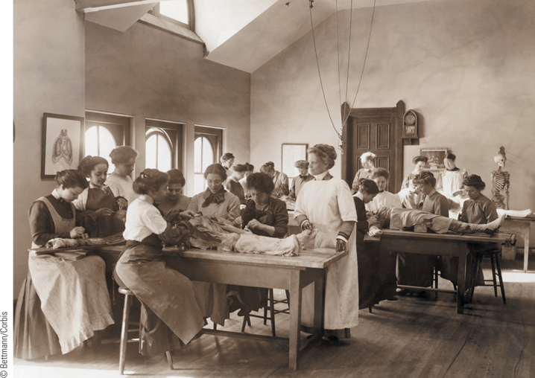
A Women’s College
Women were largely excluded from male-dominated universities before 1900. Consequently, women’s desire for higher education led to the establishment of women’s colleges, most of which were primarily teacher-training schools.
p709
Notes:
A Women’s College. Women were
largely excluded from male-dominated
universities before 1900. Consequently,
women’s desire for higher education led to
the establishment of women’s colleges, most
of which were primarily teacher-training
schools. This photograph shows female
medical students dissecting cadavers in
anatomy class at the Women’s Medical
College of Philadelphia, Pennsylvania.

Slide 42
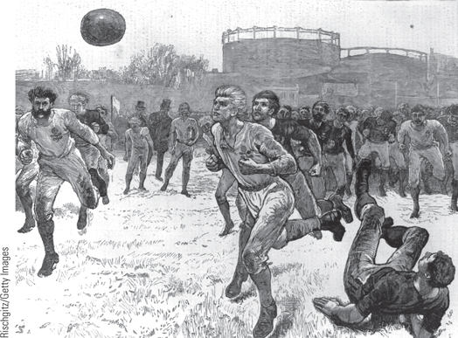
Soccer Moments (Slide 1 of 2)
Until 1863, football (soccer) in Britain was an aggressive sport with few set rules.
p710
Notes:
Soccer Moments. Until 1863, football (soccer) in Britain was
an aggressive sport with few set rules. One of the first things the
new English Football Association did after it was established on
October 26, 1863, was to set up fourteen rules of play. A sketch from a magazine called The Graphic shows a scene from
an international soccer match in 1872. The two players with the ball
have the rose of England on their shirts.

Slide 43
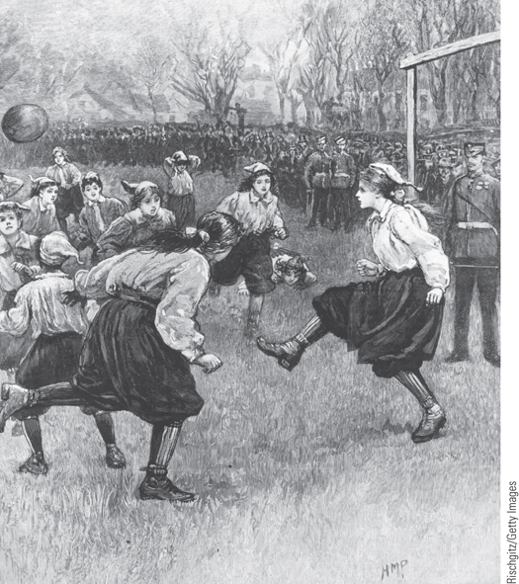
Soccer Moments (Slide 2 of 2)
A sketch from The Graphic shows the first match of the Ladies’ Football Club in 1895.
p710
Notes:
Soccer Moments. Until 1863, football (soccer) in Britain was
an aggressive sport with few set rules. One of the first things the
new English Football Association did after it was established on
October 26, 1863, was to set up fourteen rules of play. A sketch
from The Graphic shows the first match of the Ladies’ Football Club
in 1895.

Slide 44
Mass Leisure and Mass Consumption
Mass Leisure
Work and leisure as oppositional
Leisure offered escape from the urban environment
Music and dance halls
Questions of respectability
Mass tourism
Thomas Cook (1808 – 1892), pioneer
By 1900, way of life for middles and upper classes
Team sports
Growing organization and professionalism
Mass Consumption
Expansion and availability of goods

Slide 45
The National State
Western Europe: The Growth of Political Democracy
Reform in Britain
Reform Act of 1884 and Redistribution Act of 1885
Expanded suffrage to all men who paid regular taxes/rent
More representation in House of Commons
Limited land reform
The unresolved “Irish Question”
Irish desire for home rule was ignored by Parliament, despite Gladstone’s liberal efforts.
Irish groups turned to “terrorist” tactics to fight British oppressors; British respond with more oppression.
Ireland would not gain its independence until 1917; and even then, will be split .

Slide 46
The National State: Western Europe
The Third Republic in France
Franco-Prussian War, Siege of Paris in 1870
Bismarck forces French to choose new government via universal male suffrage- why?
Universal male suffrage (1871) leads to monarchist restoration!!
Radical (Parisian) republicans form the Paris Commune: a municipal government for Paris
Many were bourgeois, traumatized by the Siege of Paris
Radicals and socialists
Vain attempts to defend the Commune were crushed
Louise Michel (1830 – 1905)
Establishment of the Third Republic
Constitution of 1875: a compromise

Slide 47
The Paris Commune: March 18-May 28, 1871
April 1871: National Assembly goes to war with Paris Commune and surrounds the city with an army.
May 8: bombardment of Paris
May 21-28: Seven-day battle. 20,000 Parisians killed while communards shot hostages.
Became a legendary event in Paris and was perceived as the first time workers truly took control in a violent revolution
Important political lesson in 20th century?

Slide 48
Paris Commune: Barricade at Rue Saint-Sebastien

Slide 49
Summary [mass] executions in Paris Commune

Slide 51
The National State: France
The Third Republic (1870-1940) – when quarreling monarchists can’t agree on a new king, the National Assembly turns to a republican system:
Chamber of Deputies elected by universal male suffrage
Senate chosen indirectly
President elected by both legislative houses
Conservative president chosen:
Adolph Tiers- a monarchist (had been PM for King Louis Philippe
Longest-lasting French government since the ancién régime.
Will be destroyed by the Germans as well!

Slide 52
The Growth of Political Democracy
Spain
New constitution under Alfonso XII (1874 – 1885)
Parliamentary government dominated by Liberals and Conservatives
Defeat in the Spanish-American War, 1898
The Generation of 1898: demand for reforms
Revolt and suppression in Barcelona, 1909
Conservative forces remain in power.
Italy
Pretensions of great power status
Sectional differences in Italy: Rich north vs poor south
Chronic turmoil beyond the government’s control

Slide 53
Central and Eastern Europe: Persistence of the Old Order
Common Theme: Maintenance of Autocracy
“The makings of parliamentary government, but with authoritarian forces.”
Germany
Divisions acknowledged in the new constitution
Bicameral legislature:
Upper house: Bundesrat
Lower house: Reichstag- by universal male suffrage
Ministers and Chancellor were loyal to the Emperor
Continuation of Prussian tradition of linking army and monarchy

Slide 54
Germany
Real democracy never happened in Germany before WWI
Bismarck’s conservatism:
Kulturkampf: attack on Catholic clergy and institutions- he worked with liberals.
Outlawing the Social Democratic Party
Alarmed at its popularity
Knew he had to lure workers away from socialist party
Social welfare programs: accident insurance, health care, retirement benefits, disability.
Funded by compulsory payments from workers, employers, and state
Social Security; very progressive for the time!

Slide 55
State Socialism
Significance of Bismarck’s state socialism:
Tied workers to the state, not a union, or even a party
Fosters national loyalty
Harnesses the power and energy of the masses in favor of conservative control.
Creates the “welfare state” as a regular European feature.
Staatssozialismus: State Socialism
After WWI, state socialism will mix with racism, social Darwinism, anti-semitism, and militant nationalism to create Nationalsozialismus: NAZI
National Socialism

Slide 56
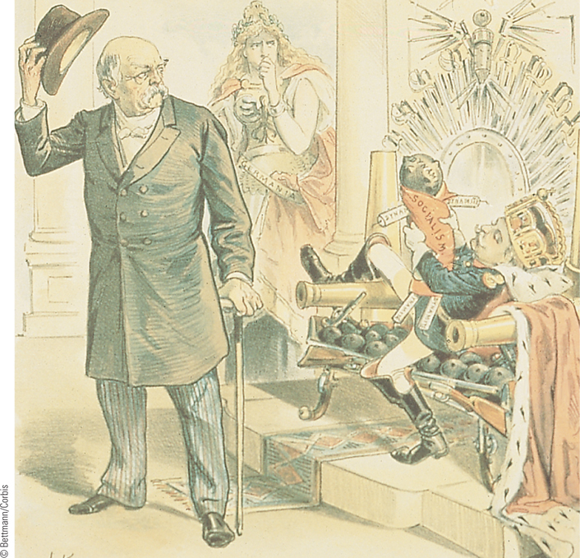
Bismarck and William II
In 1890, Bismarck sought to undertake new repressive measures against the Social Democrats. Disagreeing with this policy, Emperor William II forced him to resign.
p714
Notes:
Bismarck and William II. In 1890, Bismarck sought
to undertake new repressive measures against the Social
Democrats. Disagreeing with this policy, Emperor
William II forced him to resign. This political cartoon
shows William II reclining on a throne made of artillery
and cannonballs and holding a doll labeled ‘‘socialism.’’
Bismarck bids farewell as Germany, personified as a
woman, looks on with grave concern.

Slide 57
Central and Eastern Europe: Persistence of the Old Order
Austria-Hungary
Limited gains in the Austrian constitution of 1867
Problem of minorities worsened with universal male suffrage, 1907
The nationalities problem: Austria was so diverse, many ethnic groups resented Austrian (German) rule.
Ethnic groups wanted representation in their language.

Slide 58
Central and Eastern Europe: Russia
Russia
Refusal of liberal or democratic concessions
Alexander III (1881 – 1894)
Overturns reform and returns to repressive measures
“Russification” brutality: banned use of any language besides Russian (Russians are only 40% population of Russia!)
Increased use of the secret police: The Okrana
His father’s assassination made him see reform was a mistake.
Nicholas II (1894 – 1917)
Belief in absolute rule. Weak, indecisive
Unrealistic world view, especially with the reality of the industrial world.

Slide 59
CHRONOLOGY National States of Europe, 1871–1894: Great Britain
Event/Leader | Dates
Second ministry of William Gladstone | 1880–1885
Reform Act | 1884
p716
Notes:
CHRONOLOGY National States of Europe, 1871–1894

Slide 60
CHRONOLOGY National States of Europe, 1871–1894: France
Event | Dates
Surrender of French provisional government to Germany | 1871 (January 28)
Paris Commune | 1871 (March–May)
Republican constitution (Third Republic) | 1875
Boulanger is discredited | 1889

Slide 61
CHRONOLOGY National States of Europe, 1871–1894: Spain
Event/Leader | Dates
King Alfonso XII | 1874–1885
New constitution | 1875

Slide 62
CHRONOLOGY National States of Europe, 1871–1894: Germany
Event/Leader | Dates
Bismarck as chancellor | 1871–1890
Antisocialist law | 1878
Social welfare legislation | 1883–1889

Slide 63
CHRONOLOGY National States of Europe, 1871–1894: Austria-Hungary
Event/Leader | Dates
Emperor Francis Joseph | 1848–1916
Count Edward von Taaffe as prime minister | 1879–1893

Slide 64
CHRONOLOGY National States of Europe, 1871–1894: Russia
Leader | Dates
Tsar Alexander III | 1881–1894

Slide 65
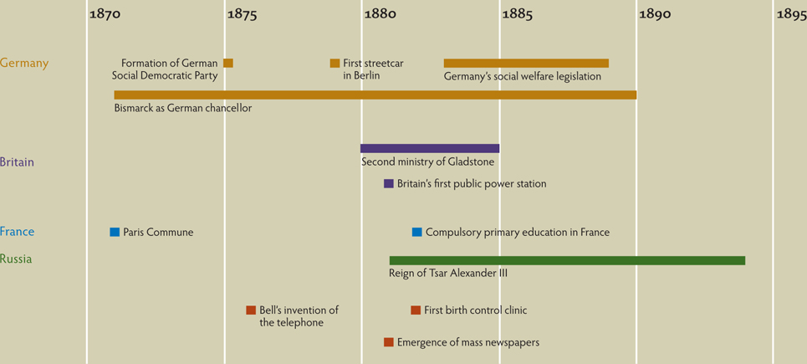
Chapter Timeline
p717

Slide 66
Discussion Questions
What were the major changes of the Second Industrial Revolution on the lives of people?
What were the changes in urban sanitation and health?
How did the industrialization of society redesign the cities?
What were the changes in education and leisure?
Why was the “old order” so persistent in Central and Eastern Europe?

