Slide 1
The Futile Search for a New Stability:
Europe Between the Wars,
1919–1939
Chapter 26

Slide 2
Focus Questions
​What was the impact of World War I, and what problems did European countries face in the 1920s?
​How did France, Great Britain, and the United States respond to the various crises, including the Great Depression, that they faced in the interwar years? How did World War I affect Europe’s colonies in Asia and Africa?
​Why did many European states experience a retreat from democracy in the interwar years? What are the characteristics of so-called totalitarian states, and to what degree were these characteristics present in Fascist Italy, Nazi Germany, and Stalinist Russia?
​What new dimensions in mass culture and mass leisure emerged during the interwar years, and what role did these activities play in Italy, Germany, and the Soviet Union?
​What were the main cultural and intellectual trends in the interwar years?

Slide 3
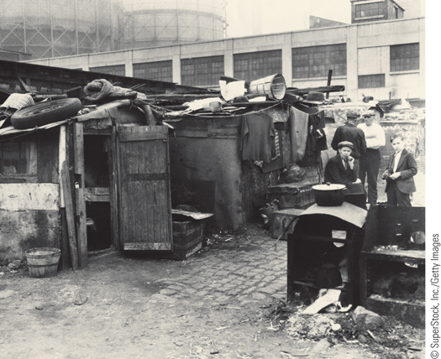
A ‘‘Hooverville’’ on the streets of the United States
p792
Notes:
A ‘‘Hooverville’’ on the streets of the United States

Slide 4
An Uncertain Peace
The Impact of World War I
  10 million dead
  Undermined whole idea of “progress”
    Nations had bought into the “slaughter” because of propaganda.
  A generation lost to war
    Many veterans became pacifists
    Some became more violent and nationalistic
  Immediate response:
    War memorials and ceremonies
    Psychological impact of “shell shock”, depression, a sense of meaninglessness and anxiety.

Slide 5
An Uncertain Peace
The Search for Security
  Weaknesses of the League of Nations
    Disarmament was not enforced.
  French policy of coercion (1919-1924)
    Desire for strict enforcement the Treaty of Versailles
    Reparations (set at $33 billion) and crisis
      German inability to pay in 1922 leads to French occupation of the Ruhr Valley
      France began to mine the wealth directly out of Germany themselves- putting German miners out of work as well.
      Collapse of the German mark and political unrest- massive inflation.
      Nazi party, led by WWI vet Adolf Hitler, tried to take power in 1923 in Munich in the Beer Hall Putsch.

Slide 6
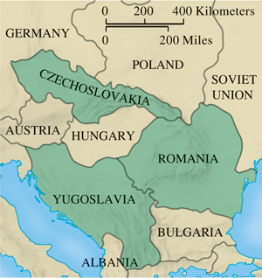
The Little Entente
p794
Notes:
The Little Entente

Slide 7
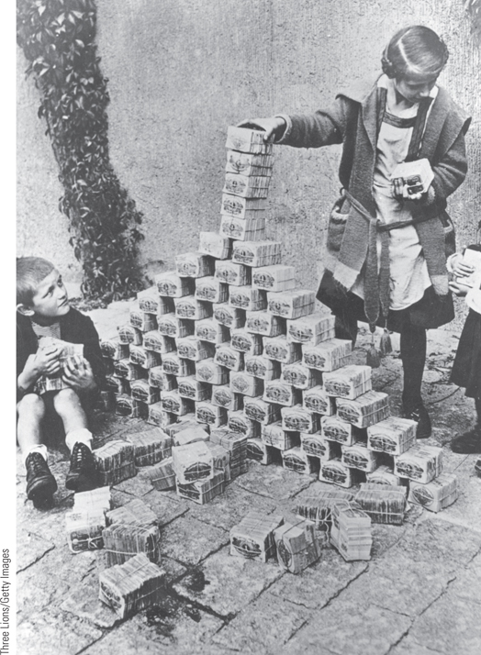
The Effects of Inflation
By the early 1920s, the value of the German mark had fallen precipitously. This photograph shows German children using bundles of worthless money as building blocks.
p795
Notes:
The Effects of Inflation. The inflationary pressures that had begun in
Germany at the end of World War I intensified during the French
occupation of the Ruhr. By the early 1920s, the value of the German
mark had fallen precipitously. This photograph shows German children
using bundles of worthless money as building blocks. The wads of
money were cheaper than toys.

Slide 8
An Uncertain Peace
The Hopeful Years (1924-1929)
  New conciliatory approaches- The Dawes Plan
  The “spirit of Locarno”
    Treaty of Locarno (1925): new cooperation between Germany and France. Germany enters League of Nations in 1926.
  Coexistence with Soviet Russia
The Great Depression
    Causes: Domestic downturn coupled with international crisis
    Unemployment
    Social and Political Repercussions
      Powerlessness of governments; democracy was questionable!
      Was dictatorship better in this situation?

Slide 9
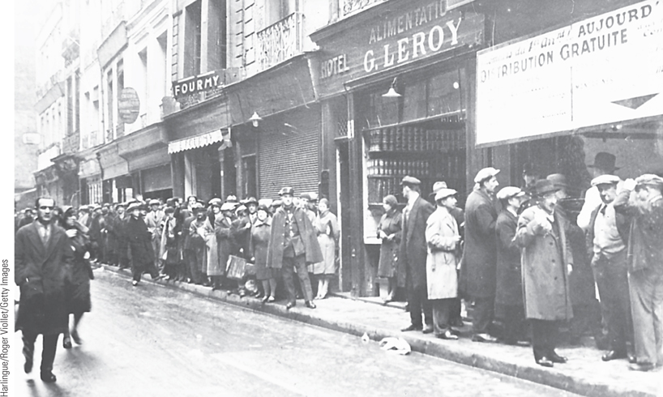
The Great Depression: Bread Lines in Paris
The Great Depression devastated the European economy and had serious political repercussions.
p796
Notes:
The Great Depression:
Bread Lines in Paris. The
Great Depression devastated
the European economy and
had serious political
repercussions. Because of its
more balanced economy,
France did not feel the effects
of the depression as quickly as
other European countries. By
1931, however, even France
was experiencing lines of
unemployed people at free food
centers.

Slide 10
The Democratic States in the West
Did WWI make the world “safe for democracy”?
Great Britain
  The challenge of the Labour Party
    Failure to solve economic problems
    Coalition claimed credit for recovery
    The push for state intervention: John Maynard Keynes (1883 – 1946)
France
  Consequences of economic and political instability
    The rise of extremists:
      The Popular Front 1936: leftist coalition of socialists and “radicals”
      Socialist leader Leon Blum created the “French New Deal” for workers, but did not cure the Depression.

Slide 11
The Democratic States in the West
The Scandinavian States
  Social Democratic governments, had more success in dealing with the Depression.
    Expansion of social services
    High taxes and large bureaucracies
The United States
  Franklin D. Roosevelt (1933-1945) and active government intervention in the economy
    The New Deal: relief, recovery, and reform
      Public works, Social Security and Labor Relations
    Slow recovery: continuing crises of unemployment

Slide 12
CHRONOLOGY The Democratic States: Great Britain
Event | Dates
First Labour Party government | 1924
Conservative Party government | 1924–1929
General strike | 1926
Second Labour Party government | 1929–1931
Beginning of National Government coalition | 1931
p799
Notes:
CHRONOLOGY The Democratic States

Slide 13
CHRONOLOGY The Democratic States: France
Event | Dates
Formation of the Popular Front | 1936

Slide 14
CHRONOLOGY The Democratic States: United States
Event | Dates
Election of Franklin D. Roosevelt | 1932
Beginning of the New Deal | 1933
Second New Deal | 1935

Slide 15
European States and the World:
The Colonial Empires
Allied nations still held their colonies.
The Middle East
  New modernizing regimes
  1932: Independent government in Saudi Arabia
  Iraq gained independence from Britain
  Mustafa Kemal/Atatürk (1881 – 1938) and a new Westernized Turkey: secularized, women’s rights, abolished aristocratic titles.
  European influence was strong in Lebanon, Jordan, Palestine, Syria.

Slide 16
Colonial Empires after WWI
India
  Mahatma Gandhi (1869 – 1948)
  Began movement for independence and social justice in India
  1919: Amritsar Massacre- a peaceful protest met by deadly force; 400 Indian civilians killed by the British army.
  Civil disobedience, with the spinning wheel as a symbol.
    Later inspired Martin Luther King
    1930 Salt March (Salt Satyagraha) got international attention.
  1935: British grant India limited internal self-government

Slide 17
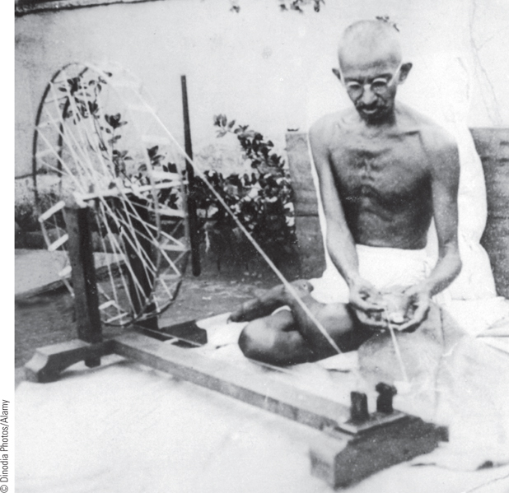
Gandhi
Mahatma Gandhi, India’s ‘‘Great Soul,’’ became the spiritual leader of
India’s struggle for independence from British colonial rule.
p800
Notes:
Gandhi. Mahatma Gandhi, India’s ‘‘Great Soul,’’ became the spiritual leader of
India’s struggle for independence from British colonial rule. Unlike many other
nationalist leaders, Gandhi rejected the materialistic culture of the West and urged his
followers to return to the native traditions of the Indian village. To illustrate his point,
as seen in this illustration, Gandhi dressed in the simple Indian dhoti rather than in the
Western fashion favored by many of his colleagues. He is also using a manual
spinning wheel to make cotton thread to protest imports of British textiles.

Slide 18
The Colonial Empires after WWI
Africa
Disappointed hopes following WWI, especially from African war veterans.
  Post-war activism and protest
    Rise in African nationalism
    Many Africans received western education- where they got ideas for self-government and freedom!
  Trade unions in Nigeria and South Africa
  1929: Nigerian women killed at protest
  African leaders and calls for independence
  Pan-Africanism
    W. E. B. Du Bois (1868 – 1963)
    Marcus Garvey (1887 – 1940)
    Jomo Kenyatta (1894 – 1978)
    Facing Mount Kenya

Slide 19
Essential Questions
How did World War I expose the weaknesses and flaws of Western Democracies, especially during the Depression?
What impact did World War I have on Europe’s colonies in Africa, the Middle East, and Asia?

Slide 20
The Authoritarian and Totalitarian States
Historians Debate: The Retreat from Democracy: Did Europe Have Totalitarian States?
  Mass politics spread democracy, but war created conditions that made people distrust it!
  New mass electorate and the movement toward radicalized politics
    Class and gender divisions; decline of middle class
    Women’s rights were curtailed after the war, rather than increased, in some countries .
    People looked to either communism (left wing) or fascism (right wing).

Slide 21
Totalitarianism
The modern totalitarian state
  Characteristics: single leader and single party with active commitment of citizens
    Mass propaganda techniques and high speed communication
    Domination of all aspects of life
    “Individual freedom” comes second to “collective will of the people”, which is determined by the dictator.
    Police surveillance state.
  The term totalitarian was first used by Mussolini to describe fascism.

Slide 22
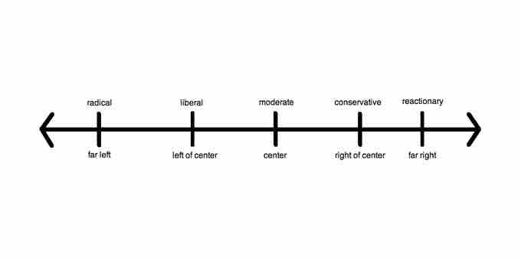
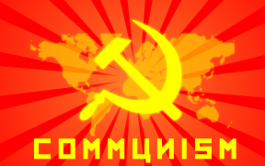
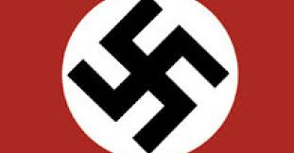
What are all these extreme politics?

Slide 23
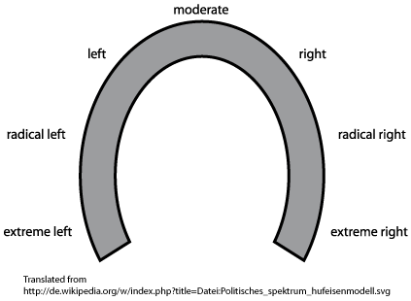
The Horse-shoe Theory

Slide 24
Fascist Italy
Impact of World War I
  Inability of government to deal with problems
The Birth of Fascism
  Benito Mussolini (1883-1945)
    Had been a school teacher and a socialist before WWI
    Formation of the Fascio di Combattimento, 1919
    Combining anticommunism, antistrike activity, nationalist rhetoric, and brute force- won the support of the middle class, who freared strikes and revolts from the poor.
      Squadristi, armed Fascists attack socialist presses.
      The Black Shirts
      Resulting parliamentary gains

Slide 25
Mussolini in Italy
1921- Fascists were 200,000 strong- mostly veterans and students (nationalism)
Believed terror tactics were necessary
Were seen as the “party of order”
    March on Rome, 1922
      Mussolini appointed prime minister, October 29, 1922 by King Victor Emmanuel III!
      Next day, they marched on Rome again to create the illusion that they took power by force.

Slide 26
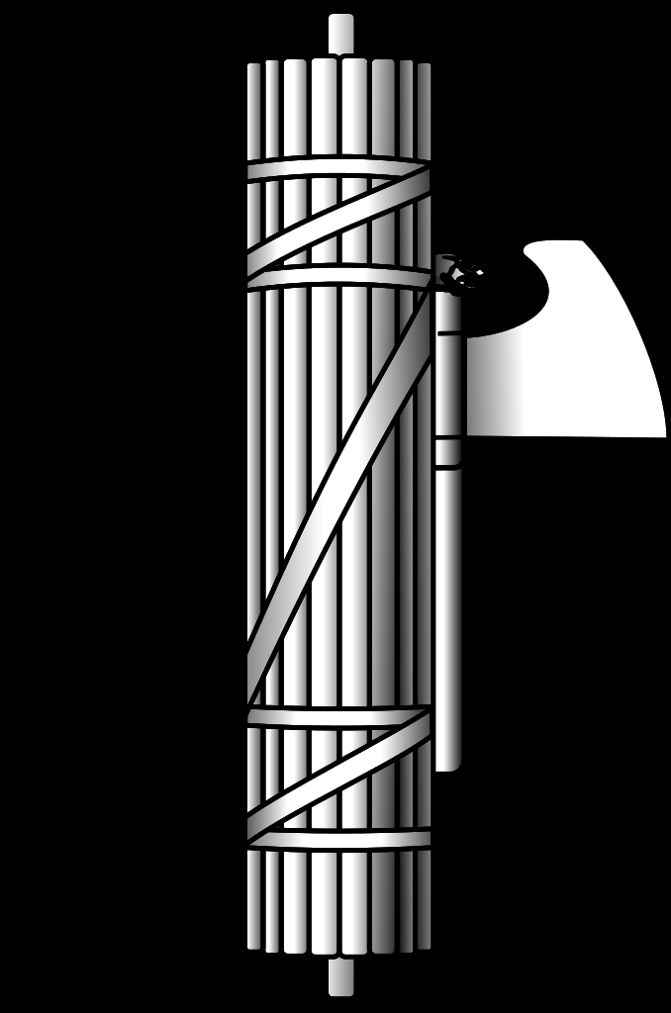
The fasces: A Roman symbol of unity and strength

Slide 27
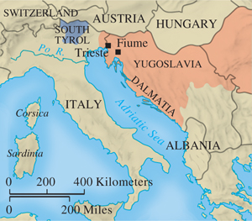
Territory Gained by Italy
p802
Notes:
Territory Gained by Italy

Slide 28
Mussolini and the Italian Fascist State
Fascist Government
  Fascist dictatorship established, 1926
    New policies: press laws, police laws, and a political monopoly
    “Rule by decree” and propaganda
  Mussolini’s view of a Fascist state: totalitarian
    Molding Italians into a single community
      Young Fascists: “Mussolini is always right!”
      Attitudes toward women
      Family as the pillar of the state; school propaganda
    Never achieves the degree of control achieved in Germany or Soviet Union
      Compromise with traditional institutions: Lateran Accords, February 1929

Slide 29
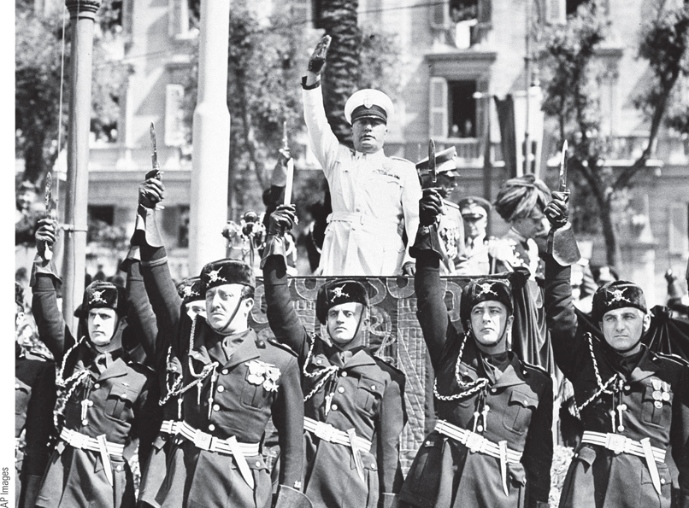
Mussolini, the Iron Duce
One of Mussolini’s favorite images of himself was that of the Iron Duce—the strong leader who is always right.
p803
Notes:
Mussolini, the Iron Duce.
One of Mussolini’s favorite
images of himself was that of the
Iron Duce—the strong leader
who is always right.
Consequently, he was often seen
in military-style uniforms and
military poses. This photograph
shows Mussolini in one of his
numerous uniforms with his
Blackshirt bodyguards giving the
Fascist salute.

Slide 30
Essential Questions
What is fascism?
What is the appeal of fascism?
Why do you think Mussolini was able to take power, despite his anti-democratic tactics?

Slide 31
CHRONOLOGY Fascist Italy
Event | Dates
Creation of Fascio di Combattimento | 1919
Squadristi violence | 1920–1921
Fascists win thirty-five seats in Parliament | 1921
Mussolini is made prime minister | 1922
Electoral victory for Fascists | 1924
Establishment of Fascist dictatorship | 1925–1926
Lateran Accords with Catholic Church | 1929
p805
Notes:
CHRONOLOGY Fascist Italy

Slide 32
Hitler and Nazi Germany
The Weimar Republic
  Unresolved political and economic problems
  Military WWI hero Paul von Hindenberg was elected president of Germany.
    He was actually a conservative monarchist- didn’t care for the idea of a republic anyway!
  The Republic was hated by both the left and right, and was largely ineffective.

Slide 33
Emergence of Adolf Hitler
Born in Vienna, Austria 1889
Formation of ideologies of racism, nationalism, and struggle, growing up in Vienna.
Moved to Munich in 1913 and served in German army during WWI.
The Rise of the Nazis
  National Socialist German Workers’ Party (Nazi), 1921
    Sturmabteilung (SA): Storm Troops- its own police force.
    The Failed Munich Beer Hall Putsch, 1923
      Hitler imprisoned: Mein Kampf
      Judges were sympathetic to Hitler.
      He was never taken too seriously!

Slide 34
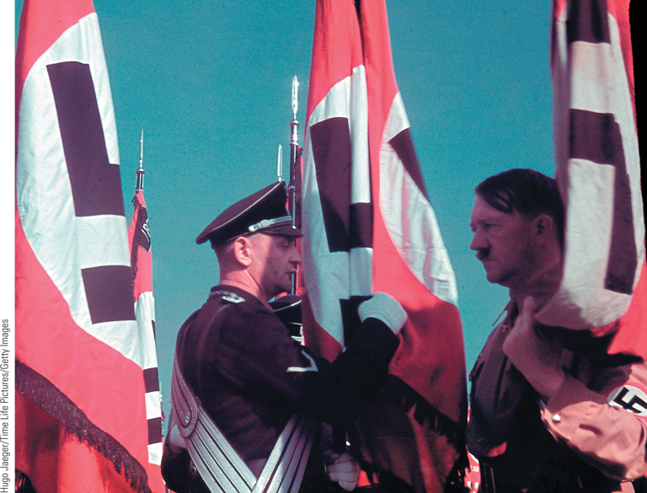
Hitler and the Blood Flag Ritual
In developing his mass political movement, Adolf Hitler used
ritualistic ceremonies as a means of binding party members to his own person.
p807
Notes:
Hitler and the Blood Flag Ritual.
In developing his mass political
movement, Adolf Hitler used
ritualistic ceremonies as a means of
binding party members to his own
person. Here Hitler is shown
touching the ‘‘blood flag,’’ which had
supposedly been stained with the
blood of Nazis killed during the Beer
Hall Putsch, to an SS banner while
the SS standard-bearer makes a
‘‘blood oath’’ of allegiance: ‘‘I vow to
remain true to my Fu¨hrer, Adolf
Hitler. I bind myself to carry out all
orders conscientiously and without
reluctance. Standards and flags shall
be sacred to me.’’ The SS originated
as Hitler’s personal bodyguard and
later became a secret police force and
instrument of terror in the Nazi state.

Slide 35
Hitler and Nazi Germany
Need for a lawful takeover of power
  Organization: Führeprinzip (leadership principle)
  By 1929, Nazi party had 178,000 members
  Youthful leaders not interested in democracy- they favored beer hall brawls and powerful speeches and rallies!
  Great Depression made it easier to get the middle and lower class support
  By 1930, Chancellor Bruning couldn’t get a majority in the Reichstag, so he had to rule by emergency decree.
    Democracy was already dying, before Hitler became dictator.
  Nazi success in the Reichstag with 1932 election
    Support of middle-class voters

Slide 36
Nazi Seizure of Power
Political maneuvering
  By 1932, Nazis had 800,000 members!
  Innovative electioneering techniques: propaganda, appeal to class interests, fears.
  Hitler realized that elections and the Reichstag weren’t that important, since the government ruled by decree anyway.
    Social Democrats were openly opposed to Hitler.
    Right-wing elites (aristocrats, industrialists, military) saw Hitler as a strong leader who would protect Germany from a Communist takeover.
      They also thought they could control him.
      They pressured Hindenberg to appoint Hitler Chancellor of Germany, and 2 months later, Hitler laid the foundation for total takeover.

Slide 37
Nazi Seizure of Power
Hermann Göring (1893 – 1946): legal Nazi terror; purged non-Nazis.
Feb. 27 1933: Fire in the Reichstag- allegedly set by Communists- gave Hitler the excuse.
  President issues Article 48- allows gov to rule by emergency decree only. Allowed Nazis to do anything.
Enabling Act, March 1933
  Gleichschaltung, coordination of all institutions under Nazi control, government could dispose of Constitution.
  Concentration camps for opponents.
  Purged Jews of civil service jobs

Slide 38
Nazi Seizure of Power
Why were Nazis so successful?
  Loss of faith in the Weimar and in democracy.
  Slogan: “Germany awake” and nationalism
  By 1933, only the army and the SA (Storm Detachment), led by Ernst Rohm, were threats.
  Hitler has them killed on June 30, 1934 (“Night of the Long Knives”)
  Gets support of the army for allowing Hindenberg to be succeeded by Hitler after he died- which he did, on Aug. 2.
  Hitler was now the sole ruler of Germany.

Slide 39
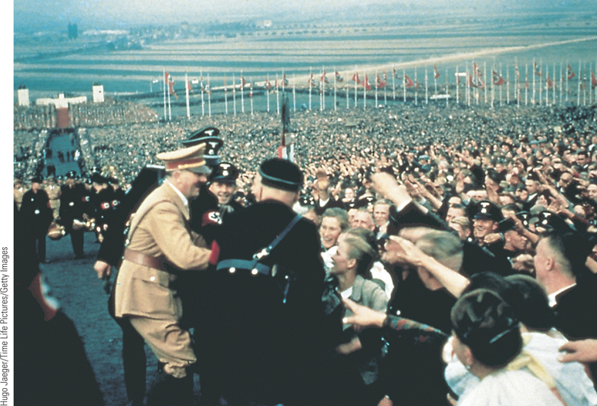
The Nazi Mass Spectacle
Hitler and the Nazis made clever use of mass spectacles to rally the German people behind the Nazi regime.
p810
Notes:
The Nazi Mass Spectacle.
Hitler and the Nazis made clever
use of mass spectacles to rally the
German people behind the Nazi
regime. These mass demonstrations
evoked intense enthusiasm, as is
evident in this photograph of Hitler
arriving at the Bu¨ckeberg near
Hamelin for the Harvest Festival in
1937. Almost one million people
were present for the celebration.

Slide 40
CHRONOLOGY Nazi Germany
Event | Dates
Hitler as Munich politician | 1919–1923
Beer Hall Putsch | 1923
Nazis win 107 seats in Reichstag | 1930 (September)
Hitler is made chancellor | 1933 (January 30)
Reichstag fire | 1933 (February 27)
Enabling Act | 1933 (March 23)
Purge of the SA | 1934 (June 30)
Hindenburg dies; Hitler as sole ruler | 1934 (August 2)
Nuremberg laws | 1935
Kristallnacht | 1938 (November 9–10)
p811
Notes:
CHRONOLOGY Nazi Germany

Slide 41
The Nazi State (1933-1939)
Developing the “Total State”
  Creation of a unified Aryan racial state
    Mass demonstrations and spectacles
    Constant rivalry gives Hitler power
    Economic control and the drop in unemployment
      Re-armament of Germany
      The Labor Front: a state-run union used to control workers and make them submit to Nazi control.
      Sponsored leisure activities to keep workers happy.
    Heinrich Himmler and the Schutzstaffeln (SS)
      Functioned by terror and ideology
      Secret police, criminal police, then execution squads, and later ran the death camps.
      Indoctrinated to “further the Aryan race”

Slide 42
The Nazi State
Churches and education brought under Nazi control
  Hitler Jugend (Hitler Youth) and Bund Deutscher Mädel (German Girls Association)
Influence of Nazi ideas on working women
  To have many children
  To work in factories during the war
Strong anti-Semitism
  Nuremberg laws, September 1935
  Kristallnacht: November 9-10, 1938
  Restrictions on Jews meant to send them a message.

Slide 43
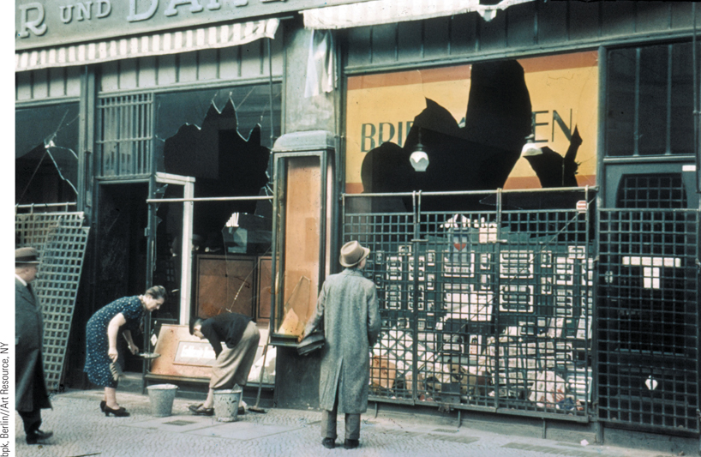
Anti-Semitism in Nazi Germany
Soon after seizing power, Hitler and the Nazis began to translate their anti-Semitic ideas into anti-Semitic policies.
p811
Notes:
Anti-Semitism in Nazi
Germany. Soon after seizing
power, Hitler and the Nazis
began to translate their anti-
Semitic ideas into anti-Semitic
policies. This photograph
shows one example of Nazi
action against the Jews as
Germans are seen passing by
the broken windows of a
Jewish shop in Berlin the
morning after Kristallnacht,
the Night of Shattered Glass,
when thousands of Jewish
businesses were destroyed.

Slide 44
Essential Questions
What does Hitler’s rise to power teach us about how democracy can die? What does it take for people to give up their constitutional freedoms and look the other way in the face of such tyranny?
Why did Hitler appeal to so many Germans?

Slide 45
The Soviet Union- a quick recap!
1917 Revolution:
  Czar Nicholas abdicates and his family is placed under House Arrest
  A new Provisional Government takes over- led by Alexander Kerensky of the Duma.
    They agree to stay in the war.
  Lenin arrives in Russia and promises Peace, Land, and Bread.
  Communist revolution, led by Lenin and Trotsky, overthrow the Provisional Government.
  Russia is plunged into a Civil War that lasts until 1921.
    Red Army defeats the White Army, and the Union of Soviet Socialist Republics (USSR, or Soviet Union) is born.
    Communists persecute the kulaks (wealthy peasants).

Slide 46
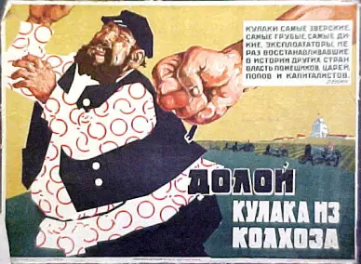
Anti-Kulak Propaganda

Slide 47
Lenin’s Hanging Order- 1918
After kulaks revolted against the requisitioning of grain by Lenin’s forces, Lenin issued the following orders on Aug. 11, 1918:
"Comrades! The insurrection of five kulak districts should be pitilessly suppressed. The interests of the whole revolution require this because 'the last decisive battle' with the kulaks is now under way everywhere. An example must be demonstrated.
1. Hang (absolutely hang, in full view of the people) no fewer than one hundred known kulaks, filthy rich men, bloodsuckers.
2. Publish their names.
3. Seize all grain from them.
4. Designate hostages - in accordance with yesterday's telegram.
Do it in such a fashion, that for hundreds of verst around the people see, tremble, know, shout: "strangling (is done) and will continue for the bloodsucking kulaks".
Telegraph the receipt and the implementation. Yours, Lenin.
P.S. Use your toughest people for this."

Slide 48
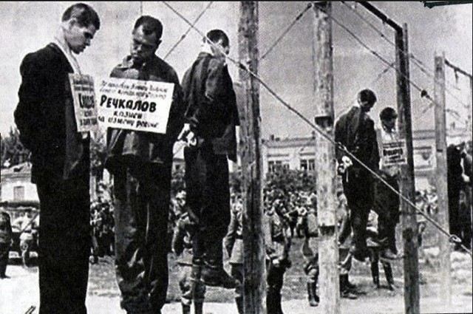
Lenin’s Hanging Order- 1918

Slide 49
The Soviet Union
Communists won Civil War
  Use of terror and “war communism”
  Gov requisition of food causes fierce peasant resistance and leads to famine (5 million dead)
    Industrial collapse as Russia is exhausted.
New Economic Policy
  Lenin’s plan to save the USSR
  Modified capitalism! Allowed some private selling and trading of small farms and businesses.
  Union of Socialist Republics established, 1922
  Revived economy; intended to be temporary
    Created wealthy class of kulaks again (remember that Lenin had previously persecuted them).
    Created bigger government and powerful state government (is that what Marx intended?)

Slide 50
The Soviet Union
The Struggle for Power
  Lenin suffers strokes, dies in 1924.
    He had been a one-man ruler, so what now?
  Division of the Politburo
    Leon Trotsky and the Left- want to end the NEP, industrialize rapidly, and world-wide communist revolution.
    Right- focus on strengthening the USSR, continue the NEP, against rapid industrialization.
    Joseph Stalin (1879 – 1953)
      From general party secretary to Communist Party control
      Supported strengthening the USSR “socialism in one country”.
      Had Trotsky expelled, then killed.
      Expels the Old Bolsheviks in 1929; starts new dictatorship

Slide 51
The Stalinist Era (1929-1939)
Sweeping Economic, Social, and Political Revolution
  First Five-Year Plan, 1928
    Emphasis on industry
    Real wages declined
    Use of propaganda and the “Stakhanov cult”
  Rapid collectivization of agriculture
    Famine of 1932-1933; 10 million peasants died
  Political control
    Stalin dictatorship established, 1929
    Political purge, 1936-1938; 8 million arrested
  Impact on citizens’ lives
    Reduced women’s rights, emphasis on family, birthrate.
    Higher education for all, especially for engineering

Slide 52
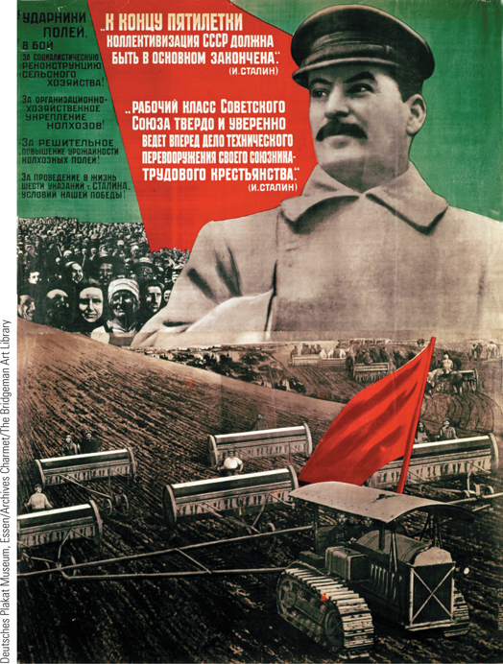
Stalin and the First Five-Year Plan
After establishing his dictatorship, Stalin sought to achieve the rapid industrialization of the Soviet Union as well as the collectivization of agriculture by his first five-year plan.
p813
Notes:
Stalin and the First Five-Year Plan. After establishing his
dictatorship, Stalin sought to achieve the rapid industrialization
of the Soviet Union as well as the collectivization of agriculture
by his first five-year plan. This poster, published in 1932 with
a photograph of Stalin, celebrates the achievements of that plan.
It reads, ‘‘At the end of the Plan, the basis of collectivization must
be completed.’’

Slide 53
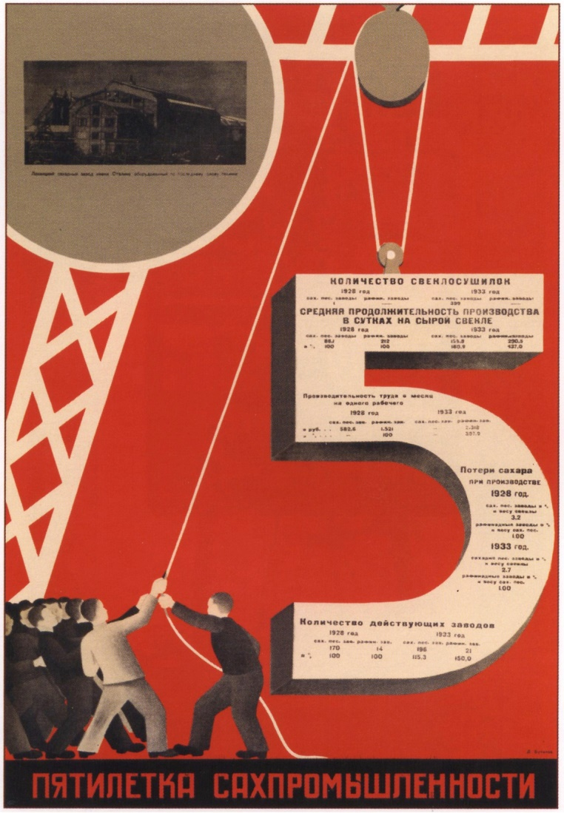
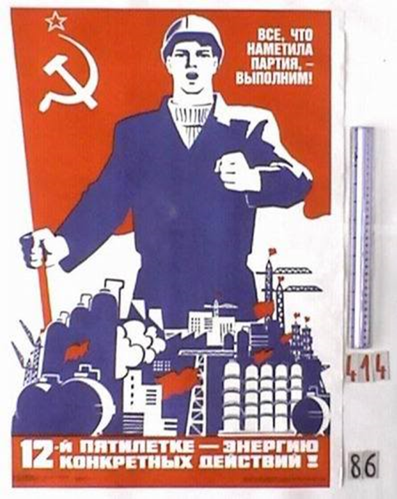
Stalin’s 5 Year Plans

Slide 54
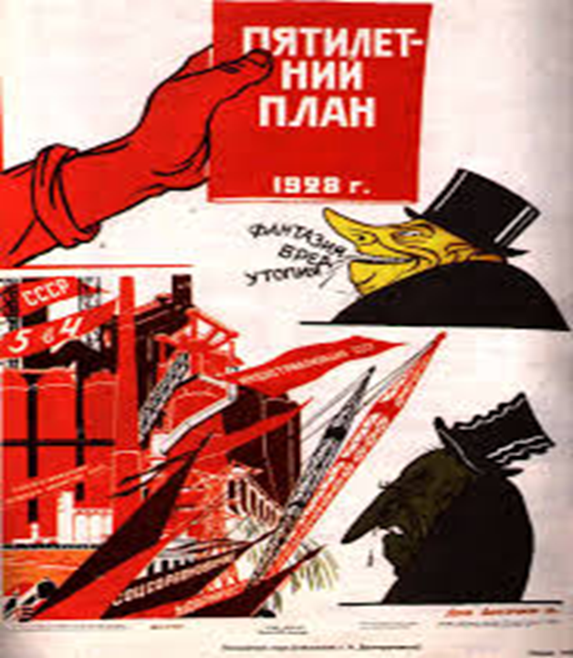
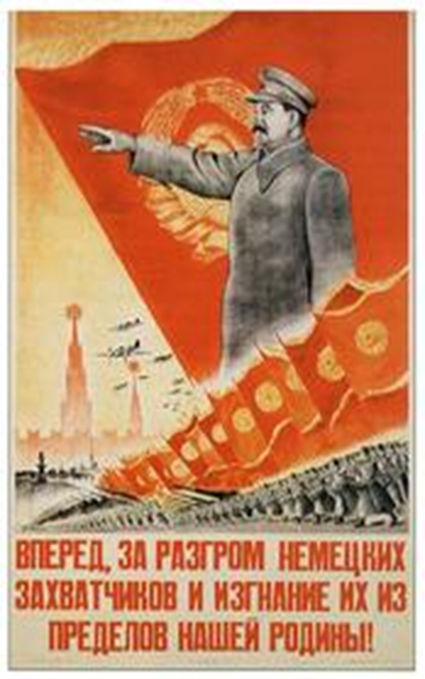
“We are 50 to 100 years behind the advanced countries. We must cover this distance in 10 years.” - Stalin

Slide 55
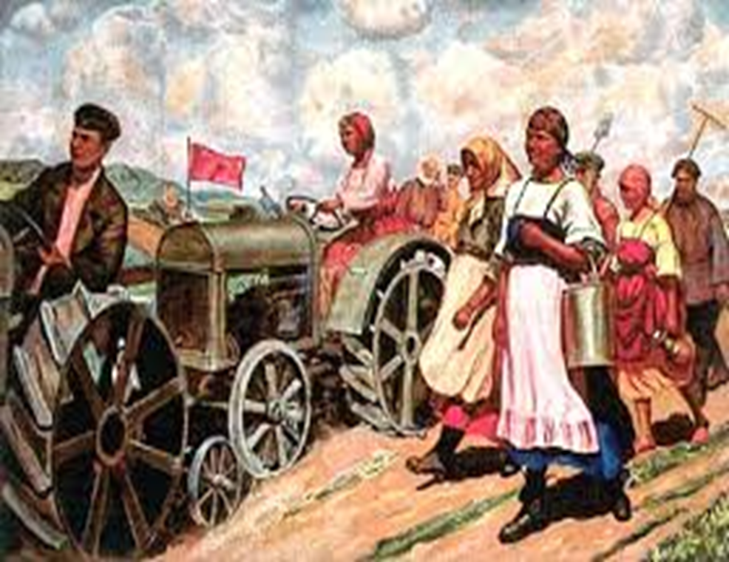
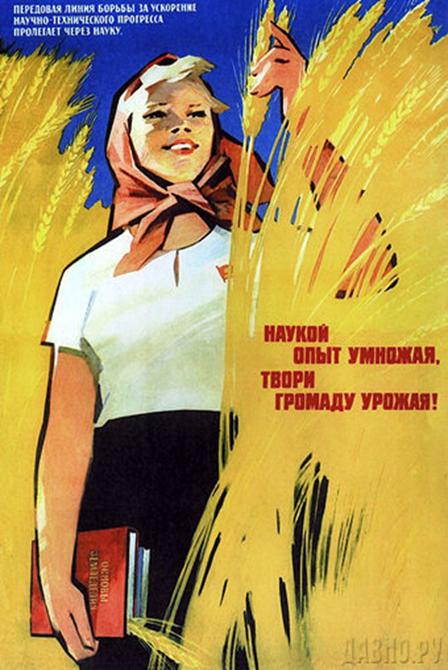
Collective Farms

Slide 56
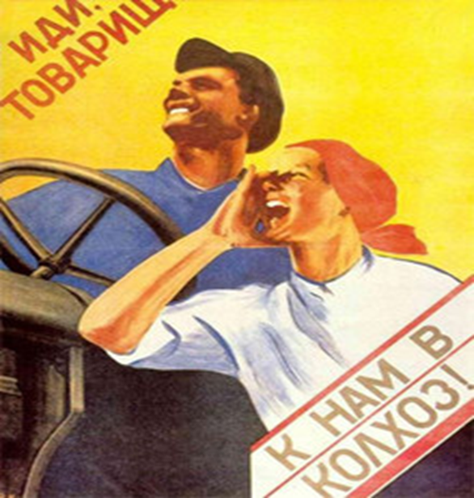
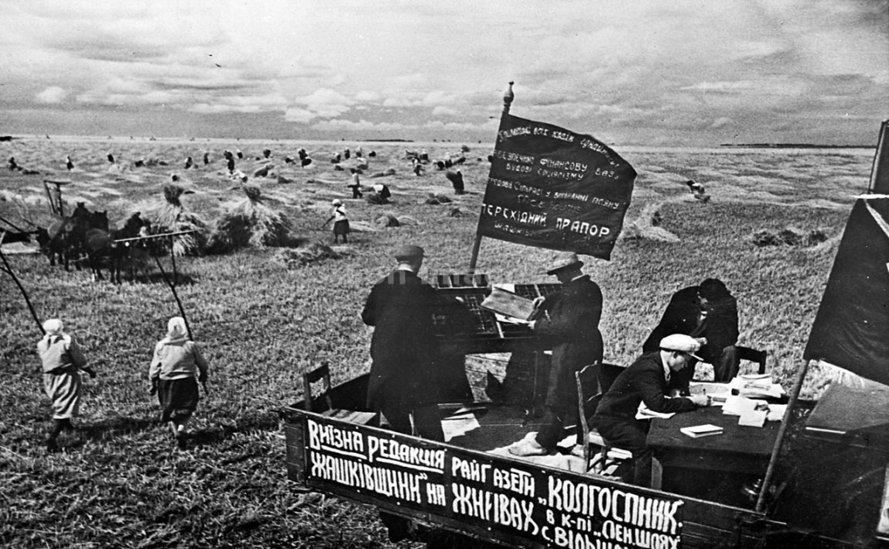
Collective Farms

Slide 57
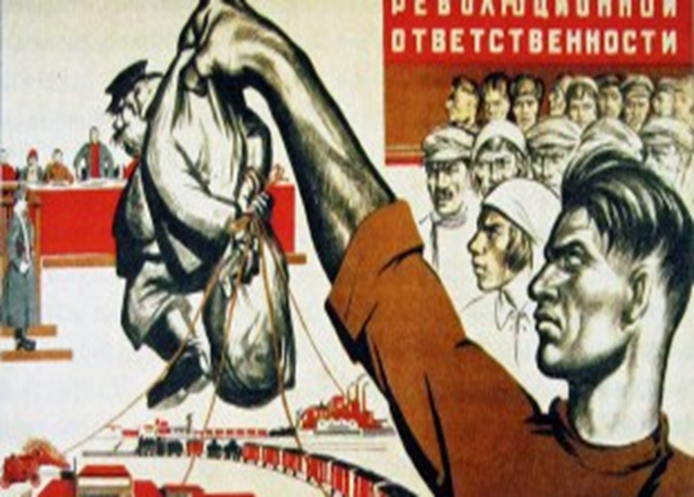
De-Kulakization

Slide 58
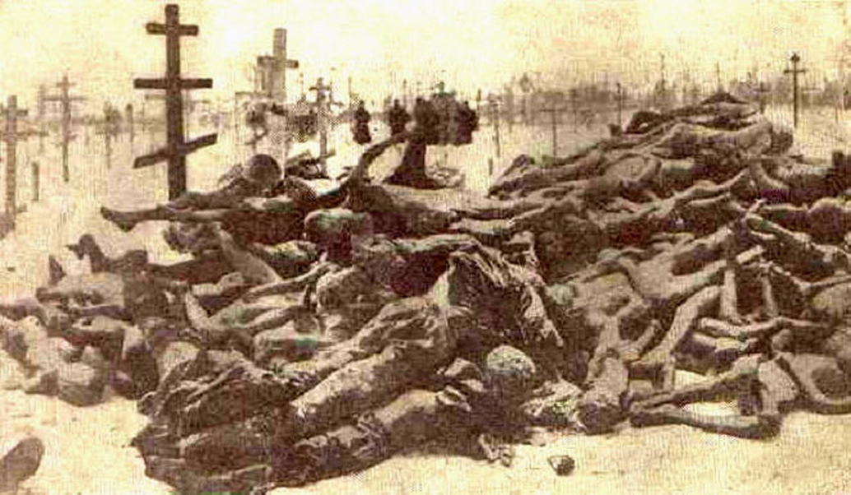
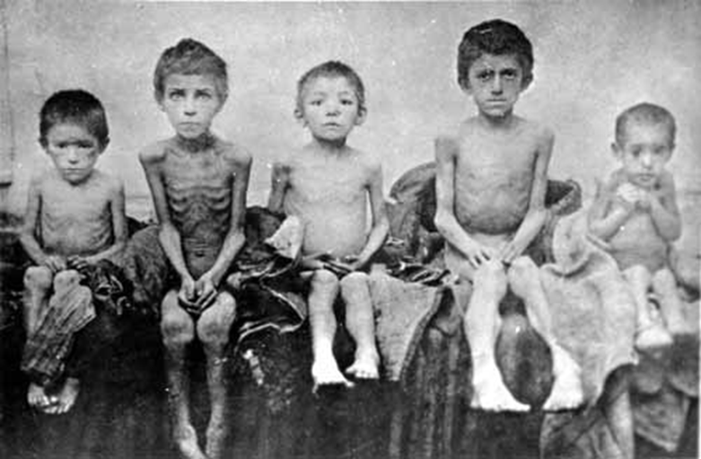
Ruthless De-Kulakization policies in Ukraine, 1933.

Slide 59
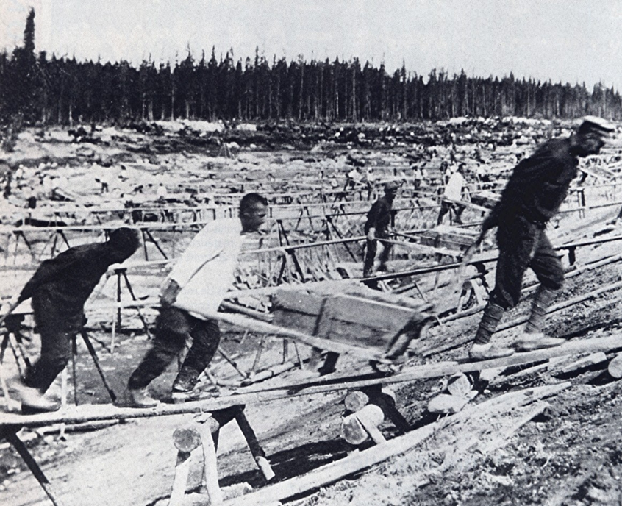
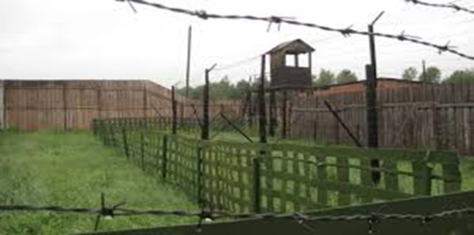
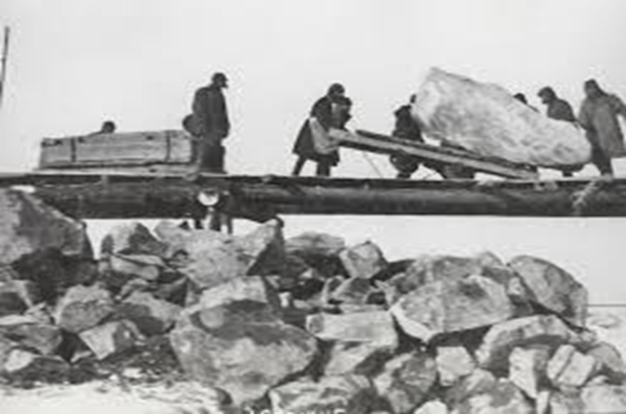
Terror tactics: The Gulag

Slide 60
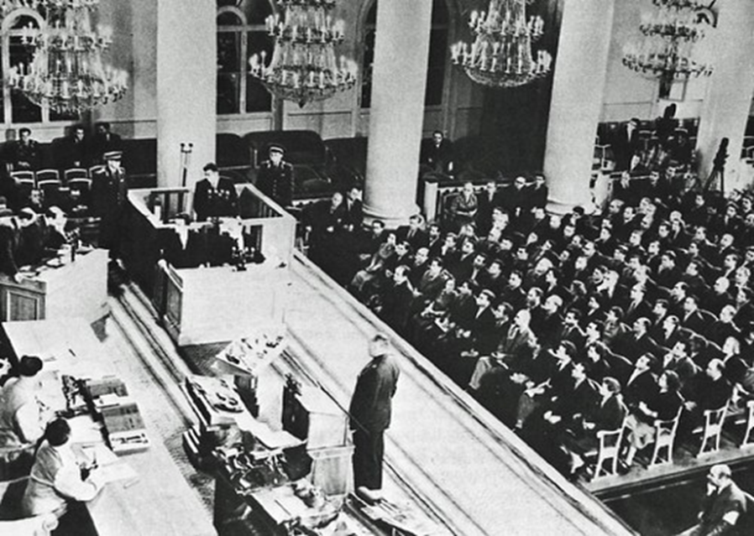
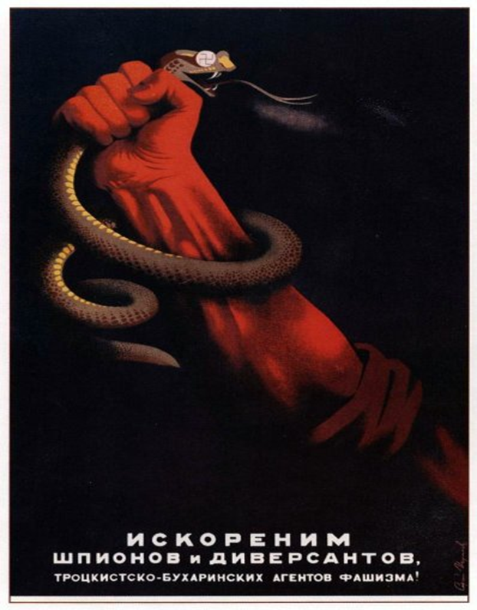
Terror tactics: Show Trials during
The Great Purge

Slide 61
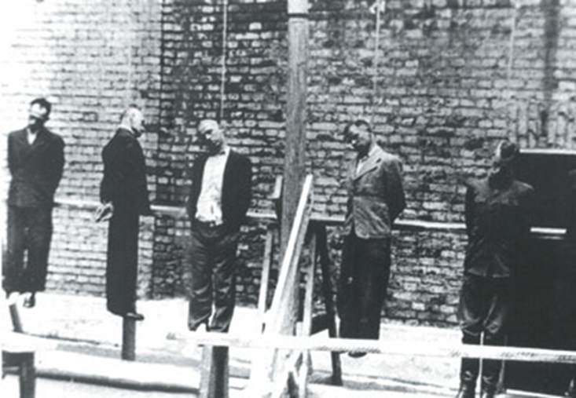
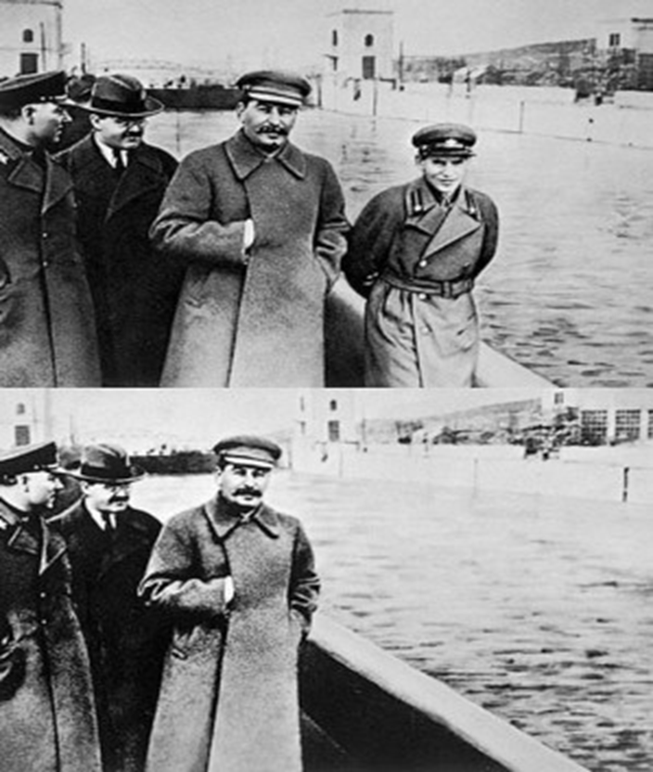
The Great Purge, 1936-1938

Slide 62
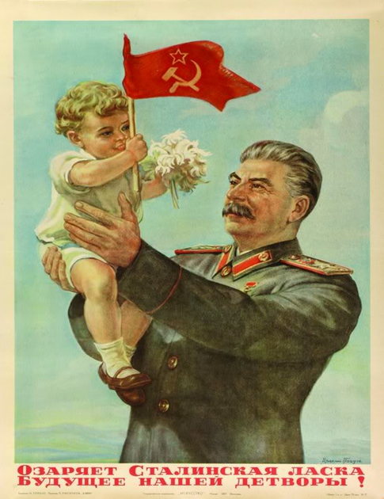
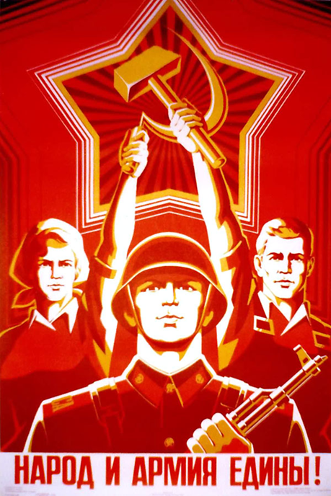
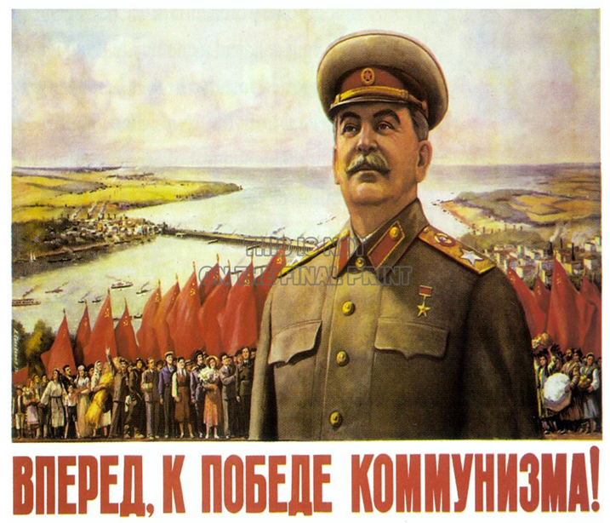
Propaganda: Socialist Realism

Slide 63
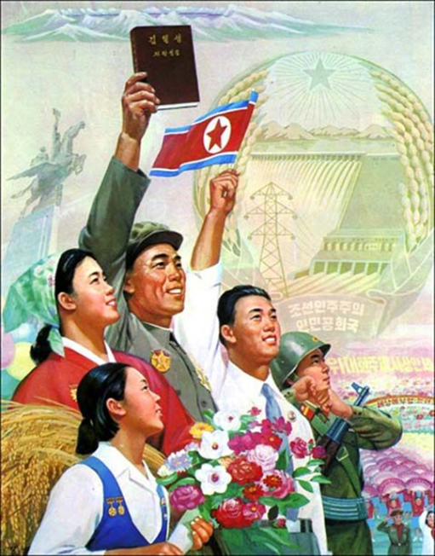
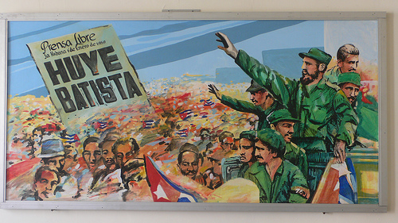
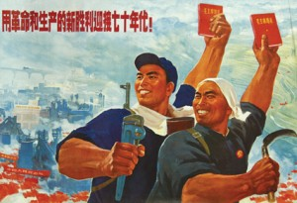
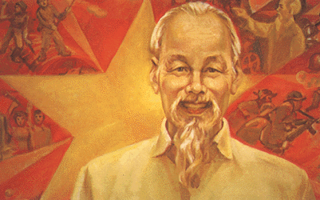
Socialist Realism
Cuba
North Korea
Vietnam
China

Slide 64
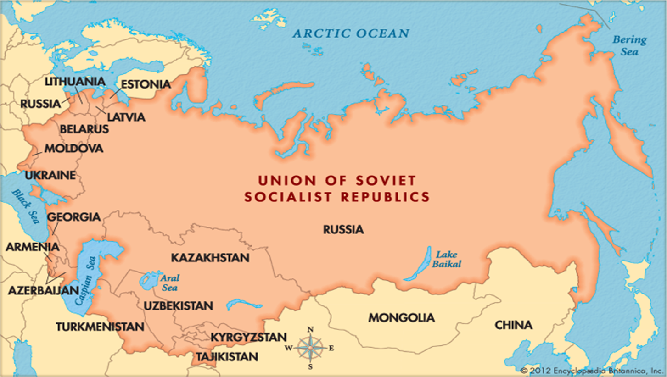
The Soviet Union
1922-1991

Slide 65
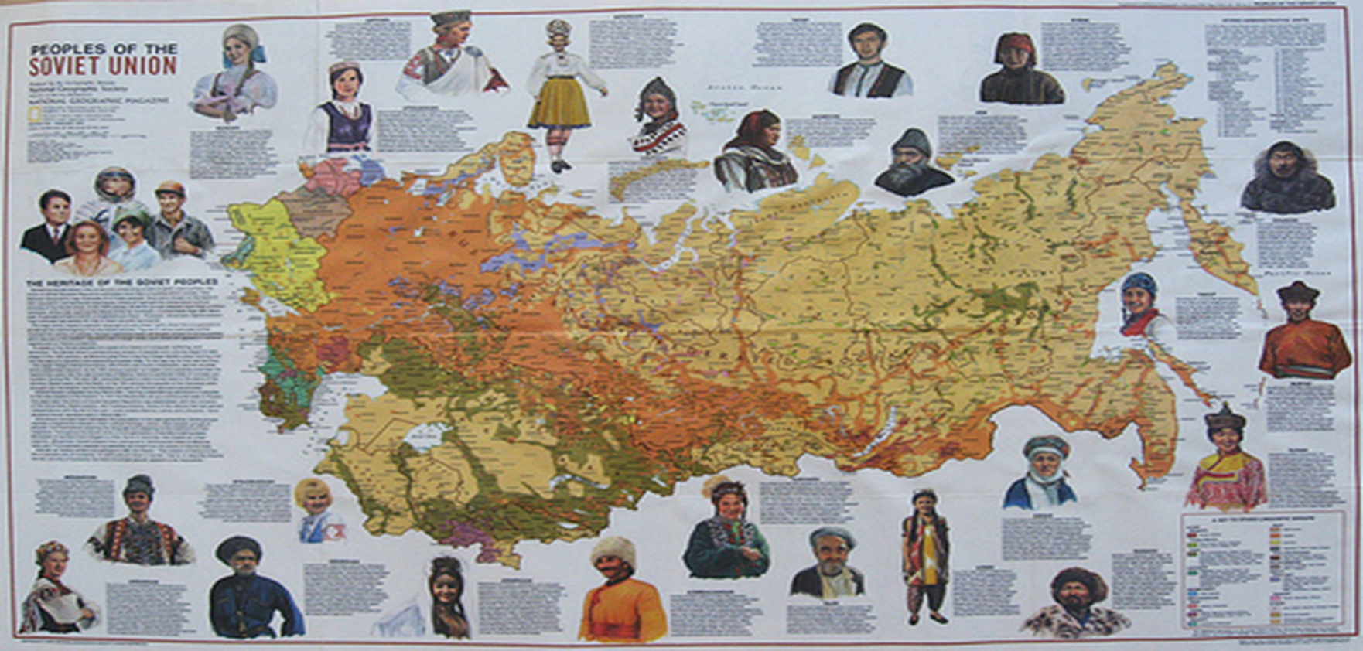
Peoples of the Soviet Union

Slide 66
CHRONOLOGY The Soviet Union
Event | Dates
New Economic Policy begins | 1921
Death of Lenin | 1924
Trotsky is expelled from the Communist Party | 1927
First five-year plan begins | 1928
Stalin’s dictatorship is established | 1929
Height of Stalin’s purges | 1936–1938
p813
Notes:
CHRONOLOGY The Soviet Union

Slide 67
Authoritarianism in Eastern Europe
Post-War Changes
  Europe’s map was drastically changed after WWI
    New States: Austria., Poland, Czechoslovakia Yugoslavia adopted parliamentary systems.
    Kingdoms of Bulgaria and Romania gain Parliamentary constitutions
    Greece: A republic in 1924
    Hungary: Parliamentary, but controlled by the aristocracy.
  So how did they go from political democracy to authoritarian regimes?

Slide 68
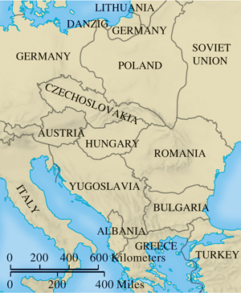
Eastern Europe After World War I
p815
Notes:
Eastern Europe After World War I

Slide 69
Authoritarianism in Eastern Europe
Authoritarianism: limited participation of the masses; gov. wants passive obedience.
Problems
  Little or no tradition of liberalism and parliamentary politics
  No substantial middle class
    Rural and agrarian states
  Ethnic conflicts
  Fear of upheaval creates quest for order and control

Slide 70
Dictatorship in the Iberian Peninsula
Spain and Portugal had agrarian, illiterate societies dominated by the Catholic Church and powerful landlords.
Spain was a parliamentary monarchy
  Couldn’t deal with tensions from industrialism and WWI, and conflict over its “empire” in Africa.
  King Alfonso XIII supported a military coup led by General Miguel Primo de Rivera.
  Alfonso left Spain in 1931, and Spain was proclaimed a republic- led by The Popular Front: left-leaning socialists, democrats, and communists (basically, anti-fascists).
  The army did not like this, and they revolted.

Slide 71
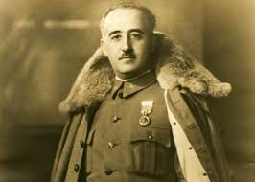
The Spanish Civil War, 1936-1939
General Francisco Franco led the military (right wing) Nationalists against the (left wing) Republicans.
  The Republicans: urban (Madrid, Barcelona), wanted modernization, workers’ rights, civilian army, secularization.
  The Nationalists: Wanted military regime, agrarian economy, the Church.
Foreign intervention:
  Britain, France, Germany, Italy, and USSR signed non-intervention agreement.

Slide 72
The Spanish Civil War
But Italy and Germany break the agreement, and begin to support Franco.
They use this as a “practice round” for their future plans– WWII and Hitler’s “blitzkrieg” campaign.
  Attack on Guernica: April 26, 1937.
  Britain and France refused to help, so Republicans turned to the USSR for help.
    Stalin sent tanks, planes, pilots.
    Some assistance from volunteers around the world, including the US.
      Ernest Hemingway!

Slide 73
Spanish Civil War
Franco claims victory on March 28, 1939, when he captured Madrid.
400,000 dead, mostly civilians
Another 200,000 were executed after, and Spain was a military dictatorship until 1975.
  Remained neutral in WWII.
  Curtailed media
  Outlawed political opposition
  Favored large landowners and businesses.
Portugal:
  Est. a republic in 1910, but strongman Antonio Salazar led a coup.
  Dictatorship for the next 40 years.

Slide 74
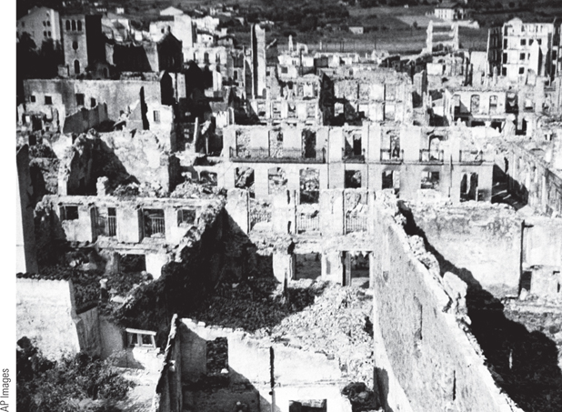
The Destruction of Guernica (Slide 1 of 2)
On April 26, 1937, the German Condor Legion dropped 100,000 tons of explosives in three hours on the small Basque town of Guernica, killing 1,654 people and wounding 889.
p817
Notes:
The Destruction of Guernica. On April 26, 1937, the
German Condor Legion dropped 100,000 tons of explosives
in three hours on the small Basque town of Guernica,
killing 1,654 people and wounding 889. The illustration
shows the ruins of Guernica after the German attack.

Slide 75
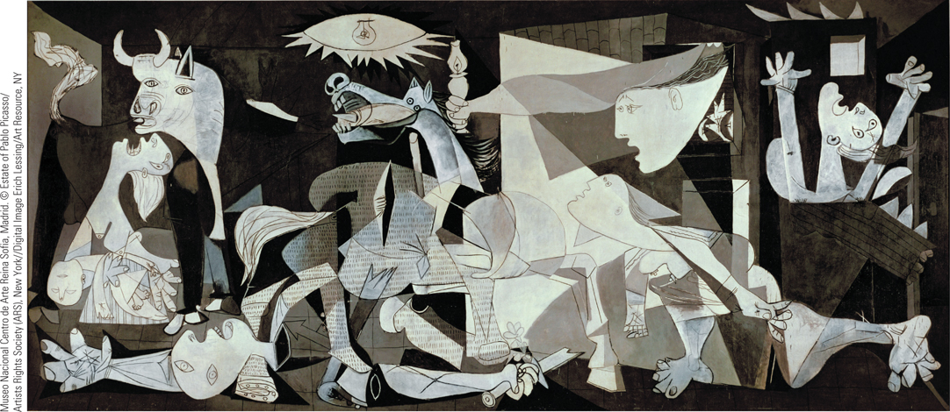
The Destruction of Guernica (Slide 2 of 2)
The scene was captured in Pablo Picasso’s Guernica (1937), a large (11 by 25 feet) Cubist piece that portrays the horror and human destruction caused by mass bombings.
p817
Notes:
The Destruction of Guernica. On April 26, 1937, the
German Condor Legion dropped 100,000 tons of explosives
in three hours on the small Basque town of Guernica,
killing 1,654 people and wounding 889. The
scene was captured in Pablo Picasso’s Guernica (1937),
a large (11 by 25 feet) Cubist piece that portrays the horror
and human destruction caused by mass bombings. The
fragmented bodies include a woman holding her dead
child, dismembered limbs, and terrified horses.

Slide 76
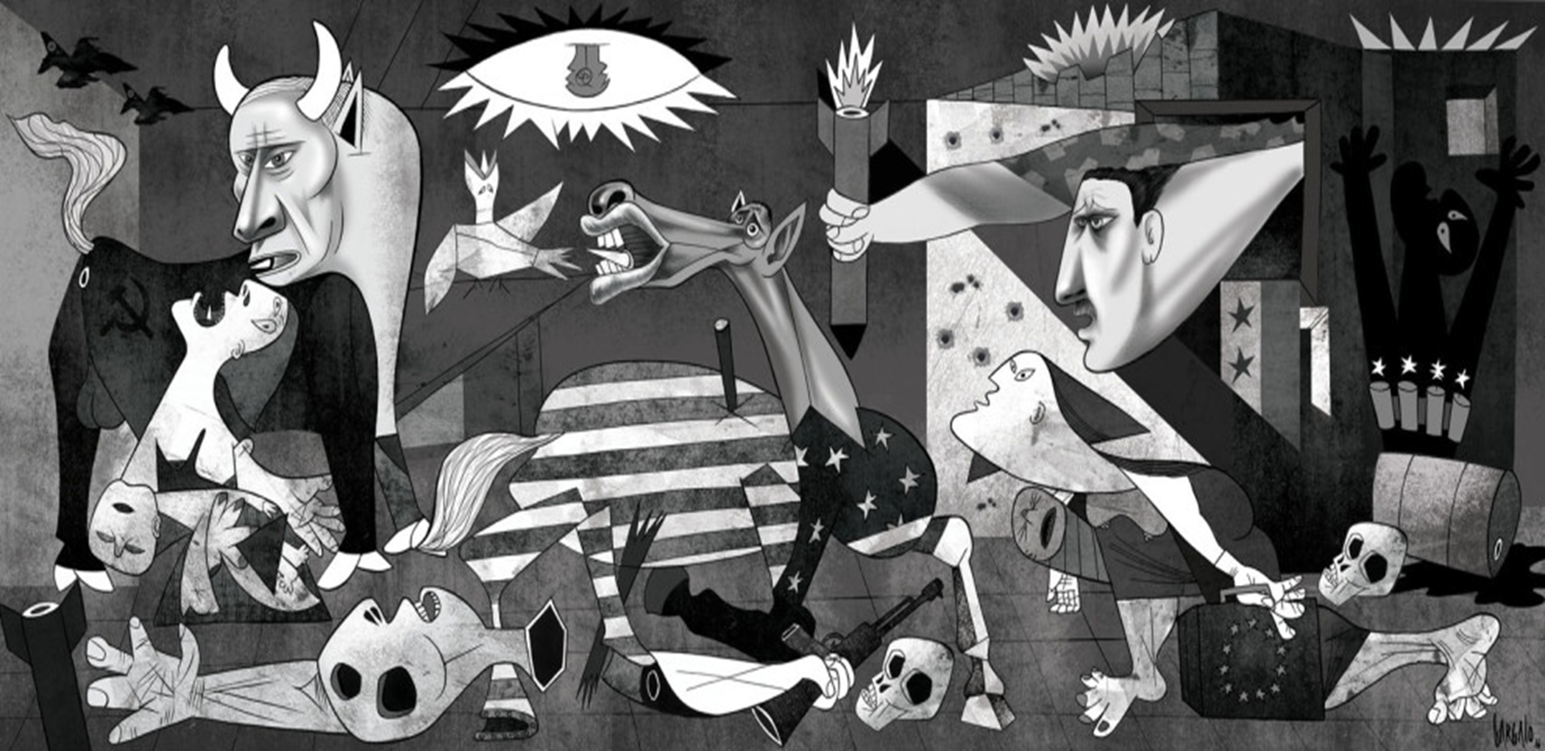
Alepponica, 2016
By Portuguese cartoonist Vasco Gargalo

Slide 77
CHRONOLOGY The Authoritarian States: Eastern Europe
Event | Dates
Pilsudski creates military dictatorship in Poland | 1926
Alexander I creates royal dictatorship in Yugoslavia | 1929
Gömbös is made prime minister in Hungary | 1932
Dictatorship of General Metaxas in Greece | 1936
Carol II crushes Iron Guard and imposes authoritarian rule in Romania | 1938
p816
Notes:
CHRONOLOGY The Authoritarian States

Slide 78
CHRONOLOGY The Authoritarian States: Eastern Europe: Spain
Event | Dates
Dictatorship of Primo de Rivera | 1923–1930
Creation of Spanish Republic | 1931
Spanish Civil War | 1936–1939
Dictatorship of Franco | 1939–1975

Slide 79
Expansion of Mass Culture and Mass Leisure
The Roaring Twenties
  Exuberant popular culture of dancing and music
    Jazz Age
Radio and Movies
  New broadcasting facilities, radio production, and mass audiences
  The popularity of movies
  Immediate shared experiences
    Used for political purposes
      Triumph of the Will, 1934

Slide 80

The Charleston
Dancing became the rage during the Roaring Twenties, and the Charleston was the most popular and enduring dance of the decade.
p818
Notes:
The Charleston. Dancing became the rage during the Roaring
Twenties, and the Charleston was the most popular and enduring dance
of the decade. This photograph shows a couple dancing the Charleston
in a scene from the London musical Just a Kiss in 1926.

Slide 81
Mass Leisure
Sports
Tourism
  Commercial air service
Organized Mass Leisure in Italy and Germany
  National recreation agencies
    Kraft durch Freude in Germany
  Increase in the homogeneity of national populations

Slide 82

Film & History: Triumph of the Will (1934)
A scene from Triumph of the Will showing one of the many mass rallies at Nuremberg.
p819
Notes:
A scene from Triumph of the Will showing one of the many mass rallies at Nuremberg.

Slide 83
Cultural and Intellectual Trends in the Interwar Years
The Impact of World War I
  Greater acceptance of prewar avant-garde ideas, previously considered shocking.
  Belief that humans are violent and irrational is validated by the war
  Enhanced by Great Depression and rise of fascism and totalitarianism, anxiety and uncertainty.
  War broke down traditional attitudes, especially about women.
    Changes in fashion and attitudes about sex
    New definition of “feminine”; no more corsets!

Slide 84
Cultural and Intellectual Trends
Nightmares and New Visions: Art and Music
  German Expressionists
    The horrors of war-
    Kathe Kollwitz, George Grosz, Otto Dix
  The Dada Movement
    “Anti-art” meant to shock and disturb viewers
    Tries to represent purposelessness of life.
    Tristan Tzara (1896 – 1945)
  Surrealism
    Seeks reality beyond the material, sensible world
    Made of unconscious, fantasies, dreams, nightmares
    Disturbing, evocative images; makes the irrational tangible. Forces us to question reality.
    Salvador Dali (1904 – 1989)

Slide 85

Hannah Hoch, Cut with the Kitchen Knife Dada Through the Last Weimar Beer Belly Cultural Epoch of Germany
Hannah Hoch, a prominent figure in the postwar Dada movement, used photomontage to create images that reflected on women’s issues.
p821
Notes:
Hannah Hoch, Cut with the Kitchen Knife Dada Through the
Last Weimar Beer Belly Cultural Epoch of Germany. Hannah
Hoch, a prominent figure in the postwar Dada movement, used
photomontage to create images that reflected on women’s issues. In Cut
with the Kitchen Knife (1919), she combined pictures of German political
leaders with sports stars, Dada artists, and scenes from urban life. One
major theme emerged: the confrontation between the anti-Dada world
of German political leaders and the Dada world of revolutionary ideals.
Hoch associated women with Dada and the new world.

Slide 86

Salvador Dali, The Persistence of Memory
Surrealism was another important artistic movement between the
wars. Influenced by the theories of Freudian psychology, Surrealists sought to reveal the world of the unconscious, or the ‘‘greater reality’’ that they believed existed beyond the world of physical appearances.
p821
Notes:
Salvador Dali, The Persistence of
Memory. Surrealism was another
important artistic movement between the
wars. Influenced by the theories of
Freudian psychology, Surrealists sought to
reveal the world of the unconscious, or
the ‘‘greater reality’’ that they believed
existed beyond the world of physical
appearances. As is evident in this 1931
painting, Salvador Dalı´ sought to portray
the world of dreams by painting
recognizable objects in unrecognizable
relationships.

Slide 87
Cultural and Intellectual Trends in the Interwar Years
Functionalism in Modern Architecture
  Buildings should be functional, with less adornment.
      Unify art and engineering
    The Chicago School in the U.S. : Louis H. Sullivan and Frank Lloyd Wright
  Bauhaus School in Germany- est. 1919
A Popular Audience
  Involvement of artists in new mass culture
  Put studios in working-class neighborhoods; idea that art can help society
  Some denounced modern art as “degenerate”

Slide 88
Cultural and Intellectual Trends
Culture of Nazism
  Nazis hated modern art and music
  Artists and writers were under the control of the state- art had to glorify the state.
Ernst Jünger: The Storm of Steel
  Rejection of “degenerate” or “Jewish” art
    Confiscated and destroyed thousands of paintings, even by Van Gogh and Picasso
    Brought back Romanticism style of the 19th century- glorifying every day simple life and patriotic history.
A New Style in Music
  Arnold Schönberg (1874 – 1951)

Slide 89

Walter Gropius, The Bauhaus
Walter Gropius was one of Europe’s pioneers in modern architecture. When the Bauhaus moved to Dessau in 1925, Gropius designed a building for its activities.
p822
Notes:
Walter Gropius, The Bauhaus. Walter Gropius was one of Europe’s
pioneers in modern architecture. When the Bauhaus moved to Dessau in
1925, Gropius designed a building for its activities. His straightforward
use of steel, reinforced concrete, and rows of windows reflects the move
to functionalism in modern architecture.

Slide 90
The Search for the Unconscious
Literature
  “Stream-of-consciousness”
    The Great Gatsby and Catcher in the Rye
  James Joyce (1882 – 1941)
    Ulysses
  Hermann Hesse (1877 – 1962)
Psychology: Carl Jung (1856 – 1961)
  Continuing impact of Freud
  Goal: a higher state of consciousness
    The “personal unconscious” and the “collective unconscious”

Slide 91
The “Heroic Age of Physics”
Continuation of the Prewar Revolution
  Ernest Rutherford (1871 – 1937)
    Splitting the atom
  Werner Heisenberg (1901 – 1976)
    The “uncertainty principle”

Slide 92

Chapter Timeline
p824

Slide 93
Discussion Questions
What were the causes of the Great Depression?
What did France feel it needed for security after the Great War? How did this affect Germany?
What were the characteristics of Nazi Germany?
What were the characteristics of Stalin’s Soviet Union?
Describe the art trends of this period. What were the lasting effects of these trends?
How did totalitarian governments manipulate art?

