Slide 1
The Deepening of the European Crisis: World War II
Chapter 27

Slide 2
Focus Questions
​What were Hitler’s foreign policy goals, and what steps did he take to achieve them between 1933 and 1939? How did Japan’s policies lead to war in Asia?
​What were the major events of World War II in Europe and in Asia, and why were the Allies ultimately victorious?
​How was the Nazi empire organized? What was the Holocaust, and what was the relationship between Hitler’s worldview, his foreign policy, and the Holocaust?
​What were conditions like on the home front for Japan and the major Western nations involved in World War II?
​What were the costs of World War II? How did the Allies’ visions of postwar Europe differ, and how did these differences contribute to the emergence of the Cold War?

Slide 3
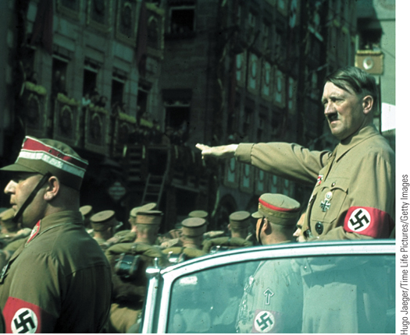
Adolf Hitler salutes soldiers marching in Nuremberg during the party rally in 1938
p827
Notes:
Adolf Hitler salutes soldiers marching in Nuremberg during the party rally in
1938.

Slide 4
Prelude to War (1933-1939)
The Role of Hitler
The doctrine of Lebensraum
The proper conditions and strategies of expansion
The “Diplomatic Revolution” (1933-1936)
German rearmament, 1935
Repudiation of disarmament clauses of Treaty of Versailles
New air force, new military draft
Occupation of the Rhineland, 1936
Appeasement based on justification of German actions.
Hitler seemed “reasonable” in light of injustice of Versailles!

Slide 5
Prelude to War 1933-1939
New Alliances
Rome-Berlin Axis, October 1936
Mussolini’s invasion of Ethiopia- 1935
Spanish Civil War- 1936 Guernica
Anti-Comintern Pact between Germany and Japan, November 1936 to fight Soviet influence in Asia
ComIntern = “Communist International” or “Third International”- Communist org founded by Lenin that advocated world communist revolution.
Hitler saw appeasement as weakness and took advantage of West’s desperate desire for peace.

Slide 6
Prelude to War
The Path to War (1937-1939)
Ongoing rearmament
Preparations for blitzkrieg (“lightning war”)
Panzer divisions and the Luftwaffe
Union with Austria, 1938
Anschluss: union of Austria and Germany
staged a phony election in Austria to make it seem that Austrians had invited Hitler to annex Austria.
Czechoslovakia
Demands for the Sudetenland, September 1938
Appeasement: the Munich Conference, September 29, 1938
Neville Chamberlain (1869 – 1940)
German dismemberment of Czechoslovakia

Slide 7
The Anschluss “Ballot”
It reads: “Do you agree with the reunification of Austria with the
German Reich enacted on March 13 and do you vote for the party of our leader Adolf Hitler?”
Result was 99.7% Austrians voted “Yes” for “Greater Germany”

Slide 8
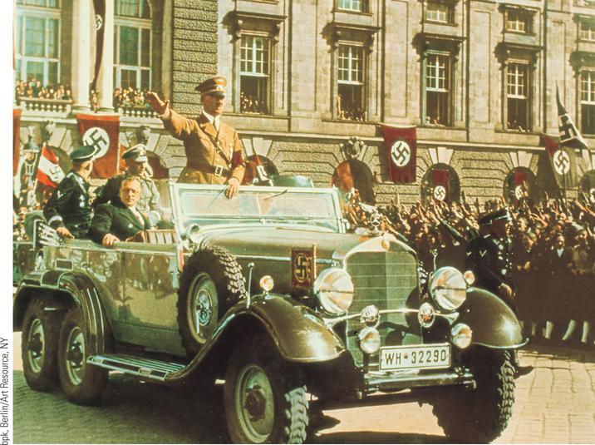
Hitler Arrives in Vienna
By threatening to invade Austria, Hitler forced the Austrian government to capitulate to his wishes.
p831
Notes:
Hitler Arrives in Vienna. By threatening
to invade Austria, Hitler forced the Austrian
government to capitulate to his wishes.
Austria was annexed to Germany. Shown
here is the triumphal arrival of Hitler in
Vienna on March 13, 1938. Sitting in the car
beside Hitler is Arthur Seyss-Inquart,
Hitler’s new handpicked governor of
Austria.

Slide 9
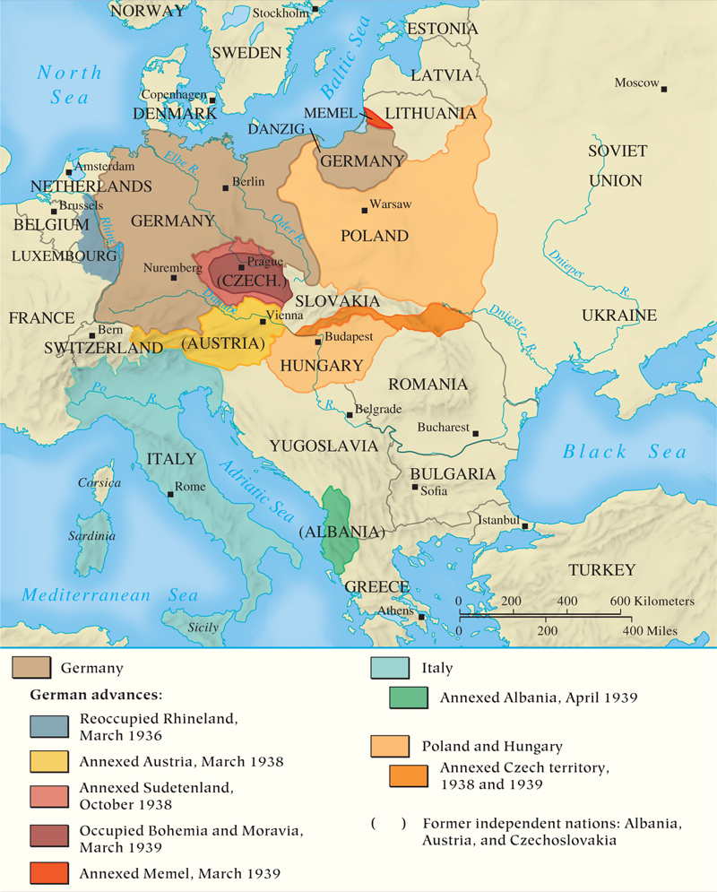
MAP 27.1 Changes in Central Europe, 1936-1939
Map 27.1 p832
Notes:
MAP 27.1 Changes in Central Europe, 1936–1939. Hitler’s main objectives in the late 1930s were
the reoccupation of the Rhineland, the incorporation into a greater Germany of lands that contained
German people (Austria and the Sudetenland), and the acquisition of Lebensraum (living space) in
eastern Europe for the expansion of the German people.

Slide 10
Neville Chamberlain after the Munich Conference, Sept 1938

Slide 11
Prelude to War, 1933-1939
Poland
Hitler demands return of Danzig, and finally the Allies realize the danger.
France and Britain realize they need Stalin’s help and begin negotiations with him.
Nonaggression pact with the Soviet Union, August 23, 1939.
Takes the whole world by surprise
Established spheres of influence for Germany and USSR and gives Hitler freedom to attack Poland.
September 1- Hitler invades Poland
September 3- Britain and France declare war on Germany
Sep 17- USSR invades eastern Poland.

Slide 12
The Nazi-Soviet Pact, 1939

Slide 13
The Nazi-Soviet Pact

Slide 14
The Nazi-Soviet Pact

Slide 15
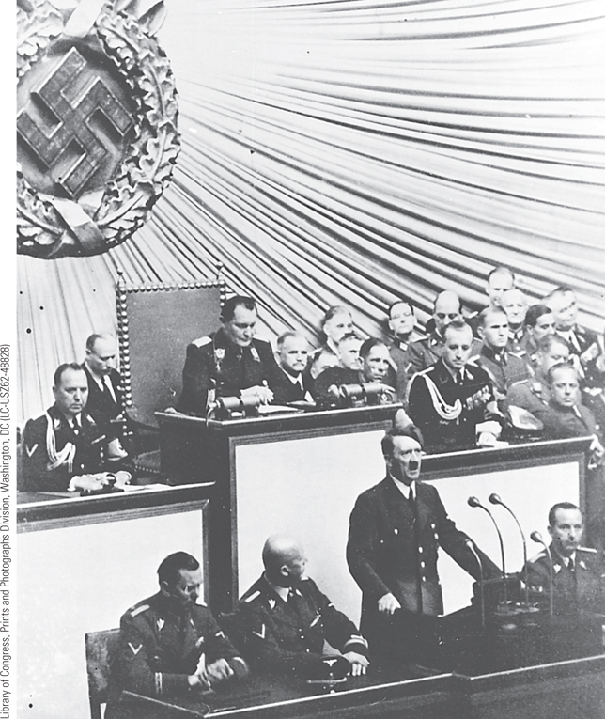
Hitler Declares War
Adolf Hitler believed that it was necessary for Germany to gain living space through conquest in the east. This policy meant war.
p834
Notes:
Hitler Declares War. Adolf Hitler believed that it was necessary for Germany to gain
living space through conquest in the east. This policy meant war. Hitler’s nonaggression
pact with the Soviet Union on August 23, 1939, paved the way for his invasion of Poland
on September 1. On that day, Hitler spoke to the German Reichstag and announced the
outbreak of war.

Slide 16
The Path to War in Asia
Rise of the Japanese
Imperial strength and weakness
Acquisition of Korea, Formosa, Manchuria, and the Marshall, Caroline, and Mariana islands
Internal tensions, economic crises, and right-wing patriotism
Japanese goals in East Asia
Military strategy targeting China
Japanese seizure of Manchuria, 1931
Chiang Kai-shek (1887 – 1975)
Seizure of Nanjing, 1937
Cooperation with Nazi Germany

Slide 17
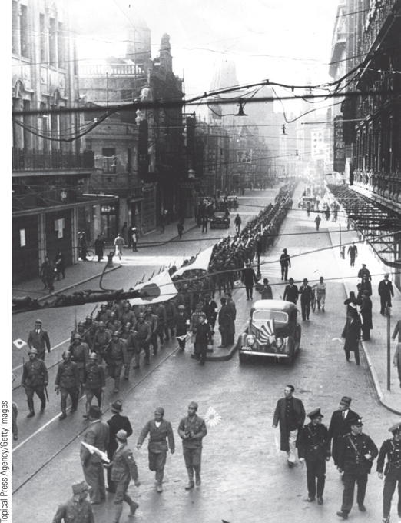
A Japanese Victory March in China
After consolidating its authority over Manchuria, Japan began to expand into northern China.
p835
Notes:
A Japanese Victory March in China. After consolidating its
authority over Manchuria, Japan began to expand into northern China.
Direct hostilities between Japanese and Chinese forces began in 1937.
This photograph shows a Japanese victory march in Shanghai at the
beginning of December 1937. By 1939, Japan had conquered most of
eastern China.

Slide 18
CHRONOLOGY Prelude to War, 1933–1939 (Slide 1 of 2)
Event | Dates
Japan seizes Manchuria | 1931 (September)
Hitler becomes chancellor | 1933 (January 30)
Hitler announces a German air force | 1935 (March 9)
Hitler announces military conscription | 1935 (March 16)
Anglo-German Naval Pact | 1935 (June 18)
Mussolini invades Ethiopia | 1935 (October)
Hitler occupies demilitarized Rhineland | 1936 (March 7)
Mussolini and Hitler intervene in the Spanish Civil War | 1936
Rome-Berlin Axis | 1936 (October)
Anti-Comintern Pact (Japan and Germany) | 1936 (November)
Japan invades China | 1937
p835
Notes:
CHRONOLOGY Prelude to War, 1933–1939

Slide 19
CHRONOLOGY Prelude to War, 1933–1939 (Slide 2 of 2)
Event | Dates
Germany annexes Austria | 1938 (March 13)
Munich Conference: Germany occupies Sudetenland | 1938 (September 29)
Germany occupies the rest of Czechoslovakia | 1939 (March)
German-Soviet Nonaggression Pact | 1939 (August 23)
Germany invades Poland | 1939 (September 1)
Britain and France declare war on Germany | 1939 (September 3)
Soviet Union invades Poland | 1939 (September 17)

Slide 20
The Course of World War II
Victory and Stalemate
Dismemberment of Poland within four weeks
Hitler’s attack in the west
“Phony War”, winter 1939-1940
Germany resumes offensive
Attacks on Denmark, Norway, Netherlands, Belgium, and France, April-May 1940
Evacuation of Dunkirk
Surrender of France, June 22, 1940
Establishment of the Vichy regime
Marshal Henri Pétain (1856 – 1951)

Slide 21
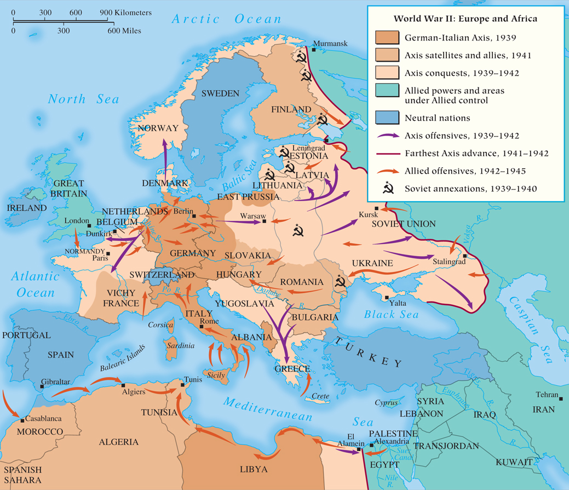
MAP 27.2 World War II in Europe and North Africa
Map 27.2 p837
Notes:
MAP 27.2 World War II in Europe and North Africa. With its fast and effective military, Germany
quickly overwhelmed much of western Europe. Hitler had overestimated his country’s capabilities,
however, and underestimated those of his foes. By late 1942, his invasion of the Soviet Union was
failing, and the United States had become a major factor in the war. The Allies successfully invaded Italy
in 1943 and France in 1944.

Slide 22
The Course of World War II (Slide 2 of 2)
The Problem of Britain
New leadership: Winston Churchill (1874 – 1965)
Battle of Britain, August-September 1940
Failure of the German Luftwaffe to weaken Britain for invasion
Possibility of a Mediterranean strategy
Invasion of the Soviet Union
Attack launched, June 22, 1941
Soviet resistance and counterattacks stalls the German offensive, December 1941

Slide 23
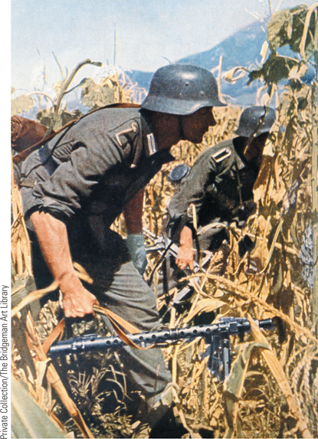
German Troops in the Soviet Union (Slide 1 of 2)
This photo shows German troops advancing by foot.
p838
Notes:
German Troops in the Soviet Union. At first, the German attack on the Soviet
Union—known as Operation Barbarossa—was enormously successful, leading one German
general to remark in his diary: ‘‘It is probably no overstatement to say that the Russian
campaign has been won in the space of two weeks.’’ This photo shows German troops
advancing by foot.

Slide 24
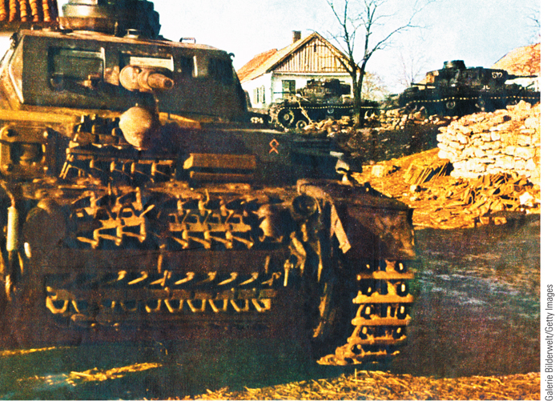
German Troops in the Soviet Union (Slide 2 of 2)
This photo shows German troops advancing by tank in the Soviet Union.
p838
Notes:
German Troops in the Soviet Union. At first, the German attack on the Soviet
Union—known as Operation Barbarossa—was enormously successful, leading one German
general to remark in his diary: ‘‘It is probably no overstatement to say that the Russian
campaign has been won in the space of two weeks.’’ This photo shows German troops
advancing by tank in the Soviet Union.

Slide 25
The War in Asia
The End of American Isolationism
Japan’s assault on Pearl Harbor and the Philippines creates global war
Japanese advances, spring 1942
Establishment of the Great East Asia Co-Prosperity Sphere
Attacks galvanized American opinion in support for war

Slide 26
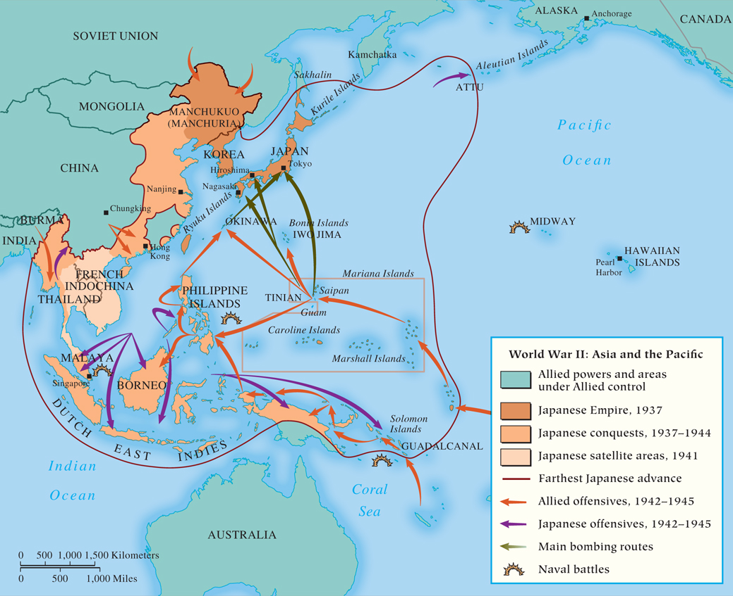
MAP 27.3 World War II in Asia and the Pacific
Map 27.3 p839
Notes:
MAP 27.3 World War II in Asia and the Pacific. In 1937, Japan invaded northern China, beginning
its effort to create a ‘‘Great East Asia Co-Prosperity Sphere.’’ Further Japanese expansion caused the
United States to end iron and oil sales to Japan. Deciding that war with the United States was
inevitable, Japan engineered a surprise attack on Pearl Harbor.

Slide 27
Turning Point of War, 1942-1943
The Grand Alliance versus the Axis Powers
Defeat of Germany the first priority
Military aid to Russia and Britain
Allies ignore political differences
Agree on unconditional surrender
Allied victory in Africa, 1943
Battle of Stalingrad
Devastation and deprivation, winter 1942-1943
German surrender, February 1943
Battle of Midway, June 4, 1942
Turning the tide in Asia
American advances across the Pacific
Mid-1943: Allies begin to win the Battle of the North Atlantic

Slide 28
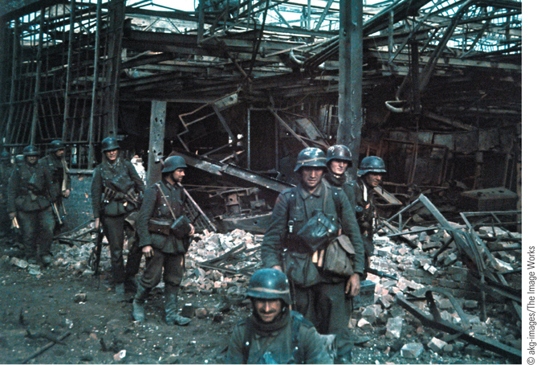
The Battle of Stalingrad (Slide 1 of 2)
Shown in the photograph is a German infantry platoon in the ruins of a
tractor factory they had captured in the northern part of Stalingrad.
p840
Notes:
The Battle of Stalingrad. The Battle of Stalingrad was a major turning point on the
Eastern Front. Shown in the photograph is a German infantry platoon in the ruins of a
tractor factory they had captured in the northern part of Stalingrad. This victory took place
on October 15, 1942, at a time when Hitler still believed he was winning the battle for
Stalingrad. That belief was soon dashed as a Soviet counteroffensive in November led to a
total defeat for the Germans.

Slide 29
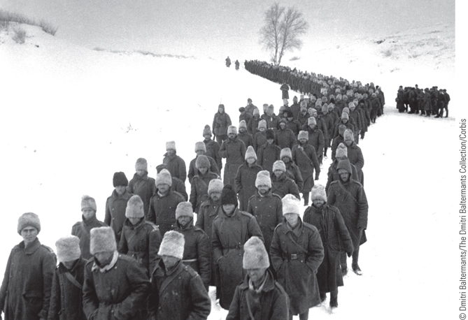
The Battle of Stalingrad (Slide 2 of 2)
The photograph shows thousands of captured soldiers being marched across frozen Soviet soil to prison camps.
p840
Notes:
The Battle of Stalingrad. The Battle of Stalingrad was a major turning point on the
Eastern Front. The photograph shows thousands of captured soldiers
being marched across frozen Soviet soil to prison camps. The soldiers in white fur hats are
Romanian. Fewer than 6,000 captured soldiers survived to go home; the remainder—almost
85,000 prisoners—died in captivity.

Slide 30
The Last Years of the War
Allied Advances in the West
Invasion of Italy, September 1943
Fall of Rome, June 4, 1944
D-Day invasion of France, June 6, 1944
Five assault divisions land on Normandy beaches
Advance into Germany
Soviet Offensive in the East
Battle of Kursk, July 5-12, 1943
Advances in eastern Europe, 1944-1945
Hitler’s suicide and German surrender
Defeat of Japan
Battle of Leyte Gulf in the Philippines: largest naval battle of World War II.
Surrender after atomic bombs on Nagaski and Hiroshima, August 1945

Slide 31
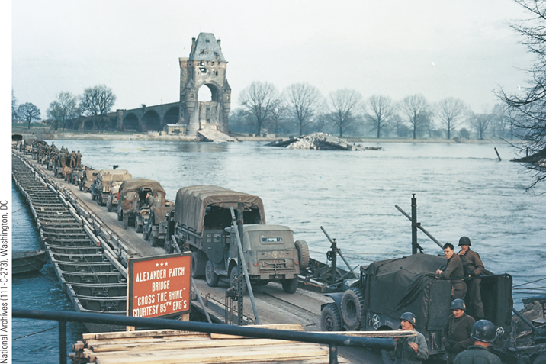
Crossing the Rhine
After landing at Normandy, Allied forces liberated France and prepared to move into Germany.
p842
Notes:
Crossing the Rhine. After landing at
Normandy, Allied forces liberated France
and prepared to move into Germany.
Makeshift bridges enabled the Allies to cross
the Rhine in some areas and advance deeper
into Germany. Units of the U.S. Seventh
Army of General Patch are shown here
crossing the Rhine at Worms on a pontoon
bridge constructed by battalions of
engineers alongside the ruins of the old
bridge.

Slide 32
CHRONOLOGY World War II (Slide 1 of 2)
Event | Dates
Germany and the Soviet Union divide Poland | 1939 (September)
Blitzkrieg against Denmark and Norway | 1940 (April)
Blitzkrieg against Belgium, Netherlands, and France | 1940 (May)
Churchill becomes British prime minister | 1940 (May 10)
France surrenders | 1940 (June 22)
Battle of Britain | 1940 (Summer)
Nazi seizure of Yugoslavia and Greece | 1941 (April)
Germany invades the Soviet Union | 1941 (June 22)
Japanese attack on Pearl Harbor | 1941 (December 7)
Battle of the Coral Sea | 1942 (May 7–8)
Battle of Midway Island | 1942 (June 4)
p843
Notes:
CHRONOLOGY World War II

Slide 33
CHRONOLOGY World War II (Slide 2 of 2)
Event | Dates
Allied invasion of North Africa | 1942 (November)
Soviets win Battle of Stalingrad | 1943 (February 2)
Axis forces surrender in North Africa | 1943 (May 13)
Battle of Kursk | 1943 (July 5–12)
Invasion of mainland Italy | 1943 (September)
Allied invasion of France | 1944 (June 6)
Hitler commits suicide | 1945 (April 30)
Germany surrenders | 1945 (May 7)
Atomic bomb dropped on Hiroshima | 1945 (August 6)
Japan surrenders | 1945 (August 14)

Slide 34
The Nazi New Order
The Nazi Empire
Organization
Some areas made into German provinces
Most occupied and administered by Germans
Racial considerations for the Nazi New Order
Plans for an Aryan racial empire
Brutality of the plans for the East
Evacuation of “inferior peoples,” colonization by ethnic Germans
Economic exploitation
Use of foreign workers
Forced labor to address German labor shortages
Cause of resistance of Nazi occupation forces

Slide 35
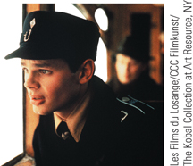
Film & History: Europa Europa (1990)
Salomon Perel/Josef Peters (Marco Hofschneider) as a Hitler Youth member.
p846
Notes:
Salomon Perel/Josef Peters (Marco Hofschneider) as a Hitler
Youth member.

Slide 36
Resistance Movements
Nazi-Occupied Europe
Sabotage, espionage, and anti-Nazi sentiments at home, governments-in-exile abroad
Charles de Gaulle’s Free French movement
Josip Broz and guerilla warfare in Yugoslavia
Communist leadership
Women’s roles
Germany
The White Rose movement
Repression by the Gestapo
Colonel Count Claus von Stauffenberg’s failed assassination attempt, July 1944

Slide 37
The Holocaust (Slide 1 of 2)
Early Nazi Policy
First focused on emigration
The SS and the Einsatzgruppen
The Final Solution: annihilation of the Jewish people
Leadership under Reinhard Heydrich (1904 – 1942)
From concentration in ghettos to death squads; 1 million Jews dead

Slide 38
The Holocaust (Slide 2 of 2)
Death camps
Plans for systematic extermination (in operation by spring 1942)
Jews to be shipped to camps in Poland, executed by Zyklon B gas, and burned in crematoria
Largest center at Auschwitz-Birkenau
Resulted in death of nearly 2 out of 3 European Jews (5 to 6 million)
The Other Holocaust
Death of at least another 9 to 10 million people
Targeting European Gypsies, “subhuman” Slavic peoples, and homosexuals
Death through slave labor
Prisoners of war

Slide 39
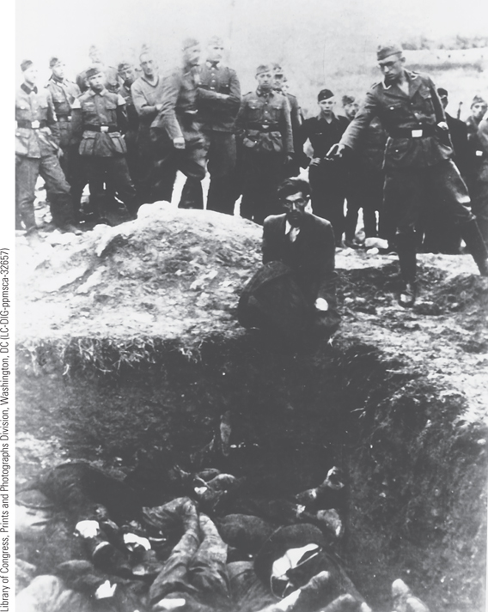
The Holocaust: Activities of the Einsatzgruppen
The activities of the mobile killing units known as the Einsatzgruppen were the first stage in the mass killings of the Holocaust.
p847
Notes:
The Holocaust: Activities of the Einsatzgruppen. The activities of the
mobile killing units known as the Einsatzgruppen were the first stage in the
mass killings of the Holocaust. This picture shows a soldier of Einsatzgruppe D
about to shoot a Jew kneeling in front of a mass grave in Ukraine. Onlookers
include members of the German army, the German Labor Service, and even
Hitler Youth. When it became apparent that this method of killing was
inefficient, it was replaced by the death camps.

Slide 40
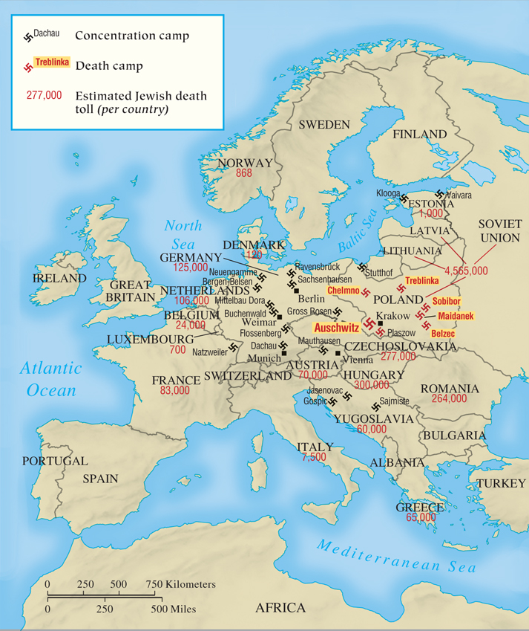
MAP 27.4 The Holocaust
Map 27.4 p848
Notes:
MAP 27.4 The Holocaust. Hitler used the fiction of the Aryan race, to which Germans
supposedly belonged, to help radicalize the German people and justify his hatred of Jews.
Hitler’s ‘‘Final Solution’’ to the ‘‘Jewish problem’’ was the mass execution of Europe’s Jews in
death camps.

Slide 41
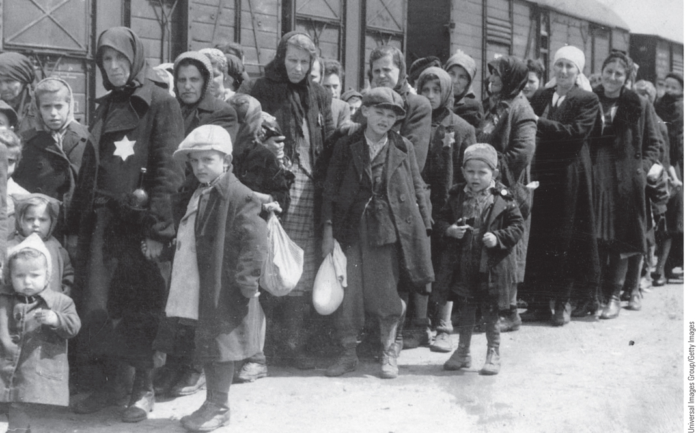
The Holocaust: The Extermination Camp at Auschwitz
After their initial successes in the east, Hitler and the Nazis set in motion the machinery for the physical annihilation of Europe’s Jews.
p849
Notes:
The Holocaust: The Extermination Camp at Auschwitz. After their initial successes in the east,
Hitler and the Nazis set in motion the machinery for the physical annihilation of Europe’s Jews. Shown here
is a group of Jews arriving at Auschwitz. It is estimated that 1.1 million people (90 percent of them Jews)
were killed there.

Slide 42
The New Order in Asia
Great East Asia Co-Prosperity Sphere
“Asia for the Asians”
Exploitation of resources
Subjection of people to severe hardships
Japanese Occupation
Korean “comfort women”
800,000 Korean forced laborers
Constructed Burma-Thailand railway

Slide 43
The Home Front
Mobilization of Peoples
Great Britain
55 percent of the people were in ‘‘war work”
By 1944, women held 50 percent of the civil service positions
“Dig for Victory” campaign
Emphasis on a planned economy
Acceptance of increased government interference
The Soviet Union
Enormous losses and sacrifice of Soviet people
Emergency mobilization
Soviet women
Combatants and laborers

Slide 44
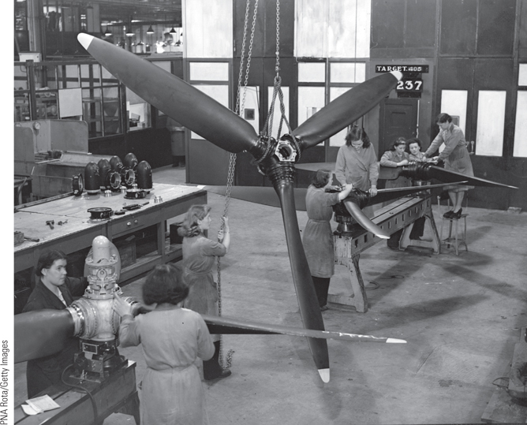
Women in the Factories (Slide 1 of 2)
Although only the Soviet Union used women in combat positions, the number of women working in industry increased dramatically in most belligerent countries.
p851
Notes:
Women in the Factories. Although only the Soviet Union used women in combat
positions, the number of women working in industry increased dramatically in most
belligerent countries. British women are shown here in a factory building Beaufort
fighter planes for the British air force in 1940.

Slide 45
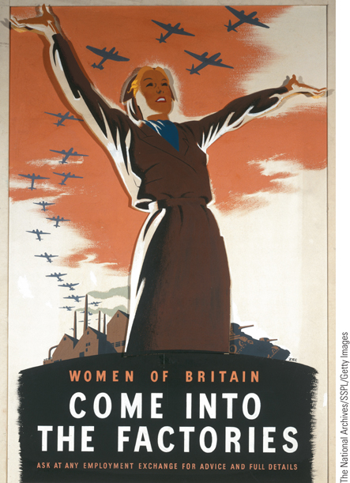
Women in the Factories (Slide 2 of 2)
Pictured is a propaganda poster encouraging women to work in the factories.
p851
Notes:
Women in the Factories. Although only the Soviet Union used women in combat
positions, the number of women working in industry increased dramatically in most
belligerent countries. Pictured is a propaganda poster
encouraging women to work in the factories.

Slide 46
The Mobilization of Peoples
The United States
Impact of mobilization
Economic and social gains and problems
Civil rights issues and tensions: African-Americans and Japanese Americans
Germany
Problematic economic policies
Continued production of consumer goods
Plunder from conquered countries
Albert Speer and rising armaments production
Total mobilization not authorized until 1944
Japan
Highly mobilized society
Values: bushido and kamikaze

Slide 47
Civilians on the Front Line: The Bombing of Cities
Luftwaffe Attacks
The Blitz in Britain
The Bombing of Germany
Allied bombing raids on German cities
Targeted American daytime bombing
Devastation of Hamburg and Dresden
Success and failure of bombing raids
The Bombing of Japan: the Atomic Bomb
Hiroshima, August 6, 1945
Nagasaki, August 9, 1945

Slide 48
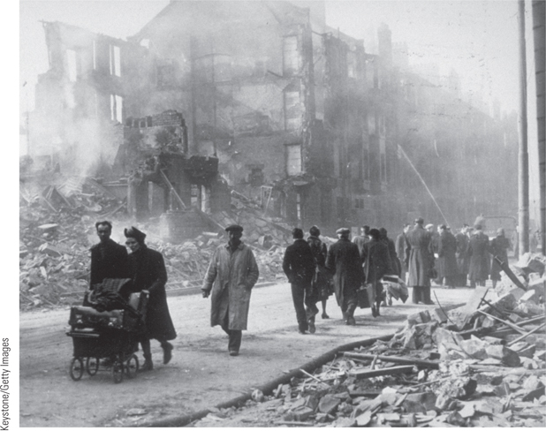
Global Perspectives: The Impact of Total War in West and East (Slide 1 of 3)
Refugees walk past a bombed tenement building, where 800 people died and 800 more were injured during a German bombing raid on Clydebank near Glasgow in Scotland in March 1941.
p855
Notes:
The Impact of Total War

Slide 49
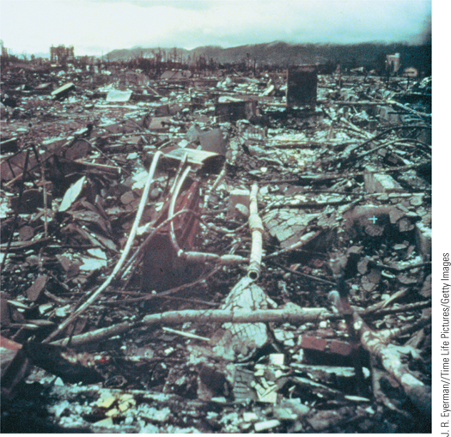
Global Perspectives: The Impact of Total War in West and East (Slide 2 of 3)
The most devastating destruction of civilians came near the end of the war when the United States dropped atomic bombs on the Japanese cities of Hiroshima and Nagasaki.
p855
Notes:
The Impact of Total War

Slide 50
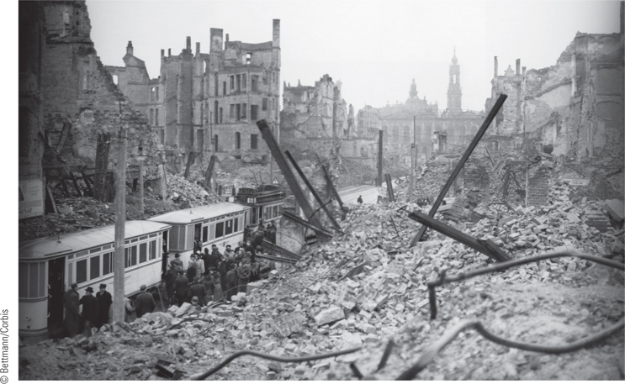
Global Perspectives: The Impact of Total War in West and East (Slide 3 of 3)
The photo shows devastation in Dresden, Germany, as a result of British and American bombing raids on February 13 and 14, 1945.
p855
Notes:
The Impact of Total War

Slide 51
Focus Question: The Conferences CCOT
What developments led to the changing relationship between the Soviet Union and the West from the Tehran Conference in 1943 to the Potsdam Conference in 1945?
In what way was the Cold War already originating before the end of World War II?

Slide 52
Aftermath of the War
The Costs of World War II
Loss of human life: 21 million soldiers and 40 million civilians dead
Displacement of 30 million people
Physical devastation; cost of $4 trillion
The Impact of Technology
Relationship between science and technology
Robert Oppenheimer and the atomic bomb
The Allied War Conferences
The Conference at Tehran, November 1943
Future course of the war, invasion of the continent for 1944
Agreement for the partition of postwar Germany

Slide 53
Aftermath of the War
The Allied War Conferences
The Conference at Tehran, November 1943
Future course of the war, invasion of the continent for 1944
Planned Operation Overlord and D-Day
Agreed on British and American invasion through France
This meant that a) they would open another front against Hitler, which Stalin had been asking for; and b) British, Americans, and Soviets would meet in the middle- Germany
Agreement for the partition of postwar Germany
Didn’t mention Poland (to avoid awkward tension)
Everyone left feeling pretty good about the direction of the war.

Slide 54
Film & History: The Imitation Game (2014)
Alan Turing in the Imitation Game
p856
Notes:
Alan Turing in the Imitation Game

Slide 55
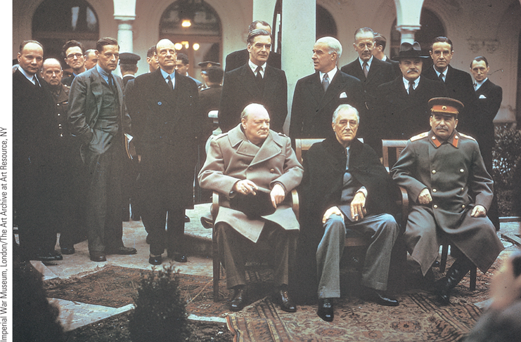
The Victorious Allied Leaders at Yalta
Even before World War II ended, the leaders of the Big Three of the Grand
Alliance, Churchill, Roosevelt, and Stalin (seated, left to right), met in wartime conferences to plan the final assault on Germany and negotiate the outlines of the postwar settlement.
p857
Notes:
The Victorious Allied Leaders at
Yalta. Even before World War II ended,
the leaders of the Big Three of the Grand
Alliance, Churchill, Roosevelt, and Stalin
(seated, left to right), met in wartime
conferences to plan the final assault on
Germany and negotiate the outlines of the
postwar settlement. At the Yalta meeting
(February 5–11, 1945), the three leaders
concentrated on postwar issues. The
American president, who died two
months later, was already a worn-out man
at Yalta.

Slide 56
Aftermath of the War
The Allied War Conferences
The Yalta Conference, February 1945
Distrust between Stalin and Roosevelt/Churchill
Stalin wants a “buffer zone”, a sphere of influence in Eastern Europe, and key resources.
Approval of FDR’s “Declaration on Liberated Europe”
American concerns:
Soviet military assistance for the war against Japan
*The atomic bomb had not yet been assured.*
Creation of a United Nations
Agreement on German surrender and partition
Free elections in Eastern Europe
Compromise on Poland:
Provisional Gov between Soviet (Communist) Poles and London non-Communist Poles.
CREATION OF THE UNITED NATIONS

Slide 57
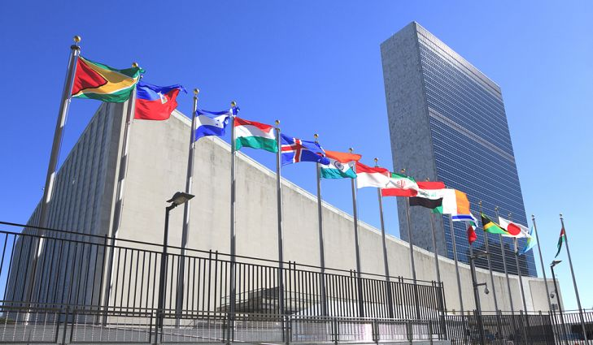
The United Nations
Established in San Francisco
Headquarters in New York City
Security Council: all 5 victorious nations
USA, Britain, France, USSR/Russia, China
General Assembly: Today- 193 nations

Slide 59
Aftermath of the War
Intensifying differences
Deteriorating relations with the Soviets once Germany was actually defeated.
USSR was angry that the US ignored their request for aid; believed it was an effort to weaken the USSR.
USA was angry that the Soviets helped install a “Stalin-ish” government in Romania.
Then Soviets arrested the London non-Communist Poles and est. a puppet communist regime in Poland.

Slide 60
The Aftermath of the War
The Potsdam Conference, July 1945
Growing problems among the Allies
Roosevelt replaced by Harry Truman
While at the conference, Truman receives report about successful testing of the atomic bomb.
Truman becomes more resolved to resist Soviet power in Eastern Europe.
Truman demands free elections in Eastern Europe.
Stalin: “NO!”
No one wanted another war.
Agreed to unconditional surrender of Japan
Agreed to divide Germany into 4 sectors: American, British, French, and Soviet

Slide 61
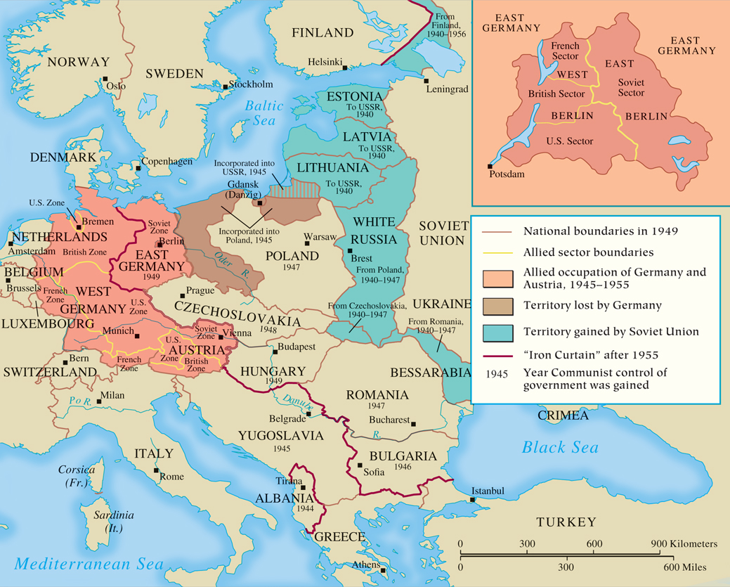
MAP 27.5 Territorial Changes After World War II
Map 27.5 p858
Notes:
MAP 27.5 Territorial Changes After World War II. In the last months of World War II, the Red Army
occupied much of eastern Europe. Stalin sought pro-Soviet satellite states in the region as a buffer
against future invasions from western Europe, whereas Britain and the United States wanted
democratically elected governments. Soviet military control of the territory settled the question.

Slide 63
August of 1945
At Potsdam (July 26), Truman warns Japan of heavy devastation and “ruinous fire from the air” if they do not surrender.
Why might Japan reject this warning?
August 6: U.S. drops 1st bomb on Hiroshima
August 8: USSR declares war on Japan, invades Manchuria.
Why is this significant??
August 9: U.S. drops 2nd bomb on Nagasaki.
August 14: Japan surrenders.

Slide 64
Chapter Timeline
p860

Slide 65
Discussion Questions
What steps did Hitler take to conquer Britain?
Why did Hitler abandon the fight for Britain and turn toward Russia?
What seemed to have been the causes of Soviet suspicions about Britain and the US throughout the war? Give examples.
How were conquered or occupied peoples treated by the Germans during the war? Give examples.
How did each country mobilize the home front for the war effort?
How and why did the peace settlement give way to the tensions that initiated the Cold War?

