Slide 1
Cold War and a New Western World,
1945–1965
Chapter 28

Slide 2
Focus Questions
​Why were the United States and the Soviet Union suspicious of each other after World War II, and what events between 1945 and 1949 heightened the tensions between the two nations? How and why did the Cold War become a global affair after 1949?
​Why and how did the European colonies in Africa, the Middle East, and Asia gain independence between 1945 and 1965?
​What were the main developments in the Soviet Union, Eastern Europe, and Western Europe between 1945 and 1965?
​What were the main political developments in North America between 1945 and 1965?
​What major changes occurred in Western society and culture between 1945 and 1965?

Slide 3
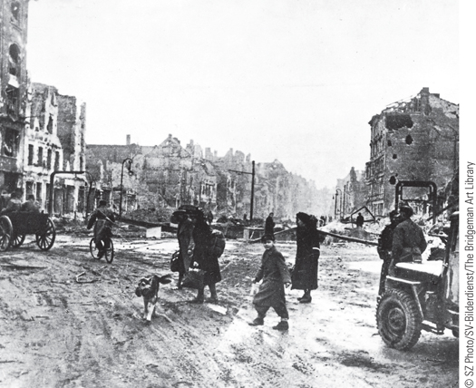
Survivors in the ruins of Berlin, Germany, at the end of World War II
p863
Notes:
Survivors in the ruins of Berlin, Germany, at the end of World War II

Slide 4
Development of the Cold War
Confrontation of the Superpowers: Who Started the Cold War?
  Divergent historical perspectives
    The tradition of power politics
    Soviet concerns about western borders
    U.S. interest in its new power and prestige
  Disagreement over Eastern Europe
    Between 1945 and 1947 Communist governments established in East Germany, Bulgaria, Romania, Poland, and Hungary
  The Truman Doctrine
    U.S. will aid any nation “threatened by the expansion of communism.”

Slide 5
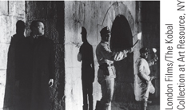
Film & History: The Third Man (1949)
Harry Lime (Orson Welles) tries to avoid capture.
p866
Notes:
Harry Lime (Orson Welles) tries to avoid capture.

Slide 6
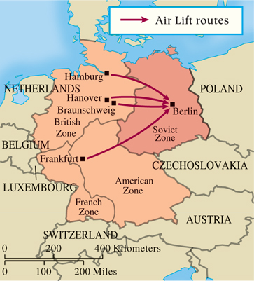
The Berlin Air Lift (Slide 1 of 2)
p866
Notes:
The Berlin Air Lift

Slide 7
Confrontation of the Superpowers
The Marshall Plan
  European Recovery Program: $13 billion for the economic recovery of war-torn Europe
The American Policy of Containment
Contention over Germany
  Re-established German Communist Party in East Germany (w/a Soviet makeover)
  Blockade of Berlin and the Air Lift, 1948-1949
  Separation
    West German Federal Republic (Konrad Adenauer) and German Democratic Republic (Walter Ulbricht), 1949

Slide 8
Confrontation of the Superpowers
New Military Alliances
  The search for security: mutual deterrence
    USSR tests its first atomic bomb- 1949
    North Atlantic Treaty Organization (NATO), 1949
      USA, Belgium, Britain, Denmark, France, Iceland, Italy, Luxembourg, the Netherlands, Norway, and Portugal, Canada.
      West Germany, Greece, Turkey
      29 countries today
    Warsaw Pact, 1955
      Military alliance (and Soviet satellite states): Albania, Bulgaria, Czechoslovakia, East Germany, Hungary, Poland, Romania.
    Once again, Europe is divided into rival alliances.

Slide 9
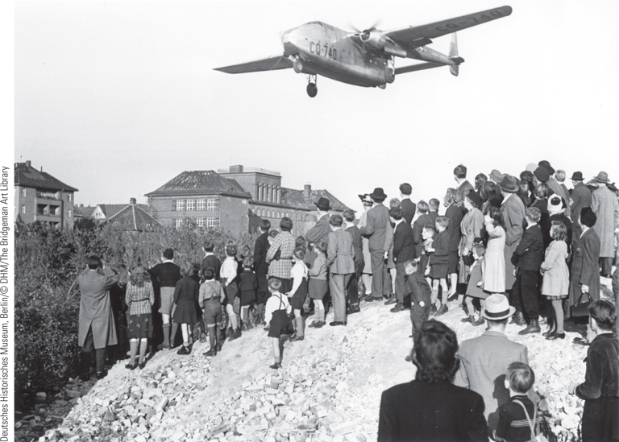
The Berlin Air Lift (Slide 2 of 2)
During the Berlin Air Lift, the United States and its Western allies flew 13,000 tons of supplies daily to Berlin and thus were able to break the Soviet land blockade of the city.
p867
Notes:
The Berlin Air Lift. During the
Berlin Air Lift, the United States and
its Western allies flew 13,000 tons of
supplies daily to Berlin and thus were
able to break the Soviet land blockade
of the city. In this photograph,
residents of West Berlin watch
an American plane land at Berlin’s
Templehof Airport with supplies for
the city.

Slide 10
Globalization of the Cold War
The Korean War
  Tensions between north and south and North Korean invasion
    The involvement of the UN
    Chinese intervention and its consequences
      Uneasy truce, 1953
The First Vietnam War
  Ho Chi Minh (1890 – 1969) and the Vietminh
  French agreement to peace, 1954
Escalation of the Cold War
  Presidency of Dwight Eisenhower, 1952-1960
    Policy of massive retaliation and new treaties

Slide 11
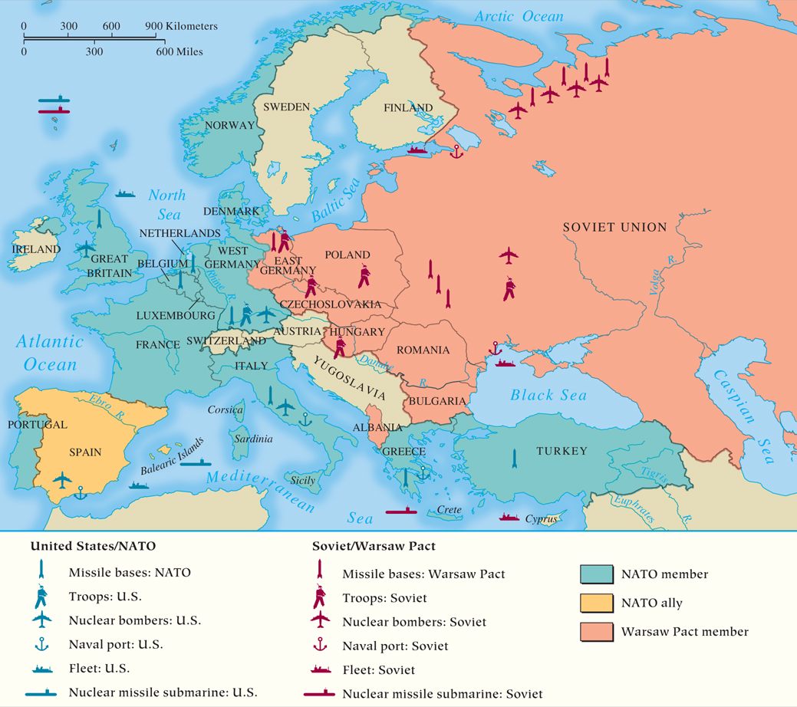
MAP 28.1 The New European Alliance Systems in the 1950s and 1960s
Map 28.1 p868
Notes:
MAP 28.1 The New European Alliance Systems in the 1950s and 1960s. With the United States as
its leader, NATO was formed in 1949 to counter the perceived military threat of the Soviet Union and
its Eastern European satellites, which formally created the Warsaw Pact in 1955. Soviet and American
troops, each backed by nuclear weapons, directly faced each other, heightening Cold War tensions.

Slide 12
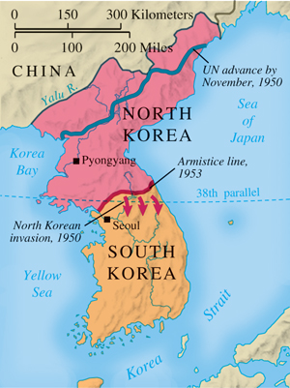
The Korean War
p869
Notes:
The Korean War

Slide 13
Globalization of the Cold War
Another Berlin Crisis
  Standoff between Nikita Khrushchev (1894 – 1971) and President John F. Kennedy (1917-1963)
    The construction of the Berlin Wall, 1961
The Cuban Missile Crisis
  The Communist regime of Fidel Castro (b. 1927)
    Failed Bay of Pigs invasion, 1961
  U.S. discovery of Soviet missiles headed for Cuba
    Kennedy orders a blockade and Khrushchev agrees to turn back ships
      Nuclear war narrowly avoided

Slide 14
CHRONOLOGY The Cold War to 1962
Event | Dates
Truman Doctrine | 1947
European Recovery Program (Marshall Plan) | 1947
Berlin blockade | 1948–1949
Communists win civil war in China | 1949
Soviet Union explodes first atomic bomb | 1949
Formation of NATO | 1949
Formation of COMECON | 1949
Korean War | 1950–1953
End of First Vietnam War | 1954
Formation of Warsaw Pact | 1955
Berlin Crisis | 1958
Vienna summit | 1961
Cuban Missile Crisis | 1962
p870
Notes:
CHRONOLOGY The Cold War to 1962

Slide 15
Europe and the World: Decolonization
Africa: The Struggle for Independence
  Older political organization become parties
Kwame Nkrumah(1909–1972) Gold Coast; Convention People’s Party, first African political party in black Africa.
Jomo Kenyatta (1894–1978); Kenya African National Union
Methods
Non-Violence: Western-educated African intellectuals
Mau Mau movement in Kenya; uhuru (Swahili for “freedom”)- violent clashes and assassinations

Slide 16
Europe and the World: Decolonization
Africa: The Struggle for Independence
  North Africa
    Egypt independent from Britain in 1922 but still under British control
    1952: Army coup overthrows King Farouk
    Independence of Morocco and Tunisia from France
      National Liberation Front (FLN); French guerrilla war in Algeria
  Complications in South Africa
    The role of the African National Congress
      Policy of apartheid
      Nelson Mandela (b. 1918)
  Independence achieved by most states, 1950s-1970s

Slide 17
Algeria: A Case Study
Became a French colony in 1827 under Charles X - brutal conquest (“scorched earth,” mass rape, murder)
Predominantly Muslim nation
French settlers known as pied-noirs or “colons”
Post-WWII; new drive for independence as economic and political dissatisfaction grows
1947; French National Assembly sanctions the creation of an Algerian Assembly - one house would represent Europeans and “meritorious” Muslims while the other would represent the remaining 8 million Muslims
Goes too far for the pied-noir, not far enough for the Muslim majority; spurs Algerian nationalism.

Slide 18
The Algerian Civil War
Began by the FLN (National Liberation Front) on November 1, 1954
Marked by guerrilla warfare - FLN bombed cafes, other targets
French respond by sending in 500,000 troops (spent about 18% of their GDP on the war by 1962)
French tactics - helicopter gunships, napalm bombs, moving entire cities under military occupation and forcing people to move from countryside
French troops imprisoned and tortured rebels
  Waterboarding, electric cattle prods, stress positions, etc.

Slide 19
End of the Algerian Civil War
The war severely divided French public opinion.
French Fourth Republic fell in May of 1958 - replaced in coup led by Charles De Gaulle (WWII leader) - ordered the drafting of a new constitution
De Gaulle was pessimistic of the war but sympathetic to the pied-noir
Starts secret peace conference in 1960 with FLN
1961 - failed coup against De Gaulle by officers angry at the negotiations
1961 - independence referendum
1962 - independence granted as pied-noir population floods into France

Slide 20
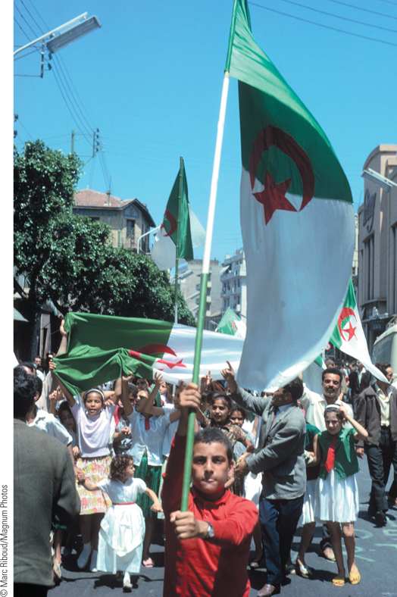
Algerian Independence
Although the French wanted to retain control of their Algerian colony, a bloody war of liberation finally led to Algeria’s freedom.
p872
Notes:
Algerian Independence. Although the French wanted to retain
control of their Algerian colony, a bloody war of liberation finally led to
Algeria’s freedom. This photograph shows Algerians celebrating the
announcement of independence on July 3, 1962.

Slide 21
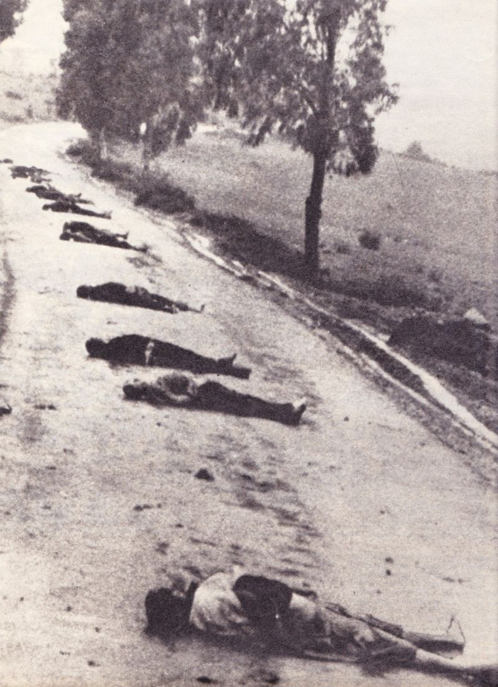
Below: Massacred Muslim Algerians on the road, 1956

Slide 22
Trailer for The Battle for Algiers
https://www.youtube.com/watch?v=vhhoS3zOskE
This film dramatizes the war and was banned in France for several years.

Slide 23
New York Times Article
Read the article “Echoes of Colonial Conflict in Algeria Reverberate in French Politics” (link)
Answer the following questions on a lined piece of paper:
  1) How has the end of the Algerian War impacted politics in contemporary France? What social, racial, and political tensions have arisen after the war?
  2) Which two visions of France’s history do its citizens have? Which vision do you believe to be more valid? Why? Can they coexist?

Slide 24
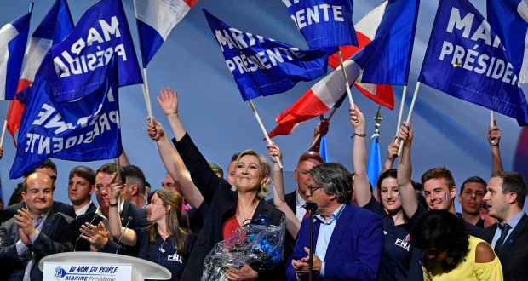
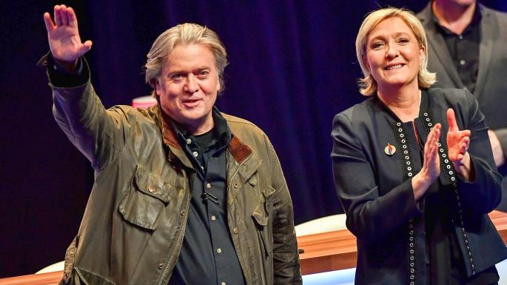
Marine Le Pen, France’s Populist Candidate. With Steve Bannon, below.

Slide 25
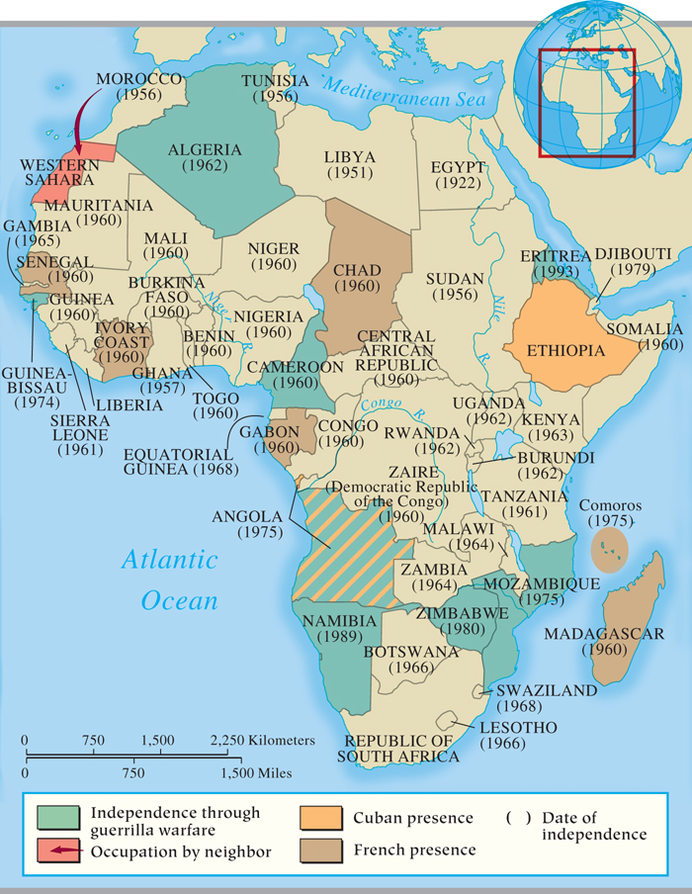
MAP 28.2 Decolonization in Africa
Map 28.2 p873
Notes:
MAP 28.2 Decolonization in Africa. By the late 1950s, Britain and France had decided to
allow independence for most of their African colonies, although France fought hard before
relinquishing Algeria. Most of the new states had difficulty promoting economic growth and
dealing with internal ethnic animosities.

Slide 26
Conflict in the Middle East
1945: The Arab League
British and French Territories
1946: Jordan independent
1942: Lebanon independent
1946: Syria independent
1963: Ba’ath Party
The Question of Palestine
Role of the Holocaust; President Truman approves the idea of an independent Jewish state within Palestine
United Nations resolution divided Palestine into a Jewish state
May 14, 1948, Zionists proclaim the state of Israel

Slide 27
Conflict in the Middle East
Gamal Abdel Nasser (1918 – 1970) and Pan-Arabism
1956: Nationalization of the Suez Canal
  The failed United Arab Republic, 1958-1961
The Arab-Israeli Dispute
  Palestine Liberation Organization (PLO)
    Leader Yasir Arafat (1929 – 2004)
  The Six-Day War, June 1967
  Israel triples territory
  Added a million Palestinians, mostly on West Bank

Slide 28
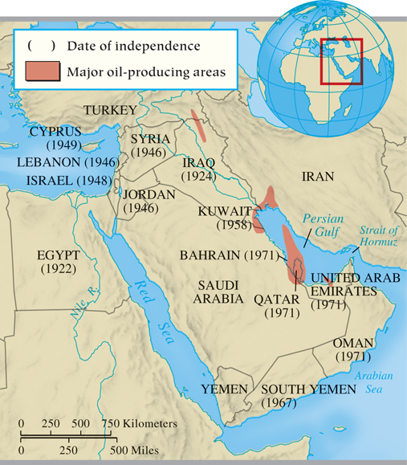
MAP 28.3 Decolonization in the Middle East
Map 28.3 p875
Notes:
MAP 28.3 Decolonization in the Middle East. Under the control of
the Ottoman Empire prior to World War I, much of the Middle East
was ruled directly or indirectly by the British and French after the
war. Britain, the main colonial power, granted independence to most
of its holdings in the first years after World War II, although it did
maintain control of small states in the Persian Gulf and Arabian Sea
region until 1971.

Slide 29
Asia: Nationalism and Communism
The Process of Independence
  India
    Tensions between Muslims and Hindus
    India divided: Hindu India and Muslim Pakistan, 1947
    Assassination of Mahatma Gandhi, January 1948
  British grant independence to Ceylon (Sri Lanka) and Burma (Myanmar)
  French efforts to keep Indochina spark a bloody struggle and division in Vietnam

Slide 30
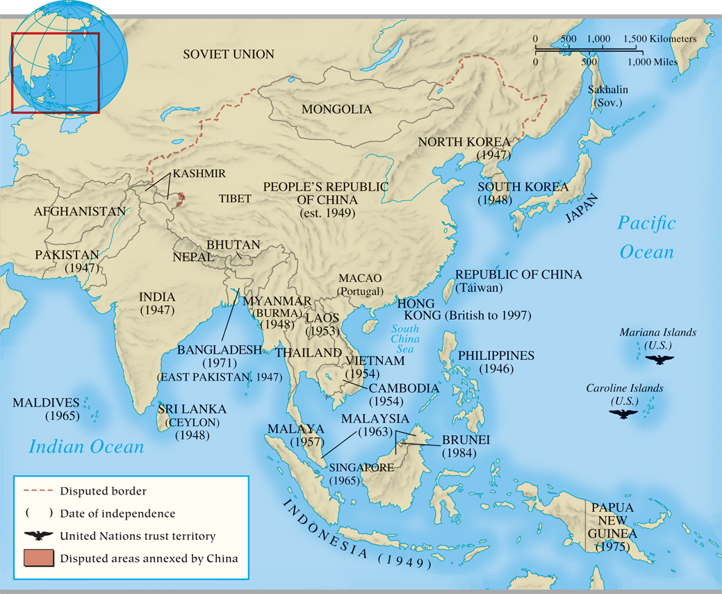
MAP 28.4 Decolonization in Asia
Map 28.4 p876
Notes:
MAP 28.4 Decolonization in Asia. Britain and the United States granted independence to their possessions in Asia soon after World War II.
France fought hard to hold Indochina but left after major military defeats. Cold War tensions in Asia led to both the Korean War and the
Vietnam War.

Slide 31
Decolonization
China Under Communism
  Chiang Kai-shek (1887 – 1975) and the Nationalists versus Mao Zedong (1893 – 1976) and the Communists
    Communist victory in 1948
      Chiang Kai-shek’s relocation to Taiwan
    Communist policies
      Collectivization of all farmland, nationalization of most industry and commerce, 1955
        Great Leap Forward, 1958
Decolonization and Cold War Rivalries

Slide 32
Recovery and Renewal in Europe
The Soviet Union: From Stalin to Khrushchev
  Stalin’s policies and removal of opponents
    Method for the recovery of the Soviet Union
      Promotion of heavy industry
      Production of few consumer goods
  Khrushchev’s rule
    Ends the forced labor camps and condemns Stalinist programs
      Encourages rebellion in satellite nations
        Soviet suppression of rebellions
    Economic policies
      Agricultural setbacks
      Industrial decline

Slide 33
Eastern Europe: Behind the Iron Curtain
Pattern of Soviet Dominance
Albania and Yugoslavia
  Growing independence of Albania
  Tito’s control of Yugoslavia
  Policy of Stalinization for Soviet satellites
    Five-year plans: industry and collectivization
1956: Upheaval in Eastern Europe
  Soviets agree to let Poland follow its own socialist plan in return for loyalty to Warsaw Pact
  Hungary’s quest for reform leads to dissent and Soviet repression

Slide 34
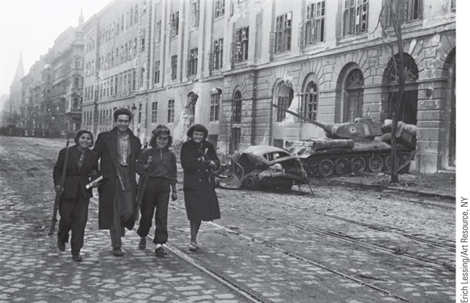
Hungarian Revolt
Young fighters are shown walking with their weapons away from the Kilian barracks in the background. The Corvin Passage behind them was a strategic transportation route that the insurgents defended by resisting Soviet tanks during the Hungarian Revolution.
p879
Notes:
Hungarian Revolt. (p.879)
Young fighters are shown walking with their weapons away from the Kilian barracks in the background. The Corvin Passage behind them was a strategic transportation route that the insurgents defended by resisting Soviet tanks during the Hungarian Revolution.

Slide 35
CHRONOLOGY The Soviet Union and Satellite States in Eastern Europe
Event | Dates
Death of Stalin | 1953
Khrushchev’s denunciation of Stalin | 1956
Attempt at reforms in Poland | 1956
Hungarian revolt is crushed | 1956
Berlin Wall is built | 1961
Brezhnev replaces Khrushchev | 1964
p880
Notes:
CHRONOLOGY The Soviet Union and Satellite States
in Eastern Europe

Slide 36
Western Europe: The Revival of Democracy and the Economy
(Slide 1 of 2)
After the War: Patterns
  Short-lived Communist successes and the return of moderates
  Relatively rapid recovery
France: the Domination of Charles de Gaulle
  The Fifth Republic, 1958
    Powers of the President enhanced
    Invested heavily in the nuclear arms race
    Student riots, May 1968
    Resignation of de Gaulle, April 1969

Slide 37
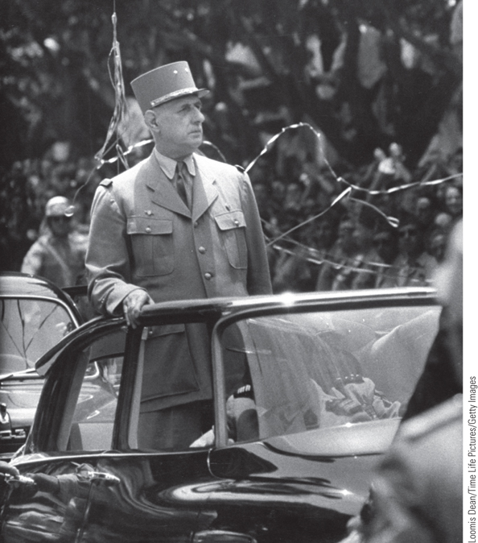
Charles de Gaulle
Charles de Gaulle returned to politics in 1958 in response to the crisis in Algeria. As president, he sought to revive the greatness of the French nation.
p881
Notes:
Charles de Gaulle. Charles de Gaulle returned to politics in 1958 in response to
the crisis in Algeria. As president, he sought to revive the greatness of the French
nation. He is shown here arriving in Algeria in 1958.

Slide 38
Western Europe: The Revival of Democracy and the Economy (Slide 2 of 2)
West Germany: a Reconceived Nation
  Chancellor Konrad Adenauer (1876 – 1967)
    Reconciliation with France
    Resurrection of the economy
    The trials at Nuremberg and the Nazi past
Great Britain: The Welfare State
  Clement Atlee (1883 – 1967)
    Nationalization, social security, and socialized medicine: model welfare state
  Slow economic recovery and loss of status as a world power
Italy: Weak Coalition Government
  Domination by Christian Democrats

Slide 39
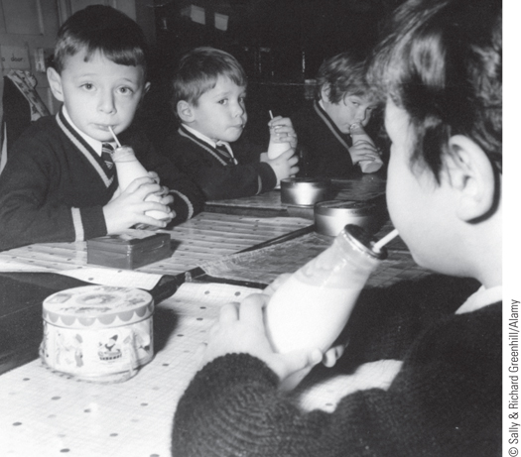
The British Welfare State: Free Milk at School
The creation of the welfare state was a prominent social development in postwar Europe. The desire to improve the health of children led to welfare programs that provided free food for young people.
p882
Notes:
The British Welfare State: Free Milk at School. The creation
of the welfare state was a prominent social development in postwar
Europe. The desire to improve the health of children led to welfare
programs that provided free food for young people. Pictured here
are boys at a grammar school in England during a free milk break.

Slide 40
Western Europe:
The Move toward Unity
Economic Solidarity
  European Coal and Steel Community (ECSC), formed 1951
    Elimination of tariffs and trade barriers
  European Atomic Energy Community (EURATOM), 1957
  European Economic Community (EEC, also known as the Common Market), 1957

Slide 41
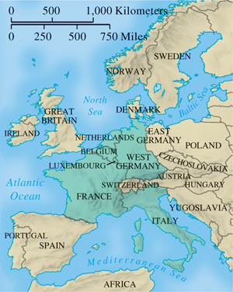
European Economic Community, 1957
p884
Notes:
European Economic Community, 1957

Slide 42
CHRONOLOGY Western Europe After the War
Event | Dates
Welfare state emerges in Great Britain | 1946
Italy becomes a democratic republic | 1946
Alcide de Gasperi becomes prime minister of Italy | 1948
Konrad Adenauer becomes chancellor of West Germany | 1949
Formation of European Coal and Steel Community | 1951
West Germany joins NATO | 1955
Suez Crisis | 1956
Formation of EURATOM | 1957
Formation of European Economic Community (Common Market) | 1957
Charles de Gaulle assumes power in France | 1958
Erhard becomes chancellor of Germany | 1963
p884
Notes:
CHRONOLOGY Western Europe After the War

Slide 43
The United States and Canada:
A New Era
American Politics and Society in the 1950s
  Continuing Influence of the New Deal
  Prosperity of the 1950s
  McCarthyism and the “Red Scare”
Decade of Upheaval: America in the 1960s
  Lyndon Johnson and the Great Society
  Civil rights movement
    Martin Luther King (1929 – 1968)
    Civil Rights Act of 1964
    Malcolm X (1925 – 1965)
The Development of Canada

Slide 44
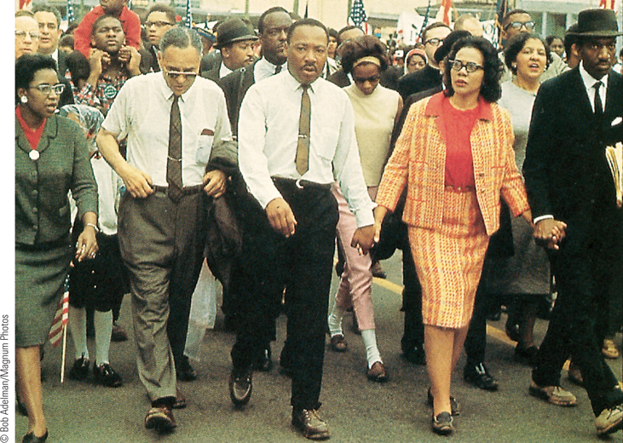
The Civil Rights Movement
In the early 1960s, Martin Luther King Jr. and his Southern Christian Leadership Conference organized a variety of activities to pursue the goal of racial equality.
p885
Notes:
The Civil Rights Movement. In the
early 1960s, Martin Luther King Jr. and his
Southern Christian Leadership Conference
organized a variety of activities to pursue
the goal of racial equality. He is shown
here with his wife Coretta (right) and
Rosa Parks and Ralph Abernathy (far left)
leading a march against racial
discrimination in 1965.

Slide 45
Postwar Society and Culture in the Western World (Slide 1 of 4)
The Structure of European Society
  The changing middle class
    Traditional middle class joined by new group of white collar workers
  A society of consumers
    Further urbanization
    Rising income of working classes
  Mass leisure
    Reduction of the work week and increase of paid holidays
    Mass tourism

Slide 46
Postwar Society and Culture in the Western World (Slide 2 of 4)
Creation of the Welfare State
  Advocates and goals
    Extension of state power to better lives of citizens
    Benefits: affordable health care, family allowances, removal of class barriers
    The cost of social services
  Gender issues in the welfare state
    Tensions over women’s roles

Slide 47
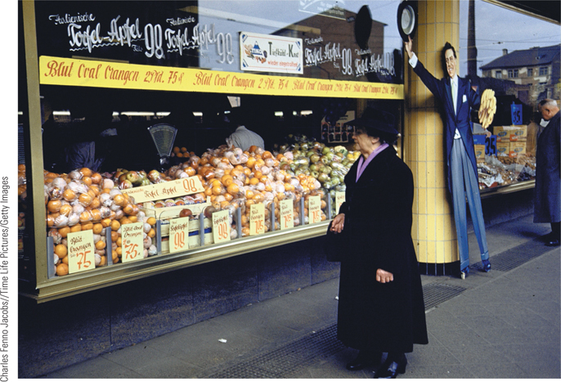
The Rise of the Supermarket (Slide 1 of 3)
German shoppers looking at bins of produce at a new supermarket in Frankfurt in 1954.
p887
Notes:
The Rise of the Supermarket

Slide 48
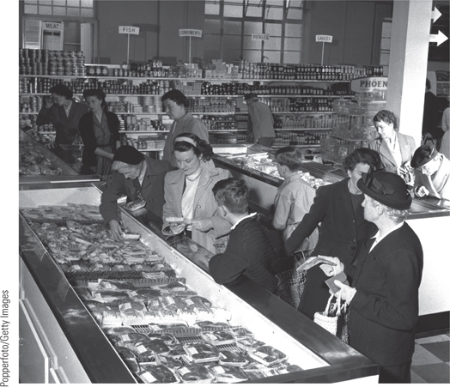
The Rise of the Supermarket (Slide 2 of 3)
Shoppers looking at wrapped packages of meat in refrigerated cases, a new phenomenon.
p887
Notes:
The Rise of the Supermarket

Slide 49
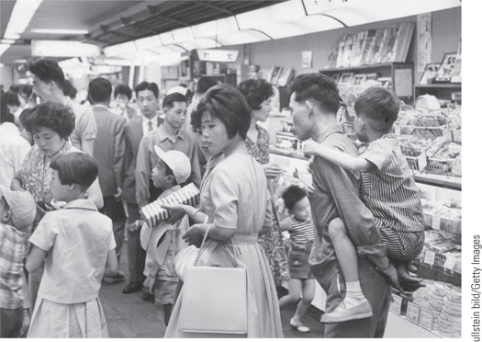
The Rise of the Supermarket (Slide 3 of 3)
A Japanese supermarket in 1963.
p887
Notes:
The Rise of the Supermarket (Photo of Japanese supermarket p.887)

Slide 50
Postwar Society and Culture in the Western World (Slide 3 of 4)
Women in the Postwar Western World
  Women in the Workforce
    Increased numbers of married women
    Maintenance of traditional wage patterns and domestic burdens
  Suffrage and the Search for Liberation
    Simone de Beauvoir (1908 – 1986)
      The Second Sex, 1949: women had been defined by differences from men

Slide 51
Postwar Society and Culture in the Western World (Slide 4 of 4)
Postwar Art and Literature
  Art
    Abstract Expressionism
      Jackson Pollock (1912 – 1956)
    Pop Art: Andy Warhol (1930 – 1987)
  Literature
    The Theater of the Absurd
      Samuel Beckett (1906 – 1990)
The Philosophical Dilemma: Existentialism
  Jean-Paul Sartre (1905 – 1980) and Albert Camus (1913 – 1960)
The Attempt to Revive Religion
  Catholic dynamism: Vatican II

Slide 52
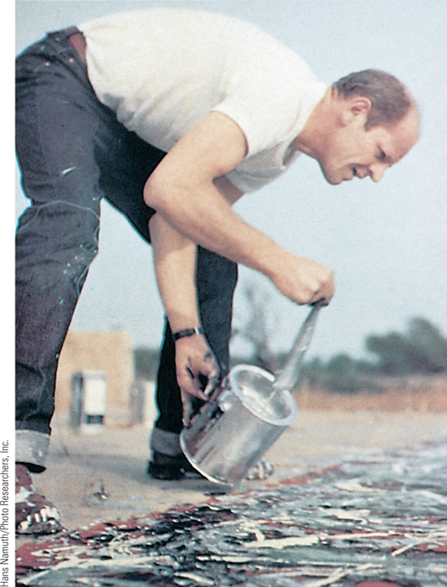
Jackson Pollock Painting (Slide 1 of 2)
After World War II, Abstract Expressionism moved to the center of the artistic mainstream. One of its best-known practitioners was the American Jackson Pollock, who achieved his ideal of total abstraction in his drip paintings.
p891
Notes:
Jackson Pollock Painting. After World War II, Abstract Expressionism moved to the center of the artistic mainstream. One of its best-known
practitioners was the American Jackson Pollock, who achieved his ideal of total abstraction in his drip paintings. He is shown here at work in his Long
Island studio. Pollock found it easier to cover his large canvases with spontaneous patterns of color when he put them on the floor.

Slide 53
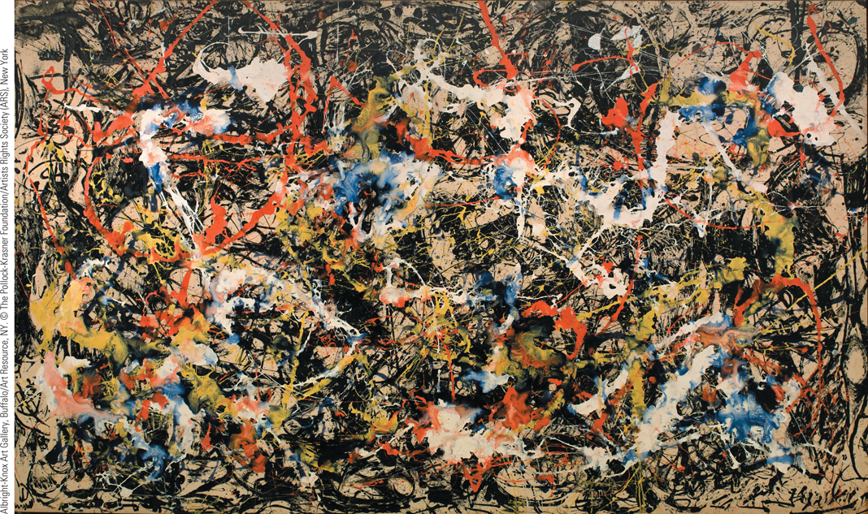
Jackson Pollock Painting (Slide 2 of 2)
Pictured is Pollock’s Convergence, painted in 1952, just four years before his death.
p891
Notes:
Jackson Pollock Painting. Pictured is Pollock’s Convergence, painted in 1952, just four years before his death.

Slide 54
The Explosion of Popular Culture
Culture as a Commodity
  Mass consumer society
The Americanization of the World
  Diffusion of American culture through movies, popular music, advertising, and television
    Rock ‘n’ roll
      American artists’ inspiration of European performers

Slide 55
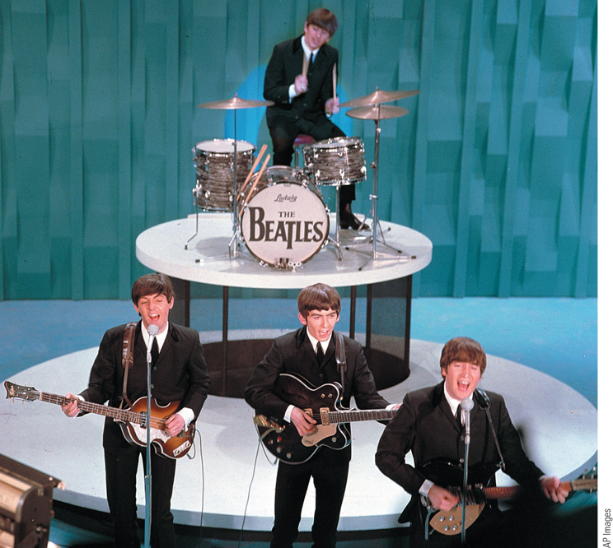
The Beatles
Although rock ‘n’ roll originated in the United States, it inspired musical groups around the world. This was certainly true of Britain’s Beatles, who caused a sensation among young people when they came to the United States in the 1960s.
p893
Notes:
The Beatles. Although rock ‘n’ roll originated in the United States, it inspired musical groups around
the world. This was certainly true of Britain’s Beatles, who caused a sensation among young people
when they came to the United States in the 1960s. Here the Beatles are shown during a performance on
The Ed Sullivan Show.

Slide 56
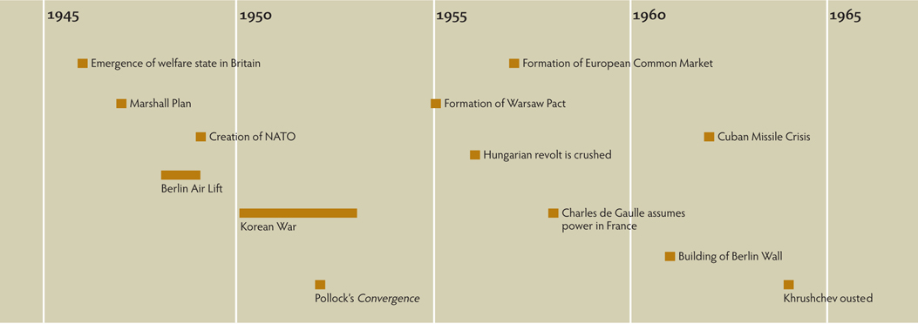
Chapter Timeline
p894

Slide 57
Discussion Questions
What factors caused decolonization?
What changes in the Eastern European countries took place under Khrushchev?
How and why did Western states adopt new strategies for unity after World War II?
Was the problem in post-colonial India more politically or religiously based?
What prevented France from becoming the third super power that De Gaulle wanted?
What societal changes, especially in the U.S., took place in the 1950s, 1960s, and 1970s?

