Slide 1
Protest and Stagnation: The Western World, 1965–1985
Chapter 29

Slide 2
Focus Questions
​What were the goals of the revolt in sexual mores, the youth protests and student revolts, the feminist movement, and the antiwar protests? To what extent were their goals achieved?
​What were the major political developments in the Soviet Union, Eastern Europe, Western Europe, and the United States between 1965 and 1985?
​What were the main events in the Cold War between 1965 and 1985, and how important was the role of détente in those events?
​What were the major social and cultural developments in the Western world between 1965 and 1985?

Slide 3
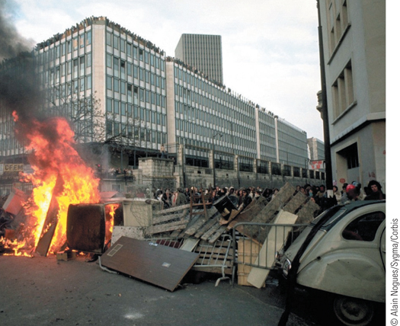
The barricades go up in Paris in May 1968
p896
Notes:
The barricades go up in Paris in May 1968.

Slide 4
A Culture of Protest
A Revolt in Sexual Mores
The so-called sexual revolution
“Permissive society”
Sex education and gay rights (decriminalization)
Birth control pill → more sexual freedom
Divorce and the breakdown in the traditional family
Women’s rights, changes in fashion
Youth Protest and Student Revolt
New attitudes toward sex and drugs
Growing political consciousness
Discontent with higher education’s restrictions and quality lead to student revolts, 1968
Deeper concerns with the direction of Western society

Slide 5
A Culture of Protest
Youth Protest and Student Revolt
New attitudes toward sex and drugs
Marijuana and LSD, mind-altering drugs
Growing political consciousness
Higher education increased, but led to crowded classrooms and neglected students.
Discontent with higher education’s restrictions and quality lead to student revolts, May 4, 1968
Deeper concerns with the direction of Western society
Students demand voice in education
May 10, 1968: Night of the Barricades.
Students were later joined by the workers in striking

Slide 6
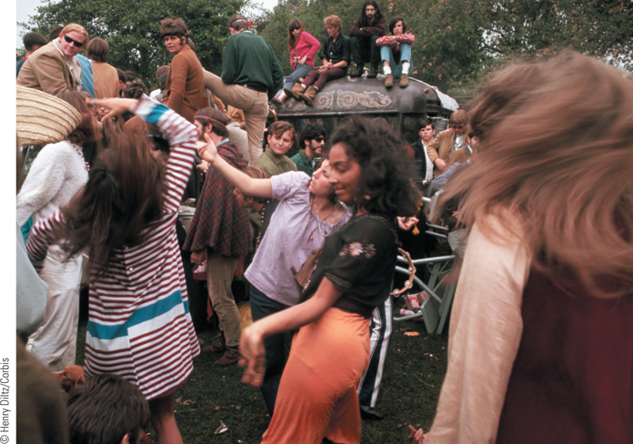
Youth Culture in the 1960s (Slide 1 of 3)
The “love-in” shows another facet of the youth movement.
p898
Notes:
Youth Culture in the 1960s

Slide 7
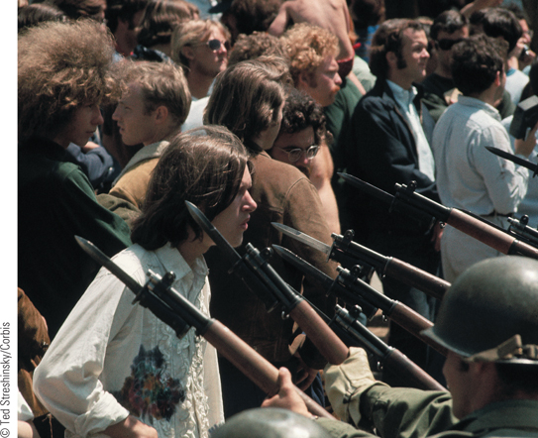
Youth Culture in the 1960s (Slide 2 of 3)
A group of young protesters face the bayonets of the National Guardsmen who had been called in by Governor Ronald Reagan to restore order on the Berkeley campus of the University of California during an antiwar rally.
p898
Notes:
Youth Culture in the 1960s

Slide 8
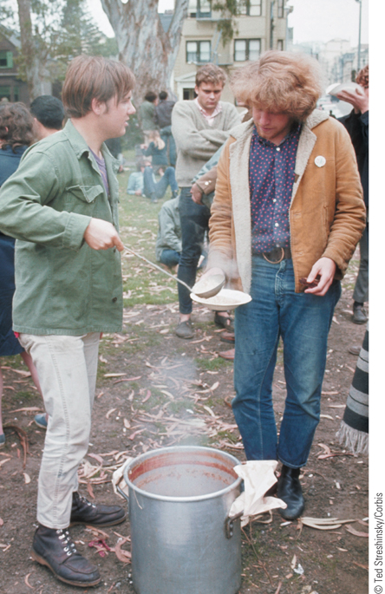
Youth Culture in the 1960s (Slide 3 of 3)
A member of the Diggers, a communal group in San Francisco, is shown feeding a flower child.
p898
Notes:
Youth Culture in the 1960s

Slide 9
A Culture of Protest
1968: Student Protests everywhere
Permanent order still prevailed: prosperous, capitalist west, and an impoverished communist east.
The Feminist Movement- because politicl and legal equality still didn’t bring true equality.
Betty Friedan (1921 – 2006)
The Feminine Mystique
National Organization for Women (NOW), founded 1966

Slide 10
A Culture of Protest
Antiwar Protests
Motivation for demonstrations in Italy, France, Britain, and the U.S.
They saw the war as a final act of imperialism.
Divided Americans and Europeans, because not everyone agreed with the protestors.
Violence dims American willingness to continue war in Vietnam

Slide 11
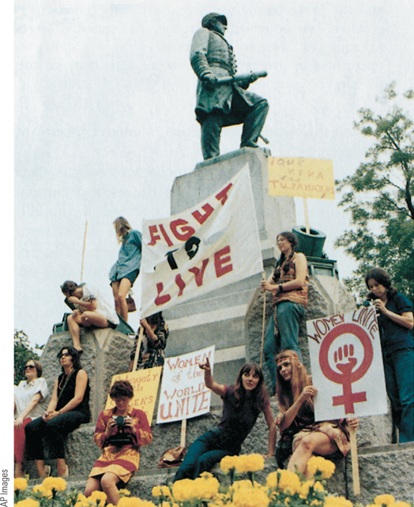
Women’s Liberation Movement
In the late 1960s, as women began once again to assert their rights, a revived women’s liberation movement emerged. Feminists in the movement maintained that women themselves must alter the conditions of their lives.
p901
Notes:
Women’s Liberation Movement. In the late 1960s, as women began
once again to assert their rights, a revived women’s liberation movement
emerged. Feminists in the movement maintained that women
themselves must alter the conditions of their lives. During this women’s
liberation rally, some women climbed the statue of Admiral Farragut in
Washington, D.C., to exhibit their signs.

Slide 12
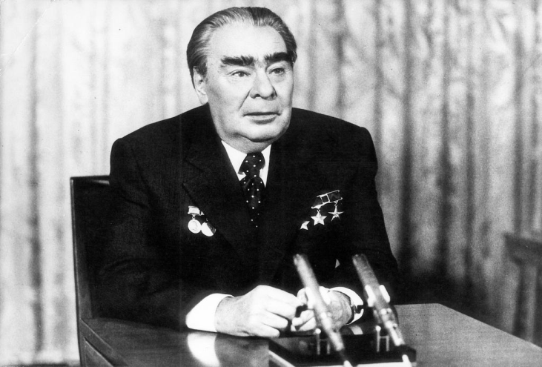
A Divided Western World
Stagnation in the Soviet Union
The Brezhnev Years: Leonid Brezhnev (1906 – 1982)
“No experimentation”: rigid adherence to traditional Soviet communism.
Brezhnev Doctrine: right to intervene if socialism threatened
Led to intervention in Czechoslovakia, 1968
Relaxed atmosphere associated with détente
Reluctant to reform the USSR

Slide 13
Brezhnev Years
Relaxed some authoritarian rule
Allowed some access to Western culture, but dissenters were punished.
People craved more Western music, fashion, art
Economic policy
Decline of overall industrial growth: focus on heavy industry and space, but not commodities.
Impact of central economic planning: inefficient bureaucracy
Agricultural problems
Bad harvests in mid-1970s force them to buy grain from the U.S.

Slide 14
Brezhnev Years
Ruling system
Unwilling to tamper with the party leadership and state bureaucracy
To rise in the party, one needed support from the party.
This creates a “party elite” oligarchy.
1980: USSR is in trouble
Low quality of life
Declining morale, economy, and work conditions.
Rise in alcoholism and infant mortality.

Slide 15
Forced Conformity in Eastern Europe
The USSR claimed to be a “workers’ paradise” in the “new world order”.
So, resistance in their Soviet satellite states and republics was embarrassing.
Attempted escapes from East Germany → Berlin Wall, for example.
Eastern European governments respond by trying to reform and relax their rule.
Soviet Union responded with brute force to crush any reforms.
Hungary, Poland, Czechoslovakia

Slide 16
Conformity in Eastern Europe
Poland
Continued labor unrest
Solidarity : an independent labor union (not controlled by the state) formed to protest food prices- STRIKE.
Led by Lech Walesa and supported by 35 million Poles including the Catholic Church.
Pope John Paul II, aka Karol Wojtyla, the first Polish Pope
Sep 1980, Head of Communist Party is replaced, and radio broadcasts a Catholic Mass for first time in 30 years.
Summer 1981: Elections were held (all candidates were communist, but still- progress!
General Jaruzelski takes lead of the Party, imposes martial law, arrests Solidarity leaders.
Prevented a Soviet invasion, like in Czechoslovakia, but martial law lasted until 1983.

Slide 17
Conformity in Eastern Europe
Hungary
Reforms under János Kádár
Legalization of small private enterprises
“Communism with a capitalist facelift”
The Prague Spring
Short-lived reforms under Alexander Dubček (1921 – 1992)
Czechoslovakia had been Stalinist under Antonin Novotny.
1968: Dubcek reforms include free speech, press, travel abroad, relaxed secret police.
“Prague Spring”: sense of free euphoria, happiness, but led to demands to withdraw from Soviet bloc.
Soviet Red Army invades to crush reforms, 1968
Gustáv Husák (1913 – 1991) re-establishes old order.

Slide 18
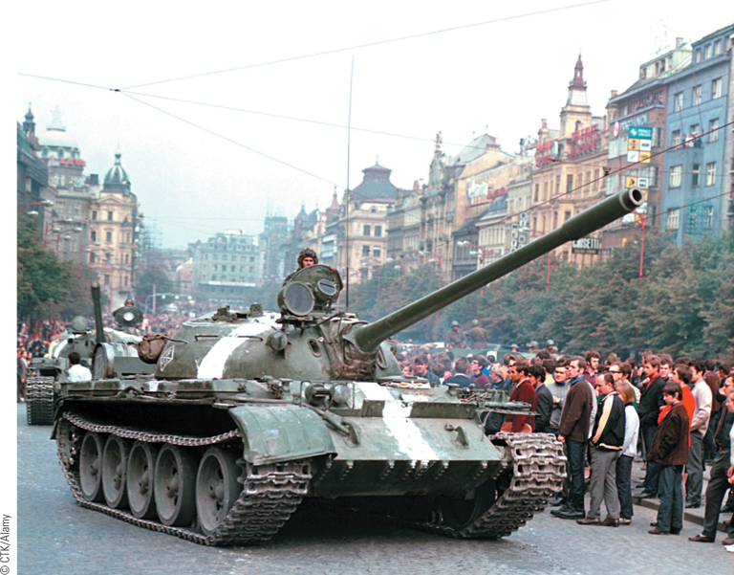
Soviet Invasion of Czechoslovakia, 1968
The attempt of Alexander Dubcek, the new first secretary of the Communist Party in Czechoslovakia, to liberalize Communist rule in that country failed when Soviet troops invaded and crushed the reform movement.
p903
Notes:
Soviet Invasion of Czechoslovakia, 1968. The attempt of Alexander Dubcek, the new first secretary
of the Communist Party in Czechoslovakia, to liberalize Communist rule in that country failed when Soviet
troops invaded and crushed the reform movement. This photograph, taken on August 21, shows Soviet
tanks in Wenceslas Square while Prague residents look on.

Slide 19
“Opposing Viewpoints: Czechoslovakia, 1968. Two Faces of Communism”
1.) What ideals are expressed by the Czech Communist intellectuals who wrote the “Two Thousand Words Manifesto”?
2.) What does the manifesto advocate for the Communist Party of Czechoslovakia?
3.) How does Brezhnev respond to the manifesto?
4.) How does the vision for communism expressed in Brezhnev’s letter differ from the manifesto, and what might be the reasons for that difference?

Slide 20
Repression in East Germany and Romania
East Germany: Faithful Soviet Satellite
Leadership of Walter Ulbricht
Industry nationalized, agriculture collectivized
Exodus to the West; young labor force flees to West, leads to economic problems. → Berlin Wall
Erich Honecker
Use of the Stasi- secret police in East Germany
Ruled with iron fist until 1989.
Stability through prosperity and repression
Romania
The iron grip of Nicolae and Elena Ceauşescu
The Securitate: weapon against dissent

Slide 21
CHRONOLOGY The Soviet Bloc
Event | Dates
Era of Brezhnev | 1964–1982
Rule of Ceauşescu in Romania | 1965–1989
Prague Spring | 1968
Honecker succeeds Ulbricht in East Germany | 1971
Emergence of Solidarity in Poland | 1980
Gorbachev comes to power in the Soviet Union | 1985
p904
Notes:
CHRONOLOGY The Soviet Bloc

Slide 22
Western Europe: The Winds of Change
1950s-1960s: Incredible economic growth
1973-1974 and 1979-1983: Severe recessions
1980s: Recovery with problems
West Germany
Chancellor Willy Brandt, 1969-1974
Ostpolitik, “opening toward the east”
Treaty with East Germany, 1972
Great Britain: Thatcher and Thatcherism
Conservative Margaret Thatcher comes to power, 1979
Economic controls: broke the unions; cutbacks
Hard line toward communism
Rebuilds the military
Conflict in the Falkland Islands

Slide 23
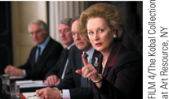
Film & History: The Iron Lady (2011)
Prime Minister Margaret Thatcher (Meryl Streep) at a cabinet meeting.
p906
Notes:
Prime Minister Margaret Thatcher (Meryl Streep) at a cabinet meeting.

Slide 24
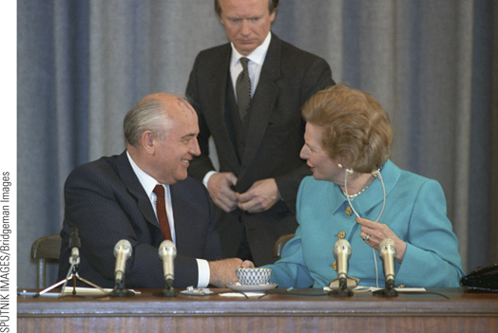
Margaret Thatcher
Great Britain’s first female prime minister, Margaret Thatcher was a strong leader who dominated British politics in the 1980s.
p906
Notes:
Margaret Thatcher. (p.906)
Great Britain’s first female prime minister,
Margaret Thatcher was a strong leader who dominated British politics in
the 1980s. Thatcher is shown here with Soviet leader Mikhail Gorbachev
at a press conference in Moscow in 1991.

Slide 25
Margaret Thatcher: ‘Thatcherism’ and the Free Market
1.) When she alluded to “experience” showing the failure of socialism, what specific events and countries may she have had in mind?
2.) Is she opposed to charity? Why then is she opposed to the Welfare State as it then stood?
3.) How does she blame labor unions for some of Britain’s economic problems?
4.) How does her rhetoric compare with other heads of state from the same time period (i.e. Reagan in the US)?
5.) Why is a free market system better than a regulated one, in her opinion?

Slide 26
Western Europe: The Winds of Change
Uncertainties in France
François Mitterrand, 1981-1995
Liberal policies to address economic crises
Reforms for workers, centralization, and nationalization
Increased minimum wage, mandatory paid vacation, 39 hour work week, taxed the rich.
Nationalization of industry didn’t work. Had to re-privatize them in the late 1980s.
Return to private enterprise in the late 1980s
Confusion in Italy
Continued coalitions
Italian Communist advocacy of Eurocommunism
Recession and terrorism in the 1970s
Red Brigade

Slide 27
Western Europe: Winds of Change
The European Community (EC)
After 1970, Western European states continued to integrate economies.
European Economic Community (EEC) started with 6 countries, joined by Britain, Ireland, Denmark, then Greece, Spain, and Portugal.
Led to international and political cooperation.

Slide 28
CHRONOLOGY Western Europe, 1965-1985
Event | Dates
Willy Brandt becomes chancellor of West Germany | 1969
Helmut Schmidt becomes chancellor of West Germany | 1974
Margaret Thatcher becomes prime minister of Britain | 1979
François Mitterrand becomes president of France | 1981
Falklands War | 1982
Helmut Kohl becomes chancellor of West Germany | 1982
p907
Notes:
p.907

Slide 29
The United States: Turmoil and Tranquility
Richard Nixon,1968-1974, and the Shift to the Right
Economic Problems
Jimmy Carter, 1976-1980
Stagflation – high inflation and unemployment
Oil embargo, 1973
The hostage crisis in Iran
The Reagan Revolution
Ronald Reagan, 1981-1989
Reverses the welfare state
Military buildup
“Supply-side economics” and deficit spending

Slide 30
Canada
Liberals in Power
Pierre Trudeau, elected in 1968
Commitment to federal union
Official Language Act
Unpopularity of efforts to impose will of federal government on provincial governments
Economic Recession and Political Change
Brian Mulroney, leader of the Progressive Conservative Party, elected in 1984

Slide 31
The Cold War: The Move to Détente
The Second Vietnam War
U.S. involvement and the domino theory of the spread of communism
Persistence of North Vietnamese, brutalization, and growing antiwar sentiment
Peace treaty signed January 1973
Reunification of Vietnam
China and the Cold War
The Great Proletarian Cultural Revolution
Continuing revolution and the Red Guards, 1966-1976
U.S.-China Relations
Nixon’s visit to China, 1972

Slide 32
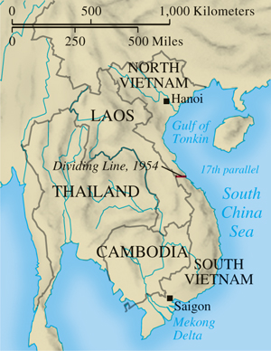
The Vietnam War
p909
Notes:
The Vietnam War

Slide 33
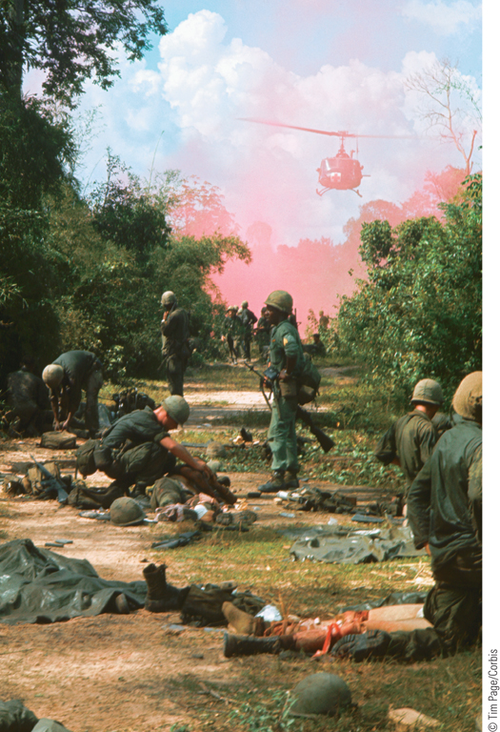
The Second Vietnam War
Between 1965 and 1973, U.S. troops fought against Vietcong guerrillas and North Vietnamese regular forces until they were finally withdrawn as a result of the Paris Agreement reached in January 1973.
p909
Notes:
The Second Vietnam War. Between 1965 and 1973, U.S. troops
fought against Vietcong guerrillas and North Vietnamese regular forces
until they were finally withdrawn as a result of the Paris Agreement
reached in January 1973. Shown here are U.S. troops after a Vietcong
attack. The helicopter that is arriving would soon remove the American
wounded from the battlefield.

Slide 34
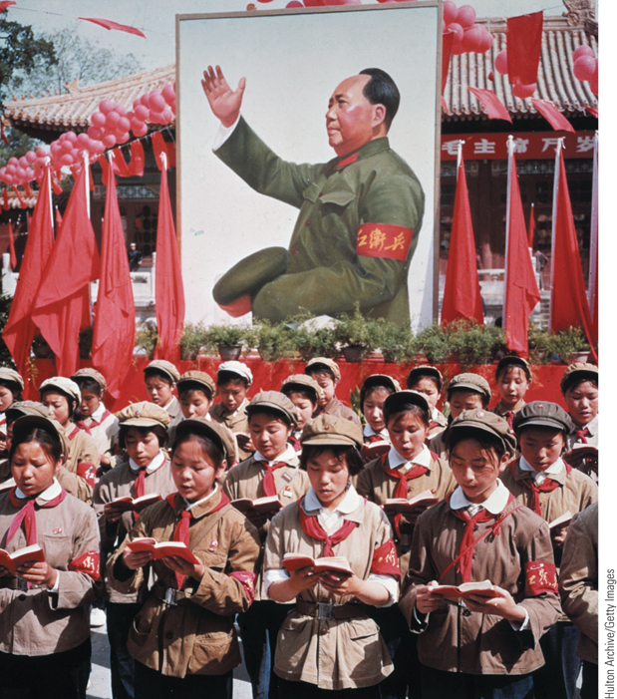
The Great Proletarian Cultural Revolution
The Cultural Revolution, which began in 1966, was a massive effort by Mao Zedong and his radical supporters to eliminate rival elements within the Chinese Communist Party and achieve the final stage of communism—a classless society.
p910
Notes:
The Great Proletarian Cultural Revolution. The Cultural Revolution,
which began in 1966, was a massive effort by Mao Zedong and his radical supporters
to eliminate rival elements within the Chinese Communist Party and achieve the
final stage of communism—a classless society. Shown here in front of a picture of
Chairman Mao Zedong is a group of Chinese children in uniform holding Mao’s Little
Red Book (a collection of Mao’s thoughts that became a sort of bible for Chinese
Communists) during the Cultural Revolution in 1968.

Slide 35
The Cold War: The Move to Détente
The Practice of Détente
Antiballistic Missile Treaty, 1972- agree to limit systems for launching antiballistic missiles, make it unlikely that either side could win.
Seen as a way to prevent war.
Helsinki Agreements, 1975
Recognized all borders in Europe since WWII, so the West acknowledged the Soviet sphere of influence.

Slide 36
The Move to Détente
The Limits of Détente
Human rights issues
Soviet invasion of Afghanistan, 1979- ended détente.
U.S. helped train Mujahideen “holy warriors” to fight off the Soviets, effectively turning Afghanistan into “The Soviet Union’s Vietnam War”
Later, the Mujahideen became the Taliban.
President Ronald Reagan’s “evil empire”
Harsh rhetoric and new arms race.
The Strategic Defense Initiative (“Star Wars”)

Slide 37
Society and Culture in the Western World
The New World of Science and Technology
New relationships between theory and practice
Impetus: the needs of World War II
Consequences: sponsorship of research by government and corporations
The computer
Revolution by silicon chip and microprocessor
New conception of the universe
Questions about the nature of reality
Dangers of science and technology
E.F. Schumacher (1911 – 1977), Small is Beautiful

Slide 38
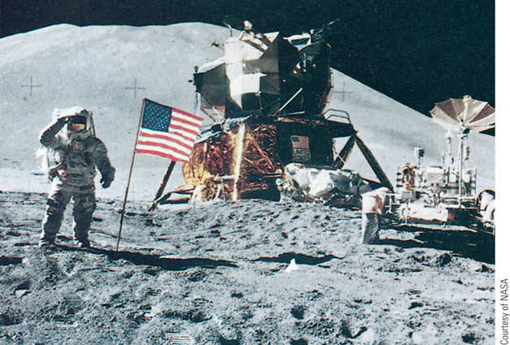
On the Moon
The first landing on the moon in 1969 was one of the great technological achievements of the twentieth century.
p912
Notes:
On the Moon. The first landing on the moon in 1969 was one of the great
technological achievements of the twentieth century. This photograph shows astronaut
James Irwin shortly after he raised the American flag during a moonwalk in 1971. The
lunar module and lunar rover are also visible in the picture.

Slide 39
Society and Culture in the Western World
The Environment and the Green Movements
Hazards and growing ecological awareness
Rise of Green parties
Postmodern Thought
Structuralism: language and signs
Ferdinand de Saussure: signifier and signified
Poststructuralism, or deconstruction
Jacques Derrida and the creation of meaning
Michel Foucault and the nature of power
The History of Sexuality

Slide 40
Trends in Art, Literature, and Music
Postmodern Styles
Art
Allen Kaprow’s “happenings”
Architecture: mixing tradition and innovation
Robert Venturi
Charles Moore
Piazza d’Italia
Literature
Gabriel García Márquez and magical realism
Milan Kundera
Music
Serialist composition: Olivier Messiaen
Minimalism: Philip Glass

Slide 41
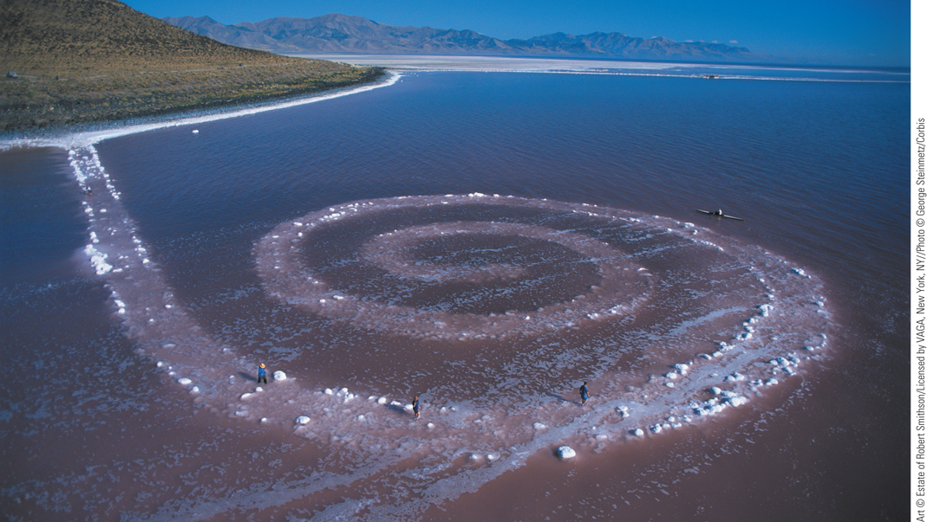
Robert Smithson, Spiral Jetty
Built on an abandoned industrial site, Spiral Jetty disappears and reappears according to the rise and fall of the Great Salt Lake’s water level.
p915
Notes:
Robert Smithson, Spiral Jetty. Built on an abandoned industrial site, Spiral Jetty disappears and
reappears according to the rise and fall of the Great Salt Lake’s water level. As seen in this 2002 photograph,
the surface has become encrusted in salt as drought has lowered the lake level. Robert Smithson filmed
the construction of Spiral Jetty, carefully noting the various geological formations included in his creation.
Earthworks like Spiral Jetty increased in number as the welfare of the world’s ecosystems became a growing
concern in the 1960s and 1970s.

Slide 42
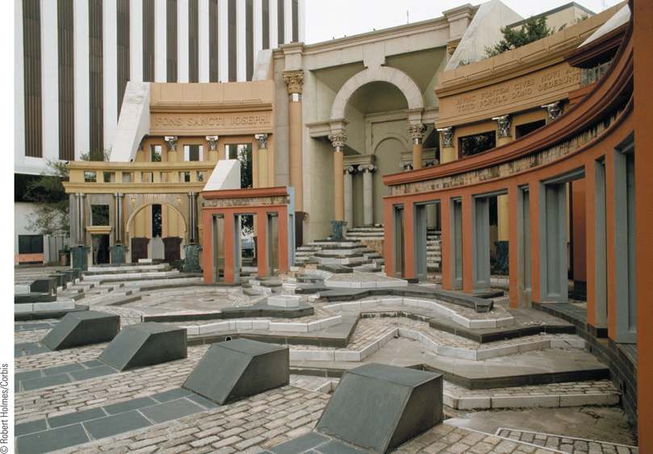
Charles Moore, Piazza d’Italia
Dedicated to the Italian communities of New Orleans, Piazza d’Italia includes a schematic map of Italy on its pavement.
p916
Notes:
Charles Moore, Piazza
d’Italia. Dedicated to the
Italian communities of New
Orleans, Piazza d’Italia includes
a schematic map of Italy on its
pavement. The architect,
Charles Moore, combined
elements from Italy’s rich
cultural past, such as Roman
columns and Renaissance
Baroque colonnades, with
modern materials like neon
lighting and stainless steel to
create an eclectic Postmodern
plaza.

Slide 43
Popular Culture: Image and Globalization
Popular music
Experimentation in musical forms
Video music
MTV
The Growth of Mass Sports
Sport as a global phenomenon
Politics and the Olympic Games
The World Cup
Popular culture: increasingly global
Marshall McLuhan (1911 – 1980) and the “global village”

Slide 44
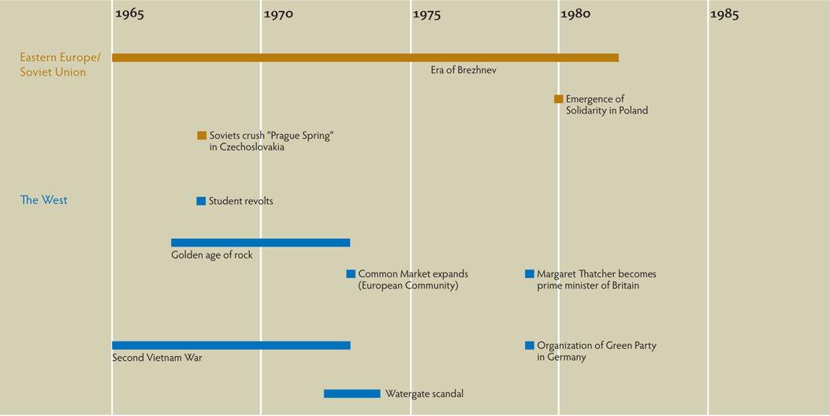
Chapter Timeline
p918

Slide 45
Discussion Questions
Examine the policies of Brezhnev. Are they old guard communist or a transition between the old Soviet regime and the more modern Soviet state to come?
How did Margaret Thatcher shape the position of Great Britain in power structure of world politics?
What is détente? How did the policies of Nixon influence relations between the West and the Communist world?
How did changes in science and technology impact Western civilization during the 1960s and 1970s?
To what degree has popular culture helped to turn the world into a “global village”?

