Slide 1
Big Busine$$
Ch 3 Lesson 3

Slide 2
“With great wealth, comes great responsibility.”
- Bill Gates

Slide 3
Rise of Big Business
Big business dominated American economy by 1900.
Laissez-faire economics allowed corporations to raise money by selling stocks, and using those profits to invest in new technology, hire large workforces, purchase new machines.
Large companies have an advantage over small companies due to operating costs.
Small companies cannot compete, and are either bought out or go out of business.

Slide 4
Consolidating Industry
Laissez-faire is good for consumers:
Competition = lower prices
This is not so good for businesses.
Drawback: no regulation of competitors means companies can make deals with eachother to fix prices (like cartels).
Competition also takes out companies, so by the 1870s most industries were left to a few LARGE corporations.

Slide 5
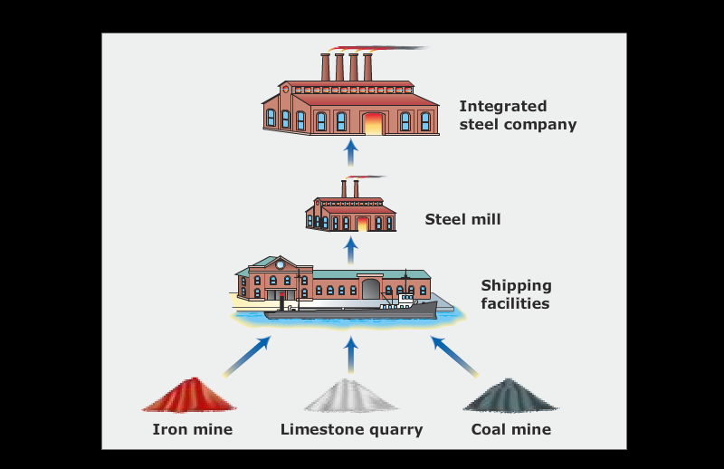
Andrew Carnegie: Steel
Vertical integration

Slide 6
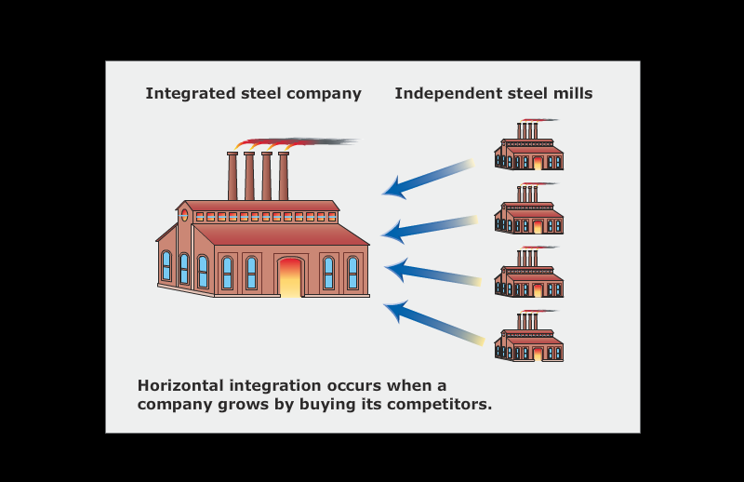
John D. Rockefeller: Oil
Horizontal Integration

Slide 7
New Business Organizations
Trusts: a legal arrangement where one person (trustee) manages another person’s property and wealth.
Created as a loophole around anti-monopoly laws in the late 1800s.
Holding Companies: corporations that produce nothing, but they own stock in other companies that do produce goods, and manages them as one large enterprise.
Most are owned by banking corporations today.

Slide 8
New Business Organizations
Investment Banking: Bankers helped companies issue stock, then sell it at a profit to investors.
Most successful was J.P. Morgan, who bought out Andrew Carnegie for $450 million.
Advertising:
Mass production → a lot of supply → need to persuade public to buy products
By 1900, advertising was a $90 million industry.
Led to mail order catalogs for department and chain stores.

