Slide 1
Urban America: IMMIGRATION
Ch 4 Lesson 1

Slide 2
“Many immigrants had brought on board balls of yarn, leaving one end of the line with someone on land. As the ship slowly cleared the dock, the balls unwound amid the farewell shouts of the women, the fluttering of handkerchiefs, and infants held high. After the yarn ran out, the long strips remained airborne, sustained by wind, long after those on land and those at sea had lost sight of each other.”
- Luciano, an Italian immigrant

Slide 3
The “New” Wave of Immigrants
25 million immigrants between 1865-1914
Most were from Europe.
Conditions in Europe:
Strict social class hierarchy
Land shortage
Disease epidemics
Unemployment
Long military drafts
Ethnic/religious persecution
Revolts, revolutions, social unrest in post-French Revolution Europe.

Slide 4
Changing American Cities: Demographics and Culture
“New” immigrants were from south and eastern Europe: Italy, Greece, Austria-Hungary, Serbia, Russia
“Old” immigrants were from northern and western Europe: Ireland, Scotland, Britain, France, Germany, Sweden, Norway, Denmark, the Netherlands.
Formed “ethnic neighborhoods” and created patterns in the urban workforce that are still prevalent today.

Slide 5
“Push” and “Pull” Factors
Push factors: What conditions made immigrants leave their home country?
Pull factors: What was it about America that attracted them?

Slide 6
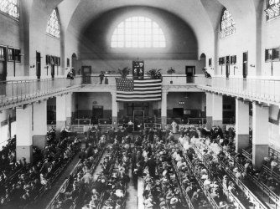
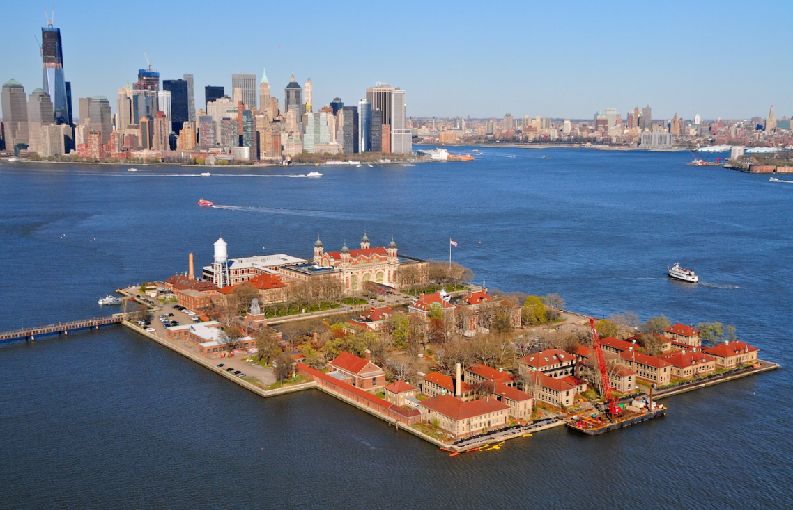
Ellis Island: New York Harbor
1892-1954

Slide 7
“Welcome to All.” J. Keppler, Puck Magazine. 1880.

Slide 8
“Where the Blame Lies”. Grant E. Hamilton, Judge Magazine. 1891, New York City.

Slide 9
Asian Immigration
Most came from China, due to the unrest in China from the Taiping Rebellion, an effect of the Opium War.
Famine, peasant revolts, civil war, poverty
Most did not strike it rich in the Gold Rush, and became railroad workers, laborers, merchants, and craftsmen.

Slide 10
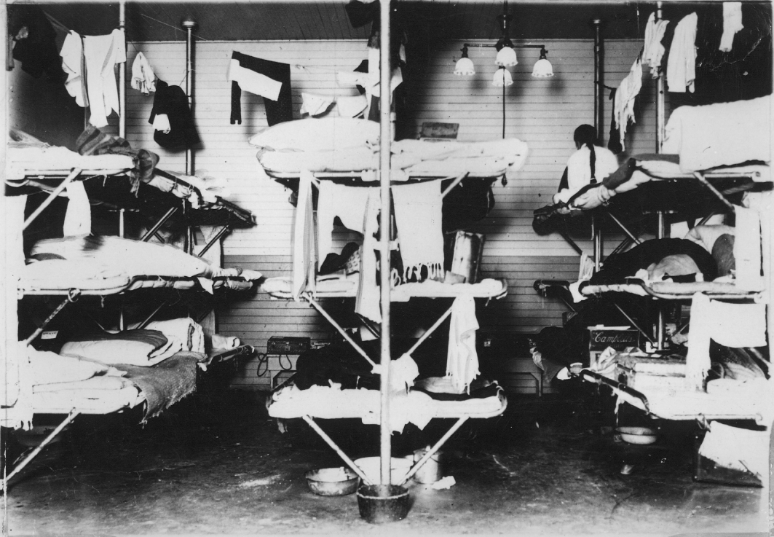
Angel Island, San Francisco Bay 1910-1940

Slide 11
Nativism Resurges
Nativism= anti-immigrant hostilities felt by “native-born” white Protestant Americans.
First surfaced in 1840s as a response to a massive wave of Irish immigrants during the Potato Famine.
Resurfaced in 1880s against Jews, Catholics, Asians, and Eastern/Southern Europeans.
Many labor unions had nativist sentiments.

Slide 13
Nativists Organize
American Protective Association (1887)
Anti-Catholic party
Workingman’s Party of California (1870s)
Anti-Chinese party
Irony: led by an Irish immigrant, Denis Kearney, who ended all speeches with “Whatever happens, the Chinese must go!”
Both gained major political followings.

Slide 16
Immigration and Urbanization

Slide 17
New Immigration Laws (both signed by President Chester Arthur)
Chinese Exclusion Act- 1882
Barred Chinese immigration for 10 years, and prevented Chinese in America from becoming citizens.
Renewed in 1892, permanent in 1902, and repealed in 1943* (Why?)
Immigration Act- 1882
Federal government oversaw immigration, hired immigration agents, gave them power of inspection, imposed a tax on immigrants arriving by ship.

