Slide 2
The Rise of Segregation
Ch 4 Lesson 5

Slide 3
Resistance and Repression
Review: The End of Reconstruction
Compromise of 1877: Federal troops pulled out of the South in return for a Republican victory in the very close 1876 Election.
After Reconstruction ended, most African Americans in the south still lived in poverty as sharecroppers.
Farmers who pay rent with crops, often to former masters.
Literally “dirt poor” and in chronic debt.

Slide 5
The Exodusters
Benjamin “Pap” Singleton: African Americans will never really get ahead in the south. Move west to Kansas!
“Exodusters”: Between 6,000-15,000 free Afro-Americans moved west.
Est. Colored Farmers National Alliance.
Aligned with the Populist Party.
Bad news for the Democrats, because poor whites + free blacks could be unstoppable.
Democrats used racism to appeal to poor whites, and made it difficult for black people to vote.

Slide 6
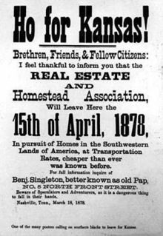
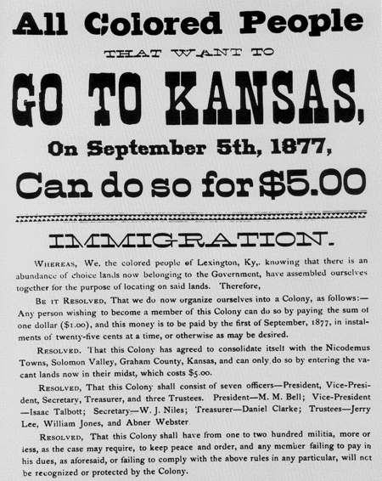
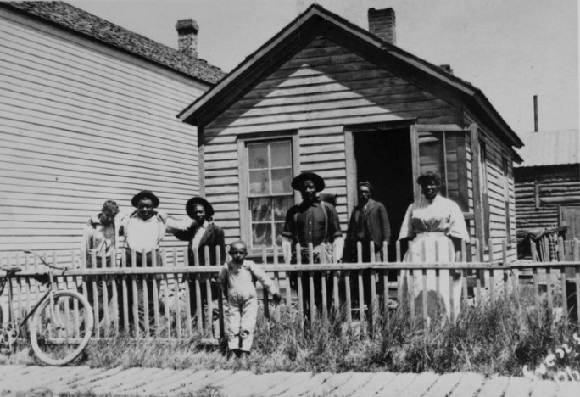

Slide 8
Imposing Segregation
The Loophole on the 15th Amendment:
Prohibits denying citizens the right to vote “based on race, color, or previous condition of servitude”…
But it doesn’t say you can’t prohibit on another basis!
Southern states began to pass “restrictions”
Poll Tax
Literacy test
Grandfather clause (allowed poor whites to vote).
This happened slowly and gradually- not overnight.

Slide 9
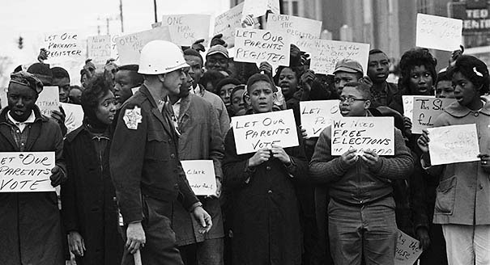

Slide 10
Legalized Segregation
Discrimination was everywhere, but in the South it was legally mandated.
Jim Crow laws enforced segregation.
How was this allowed to happen?
1875: Civil Rights Act was passed by the Supreme Court.
Prohibits discrimination in public and selecting jurors.

Slide 11
Legalized Segregation
1883: Supreme Court overturns the Civil Rights Act (one year after the Chinese Exclusion Act).
Supreme Court ruled that no “state” could discriminate against citizens- but private businesses can.
Set the stage for segregation: restaurants, railroad cars, busses, theaters, drinking fountains, schools, hotels…

Slide 12
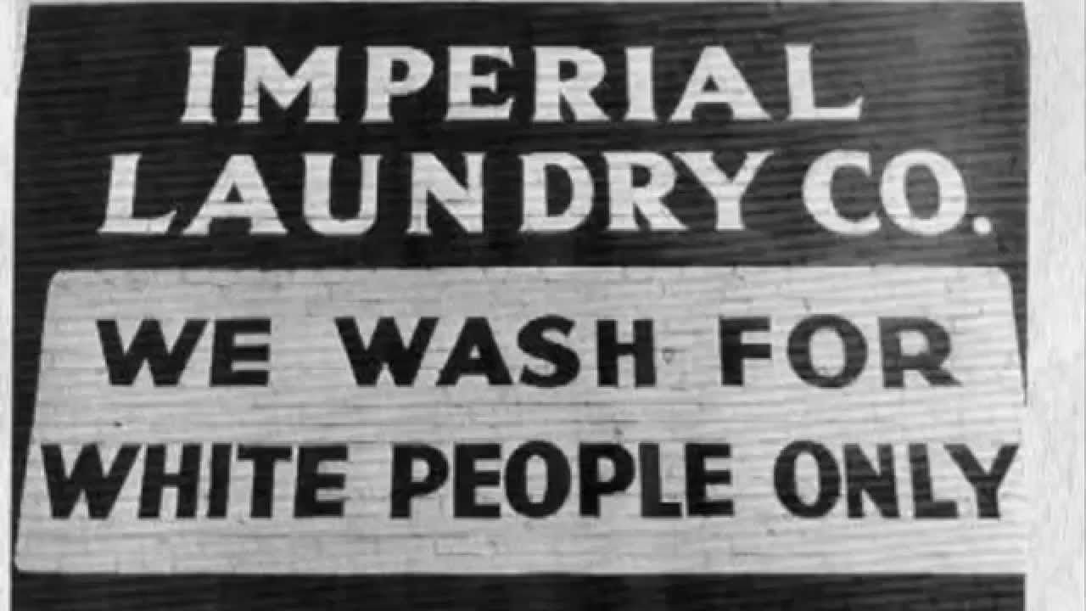
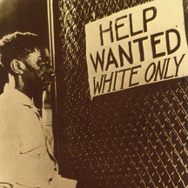

Slide 13
Plessy v. Ferguson
1892: Homer Plessy, a black man, challenged a Louisiana law when he was arrested for riding in a whites-only rail car.
Supreme Court upheld the laws and established the “separate but equal” policy that served as a legal basis for Jim Crow for 50 years.

Slide 14
Who is this man?

