Slide 1
American Imperialist Vision
Ch 5 Section 1

Slide 2
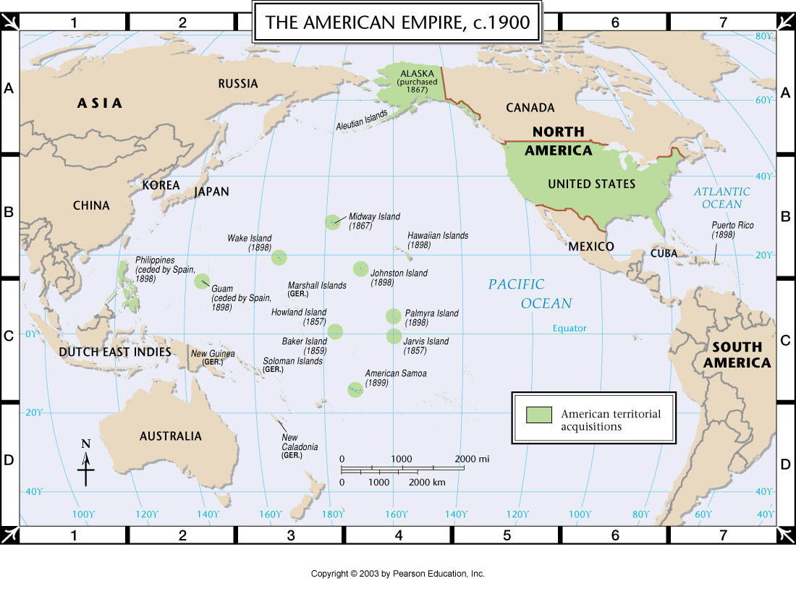

Slide 3
Imperialism and “Manifest Destiny”
Old | New
Promoted by agricultural and/or religious interests | Promoted by industrial interests
Goals: “God, Glory, and Gold” | Goals: new markets, cheap labor and resources, and military bases
Where: In North America | Where: Outside North America
Influenced by sectional concerns | Influenced by nationalist concerns

Slide 4
Support for Imperialism
America wanted to be like the large European powers, and protect its overseas “investments”.
  “Protectorates”: local rulers were left in place, but had to follow European orders. In exchange, they received protection from outside invasions.
Manifest Destiny + Social Darwinism + “Anglo-Saxonism” + New markets/industrialism = Feeling of superiority
  John Fiske, British historian: English-speaking nations are superior, and fit to dominate others.
  Josiah Strong, American Anglo-Saxon preacher: link imperialism to Christianity (missionaries).

Slide 5
Building a Modern Navy
U.S. became more assertive in its foreign policy against Europe.
  Monroe Doctrine, 1823: Europe may no longer interfere in Latin America/Western Hemisphere.
  Almost went to war with Germany over Samoa.
America needs a navy and military to match European powers.
  Supported by presidents Harrison, McKinley, and T. Roosevelt

Slide 6
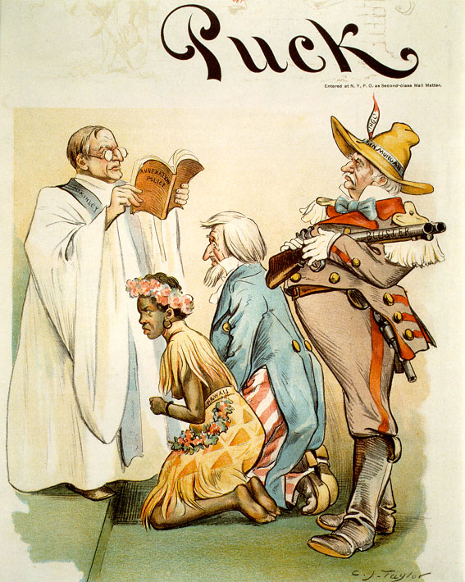
Notes:
Senator John Tyler Morgan, a Democrat from Alabama, forces the shotgun wedding. Morgan was a racist and ex-slave holder who pushed for American imperialism.

Slide 7
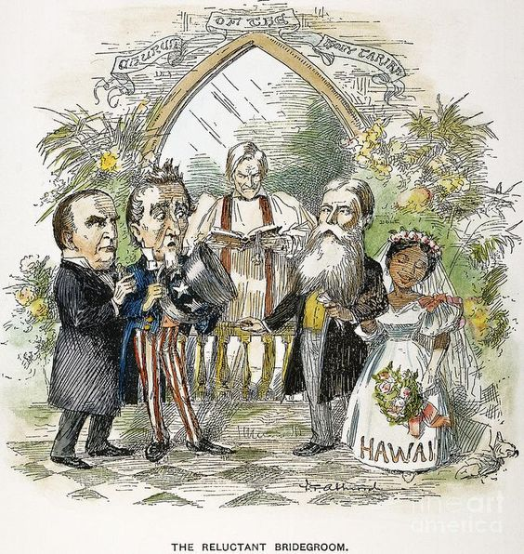
Notes:
McKinley as the best man and Sanford Dole gives away the bride.

Slide 8
The White Man’s Burden
Look at each image, and determine:
  What is happening in the cartoon?
  What is the message?
  What are the meanings of some symbols/figures?
  Is the image in support of imperialism, or against it?

Slide 9
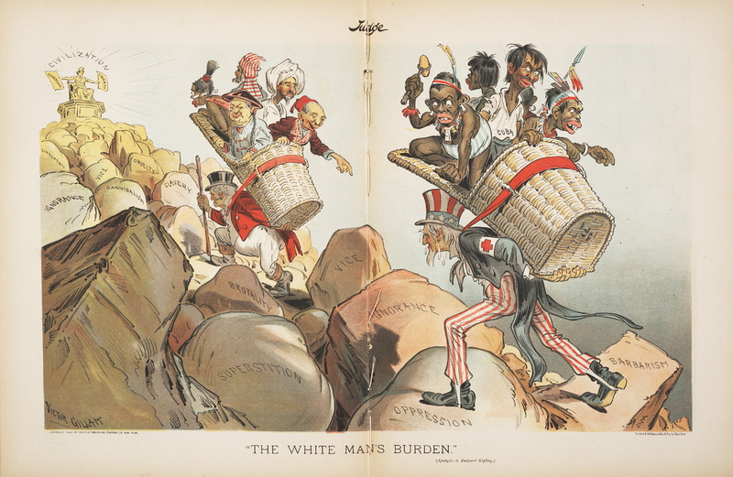
“The White Man’s Burden”

Slide 10
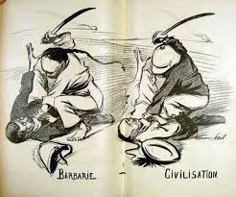
Barbarism/Civilization

Slide 11
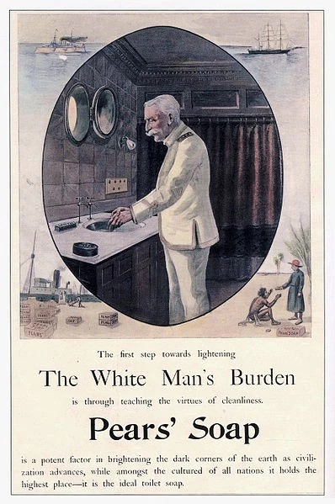
Soap Advertisments

Slide 12
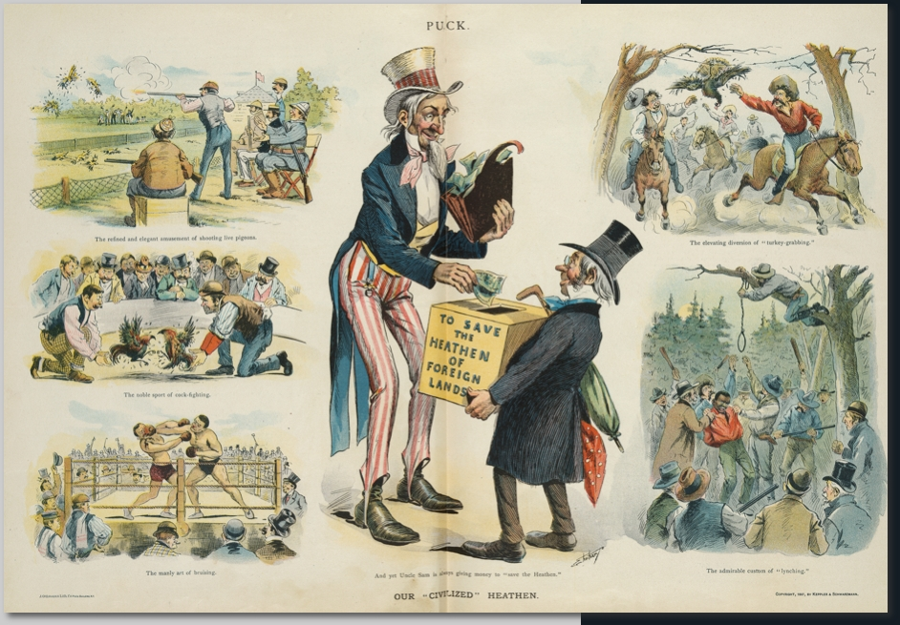
“Our Civilized Heathen”

