Slide 1
Theodore Roosevelt And William Howard Taft
Progressive Era Presidents

Slide 2
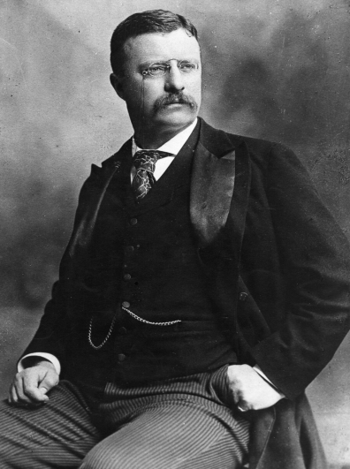
Theodore Roosevelt
Avid outdoorsman
In foreign policy, was a big believer in Social Darwinism and American imperialism.
Domestically, he was a Progressive.
Offered a “Square Deal” for all Americans:
1. Control of corporations and trusts
2. Consumer Protectionism
3. Conservation of America’s natural resources

Slide 3
Teddy on Trusts
Believed that trusts and big business were important for American prosperity, but was suspicious of their concentration of wealth and power.
Too easily corrupted, and must therefore be monitored closely.
He changed the relationship between the federal government and business forever.
How much should the government regulate business?
When is it no longer “laissez-faire”?

Slide 4
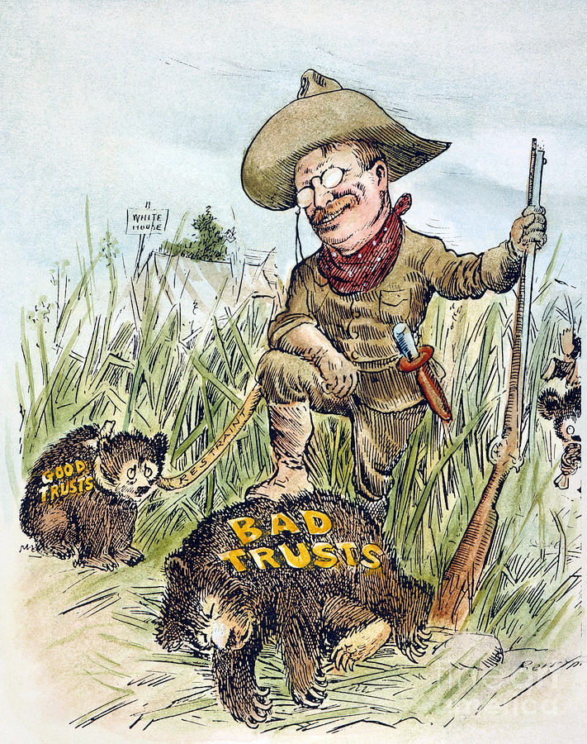
Teddy on Trusts
Targeted J.P.Morgan’s Northern Securities railroad holding company when it was about to merge into a monopoly.
Roosevelt was hailed as a “trustbuster.”

Slide 5
“Speak softly, but carry a big stick.”

Slide 6
Teddy on Consumer Protectionism

Slide 7
Teddy on Consumer Protectionism
Samuel Hopkins Adams- muckraker journalist who wrote about patent medicines.
Upton Sinclair wrote The Jungle. (1906)
Responded with the Meat Inspection Act (1906) and Pure Food and Drug Act (1906)
USDA: US Dept of Agriculture
FDA: Food and Drug Administration
Raised food prices; people were OK with it.
Another change in the relationship between government and business.

Slide 8
Teddy on Conservation
Best remembered for his environmental causes.
Conservation should be guiding principle in managing our natural resources.
Put nature before business
Changed landscape and economy of the West with irrigation and land development.
Est. US Forest Service in 1905, led by Gifford Pinchot.
Apply scientific standards to managing forests and parks.

Slide 9
Roosevelt and John Muir, Glacier Point, Yosemite, 1903

Slide 10
Teddy’s Legacy
Changed role of federal government
His “bully pulpit” was his seat in the White House.
Increased power of the executive branch
More Americans looked to government as a way to solve problems.
“The President is a steward of the people and should take whatever action necessary for the public good unless expressly forbidden by law or the Constitution. I do not usurp power but I greatly broaden the use of executive power.”

Slide 12
William Howard Taft
Taft considered himself a Progressive, but actually angered other Progressives.
Tariff reform split Republicans:
Progressive republicans wanted reduced tariffs
Conservative republicans wanted high tariffs
Replaced James Garfield, Sec of the Interior (a fierce consrvationist) with Richard Ballinger, a corporate lawyer.

Slide 13
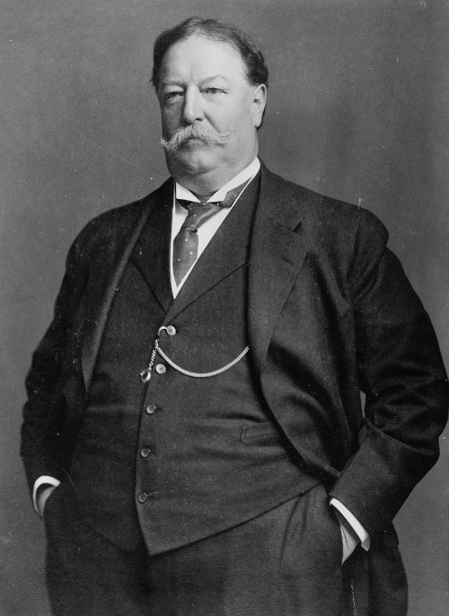
William Howard Taft
So unpopular, he lost his second term.
Was he a Progressive?
Busted more trusts that Teddy
Est Children’s Bureau to investigate child labor
Est Bureau of Mines
Expanded forest lands

Slide 14
Send a President a Valentine!
Create a Valentine card for any of the Progressive presidents- Teddy Roosevelt, W.H. Taft, or Woodrow Wilson.
It can be from a progressive reformer/muckraker or from anyone, even you.
Must include something you love about them regarding their reforms (i.e. their tax plan, social reforms, etc.)
Should have a ridiculous, cheesy line and maybe even rhyme.

