Slide 1
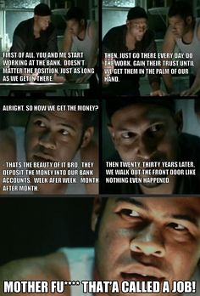

Slide 2
The Wilson Years
The End of Progressivism
Ch 6 Section 3

Slide 3
The Election of 1912
Democratic Nominee | Republican Nominees
Woodrow Wilson Academic career, fairly new to politics President of Princeton Governor of New Jersey Since Wilson’s victory, progressivism has been associated w/ Democrats | William Howard Taft - Conservative ________________ Theodore Roosevelt Progressive “Bull Moose” Split Republican Party made it possible for the Democrats to win.

Slide 4
Roosevelt vs. Wilson
Roosevelt: “New Nationalism” | Wilson: “New Freedom”
Accepted large trusts, but believed in monitoring them (Dept of Commerce and Labor). Supported laws to protect women, children, and provide worker’s comp. | - Didn’t like T. Roo’s “regulated monopoly” and thought the fed government had too much power over the economy (reduced competition).

Slide 5
Wilson’s Reforms
Income Tax and the 16th Amendment
Direct tax- tax on a person or their property (i.e. property tax)
Indirect tax- Someone pays, but the burden is actually on someone else (i.e. sales tax)
Until 1900, the government used to raise most funds through indirect taxes.
But progressives think the best way to raise $$$ is through income taxes.
Why?? Who pays more indirect taxes? Wh would pay more income taxes?

Slide 6
Income Tax!!!!!!!!!
Income tax is graduated (based on how much $$$ a person makes).
Congress had struck down a law on income taxes because it taxed all income, not just wages (i.e. property rent, stock dividends…)
It was unconstitutional because it was not proportionally divided among states.
But this means that income taxes fall on only wages– working people who cannot afford to invest.
So working people would be paying more income taxes than rich people who make money by other means.

Slide 7
16th Amendment
Progressives wanted an amendment that would tax all income, regardless of the source, without dividing proportionally among the states.
Supported by Taft and Roosevelt, and passed Feb 1913.
Wilson later addressed Congress himself (1st State of the Union address) and asked to reduce tariffs and establish a federal income tax.
Revenue Act (Underwood-Simmons) 1913- reduced tariffs to 30% and established federal income tax.

Slide 8
Where does your federal income tax $ go???
25%: Military (Defense Budget)
22.5%: Health care programs
17%: Various programs for those in need (retirement benefits for fed employees, food welfare, child tax credit, etc)
8%: pay off interest on national debt
4.5%: Veterans benefits
3.3%: Education
2%: Immigration and law enforcement programs
2%: Natural Resource Management
1.7%: International initiatives (diplomatic missions, humanitarian aid, etc)
1%: Science programs (NASA, etc)

Slide 9
The Federal Reserve
Federal Reserve Act 1913- created regional reserve banks (12 total).
President appoints Board of Governers who supervise the bank.
They set the interest rates and control the amount of $ in circulation.
One of the most significant pieces of legislation in American history.
Uses monetary policy to manage the nation’s economy.
If the Fed sets low interest rates, people borrow more → increases money in circulation.
If they set high interest rates → decreases $ in circulation, which reduces inflation.

Slide 10
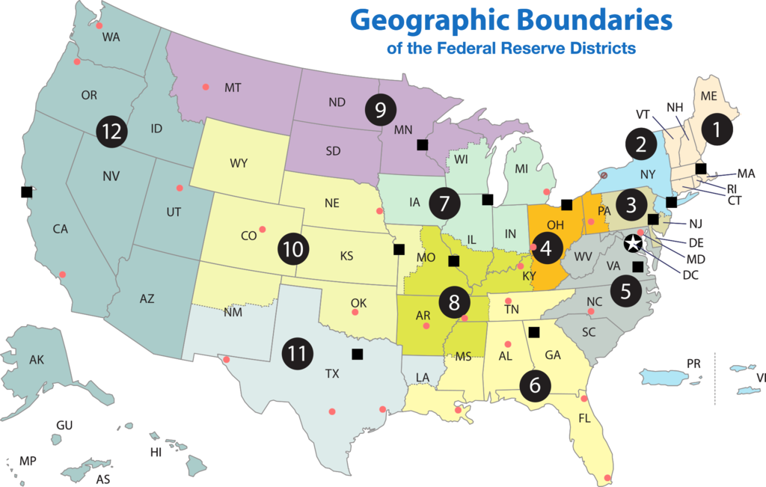

Slide 11
Anti-Trust Action Regulating Big Business
Wilson was anti-trust at first, but later realized Roosevelt was right.
Created the Federal Trade Commission (FTC) to monitor companies.
Ensures they don’t engage in unfair trade practices.
Clayton Anti-Trust Act: outlawed price manipulation and other unfair practices.
Hailed by union leaders as the “Magna Carta” of workers.

Slide 12
Limits of Progressivism
Wilson and Roosevelt both expanded the size of the fed government and power of the President; regulated economy and finance of the country.
Could not end racial or religious discrimination or Jim Crow laws.
1905 Niagara Movement- W.E.B. Du Bois amd other African American leaders met to demand equal rights and end lynching.
After 1908 race riots in Springfield, Ill., NAACP was founded.
Anti-Defamation League was founded to fight anti-Jewish discrimination after lynching of Leo Frank.

