Slide 1
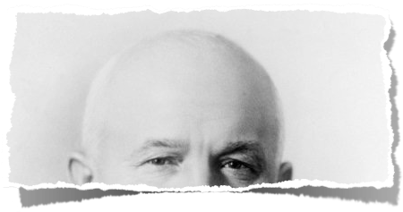
WHO? WHAT? WHY?

Slide 2
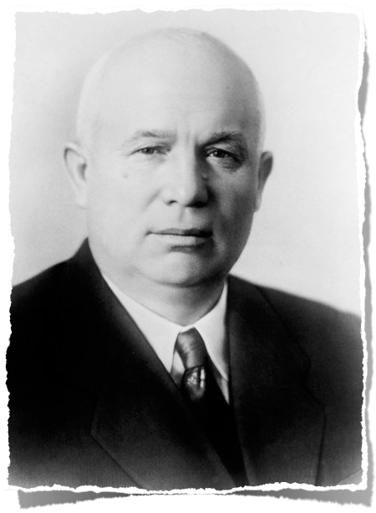
WHO? WHAT? WHY?

Slide 3
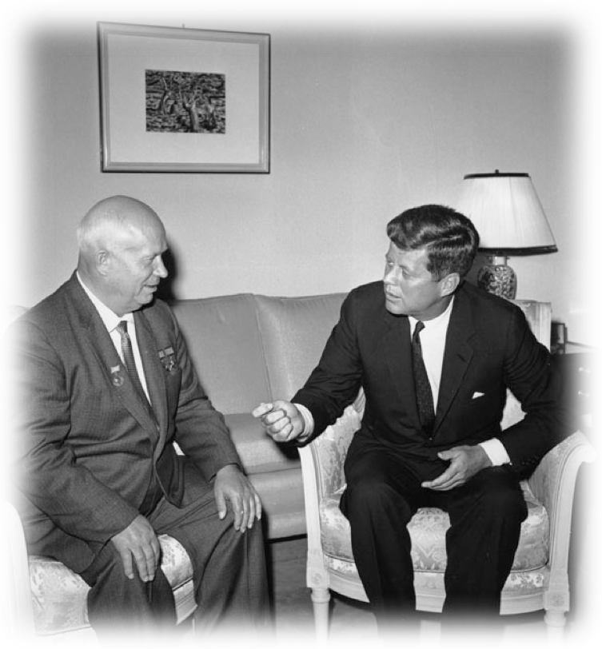
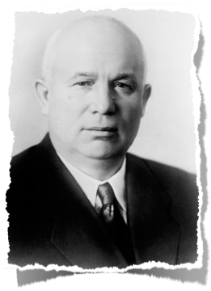
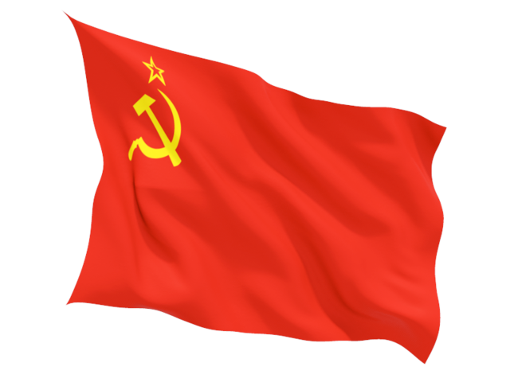
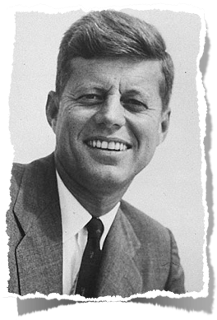

Slide 4
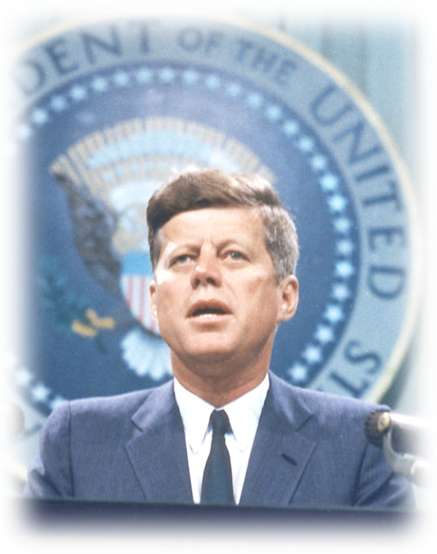
CRISES
UNDER KENNEDY

Slide 5
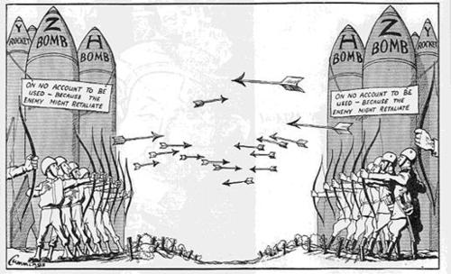
Brinksmanship: Eisenhower had relied on this heavily. “MAD”= Mutual Assured Destruction

Slide 6
kennedy
THE
DOCTRINE
JFK FELT IKE HAD NOT DONE ENOUGH TO KEEP COMMUNISM FROM 3RD WORLD
poorer nations in Asia, Africa, Latin America were warming to communism (Cuba fell in ’59)
FEARFUL OF NUCLEAR ARMAGEDDON, JFK REDEFINED COLD WAR POLICY:
he turned away from “MAD” and advocated a
“FLEXIBLE RESPONSE”
he built up conventional military to allow for non-nuclear solution to minor conflicts
he developed elite special military forces (AKA Green Berets) for covert operations

Slide 7
BEFORE LONG, KENNEDY’S NEW POLICY TOWARD THE SOVIETS WOULD BE PUT TO THE TEST!
khrushchev sensed kennedy’s youth as a weakness
he would test kennedy WITH aggressive new global advances
jfk would deal with crises that would could mean nuclear war

Slide 8
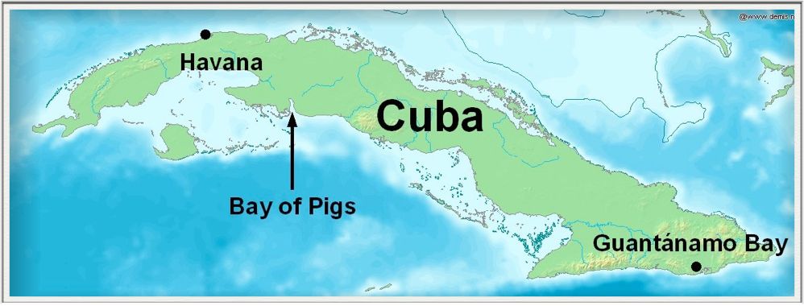
THE BAY OF PIGS INVASION

Slide 9
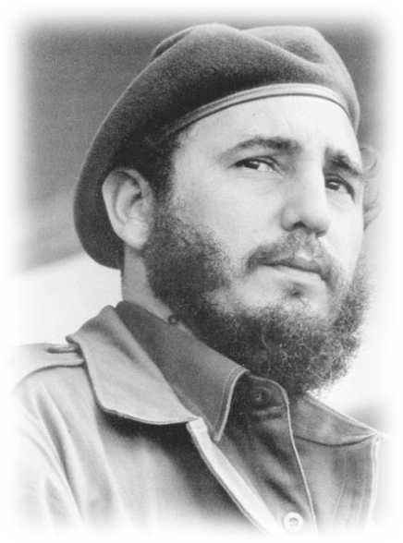
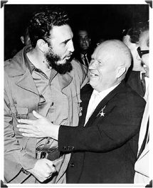
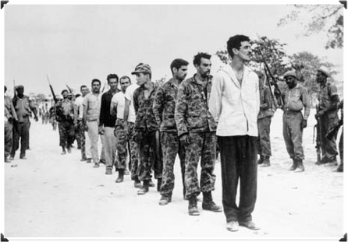
CUBAN
THE
DILEMMA
1959 - COMMUNIST REBEL FIDEL CASTRO SEIZES CONTROL OF CUBA (90 MI OFF MIAMI)
Castro relied heavily on Soviet aid, which made Cuba a major threat on US doorstep
US cut off diplomatic relations w/ Cuba & 1000s of Cuban exiles fled to America
1961 - jfk approves a plan to invade cuba w/ cia-trained cuban exiles
the plan fails miserably as everything breaks down & exiles are killed or captured
JFK PUBLICLY ACCEPTS RESPONSIBILITY
the operation is a public defeat for US and bolsters Soviet cause to defend Cuba from US

Slide 10
KHRUSHCHEV DECIDES TO PUSH HARD AFTER THE AMERICAN BLUNDER AT THE BAY OF PIGS
JFK & KHRUSHCHEV MEET IN VIENNA
KHRUSHCHEV AGGRESSIVELY TESTS KENNEDY’S YOUTH & INEXPERIENCE
HE THREATENS TO BLOCKADE WEST BERLIN & JFK REFUSES TO BACK DOWN

Slide 11
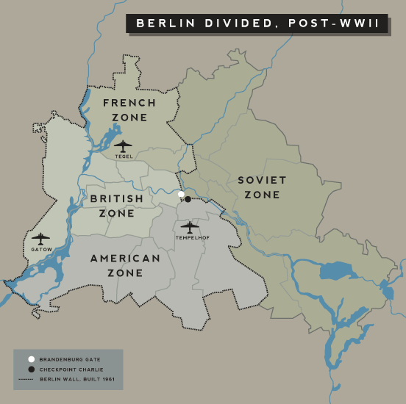
THE BERLIN CRISIS

Slide 12
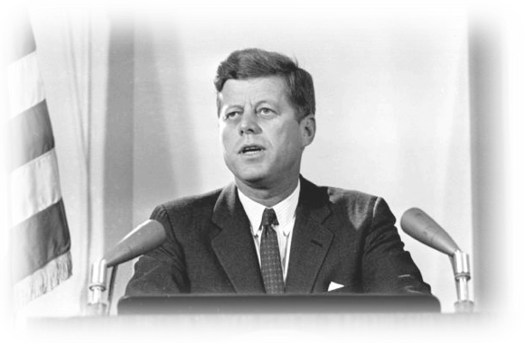
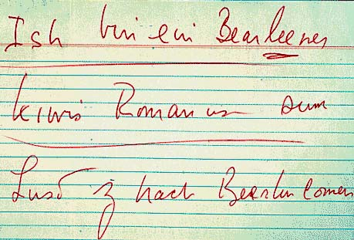
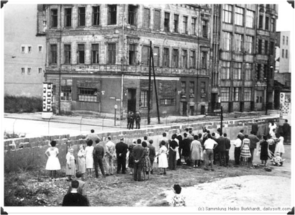
BERLIN
BERLIN
& THE
DIVIDED
WALL
KENNEDY BEGAN TO SHOW HIS DETERMINATION TO CONTAIN COMMUNISM
on a TV address, JFK defiantly declared US wouldn’t be driven from West Berlin
Kennedy had the advantages on superior nukes & moral right in eyes of the world
AUGUST 13, 1961 - UNDER DARKNESS, KHRUSHCHEV ERECTS THE BERLIN WALL
the concrete wall keeps East Berliners from escaping to West Berlin
JFK TRAVELS TO WEST BERLIN TO SPEAK
he defiantly slams the wall as an ugly symbol of communist oppression against freedom everywhere

Slide 13
kennedy’S
BERLIN
SPEECH

Slide 14
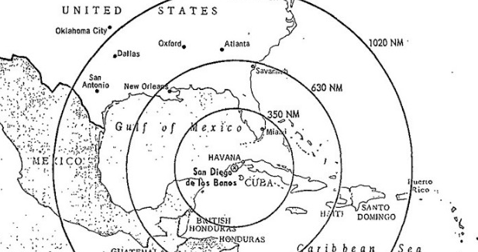
THE CUBAN MISSILE CRISIS

Slide 15
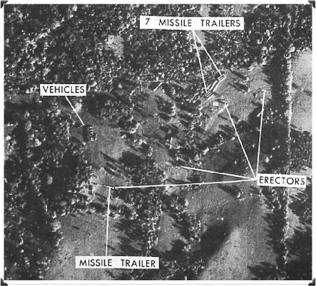
SOVIET
WEAPONS
CUBA
IN
SUMMER 1962 - SOVIET SHIPS DELIVER WEAPONS TO CASTRO REGIME IN CUBA
instantly, JFK warns that the US will not tolerate Soviet offensive weapons in Cuba
Secretly, Kennedy & his cabinet prepare options for airstrikes & land invasion of Cuba
OCT. 14, 1962 - US PLANES PHOTOGRAPH SOVIET MISSILE BASES IN CUBA
some of the missiles were armed w/ nukes and were ready to launch immediately
OCT. 22, 1962 - KENNEDY ADDRESSES THE NATION ON TV
aware that the missiles could destroy US cities in minutes, JFK promises MAD if Soviets attack

Slide 16
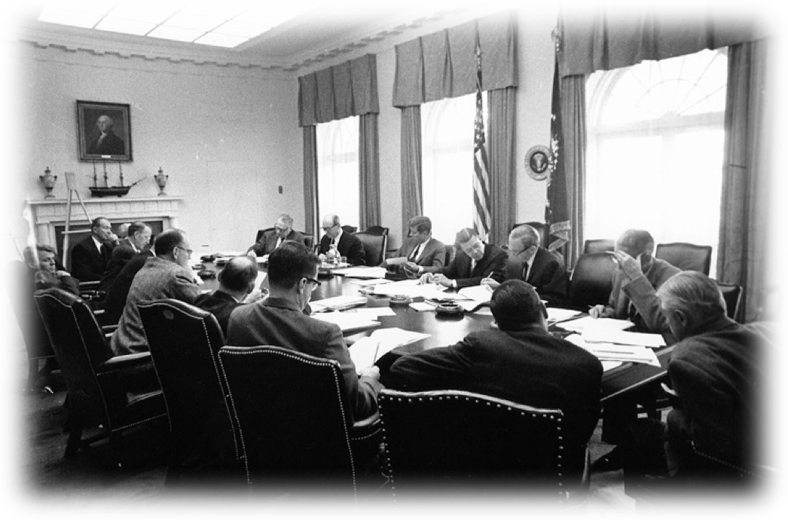

Slide 17
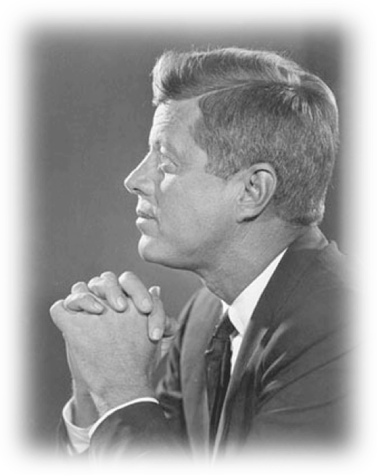
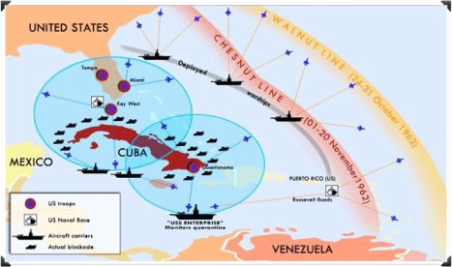
THE
BLOCKADE
CUBA
OF
FOR 6 DAYS, THE WORLD FACED THE REAL POSSIBILITY OF NUCLEAR ANNIHILATION
Kennedy & his cabinet met all day each day, debating how to protect the country while trying to avoid nuclear war with the Soviets
FINALLY, KENNEDY DECIDES ON A NAVAL QUARANTINE OF CUBA
massive naval forces blockade the island & threaten to sink Soviet ships bound for Cuba
when soviet ships reached the blockade, they turned around
Kennedy’s resolve to keep nukes out of Cuba proved too much and Khrushchev flinched

Slide 18
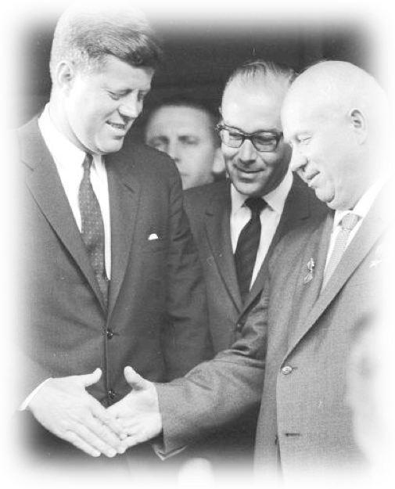
THE
RESULTS
OF THE
CRISIS
TO THE WORLD, THE US HAD WON THE CRISIS AND KHRUSHCHEV LOST PRESTIGE
Kennedy had proven his resolve and had shed the idea he was young and weak
secretly, the two sides agreed on several things to end the crisis:
the Soviets would dismantle and remove all weapons from Cuba immediately
the United States agreed not to invade Cuba
the US also agreed secretly to remove it’s nukes in Turkey (equal to missiles in Cuba)

Slide 19
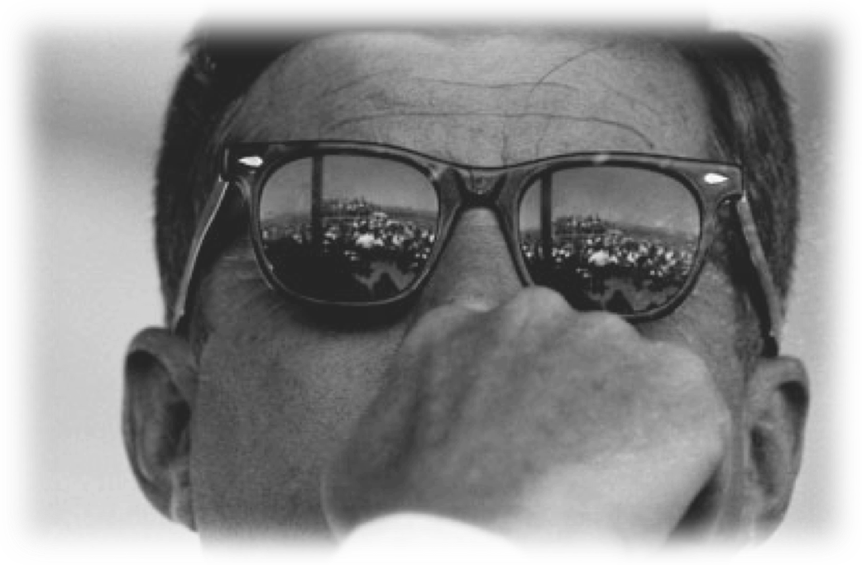
CRISES
UNDER KENNEDY

Slide 20
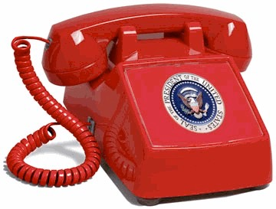
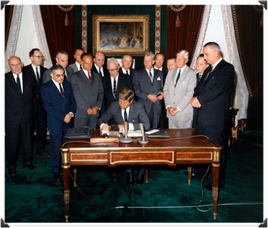
CRISES
LEAD TO
NEGOTIATION
NUCLEAR HOTLINE
BOTH KENNEDY & KHRUSHCHEV BEGAN TO REALIZE ACCIDENTAL WAR WAS EASY
BOTH LEADERS COULD COMMUNICATE INSTANTLY IF ANOTHER CRISIS AROSE
LIMITED TEST BAN TREATY
1963 - A TREATY IS SIGNED THAT BANNED NUCLEAR TESTING IN THE ATMOSPHERE (YAY EARTH!)

Slide 21
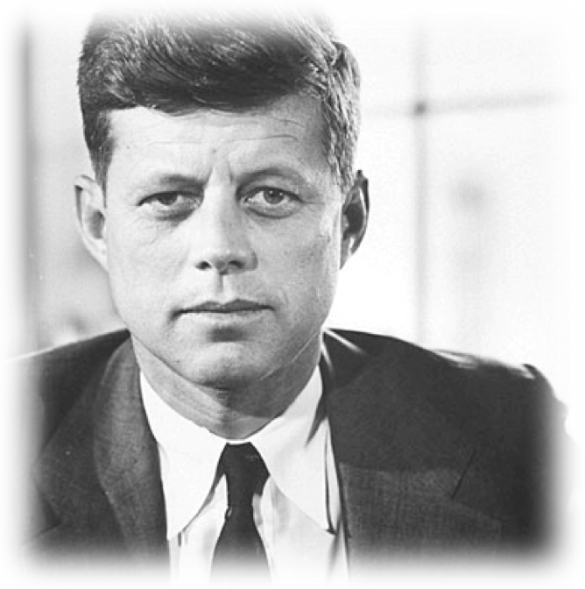
SITUATION DEBRIEFING
1) 3 things you learned about Bay of Pigs invasion
2) 3 things you learned about the Berlin Crisis
3) 3 things you learned about Cuban Missile Crisis

