Slide 1
AP EURO Writing Workshop
DAY 1

Slide 2
GOALS
Review G-PERSIA/Notetaking
Introduce you to AP College Board Style of Writing
Teach you the parts of an AP Euro College Board Essay
Introduce and write FIRST ESSAY.
Due Two Weeks

Slide 3
You today?

Slide 4
You one year from now.

Slide 5
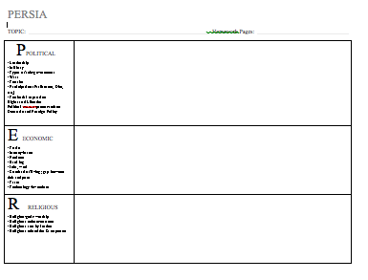

Slide 6
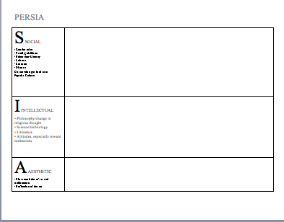

Slide 7
Cornell Notetaking

Slide 8
AP College Board Writing Expectations
80 Multiple Choice Questions
3 Essays
2 FRQs
30 minutes each
1 DBQ
45 minutes

Slide 9
The Differences
FRQ
DBQ
2 of them on exam
30 minutes each
You can choose the prompt from 6 choices (1 from 2 groups of 3)
Basic 5 paragraph essay
Thesis
3 arguments
Examples that you’ve studied and know.
1 of them the exam
15 minutes to read/brainstorm
45 minutes to write
12 -14 documents
You read them.
You use them to write an essay.
Has more requirements

Slide 10
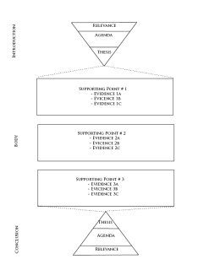
What are the parts of an essay?
Introduction
End with your thesis statement
Body paragrpahs
Each body paragraph addresses 1 argument
Identifiied in the thesis
Conlcusion

Slide 11
Intro & Thesis Statement
It is YOUR opinion, your position; it is what you are TRYING TO PROVE in your essay
Can’t be wrong if you have arguments to support it.
It’s usually one, maybe two sentences
It is EXPLICIT
It usually ends your introductory paragraph.

Slide 12
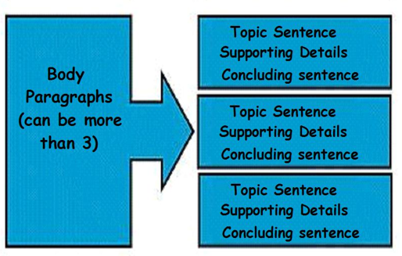

Slide 13
Thesis Statement
Clayton Valley Charter High School is the best school in Contra Costa County because it has the greatest diversity of students, it has the greatest teachers and is a technology magnet.
First sentence of first body paragraph:
One reason CVCHS is the best school in the county is because it has the greatest diversity of students.
(NOT EXPLAIN AND PROVE THIS)
First sentence of second body paragraph
Additionally, CVCHS has the greatest teachers.
(NOT EXPLAIN AND PROVE THIS)
First sentence of third body paragraph
Lastly, CVCHS is a technology magnet, therefore making it superior to all other schools in the district.
(NOT EXPLAIN AND PROVE THIS)

Slide 14
Should CVCHS change the school dress code?
Come up with 3 arguments to support your opinion.
1.
2.
3.
Now lets develop a thesis statement!

Slide 15
Do violent video games contribute to youth violence?
Come up with 3 arguments to support your opinion!
1.
2.
3.
Now lets develop a thesis statement!

Slide 16
Are social networking sites good for our society?
Come up with three arguments to support your opinion.
1.
2.
3.
Now lets develop a thesis statement!

