Slide 1
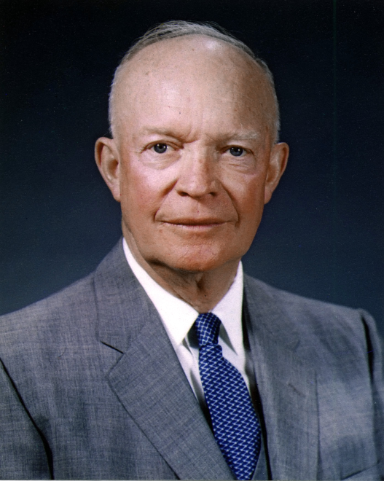
The Cold War: The Eisenhower Presidency
Chapter 13 Lesson 4

Slide 2
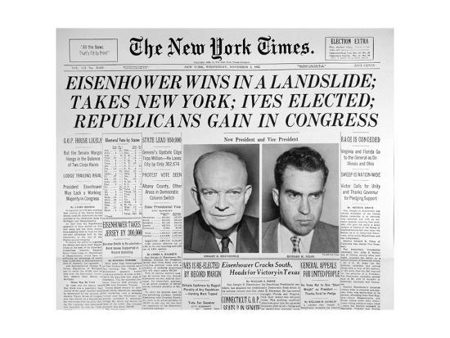
The Election of 1952
Truman did not run again
1952: Democrats choose Adlai Stevenson, Republicans choose Dwight Eisenhower.

Slide 3
Policy of “Massive Retaliation”
Best way to beat Communism is with a great economy.
Nuclear weapons give “More Bang for Your Buck”.
Korean War proved we can’t beat communism with a series of small wars- we need to prevent wars altogether.
Nuclear weapons promise massive retaliation, and discourages war.

Slide 4
The Nuclear Triad
Long range bombers
B-52 Bomber Plane (1955)
Still in use today
ICBMs- Inter-Continental Ballistic Missiles
Can reach anywhere in the world in 30 minutes
Land-based missiles
Atlas Missile was the 1st.
Same technology used by NASA to launch rockets and satellites
Missile-carrying submarines
The Polaris launched in 1960 carrying 16 nuclear missiles.

Slide 5
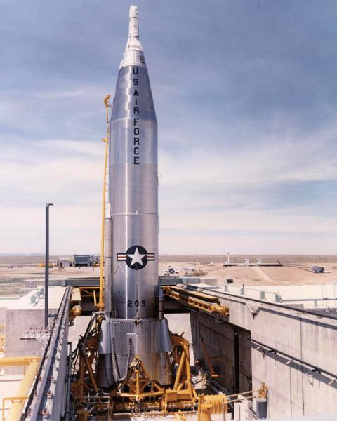
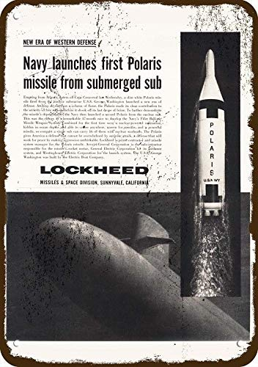
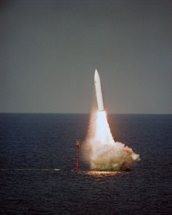
The SM-65 Atlas ICBM
The Boeing B-52 Stratofortress
The Polaris submarine
missile

Slide 6
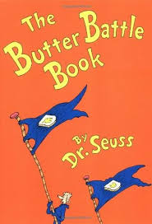
Results of this policy:
Eisenhower reduces the size of the military and military spending
Increased size of nuclear arsenal from 1,000 nuclear bombs in 1953, to 18,000 in 1961.
Created an arms race with the Soviet Union.
How big can nuclear weapons get? How does one “win”?
What happens when the biggest one is built?

Slide 7
Brinkmanship
The policy of being constantly on the brink of war.
Eisenhower’s critics coined this term for his policy.
Taiwan Crisis in 1954
Brinkmanship worked
The Suez Crisis in 1956
A diplomatic victory for the Soviet Union, since the Soviets offered to help the Arab nations.
Brinkmanship did not work in this case.

Slide 8
Covert Operations
Brinkmanship could prevent war, but could not prevent communist revolutions in developing nations.
Eisenhower used covert (secret) operations by the CIA to overthrow communist-friendly leaders in other nations and replace them with American-approved regimes.
This actually led to instability and dictatorships in many countries, even if it benefitted the US in some ways.
Examples in Iran and Guatemala

Slide 9
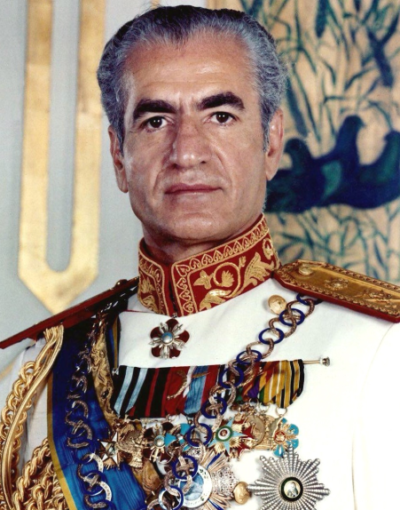
Iran
The CIA helped overthrow the Iranian Prime Minister Mohammad Mossadegh, who wanted to nationalize Iran’s oil.
America replaces him with the Shah (prince) of Iran, who was friendly to American interests.
He would later be overthrown in a revolution in 1979, and lead to massive instability in Iran even to this day.
Mohammad Reza Pahlavi,
The Shah of Iran

Slide 10
Guatemala
Communist-supported Guatemalan President Jacobo Arbenz Guzman started land reforms, taking over plantations.
Including land owned by United Fruit Company* (an American company).
The CIA trained opposition troops to overthrow his government, and Guzman left office.
Because of this, Guatemala was in a state of civil war from 1954 until 1996!!!
Genocides, mass murder, kidnappings and massacres.
Hundreds of thousands left Guatemala and headed north as refugees.

Slide 11
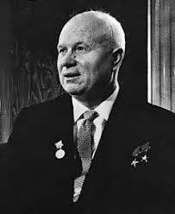
Trouble in Eastern Europe
Stalin died in 1953; succeeded by Nikita Khrushchev.
He denounced Stalin in a secret speech.
The CIA obtained a copy of the speech and spread copies of it all over Eastern Europe.
Khrushchev was humiliated.
Meant to undermine communism and make people doubt it.
It worked: Hungarian Uprising in 1956.
Khrushchev would have tolerated more freedoms in Eastern Europe, but now to save face invaded Hungary and brutally crushed the uprising.

Slide 12
Sputnik and the Space Race
When America launched its first ICBM, it was shocked to learn that the Soviet Union already had them!
Launched Sputnik on Oct 4, 1957
First satellite to orbit the Earth.
The U.S. launched their first satellite, Explorer 1, four months later.
1958: Eisenhower established NASA
Starts a Space Race between the US and USSR
Today, satellites are used in everyday technology

Slide 13
The Eisenhower Doctrine
Extends the Truman Doctrine to the Middle East.
Due to the fact that Egyptian President Gamal Abdel Nasser started the Pan-Arab movement and was linked to the Soviet Union.
July 1958: Left-wing rebels, supported by the USSR, take over Iraq.
Lebanon asked the US to intervene; Eisenhower sent 5,000 Marines to Beirut.

Slide 14
Khrushchev and the US
After crushing Hungarian Uprising, Khrushchev boasts: “We will bury capitalism… Your grandchildren will live under communism.”
He demands withdrawal of Allied troops from West Berlin, but backed down after threats from NATO.
Brinksmanship worked!
Eisenhower invites Khrushchev to the US and the meeting went… well.
Except when he got mad when we wasn’t allowed into Disneyland in California!

Slide 15
A Spy Plane is Shot Down
Eisenhower and Khrushchev planned a summit meeting in Paris.
Just before the meeting, the Soviets shot down an American U-2 spy plane.
Eisenhower denied it; Khrushchev produces the pilot (Francis Gary Powers), puts him on trial, and hold him prisoner for 2 years.
He was later returned to the US via a prisoner exchange.
The Paris Summit never happened.

Slide 16
Francis Gary Powers on trial in Moscow (seated on the right)

Slide 17
Eisenhower says good-bye
In 1961, he reached the end of his presidency.
In his Farewell Address, he warns America about the military-industrial complex- even though he helped create it!
A relationship between the military and the defense industry that promotes greater military spending and influences government policy.
In other words… there is money to be made in war.

Slide 18
The Military-Industrial Complex

Slide 19
Eisenhower’s Disappointment
He avoided all-out war, contained communism, and asserted American dominance.
BUT… also saw communism on the rise in Vietnam and saw Fidel Castro successfully build a communist regime in Cuba- our own front yard!
“As one who has witnessed the horror and lingering sadness of war… I wish I could say tonight a lasting peace is in sight.”

Slide 20
What does this say about
Eisenhower?
Did he have regrets about
building up the nuclear
arsenal?

Slide 21
Your assignment
Read Eisenhower’s Farewell Address.
Remember when we read Washington’s Farewell Address? How do these compare?
Answer the reading questions and submit via Google Classroom.

