Slide 1
Eisenhower to Kennedy
The 1960s

Slide 2
Eisenhower says good-bye:
Warned his successors of the military-industrial complex in his Farewell Address.
Relationship between the military, Congress, and the defense industry to promote greater military spending and influence government policy.
Eisenhower’s two terms saw massive military expansion, though he tried to deter it.

Slide 3
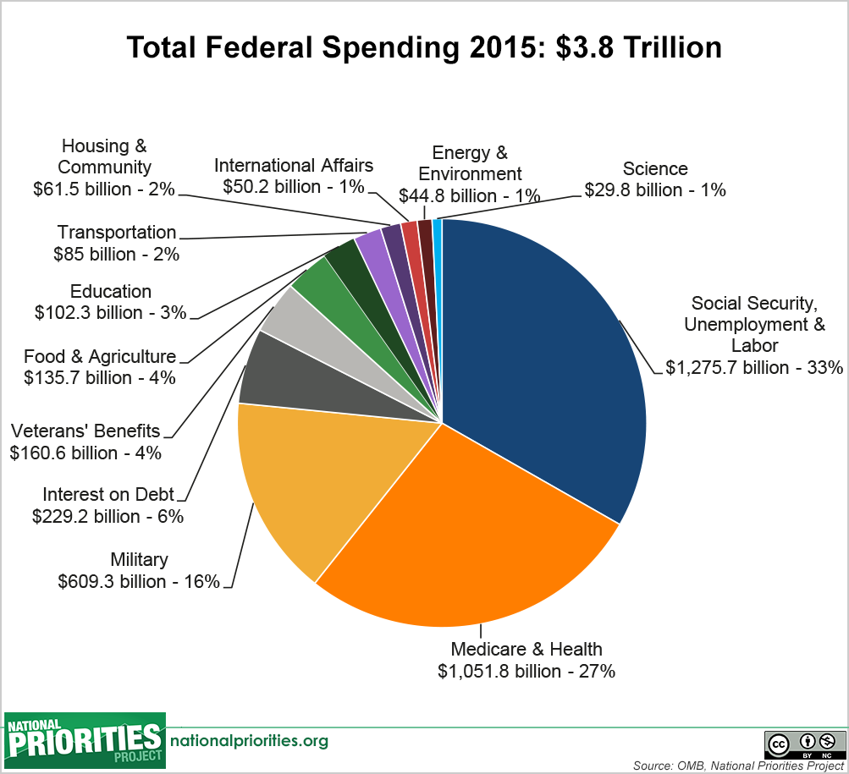

Slide 4
John F. Kennedy: The New Frontier
Election of 1960:
JFK- Democrat from Massachusetts, wealthy family, and Catholic
Richard Nixon- Republican from California
First ever televised presidential debate- Sep. 1960
Kennedy wins a narrow victory
Youthful, hopeful, handsome, progressive.
The “Kennedy Mystique”
Won the African-American vote.
Glamorous wife Jackie was beloved.

Slide 5
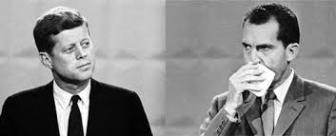
The Kennedy-Nixon Debate on TV

Slide 6
The Kennedy Mystique

Slide 7
“The New Frontier”
His cabinet was named “Camelot”
Wanted to increase aid to education, health insurance for the elderly, improve cities.
Congress did not want to; too expensive.
Southern Democrats did not support him.
Many programs never passed, but still managed to accomplish some major reforms.
Two ways to improve economy:
Deficit spending
Increase funding for defense and space exploration.

