Slide 1
Farming the Plains: The Homestead Act
Ch. 2 Lesson 2

Slide 2
Beginnings of Settlement
The Great Plains:
Harsh climate all year round
Scarce trees, lack of timber
Used to be thought of as useless, but now is America’s Wheat Belt, thanks to:
Railroads
Massive irrigation projects
Railroads stimulated growth: transported people and goods, making life possible in the Plains.

Slide 3
The Homestead Act (1862)
Another of Lincoln’s great achievements
A form of economic nationalism: when the government uses legislative or executive power to stimulate the economy.
Started as a “Free Soil” idea:
Mostly northerners (Republicans), before the Civil War, wanted to ensure that as the nation expanded west, land was “free” of slavery.
No slavery= good for the economy (jobs, immigration, etc).
Lincoln had been a member of the Free Soil Party.

Slide 4
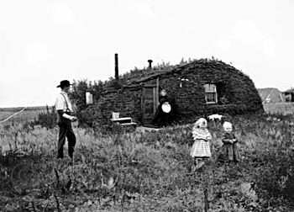
The Homestead Act (1862)
Free Soil could not happen before the Civil War (due to Compromises over slavery and Southern stance against emancipation and immigration).
But during the Civil War (1862), no southerners could stop it from passing.

Slide 5
The Homestead Act
For a small fee, a person could file for a homestead- public land available for settlement.
160 acres!
Advocated yeoman farmer idea of Jefferson’s dreams (but without the slavery).
People who own their own land sustain it, work hard, produce, are financially independent, and contribute to the economy.
The Plains needed to be put to use; people needed to be encouraged to settle there- as free land.

Slide 6
The Homestead Act
Rules:
1. No rebels could apply (no Southerners).
2. Any free person over the age of 21 who was the head of household.
Women, free blacks, and immigrants could apply!
3. Had to work the land- farm- for 5 years and produce. Then you would own it.
Roots of the Republican party: Economics and Individual Ownership.

Slide 7
Technology and Food
New farming methods:
Steel plows, seed drills, irrigation, and railroads
Sodbusters- those who plowed the Plains
Wheat was the crop of choice in this climate.
Bonanza farms- large industrial farms with huge profits and hired labor, invested in property and equipment.

Slide 8
The Frontier Closes
By the 1880s the U.S. was the world’s largest wheat exporter
Severe drought forced farmers to mortgage their land or forfeit it to the bank.
April 22, 1889: Government opens the last large settlement: The Oklahoma Land Rush.
A race for free land.
“The Sooner State”
The next year, the Census Bureau announced there was no longer a frontier. America had been settled from sea to sea.

