Slide 1
Harlem Renaissance Art

Slide 2
3 Themes
African Heritage
Slavery and Suffering: “Folk Culture”
New 20th Century African American Voice

Slide 3
An Idyll of the Deep South, from Aspects of Negro Life series Aaron Douglas, 1934

Slide 4
Fetiche et Fleurs (Fetish and Flowers) Palmer Hayden, 1926

Slide 5
Photography of James VanDerZee

Slide 6
Photography of James VanDerZee

Slide 8
Themes of the Harlem Renaissance
African Heritage
Beauty in history and culture
Rediscovery
African American Folk Culture
Struggle and Slavery
“Soulfulness”
New 20th Century Voice
Defiance and resistance
Pride

Slide 9
Jazz and Blues
Mix of Dixieland and ragtime, rhythm and improvisations, imaginative solos.
Shared Characteristics of the 1920s:
Improvisation- experimentation and freedom.
Individualism
Women were prominent performers
Voiced the struggle of black Americans
Who didn’t like jazz?
Some believed it was associated with alcohol, speakeasies, crime, and moral decline.

Slide 10
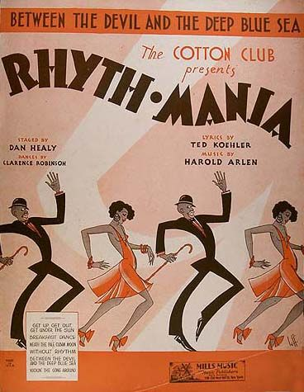
The Cotton Club

Slide 11
Positive Impact of Jazz Music
Connected people across races
Hugely popular around the world, especially Europe (where fascism and anti-Semitism were on the rise).
Possibly the greatest cultural movement that has ever impacted American pop culture.
African American art and music continues to evolve today and is widely imitated.

