Slide 1
Images of the Civil Rights Movement

Slide 2
1896: “Separate But Equal”

Slide 3
Homer Plessy

Slide 4
1954: Brown vs. Board of Education Separate is NOT Equal.

Slide 5
1955: Rosa Parks Montgomery, Alabama

Slide 6
The Reverend Dr. Martin Luther King, Jr.

Slide 7
1957: The Little Rock Nine Little Rock Central High School, Arkansas

Slide 8
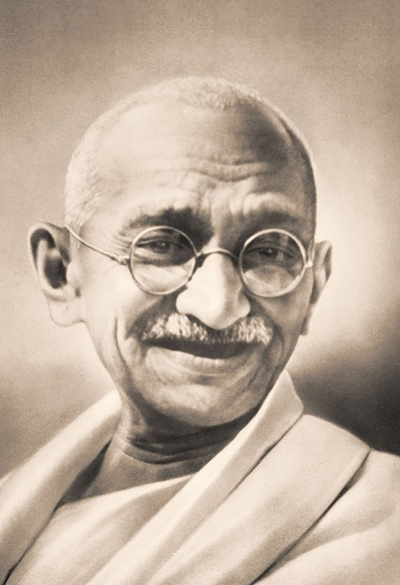
Non-violent protest
Martin Luther King was directly inspired by India’s Mohandas Gandhi in his use of non-violence to protest British oppression and liberate India.
Satyagraha- passive political
resistance.

Slide 10
Non-violent protest

Slide 11
1963: Lunch counter sit-ins
Satyagraha: The “Soul-Force” and
Quiet Pursuit of Truth.

Slide 12
Martin Luther King, Jr: A Christmas Sermon for Peace: 12/24/1967
I've seen too much hate to want to hate, myself, and every time I see it, I say to myself, hate is too great a burden to bear. Somehow we must be able to stand up against our most bitter opponents and say: We shall match your capacity to inflict suffering by our capacity to endure suffering. We will meet your physical force with soul force. Do to us what you will and we will still love you.... But be assured that we'll wear you down by our capacity to suffer, and one day we will win our freedom. We will not only win freedom for ourselves; we will appeal to your heart and conscience that we will win you in the process, and our victory will be a double victory.

Slide 13
1960: Ruby Bridges New Orleans, Louisiana

Slide 14
The Problem We All Live With by Norman Rockwell, 1964.

Slide 15
1964: “Freedom Summer”
Three Civil Rights Workers,
Members of CORE (Congress for
Racial Equality) went missing in
Meridian, Mississippi.
They were murdered by the KKK.
Andrew Goodman
James Chaney
Michael Schwerner

Slide 16
Southern Justice: Murder in Mississippi by Norman Rockwell, 1965

Slide 17
Bloody Sunday: March from Selma to Montgomery, 1965

Slide 18
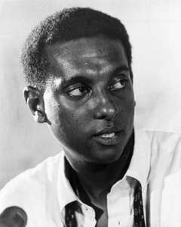
Malcolm X and Stokely Carmichael: Black Power.

