Slide 1
Labor Unions
Ch 3 Section 4

Slide 2
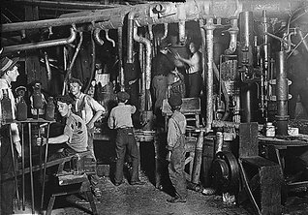

Slide 3
The true cost of “Laissez-Faire”?
Horrible working conditions in industrial America.
Despite the massive gap between the rich and poor, the standard of living still rose 50% between 1860 and 1890 (mainly due to the growing middle class).
In 1900, the average worker made $0.22/hour, 59 hours a week.
($623 a year with no vacations, 12 hours a day)

Slide 5
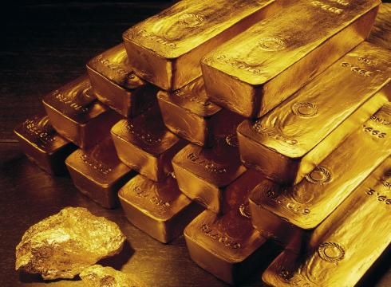
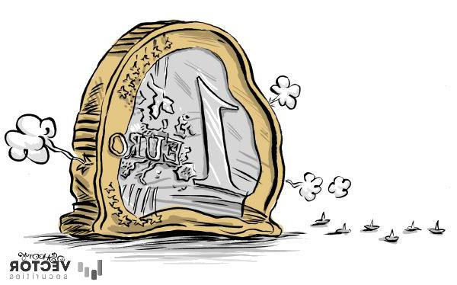
Deflation
A rise in the value of money: 1865-1897
Less money in circulation due to U.S. adherence to the “gold standard”*
This is good for banks and railroads, but bad for farmers, because deflation causes prices to drop.
Deflation also causes workers’ wages to be cut.
Workers start to organize to protect their rights and wages.

Slide 7
Early Unions
Craft workers (highly skilled, better pay)
Formed trade unions to protect themselves against “big industry”.
Common laborers (unskilled, lower pay)

Slide 8
Opposition to Unions
Employers saw unions as a conspiracy to destroy property rights.
Blacklists and lockouts were used against workers.
In case of strike, companies brought in strikebreakers, or “scabs”.
Union-busting was successful, because there were no laws to protect workers.
Courts and government sided with big business.
Unions were seen as “un-American” and dangerous due to association with European socialism, and clashes with police and army during protests.

Slide 9
The Struggle to Organize
The Great Railroad Strike- 1877.
After third wage cut, railroad workers went on strike →12 days of bloody fighting, federal troops sent in.
100 dead, $10 million in damages.
Led to perception that organized workers were dangerous.
The Knights of Labor- est 1869
Opposed strikes in favor of boycotts and arbitration.
Welcomed women and African-Americans
Called for end to child labor.

Slide 10
The Struggle to Organize
The Haymarket Riot- 1886
Strike on May 1 for an 8 hour work day in Chicago.
Led to police-involved shooting and a bombing; 10 police were killed.
8 arrested, 4 executed, including one member of the Knights of Labor.
Led to increased perception that unions were dangerous.

Slide 12
Homestead and Pullman
1892: Steel mill in Homestead, Pennsylvania, owned by Carnegie and managed by his partner Henry Frick.
Wages cut 20%, and he locked out employees.
Hired Pinkerton Detective Agency to hire scabs.
A 14 hour fight with striking workers led to several dead and injured; the strike ended.
1894: Pullman Palace Car Company
In the company town of Pullman, wages were cut, but not rents.
American Railway Union workers refused to handle Pullman cars; once again federal troops were called in.
Supreme Court injunction to halt boycott gave managers the advantage against unions again.

Slide 13
