Slide 1
Nativism, Immigration, and Political Machines
The Gilded Age

Slide 2
Nativism
Nativism= anti-immigrant hostilities felt by “native-born” white Protestant Americans.
First surfaced in 1840s as a response to a massive wave of Irish immigrants during the Potato Famine.
Resurfaced in 1880s against Jews, Catholics, Asians, and Eastern/Southern Europeans.
Many labor unions had nativist sentiments.

Slide 3
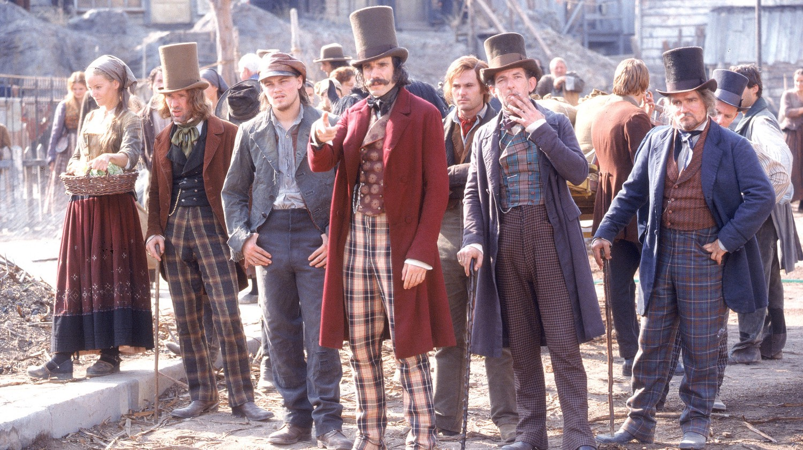
Nativism
The Know-Nothing Party and the Bowery Boys were notorious violent street gangs and political groups that were anti-Catholic.

Slide 4
Nativists Organize
American Protective Association (1887)
Anti-Catholic party
Workingman’s Party of California (1870s)
Anti-Chinese party
Irony: led by an Irish immigrant, Denis Kearney, who ended all speeches with “Whatever happens, the Chinese must go!”
Both gained major political followings.

Slide 5
Political Machines
Rose to power as a result of urbanization problems.
Cities grew too fast for governments to help regulate them.
Political machine: an informal political group designed to gain and keep power through use of bribery, fraud, and embezzlement, run by a party boss.
Poor immigrants could not rely on anyone else to help them, so they turned to Party Bosses.

Slide 6
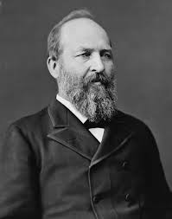
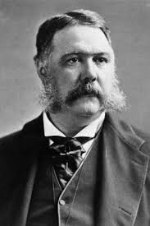
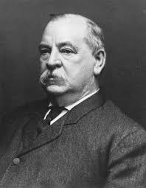
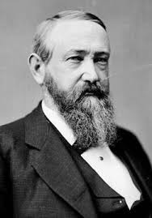
Gilded Age Presidents: Why are they the “Forgotten Presidents?”
Rutherford B. Hayes
1877-1881
James A. Garfield
March-Sep 1881
Assassinated in office
Chester A. Arthur
1881-1885
Grover Cleveland
1885-1889
and
1893-1897
Benjamin Harrison
1889-1893

Slide 7
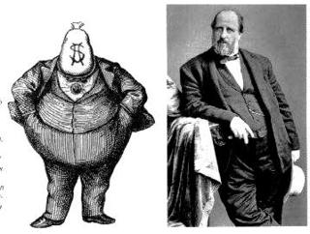
Political Machines
William “Boss” Tweed, of Tammany Hall in New York City, a political machine that dominated the Democratic Party.

Slide 8
What did Boss Tweed do?
Helped poor immigrants find jobs and housing, in exchange for votes.
Helped build the Brooklyn Bridge and Central Park.
Rigged elections, bribed judges and officials, embezzled millions of dollars, gained graft money through dishonest expenses.
Incredibly rich and powerful, “owned” New York, escaped prison and sailed to Spain.
He was the “El Chapo” of his day.

Slide 9
Political Machinery Game: “You Scratch My Back…”
Each player takes role of a PB (Party Boss), a BE (Business Executive) or a UL (Urban Laborer).
To move around the game board, flip a coin. Heads= 1 space, Tails= 2 spaces
Each player starts with 5 points, and can win or lose points according to the turns.
Scores should be recorded during play.
When a player lands on “Secret Memo” player chooses a Secret Memo card. One point is given to the person that most likely would have written that memo.
The player with the most points at the end wins the game!

