Slide 1
Populism and Politics in the Gilded Age
Chapter 4-4

Slide 2
Civil Service Reforms
The “spoils system” grew unpopular after the Civil War.
Giving people jobs for their loyalty allows dishonesty and incompetence.
Giving people jobs based on merit leads to competition for jobs for people with more knowledge and skills.

Slide 3
Economic Policy Debate
By the 1880s, people were distrustful of the government, corporations and banks.
Especially farmers and small businesses.
Wanted the government to regulate business and railroad rates more.
They felt the government was not looking out for their interests- only for big business.
Tariffs: Taxes on imports.
Democrats are against them, because it raises prices, making it difficult to export their crops.
Most Democrats were southern and/or rural.

Slide 4
Economic Policy Debate
1888 Election:
Benjamin Harrison (R)- supported by industrialists who favored high import tariffs. (why?)
Grover Cleveland (D)- campaigned against high tariffs, but was known to be “moderate”.
Harrison lost the popular vote, but won the electoral vote. (Sound familiar?)
Later, a bill was passed that cut taxes and tariffs, but raised prices on all goods.
It was expensive to be poor!

Slide 5
Unrest in Rural America
Populism: Political movement popular with farmers in the 1890s.
Wanted free coinage of silver (did not want to rely only on gold).
Pass laws to protect farmers and grant more loans.

Slide 6
The Money Supply
Farmers thought changing currency would help.
Greenbacks were printed during the Civil War- paper money “fiat currency”- based on faith.
→Led to inflation
→ Inflation raises prices
3 currencies after Civil War:
Greenbacks
Gold and silver coins
Government bonds

Slide 7
The Money Supply
To control inflation, government paid off bonds, stopped greenback printing, and stopped minting silver coins.
That left the U.S. with just gold.
→ Led to deflation.
Bad for farmers, because prices dropped so low, they had to borrow money for seed and supplies.
But interest and mortgage rates went up too, because there was less $$ in circulation.

Slide 8
Farmers Organize
The Grange and The Farmers’ Alliance
Failed- too small (compared to banks) to succeed.
Became distrustful of Democrats too.
Formed “The People’s Party” and held a convention in 1892. Their platform:
Silver coinage
Gov. ownership of railroads
Graduate income tax
Supported unions’ 8 hour work day
Immigration restrictions
Grover Cleveland (D) won election of 1892.

Slide 9
Election of 1896
People’s Party was back- and they focused on silver coinage.
Knew Republicans would support a gold standard.
But at the Democratic National Convention, William Jennings Bryan (D), gave his famous “Cross of Gold” speech and was chosen as Democratic nominee.
Populists had to make a choice- support the Democrats’ Bryan (who was pro-silver) or run their own nominee.
They backed Bryan. And he lost.
William McKinley- Republican- won in 1896.
He had the urban vote.

Slide 11
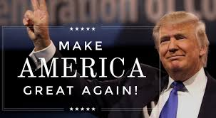
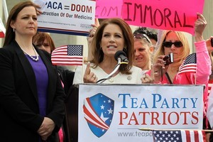
Why does Populism matter?
Even though it failed, it showed there are two Americas: Urban and Rural.
Their ideas were eventually adopted (except for silver coinage). People power works- but sometimes slowly.
It makes a comeback every now and then:

Slide 12
The Wizard of Oz and Populism

Slide 13
Word Bank
Bankers
Washington D.C.
Middle Class
Industry
Nature
William Jennings Bryan
The Gold Standard
Change
Farmers
Silver coinage
Americans
Politicians
Northern businesses/unions

