Slide 1
Reconstruction
What does it take to rebuild a nation after a devastating war?

Slide 2
Dresden, Germany after World War II

Slide 3
Aleppo, Syria today

Slide 4
Atlanta after Sherman’s March, 1865

Slide 5
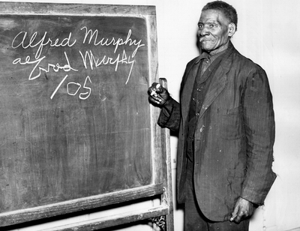
Alfred Murphy, an ex-slave

Slide 6
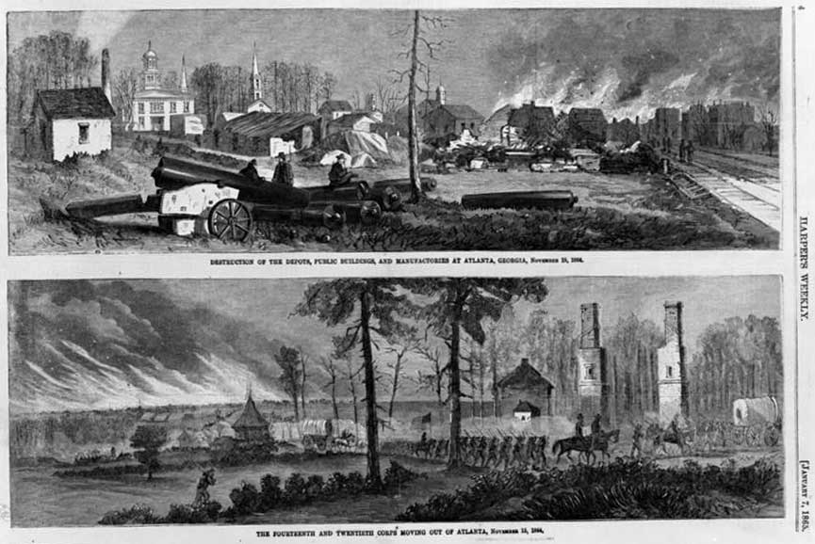
Destruction of the Depots, Public Buildings, and Manufactories at Atlanta, Georgia, Nov 15, 1864
and The Fourteenth and Twentieth Corps Moving Out of Atlanta, Nov 15, 1864

Slide 7
Ruins of Atlanta, GA, 1864

Slide 8
Negro Laborers at Alexandria Near Coal Wharf, c. 1860-1865

Slide 9
Painting: Sherman’s March to the Sea, by Alexander Hay Ritchie, 1868

Slide 10
Thomas Nast’s The Union Christmas Dinner, 1864

Slide 11
James Plantation Freedmen’s Bureau School (c. 1868)

Slide 12
South Carolina’ Government Carpenter’s Shops

Slide 13
Political Cartoon: The First Vote (1867)

Slide 14
Thomas Nast’s “Worse Than Slavery” (1874)

