Slide 1
Romantic or Realism

Slide 2
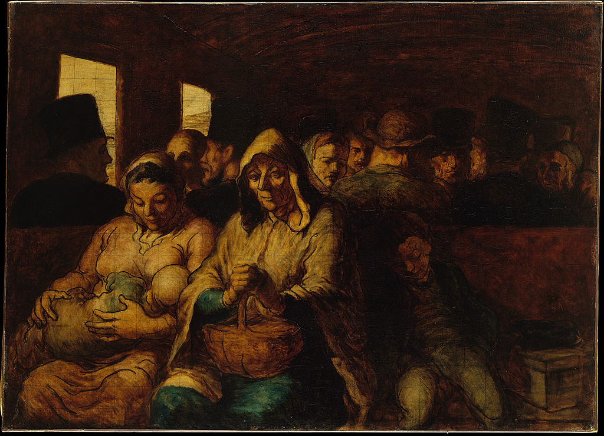
Honoré Daumier, Third Class Wagon, 1862.

Slide 3
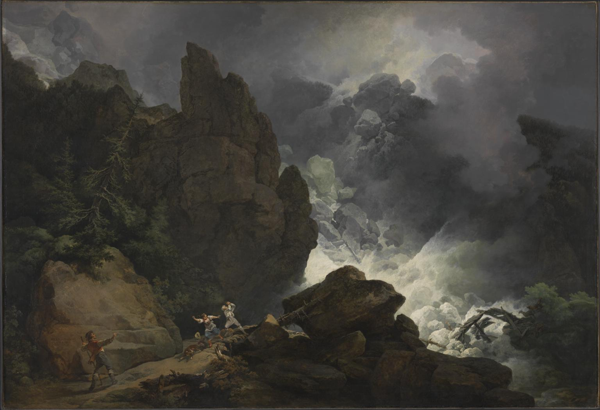
Philip James de Loutherberg, An Avalanche in the Alps, 1803

Slide 4
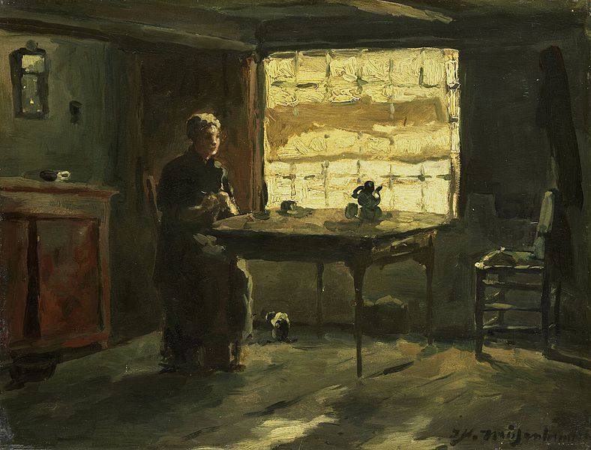
Jan-Hendrik Weissenbruch, Farmhouse Interior, 1870

Slide 5
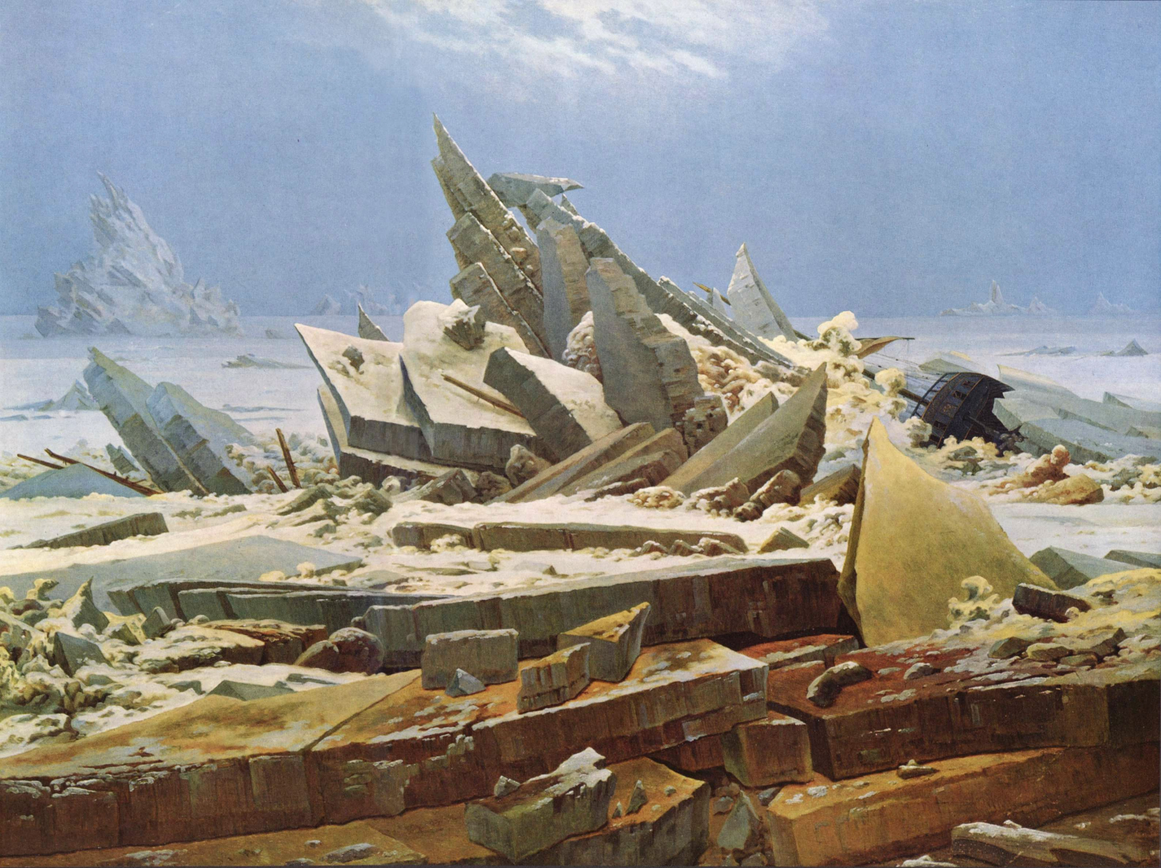
Caspar David Friedrich, Sea of Ice, 1824

Slide 6
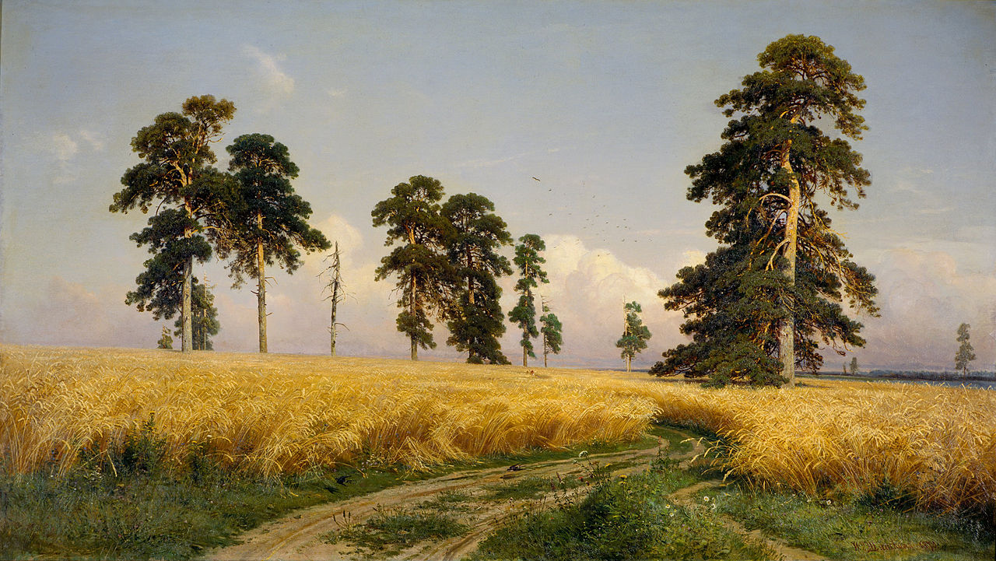
Ivan Shishkin, A Rye Field, 1878

Slide 7
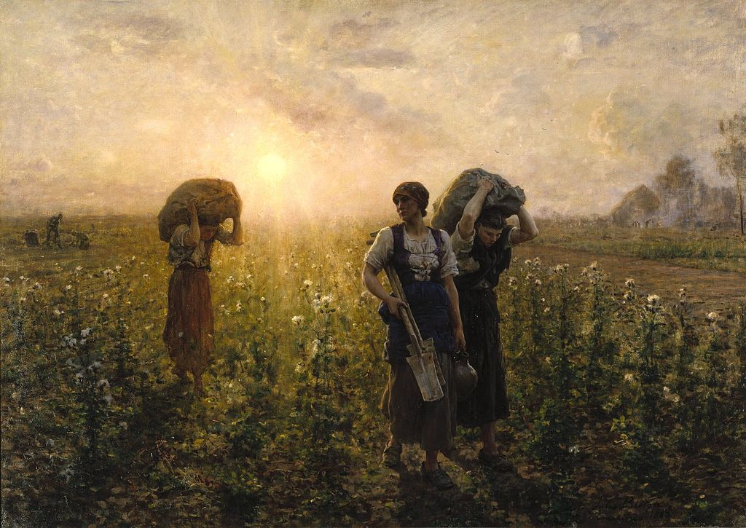
Jules Breton, The End of the Working Day, 1886

Slide 8
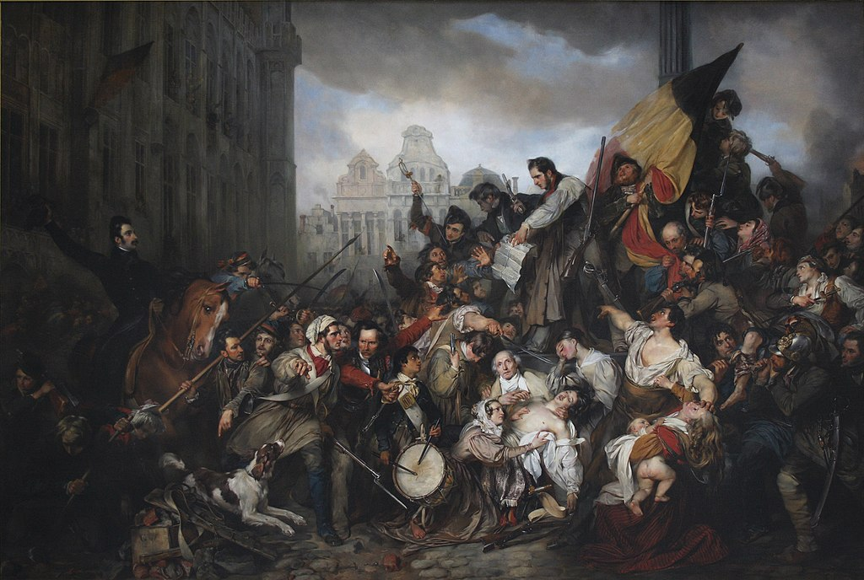
Gustave Wappers, Episode of the Belgian Revolution of 1830, 1834

Slide 9
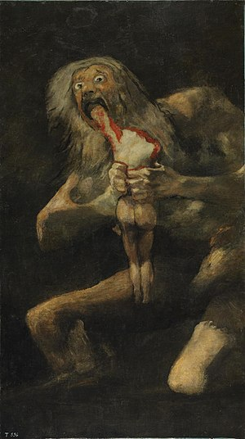
Francisco Goya, Saturn Devouring His Son, 1823

Slide 10
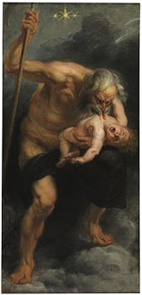
Also Saturn Devouring His Son, by Peter Paul Rubens, 1636. It is neither Romantic or Realist. What style is it?

