Slide 1
ROMANTICISM
GALLERY

Slide 3
The romantic movement
Romanticism – intellectual movement that was a reaction against the Enlightenment
Urged a revival of Christianity
Focused on art, music, and literature of medieval times

Slide 4
English romantic writers
Samuel Taylor Coleridge – wrote Gothic poems of the supernatural
William Wordsworth – wrote, sometimes with Coleridge, about how humans lose their childlike imagination as they get older
Lord Byron – rebel Romanticist, who wrote about personal liberty and mocked his own beliefs in famous works such as Don Juan (1819)
Mary Godwin Shelley – daughter of Mary Wollstonecraft, wrote Frankenstein: or, The Modern Prometheus; considered the first science fiction novel

Slide 5
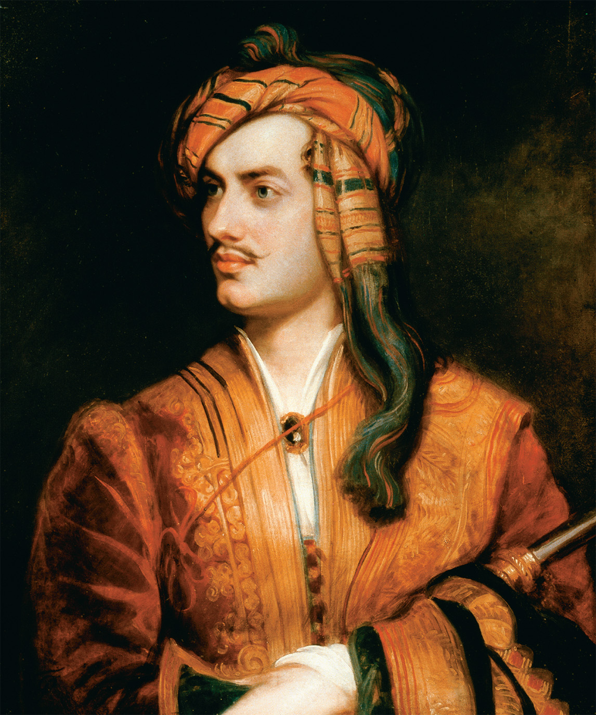
George Gordon, lord Byron 1788-1824
Shown here in Albanian clothing, was a fierce supporter of the Greek Revolution, and died of fever in Greece.
He was considered a womanizer and his personal life was scandalous, but his poetry was immensely popular within the Romantic movement.

Slide 6
German romantic writers
Friedrich Schlegel – Progressive who attacked prejudices against women in novels such as Lucinde (1799)
Johann Wolfgang von Goethe – writings were part Romantic mode / part criticism of Romantic excess
Faust – Part I (1808) – long dramatic poem about man who makes a pact with the devil
Faust – Part II (1832) – taken through many mythological adventures, man dedicates his life to humankind

Slide 7
Romantic art
Neo-Gothicism
Supported the church and saw liberalism as evil
Style of art seen in architecture and paintings
Nature
Sublime – subjects from nature arouse strong emotions and raise questions about how much we control our lives
Famous naturalists include Caspar David Friedrich and Joseph Mallord William Turner

Slide 8
What romantics think
The answers to life’s most puzzling questions can be found through discussions with a simple person who lives in the country close to nature- not with a sophisticated, well-educated person from the city.
The answer to life’s most puzzling questions can be found through a connection with nature.
The use of one’s imagination is more important than rational thought.
Subjectivity (emotional feeling) is more important than objectivity (rational thought).
Knowledge is gained through gut reactions and subjective hunches rather than level-headed, objective, deductive thought.

Slide 9
What romantics think
Nature is more important than art.
Experimental trial and error is a better process than the conventional scientific method.
Poetry should be spontaneous and full of emotion, not planned and straightforward.
Sensitivity, feelings and spontaneity are more important than intellectualism.
“Dare to be” is a better battle cry than “Dare to know”.

Slide 10
CHARACTERISTICS OF ROMANTICISM
Romantic Characteristics | Description of Characteristic
Interest in the common man and childhood | Believed in the natural goodness of humand which is hindered by the urban life of civilization. They believe that the savage is noble, childhood is good and the emotions inspired by both beliefs cause “the heart to soar”.
Strong senses, emotions, and feelings | Knowledge is gained through intuition rather than deduction. This is best summed by William Wordsworth, who said “all good poetry is the spontaneous overflow of powerful feelings.”
Awe of nature | Stressed in art nd language through the experience of sublimity through a connection with nature. Reject the rationalization of nature by the previous thinkers of the Enlightenment period.
Celebration of the individual | Elevate the achievements of the misunderstood, heroic individual outcast.
Importance of imagination | Legitimized the individual imagination as a critical authority.

Slide 11
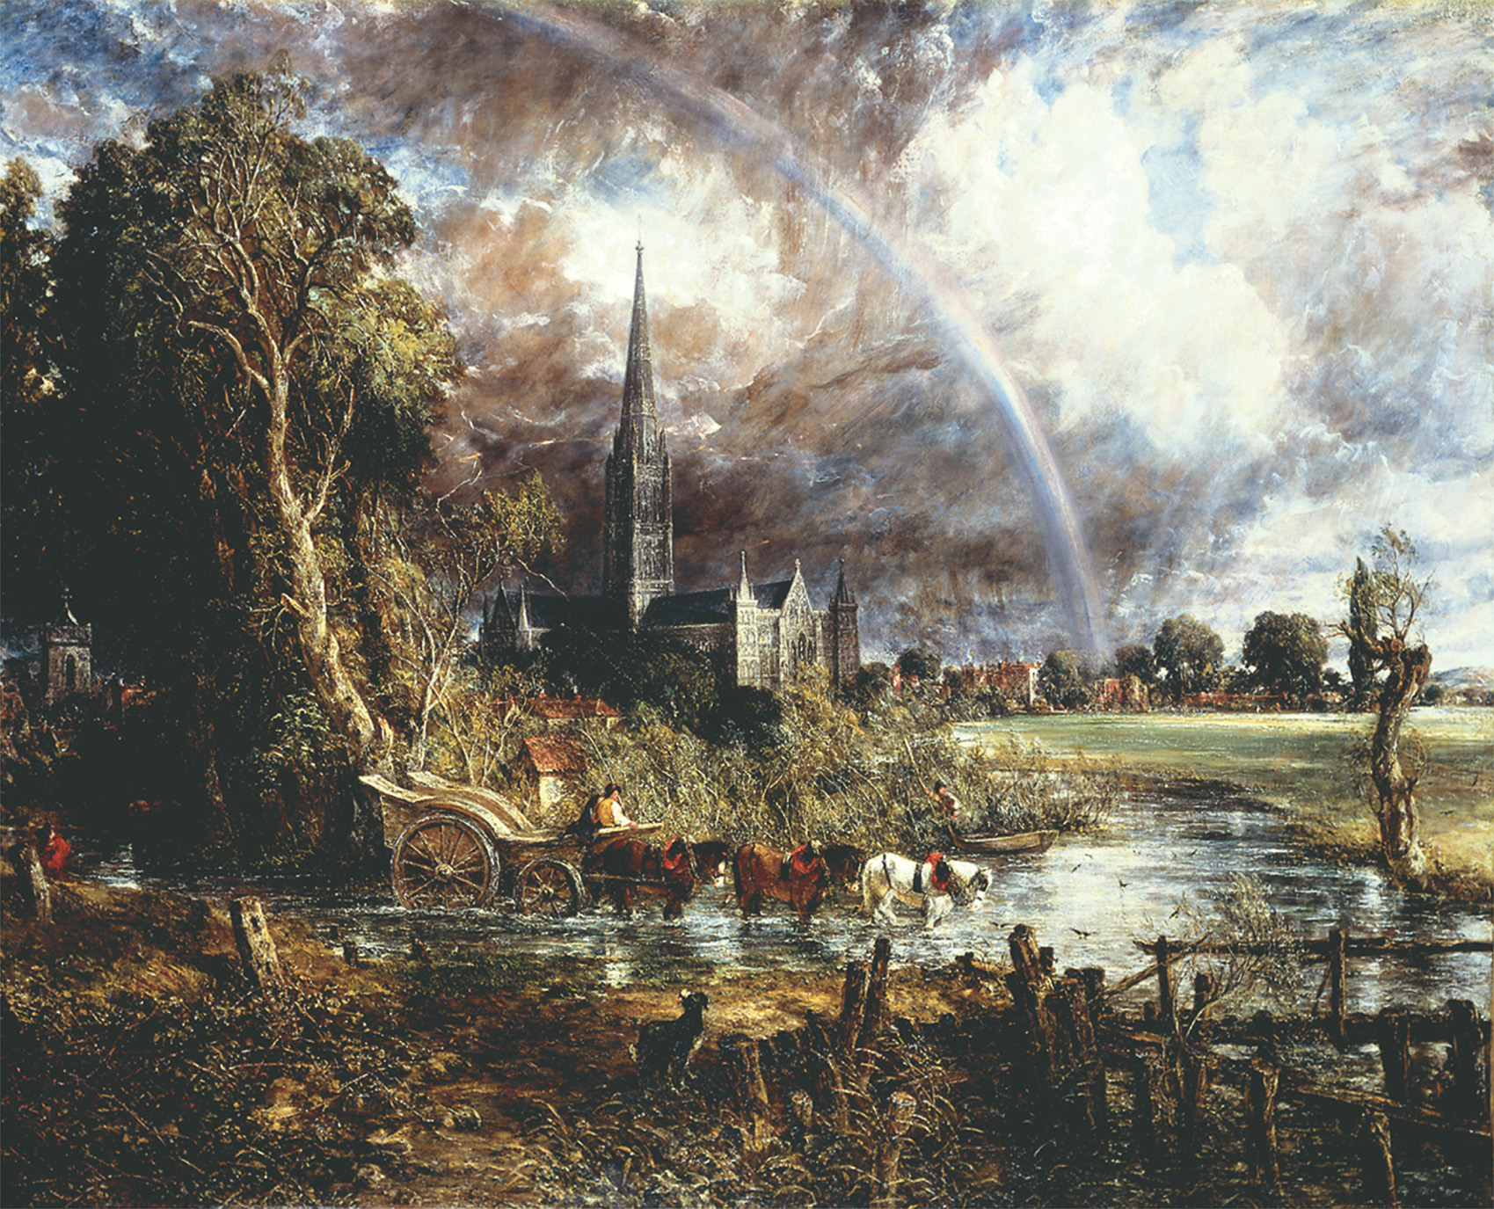
John Constable, Salisbury Cathedral from the Meadows, 1831

Slide 12
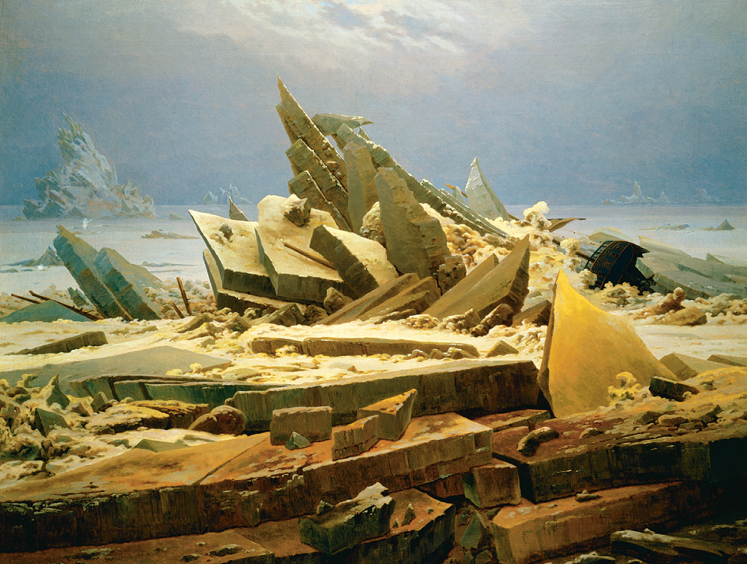
Caspar David Friedrich, The Polar Sea or Sea of Ice, 1824

Slide 13
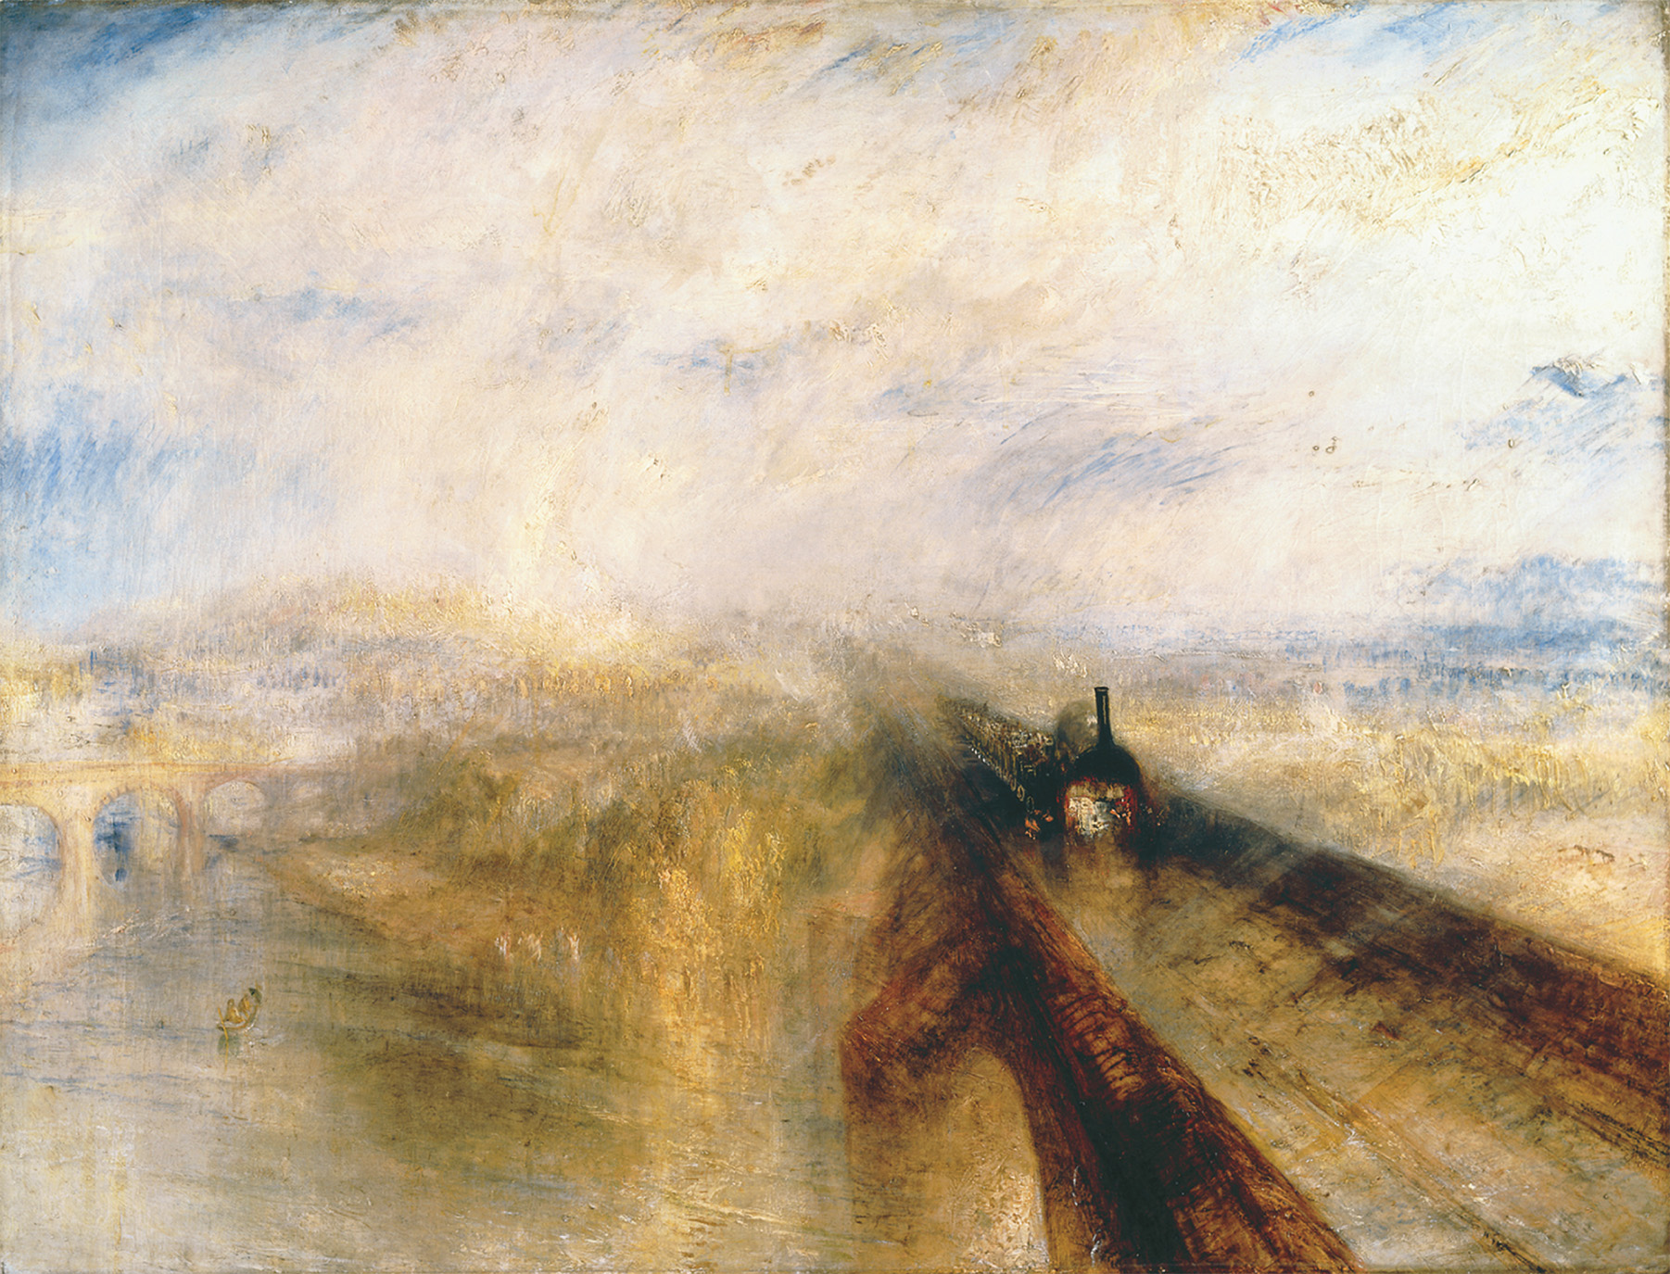
Joseph Malford William Turner, Rain, Steam, and Speed- The Great Western Railway, 1844. Captures the tension
Many Europeans felt about the clash of their natural environment with new industry and technology.

Slide 14
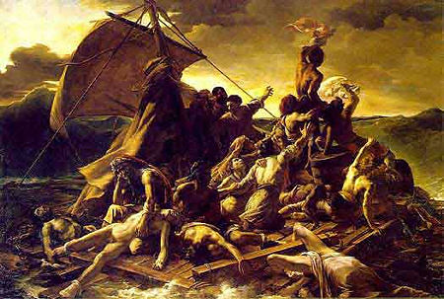
Theodore Gericault, The Raft f the Medusa, 1819. At the Louvre, the real size of this painting is 16 x 23 ft.

Slide 15
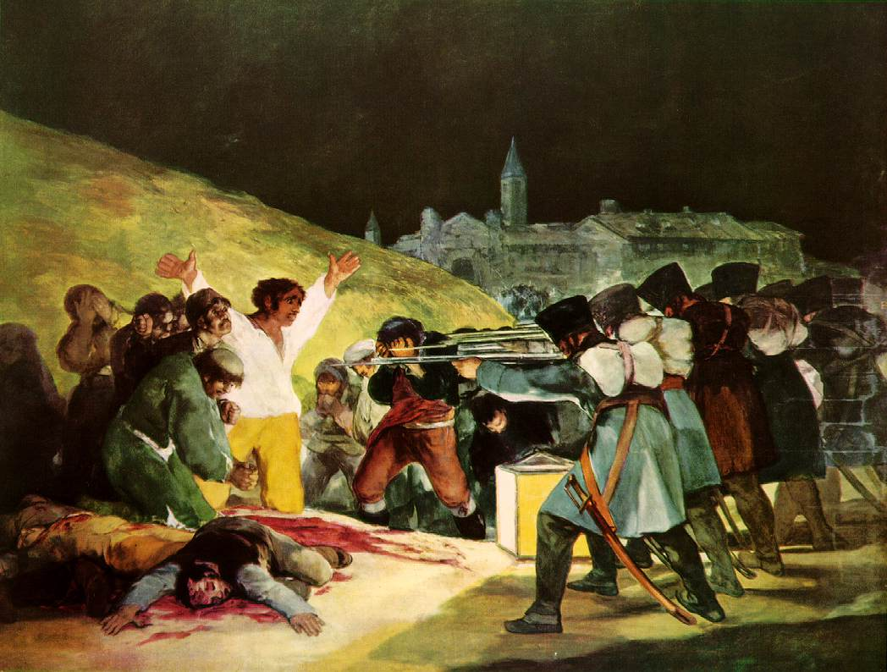

Slide 16
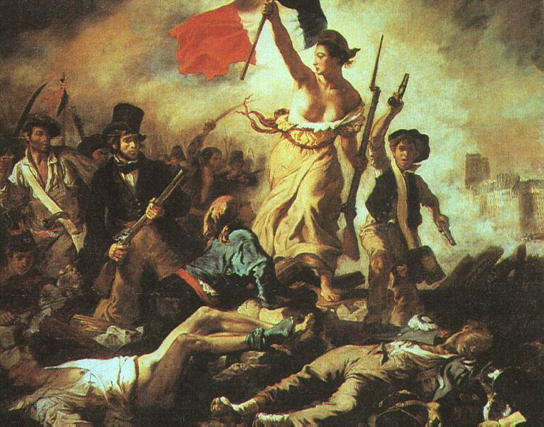

Slide 17
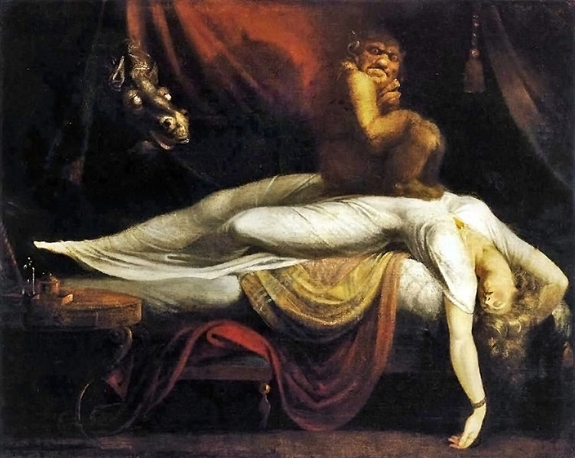

Slide 18
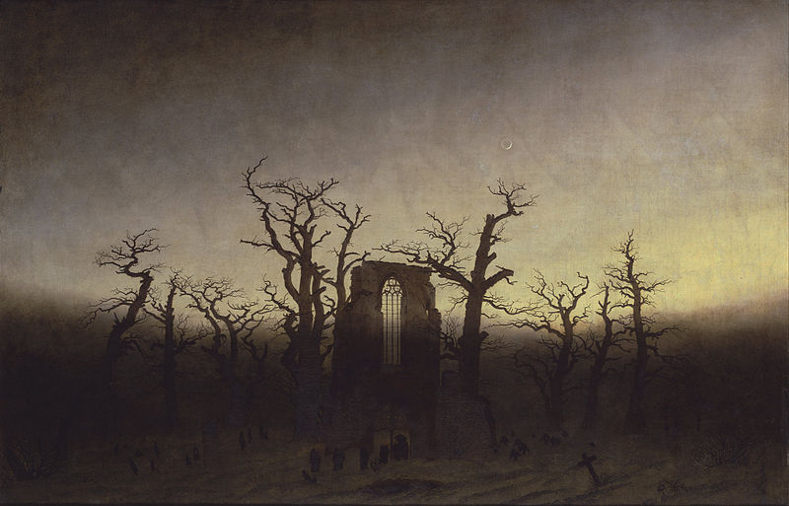

Slide 19
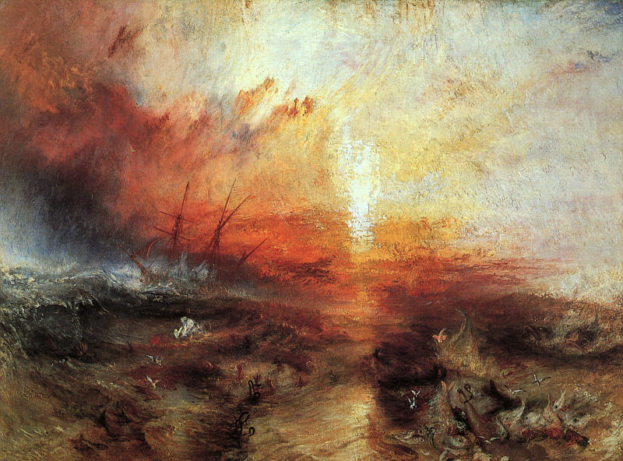

Slide 20
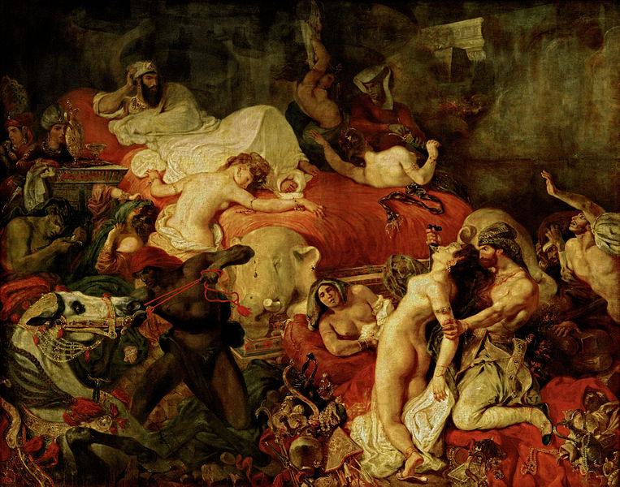

Slide 21
She Walks in Beauty
BY LORD BYRON (GEORGE GORDON)
She walks in beauty, like the night
Of cloudless climes and starry skies;
And all that’s best of dark and bright
Meet in her aspect and her eyes;
Thus mellowed to that tender light
Which heaven to gaudy day denies.
One shade the more, one ray the less,
Had half impaired the nameless grace
Which waves in every raven tress,
Or softly lightens o’er her face;
Where thoughts serenely sweet express,
How pure, how dear their dwelling-place.
And on that cheek, and o’er that brow,
So soft, so calm, yet eloquent,
The smiles that win, the tints that glow,
But tell of days in goodness spent,
A mind at peace with all below,
A heart whose love is innocent!

Slide 22
"THE WORLD IS TOO MUCH WITH US; LATE AND SOON"
By William Wordsworth
Romantic British Poet
THE world is too much with us; late and soon,
Getting and spending, we lay waste our powers:
Little we see in Nature that is ours;
We have given our hearts away, a sordid boon!
The Sea that bares her bosom to the moon;
The winds that will be howling at all hours,
And are up-gathered now like sleeping flowers;
For this, for everything, we are out of tune;
It moves us not.--Great God! I'd rather be
A Pagan suckled in a creed outworn;
So might I, standing on this pleasant lea,
Have glimpses that would make me less forlorn;
Have sight of Proteus rising from the sea;
Or hear old Triton blow his wreathed horn.

