Slide 1
Settling the West
Miners and Ranchers
Ch. 2 Lesson 1

Slide 2
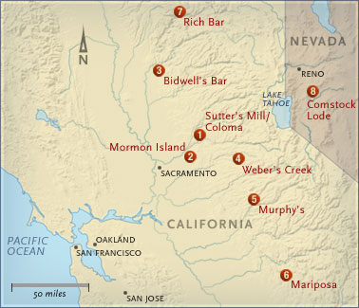
Growth of Mining
“Boom Towns”

Slide 3
San Francisco during the Gold Rush

Slide 4
San Francisco Harbor, 1851

Slide 5
Did everyone strike it rich?
No. Most people didn’t find enough gold or silver to make the trip worth it.
The people who found the most success were the merchants who catered to the needs of the mining populace. Grocers, hardware stores, blacksmiths, and…
Levi Strauss

Slide 6
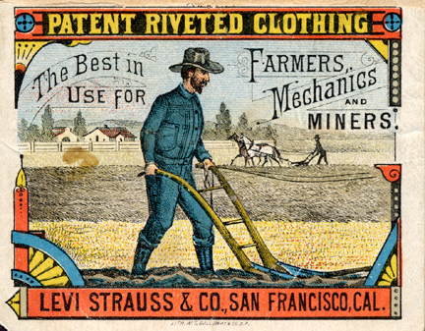
The first true American fashion statement

Slide 7
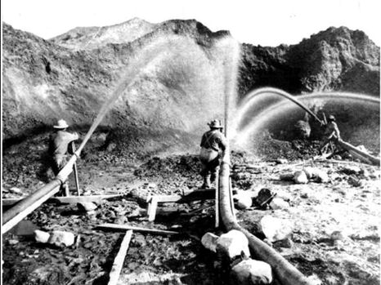
Mining Technology
Mining led to the statehood of North Dakota, South Dakota, Montana, and Arizona.
Changed the environment and geology of these regions.
Hydraulic Mining

Slide 8
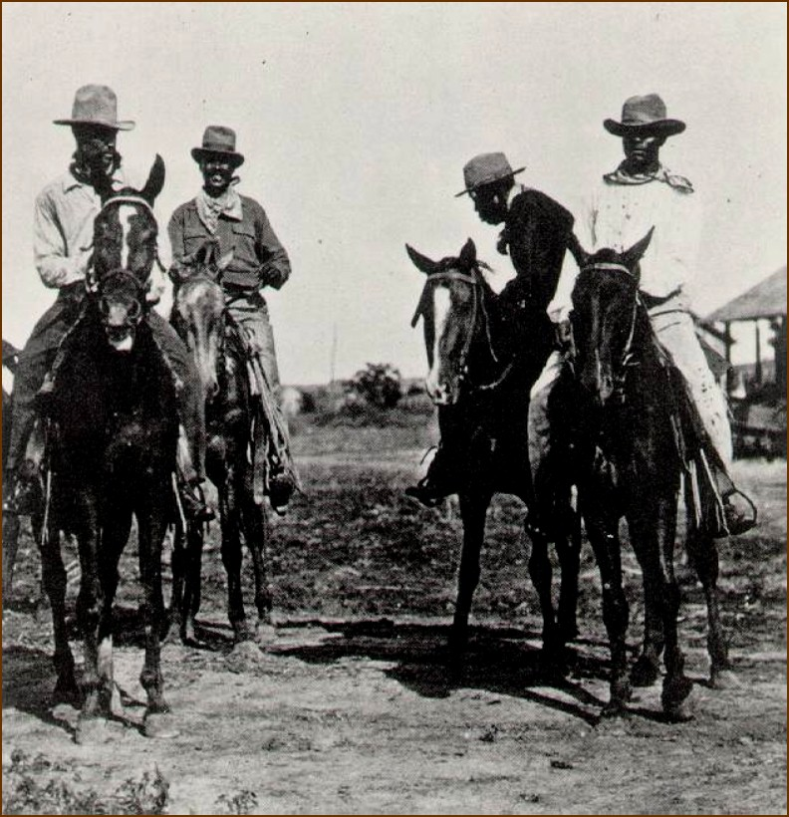
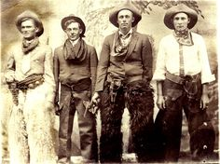
Ranching and Cattle Drives
Open range ranching= Employment for cowboys $$$

Slide 9
Settling the Hispanic Southwest
Haciendas were massive land estates owned by Hispanic elites.
The gold rush brought the end of haciendas as more settlers came in and claimed land. The haciendas were deeded from Spain, which no longer owned the land.
Hispanic Americans lost their land to fraud, lawsuits, and raids.

Slide 10
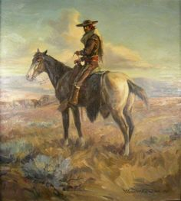
Settling the Hispanic Southwest
Hispanic Americans moved to larger cities, in Spanish speaking neighborhoods called barrios, which have kept Hispanic culture and language alive for over a century.

Slide 11
How do foreigners see America?

Slide 12
How do foreigners see America?
Read Baron Joseph Alexander von Hubner’s (from Austria) account of a Boom Town in Utah.
Annotate, annotate, annotate!

