Slide 1
Toward a New Heaven and a New Earth: The Scientific Revolution and the Emergence of Modern Science
Chapter 16

Slide 2
Focus Questions
​What developments during the Middle Ages and the Renaissance contributed to the Scientific Revolution of the seventeenth century?
​What did Copernicus, Kepler, Galileo, and Newton contribute to a new vision of the universe, and how did it differ from the Ptolemaic conception of the universe?
​What did Paracelsus, Vesalius, and Harvey contribute to a scientific view of medicine?
​What role did women play in the Scientific Revolution?
​Why is Descartes considered the “founder of modern rationalism”?
​How were the ideas of the Scientific Revolution spread, and what impact did they have on society and religion?

Slide 3
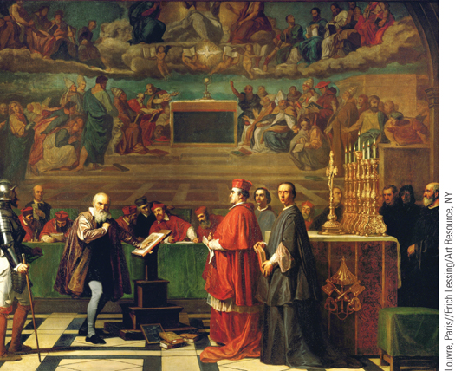
A nineteenth-century painting of Galileo before the Holy Office in the Vatican in 1633
p472
Notes:
A nineteenth-century painting of Galileo before the Holy Office in the
Vatican in 1633

Slide 4
Background to the Scientific Revolution
Ancient Authors and Renaissance Artists
Limitations in the perspectives of medieval scientists
The Renaissance and ancient knowledge
Contradictions of medieval authorities
Close observation of nature
Perspective and anatomical proportions
Technological Innovations and Mathematics
Tensions between technology and Scientific Revolution
Mathematics regarded as key to understanding
Renaissance Magic
Hermetic magic and alchemical thought

Slide 5
Toward a New Heaven: A Revolution in Astronomy (Slide 1 of 2)
Medieval Cosmological Views
Based on Aristotle, Ptolemy, and Christian theology
Geocentric conception
Concentric spheres with fixed earth at center
Nicolaus Copernicus (1473 – 1543)
On The Revolution of the Heavenly Spheres
Observation and heliocentric conception
The conservatism of Copernicus
Creates doubt about the Ptolemaic system

Slide 6
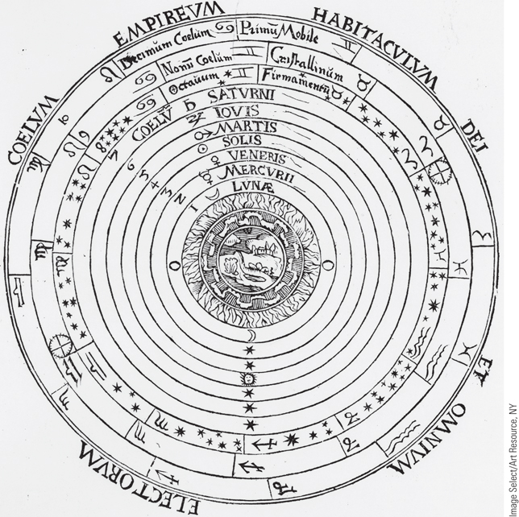
Medieval Conception of the Universe
As this sixteenth-century illustration shows, the medieval cosmological view placed the earth at the center of the universe, surrounded by a series of concentric spheres.
p474
Notes:
Medieval Conception of the Universe. As this
sixteenth-century illustration shows, the medieval
cosmological view placed the earth at the center of the
universe, surrounded by a series of concentric spheres.
The earth was imperfect and constantly changing,
whereas the heavenly bodies that surrounded it were
perfect and incorruptible. Beyond the tenth and final
sphere was heaven, where God and all the saved souls
were located. (The circles read, from the center
outward: 1. Moon, 2. Mercury, 3. Venus, 4. Sun,
5. Mars, 6. Jupiter, 7. Saturn, 8. Firmament (of the Stars),
9. Crystalline Sphere, 10. Prime Mover; and around the
outside, Empyrean Heaven—Home of God and All the
Elect, that is, saved souls.)

Slide 7
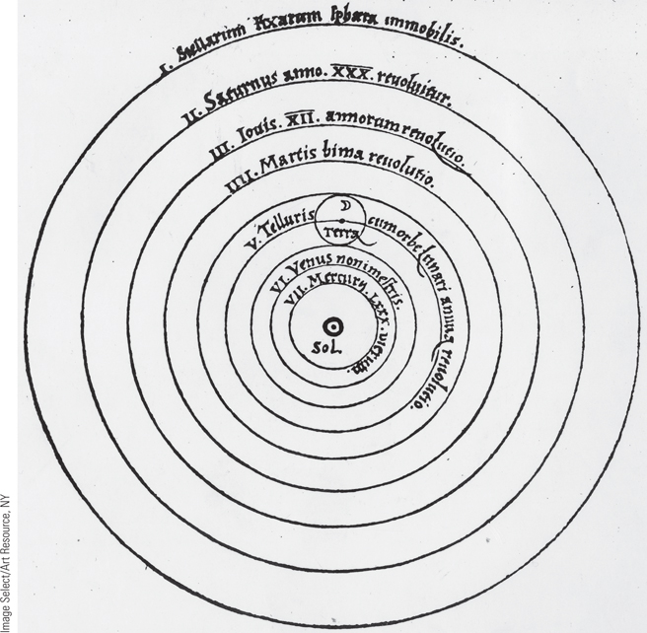
The Copernican System
As shown in this illustration from the first edition of the book, Copernicus maintained that the sun was the center of the universe and that the planets, including the earth, revolved around it.
p475
Notes:
The Copernican System. The Copernican system
was presented in On the Revolutions of the Heavenly
Spheres, published shortly before Copernicus’s death.
As shown in this illustration from the first edition of
the book, Copernicus maintained that the sun was the
center of the universe and that the planets, including
the earth, revolved around it. Moreover, the earth
rotated daily on its axis. (The circles read, from the
inside out: 1. Sun; 2. Mercury, orbit of 80 days;
3. Venus; 4. Earth, with the moon, orbit of one year;
5. Mars, orbit of 2 years; 6. Jupiter, orbit of 12 years;
7. Saturn, orbit of 30 years; 8. Immobile Sphere of the
Fixed Stars.)

Slide 8
Toward a New Heaven: A Revolution in Astronomy (Slide 2 of 2)
Tycho Brahe (1546 – 1601)
Uraniborg Castle
Rejected Aristotelian-Ptolemaic system
Johannes Kepler (1571 – 1630)
Hermetic thought and mathematical magic
Laws of planetary motion
Discrediting the Aristotelian-Ptolemaic system
Eliminating the idea of uniform circular motion
Galileo Galilei (1564 – 1642)
The telescope and The Starry Messenger
Galileo and the Inquisition
Problem of motion; principle of inertia

Slide 9
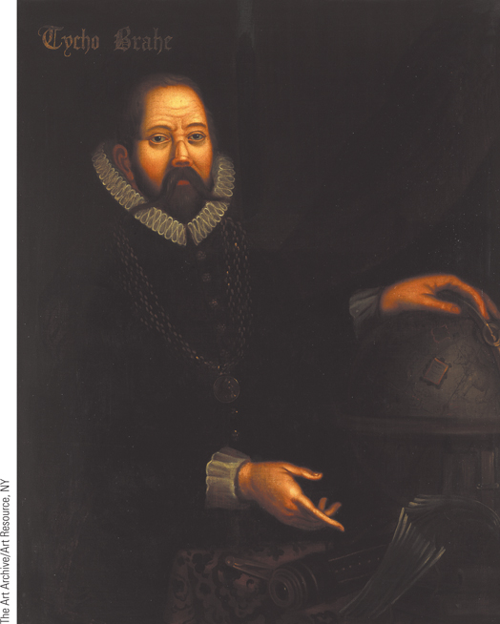
Tycho Brahe
Brahe’s work at the Uraniborg observatory provided astronomers with the best data on the position of the celestial bodies.
p477
Notes:
Tycho Brahe. (p.477)
Brahe’s work at the Uraniborg observatory provided astronomers with the best data on the position of the celestial bodies. He published his results in Of More Recent Phenomena of the Ethereal World in 1588. He is depicted here in a sixteenth-century Dutch oil painting with a silver nose; his own nose was cut off during a duel.

Slide 10
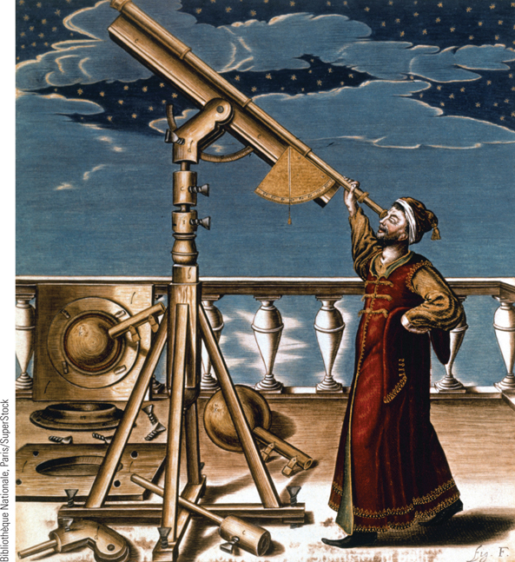
The Telescope (Slide 1 of 2)
The invention of the telescope enabled Europeans to inaugurate a new age in astronomy. Shown here is Johannes Hevelius, an eminent German-Polish
astrologer (1611–1697), making an observation with his telescope.
p480
Notes:
The Telescope. The invention of the telescope
enabled Europeans to inaugurate a new age in
astronomy. Shown here is Johannes Hevelius
(huh-VAY-lee-uss), an eminent German-Polish
astrologer (1611–1697), making an observation
with his telescope. Hevelius’s observations were
highly regarded. He located his telescope on the
roof of his own house, and by the 1660s, his
celestial observatory was considered one of the
best in Europe.

Slide 11
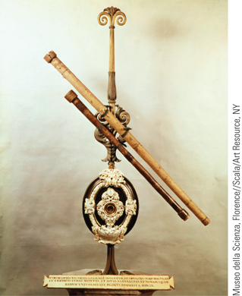
The Telescope (Slide 2 of 2)
The photograph above shows Galileo’s original telescope, built in 1609.
p480
Notes:
The Telescope. The photograph above shows
Galileo’s original telescope, built in 1609.

Slide 12
Isaac Newton (1642 – 1727)
Early Achievements
Invention of calculus- for calculating rates of change
Composition of light, experiments with prisms
“Optics”
Professor of math at Cambridge
Mathematical Principles of Natural Philosophy, or Principia (1684 – 1686)
Newton and the Occult
“The last of the magicians”
Interest in alchemy and hermeticism (theosophy and astrology)

Slide 13
Isaac Newton
Universal Law of Gravitation
A new cosmology
Three laws of motion
Provided a synthesis of the work of his predecessors- explained why the planets move in ellipses
One universal law, mathematically proved, governs the universe.
Consequences: world seen in mechanistic terms
God is “everywhere present”
The “world-machine” view- God is seen as a “clockmaker” who created the universe and set it to function on its own.
Einstein’s theories will later alter this view.
Widely accepted in England, took longer to accept elsewhere.

Slide 14
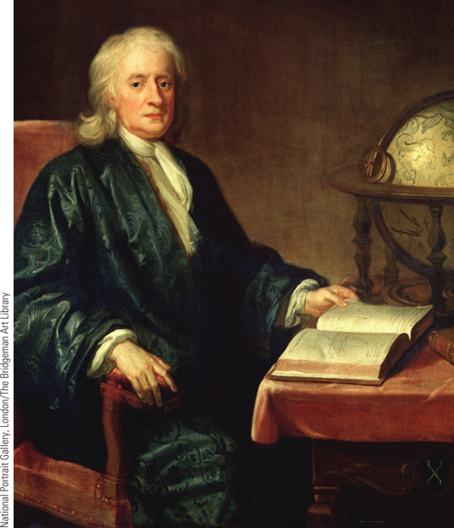
Isaac Newton
With a single law, that of universal gravitation, Isaac Newton was able to explain all motion in the universe.
p483
Notes:
Isaac Newton. With a single law, that of universal gravitation, Isaac
Newton was able to explain all motion in the universe. His great
synthesis of the work of his predecessors created a new picture of the
universe, one in which the universe was viewed as a great machine
operating according to natural laws. Enoch Seeman painted this portrait
of Newton one year before his death.

Slide 15
CHRONOLOGY Important Works of the Scientific Revolution
Work | Dates
Copernicus, On the Revolutions of the Heavenly Spheres | 1543
Vesalius, On the Fabric of the Human Body | 1543
Galileo, The Starry Messenger | 1610
Harvey, On the Motion of the Heart and Blood | 1628
Galileo, Dialogue on the Two Chief World Systems | 1632
Cavendish, Grounds of Natural Philosophy | 1668
Newton, Principia | 1687
p484
Notes:
CHRONOLOGY Important Works of the Scientific
Revolution

Slide 16
Advances in Medicine and Chemistry
Galenic hypotheses; purging and bleeding; herbal medicines
Paracelsus (1493 – 1541)
“Father of modern medicine”
Rejection of Aristotle and Galen
The macrocosmic-microcosmic principle
“Like cures like”
Disease is result of “chemical imbalance”

Slide 17
Advances in Medicine and Chemistry
Andreas Vesalius (1514 – 1564)
On the Fabric of the Human Body (1543)
Based on dissection of a human body
Book would not have been possible without Renaissance artistic advances and printing press advances.
Origins of blood vessels: the heart, not the liver
William Harvey (1578 – 1657)
On the Motion of the Heart and Blood (1628)
Chemistry
Robert Boyle (1627 – 1691)
Antoine Lavoisier (1743 – 1794)
Atoms, chemical elements, and rules of chemical combination

Slide 18
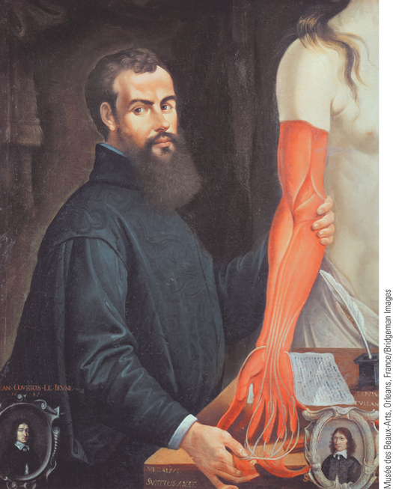
Andreas Vesalius
In this seventeenth-century French portrait of Andreas Vesalius, Vesalius is portrayed with one of his cadavers.
p485
Notes:
Andreas Vesalius. (p.485)
In this seventeenth-century French portrait of Andreas Vesalius, Vesalius is portrayed with one of his cadavers. His work established new understanding of the human body while the developments in artistic representation during the Renaissance allowed for more accurate representations of his findings, as seen here.

Slide 19
Women in the Origins of Modern Science
Elite daughters of England and France had access to informal education.
Margaret Cavendish (1623 – 1673)
Observations upon Experimental Philosophy
Grounds of Natural Philosophy
Attacks on rationalist and empiricist approaches to scientific knowledge
Did not believe humans could control nature through science- nature is too powerful.

Slide 20
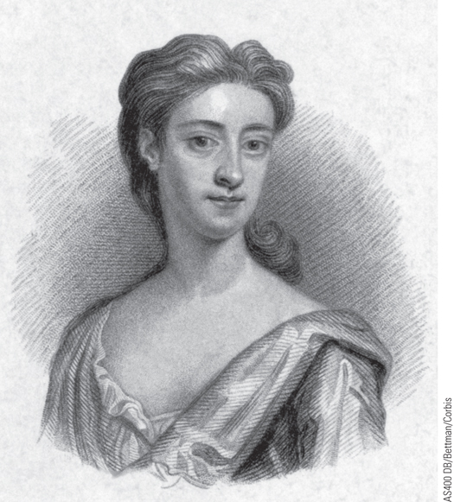
Margaret Cavendish
Shown in this portrait is Margaret Cavendish, the duchess of Newcastle. She was a prolific writer, responsible for plays, biographies, poetry, and prose romances, as well as works in philosophy and science.
p486
Notes:
Margaret Cavendish. (p.486)
Shown in this portrait is Margaret Cavendish, the duchess of Newcastle. She was a prolific writer, responsible for plays, biographies, poetry, and prose romances, as well as works in philosophy and science. Unlike most female authors of the time, who wrote anonymously, she used her own name on her works.

Slide 21
Women in Science
In Germany, women in the crafts had more access to informal education.
One in 7 astronomers in Germany was a woman.
Maria Sibylla Merian (1647 – 1717)
Entomology and the craft tradition
Worked in her father’s workshop- printer
Illustrator, observer of plants and animals
Maria Winkelmann (1670 – 1720)
Achievements in astronomy- original contributions
Difficulties with the Berlin Academy
Typical difficulties of women in science- no formal laws excluded them, but were shut out anyway.

Slide 22
Debates on the Nature of Women
The Querelles des Femmes-
Most vocal opinions came from men.
Tradition: women as inherently base, prone to vice, easily swayed, and “sexually insatiable”
Educated women were seen as more “like men”
Challenges to tradition
Women joined debate in the 17th century, rejecting this view
Like educated women before them, they argued women also had rational minds and could be improved through education

Slide 23
Continuity and Change Over Time?

Slide 24
Continuity and Change Over Time?

Slide 25
Continuity and Change Over Time?
Missouri Representative Todd Akin (R). Also a member
of the House Committee on Science, Space, and
Technology.

Slide 26
Debates on the Nature of Women
The impact of science
The new anatomy
“Scientific proof” that women were meant to be childbearers and intellectually inferior
This “science” was also later used to “prove” inferiority of Africans, Asians, Native Americans, and Jews.
Powerful tools can also be powerful weapons.
Women’s loss of traditional spheres of influence
Midwifery taken over by male physicians (except in lower classes)
Irony of the Scientific Revolution: Reaffirmation of traditional ideas about the nature of women

Slide 27
Continuity and Change Over Time?
Pat Robertson
American media
mogul, executive
chairman, and
Southern Baptist
Minister. Ran for
President in 1988.

Slide 28
Toward a New Earth: Descartes, Rationalism, and a New View of Humankind
Rene Descartes (1596 – 1650)
Lower French noble; served in Thirty Years War
“Vision of ecstatic illumination of the mystic”- or what we call today a “breakthrough”
Reflections on doubt and uncertainty
The 1600’s were confusing times
New discoveries led to doubt of all previous thoughts.

Slide 29
René Descartes
Discourse on Method (1637)
Can only be sure of one thing- your own existence
“I think, therefore I am.” (Cogito, ergo sum)
Separation of mind and matter
Cartesian Dualism- separation of mind (the infinite, God, reason) and matter (the body, the physical world, the finite).
Mathematics are reason; numbers are infinite
You can doubt the physical senses/world, but the mind is part of the infinite. It is the path to knowledge.
Mathematics is the mind’s best tool.
Therefore we can understand the universe as a clock- God is the great clockmaker and geometrician.
Consequences: the birth of modern rationalism

Slide 30
René Descartes
Consequences: the birth of modern rationalism
The theory that opinions and actions should be based on reason and knowledge rather than religious belief, emotional response, or even experience itself.
His books were later banned by the church
Devastating implications for traditional religious views of the universe, and humans’ views of themselves.

Slide 31
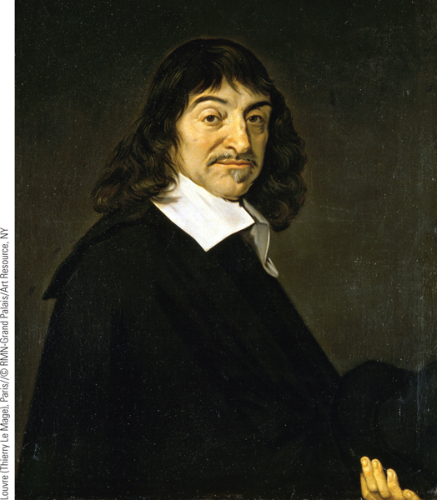
Descartes
Rene´ Descartes was one of the primary figures in the
Scientific Revolution.
p489
Notes:
Descartes. Rene´ Descartes was one of the primary figures in the
Scientific Revolution. Claiming to use reason as his sole guide to truth,
Descartes posited a sharp distinction between mind and matter. He is
shown here in a portrait done around 1649 by Frans Hals, one of the
painters of the Dutch golden age who was famous for his portraits,
especially that of Descartes.

Slide 32
The Scientific Method and the Spread of Scientific Knowledge
The Scientific Method
Francis Bacon (1561 – 1626)
Rejection of Copernicus and Kepler; Misunderstanding of Galileo
The Great Instauration and correct scientific method (his true accomplishment)
Father of empiricism- practice of relying on experimentation and observation for knowledge.
Built on inductive principles, proceeding from the particular to the general
Experimentation and domination of nature- control and domination of nature should be central focus of science
20th century: study environmental impacts

Slide 33
Inductive reasoning: from the specific to the general
The white-eyed fruit fly has RNA
The red-eyed fruit fly has RNA
The Hawaiian fruit fly has RNA
Therefore all fruit flies have RNA

Slide 34
The Scientific Method
Descartes
Deduction and mathematical logic
Steps in an argument must be solid, like a mathematical proof
Start with more “self-evident” truths, and deduce logical conclusions from there.
Rational deduction: From the general to the specific:
All organisms have RNA
The fruit fly is an organism
Therefore the fruit fly has RNA
Newton’s unification of Bacon’s empiricism and Descartes rationalism

Slide 35
The Scientific Method
Newton’s unification (synthesis) of Bacon’s empiricism and inductive reasoning with Descartes’ rationalism and deductive reasoning.
Begin with scientific observations and experiments, and then arrive at general concepts… and then deduce new knowledge from those by testing and verifying (modern science!)
The Scientific Method answers the question “How?” but not “Why?”
The Church still held (holds) importance there.

Slide 36
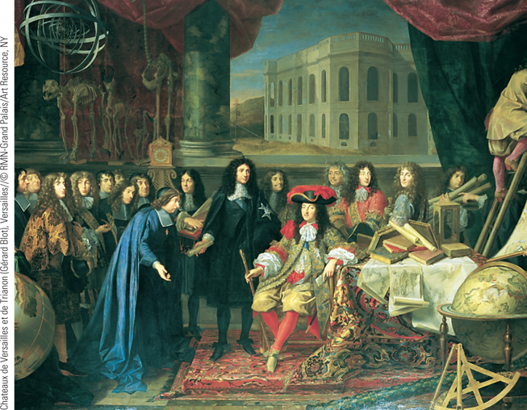
Louis XIV and Colbert Visit the Academy of Sciences
In the seventeenth century, individual scientists received royal and princely patronage, and a number of learned societies were established.
p491
Notes:
Louis XIV and Colbert Visit the Academy of Sciences. In the seventeenth century,
individual scientists received royal and princely patronage, and a number of learned
societies were established. In France, Louis XIV, urged on by his controller general, Jean-
Baptiste Colbert, gave formal recognition to the French Academy in 1666. In this painting
by Henri Testelin, Louis XIV is shown seated, surrounded by Colbert and members of the
French Royal Academy of Sciences.

Slide 37
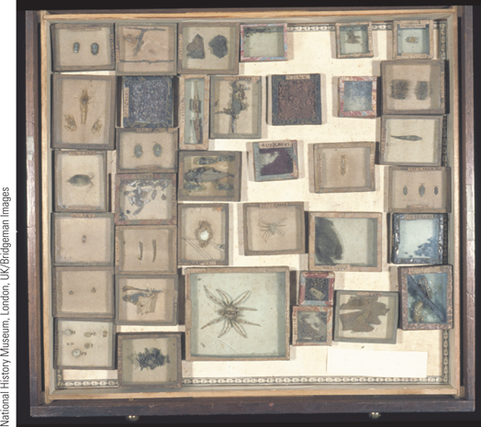
Images of Everyday Life: The Science of Collecting (Slide 1 of 3)
Various beetles and arachnids
p492
Notes:
Various beetles and arachnids

Slide 38
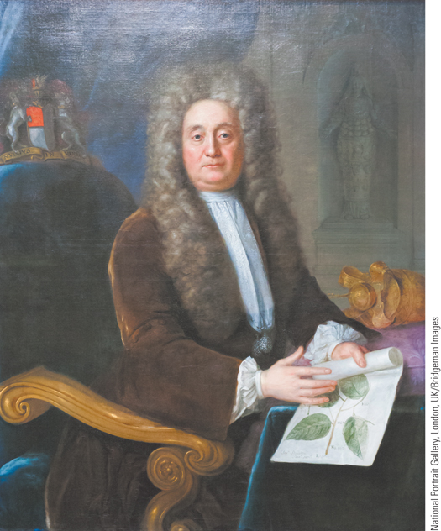
Images of Everyday Life: The Science of Collecting (Slide 2 of 3)
Sir Hans Sloane
p492
Notes:
Sir Hans Sloane

Slide 39
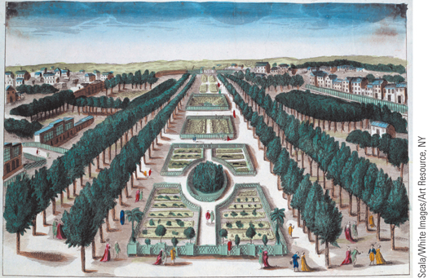
Images of Everyday Life: The Science of Collecting (Slide 3 of 3)
French Royal Botanical Garden
p492
Notes:
(French Royal Botanical Garden) Scala/White Images/Art Resource, NY

Slide 40
The Scientific Method and the Spread of Scientific Knowledge
The Scientific Societies
English Royal Society
Informal meetings at London and Oxford
Received formal charter in 1662 from Charles II
French Royal Academy
Informal meetings in Paris
Formally recognized by Louis XIV (1666)
Contributions
Recognition of the practical value of scientific research
Focus on theoretical work in mechanics and astronomy

Slide 41
The Scientific Method and the Spread of Scientific Knowledge
Science and Society
People recognized science’s rational superiority
Economic implications
Science offered new ways to exploit resources for profit
Science as a part of elite culture
Political implications
Linking the scientific conception of the natural world to social stability
Patronage to bolster military applications

Slide 42
Science and Religion
Tensions between Science and Religion
Benedict de Spinoza (1632 – 1677)
Philosophy of pantheism (monism)
Reason creates happiness and freedom
Blaise Pascal (1623 – 1662)
Sought unity of science and religion
Pensées (Thoughts)
Sought to convert rationalists to Christianity
Christianity not contrary to reason
Reason had limits
His famous wager

Slide 43
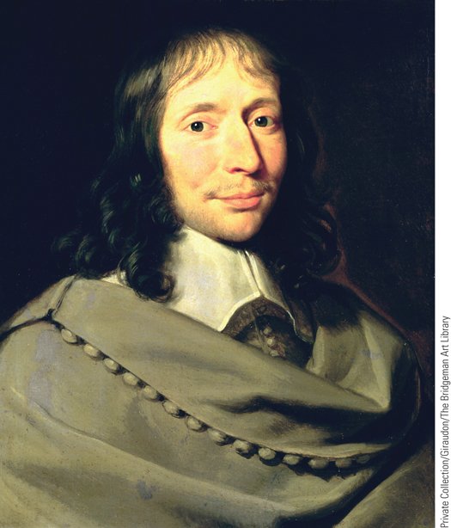
Blaise Pascal
Blaise Pascal was a brilliant scientist and mathematician
who hoped to keep science and Christianity united.
p494
Notes:
Blaise Pascal. Blaise Pascal was a brilliant scientist and mathematician
who hoped to keep science and Christianity united. In his Pense´es, he
made a passionate argument on behalf of the Christian religion. He is
pictured here in a portrait by Philippe de Champaigne, a well-known
French portrait painter of the Baroque period.

Slide 44
CHRONOLOGY Consequences of the Scientific Revolution: Important Works
Work | Dates
Bacon, The Great Instauration | 1620
Descartes, Discourse on Method | 1637
Pascal, Pensées | 1669
Spinoza, Ethics Demonstrated in the Geometrical Manner | 1677
p495
Notes:
CHRONOLOGY Consequences of the Scientific
Revolution: Important Works

Slide 45
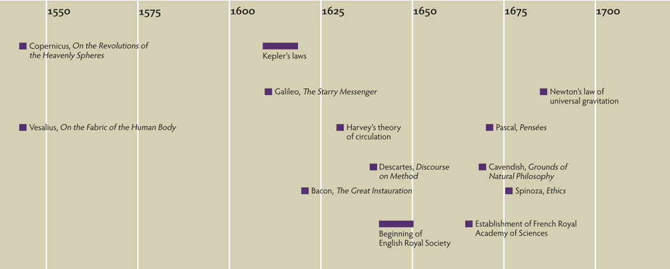
Chapter Timeline
p497

Slide 46
Discussion Questions
How did the Middle Ages and the Renaissance contribute to the Scientific Revolution?
Why were advances in mathematics so important during the Scientific Revolution?
Why did religious leaders react so negatively to the new advances in Science, especially in astronomy?
Why is Newton’s Principia called the “hinge point of modern scientific thought”?
How did women come to play such an important role in the Scientific Revolution?
Why did scientific societies refuse to recognize women involved in the sciences?

