Slide 1
The Civil War and Reconstruction
Chapter 1 Lesson 5

Slide 2
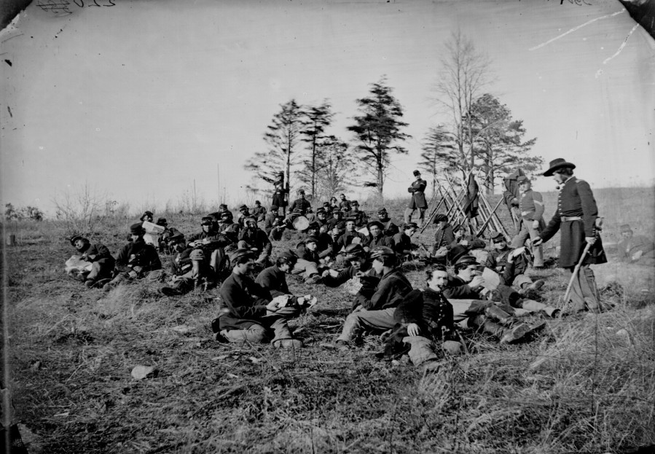
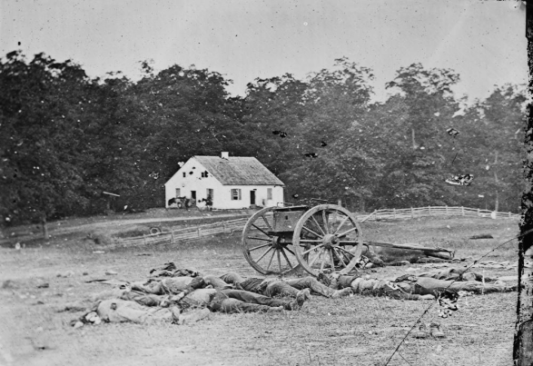
The Civil War: America’s First “Modern War”
It was photographed!
Large civilian army
Modern ammunition caused more deaths
Use of trenches and barricades
War of attrition: each side tries to exhaust the other. This led to massive casualties (which we will see again in World War I)

Slide 3
I. The North and the South
The North | The South
23 million people 90% of factories were in the north Had more ammunition and supplies Twice as many railroads Controlled national treasury Large banks = more war bonds | Only 9 million people, 1/3 of which were slaves Many experienced war officers Poor, less industrialized Large amount of poor whites and indebted farmers Small banks, less cash, less war bonds Could tax its people, but many refused to pay Paper money → high inflation

Slide 4
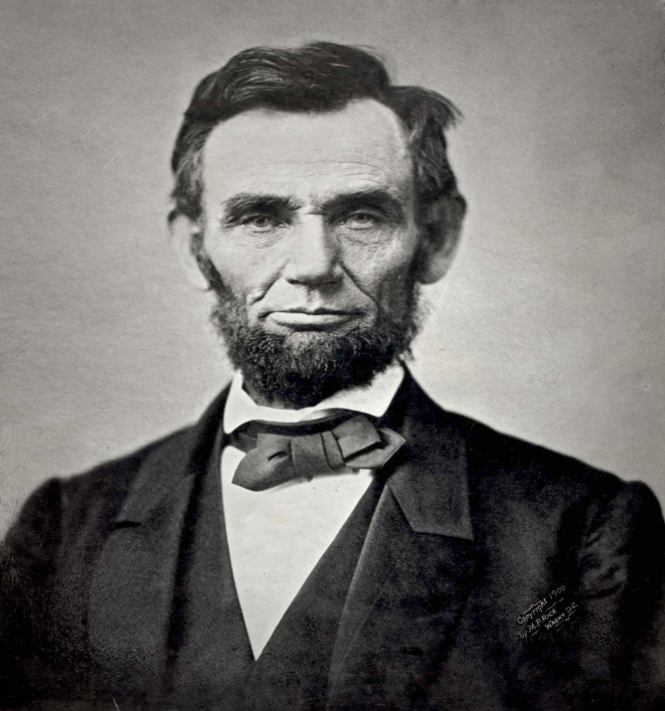
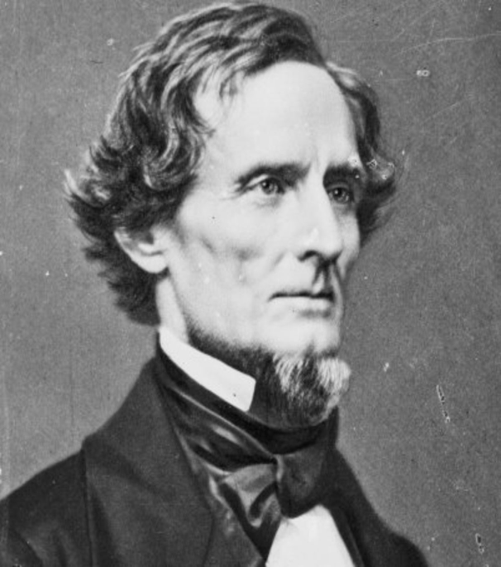
The War: 1861-1865
Union President: Abraham Lincoln | Confederacy President: Jefferson Davis

Slide 5
The War: 1861-1865
The south seceded due to Lincoln’s promise that he would contain slavery (not allow it to spread). There would be no compromising.
April 12, 1861: Confederate forces fire on federal troops at Fort Sumter.
Border states had to choose between Union and Confederacy- Virginia seceded from the Union after Fort Sumter.
Lincoln responds with military force, and the North enthusiastically supported him (even many Democrats who wanted to preserve the Union).

Slide 6
The Fractured Union

Slide 7
Early Battles:
First Battle of Bull Run- A Confederate victory- made it clear the North would need a large, well-trained army.
April 1862_ Union’s General Ulysses S. Grant seizes New Orleans- the south’s biggest city, and gains control of the lower Mississippi River. Caused Kentucky and Tennessee to fall as well.
Battle of Antietam: September 17, 1862. Bloodiest one-day battle in American history.
Union’s General McClellan and Confederacy’s General Lee . More than 6,000 killed, 17,000 wounded, and 2,000 captured or missing.

Slide 8
Emancipation Proclamation
September 22, 1862
Battle of Antietam made Lincoln realize that slavery had to end altogether.
All slaves in states that were in rebellion against the U.S. would be freed January 1, 1863.
Transformed the war into a liberation, moral war.
Made both sides more determined to fight.

Slide 9
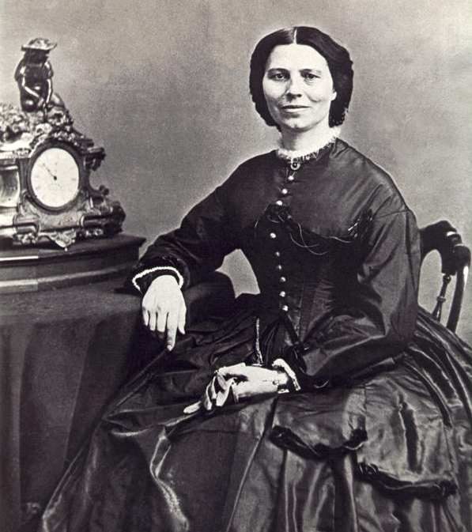
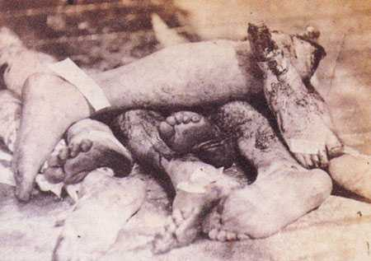
Conditions on the battlefield
Two-thirds of all soldiers dies of infections and diseases rather than actual combat.
Women played prominent roles as nurses.

Slide 10
Final Battles
Vicksburg, Mississippi: May 1863. Grant captures last Confederate stronghold by laying siege to the city. Confederate troops there surrendered July 4, 1863.
Gettysburg, Pennsylvania: July 2 1863. Lee’s forces attacked Union troops near the town, and Lee ordered 15,000 men to attack. Union held their ground.
7,000 casualties in 30 minutes.
Didn’t break Union lines.
Confederate troops retreat to Virginia, and they remained on the defensive.
More than 50,000 casualties total!

Slide 11
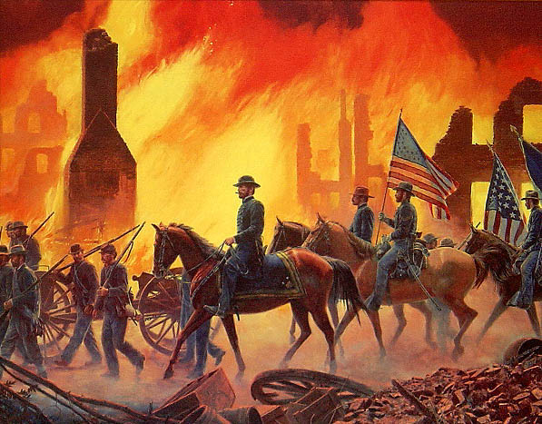
Final Battles
June 1864: Grant seizes city of Petersburg, Virginia
September 1864” General William Tecumseh Sherman captures Atlanta, Georgia, and begins his “March to the Sea”, burning and pillaging the path.

Slide 12
Andersonville Prison, Georgia
Large Confederate military prison
Held 45,000 Union Prisoners of War, 13,000 of which died of malnutrition, starvation and disease.
Only operated in the last 12 months of the war.
Managed by Capt. Henry Wirz, who was tried and executed for war crimes at the war’s end.
Horrific conditions, many prisoners lost their minds and believed they were truly in hell.

Slide 13
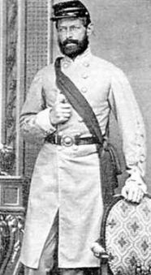
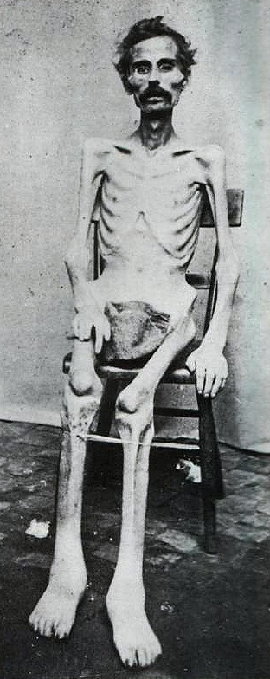
Andersonville Prison, Georgia

Slide 14
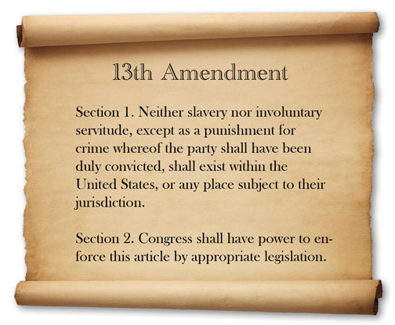
The Thirteenth Amendment
January 31, 1865- passes the House of Reps, goes to states for ratification.
Not ratified until December 1865!
Banned slavery in the United States.
Culmination of the abolition movement that had been brewing for nearly a century.

Slide 15
The War Ends
Union troops cut last rail lines into Petersburg, Virginia- essentially trapping Confederate troops behind enemy lines.
Lee surrenders to Grant at Appomatox Court House on April 9, 1865.
Grant was generous and allowed troops to keep their horses and go home.
Two days later, Lincoln was assassinated.
The Union was slaved, slavery was over, and now the South faced the task of reconstructing its society without slavery.

Slide 16
The War Ends

Slide 17
Reconstruction
Lincoln’s Plan: Offered amnesty to all southerners who swore oath of loyalty to the United States and accepted new terms on slavery.
Radical Republicans did not want Confederates to return to power; wanted to guarantee black people the right to vote.
Andrew Johnson’s Plan:
Tennessee Democrat, became president after Lincoln’s death.
Offered amnesty to Southerners on lenient terms- was not in favor of black voting rights.

Slide 18
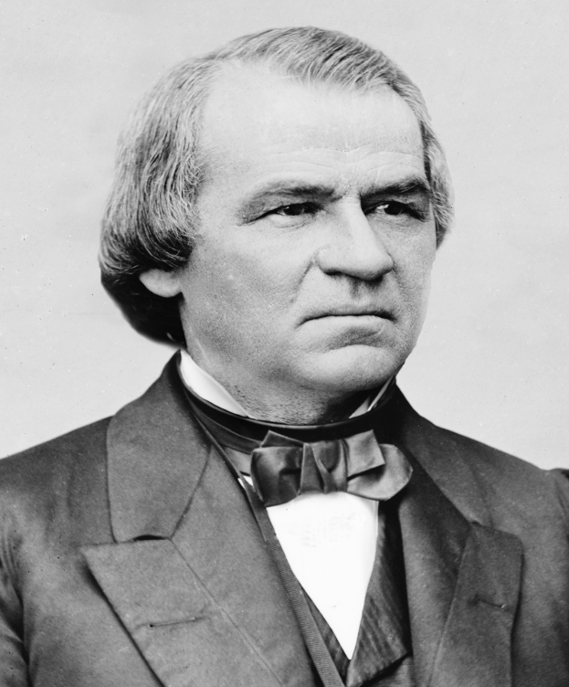
Reconstruction
Republicans were outraged that South elected former Confederate officials to Congress.
Former Confederates tried to pass laws called “black codes” to limit the rights of newly freed African Americans.
Andrew Johnson was the first president to be
impeached in American history. His policies
put him in conflict with House Republicans.

Slide 19
The Fourteenth Amendment
Passed in June 1866, to prevent “black codes”.
Granted citizenship to all those born in the U.S., regardless of race.
No state could deprive someone of their rights
Equal protection under the law
(This would later be used to help women gain the vote, and LGBT to gain equal marriage rights).

Slide 20
Military Reconstruction Act
March 1867
Divided former Confederate states into 5 military districts under military control.
In order to gain back control of their states and elect members to Congress, Southern states had to ratify the 14th Amendment.
This is a major turning point- as it was also used to expand federal power over the states AND extend civil rights to people.

Slide 21
The Fifteenth Amendment
Republicans hated Andrew Johnson and voted to impeach him.
He wasn’t- it ended in the Senate one vote short of conviction.
Ulysses S. Grant elected president in 1868.
Republicans passes 15th Amendment to give African Americans the right to vote.
Brought African Americans into politics and changed southern politics.
Angered white Southerners who fought against federal government.

