Slide 1
The Gilded Age
Political Cartoons Gallery Walk
“All that glitters is not gold”

Slide 2
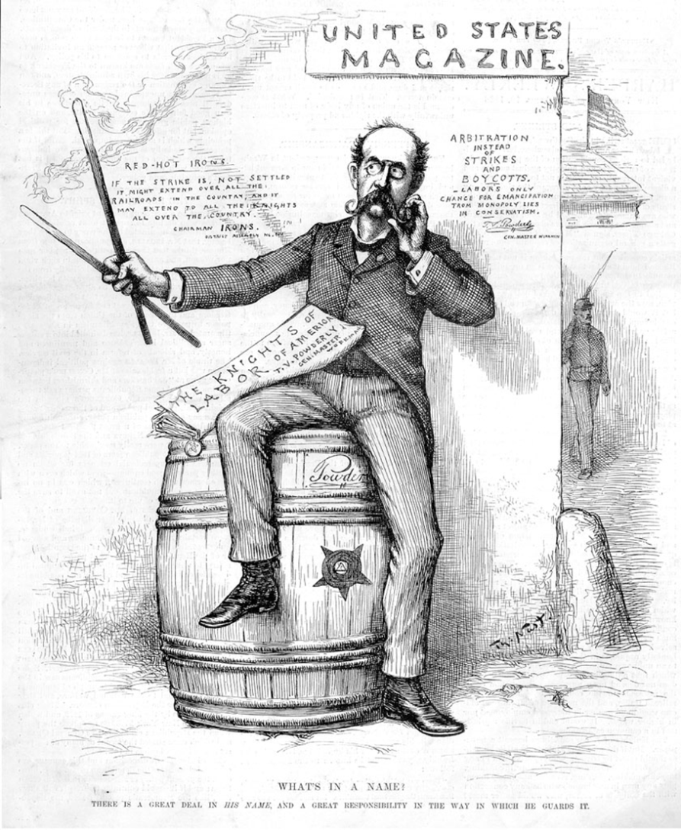
#1: “What’s In a Name?”, Harper’s Weekly, 1886. Thomas Nast.

Slide 3
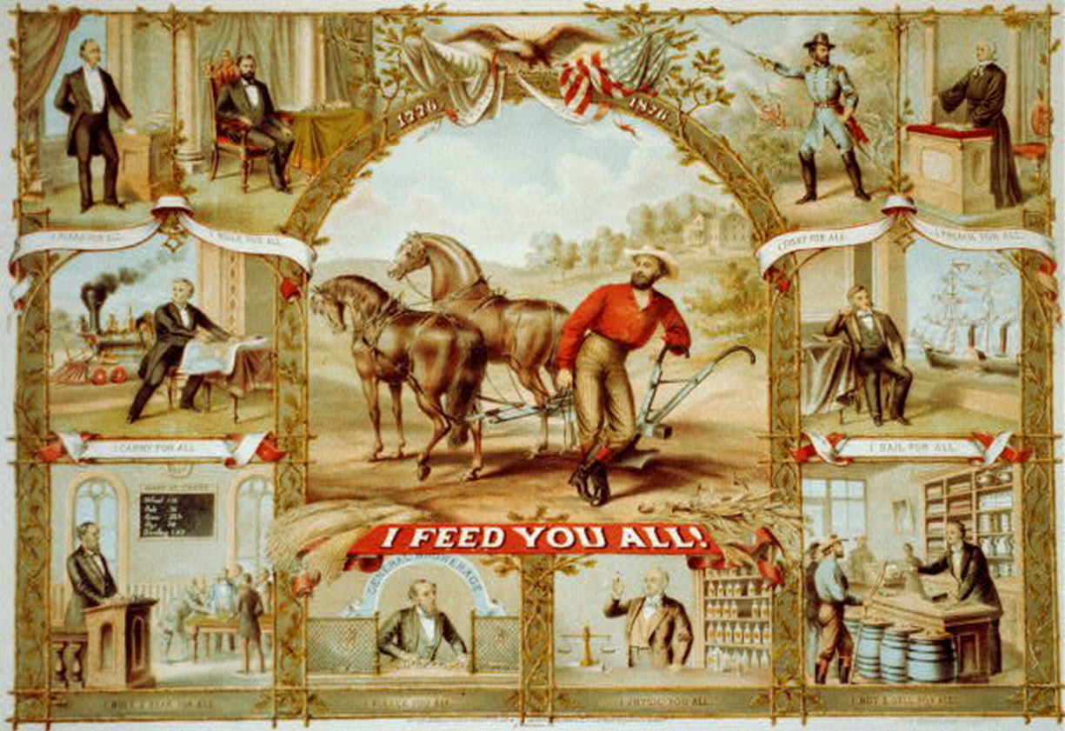
#2: “I Feed You All”. American Oleograph Company, 1875.

Slide 4
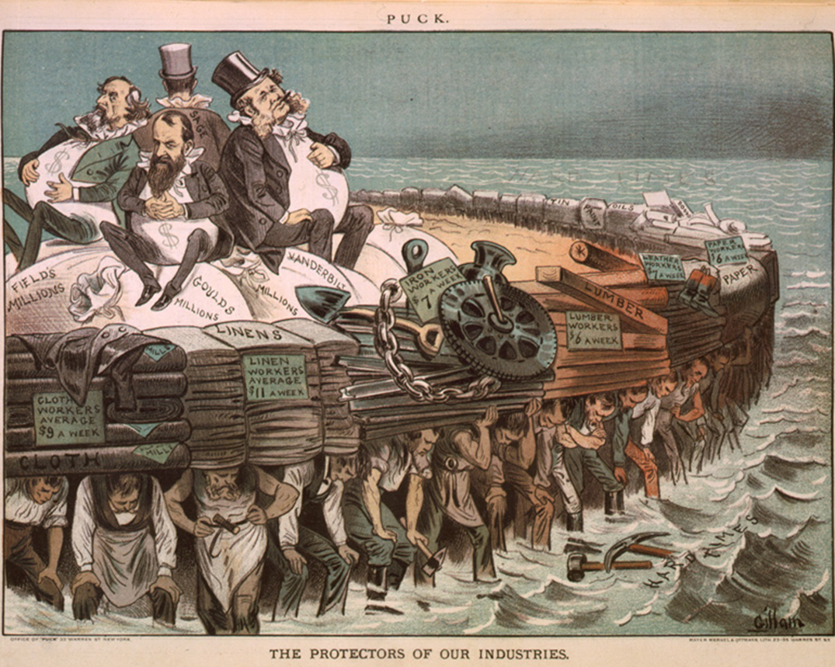
#3: “The Protectors of Our Industries”. Bernhard Gilliam, 1883. Puck Magazine.

Slide 5
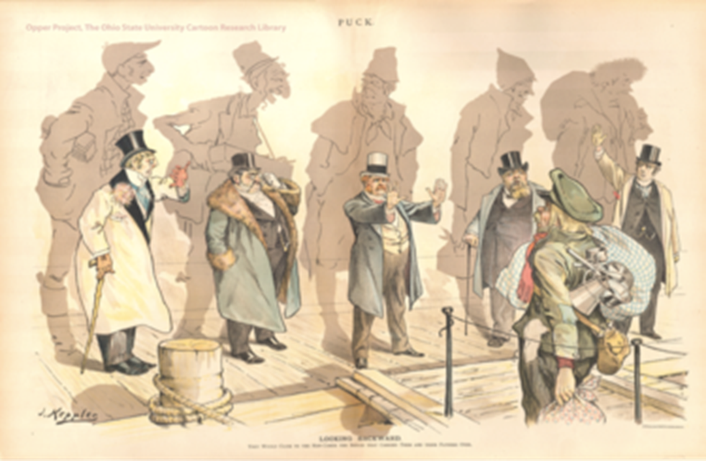
#4: “Looking Backwards.” Joseph Keppler, Puck Magazine. 1893, New York City.

Slide 6
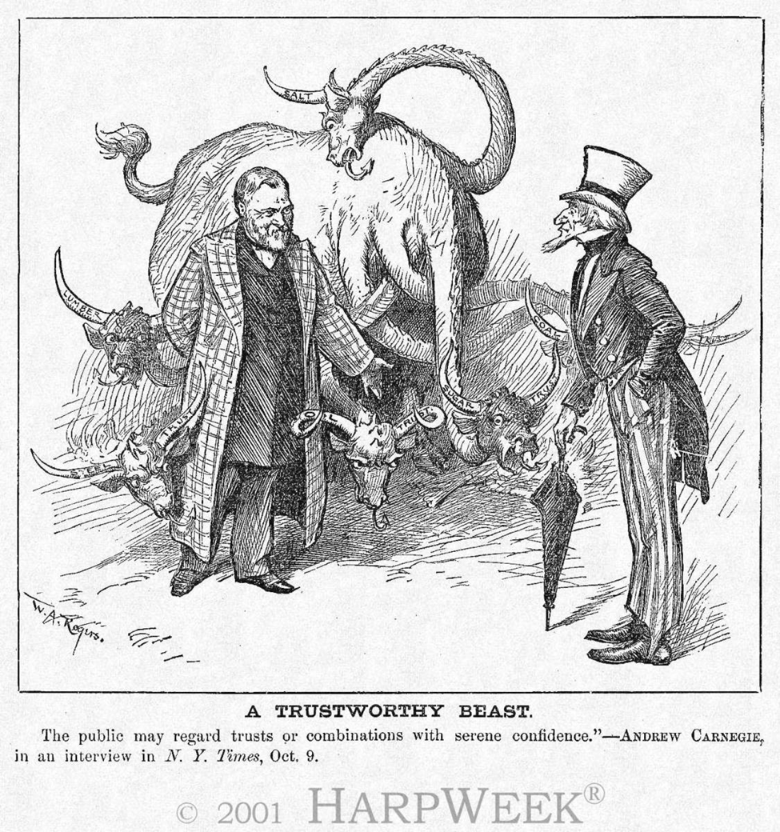
#5: "The Trustworthy Beast." W. Rogers, Harper's Weekly, 1888.

Slide 7
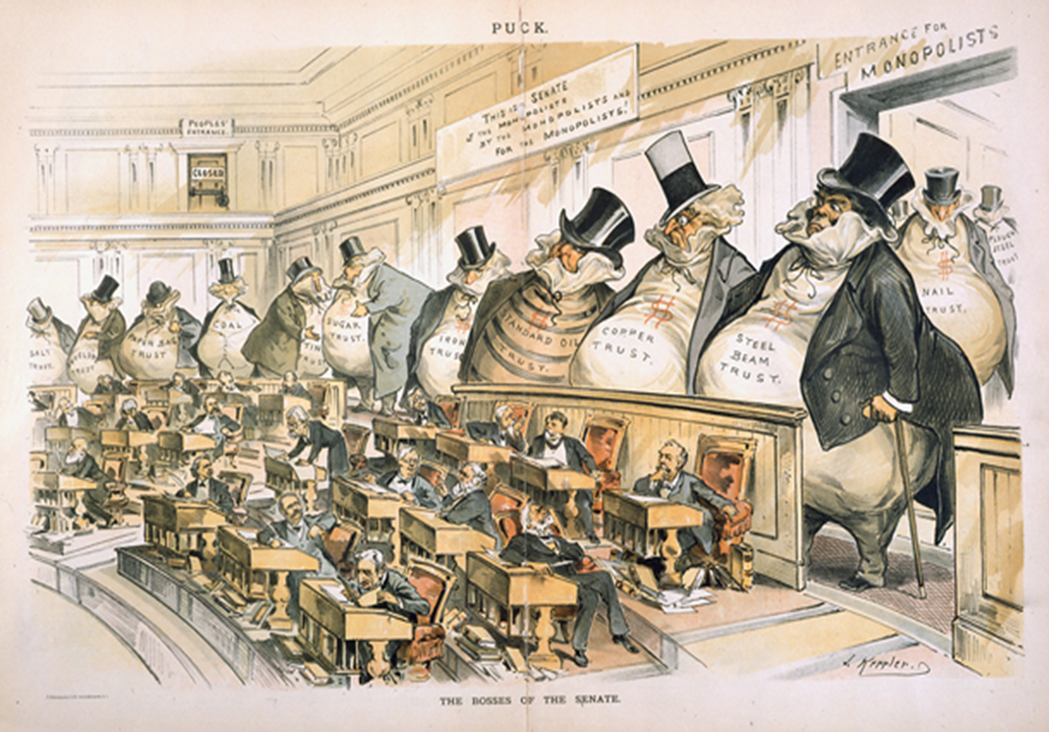
#6: "The Bosses of the Senate," J. Keppler, Puck, 1889

Slide 8
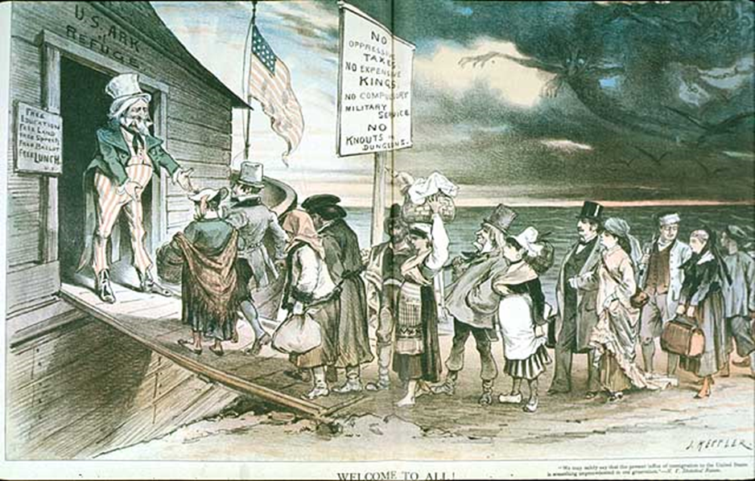
#7: “Welcome to All.” J. Keppler, Puck Magazine. 1880.

Slide 9
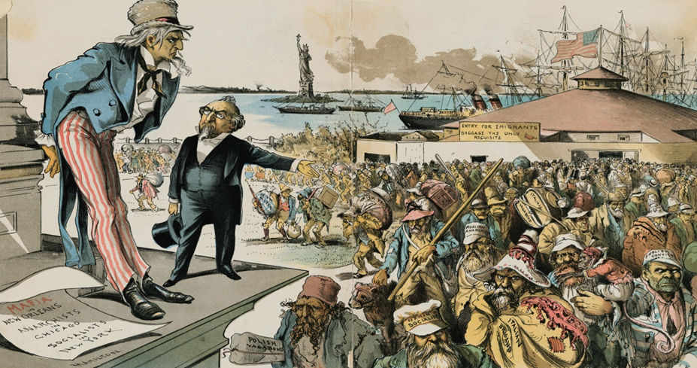
#8: “Where the Blame Lies”. Grant E. Hamilton, Judge Magazine. 1891, New York City.

Slide 10
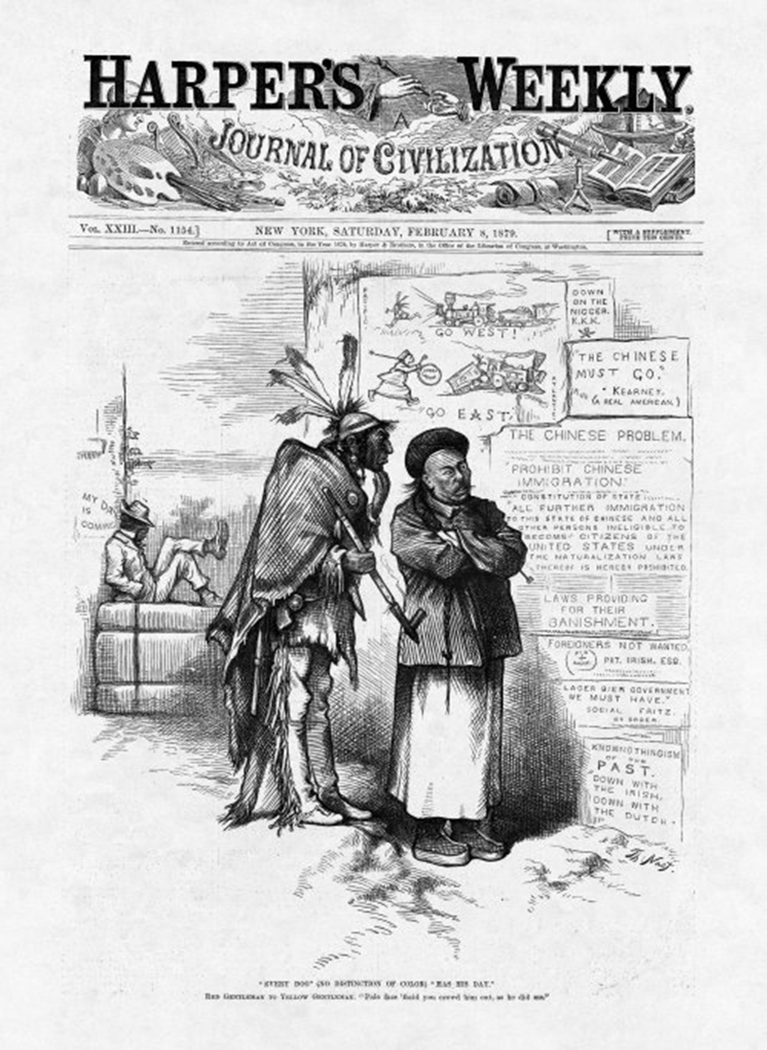
#9: “Every Dog (No Distinction of Color) Has His Day,” Thomas Nast, Harper’s Weekly, 1879

