Slide 1
The Native American Wars
Chapter 2 Lesson 3

Slide 2
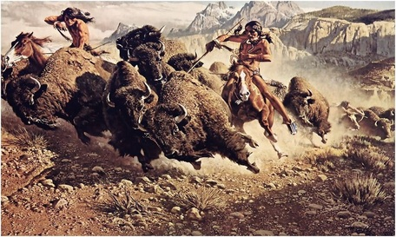
Struggles of the Plains Indians
- Most tribes were nomads who hunted buffalo for their survival.
- Settlers and railroads destroyed the buffalo and took Native land, sparking major conflicts.

Slide 3
Dakota Sioux Uprising
1862: Dakota Sioux lived on reservation in Minnesota in exchange for annuities from the government, which they often didn’t get.
Poverty and starvation
Local traders refused to trade for food on credit, so the Dakota launched a rebellion and killed hundreds of white settlers.
After 38 were sentenced to death, the rest fled to Dakota Territory.

Slide 4
Red Cloud’s War
Lakota Sioux Chiefs of the Dakota territory:
Red Cloud, Crazy Horse, Sitting Bull.
1866: U.S. Army building forts along the Bozeman Trail, when Red Cloud tricked Capt. William Fetterman’s unit into coming out to stop a “small raiding party”.
Fetterman’s unit was wiped out → Red Cloud’s War

Slide 5
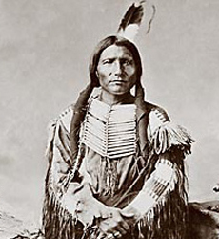
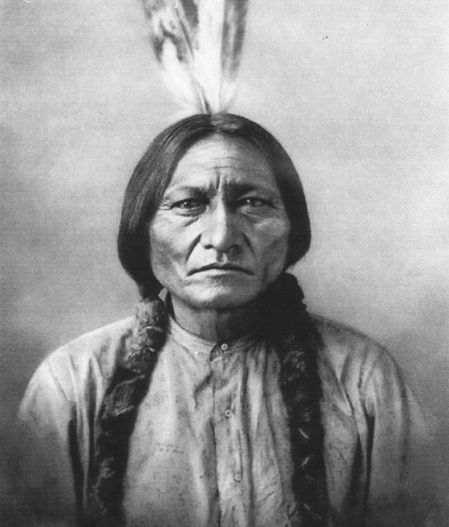
The Lakota Sioux Chiefs
Red Cloud Crazy Horse Sitting Bull

Slide 6
Sand Creek Massacre
Colorado Territory:
Tensions between miners and the Cheyenne and Arapaho
Native American raids led to government intervention.
Nov. 1864: Chief Black Kettle brings hundreds of Cheyenne to Fort Lyon to negotiate with the army. While making camp at nearby Sand Creek (with army’s permission), they were massacred by Col. John Chivington’s Volunteers.

Slide 7
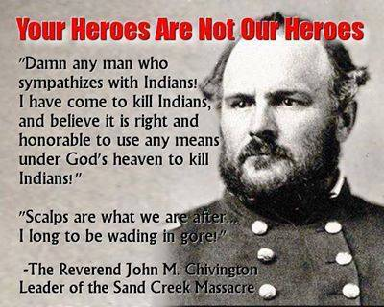
Sand Creek Massacre

Slide 8
Doomed Plan for Peace
1867- Congress formed Indian Peace Commission (with no actual Indians in it!)
Proposed creation of 2 large reservations on the Plains: One for Sioux, another for other tribes.
Would be run by federal agents.
Congress pressures Native American people into signing, but could not ensure anyone- white or Native- would actually follow the agreement.
Didn’t prevent settlers from violating boundaries.
Indians faced poverty, starvation, corruption, and despair, so many just left the reservation.

Slide 9
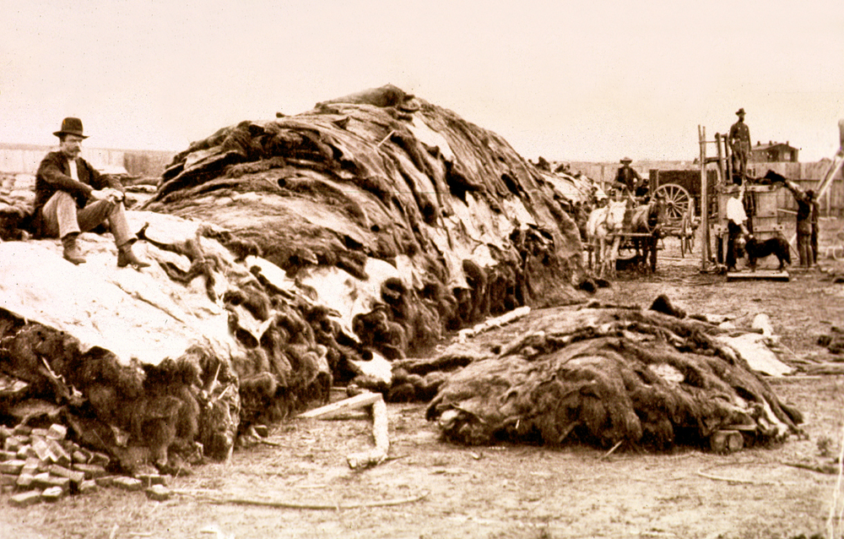
Last Native American Wars
Buffalo were increasingly killed by railroads, settlers, and poachers, encouraged by the Army in an effort to get rid of Native Americans.
By 1889, so few buffalo were left, they nearly went extinct.

Slide 10
Battle of Little Big Horn
1876: Since settlers violated Lakota Sioux boundaries to mine gold in the Black Hills, Indians felt they could violate the treaty too.
Natives left the reservation to hunt in Bighorn Mountains, Montana.
Gov sent expedition led by Lt. Col. George A. Custer.
Custer and his 200 men were all killed by Sitting Bull’s army of over 2,000 warriors.
Sitting Bull fled to Canada, but his followers were forced back on the reservation.

Slide 11
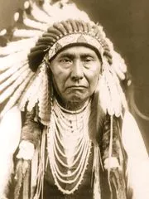
The Nez Perce
Flight of the Nez Perce people to the west
Led by Chief Joseph: “I will fight no more forever.”
Journey of 1,300miles before finally admitting defeat to the US army and exile to Oklahoma.

Slide 12
Wounded Knee
Lakota Sioux reservation: 1890
Ghost Dance performed despite being outlawed by the government
Sent army to arrest Sitting Bull, and battle began at Wounded Knee Creek in South Dakota; Sitting Bull killed and Ghost Dancers fled.
Another battle followed December 29, 1890: 200 Lakota men, women, and children were killed.

Slide 13
The Dawes Act and Americanization
Many Americans sympathized with Natives.
Felt assimilation would solve problems.
Bureau of Indian Affairs created “schools” for native children
Dawes Act: 1887
Divided reservation into allotments for farming and ranching
Why wasn’t this successful?

