Slide 1
The Rise of Progressivism
Ch 6 Section 1

Slide 2
What is it?
A reaction to the various social problems of the Gilded Age, laissez-faire unregulated market, urbanization and industrialization.
It’s not really an actual political movement with set goals.
It is a collection of different ideas and approaches to solve the many social-economic problems (i.e., corruption, poverty, segregation, violence, child labor, injustice).

Slide 3
Who are the Progressives?
Democrats and Republicans
People who believe in science and technology as a way to improve society.
Social workers, journalists, teachers, politicians, clergy.
Muckrakers: Crusading journalists set out to expose and investigate social conditions and political corruption.

Slide 4
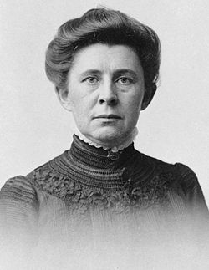
“Muckrakers”
Nicknamed by Teddy Roosevelt
Ida Tarbell- invented investigative journalism, wrote book The History of the Standard Oil Company.

Slide 5
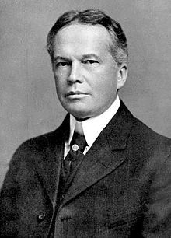
“Muckrakers”
Charles E Russell- politician and Pulitzer winner; journalist exposed poverty in cities and corruption.
His reports inspired Upton Sinclair’s The Jungle.
A founder of the NAACP; fierce civil rights leader.

Slide 6
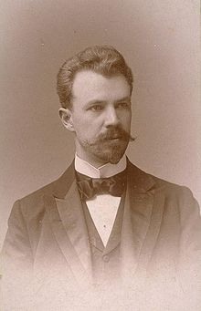
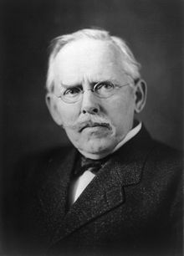
“Muckrakers”
Lincoln Steffens- journalist who exposed vote stealing and political machines like Boss Tweed.
Jacob Riis- Wrote How the Other Half Lives, a book with photos and descriptions of poverty, disease, and crime in NYC.

Slide 7
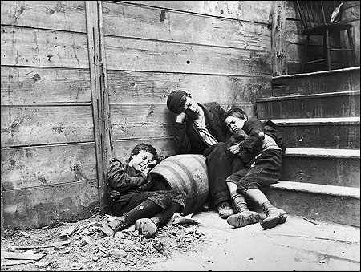
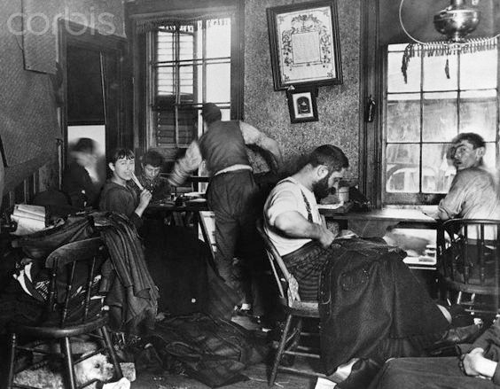
How the Other Half Lives

Slide 8
How did Progressives reform government?
Make government more efficient:
The Principles of Scientific Management, by Frederick Taylor (1911):
Manage time better
Break down tasks into small parts
Put experts in charge of departments
Use standardized tools

Slide 9
How did Progressives reform government?
Make government more democratic, responsive to citizens, and accountable to voters.
Wisconsin’s Robert La Follette urges states to hold direct primary elections:
Vote held by all members of a political party to decide their candidate for office.
Would take away power from corrupt party bosses and give it to voters.

Slide 10
Other reforms (vocab terms):
Initiative: the right of citizens to place a measure or issue before the voters or state legislature for approval.
Citizens have to gather signatures (petition).
Indirect initiative- it goes to the state legislature. If they don’t vote on it, it becomes a…
Direct initiative- gets placed on the ballot, the people vote on it.

Slide 11
Other reforms (vocab terms):
Referendum: allows citizens to vote on proposed laws directly (propositions).
Recall: Voters have the right to remove unsatisfactory elected officials from office with a new election.
The 17th Amendment (1912): Direct election of state senators by the people.
Designed to end corruption by party bosses.
Removed one of the state legislature’s checks on federal power.

Slide 20
Molly Eliot Seawald, anti-suffragist
“It has often been pointed out that women should not pass laws on matters of war and peace, since no woman can do military duty… nor can have any practical kowledge of shipping and navigation… railways and mining, or any subjects of the highest importance… Also there seems to be a close relationship between suffrage and divorce….”

Slide 21
Article from an anti-suffrage newspaper, 1912
“The Suffragist’s ideal is a kitchen-less house… she denounces housekeeping as degrading. The Suffragists teach women to revolt against the daily task of tending child and house…”

Slide 22
Rep. John A. Moon of Tennessee- 1918
“In those Southern states where the colored population outnumbers the white, to double the number of ignorant voters by giving colored women the right to vote would produce a condition that would be intolerable.”

