Slide 1
The Sectional Crisis
Before the Civil War
Chapter 1 Lesson 4

Slide 2
I. Manifest destiny
Louisiana Purchase:
250,000 move across the country- all the way to Pacific coast.
Idea that God gave the continent to Americans
Provokes Native American anger
Encouraged to settle in Texas- which was in Mexico.
Tensions → War with Mexico
Americans lost at The Alamo, but won at Battle of San Jacinto 1836
Texas wanted to join the union as a slave state.
1844 election: Democrat James K. Polk promises to annex Texas and demands Oregon country (partially still under British control).

Slide 3
The 49th parallel: America acquires Oregon, Washington, and Idaho.

Slide 4
The Mexican-American war
Mexico was outraged about Texas’ entry into U.S.- 1845
Would not allow purchase of California.
January 1846: General Zackary Taylor leads army into disputed territory to provoke Mexicans to fire first.
May: Mexicans attack U.S. troops; Congress votes for war.
June: “Bear Flag Revolt” against Mexico in California
Sept 1847: U.S. troops seize Mexico City
Feb 1848: Treaty of Guadalupe-Hidalgo:
Mexico gives U.S. 500,000 sq miles- California, Nevada, Utah
Rio Grande= southern border of Texas
U.S. gave Mexico $15 million

Slide 5
Treaty of Guadalupe-Hidalgo:

Slide 6
II. Slavery and westward expansion
California applies for statehood: should it be a slave state?
Popular sovereignty- idea that each state should decide for itself if it wanted slavery.
Zachary Taylor (a Whig) wins the 1848 election.
Gold found in California in 1849: CA had to be admitted ASAP
Senator Henry Clay (Kentucky): The Compromise of 1850:
CA would be a “free” state
Washington DC would end slave trade, but slavery itself continued.
New land from Mexico would decide on slavery for themselves.
Fugitive Slave Law to help southern states “retain” runaway slaves.

Slide 7
The Fugitive slave law:
Blacks could not testify
Little proof was needed to send a black person “back” to the south, and only whites could testify
Created more hostility towards southerners
Led to the Underground Railroad: an informal network of “conductors” that led runaway slaves to freedom.
Harriet Tubman
In Cincinnati, OH: Harriet Beecher Stowe wrote “Uncle Tom’s Cabin” to show the horrors of slavery.
Used appeal of Christian faith to change perceptions of slavery
Best selling novel of the 1800’s.

Slide 8
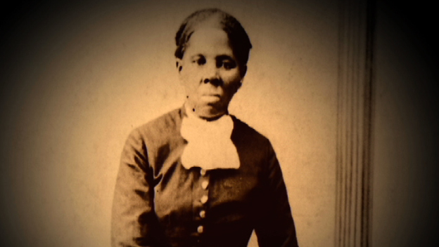
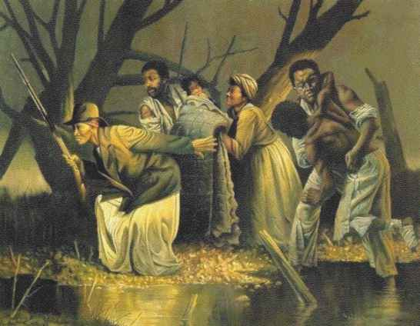

Slide 10
“Bleeding Kansas”
America needed a trans-continental railroad
Senator Stephen Douglas (D- IL) tried to pass bill to organize territory of Nebraska- still unorganized.
Southerners wanted Congress to repeal part of the Missouri Compromise to allow slavery in the Nebraska.
Territory would be split: Nebraska, in the north = free state.
Kansas, in the south = slave state
Kansas-Nebraska Act, 1854
Northerners rushed to Kansas to create an anti-slavery majority before election of 1855.
But were met with thousands of armed Missourians (“border ruffians”) who crossed the border to vote illegally for pro-slavery laws!
Anti-slavery settlers formed their own constitution, and now Kansas had two governments: one pro-slavery, one anti-slavery.
Violent attacks and territorial civil war → “Bleeding Kansas”

Slide 11
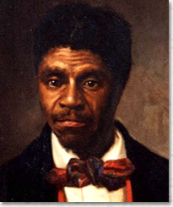
More Politics and sectional divide
The Whig Party fell apart due to conflict over slavery
Dred Scott v. Sandford, 1857
An enslaved man sued for freedom when his owner took him to a free state to work.
Supreme Court ruled against him because since he was black, he was not considered a citizen, and therefore had no rights.
Judge Taney also said the Missouri Compromise itself was unconstitutional, since the federal government cannot ban slavery in the territories.

Slide 12
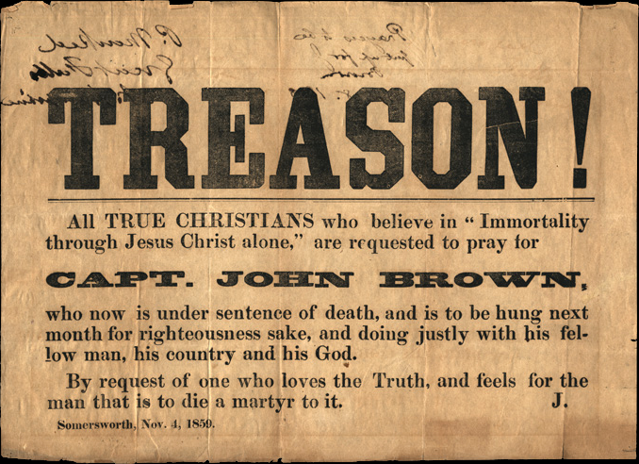
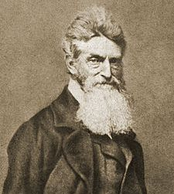
III. The union dissolves
1859- John Brown’s Raid on Harper’s Ferry, Virginia
Northerners saw him as a martyr
Southerners saw this as more “northern aggression”

Slide 13
The election of 1860
The South viewed Brown’s raid as a turning point, and no longer wanted to cooperate with the North.
Northern Democrats chose Stephen Douglas (D-IL) as their candidate, but southerners chose their own- John Breckenridge (D-KY)
Republicans chose Abraham Lincoln (R-IL), who won the election.
Dec 1860- South Carolina secedes from the union.
By April, the rest of the southern states seceded and created the Confederate States of America.
Southerners saw themselves as similar to Patriots in the Revolution.

