Slide 1
The Spanish American War
“A Splendid Little War”
Ch 5 Section 2

Slide 2
What is “yellow journalism”?
Exaggerated sensationalist or even false stories meant to sway public opinion and evoke emotional responses.
Propaganda
Is it different from today’s “fake news” or “clickbait”?
William Randolph Hearst, newspaper tycoon: “You furnish the pictures, I’ll furnish the war.”

Slide 3
Yellow journalism
Cuba was one of Spain’s last colonies in the West.
The U.S. wanted to support its revolt against Spain because of the economic links to Cuba (sugarcane, railroads, and mining).
President Cleveland was neutral, but some newspapers published exaggerated stories about Spanish atrocities in Cuba to raise public support for war against Spain.
And to SELL MORE NEWSPAPERS $$$$$

Slide 4
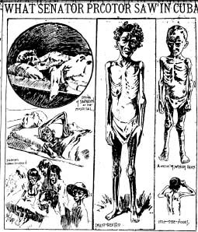
Are these reliable?

Slide 6
America Supports Cuba
Spain sends 200,000 troops to crush revolt.
Thousands of Cubans placed in concentration camps.
William McKinley becomes president in 1897, and he wanted to help end the conflict.
Riots break out in Havana between loyalists and rebels- January 1898.
McKinley send the USS Maine to protect Americans there.

Slide 7
The USS Maine Explosion

Slide 8
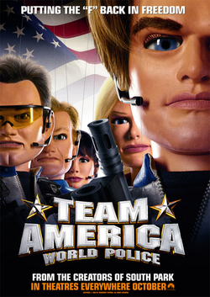
The USS Maine Explosion
Probably an accident.
Americans blamed Spain anyway (thanks to all that yellow journalism).
“Remember the Maine, and to hell with Spain!”
Jingoism: aggressive, extreme nationalism with aggressive foreign policy and war mongering.

Slide 9
Opinion:
When is it appropriate to send US troops to fight and face death on foreign soil?

Slide 10
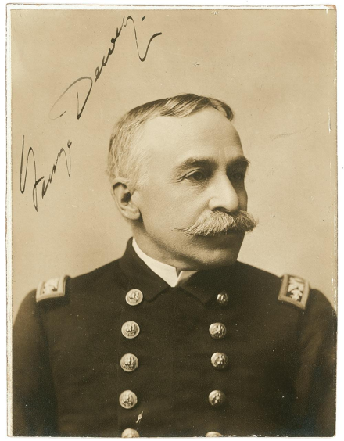
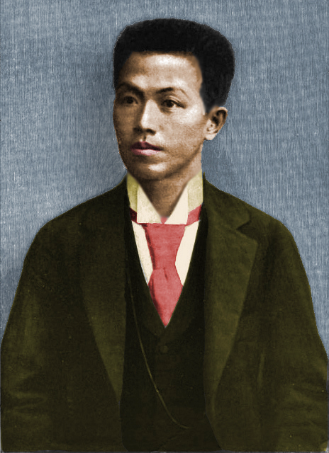
War on Two Fronts The Philippines
Spain declares war- April 1898
Navy Commodore George Dewey.
Hong Kong to Manila Bay, destroys Spanish fleet.
20,000 troops sail from San Francisco to Manila and seize Manila (picking up Guam on the way).
Dewey calls on Emilio Aguinaldo and his rebel forces to seize islands from Spain.

Slide 11
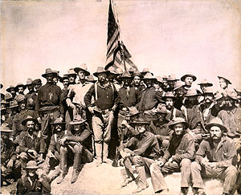
War on Two Fronts Cuba
Yellow fever struck many soldiers.
US Volunteers were unorganized and inexperienced.
Teddy Roosevelt and the Rough Riders, with the 9th and 10th cavalry (all black soldiers) led the charge.
17,000 US troops land in Cuba.
Spanish fleet destroyed (again) and Spain surrenders.
USA occupies Puerto Rico.

Slide 12
Debate Over Annexation
What should America do with its newly acquired empire?
Guam, Puerto Rico, Cuba, the Philippines.
What are the benefits? What are the risks/costs?
Treaty of Paris, 1898-
Cuba is independent.
US keeps Puerto Rico, Guam, and buys Philippines for $20 million.

