Slide 1
The War’s Impact
Economic Turmoil, Racial Unrest and the Red Scare after WWI

Slide 2
Economic Mess After WWI
No more government control of economy →
Businesses raised prices →
Rapid inflation →
Factories laid off workers →
Unemployment, no jobs for veterans →
Unions begin to ask for better wages →
Business leaders want to bust unions →
STRIKES AND RIOTS: 1919 was a violent year at home.

Slide 3
Strikes and Riots of 1919-1920
Seattle General Strike: paralyzed the city for 5 days.
Boston Police Strike: 75% of police on strike → riots and looting; National Guard called in.
The Steel Strike: 350,000 steelworkers strike.
US Steel hires African American and Mexican workers as replacements → racial tension → violent riots and rise of the KKK.

Slide 4
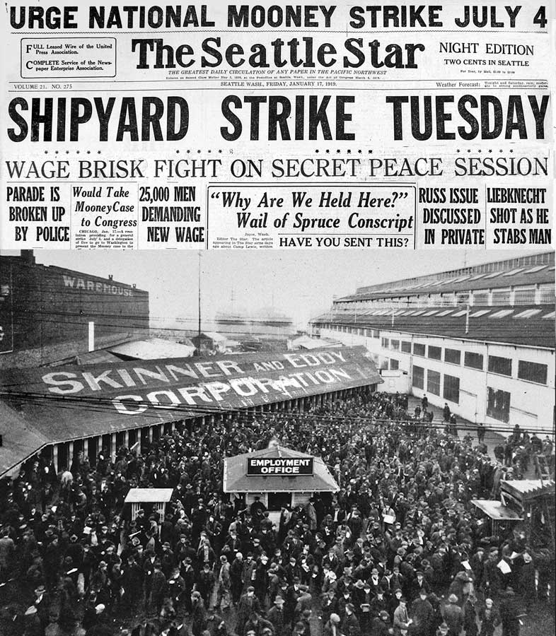
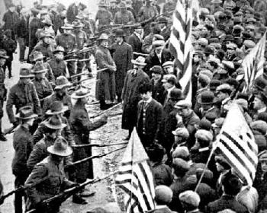
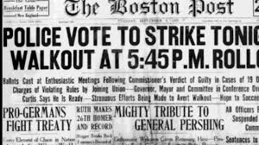

Slide 5
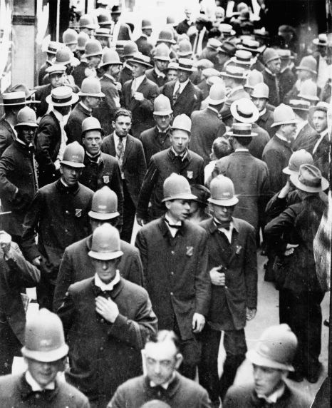
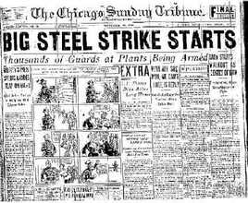
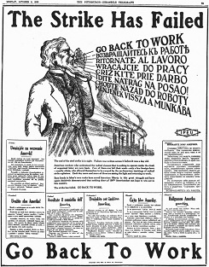

Slide 6
Racial Unrest
African-Americans in the Great Migration moved north for factory jobs.
They were blamed by laid-off workers and unemployed veterans for “stealing” jobs.
Summer of 1919- 25 race riots broke out across America:
Longview, Texas
Washington DC (4 days long)
Chicago (lasted two weeks- 38 dead, 500 injured)

Slide 7
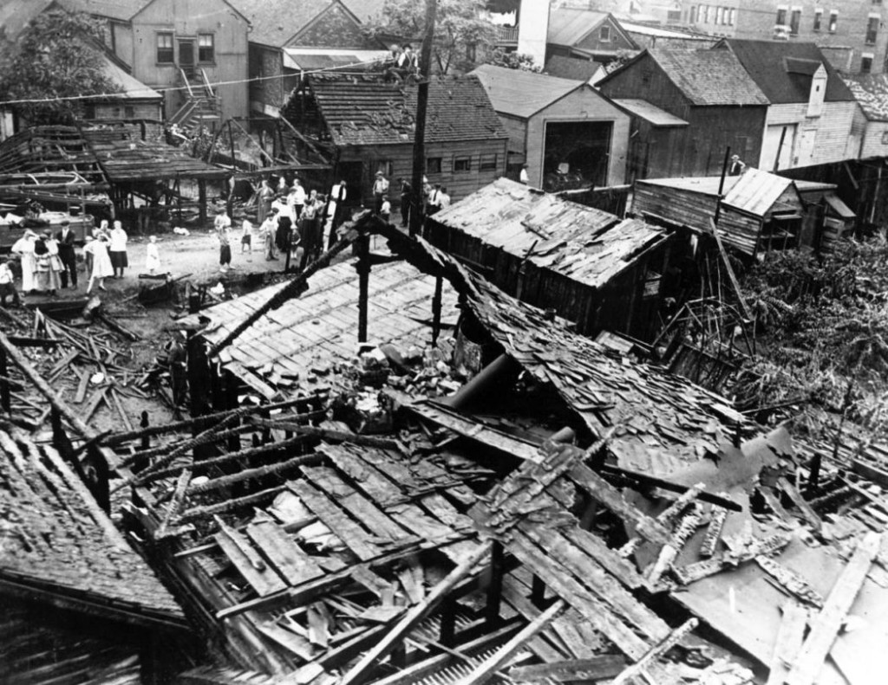
Chicago Race Riots

Slide 8
Marcus Garvey
Jamaican-born black nationalist and entrepreneur.
Very controversial figure; endorsed “Back to Africa” movement.
African-Americans cannot live a fair life in America.
Met with, and “thanked” the KKK for their “honesty” and motivation to improve life for African Americans.

Slide 10
The Red Scare
Fear of communism sparked by:
Communist Revolution in Russia
Continuing immigration from Eastern Europe
Violent strikes and riots
Economic turmoil
April 1919: Thirty bombs intercepted in the mail- all sent to prominent Americans
May 1919: Parade to protest jailing of Eugene Debs turns into riot; 2 killed.
June 1919: 8 bombs in 8 cities explode within minutes of each other.

Slide 11
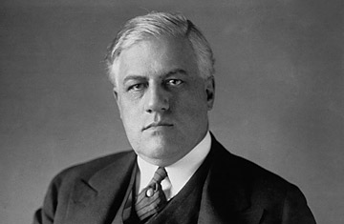
A. Mitchell Palmer
U.S. Attorney General
Recipient of one of those mail bombs

Slide 12
The Palmer Raids
Palmer creates General Intelligence Division, now known as the FBI.
Orders series of raids against foreign and radical groups of “hyphenated Americans”.
250 Russian immigrants deported without trial.
January 1920: 6,000 arrested; 600 deported
Suspended civil liberties.
Jailed and deported without trial or attorney

Slide 13
1920 Wall Street Bombing

