Slide 1
The Young Republic
Chapter 1 Lesson 2

Slide 2
What was new about the American Republic?
It was a republic.
Latin for “thing of the people”.
Citizens were equal before the law, and social class was irrelevant.
HOWEVER…
Not everyone was a citizen, so not everyone was “equal”.
People’s rights were restricted based on race, class, gender.

Slide 3
The Articles of Confederation
Patriots had envisioned a central government with very limited powers: could regulate foreign trade, military, war, peace, and alliances, but not states’ affairs, and COULD NOT TAX PEOPLE OR STATES.
The Articles were approved in 1777, ratified in 1781.
A loose union where each state had its sovereign independence.
All states had equal representation (one vote).
Laws needed approval of 9 states, but changes needed unanimous consent.

Slide 4
The U.S. Constitution
Delegates met to revise the Articles in 1787.
Support for a national government with power to levy taxes and bind states.
3 branches of government: Executive, Legislative, Judicial.
How should states be represented?

Slide 5
Representation
Virginia Plan (James Madison)- LARGE STATES
Representation based on population
New Jersey Plan (William Paterson)- SMALL STATES
Equal representation in all states
The Connecticut Compromise (Roger Sherman)
Bi-cameral (2 House) Legislature- The Congress.
Lower House= House of Representatives, with representation by population.
Upper House= The Senate, with two Senators for each state

Slide 6
Question of slavery
Did slaves count as part of the population to be considered for representation?
South said yes, North said no.
South threatened to secede from the union (wouldn’t be the last time!) if they did not count slaves.
The 3/5 Compromise: Slaves would count as 3/5 of a person for determining taxation and population.
(The slave trade was later banned in 1808, and slavery was abolished in 1865.)

Slide 7
Federalism
Established by the U.S. Constitution
Power is divided between national and state governments:
Checks and balances prevent tyranny
States’ rights are preserved, while maintaining a strong central government.

Slide 8
Ratification and the Bill of Rights
9 out of 13 states had to ratify it.
Federalists= Supporters of the Constitution
Divide power between federal and state governments
Summarized their support in The Federalist papers, by Madison, Jay, and Hamilton.
Anti-federalists= Opposed to ratification*
*Or very suspicious of the Constitution
Wanted states’ powers to be supreme over federal government.
Federalists promised to attach a Bill of Rights to the Constitution once it was ratified to protect peoples’ rights.

Slide 9
The Rise of Political Parties
Washington is elected president in 1789.
Appoints Jefferson as Secretary of State
Appoints Hamilton as Secretary of the Treasury
Debt was the biggest concern, and both men passionately disagreed on how to address it.
Hamilton wanted to establish a national bank, claiming it was an implied power in the Constitution.
Jefferson said establishing a bank was not an enumerated power.

Slide 10
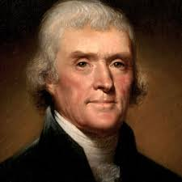
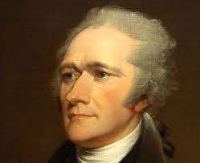
Jefferson vs Hamilton
“Democratic Republican”
Wealthy Virginia planter; slaveowner
Envisioned agrarian economic society with weak central gov. He feared tyranny of government.
Pro-France
Suspicious of banks, corporations, and monied interests and their influence on government.
Payment of national debt only- favors debtors.
“Federalist”
New Yorker by way of St. Croix; poor orphan.
Envisioned a commercial economy based on shipping, banking, manufacturing, and trade, and a strong central government. He feared “mob rule of democracy”
Pro-Britain
Payment of national and state debts (assumption of debts)- favors creditors

