Slide 1
US Foreign Policy
Chapter 5 Section 3

Slide 2
A fight breaks out in the forum between two students. You go see who it is…
The fight is between one student who is a fairly good friend of yours. The other student is a former friend, and you no longer speak to him/her.
What do you do?

Slide 3
Your options:
1. Turn away and leave because this does not concern you, and you do not want to get in trouble.
2. Get other students to help you break up the fight before they hurt each other.
3. Get into the fight on your friend’s side and punch the other kid in the face, because he/she deserves it.
4. Punch them both in the face as hard as you can, knocking them both out to show the whole school that you are the toughest person in school.

Slide 4
Questions:
Which foreign policy stance has the US appeared to favor most? The least?
Do you notice any patterns in US foreign policy over the course of US history?
What do you think might explain the constant shifting of US foreign policy from one stance to another?
Why do you think the US began taking a more active role in world affairs in the 20th century?
Where on the foreign policy spectrum should the US position itself today? Explain.

Slide 5
Types of Diplomacy
Imperialism: Forceful influence or conquest.
Military strength and nationalist cause
Japan: Threats led to unfair trade treaties.
Japan modernized in order to compete with the West.
Philippines, Hawaii: Political or corporate takeover
Asia:
Open Door Policy in China

Slide 6
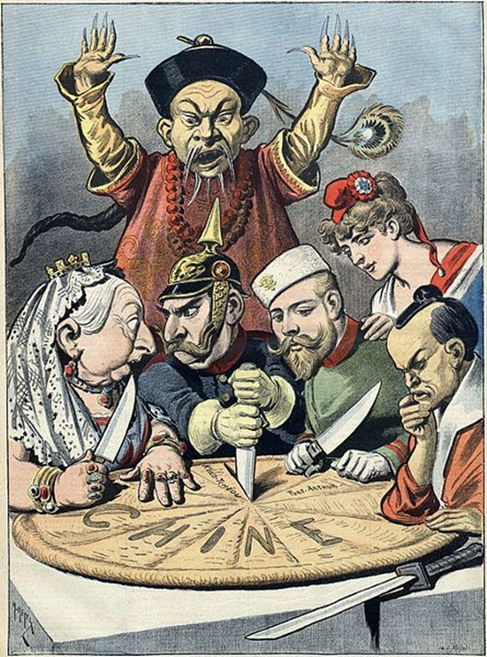
Open Door Policy
Prevented this (a total partition of China by European powers):

Slide 7
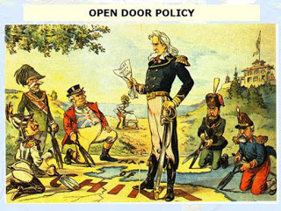
Open Door Policy
And instead established this:

Slide 8
Testing American Response: The Boxer Rebellion
Righteous Harmonious Fists (the “Boxers”) wanted to rid China of “foreign devils” and Christian missionaries.
Attacked foreign embassies, killed 200 foreigners.
Response: a multinational force crushed the rebellion.
Germany, Austria-Hungary, Britain, France, Japan, Russia, Italy, and the USA.

Slide 9
The Boxer Rebellion: A Global Response

Slide 10
Roosevelt and Taft
Roosevelt: “Big Stick Diplomacy”
“Speak softly, but carry a big stick”
Helped negotiate peace in Russo-Japanese War over Korea, kept China’s door open.
Panama Canal:
Increase trade and economic growth
Make trade more efficient
Would be a great display of American strength, engineering, ability, and political prowess.

Slide 11
Panama Canal
48-mile artificial waterway through the isthmus of Panama (used to be part of Colombia)
Connects Atlantic and Pacific Ocean
America took 10 years to build it
Key conduit of maritime trade

Slide 12
The Panama Canal

Slide 13
The Panama Canal

Slide 14
Roosevelt and Taft
Roosevelt Corollary (to the Monroe Doctrine):
The U.S. will intervene in Latin American affairs when necessary to maintain political/economic stability.
“Europe, seriously stay out of Latin America!”
Goal: To prevent Europe from using debt of Latin America to justify their intervntion in the region.

Slide 15
Roosevelt and Taft
Taft: “Dollar Diplomacy”
Less emphasis on military force
More emphasis on economic “wooing” to develop trade and industry.
Support L.A. industry and trade, loan them money.
Increase American trade and profit
Pull Latin America our of poverty

Slide 16
Wilson’s Diplomacy
Wilson: “Moral diplomacy”
Set an example for the world, help countries develop their own democracy.
Is that what he did in Mexico?
Mexican Revolution breaks out to overthrow Dictator Porfirio Diaz. (1913)
Diaz was replaced by General Huerta, a brutal violent leader.
Not what Wilson had in mind for Mexico

Slide 17
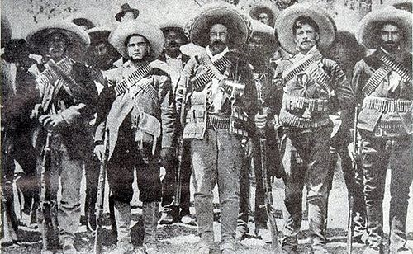
Wilson: Moral Diplomacy
Armed Huerta’s opponents, then occupied city of Veracruz after a conflict involving American sailors (and news of a German war ship docking there).
Did not get the welcome he was expecting!

Slide 18
Wilson’s Moral Diplomacy
Wilson then supported Venustiano Carranza, armed him and helped him seize power.
Led to a major conflict against Pancho Villa and guerilla fighters.
What did Wilson learn?
You can’t shoot or bomb a country into democracy.
“Moral diplomacy” can really only be for countries that are already democratic.

