Slide 1
WWI Propaganda

Slide 2
Britain in WWI
Suffered extremely heavy losses
Shock of mass casualties, often all from the same town
Battle of the Somme: July 1- Nov 13, 1916
20,000 dead ON THE FIRST DAY, including 60% of its officers
It was a BRITISH victory
Tried to lift morale on home front with propaganda
Needed American intervention
Even cut telegraph wires to prevent other European news from reaching America, so US got British-biased news.

Slide 13
Music in World War I
Music changed before WWI, and then in response to WWI.
It was important to those on the homefront, as well as abroad.
Home front:
“Over There” by George C. Cohan
Abroad:
“On Patrol in No Man’s Land” by James Reese Europe

Slide 14
James Reese Europe

Slide 15
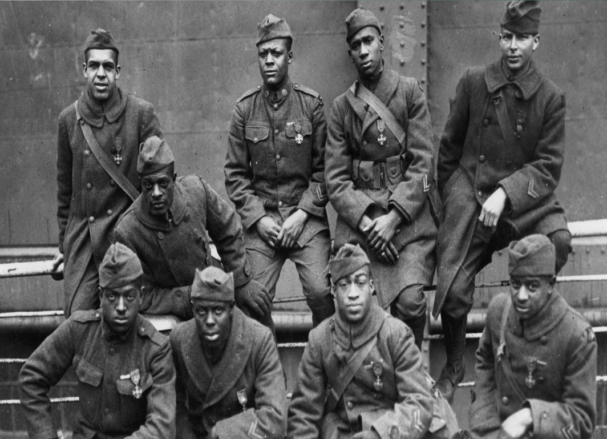
James Reese Europe and the Harlem Hellfighters
The 369th Infantry, with their French medals,
The Croix de Guerre

Slide 16
James Reese Europe
African American composer, music arranger
From Alabama, then moved to NY and DC
Organized the Clef Club, a society for African Americans in the music industry.
First band to play proto-jazz, or “rag-time” music at Carnegie Hall, and one of the first African Americans to play there in 1912- “A Concerto of Negro Music”
His “Society Orchestra” headlined dancers and popularized the “foxtrot”.

Slide 17
James Reese Europe
During WWI, served as Lieutenant in the 369th (The “Harlem Hellfighters”) assigned to a French unit. Every man won the Croix de Guerre.
While travelling in France with the military band, European soldiers became obsessed with American music, and the Jazz Age of Europe was born.
After the war, he recorded some of the earliest jazz and ragtime hits, including “I’m Just Wild About Harry”.

Slide 18
